Slide 1
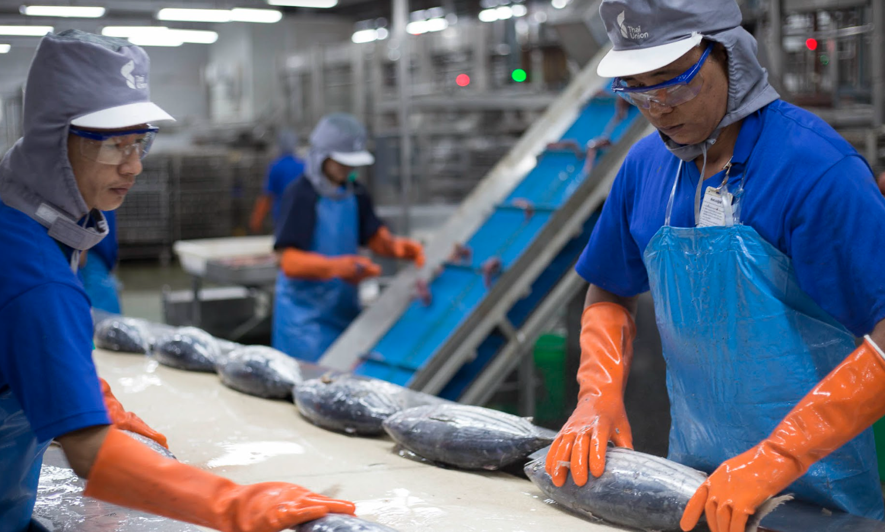
SLAVERY AND EXPLOITATION IN BUSINESS SUPPLY CHAINS

Slide 2
The most important component of International Trade
PEOPLE

Slide 3
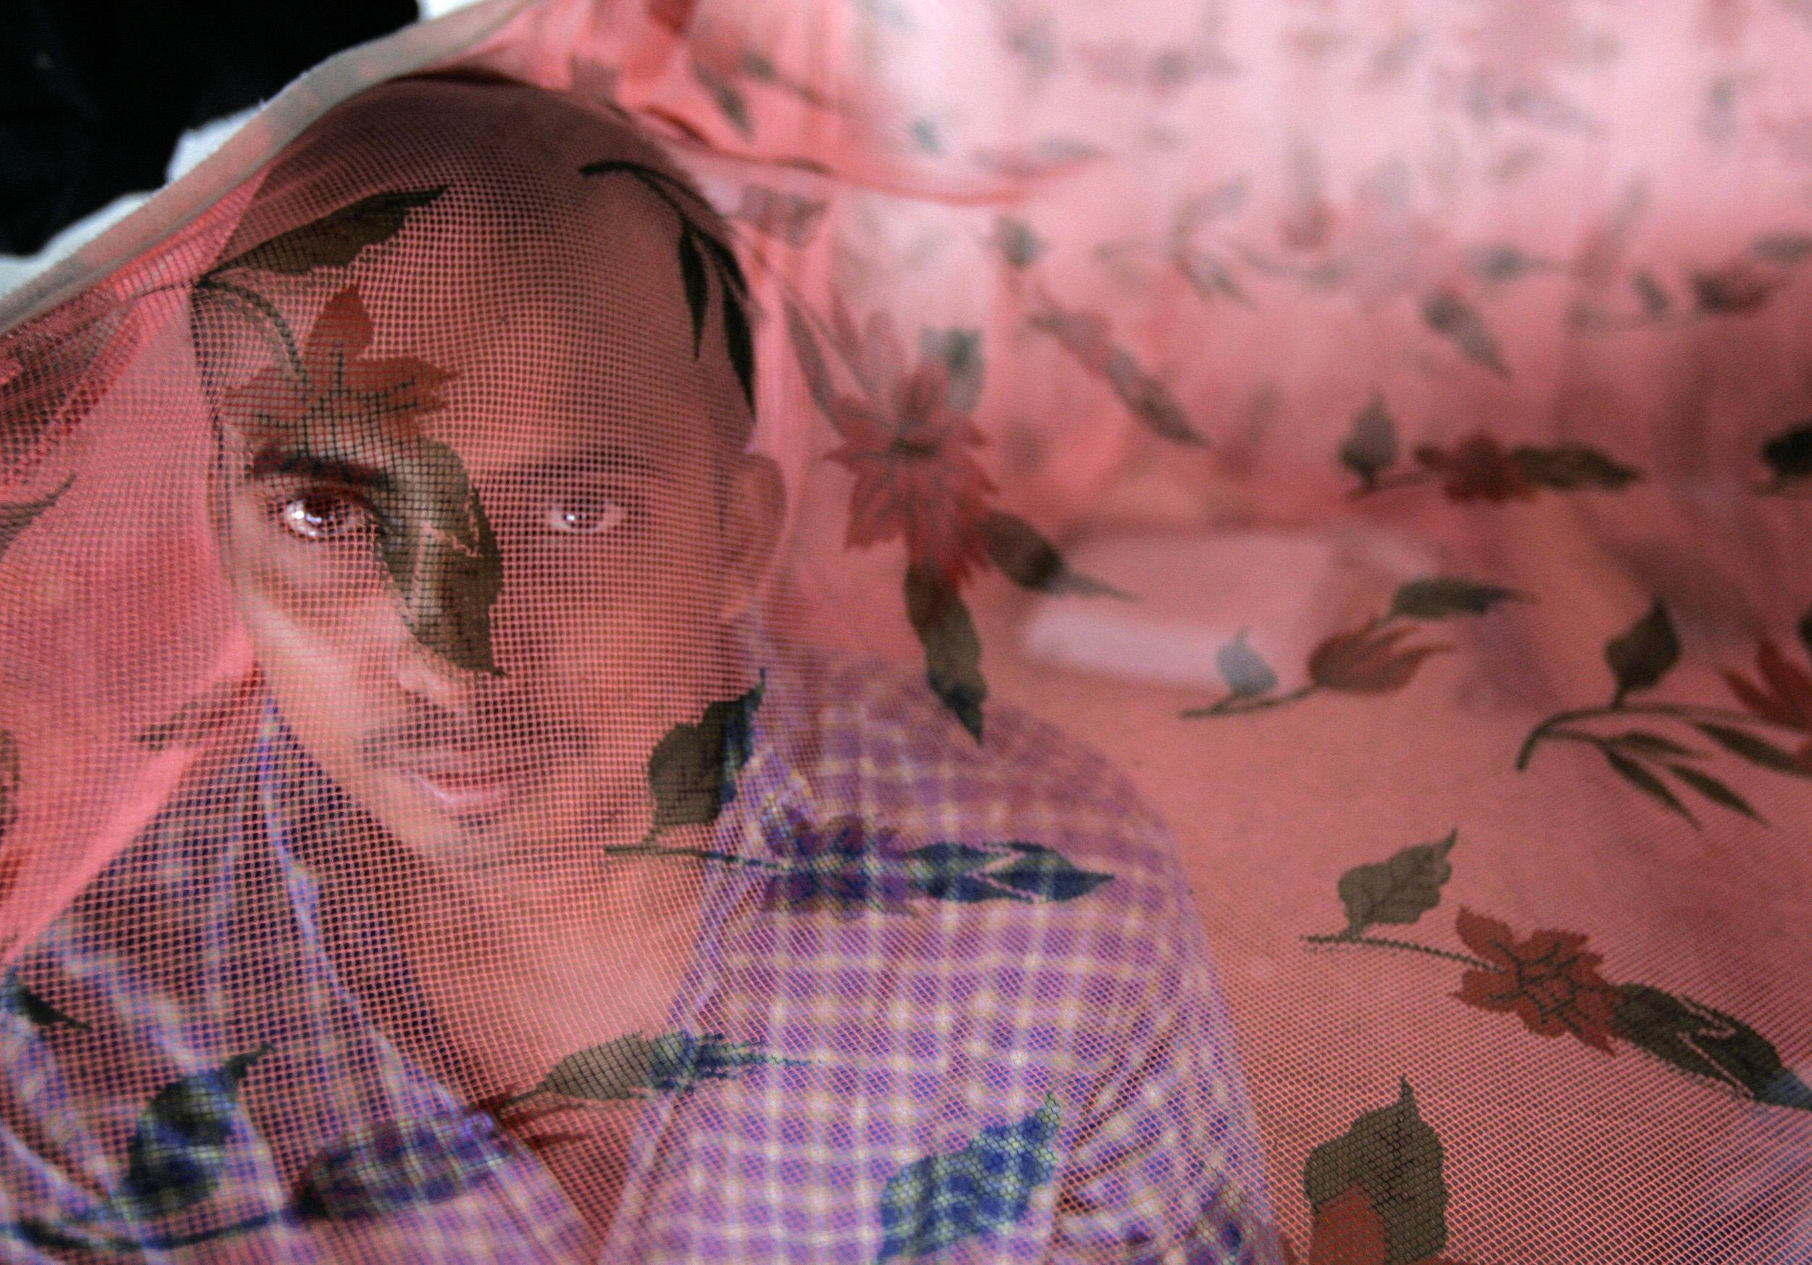
“There is an invisible workforce consisting of millions of laborers from some of the poorest corners of Asia,” - ILO

Slide 4
TRAPPED!
EXPLOITATION = INABILITY TO LEAVE

Slide 5

IS MODERN SLAVERY THE SAME AS HUMAN TRAFFICKING?
NOPE!
“Trafficking is simply a mechanism or conduit that brings people into slavery.”
- Kevin Bales, Zoe Trodd & Alex Kent Williamson, “Modern Slavery”
Notes:
The terms “modern slavery” and “human trafficking” are often used interchangeably. Try to think of it this way: slavery is a situation, trafficking is the process that got people in this situation.
When we say trafficking, we’re ACTUALLY talking about PUTTING people into this exploitation. It’s the mechanism we’re referring to.
A lot of work, including Global Slavery Index, looks at trafficking as a form of slavery. In Indian law, there’s no term called “modern slavery”. But, that doesn’t make using the term “modern slavery” wrong. A lot of international organisations use it. They do it to drive a message about how slavery is not dead.
It is a globally accepted term, but in some countries, lawmakers have not defined it well for the public to understand. When a human being in exploited and left in a position where they cannot leave the situation because of the circumstances they are in, they are part of the nexus called Modern Slavery.

Slide 6
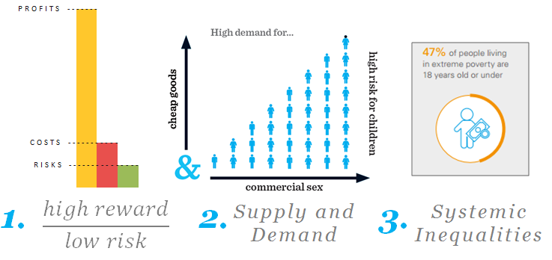
What fuels trafficking
Unicef USA
Notes:
So, all the push and pull factors we talked about can be summed up broadly like this.
The first one, this is where “poor law enforcement” comes in. Traffickers can expect to make a lot of money with minimal fear of punishment or legal consequence. This high reward, low risk dynamic makes human trafficking the second most profitable illegal industry— second only to the drug trade. And, drugs are sold in one transaction, human beings may be sold over and over again. The costs are low -- $90 for a person on an average. And the profits are extremely high- $150 billion from the whole trade annually.

Slide 7
THAILAND - SOME FACTS
More than 600,000 victims are trafficked for work
Myanmar, Cambodia, Laos
Seafood, Construction and Textile
Tier 2 Watch List since 2016
U.S. imports 63% of its fish
Thai govt actively implementing legislation to combat Modern Slavery
Sources: Global Slavery Index Exodus Road, Thailand NGO
Notes:
According to the Global Slavery Index (2018), there are more than 600,000 victims of human trafficking in Thailand.
Victims are mostly economic migrants coming from Myanmar, Cambodia, and Laos. What pulls them into Thailand?
seafood, construction, or textile industries are the three main areas where you find victims of trafficking and modern slavery. Thailand was ranked in Tier 3 in the 2014 and 2015 reports, amid international media’s exposés of poor working conditions for migrant workers on Thai fishing boats, dubbed “modern slavery”. Thailand was promoted to Tier 2 Watch List in 2016, and again, to Tier 2, a position the country had maintained since 2018.
While Thailand does not fully meet the minimum standards for the elimination of human trafficking, the Thai government is actively implementing legislation to further combat it.
The Thai government is steadily increasing the programs and budgets for help centers, introducing more severe judicial penalties and labor restrictions, and assigning advanced training to court personnel, law enforcement, and prosecutors working on cases. However, corruption amongst Thai police and the exclusion of immigrants and sex workers from legislation remain two major obstacles to anti-trafficking in Thailand.
Data is from an NGO in Thailand called Exodus Road.

Slide 8
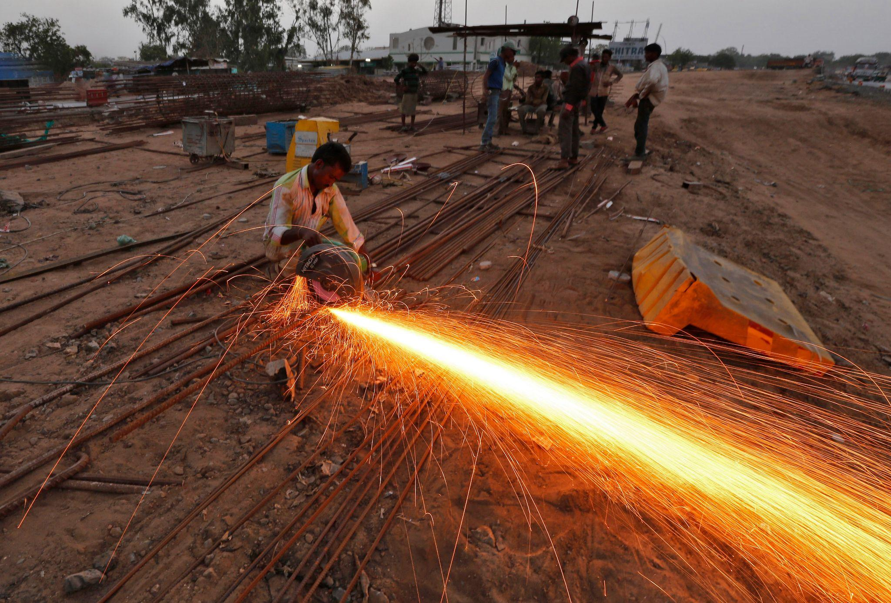
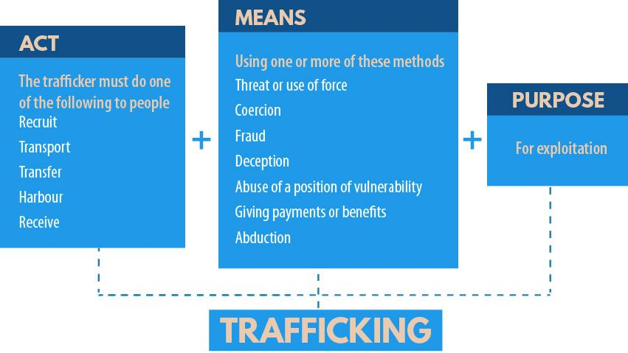
WHO IS A TRAFFICKED VICTIM?
— United Nations Office on Drugs and Crime
Notes:
Human trafficking has 3 core elements
The Act— What is done
The Means— How it is done
The Purpose— Why it is done

Slide 9
MODERN SLAVERY LAWS
A company has a responsibility to respect the human rights of all workers in its supply chain – even if those workers are not its own employees.
UNITED KINGDOM
UNITED STATES
AUSTRALIA
BRAZIL
FRANCE
GERMANY
ITALY
Notes:
The UNGPs require businesses to address adverse human rights impacts arising from their own activities, as well as their business relationships with other parties – this could include its business partners, actors in its supply chain, and any other entities directly linked to its business operations, products, or services. A company’s human rights obligations therefore cover its whole supply chain – and not just its direct employees. This includes the company’s suppliers, raw material providers, sub-contractors, and outsourcing partners.
Is there any country that has strict laws on ensuring no slavery in supply chains?
U.K. -- From October 2015 a company carrying out any part of its business in the UK that produces a total turnover of more than £36 million must publish an annual 'slavery and human trafficking statement'. The statement will disclose the steps a company has taken to ensure its supply-chain is free from slavery.
U.S. – 2022 - The Slave-Free Business Certification bill, introduced by Senators Josh Hawley and Kirsten Gillibrand, will require certain large companies to carry out annual audits on their supply chains to ensure they are free of slave labour.
If successful, eligible companies could be fined up to $1m if forced labour is identified in their supply chains. In December 2021, US President Joe Biden passed the Uyghur Forced Labor Prevention Act into law, which requires companies to prove they are not funding forced labour in China’s Xinjiang region. Apple and Nike were accused by the Australian Strategic Policy Institute of having forced labour from the region in their supply chains.
Australia – 2018 Modern Slavery Act - The Act established a national Modern Slavery Reporting Requirement which applies to large businesses and other entities in the Australian market with annual consolidated revenue of at least AUD$100 million.
Then there’s Brazil (which is a source for Timber exports), France, Germany and Italy. What is common between these countries – they are all developed and part of the G20.

Slide 10
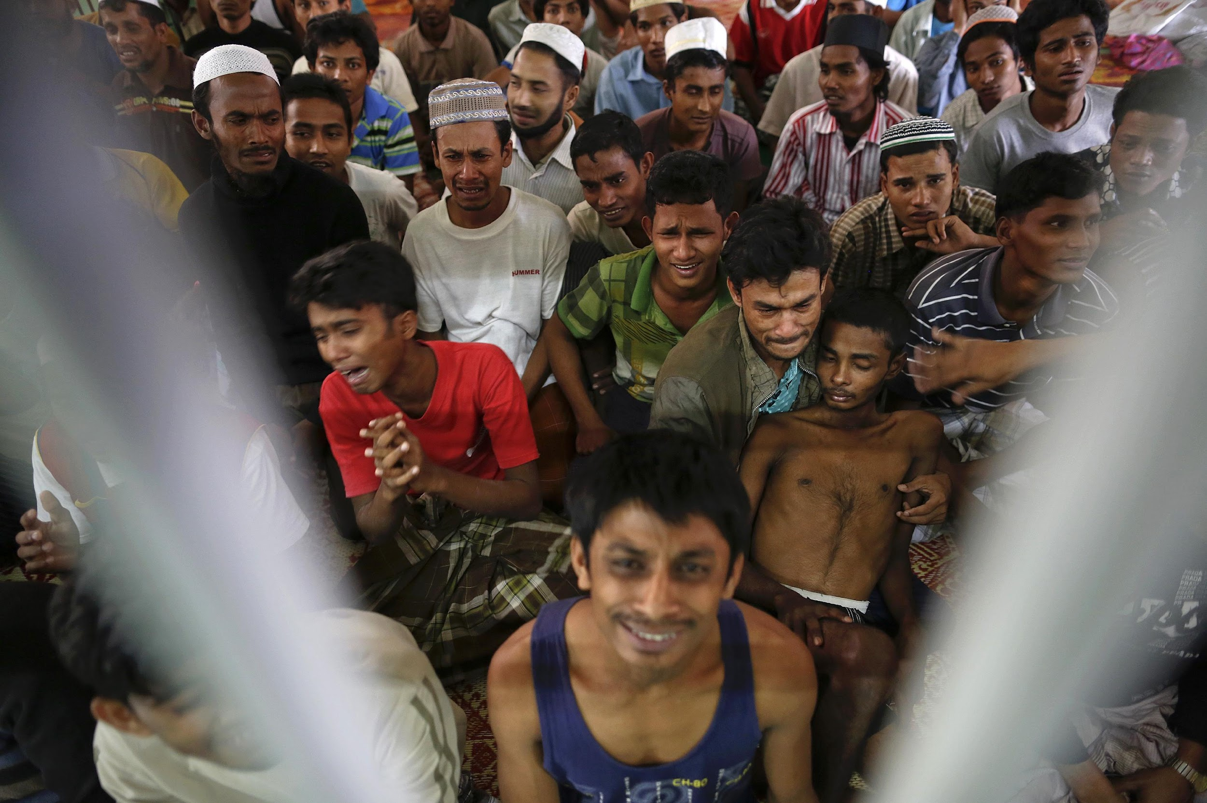
A TRAFFICKING ROUTE?
Destination
Transit
Source
Notes:
We understood Act, Means and Purpose.
Now let’s talk about how trafficking is usually done. This also addresses the question of how various countries contribute to trafficking. Typically it has three major points: source, transit and destination.
The source are usually areas where people are desperate for a better life, be it because of Political instability, militarism, civil unrest, internal armed conflict and natural disasters.
Transit countries are those that make specific routes for victims of trafficking to pass through. They are the connecting line of point A and point B. Due to the convenience of their location between continents, many of the Pacific Islands are considered transit regions. 80% of international human trafficking journeys cross through official border points, such as airports and land border control points. So, border agencies and service providers at border points…they have a crucial role in identifying potential/ suspected victims. According to the ILO, 84% of cases are women, versus 73% men. And also, 80% of cases are adults, versus 56% children.
Destination countries are those that have high demand.. And are usually developed.
Scholars have focused on the supply and demand model of economics to explain the trends of source and destinations countries. The supply and demand model argues that transnational human trafficking is based on a market mechanism that balances the supply of victims from origin countries with the demand for victims in destination countries (Broderick, 2005; Pearce & Davis, 2000). Supply is provided by countries with high unemployment rates, causing victims to be easily enticed with false promises of employment (Hodge, 2008; Masci, 2006). On the other hand, in countries where labor is expensive, the need for cheaper labor creates a high demand of workers from other countries (Anderson & Davidson, 2003). Human trafficking grows best in extreme poverty and its labor is demanded by wealthy nations (Bales, 2003; Hughes and Denisova, 2001).
This story by Vice Media explains the trafficking route well. https://www.vice.com/en/article/jgqa3d/rohingya-brides-thought-they-were-fleeing-violence-then-they-met-their-grooms
NEXT FEW SLIDES ARE ONLY FOR INDIA JOURNALISTS
IF YOU HAVE TIME -- Give them the Reuters Pulitzer winning story on Rohingyas, and let them figure out the source, transit and destination.

Slide 11
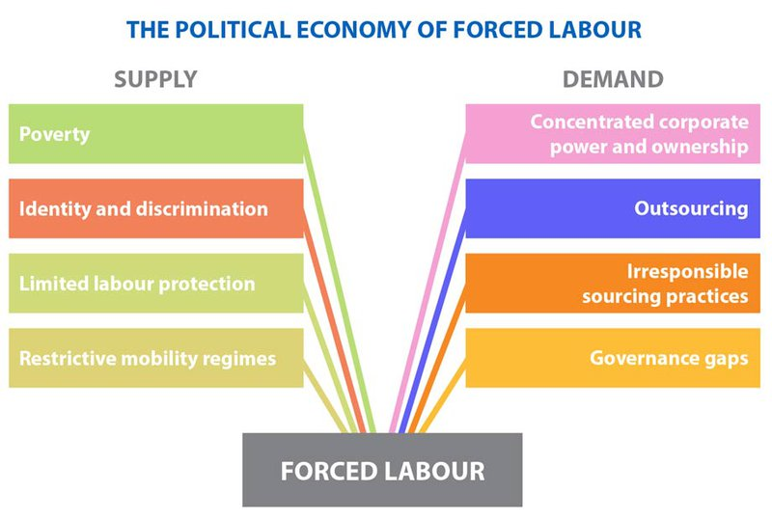
PRODUCT SOURCE
Notes:
Let’s look at the supply side and what factors increase the risk of slavery or trafficking.
Profits have driven companies to human rights abuse, turning a blind eye to what is happening in their supply chain.
From illegally trafficked workers to the indigenous people whose traditional lands have been lost to industrial scale plantation, many of those who suffer most from business-related human rights abuses receive little protection from state actors.
Nike is Vietnam’s largest private employer. It also has large factories in Malaysia that have been accused of running sweatshops. Video: ttps://www.youtube.com/watch?v=e9ZktmrGGMU
Activity – Break into groups and do desktop research on at least 2 global companies that use YOUR COUNTRY’S resources (aka people) to make profits. Where in the supply chain does your country come? Are there stories written about trafficking or exploitation in those factories? How can you give it a solutions approach? (Discuss)

Slide 12
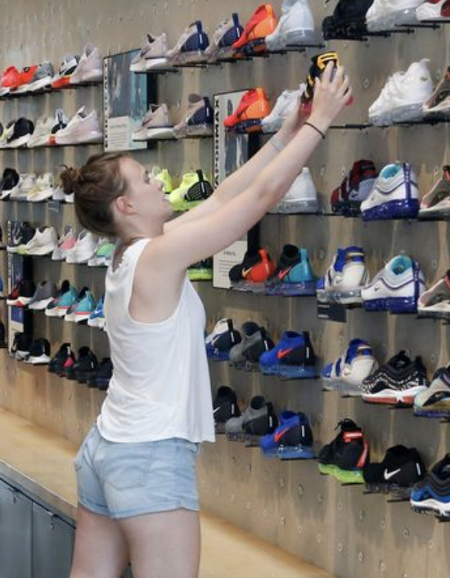

PRODUCT DESTINATION
Low levels of vulnerability
Buy products from countries with high risk for slavery
Cannot regulate labour conditions
Cannot monitor production
Topline and Bottomline
Notes:
Before we talk about countries where the exploitation is taking place, which typically are the world’s least developed countries and particularly those that are heavily impacted by known risk factors, such as conflict, failure of rule of law, mass displacement, and endemic discrimination (all desperations). While this focus is important, the realities of global trade and commerce make it inevitable that products generated by modern slavery will travel across borders and into higher income countries where the prevalence of modern slavery is LOW. These are the countries, btw, that have enacted laws on modern slavery too. In these countries, the citizens enjoy low levels of vulnerability. Businesses and governments in G20 countries are importing products that are at risk of modern slavery, with hardly any effort being applied by governments to regulate the labour conditions involved in their production.
The G20 countries collectively account for nearly 80 percent of world trade and about 85 percent of the world’s GDP.⁴ Two of the G20’s member countries, China⁵ and the United States (US),⁶ are the world’s largest exporting and importing economies respectively. It has been estimated that two-thirds of the world’s richest entities are now multinational corporations rather than governments.1 There are oil companies which are wealthier than many Asian governments; Walmart and McDonald’s are both in the top five private employers in the world; and the revenue of a big firm like Apple is greater than even large countries.2
Why should they care? And so UN stepped in.

Slide 13
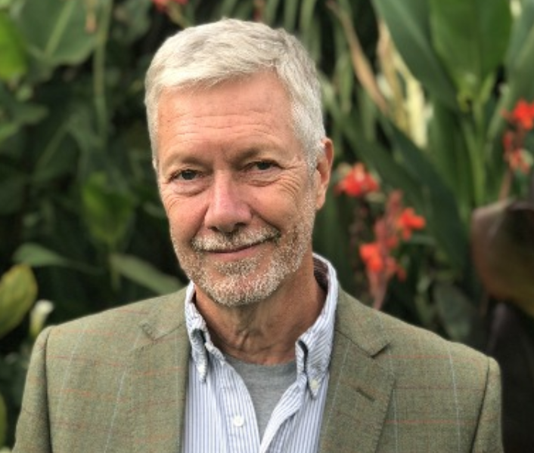
BIG BUSINESS
“People do not enslave people to be mean to them. They do it to make a profit.”
— Kevin Bales Co-founder of ‘Free the Slaves’
Notes:
a co-founder and previously president of Free the Slaves, the US sister organization of Anti-Slavery International.

Slide 14
Out of the 24.9 million people trapped in forced labour, 16 million people are exploited in the private sector such as domestic work, construction or agriculture – ILO, 2022
How much profit does human trade generate for businesses per year?
$150 billion per year (Global Slavery Index)
Notes:
It’s estimated that internationally there are between 20 million and 40 million people in modern slavery today. Assessing the full scope of human trafficking is difficult because so cases so often go undetected
Human trade earns global profits of about $150 billion per year (2014), $99 billion comes from sexual exploitation. Most profits from human trafficking are made in the developed world. $99 billion from commercial sexual exploitation
$34 billion in construction, manufacturing, mining and utilities
$9 billion in agriculture, including forestry and fishing
$8 billion dollars is saved annually by private households that employ domestic workers under conditions of forced labor
Globally, an estimated 71% of enslaved people are women and girls, while men and boys account for 29%
Estimates suggest that about 50,000 people are trafficked into the US each year, most often from Mexico and the Philippines.
1 in 4 victims of modern slavery are children
Out of the 24.9 million people trapped in forced labour, 16 million people are exploited in the private sector such as domestic work, construction or agriculture
Cost to free a person includes the medical care, the legal care, the outreach

Slide 15
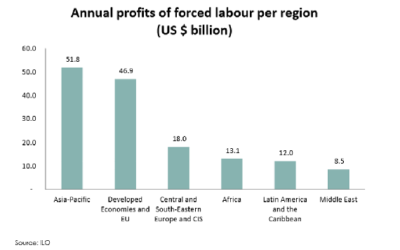
X
Notes:
You can see the profits are much higher in Asia Pacific, which means this region employs a lot of slave labour. From 2018.

Slide 16
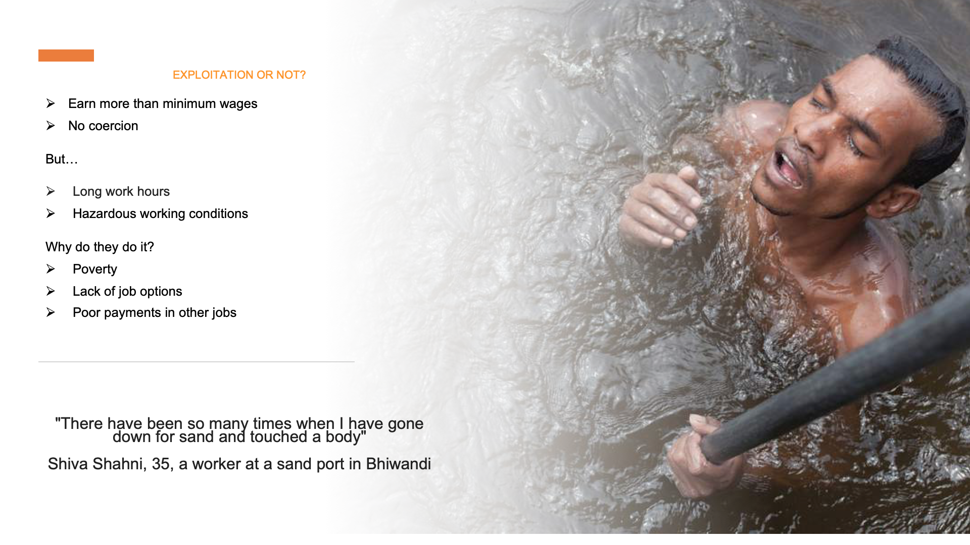
EXPLOITATION OR NOT?
Notes:
This is a story of exploitation of sand diggers in bhiwandi. Sand mining has been declared illegal in most parts of India with countless court petitions highlighting the danger it poses to coastlines, marine life, and sand reserves.
Uneven depths in creeks and rivers caused by illegal sand mining can spark currents and whirlpools, posing a danger not just to miners but anyone using the rivers, with multiple drownings across India blamed on the black market for sand.

Slide 17
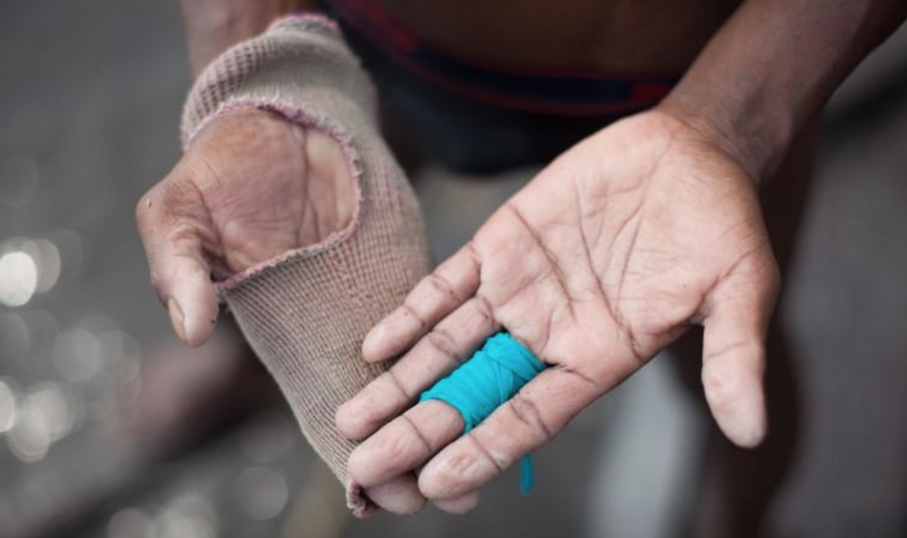
A sand miner shows the glove he wears while mining sand at Vasai creek in Bhiwandi, Thane on May 2, 2017. THOMSON REUTERS FOUN
HOW MANY STORIES GET DONE ABOUT PROPER GEAR THAT LABOURERS NEED FOR THEIR JOB?
Notes:
A sand miner shows the glove he wears while mining sand at Vasai creek in Bhiwandi, Thane on May 2, 2017. THOMSON REUTERS FOUNDATION

Slide 18
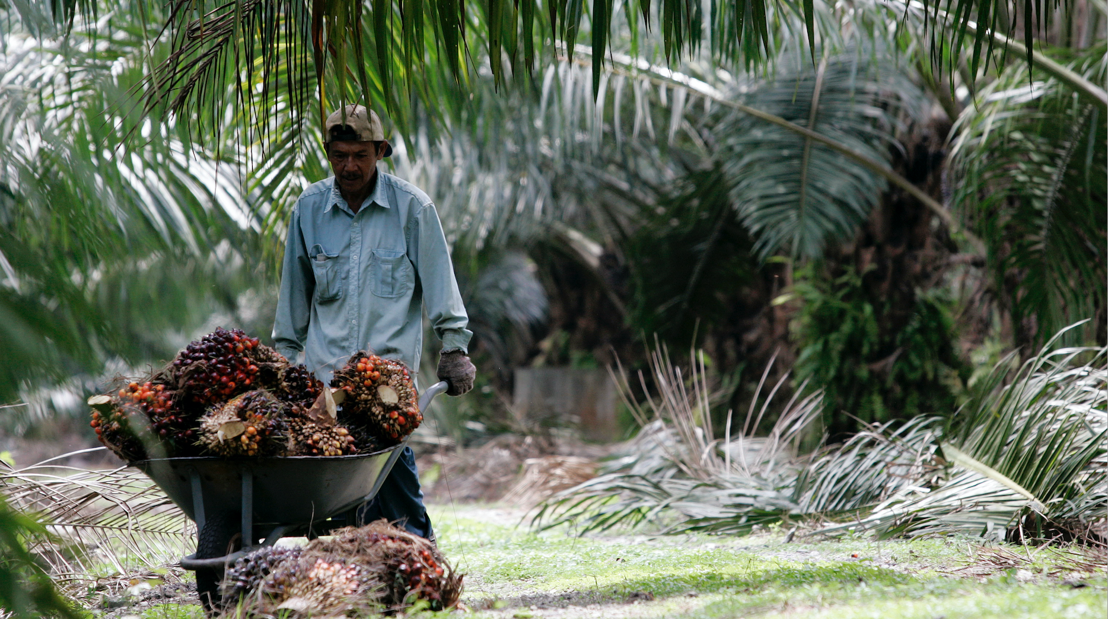
Notes:
Zainal Abd Halim- Worker pushes a wheelbarrow of palm oil fruits at a plantation near Kuala Lumpur.jpg
Palm oil comes from Indonesia and Malaysia
Sime Darby Plantation Berhad, the world’s largest oil palm grower, is fighting a US ban on its products after reported labour violations at its plantations. the Customs and Border Protection (CBP) agency has banned its products for more than a year following allegations of forced and convict labour at its Malaysian plantations.

Slide 19
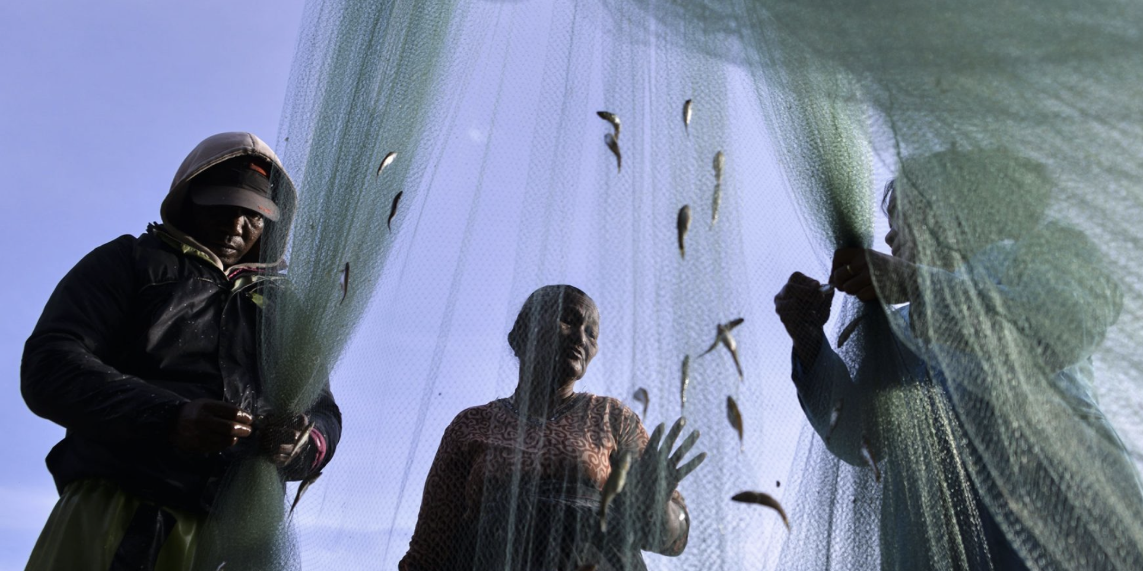
Notes:
Aceh province, Indonesia, August 2019. Fishermen collect their catch. Fishing is a high-risk industry for forced labour. Migrant workers are particularly at risk of exploitation in the Indonesian fishing industry. Photo Credit: Chaideer Mahyuddin / AFP. Getty Images.

Slide 20
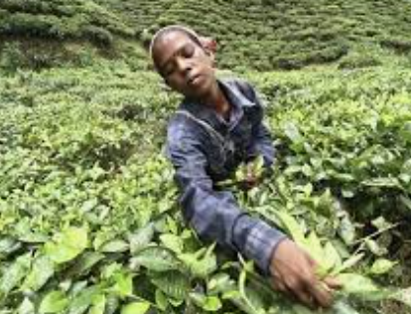
Notes:
Photo Credit: REUTERS/Utpal Baruah - A worker plucks tea leaves at the Amchong tea estate in Assam.
Similarly, India is one of the top 5 exporters of tea leaves in the world – once again because of high demand in the west. The world also gets its tea from Kenya, as well as China and Sri Lanka that have high demand. We talked about how climate affects slavery, and this is one example where Kenya was unable to deliver tea because of droughts. This increased the demand for tea in Assam. This was a business story, but no story was done on how did companies in Assam manage to increase their resources... Or workers … to meet this demand.

Slide 21
UN SDG FOR MODERN SLAVERY
8.7 Take immediate and effective measures to eradicate forced labour, end modern slavery and human trafficking and secure the prohibition and elimination of the worst forms of child labour, including recruitment and use of child soldiers, and by 2025 end child labour in all its forms.
Notes:
Adopted by the UN Human Rights Council in 2011, the UNGPs placed on the international agenda the issue of identifying potential adverse impacts on human rights by business activity.
In September 2015, all 193 Member States of the United Nations adopted a plan for achieving a better future for all — laying out a path over the next 15 years to end extreme poverty, fight inequality and injustice, and protect our planet. At the heart of “Agenda 2030” are the 17 Sustainable Development Goals (SDGs
The UN Sustainable Development Goals (SDGs) and in particular Target 8.7, which calls for effective measures to end forced labour, modern slavery, and human trafficking, as well as child labour in all its forms,³ has further contributed to the push within the international community to eradicate modern slavery, including through initiatives and policies to ensure public and private supply chains are free from this crime.

Slide 22
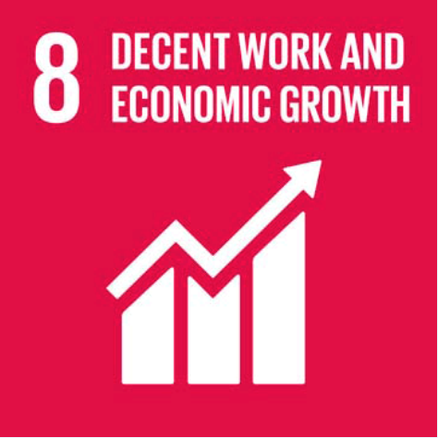
Notes:
PHOTO CREDIT: Damir Sagolj - Rohingya people from Myanmar, who were rescued from human traffickers inside a communal cell at Songkhla IDC

Slide 23
7 News Australia – Video of how a journalist exposed human trafficking in Nike's sweatshop factory in Malaysia
- https://www.youtube.com/watch?v=e9ZktmrGGMU

Slide 24
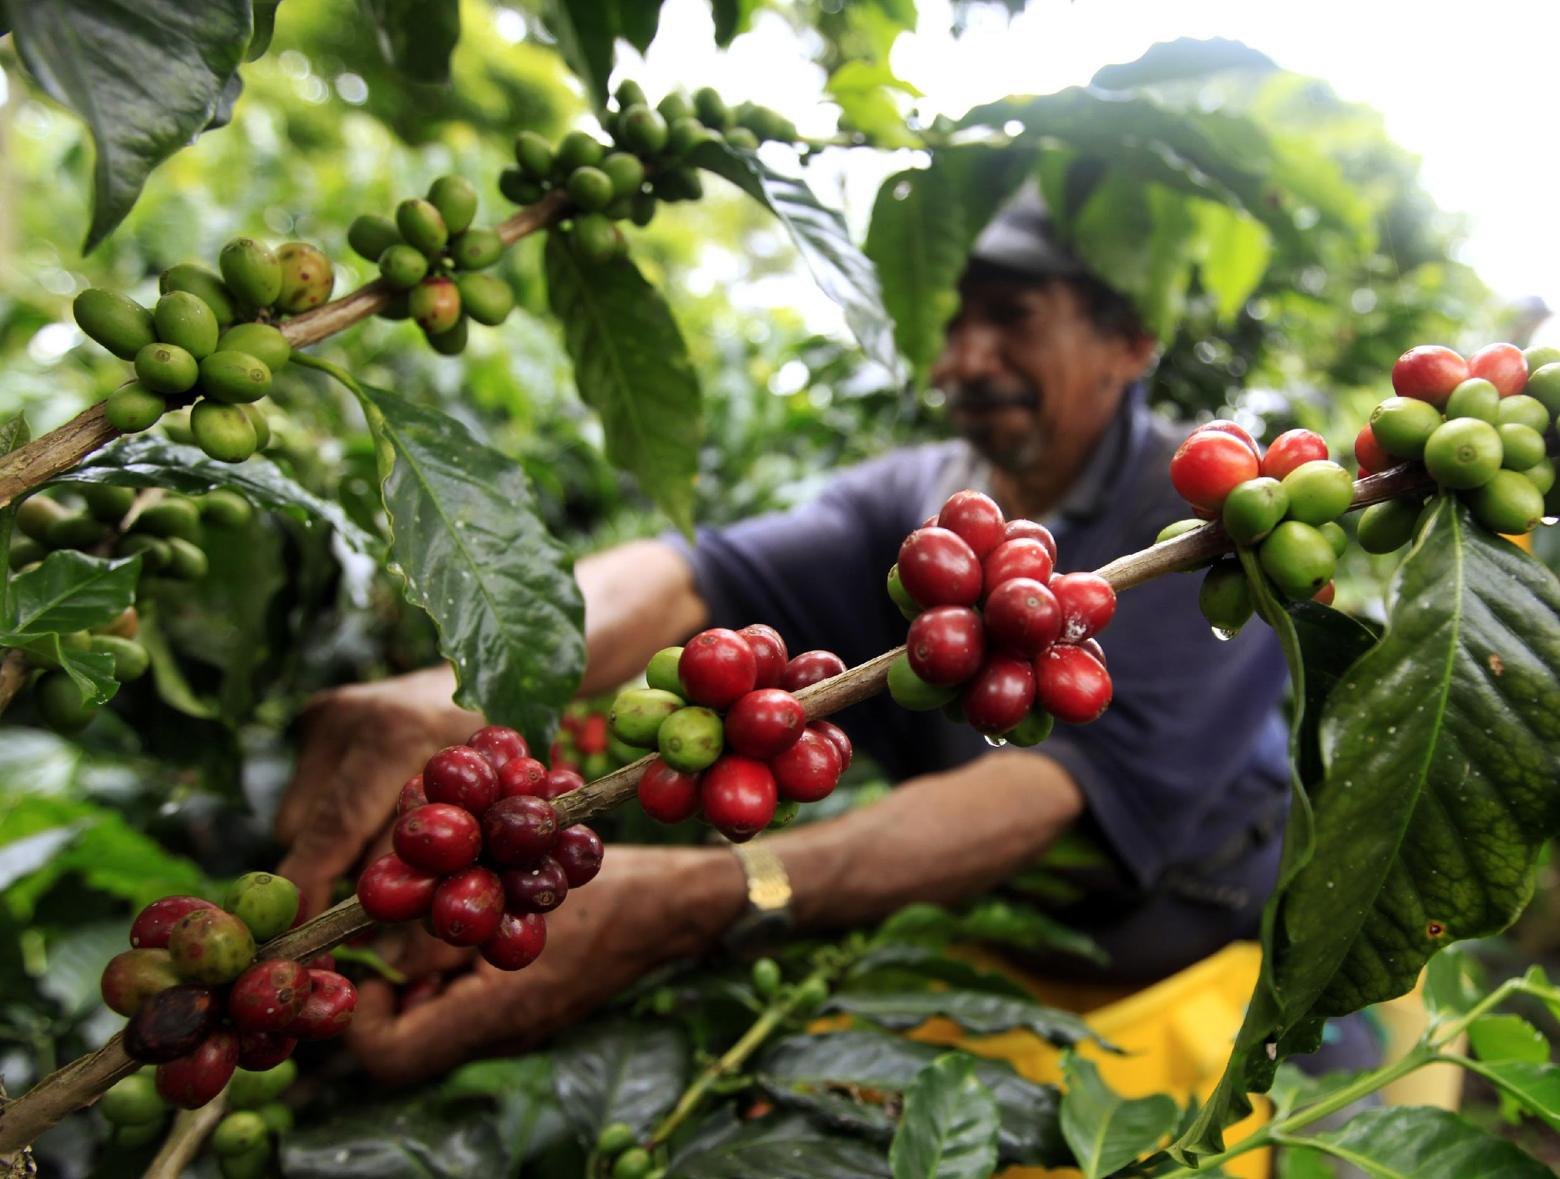
Research, Research, Research…
Where do the raw materials come from?
Where are they assembled?
Who provides the labour for the extraction of the raw materials and assembly of the product?
Who finances the making of the product?
Who profits at each stage of the product life cycle?
Who are the intermediate and end-consumers of the product?
Notes:
Because of the complexities of global supply chains, identifying how brands and consumers may be connected to situations of exploitation can be a challenging task. When undertaking these inquiries, it is important to consider many questions and do ample research for any product.

Slide 25
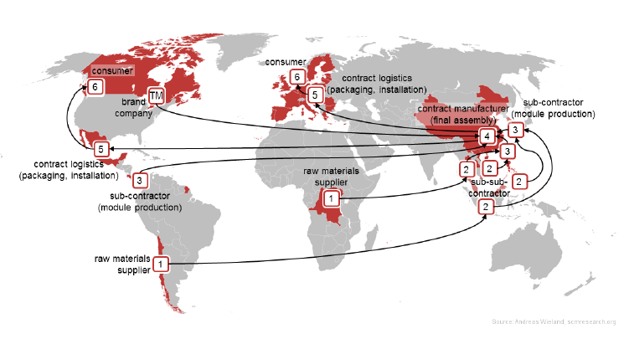
Tracking the Supply Chain
Notes:
In this example, we’ll try and understand why writing a simple story about supply chain is so difficult. And why a reporter needs to understand the route from raw material to retail.
Here, raw materials are supplied from suppliers in South America and Africa (1). The materials are refined and assembled into components by sub-sub-contractors in Southeast Asia, who assemble components for a sub-contractor to build product modules. (2 and 3).
The modules are then sent to a manufacturer (the main contractor) for final assembly.(4)
The contractor then contracts with companies in Europe and Central America to arrange for the packaging and installation of products (5) for consumers in Europe and North America. (6)
These products are sold under the brand of a company which is incorporated in North America which receives the profits and proceeds of sale – TM
So, there are 6 steps in this supply chain involving 7 or 8 different countries. Getting some sort of cross-border story done on slavery is a herculean task but not impossible especially if a news company has bureaus/stringers/fixers around. It can also be a dangerous story as you might open a pandora’s box.
Also don’t forget that supporting all these contracts and transactions are financial services companies that provide the funding to support the supply chain and facilitate payments between different actors. You also have logistics and shipping companies that move raw materials, components, and finished products around the world.
Imagine the amount of people required to do every job in this supply chain.

Slide 26
USE THE RIGHT TERMINOLOGY
Shape audience perceptions
Interpret data sources
Boost Credibility
Have an Impact
Responsible reporting
Provide CONTEXT
Notes:
Shaping audience perceptions: Framing an issue or situation as one of “slavery”, instead of “trafficking” or “forced labour” can significantly shape how readers and viewers will react to a story.
Interpreting data sources: Understanding the correct terminology can help journalists to understand sources of data and statistics, and to determine which sources and data are relevant to a story. For example, statistics on victims of trafficking are not the same as statistics on forced labour, or statistics on ‘modern slavery’ generally.
Credibility: Using incorrect terminology can also undermine the impact and credibility of a story. For example, if a journalist incorrectly refers to statistics on human trafficking in an article about forced labour, this may undermine the credibility of the story among readers who know that the two are not the same. This in turn may undermine the impact of the story.
Responsible reporting and legal risks: Using the correct terminology is especially important when reporting on alleged crimes. For example, if a suspect is charged with human trafficking or migrant smuggling, it would not be ethical or responsible to report that the suspect had been charged with “slavery”. Incorrectly labelling a situation as one of slavery or some other form of exploitation – especially where no such crime exists under applicable local laws – may also carry risks of civil or criminal defamation for journalists, sources, and other persons involved in the story. In jurisdictions such as Thailand, journalists and activists that expose alleged corporate human rights abuses are regularly subject to criminal defamation actions in retaliation for their work.
Provide Context: No news story is complete without context, or a nutgraph. A para or two that gives the whole picture to the reader. For example, outsourcing of work to a garment factory and enforcing limited work hours is a human rights story for a reader in the west, but explaining that the worker need more wages and therefore works extra hours provides context. It is a case of lower wages not increased hours.

Slide 27
Contract slavery: The fastest growing form of modern slavery in the world today (ILO)
legally binding agreement that is entered into between two parties
individuals are forced into servitude through debt bondage
provisions that require the individual to work long hours, without breaks
Pathetic living conditions
Confiscation of passports

Slide 28
Story ideas – Product source and tracking the supply chain
Globalslaveryindex.org
Methodology
G20 imports
How many products can you find from your country ‘at risk of modern slavery’?
Are you able to find one place where these products are found in abundance?

