Slide 1


Mental Health & Wellbeing for Frontline Workers
Closing the Gap with Digital Tools
Lauren Magoun
Sr. Health Strategy Specialist, Research & Data Team
May 2024

Slide 2
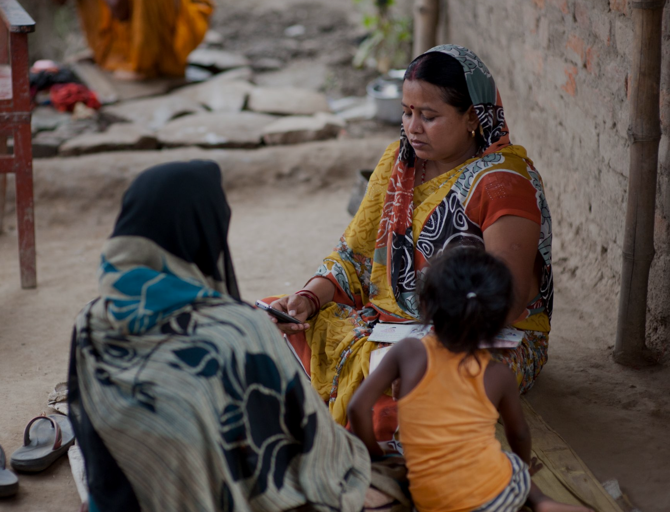

Vision
A world where all people have access to the services they need to thrive
Mission
To build and scale sustainable, high-impact digital solutions that amplify frontline work
Notes:
"Good afternoon, everyone. I’m Lauren Magoun from Dimagi, a social enterprise and technology company focused on improving health and social outcomes through digital solutions for frontline workers." I sit on our research team at interaction of research, mental health and technology.
Today
First I am going to tell you very briefly about where I work, and who we work with…
then share how I think about mental health @ work and situate it in the the world in terms of equity
Then what Dimagi is doing to support better jobs for better outcomes in our world through an app to build resilience of FLWs.
Founded in 2002, Dimagi is one of the few successful social enterprises to provide digital solutions in LMICs, with its open source solutions.. Today, more than 130,000 FLWs in over 130 countries use our products to deliver services to clients…. In five years, we’re expecting to reach half a million Frontline Workers. We also work in the US, where we provide care coordination, infectious disease management d ans social care coordination solutions, services and analytics.

Slide 3
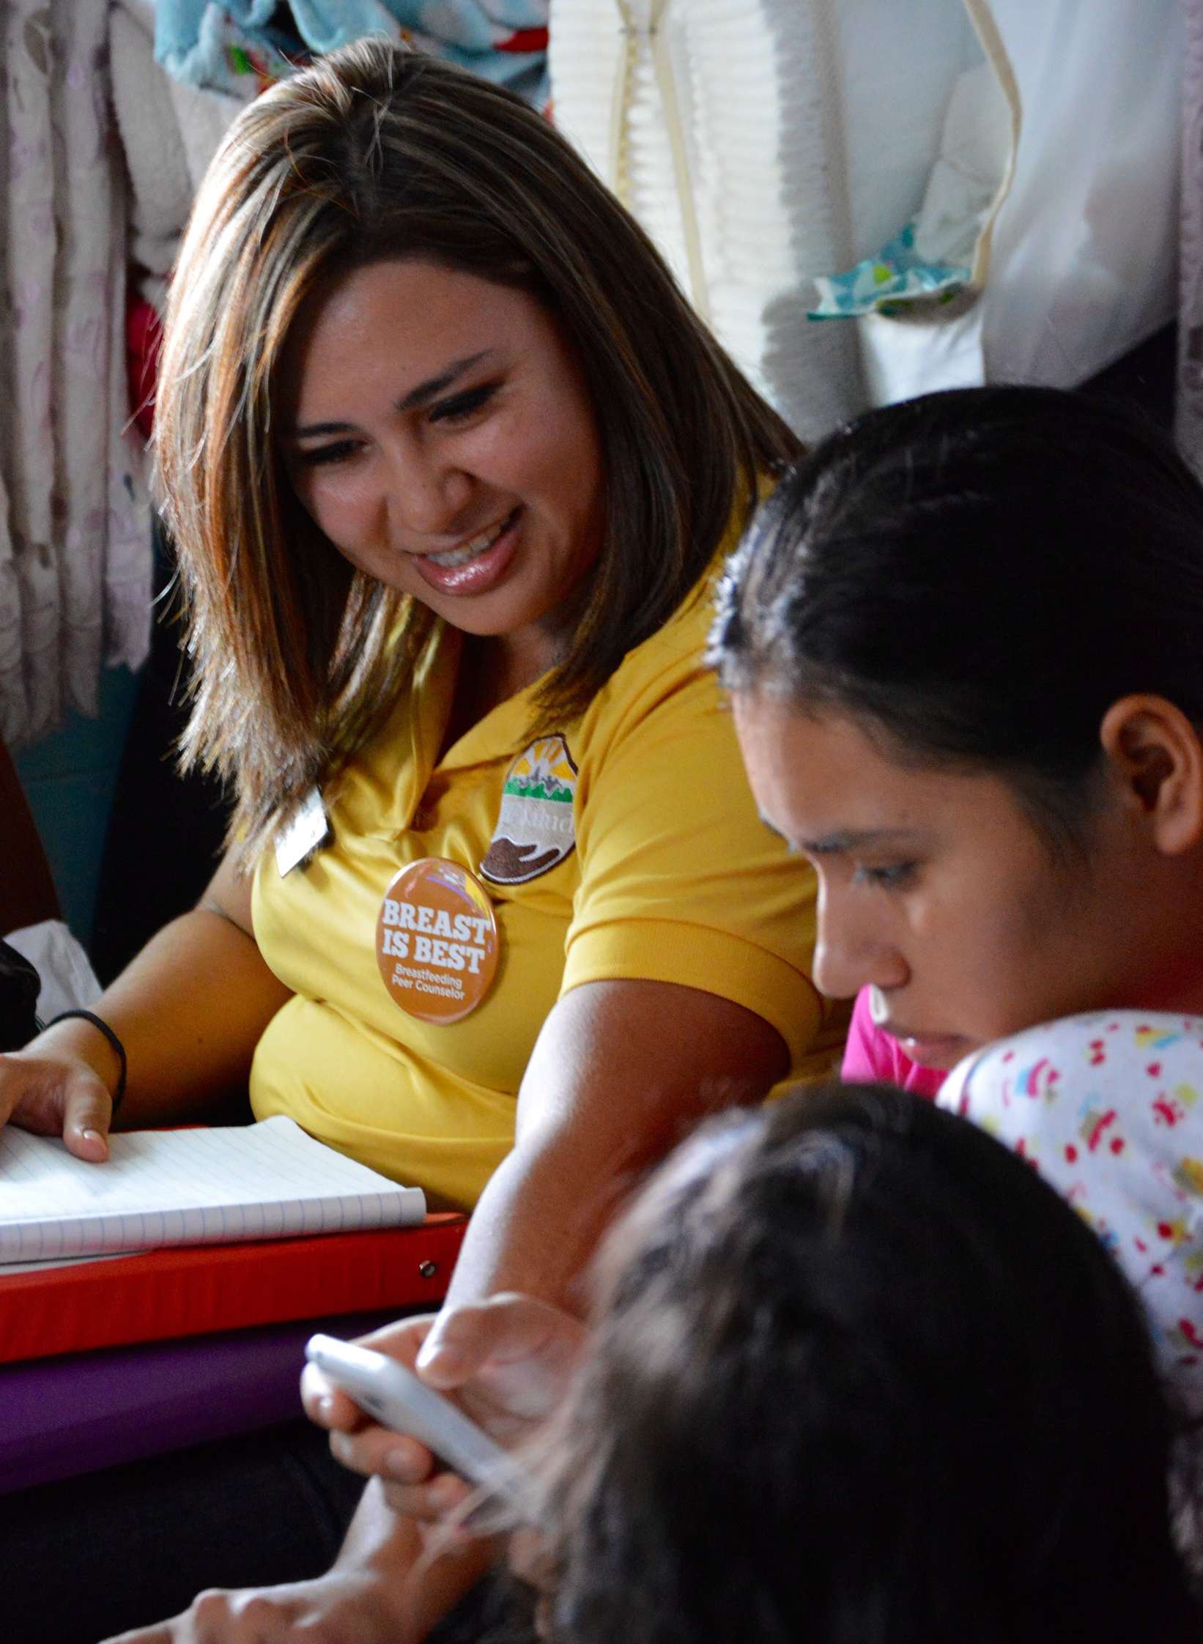

Who Are Frontline Workers?
Generally, women with limited training or education who provide health services for hundreds of people in their own communities. Often hired by governments or NGOs for little money, sometimes none.
8 million estimated Frontline Workers across large programs, almost all in Africa and Asia.
86% in Africa are non-salaried. Majority are volunteers with some or no compensation.
What Do They Do?
Preventing, detecting, and managing leading killers (diarrhea, pneumonia, malaria, HIV, TB)
Supporting mothers through pregnancy, birth, and under-5 care
Immunization for common infections
Responding to pandemics and emergencies
Frontline Workers also are often the only point of direct services or link to a distant health system.
Notes:
So what do I mean by frontline workers?mentioned 2x in our mission and vision.. Billions of people around the world, but primarily in low- and middle-income countries depend on Frontline Workers for healthcare and other essential services. Preventing, detecting, and managing leading killers (diarrhea, pneumonia, malaria, HIV, TB) - Supporting mothers through pregnancy, birth, and under-5 care - Immunization for common infection - Responding to pandemics and emergencies FLWs are often from the communities they serve and act as the primary point of contact to the health system…They typically receive little training and low pay. Some are members of the informal sector, with seasonal or short-term work.
These FLWs tend to be women, and are often unpaid, or lightly incentivcized…
In the US, our tools are typically used by people in community health clinics, or in frontline healthcare roles at interface of the public health and healthcare ystems..primarily today alking about our work in workplace mental health in LMICs, ..
We build digital tools to support their wok in a variety of ways - tools are adapted and customized for lcoal communities..

Slide 4

“
We will put a stake in the ground around the need to improve Frontline Workers’ jobs as being on the critical path to improving wellbeing outcomes.
“
Dimagi’s 5-Year Strategy
2022-2026
Notes:
We have made it a key part of our global strategy to improve the jobs of this underserved workforce. We have several initiatives to support this goal, and today I will speak about one of them involving mental health in a workplace context..
Regardless of the initiative wel always focus on user-centered design, working closely with communities to ensure our tools meet their specific needs. This approach ensures that our solutions are effective and truly beneficial for frontline workers. We also focus on how we can build cost-effective and scalable and open-source solutions.

Slide 5
Big Picture: Mental Health @ Work
Creating Mental Health Promoting Workplaces
Supporting Employees with MH Disorders and those caring for them
Appropriate workloads
Control over work
Safe working conditions (physically and psychologically)
Appropriate pay and development
Paths to additional skills and promotions
Culture of equity, fairness and belonging
About 15% of working adults have a MH disorder.
Health insurance that is affordable AND has in-network providers with openings
Flexible schedules, sufficient PTO to accommodate health and wellbeing.
Supervisors that are supportive.
WHO: Mental Health at work
Notes:
A way to make a job better is, of course, is to focus on mental health of workers… in my view there are 2 buckets of ways to improve “mental health at work”
Work as a protective factor – providing good work, fair pay, a sense of purpose, and social connection, bring in wellness initiatives and stress reduction practices..
Supporting employees with mental health disorders, roughly 15% of a workforce, and employees who are caregivers of those with MH conditions.
Dimagi focuses on the first aspect, working with partners to improve overall job quality for frontline workers. Today, I will specifically cover our efforts to prevent and alleviate burnout.

Slide 6
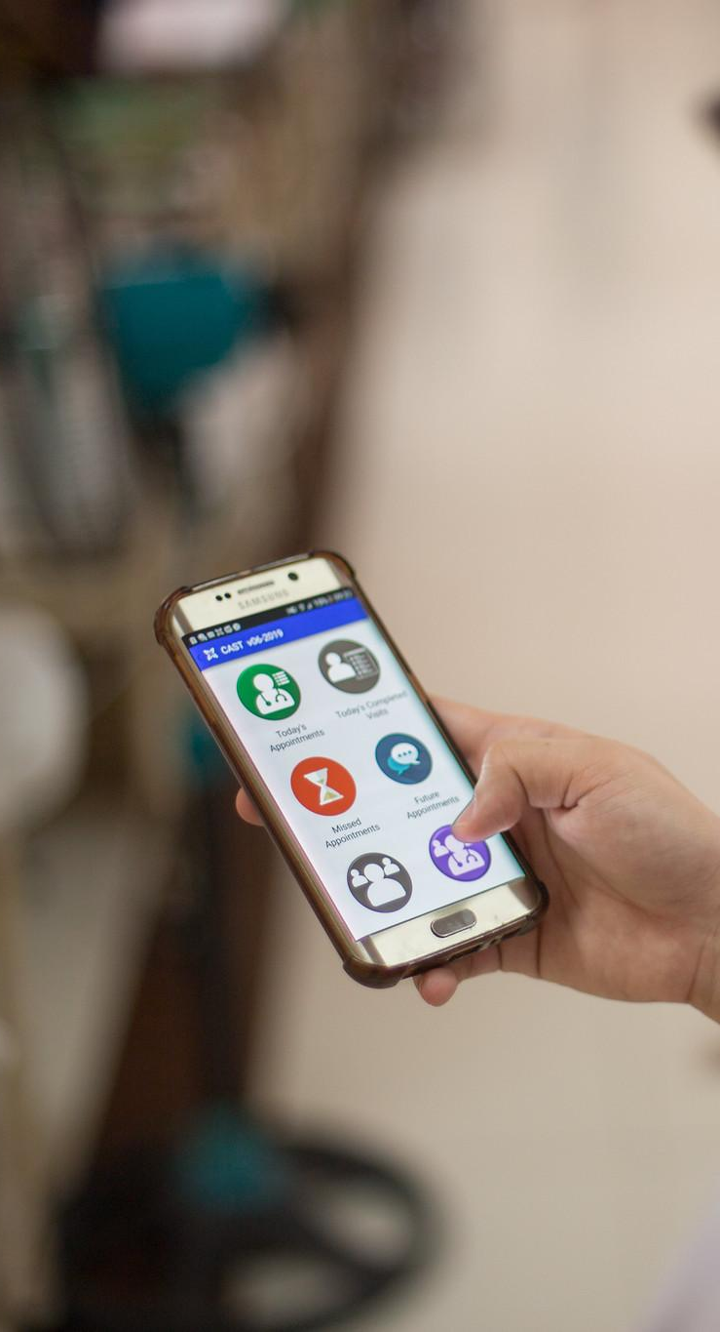

Equity
Notes:
Before I discuss Dimagi's initiative to reduce burnout in frontline workers, I want to emphasize the importance of equity. Improving workplace mental health is essential but not sufficient to address the overall mental health needs of the workforce.

Slide 7
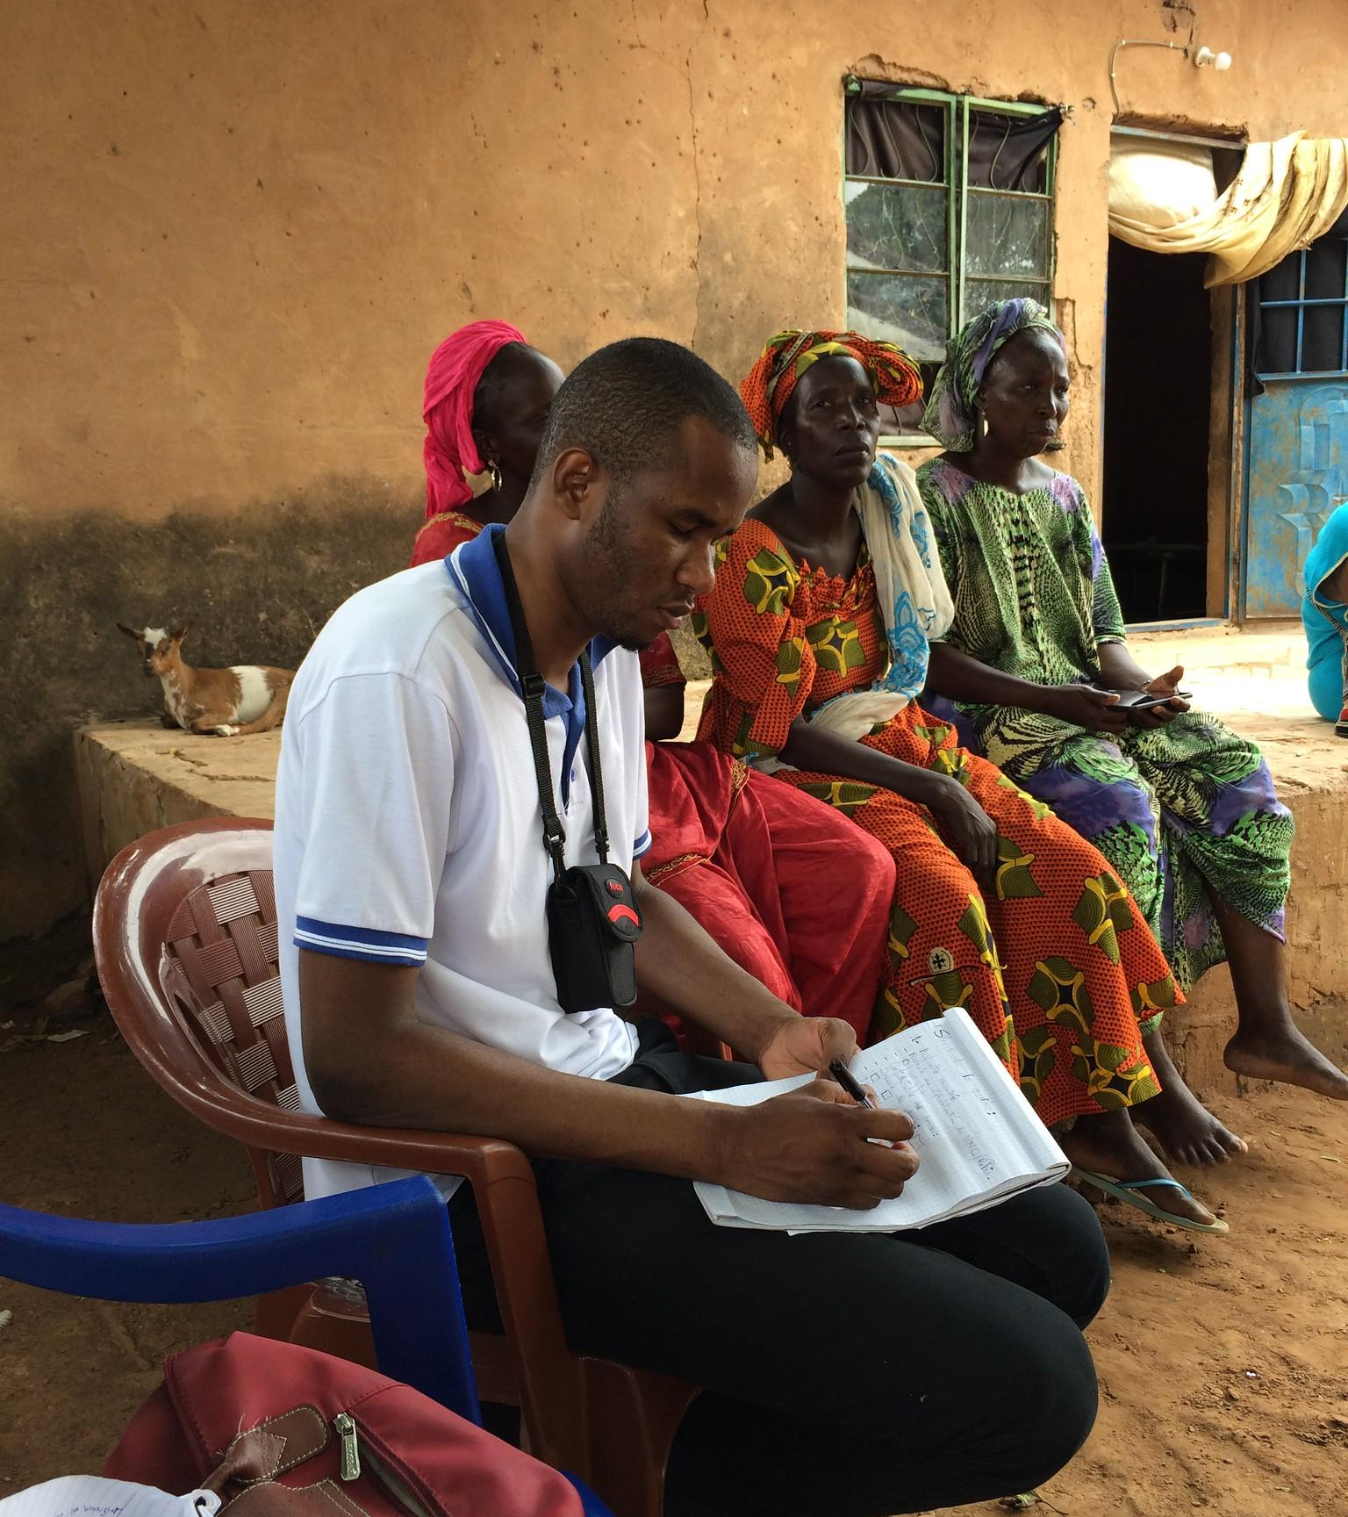
Informal Workforce
60%
Of the 2 Billion workers worldwide are working outside of formal employment
15%
Of “advanced” economies GDP comes from informal sector
IMF and ILO Data
Notes:
Even with comprehensive workplace mental health solutions, they would only reach 40% of workers worldwide. Most people globally work in the informal sector, which lacks HR support, including many frontline workers.
This issue is not limited to low- and middle-income countries; 15% of the GDP in advanced economies comes from the informal sector, representing a significant portion of the workforce.

Slide 8
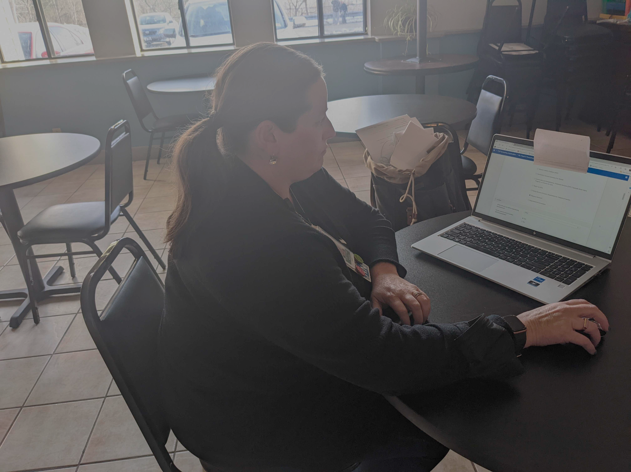
US Inequities
24%
Don’t have health insurance offered by their private workplace
<12%
Of small employers have comprehensive wellness programs
US Census and CDC
Notes:
n the US, there are significant disparities in workplace mental health. Nearly 24% of workers in the private sector aren’t offered insurance. While almost 50% of employers do offer comprehensive wellness programs, there's a huge gap by employer size and industry, with many programs being merely informational. Only 8-12% of small employers (fewer than 100 employees) offer comprehensive wellness programs and even fewer things like stress management and the linke.
In my research work with digital wellness and telehealth programs, it's clear these benefits are usually available only to employees of larger companies or those in white-collar jobs.

Slide 9
WellMe
Notes:
Back to our work at Dimagi on supporting FLWs…like all our work, our apps need to be part of comprehensive implementation and programs…an app rarely solves problems without support, training and wrap around services..

Slide 10



The Impact of Burnout
Burnout is an occupational phenomenon that can negatively impact Frontline Workers’ energy levels, the connection they feel to their work, and their professional efficacy..
Emotional Exhaustion
Energy depletion or exhaustion
Depersonalization
Mental distance from, negativity/cynicism towards work
Low Personal Achievement
Reduced professional efficacy
WHO 2019 & Dugani S, Afari H, Hirschhorn LR et al. 2018
Notes:
We know healthcare workers of all sorts are burned - which is even now officially in the ICD-11 recogonizing that it can resulting from chronic workplace stress that has not been successfully managed. It is characterized by three dimensions:
feelings of energy depletion or exhaustion;
increased mental distance from one’s job, or feelings of negativism or cynicism related to one's job; and
reduced professional efficacy.
Burn-out refers specifically to phenomena in the occupational context and should not be applied to describe experiences in other areas of life.”
While not a medical diagnosis, it impacts peoples wellbeing.

Slide 11
We
need
to do
More
About
Burnout
Evidence-Based Approaches
Building resilience is one evidence-based approach to counteracting burnout
Appropriately Adapted
Messaging should be adapted to resonate with Frontline Workers in a given geography, language, and context
Scalable
In order to tackle the challenge of burnout, we need solutions that are scalable
Share What We Learn
Evidence from LMICs is limited; as we do more about burnout, we also need to share what we learn with the community
Notes:
What can we do? We want to bring together known, evidence based approaches, adapte them for - tone, examples, language for FLWs..

Slide 12
Our Approach: Building Resilience
WellMe leverages the power of digital technology to teach resilience-building skills at scale
Stress
Management
Self Care
Connect to
Others
Mindfulness and Relaxation
Connect to Purpose
Notes:
We are basing our approach on these 5 core areas…

Slide 13

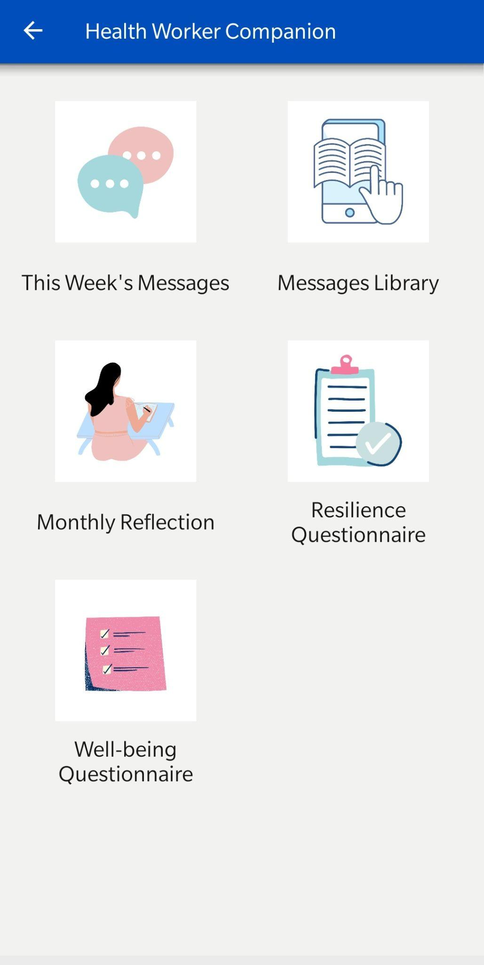





WellMe Design
WellMe
1
Evidence-based learning materials
Learn
Practice
2
Practice to reinforce skills for wellbeing
My Favorites
My Profile
3
Tailored to individual preferences and feasibility
4
Auto-generated insights and progress tracking
Help
5
Appropriate referral to mental health resources

Slide 14
Testing our Hypothesis
1
Substantial use of WellMe will increase Frontline Worker resilience and wellbeing
Provable in the short term
2
We can cost-effectively foster use of WellMe by Frontline Workers
Improved resilience and wellbeing will improve Frontline Worker retention
3
Requires multi-year studies
Improved resilience and wellbeing will improve outcomes for the communities FLWs serve
4

Slide 15
WellMe Deployments
500+
FLWs
WellMe has been used by 500+ FLWs and nine partner organizations across six countries– India, Uganda, Nigeria, Kenya, Malawi, and Ethiopia.
WellMe is currently available in English, Hindi, and Tigrinya. Additional languages will be added in the future depending on need.
6
Countries
3
Languages

Slide 16

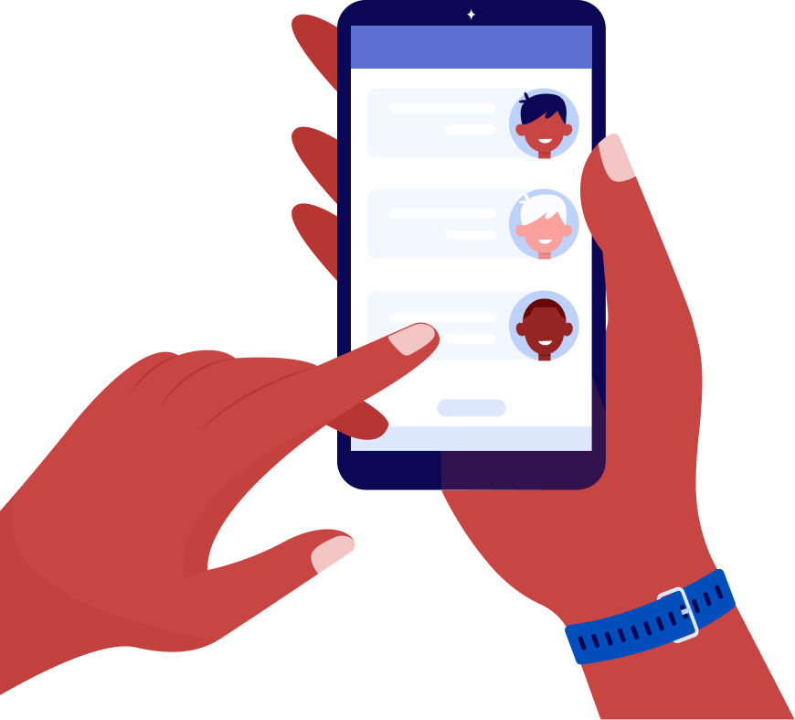
Mental Health at work is critically important AND large gaps in access to it remain.
Digital tools may be a scalable and impactful way to help.
WellMe
Learn
Practice
My Favorites
My Profile
Help
Learn More
https://sites.dimagi.com/wellme

Slide 17


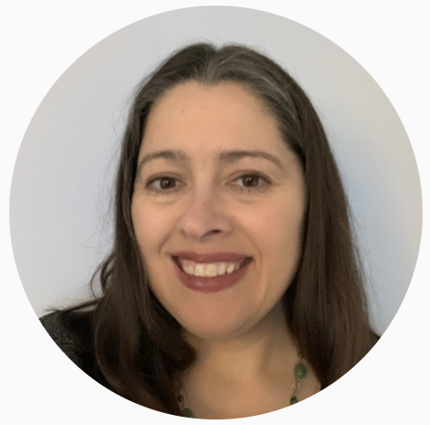


Lauren Magoun
Senior Health Strategy Specialist
lmagoun@dimagi.com
Dimagi
Thank You

