Slide 1

Employee Assistance Programs
National Press Foundation
May 22, 2024

Slide 2

Kathleen Crowley, LCSW, ACSW, CEAP
A little about me…
Licensed Social Worker (LCSW)
Member of the Academy of Certified Social Workers (ACSW)
Certified Employee Assistance Professional (CEAP)
35 years of experience in the Behavior Health Field with 10 years in EAP
Professional speaker on issues related to organizational psychology/development
Notes:
This is me on a really good hair day!

Slide 3

Objectives
Points of Interest with EAP’s
Where They Come From
How They Work
How Their Effectiveness is Measured
Common Misconceptions

Slide 4

History of EAP’s
Alcoholics Anonymous (1939)
Senator Hughes and The Hughes Act (1969)
National Institute on Alcoholism and Alcohol Abuse (1970)
Boston College, Utah, Otto Jones (EAP) and Dale Masi
Dr. Masi created training programs
Creation of the EAP model for the Federal Government
Notes:
Drinking on the job used to be normal! In 1939 with the development of AA
Secretary of HSS, Joseph Califano brought Dr. Masi to Washington
In the 1970’s a Senator spoke up about his concern for the mental health of the workforce since their was the NIH and the NIMH – this Senator was a recovering alcoholic and he made sure the NIAAA was formed as a part of the Fed Gov’t. That law said that all fed ee’s must have a program where they can receive help if they need it.

Slide 5

Purpose of EAP’s
Purpose:
  Personal issues impacting work performance, health and well-being
  Decrease absenteeism and presenteeism
  Increase productivity
  Improve job satisfaction and moral
Notes:
Purpose, to help address personal issues that impact the professional
This is done through counseling session models as well as essential services like: Childcare services, elder care services, financial, and one of the biggest is legal. We also do critical incidents.
Ie what AHC did for nurses and childcare and transportation during the pandemic
Some studies indicate that offering EAPs may result in various benefits for employers, including lower medical costs, reduced turnover and absenteeism, and higher employee productivity.

Slide 6
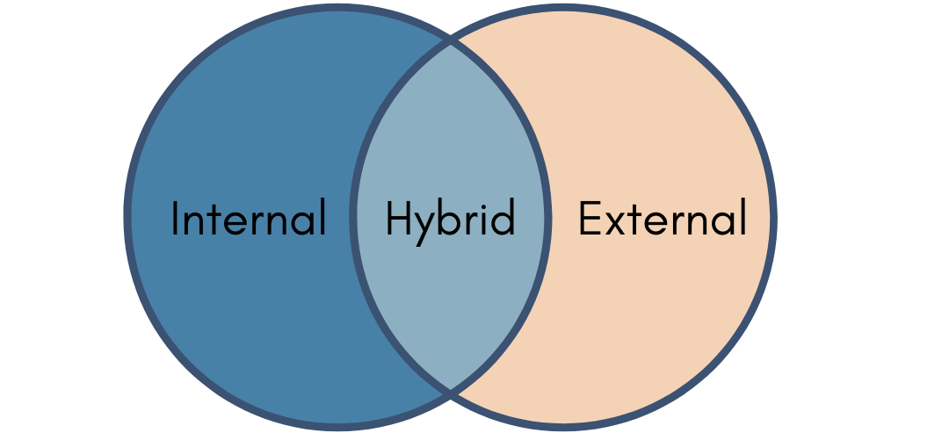
Different Models
Notes:
Internal knowledge of the organization and the providers are employed by the org
External uses providers not affiliated with the org
Hybrid. LWS example

Slide 7

How is their effectiveness measured?
Industry standard
DATA collection
Indicators
  Reduced stress levels
  Improved work-life balance
  Increase job satisfaction
  Enhanced coping skills
Notes:
EAPA recognizes that organizations are different, not only in size but industry, gender, culture and
Track utilization
Surveys
This is controversial because it is difficult to have a an actual goal as all industries are made up differently. Therefore measuring utilization for a large banking/legal industry against health care would look much different. Gender plays a role

Slide 8

Common Misconceptions
Formal referrals/punitive work
EAP’s are only for serious issues
EAP’s aren’t confidential
EAP’s only offer counseling
Unnecessary if you have healthcare

Slide 9
For More Information
Follow Adventist HealthCare LifeWork Strategies on LinkedIn for the latest health and well-being updates!

