Slide 1


2024 Elections Reporting Fellowship/Mentorship
Jehangir Khattak - jehangir.khattak@journalism.cuny.edu
Mythili Sampathkumar - mythili.sampathkumar@journalism.cuny.edu

Slide 2
What is Community Media?
Mostly nonprofit news outlets with a hyperlocal focus
  Hyperlocal does not always mean geographical area
Ethnic media
Can be digital, broadcast, but print still has a strong hold on this sector
Not to be conflated with public media like NPR, PBS, etc.
Some examples in NYC:
  New York Amsterdam News
  Sing Tao
  Khasokhas

Slide 3
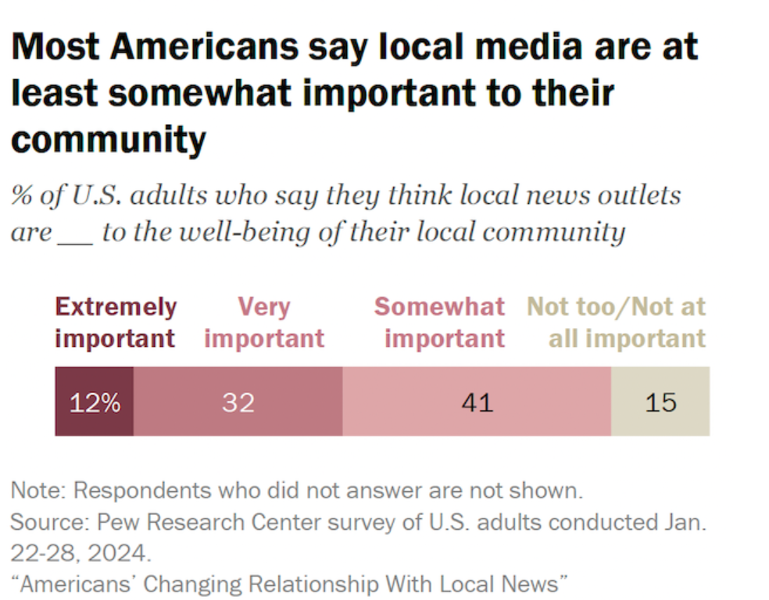
Why is community media important to elections coverage?

Slide 4
Why is community media important to elections coverage?
Because of its reach and loyal following with the communities this media covers
Because of the community angle in its reporting which creates political stakes
Because its coverage increases civic engagement and can increase voter turnout
Another way of looking at it - this is from Gallup, October 2023
32% say they have "a great deal" or "a fair amount" of trust
14% of Republicans express trust, down from 32% last year
Confidence drops among younger and older Americans
“Majorities of both major parties say local media in their area are doing their jobs well. While Republicans and GOP-leaning independents are slightly less positive than Democrats and Democratic leaners in their opinions of local media, views of local news don’t have the same stark political divides that exist within Americans’ opinions about national media.” - Pew Research Center

Slide 5
Why is community media important to elections coverage?
Much of mainstream media covers the presidential race or well-known U.S. Senate races and often, especially in broadcast media, the ‘horserace’ is what is covered extensively because of their general audience.
Community media journalists, on the other hand, provide a crucial, hyperlocal perspective on not just national elections but state and local elections as well as ballot initiatives — the parts of American politics that impact their communities’ day-to-day lives in tangible ways but are often overlooked and underappreciated by larger media outlets and their audiences.

Slide 6
What is the Center for Community Media and what do we do?
The mission of CCM is to serve news organizations that provide essential local coverage for populations whose voices and issues are underrepresented in mainstream media. The Center serves as a hub of information, resources, and training aimed at increasing the sustainability of this news media sector.
We offer:
Trainings covering both editorial and and marketing
Mentorship programs, including the elections reporting one
Ads Boost Initiative offers ads resources, media kit prep support, an updated media directory, work with MOECM for better engagement with the community media etc.
BMI, AMI and LMI offer customized professional development programming to major sectors of the community media
Weekly Newsletter covers latest news from the sector besides what’s happening at the Center
Research, surveys and consistent engagement with the media to better. We are about to release a major report about Asian media.

Slide 7
The Elections Reporting Mentorship
16 professional journalists chosen from a large number of applicants
Represent Caribbean, Latino, Arab, Irish, Indian, Chinese, Black, and other communities in the metro area and their stories will be published in English, Spanish, Nepali, Chinese, and Arabic.
Three stories to be produced over the course of the mentorship
Attending training and editorial sessions
We work with in-house editors
Exposes reporters to a new beat or deepens their expertise

Slide 8
Stories from our cohort
For City Limits, Mary Cunningham reported on New York state’s version of the Equal Rights Amendment and its provision regarding reproductive rights being included on the ballot in November.
Rommel H. Ojeda did a bit of service journalism for Documented, providing useful information for naturalized citizens voting for the first time in NYC.
Alec Meeker of Bushwick Daily explored how redistricting is affecting Bushwick and how that intersects with a changing demographic in the district. Check out his custom maps!
Reporte Hispano’s Gery Vereau looked at the elections through the lens of chifa, a Peruvian-Chinese dish made with meat and rice, and spoke to voters at various chifa restaurants in the metro area while weaving in the perspective of how immigrant communities often bring their experiences with politics in their home countries with them in the U.S.

Slide 9
Sign up for our newsletter!
https://go.journalism.cuny.edu/l/930393/2022-05-16/mlhn
Follow us on Twitter/X: @ccmnewmarkJ
And on LinkedIn: https://www.linkedin.com/showcase/ccmnewmarkjschool/

