Slide 1


The Business Case for
Workplace Mental Health
Betsy Schwartz, MSW, Director, Center for Workplace Mental Health, APAF

Slide 2
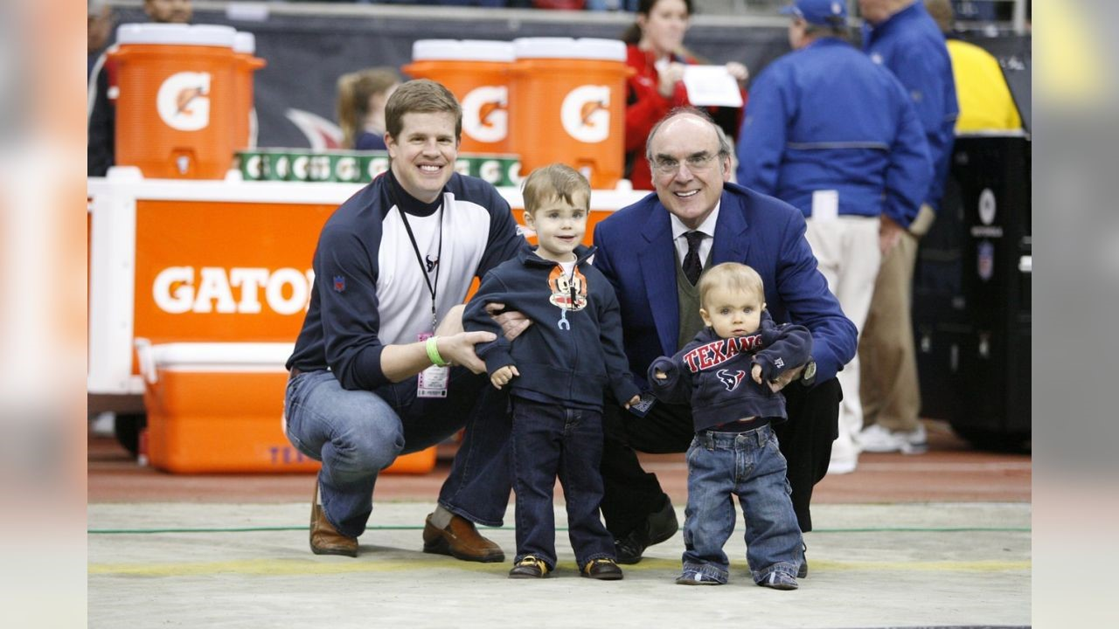

Slide 3

The Case is Clear Employee Mental Health Impacts the Bottom Line
65% of employees said their mental health affected their ability to do their jobs (2023), up from 60% in 2022.
46%
42%
36%
Less Focused
Less Engaged
Less Productive
Lyra, State of Workforce Mental Health Report, 2024

Slide 4
Mental Health Costs to Global Economy Direct vs. Indirect
12B
$1T
$322B
Lost Workdays from Depression & Anxiety
Lost Productivity from Missed Working Days
Turnover & Lost Productivity $ Costs Due to Low Well-being
Future Leaders Disproportionately Impacted
68% of millennials and 81% of Gen Z reported they have left their job for mental health reasons
World Health Organization, Mental Health at Work, September 2022
Gallup, Wellbeing and Workplace Study, October 2022
Notes:
Depression & Anxiety cost the global economy 12 billion working days every year, which is $1 trillion per year in lost productivity
$322Billion: The global costs associated with turnover and lost productivity
because of low well-being.

Slide 5



Organizational Commitment to Workforce Mental Health
1 in 4 (26%) organizations Indicated that they have a formal strategy for workforce mental health
Commitment
Impact
67% of global leaders expressed a commitment to workforce mental health
54% of organizations that do have a formal strategy are better positioned to impact workforce mental health, scoring 54% higher
Strategy
One Mind at Work: Mental Health at Work Index Key Findings, 2024

Slide 6

Mental Health Care Works
1 in 5 adults have a mental health condition
Less than half receive the care they need
70 - 90% of individuals improve with treatment
Overall cancer survival rate is currently 68%
SAMHSA, 2021 National Survey on Drug Use and Health

Slide 7


Barriers to Mental Health Care
¾ of US adults believe mental health issues are handled worse than physical health issues.
Top Barriers to Mental Health Care
1
ACCESS: Difficulty finding a provider
COST: Affordability of care
2
Gallup, Americans Perceive Gaps in Mental, Physical Healthcare, May 2024

Slide 8

Employer Challenges
Access to Care
Insurance Coverage
Fear and Shame
Notes:
Combine 7&8

Slide 9





Increasing Access: Innovative & Creative Solutions
Leading employers are getting creative on increasing access to care by
Enhancing or Replacing Employee Assistance Programs (EAP) with Digital Point Solutions
Providing Onsite Counseling
Contracting with Institutions/Practices for Care Options
Leveraging Purchasing Power to Enhance Solutions and Increase Access
Advocating for Integrated Care Models (Collaborative Care Model) that Provide MH Care in the Primary Care Setting and Extend the MH Workforce.
Providing Mental Health Manager Training (NTA at Work).

Slide 10

What can journalists do?
Choose words wisely, language matters.
Convey that treatment works.
Notes:
Words matters (portraying conditions OVER illness or challenges). When reporting, use care in distinguishing when events are rooted in a mental health condition vs. heinous crimes.
Report on innovations in health care that have improved treatment of mental health conditions and substance use.
Amplify need to mental health parity. Learn about and report on collaborative care as

Slide 11


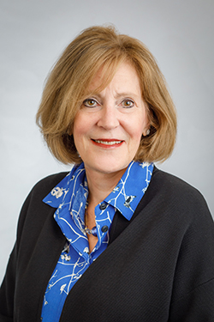


Stay in Touch!
Emma Jellen
Associate Director
Email: ejellen@psych.org
Betsy Schwartz
Director
Email: bschwartz@psych.org
Shayla Gerity
Program Manager,
Email: sgerity@psych.org
visit: workplacementalhealth.org

Slide 12

Q&A

