Slide 1
Psychologically Healthy Workplaces Building Psychological Capital
Dr. Dennis P. Stolle
Senior Director of Applied Psychology
dstolle@apa.org
American Psychological Association | Science Directorate
May 2024 | NPF | Washington, DC

Slide 2
Psychologically Healthy Workplaces
Notes:
Our goals include striving to bring psychological wellness and top psychological performance to the entire population.
One way to reach large portions of the population is through the workplace.

Slide 3
80,000 -90,000 Hours
Notes:
Not only does it give you access to large numbers of people, it gives you access to a very influential part of many people’s lives.
Just the amount of time alone
Further, many people’s self identity is intertwined with their job or career

Slide 4

Notes:
Ever since the pandemic, there has been a lot of talk about “mental health” in the workplace.
So much talk of mental health that the term “mental health” has almost begun to lose meaning.
Does mental health just mean the absence of mental illness? Or does it mean something else?
Article about something as serious as suicide – something as seemingly trivial as zoom fatigue
It is important to get oriented to what we are referring to when we talk or write about mental health

Slide 5
Mental health is a state of mental well-being that enables people to cope with the stresses of life, realize their abilities, learn well and work well, and contribute to their community. It is an integral component of health and well-being….
Mental health is more than the absence of mental disorders. It exists on a complex continuum, which is experienced differently from one person to the next, with varying degrees of difficulty and distress and potentially very different social and clinical outcomes.
Notes:
I like the definition provided by WHO
It is a state of mental well-being that enables people to cope with the stresses of life, realize their abilities, learn well and work well, and contribute to their community
MH is more than the absence of mental disorders. It exists on a complex continuum.

Slide 6
Mental health is a state of mental well-being that enables people to cope with the stresses of life, realize their abilities, learn well and work well, and contribute to their community. It is an integral component of health and well-being….
Mental health is more than the absence of mental disorders. It exists on a complex continuum, which is experienced differently from one person to the next, with varying degrees of difficulty and distress and potentially very different social and clinical outcomes.
Severe Mental Illness
Mental Illness
Languishing
Coping
Psychological Fitness
Flourishing
Notes:
My version of the continuum. Other people have drawn it differently, but generally makes the same point.
Ranges all the way from severe MH to psychological flourishing

Slide 7
Mental health is a state of mental well-being that enables people to cope with the stresses of life, realize their abilities, learn well and work well, and contribute to their community. It is an integral component of health and well-being….
Mental health is more than the absence of mental disorders. It exists on a complex continuum, which is experienced differently from one person to the next, with varying degrees of difficulty and distress and potentially very different social and clinical outcomes.
Severe Mental Illness
Mental Illness
Languishing
Coping
Psychological Fitness
Flourishing
Notes:
Psychology is a broad field. Broader than psychiatry.
Roughly speaking, we could say that psychologists who are therapists tend to focus more on the left side of the continuum.
And they tend to focus on treating individuals after a problem has come up.

Slide 8
Mental health is a state of mental well-being that enables people to cope with the stresses of life, realize their abilities, learn well and work well, and contribute to their community. It is an integral component of health and well-being….
Mental health is more than the absence of mental disorders. It exists on a complex continuum, which is experienced differently from one person to the next, with varying degrees of difficulty and distress and potentially very different social and clinical outcomes.
Severe Mental Illness
Mental Illness
Languishing
Coping
Psychological Fitness
Flourishing
Notes:
And roughly speaking, we could say that psychologists like me – social psychologists, organizational psychologists, personality psychologists, and so on – tend to focus more on the right side.
And they tend to focus more on how groups of people interact with one another and focus not on treating mental illness but more on preventing languishing and promoting happiness, optimal wellbeing, and top psychological performance.

Slide 9
Two Approaches
1. Individual
2. Organizational
Notes:
That framework I just described also gives us a model for understanding the two separate tool boxes that exist for addressing psychological wellbeing in the workplace.
One is to focus on individual wellness. The other is to focus on organizational strategies that promote the wellness of all.
These two strategies actually played out in the media earlier this year.

Slide 10
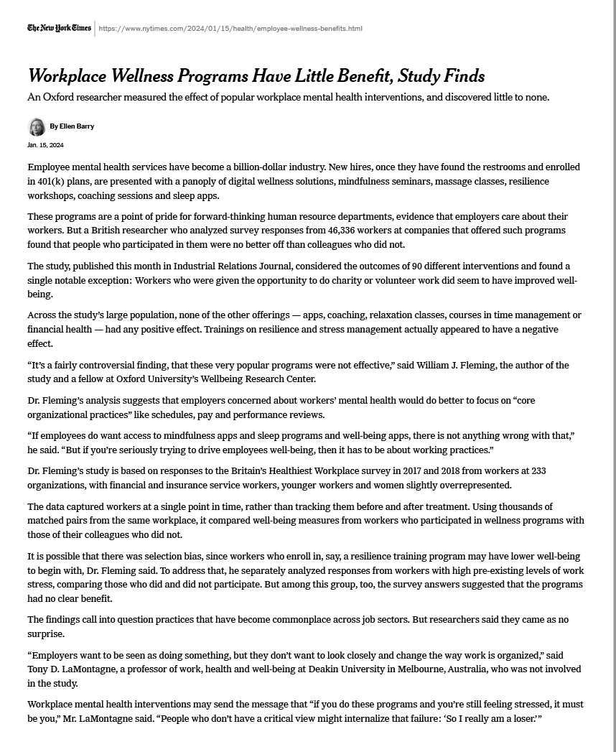
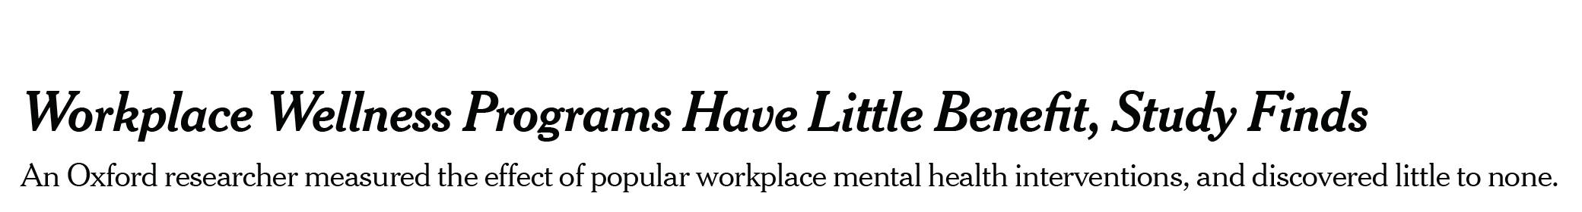
Jan. 15, 2024
Notes:
A major newspaper published this headline in January. I blocked out the publication and reporter because I’m not trying to call attention to anyone in particular.
I am in close touch with the community of experts who work on programs to enhance workplace wellbeing, so this headline led to a lot of hand wringing.

Slide 11
Jan. 15, 2024
Employee mental health services have become a billion-dollar industry. New hires … are presented with … digital wellness solutions, mindfulness seminars, massage classes, resilience workshops, coaching sessions and sleep apps.
But a British researcher … found that people who participated in them were no better off than colleagues who did not.
Notes:
But when you actually read the article, you begin to see that the study author is talking about things like massage classes and sleep apps.
Then, when you go to the actual underlying study by Dr. Fleming…

Slide 12
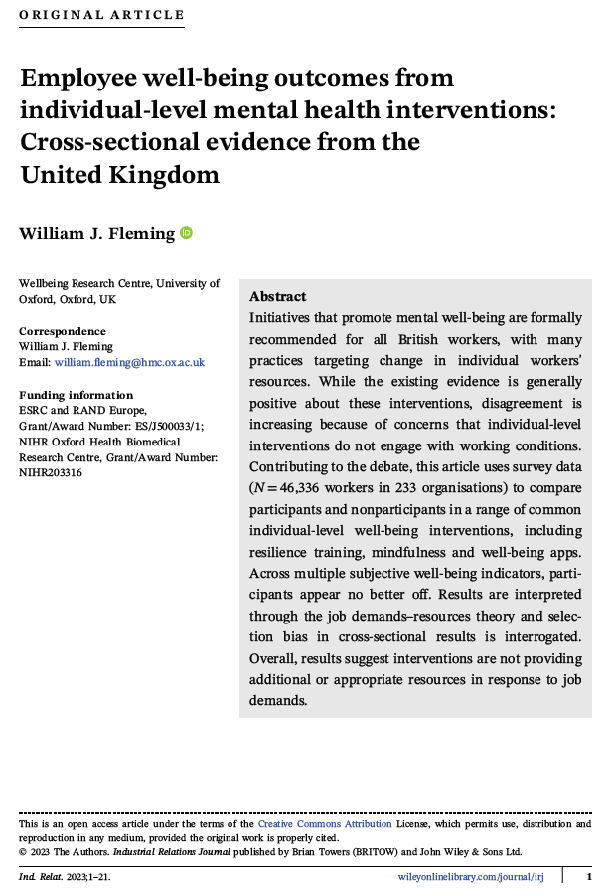
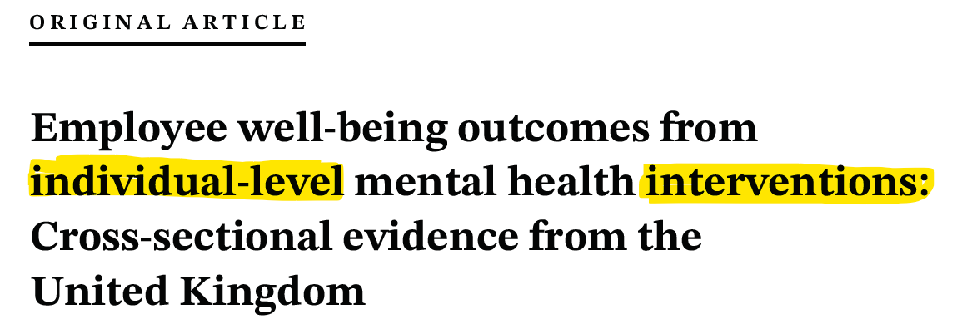
Notes:
You see that the focus of the article is individual-level interventions, not organizational level.

Slide 13
Jan. 15, 2024
Dr. Fleming: “If employees do want access to mindfulness apps and sleep programs and well-being apps, there is not anything wrong with that,” he said. “But if you’re seriously trying to drive employees’ well-being, then it has to be about working practices.”
“There is recent and highly credible data that things like mental health programs do improve all those metrics that he mentions,” Dr. Chekroud said. “That’s the baby you shouldn’t be throwing out.”
Notes:
The news article says the same thing, but only pretty deep into the article. The person who only reads headlines might have never seen this.

Slide 14
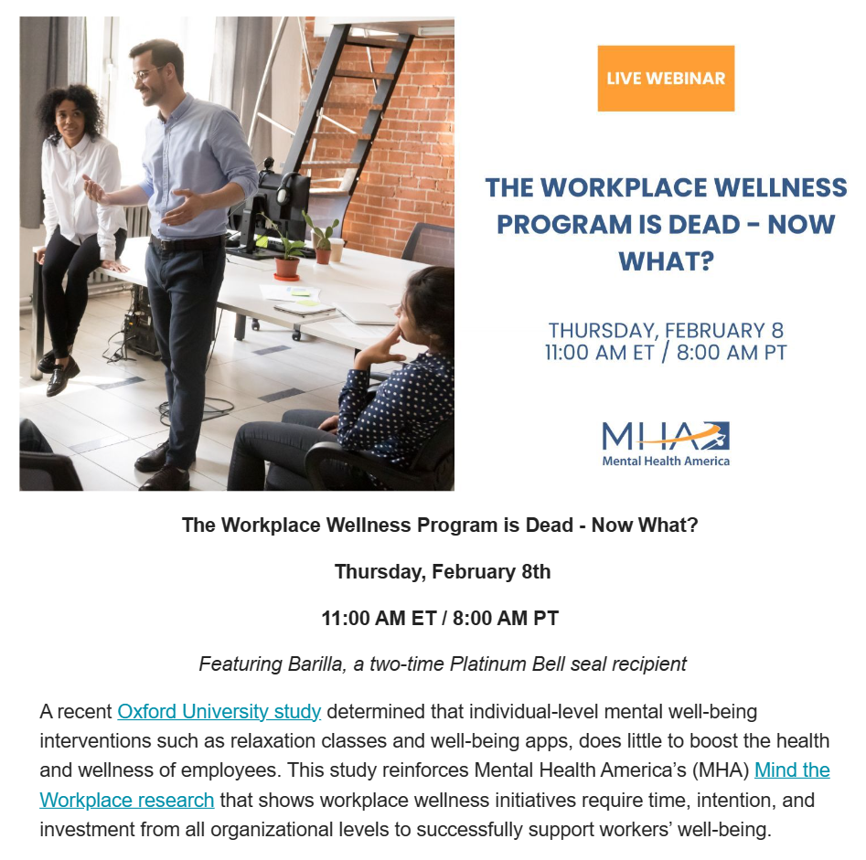

A recent Oxford University study … reinforces … that … workplace wellness initiatives require time, intention, and investment from all organizational levels.
Notes:
And it did not end with that initial article. Other organizations then followed suit by with events like this webinar with the title: The workplace wellness program is dead. Only in smaller print below do you see that they are saying that well executed organizational level programs do in fact work.

Slide 15
Psychological Capital
Notes:
Let’s turn to psychological capital.
How many of you have heard of this term before today?
I want to introduce you to it because it is a concept that incorporates aspects of both individual level interventions and organizational level, and it has science to support its effectiveness.

Slide 16
Psychological Capital
Notes:
Financial capital, human capital, social capital
Psychological capital. Can actually build up a reserve of psychological wellbeing that you can make withdrawals from when times get tough.
This can be measured at both an individual and organizational level.
If an organization is low in psych capital, when that first big setback happens – contract, lawsuit, economic downturn – people head for the door.

Slide 17
Hope
Psychological Capital
Notes:
There is some path forward. May not be easy. But there is a way.

Slide 18
Efficacy
Hope
Psychological Capital
Notes:
Self-efficacy. Sense that I myself, or my organization, might have what it takes to follow that path forward. We can get things done. We can get through this.

Slide 19
Efficacy
Resilience
Hope
Psychological Capital
Notes:
Return to baseline after a psychological distress.
When the path is followed, people have the ability to get all the way back to baseline. Or, better yet, get stronger than they were before. A lot like learning from mistakes.

Slide 20
Efficacy
Resilience
Hope
Optimism
Psychological Capital
Notes:
A generalized sense that everything will be ok. Not irrational. Not naïve. Instead, a very practical and accurate assessment of, “you know what, we had a setback, there is a path forward, it won’t be easy, but we probably have what it takes, and even if we don’t, the world is not going to end. We will all be ok.”

Slide 21
E
R
H
O
Psychological Capital
Notes:
HERO

Slide 22
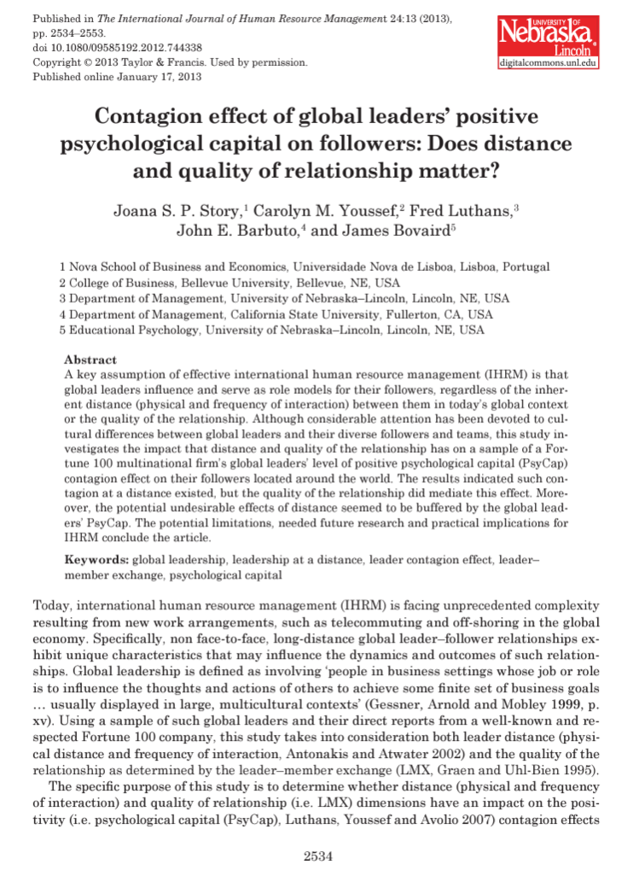
[W]e proposed and empirically demonstrated a positive contagion effect between global leaders’ PsyCap and their followers’ PsyCap.
Notes:
Here is where it gets really interesting – contagious mindset.
Even spanning distant offices. So, even in the world of global and remote work.

Slide 23


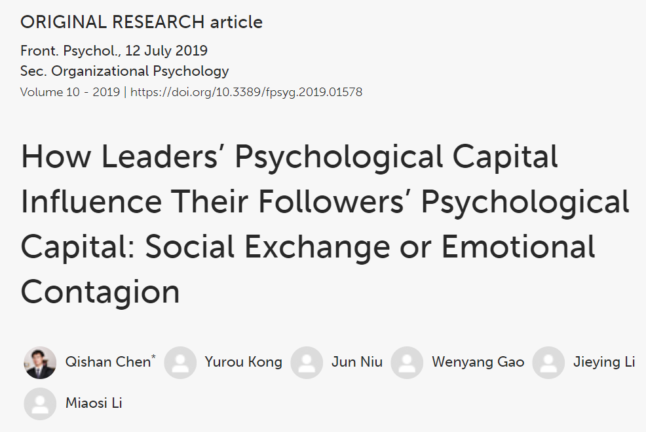
Conclusion
Leaders’ psychological capital has a positive influence on their followers’ psychological capital….
Notes:
Studies where leaders are given training in developing their psychological capital and their followers end up with an increase in psycap even though they did not even know their leaders were going through the training.

Slide 24
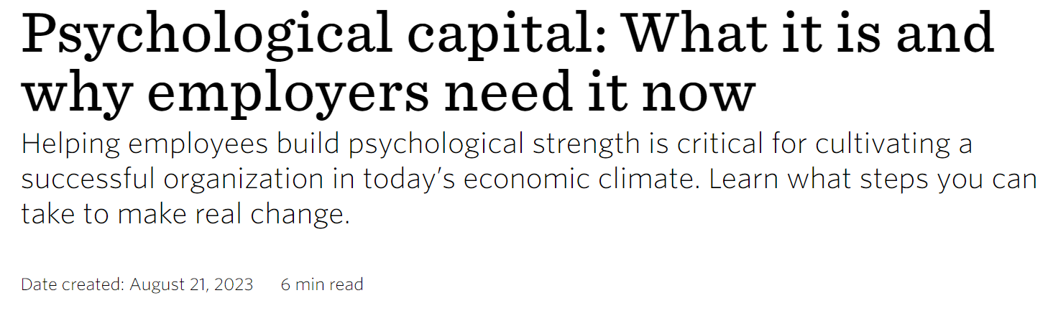
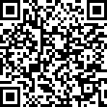
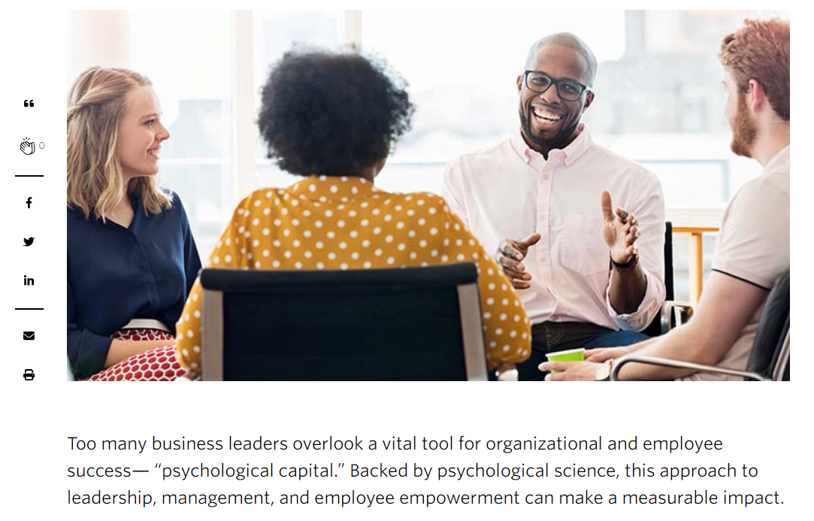


Slide 25
Psychological Safety
Workplace
Burnout
Psychological Capital

Slide 26
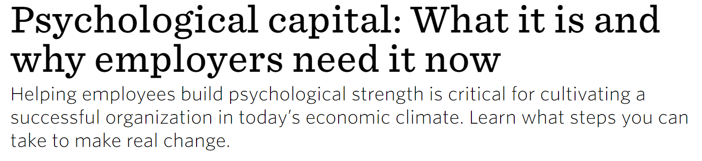
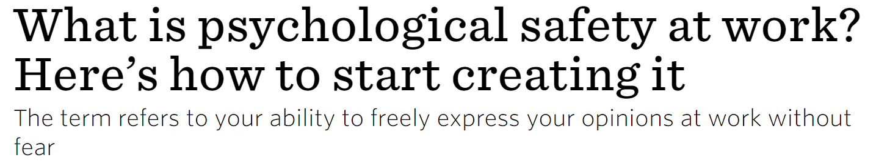
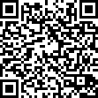
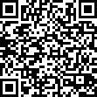
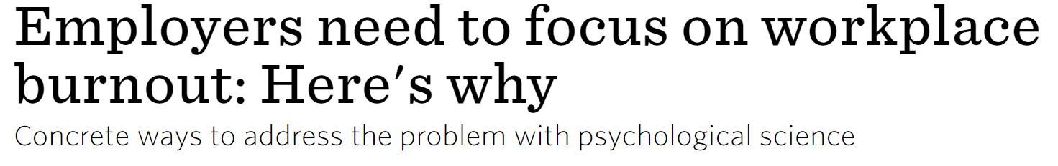
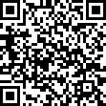
Psychological Safety
Workplace
Burnout
Psychological Capital

Slide 27
Questions & Discussion Dennis P. Stolle, JD, PhD dstolle@apa.org
Notes:
Let’s turn to psychological capital.
How many of you have heard of this term before today?
I want to introduce you to it because it is a concept that incorporates aspects of both individual level interventions and organizational level, and it has science to support its effectiveness.

