Slide 1


Reframing Employee Health: Moving Beyond Burnout to Holistic Health
May 2024
Kana Enomoto, Director of Brain Health at the McKinsey Health Institute

Slide 2




Who we are
The McKinsey Health Institute (MHI) is an enduring non-profit-generating entity
MHI believes, over the next decade, humanity could add as much as 45 billion extra years of higher-quality life, which is roughly six years per person on average —and substantially more in some countries and populations
MHI’s mission is to catalyze the actions needed across continents, sectors, and communities to realize this possibility
What we focus on
Brain Health
Infectious Diseases
Healthcare Worker Capacity
Healthy longevity
Equity & Health
Healthy Living
Sustainability & Health
What we do
Convene and enable leaders
Advance research
Create and promote open-access data assets
Stimulate innovation
Notes:
Future, Vision, Bold statement

Slide 3
MHI views holistic health in four dimensions
Social: an individual’s ability to build healthy, nurturing, genuine, and supportive relationships
Personal behaviors
Interventions
Physical
Physical: the extent to which an individual can competently perform physical tasks and activities without significant discomfort
Mental: an individual's cognitive, behavioral, and emotional state of being
Social
Mental
Personal attributes
Environment attributes
Spiritual: the extent to which people integrate meaning in their lives
Spiritual
Holistic Health: an integrated view of an individual's mental, physical, spiritual, and social functioning
An employee’s health may shift along this continuum over time
Critical employee health
Strong employee health
Note: Grounded in the WHO definition: “a state of complete physical, mental and social well-being and not merely the absence of disease or infirmity”

Slide 4

… while 1 in 5 employees indicate that they are feeling total burnout, driven by four core symptoms
57% of employees feel that they have good health across all four dimensions of health…
(Exhaustion, mental distance, cognitive impairment, emotional impairment)
Note: Holistic health data represents the percentage of respondents that scored an average for 4 or higher across the 4 dimensions of health; Burnout symptoms data represents the percentage of respondents that scored an average for 3 or higher across the 4 dimensions of burnout symptoms. .
Source: MHI Employee Holistic Health Survey 2023

Slide 5
For employees to thrive, organizations should both address burnout symptoms and support good holistic health – just one is not enough
Global opportunity gap, % share of employees
Low burnout symptoms
Managing
Faring well
Lower functioning while maintain-ing ability to deal with work demands
Higher functioning and coping well, effectively addressing work demands while growing and developing
29
51% of employees report either sub-optimal holistic health, higher burnout symptoms, or both – what we call the ‘opportunity gap’
Decreasing burnout symptoms
49
13
9
Drowning
Stretching
Lower functioning but not coping well, overwhelmed and paralyzed by work demands
Higher functioning but not coping well, overwhelmed by work demands
High burnout symptoms
Sub-optimal functioning
Well-functioning
Increasing holistic health¹
1. "High" burnout symptoms is defined as employees reporting burnout symptom scores greater than or equal to 3 and "low" burnout symptoms is defined as employees reporting burnout symptom scores less than 3. "Well-functioning" on holistic health is defined as employees reporting holistic health scores greater than or equal to 4 and "sub-optimal functioning" on holistic health is defined as employees reporting holistic health scores less than 4.
Source: MHI Employee Holistic Health Survey 2023

Slide 6


Why Employee Health
Prioritizing investment in mental health at work creates meaningful upside for global economies and significant value for employers
Our analysis found an incremental economic value of $1,100-3,500 USD per employee of investing in optimal well-being globally
Capturing just 10% of the total opportunity could yield up to $1.17 trillion of annual value and raise the global GDP by more than 1%
Every 1-3% increase in global workforce participation is worth a further $1.4 billion to $4.2 billion
Opportunity, in billions USD
Attrition
~$288-886
Total direct costs of poor employee well-being
~$3.7-11.7 trillion
total opportunity available by investing in employee health and well-being
Absenteeism
~$569
Presenteeism & Productivity
~$2,116-9,331
Total benefits created through good well-being
Retention
~$366-596
Attraction
~$316
1. Excluding direct healthcare costs globally, as these vary widely country to country

Slide 7





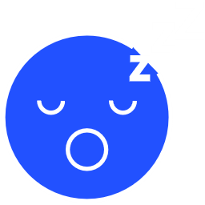
MHI’s recent “Nine to Thrive” report outlines 6 key enablers employers can use to promote employee brain health and wellbeing
Enabler
Sample practices
Social interaction
Establishing a zero-tolerance policy for toxic workplace behavior
Implementing anonymous reporting processes
Mindsets and beliefs
Defining a company’s mission so that employees are inspired – and compelled to bring their best selves to work – by it
Productive activity
Creating opportunities for employees to engage in volunteering, hobbies, activism, traveling, and other activities both within and outside of their job
Stress
Building in recovery time for employees to regain their energy after high-demand periods or projects
Economic security
Ensuring that compensation and benefits cover an employees’ basic needs
Sleep
Creating work environments with natural light and access to healthy foods
Limiting or discouraging employees from being online after hours

Slide 8
A recipe for a thriving workforce
Treat employee health as a strategic imperative
Take an organization-wide approach (not just focusing on individual interventions)
Invest better, not more
Hold leaders accountable to outcomes
McKinsey Health Institute
8

Slide 9
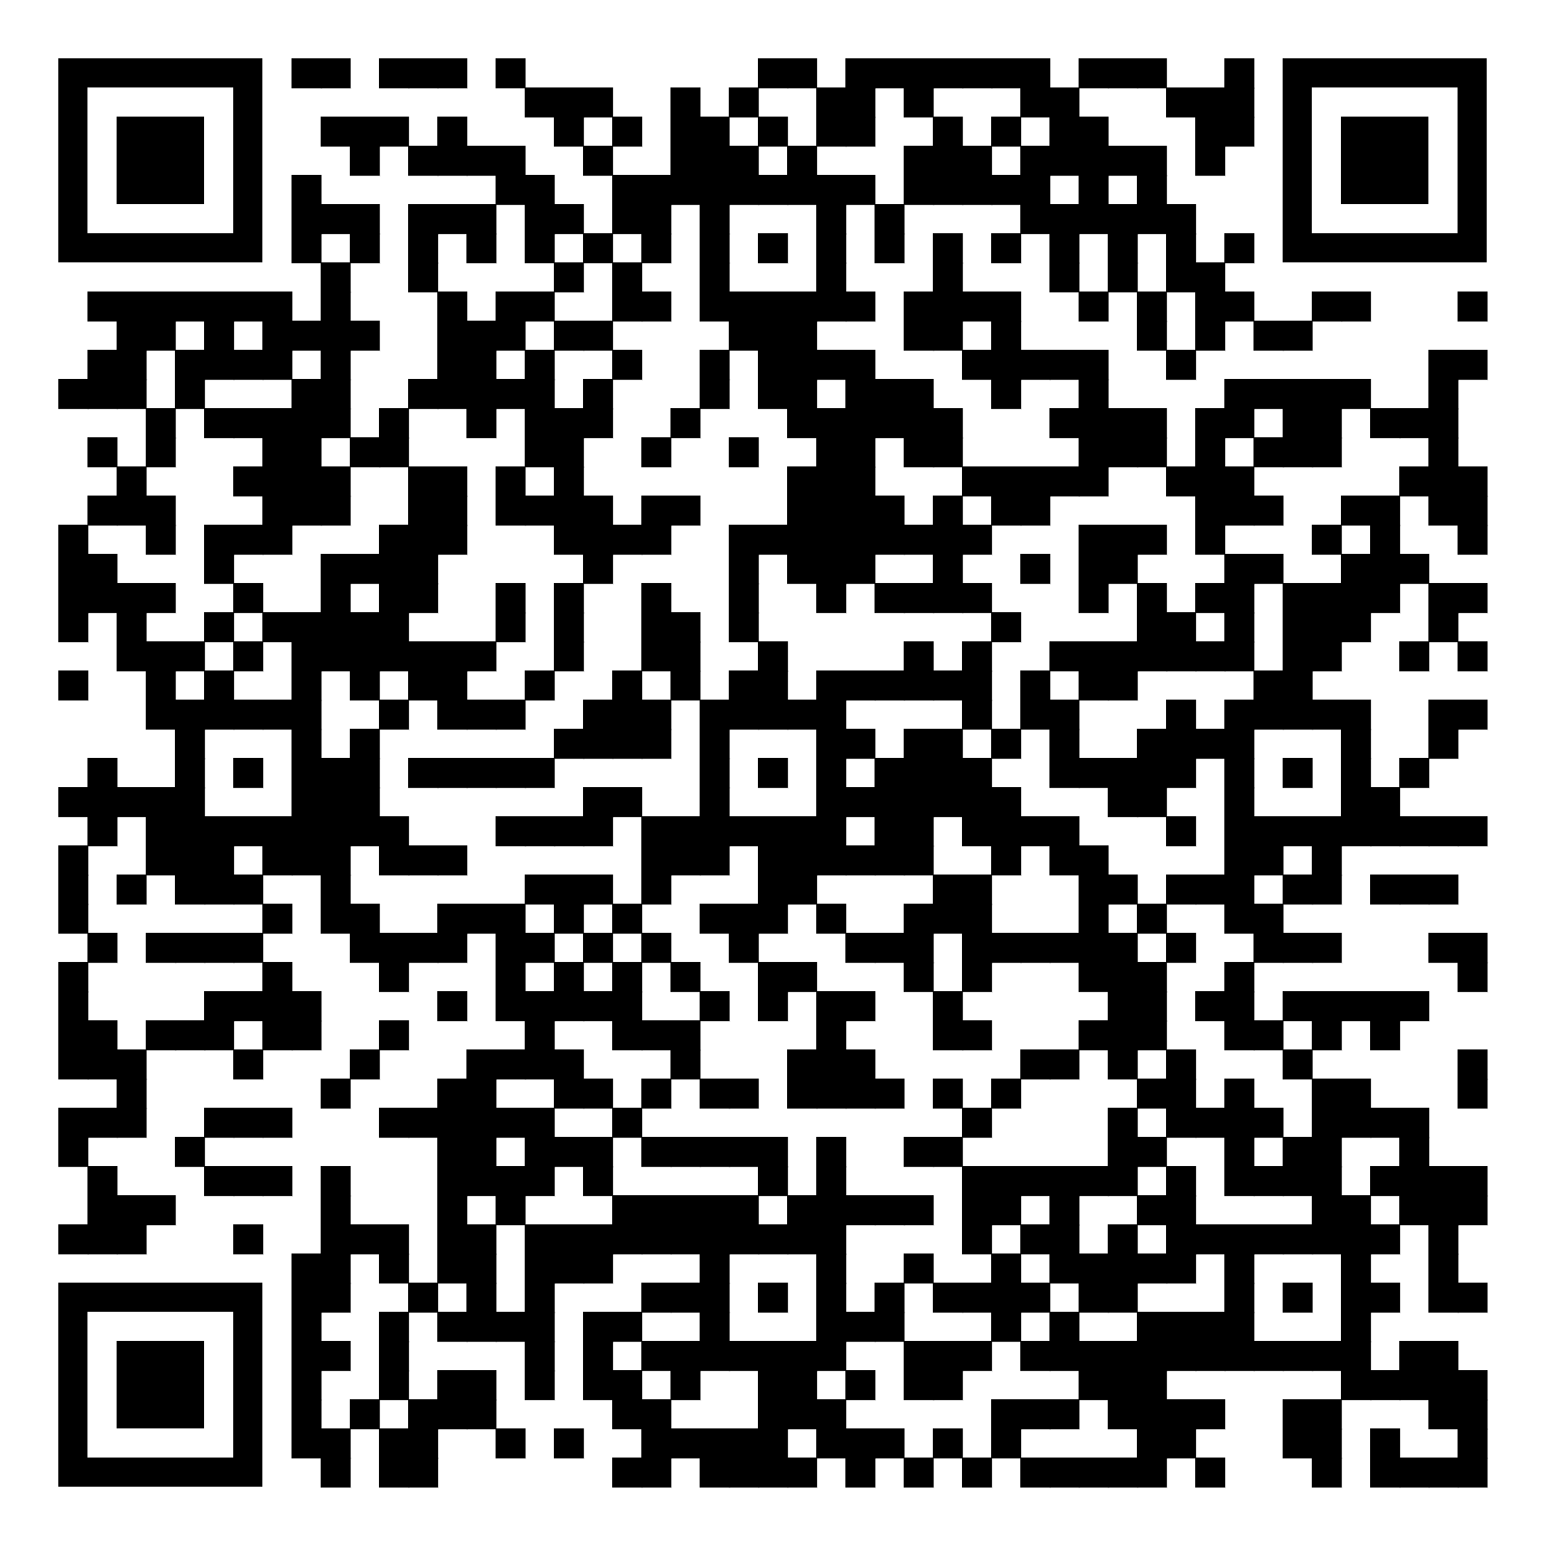
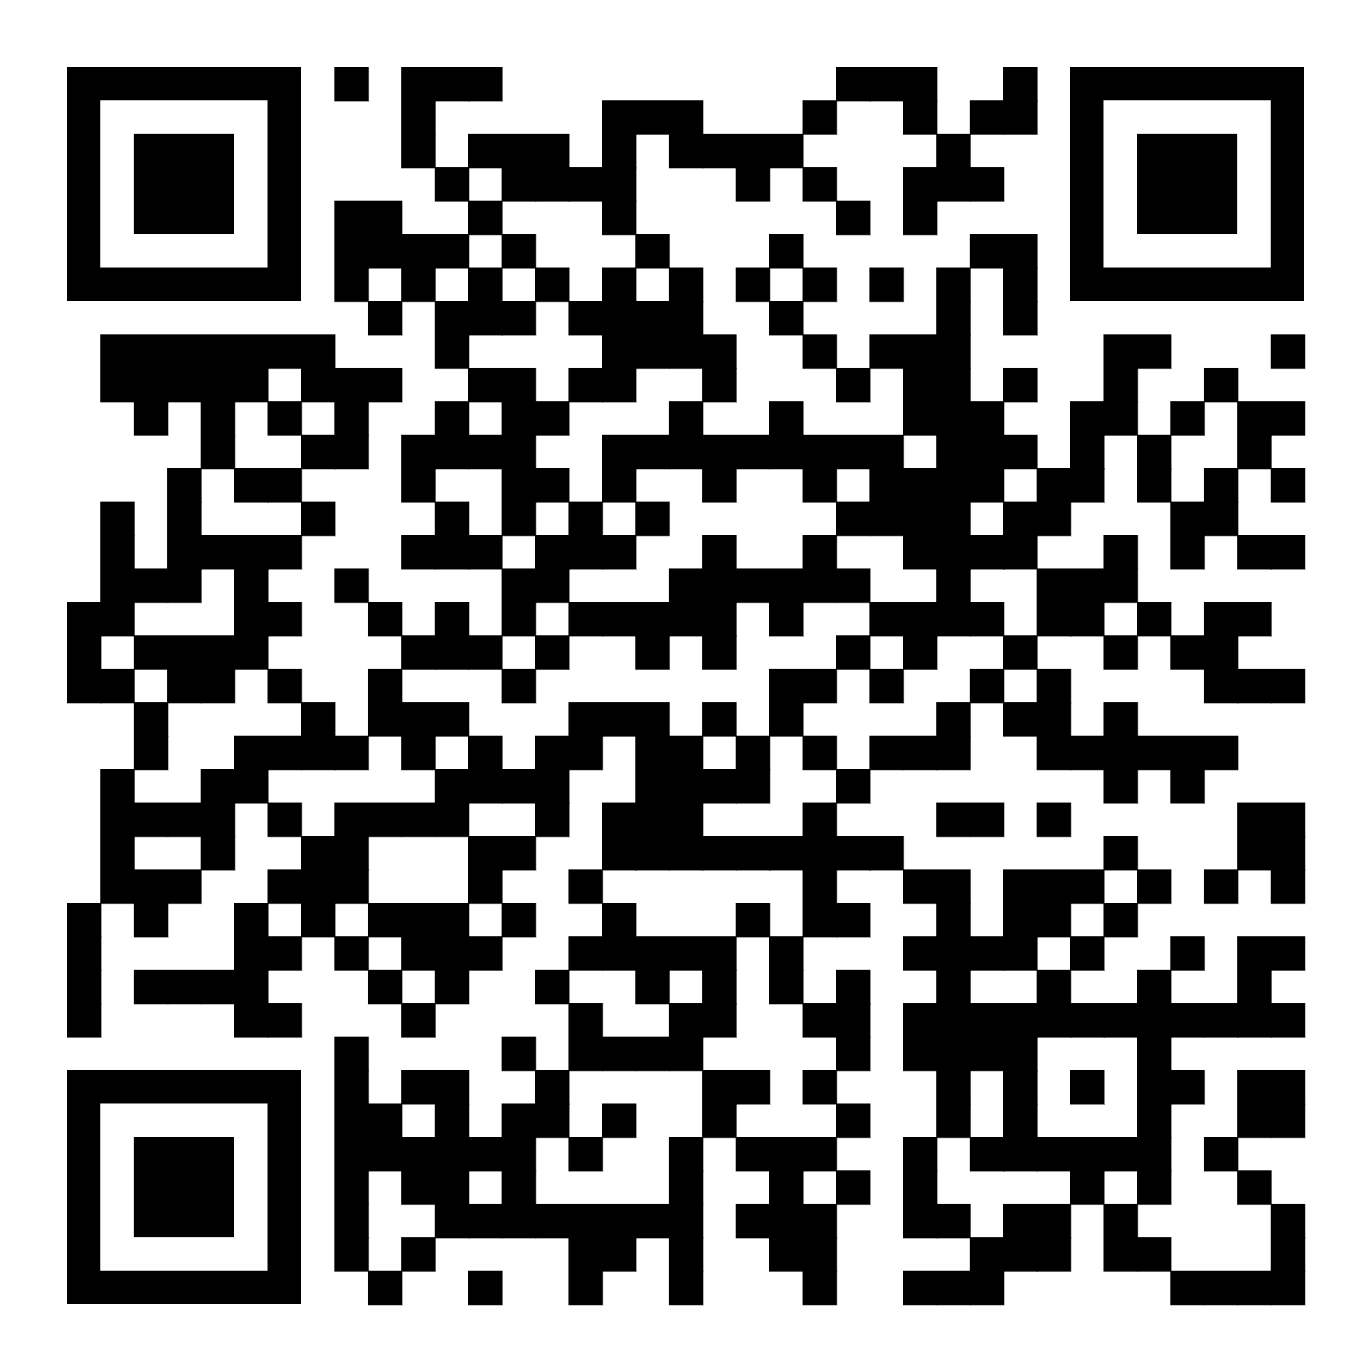
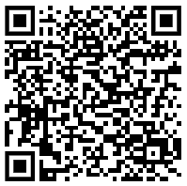
To learn more…
Keep up with our Employee Health and Well-being publications
Visit our Employee Health Platform to learn more about our free-of-charge survey and action planning tools
Follow us on LinkedIn

