Slide 1
Mental Health and the
Employment Provisions of the
Americans with Disabilities Act
National Press Foundation Fellows Event
May 22, 2024
Sarah DeCosse
Assistant Legal Counsel for ADA & GINA Division
Office of Legal Counsel, EEOC
sarah.decosse@eeoc.gov

Slide 2
Today’s Presentation
Background on the EEOC
Development of Federal Employment Laws for People with Disabilities
ADA Overview
Special Topics
Several Slides Providing Links to EEOC Resources

Slide 3
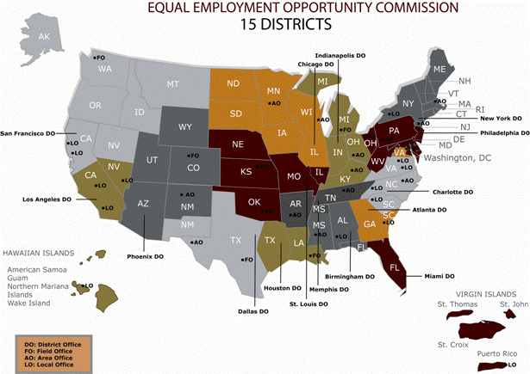
Equal Employment Opportunity Commission
- Created in 1965 to Enforce Federal Equal Employment Opportunity Laws
- Bipartisan Commission of 5 Presidential Appointees (No More than 3 from Same Party)
- DC Headquarters and Over 50 Regional Offices

Slide 4
A Very Short History of Federal Employment Laws for People with Disabilities
Smith-Fess Act of 1920 (repealed in 1973) assisted veterans returning from World War I, provided training, counseling, placement, and rehabilitation services.
Rehabilitation Act of 1973 Section 501 (and 503, 504) addresses employment, prohibits discrimination against qualified individuals with disabilities in federal (or federally-funded) employment.
Americans with Disabilities Act of 1990 prohibits employment discrimination in the private sector and by state and local governments (and offers other protections).

Slide 5
ADA History – Role of Stereotypes/Fears/Myths
“[People with disabilities] have been subjected to unequal and discriminatory treatment . . . resulting from stereotypical assumptions, fears and myths not truly indicative of the ability of such individuals to participate in and contribute to society.”
ADA Legislative History, HR Rep. 101-485 Part II, 1990
“Historically, employment application forms and employment interviews requested information concerning an applicant’s physical or mental condition. This information was often used to exclude applicants with disabilities—particularly those with so-called hidden disabilities, such as . . . emotional illness . . . before their ability to perform the job was even evaluated.” ADA Leg. Hist. HR Rep 101-485

Slide 6
Disability Discrimination Laws Enforced by EEOC
EEOC enforces:
  Title I of the Americans with Disabilities Act (ADA)
  Sections 501 and 505 of the Rehabilitation Act of 1973 (Rehabilitation Act)
These laws apply to private employers with at least 15 employees, employment agencies, and labor organizations; and government agencies.

Slide 7
Shifts over 10 Years for Select ADA Charge Data:
Available at: EEOC Enforcement and Litigation Statistics
(search for ADA Charge Receipts by Impairment Basis)
Impairment | 2013 | 2023
Anxiety Disorder | 6.4% | 13.5%
Depression | 7.1% | 8.5%
Manic Depressive Disorder (Bipolar Disorder) | 0.6% | 2.9%
Other Psychological Disorders | 1.6% | 3.5%
Post Traumatic Disorder (PTSD) | 2.8% | 7%
Schizophrenia | 0.4% | 0.4%
Total | 18.9% | 35.8%

Slide 8
What is an ADA disability?
Individualized Assessment: Does the individual have an ADA disability?
  “Actual Disability” — a physical or mental impairment that substantially limits a major bodily function or other major life activity
  “Record of” — a history/record of an “actual disability” in the past
  “Regarded as” – subject to prohibited action because of actual or perceived impairment (that is not transitory and minor)
Under the ADA Amendments Act:
  Definition of disability must be construed in favor of broad coverage.

Slide 9
Pitfall: Failing to Apply ADA Amendments Act of 2008
The ADA Amendments Act (ADAAA): Created “rules of construction” in favor of “broad coverage” re how to determine if a physical or mental impairment “substantially limits” a major life activity:
  Limitation need not be permanent, long-term, severe, or significantly restricting
  Major life activities include major bodily functions (such as neurological or brain function).
  Only need impact on 1 major life activity or 1 major bodily function.
  Benefits of mitigating measures should not be considered (such as medication)
  Conditions that are episodic or in remission should be considered in their active state (such as bipolar disorder or schizophrenia)
Examples of impairments that will “virtually always” be substantially limiting. These include: major depression, PTSD, bipolar disorder, schizophrenia, and OCD. (29 CFR 1630.2(j)(3)(iii)).
  Mental health conditions that are ADA disabilities are not limited to those identified in this list.

Slide 10
Disability Discrimination
The ADA prohibits discrimination on the basis of disability in:
  Hiring
  Advancement
  Discharge and
  Other terms and conditions of employment, including pay.

Slide 11
Disability Harassment
Can originate from:
  Co-workers, Supervisors/Managers
  Business Owners/Senior Officials
  Customers/Clients, Non-Employees
Because of disability
  Applicant’s or employee’s current or past disability
  Belief that an applicant or employee has a disability
  Applicant’s or employee’s association with a person with a disability
Objective Hostility – Conduct so severe or frequent that reasonable person in employee’s position would conclude conditions are abusive; AND
Subjective Hostility – Employee actually found conduct to be hostile – that is, the employee did not welcome the conduct

Slide 12
Reasonable Accommodation
Applicants and employees with disabilities have a right to request “reasonable accommodations,” if needed for a known physical or mental limitation.
Applicants/employees qualified, with or without reasonable accommodation.
Reasonable Accommodation = a change to the way things are normally done in work environment that enables individual with a disability to have an equal opportunity to:
  Apply for a job
  Perform essential job functions
  Access/enjoy job benefits and privileges
How to ask for accommodation? No magic words needed.
One option – “I need a change because of an impairment.”

Slide 13
NOT a Reasonable Accommodation
Lowering performance or productivity standards.
Excusing violations of conduct rules that are job-related and consistent with business necessity.
Removing an essential function.
Changing someone’s supervisor (but may need to change supervisory methods).
Monitoring an employee’s use of medication, providing personal use items (e.g. a prosthesis or wheelchair).
Actions that would result in undue hardship.

Slide 14
Possible Reasonable Accommodations for Mental Health Disabilities
Sick leave or unpaid leave for reasons related to mental health, flexible use of vacation leave | Job coaching, additional training
Flexible workplaces, such as part-time hours or telework | More frequent and/or flexible breaks
Modifications to space/location, such as better lighting, private office, away from noisy machinery | Addition of room dividers, partitions or sound-proofing to reduce noise or visual distractions
Audio or video recorders for recording/reviewing meetings or training sessions | White noise or environmental sound machines
Modifications of non-essential job duties or restructuring job to include only essential duties | Additional or modified training materials
Implementation of flexible and supportive supervisory style | Creation and use of tools, such as daily “to-do” lists, checklists, or written instructions
Regularly scheduled meetings to discuss workplace issues | Software that minimizes distractions.
DOL-Funded Resource: Job Accommodation Network at https://askjan.org/

Slide 15
Employee/Employer Interactive Process
Employer should take a problem-solving approach, communicate with employee, to determine a reasonable accommodation
May consult resources, such as Job Accommodation Network: www.askjan.org
Employer can identify potential accommodations and assess effectiveness of each
Employer may consider individual’s preference but can make ultimate choice between effective accommodations

Slide 16
Undue Hardship
Employer required to provide a reasonable accommodation unless it would pose an “undue hardship.”
Undue hardship = significant difficulty or expense
Fact-specific determination. Relevant factors include:
  Nature and cost of accommodation
  Financial resources of the employer
  Size of employer
  Effect of reasonable accommodation on employer’s operations
If a particular reasonable accommodation would pose an undue hardship, employer must determine if there is an alternative reasonable accommodation that would be effective and not pose an undue hardship.

Slide 17
Protections for All:
Limits on Disability-Related Questions and Medical Exams
The ADA limits employers’ ability to make disability-related inquiries and/or require medical exams, even if individuals do not have disabilities.
3 stages:
Application/Before an employment offer is made: No disability-related inquiries. No medical exams.
  If individual seeks reasonable accommodation, some follow up OK.
Post conditional offer/pre-start of employment: OK if same inquiries or exam required of everyone. Follow up questions/exams permitted if medically related to information already received.
During employment – Generally, no. Performance better measure of ability to perform job. Only under a few limited circumstances, such as if individual asks for accommodation, but then limited to what is needed for that purpose.

Slide 18
Protections for All:
Medical Information Confidentiality
Employers must keep all applicants’ and employees’ medical information confidential
  There are limited exceptions, such as following up on reasonable accommodation request or an EEOC investigation.
Medical information must be kept in separate medical files

Slide 19
Protections for Those Engaging in Protected Conduct:
Retaliation & Interference
Applicants and employees have a right to:
  Request a reasonable accommodation for a disability
  Complain at work about disability discrimination or file a charge or complaint
  Participate in a disability discrimination investigation or lawsuit
  Reasonably oppose disability discrimination
It is illegal for employers to:
  Retaliate against applicants or employees for doing any of the above
  Interfere with an applicant’s or employee’s rights under disability discrimination laws

Slide 20
Special Topics: Direct Threat Defense
ADA permits employers to raise a “direct threat” defense about possible safety concerns. A “direct threat” requires an individualized assessment that satisfies 2 elements:
1. The individual with a disability would pose a “significant risk of substantial harm” to themself or others:
  Requires an individualized assessment, speculative harm is insufficient. Unfounded assumptions and stereotypes are NOT evidence.
  Mental health condition risk assessments, in particular, must be based on behavior and not misperceptions, ignorance, or irrational fears.
  Must be based on “reasonable medical judgement” and/or other “objective evidence.”
2. And, the “significant risk of substantial harm” cannot be eliminated or reduced by reasonable accommodation.
EEOC v. Anant Enterprises LLC et al. (Omaha, NE, December 2023) – Resolved case alleging that employee was fired after going to the hospital for treatment for depression, based on stereotypes and fears that he might hurt other people.

Slide 21
Special Topics: Artificial Intelligence
Software incorporating algorithmic decision-making can raise ADA concerns when:
  It violates the ADA’s limitations on disability-related inquiries or medical exams;
  An applicant or employee seeks a reasonable accommodation and the employer does not provide one, absent undue hardship;
  An employer relies on the tool to intentionally or unintentionally “screen out” an individual with a disability, even though that individual is able to do the job, with or without a reasonable accommodation.
    Screen out occurs when a disability prevents the individual from meeting – or lowers their performance on – a selection criteria, and the individual loses a job opportunity as a result.
For example, an individual with anxiety required to take a timed test may not have their job skills accurately measured without a reasonable accommodation, such as additional time to take the test.
Or, screen out could occur if a chatbot is programmed to reject all applicants with breaks in employment. If an individual did not work for a period of time to receive treatment for bipolar disorder, then the chatbot may function to “screen out” that person because of a disability.
EEOC Resource: The ADA and the Use of Software, Algorithms, and Artificial Intelligence to Assess Job Applicants and Employees

Slide 22
Special Topics: Substance Use Disorder
ADA excludes from coverage “an individual who is currently engaged in the illegal use of drugs.”
But, the ADA does not exclude, individuals who:
  Are in or have completed a drug rehabilitation program and are not engaging in the illegal use of drugs;
  Individuals with SUD (such as opioid use disorder) who are taking prescribed medications, sometimes called MOUD – medications for opioid use disorder or MAT – medication assisted treatment, such as buprenorphine or methadone.
When evaluating if impairment is a disability, the positive effects of a mitigating measure, such as prescribed MAT, must be disregarded.
EEOC Resource: Use of Codeine, Oxycodone, and Other Opioids: Information for Employees
HHS Resource: National Survey on Drug Use and Health (samhsa.gov)

Slide 23
Special Topics: Opioid Use Disorder and MAT
Potential Issues
  Applicants rejected or employees terminated when employer learns about MAT.
  Employer undertakes permissible drug testing. Prescribed medication results in positive drug test. But, employer does not allow individual to show that medication is being taken as prescribed.
  Possible exceptions – If concern applicant or employee cannot do the job safely, then employer can attempt to demonstrate “direct threat.” In some limited circumstances, individual may be disqualified under a federal law.
EEOC v. Dragon Rig Sales and Service, LLC and The Modern Group (Beaumont, TX, May 2024) - Resolved complaint alleging that employer wrongfully withdrew an applicant’s offer of employment after learning of use of prescription medication to treat anxiety and OUD. Alleged that:
    Companies withdrew offer of employment without engaging with applicant to determine if he could perform the essential job functions, with or without reasonable accommodation, even though he passed required drug test.
Companies agreed to pay $35,000, implement management training, policy revisions and other relief

Slide 24
Special Topics: Role of Mental Health Providers
Mental health providers may assist their clients in identifying a need for workplace reasonable accommodations and support those requests by speaking to employers.
Mental health providers may be asked to respond to employer inquiries about safety risks, potential “direct threat.”
EEOC Resources
  The Mental Health Provider's Role in a Client's Request for a Reasonable Accommodation at Work
  How Health Care Providers Can Help Current and Former Patients Who Have Used Opioids Stay Employed

Slide 25
Select EEOC Mental Health Matter Resolutions
EEOC v. Citizens Bank, N.A. (Cranston, RI, November 2023) – Resolved complaint alleging that bank failed to reassign employee with anxiety disorder to open positions (per employee’s request) or discuss other accommodations.
EEOC v. Hobby Lobby Stores, Inc. (Olathe, KS, May 2023) – Resolved case alleging that employer fired employee with anxiety, depression, and PTSD who requested use of service dog as a reasonable accommodation.
EEOC v. Ranew’s Management Company (Milner, GA, 2022) – Resolved allegations that employee diagnosed with severe depression was fired after taking six weeks off of work, per doctor’s recommendation.
EEOC v. Hollingsworth Richards, LLC (Covington, LA, 2022) – Resolved case alleging that employer subjected employee to an unlawful medical exam and discharged her based on her use of ADHD medication.
EEOC v. Party City Corporation (Rockaway, NJ, 2019) – Resolved complaint alleging that employer denied applicant with severe anxiety and on autism spectrum a job coach as reasonable accommodation.

Slide 26
EEOC Resources on ADA Definition of Disability
Definition of Disability: 2008 ADA Amendments Act Changes
  EEOC’s ADA Amendments Act resource page.
ADA Amendments Act of 2008
  Statutory text of the ADA Amendments Act.
Fact Sheet on the EEOC's Final Regulations Implementing the ADAAA
  EEOC technical assistance document explaining the changes introduced to the ADA regulations by the ADA Amendments Act.
*Some EEOC documents were issued prior to the ADA Amendments Act.

Slide 27
EEOC Resources on Reasonable Accommodation and Undue Hardship
Reasonable Accommodation
  EEOC’s Reasonable Accommodation Landing Page
Depression, PTSD, & Other Mental Health Conditions in the Workplace: Your Legal Rights
  EEOC technical assistance on mental health conditions.
Enforcement Guidance on Reasonable Accommodation and Undue Hardship under the ADA
  EEOC guidance on reasonable accommodation.

Slide 28
EEOC Resources on Harassment
Enforcement Guidance on Harassment in the Workplace – 4/24
  Summary of Key Provisions: EEOC Enforcement Guidance on Harassment in the Workplace
  Questions and Answers for Employees: Harassment at Work
  Small Business Fact Sheet: Harassment in the Workplace
EEOC v. Mine Rite Technologies, LLC (Buffalo, WY, 2018) – Resolved complaint alleging harassment against veteran with PTSD.

Slide 29
Additional EEOC Resources
Mental Health Conditions: Resources for Job Seekers, Employees, and Employers
  EEOC’s Mental Health Landing Page
Disability-Related Questions, Medical Exams, and Confidentiality
  EEOC’s Disability-Related Questions and Medical Exams Landing Page
Select List of Resolved Cases Involving Mental Health Conditions Under the ADA
  Updates expected soon, but all EEOC disability-related press releases available at: EEOC Newsroom Search for Disability

Slide 30
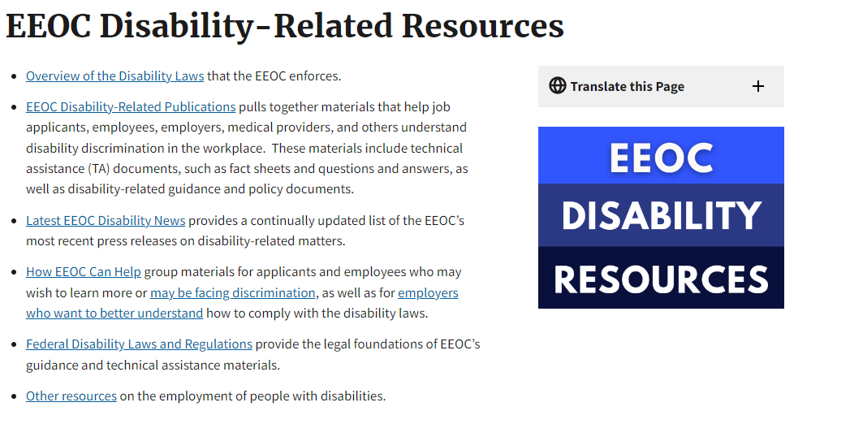
EEOC’s Disability-Related Resources Landing Page: https://www.eeoc.gov/eeoc-disability-related-resources
Search for “disability” at EEOC.gov

Slide 31
Happy to Answer
Any Questions
Sarah DeCosse
Assistant Legal Counsel for ADA & GINA Division
Office of Legal Counsel, EEOC

