Slide 1
Creating a Culture of Supporting
Employee Well-Being
Nabil El-Ghoroury, PhD, CAE
Executive Therapy & Consulting
www.executivetherapy.solutions

Slide 2

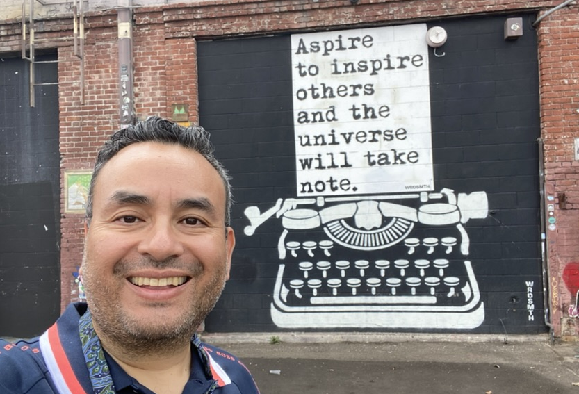
About Me
PhD in Clinical Psychology
Licensed psychologist in VA, OH
  Can see patients in 40 states
13 years as a nonprofit executive
4 years as CEO
Executive Therapy & Consulting
  Telehealth psychotherapy
  Speak on mental health to organizations and businesses
  Retreats
  Executive coaching

Slide 3
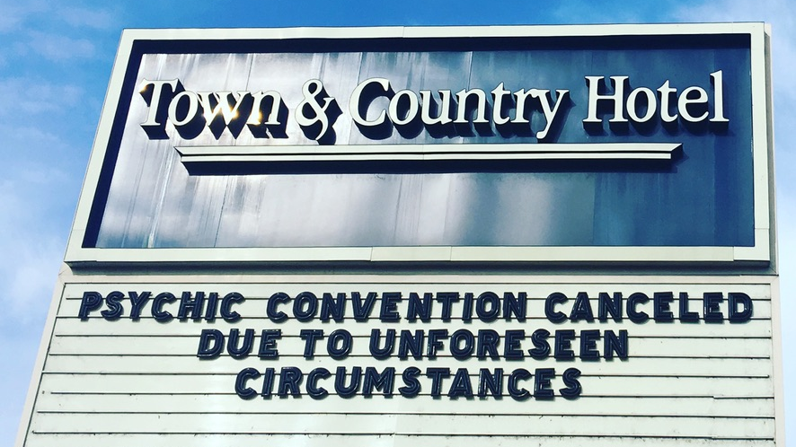
Notes:
Dr. Nabil

Slide 4

This Photo by Unknown Author is licensed under CC BY-SA

Slide 5

What is workplace culture?
Clear values and mission connected to a greater good
High quality senior leadership
Learning and career growth opportunities
This Photo by Unknown Author is licensed under CC BY-SA-NC

Slide 6
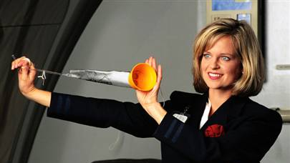
Why well-being is important
This Photo by Unknown Author is licensed under CC BY-NC-ND

Slide 7
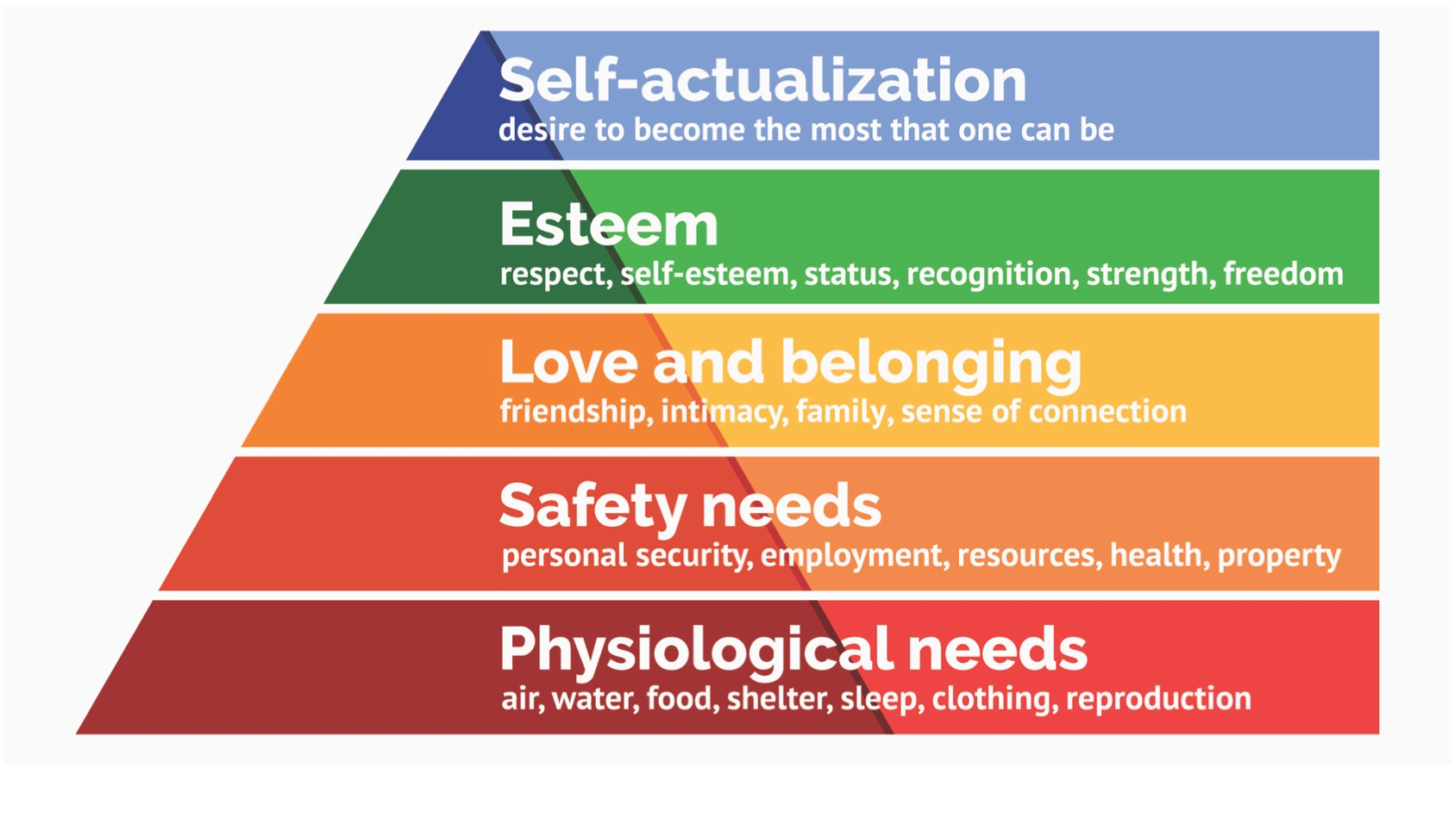
This Photo by Unknown Author is licensed under CC BY-NC-ND

Slide 8

What is the ROI on employee well-being?
Employee recruitment & retention
  86% of employees believe companies should support mental health
  More than 3 in 4 employees said their mental health affects productivity
  50% of millennials, 75% of Gen Z have left positions in part to mental health
  One star more on Glassdoor > $10k higher salary
This Photo by Unknown Author is licensed under CC BY

Slide 9
MENTAL HEALTH IN CORPORATE AMERICA
45% of Americans reported a mental health illness in 2023
  Compared to 31% in 2019
  For 18-34 year olds – 50%
Nearly 4 in 5 employees reported work-related stress in the last month
25 – 45% of employees experience
  Lack of energy
  Cognitive weariness
  Emotional exhaustion
  Physical fatigue
Up to 80% of employees report burnout in 2024
  American Psychological Association, 2023, 2021, Linked In, 2024
Notes:
Dr. Nabil

Slide 10
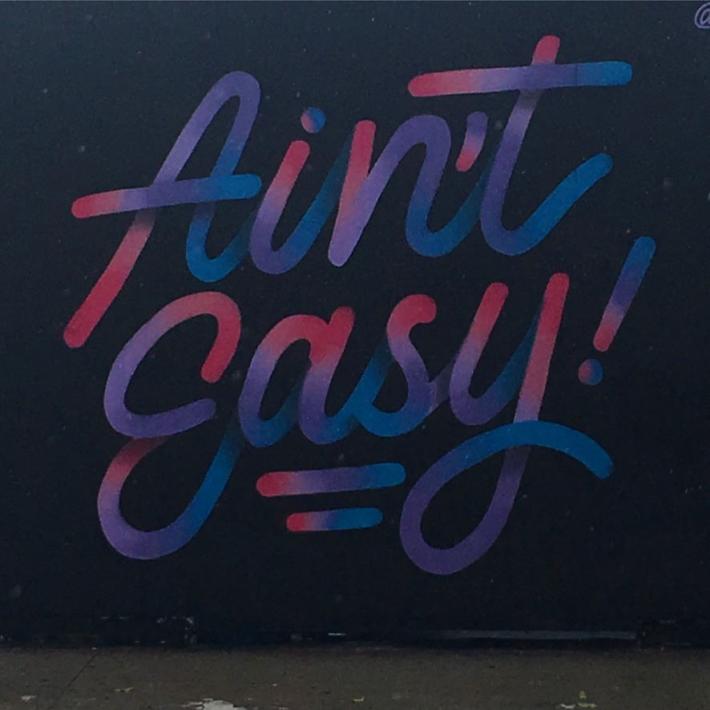
Strategies to Promote
Employee Well-Being
Organizational
Level

Slide 11

INCORPORATE MENTAL HEALTH INTO POLICIES/PROCEDURES
PTO
Personal leave
FMLA
Medical appointments
Notes:
Dr. Nabil
PTO
Personal leave
FMLA
Medical appointments

Slide 12
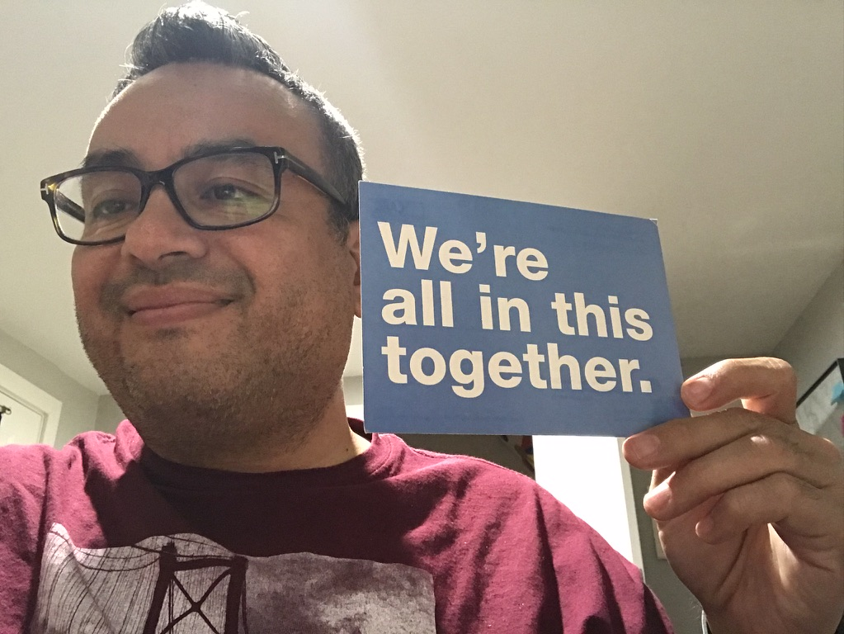
COMMUNICATE
Notes:
Dr. Nabil
Employees want to know what is going on – communicate more than you think you need to
In the absence of information, people will come up with much worse theories
Sharing information, even if you don’t know, is helpful to your team.

Slide 13
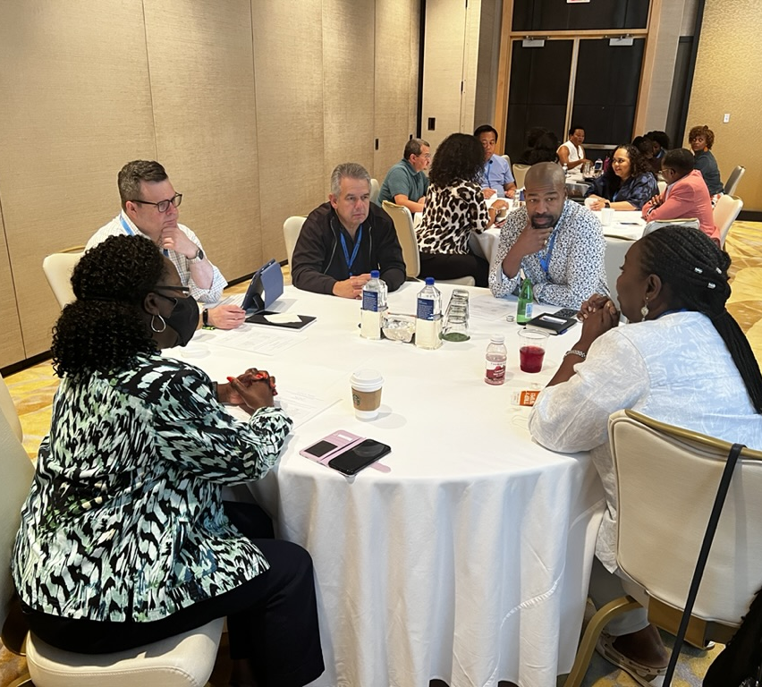
TRAIN YOUR MANAGERS
Notes:
Dr. Nabil
Managers need resources to be effective
West Monroe found that nearly 60% of managers who have one staff reporting to them received no training, over 2 in 5 who supervise 3 or more employees received no training
SHRM – overwhelming majority of employees report that managers with poor training create stress and extra work

Slide 14
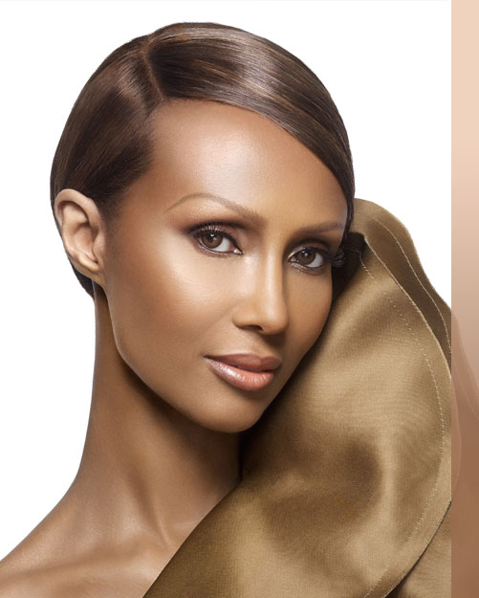

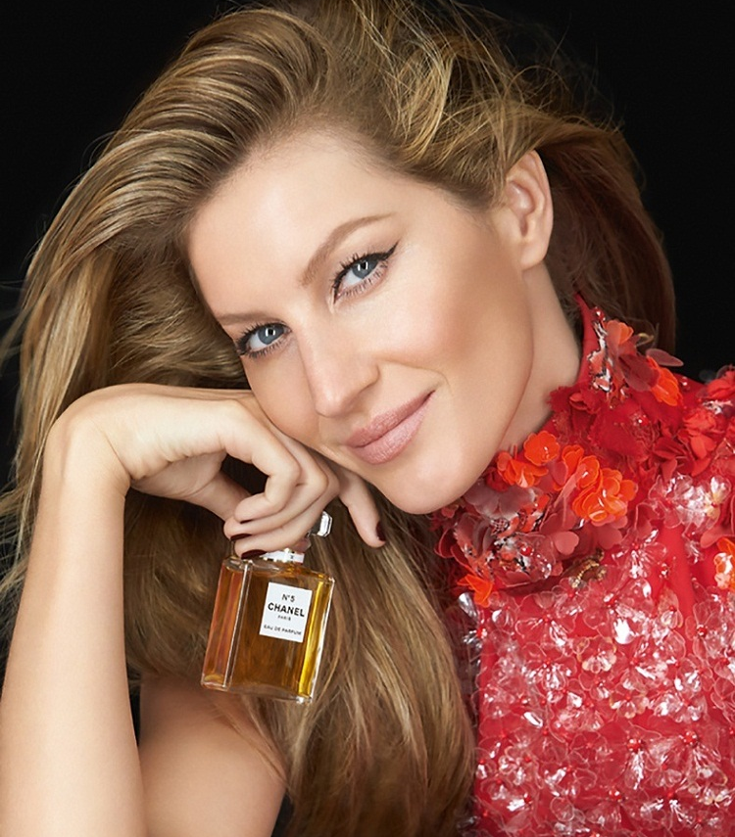
MODEL MENTAL HEALTH and WELL-BEING
This Photo by Unknown Author is licensed under CC BY-NC
This Photo by Unknown Author is licensed under CC BY-NC-ND
This Photo by Unknown Author is licensed under CC BY-NC
Notes:
Dr. Nabil

Slide 15
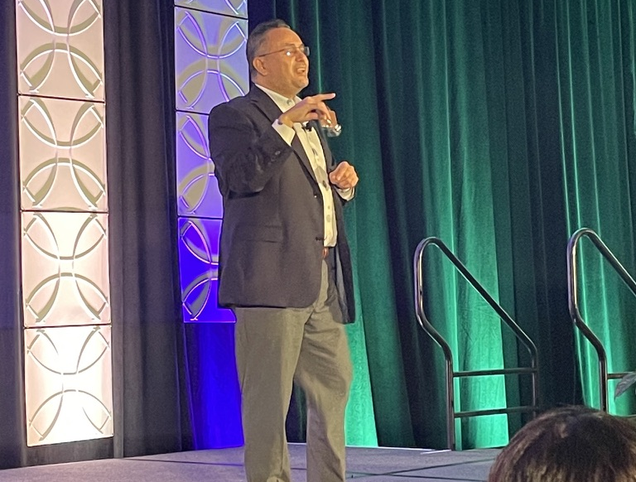
EAP
Bringing in experts to talk about mental health
  EAP
  Wellness leaders
Create a wellness resource group
Self-insurance for mental health services
PROVIDE RESOURCES
Notes:
Dr. Nabil
Managers need resources to be effective
= being a good attorney DOES NOT EQUAL being an effective leader of a team of attorneys
Bring in experts- to teach communication, managing, emotional intelligence skills
Coaching to support the lessons learned in training

Slide 16

Strategies to Promote
Employee Well-Being
Manager Level

Slide 17

Manager Level Strategies
Paying attention to staff
Reflective listening skills
Managing workflow
Flexibility
Respecting boundaries
Intentional breaks – meetings for 25/50 minutes

Slide 18
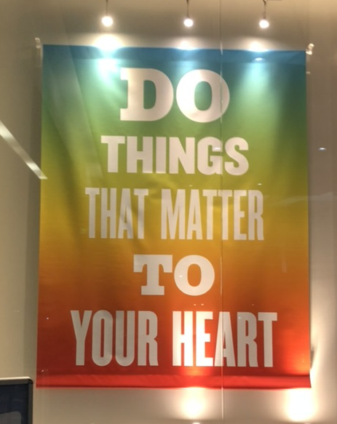
Purpose
Organizations with purpose-driven cultures
  Higher employee retention
  Higher performance
Are you proud of where you work?
Do you find meaning in your work?
Do you have fun at work?

Slide 19
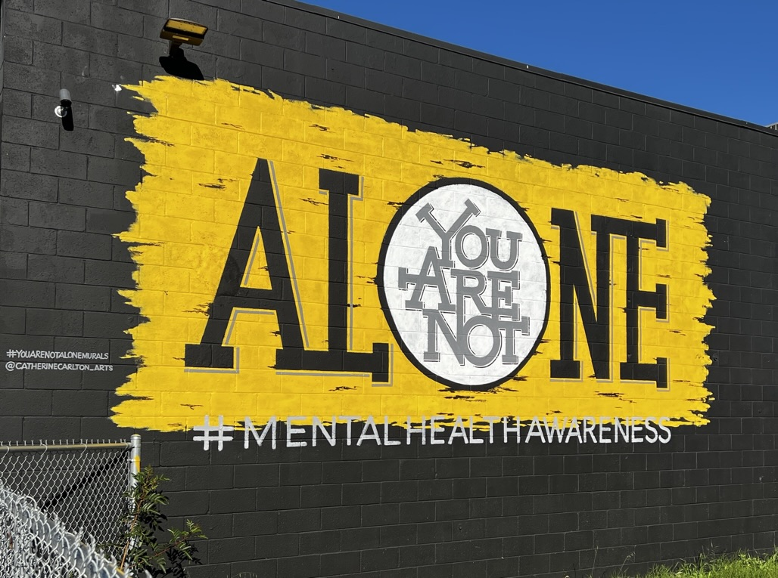
Strategies to Promote
Employee Well-Being
Employee Level

Slide 20

Individual Strategies
Mindfulness
Deep breathing
Exercise
Social connection

Slide 21
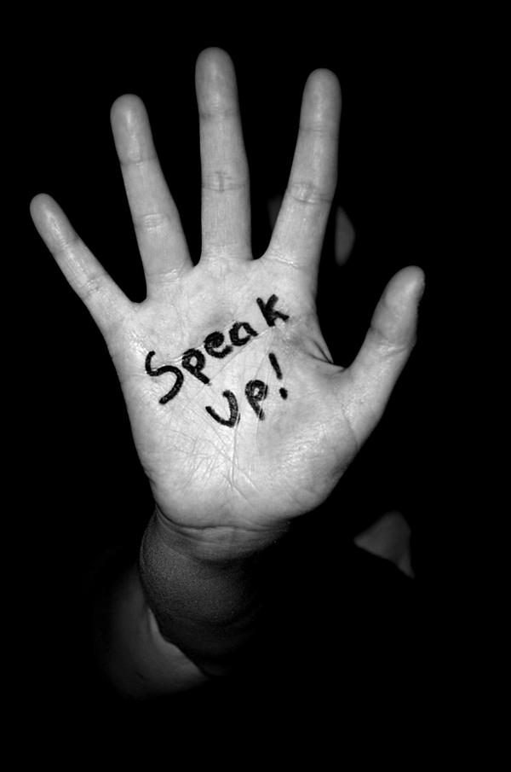
ASSERTIVENESS
This Photo by Unknown Author is licensed under CC BY-NC-ND
Notes:
Dr. Nabil
Employees should speak up about concerns that they have
- Work load, expectations

Slide 22
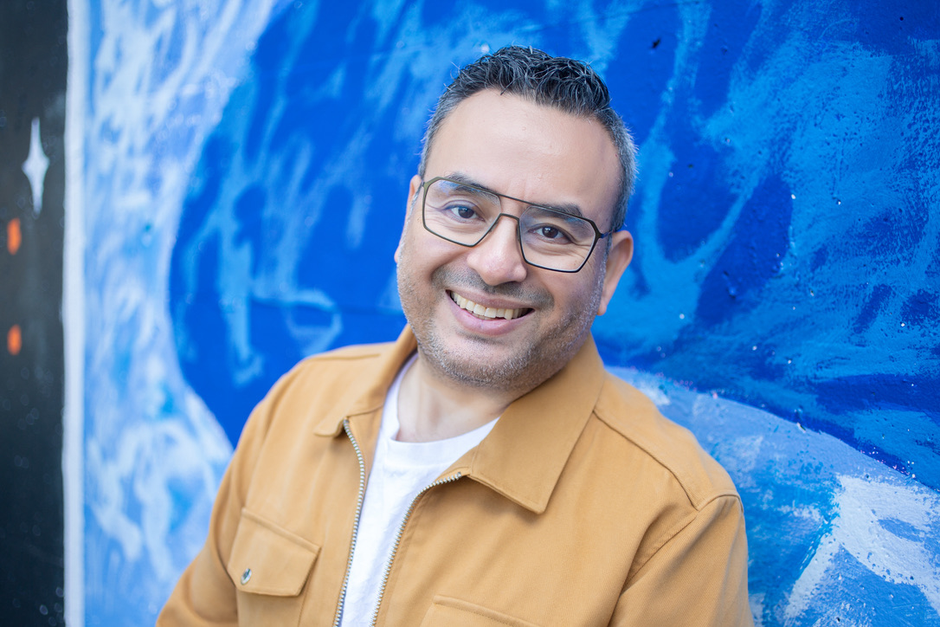

Nabil El-Ghoroury, PhD, CAE nabil@executivetherapy.solutions www.executivetherapy.solutions
@DrNabil on Twitter
202-753-4773 (text/voice)

