Slide 1




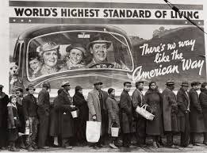
What Are The Mentally Healthiest Companies Doing?
Ron Goetzel, PhD
Director of the Institute for Health and Productivity Studies
Johns Hopkins Bloomberg School of Public Health

Slide 2
What is the headline?

Slide 3

Headlines…
Investing in the mental health and well-being of employees improves business performance
In addition to focusing on their carbon footprint, employers now focus on their carbon-based lifeforms – their workers
Responsible employers pay attention to their customers, shareholders, and employees – the payoff is a sustainable business
ESG (environmental, social, and governance) metrics developers are now considering adding an H factor – employee health and well-being

Slide 4

What is the story line?
170 million Americans go to work each day
People spend most of their waking hours at work
Employers can use the time people spend at work by introducing psychosocial, organizational, and environmental (POE) programs, policies, and supports that make workers healthier and happier
Happy employees are more productive
Healthy workers contribute to business success

Slide 5
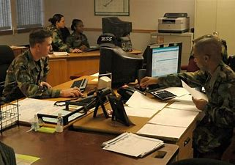

Under Pressure
Outsourcing, “right-sizing,” layoffs, reductions in force, “the great resignation”
Global competition for talent
Innovation, adaptation, reengineering - AI
Increased reliance on technology
Information overload

Slide 6

The Fallout
Increased job demands
Detachment and depersonalization
Increased health care usage
Increased absenteeism & presenteeism
Low job morale
Increased disability rates
On the job accidents
Work - life imbalance
High stress

Slide 7
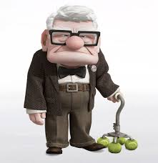
Also, we’re a lot more grumpy these days

Slide 8
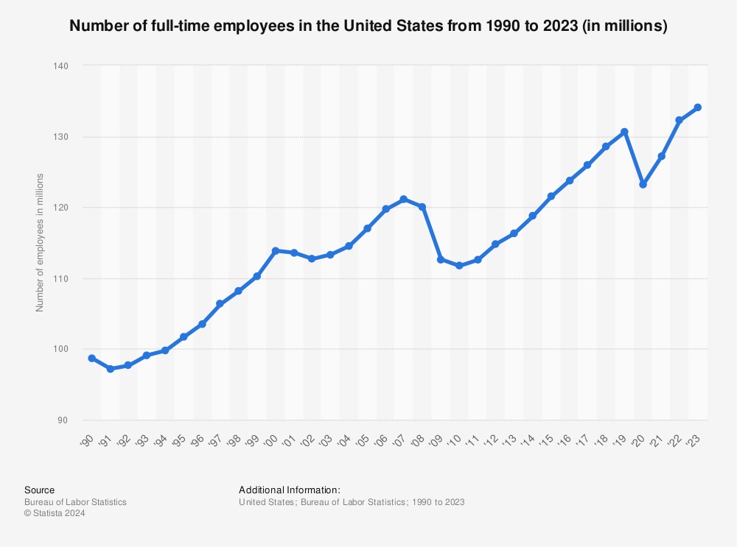
Back up…How many of us go to work every day? A lot! (~ 170 million Americans)

Slide 9
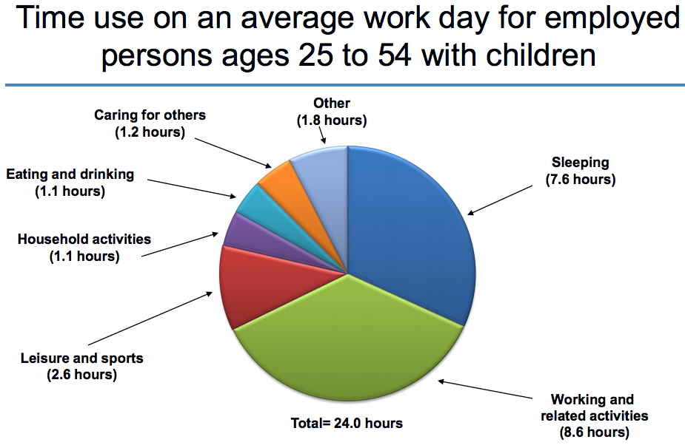

How do we spend our typical days?

Slide 10
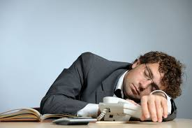
How some of us spend our day at work

Slide 11
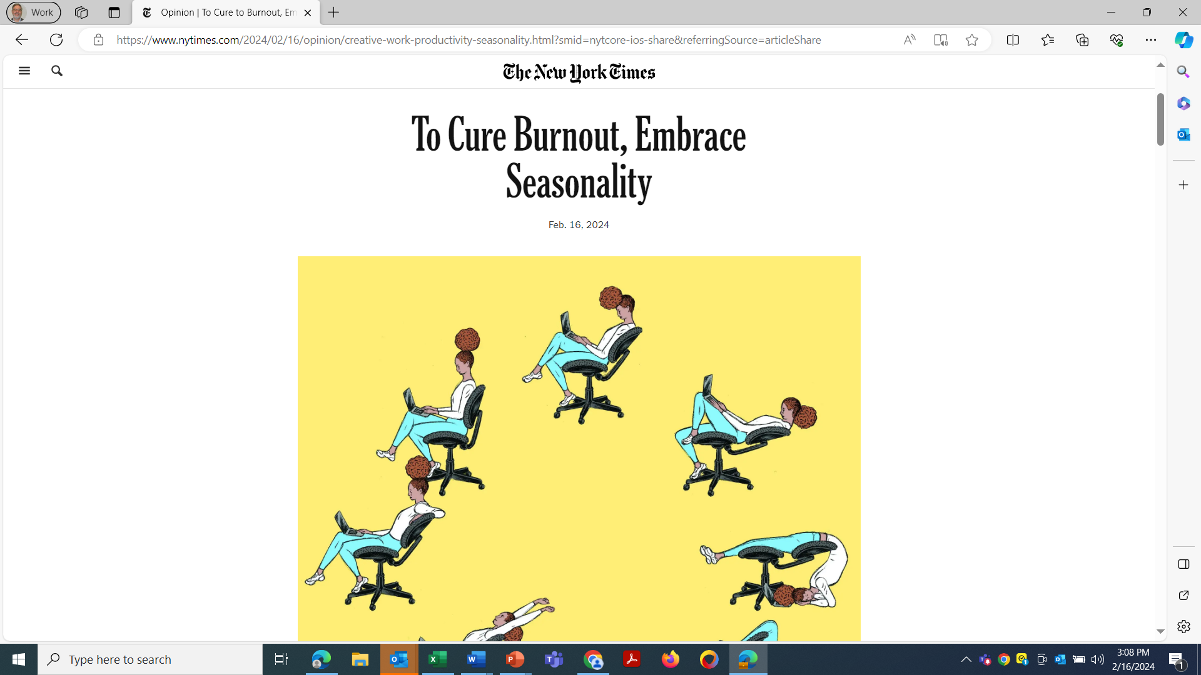
One Solution: Planned laziness
Opinion | To Cure to Burnout, Embrace Seasonality - The New York Times (nytimes.com)

Slide 12

Start Over…Poor Health is Expensive
Drill Down…
Medical and Rx
Absence/work loss
Disability
Safety incidents
Presenteeism
Underlying risk factors

Slide 13
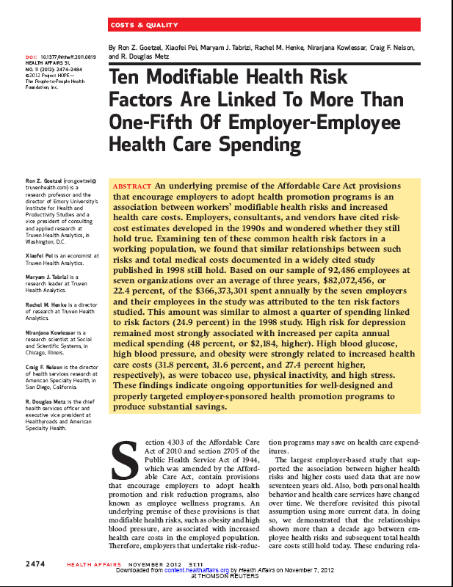
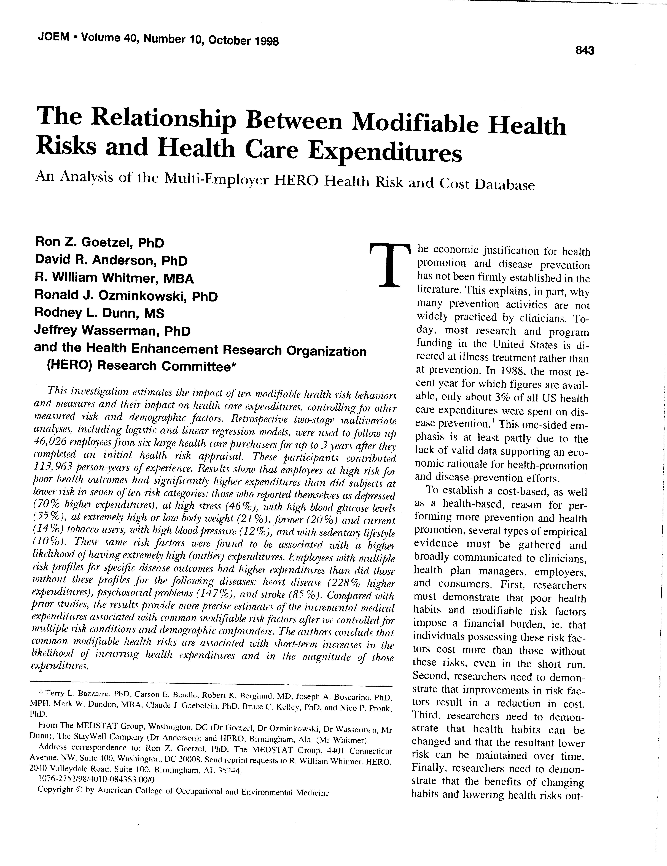
HERO I, II, III Studies (1998, 2012, 2022): Depression is a Costly Disease

Slide 14
The Big Picture: Burden of Illness by Condition – Mental Health Conditions Have A Huge Presenteeism Costs
Using Average Impairment and Prevalence Rates for Presenteeism
($23.15/hour wage estimate)
Source: Goetzel, Long, Ozminkowski, et al. JOEM 46:4, April, 2004)

Slide 15


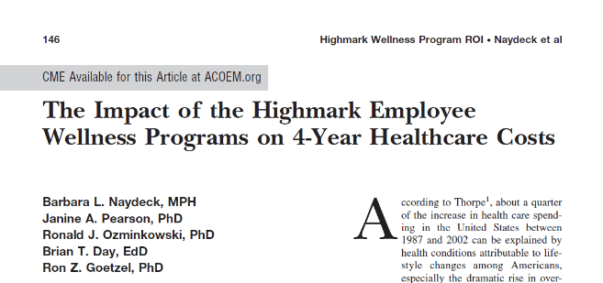
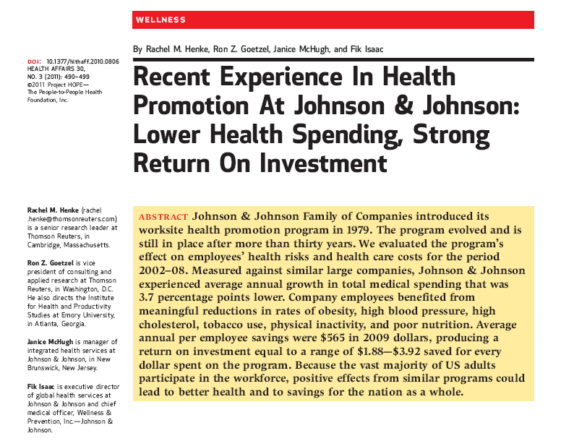


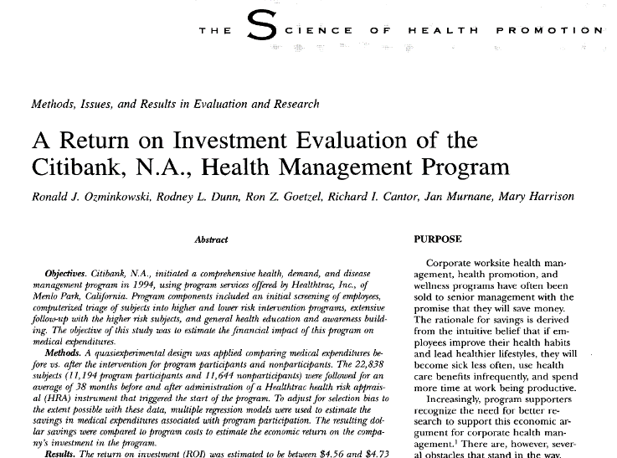


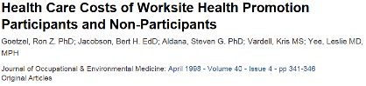
There are organizations that have figured out the “secret sauce”

Slide 16
Some Stats…The Role Human Nature Plays in Organizational Success
Jim Harter
Gallup
Gallup. State of the Global Workplace 2023 Report. Washington, D.C.;

Slide 17
Employee Engagement Trends Globally, in the U.S. and in Best Practice Organizations
First Global Drop
in Over 10 Years;
U.S. Drop Followed
Notes:
Internal Notes:
For more details: https://www.gallup.com/workplace/468173/workplace-findings-leaders-need-navigate-year.aspx
Percentages for U.S. engagement are calculated using data from various sources over the course of the trend (e.g., G1K, Gallup Panel workforce surveys).
Percentages for global engagement are calculated using annual World Poll data. 2022 global numbers will be added when available.
Percentages for best-practice organizations are based on Gallup Exceptional Workplace Award winners.
Talking Points:
As we look at the state of engagement in the U.S. in Q1 2023, we see a continuation of the slump we’ve been experiencing since 2020. After a ten-year rise and record highs in 2020, engagement dropped and is holding stagnant.
In addition to exploring the role of the manager in addressing this trend as we’ve just discussed, this persistent slump prompts us to understand what is causing this drag nationwide by looking at the specific items experiencing the most significant declines.

Slide 18
Emerging Workplace Expectations Are Shifting
What future workers want and need
My Paycheck
My Satisfaction
My Boss
My Annual Review
My Weaknesses
My Job
My Purpose
My Development
My Coach
My Ongoing Conversations
My Strengths
My Life
LEADER AS COACH
THE PAST
OUR FUTURE
18

Slide 19
Meaningful Feedback Once Per Week
16% say their last conversation with their manager was “extremely meaningful”: 80% engaged
Five factors
Recognition or appreciation for recent work
Collaboration and relationships
Current goals and priorities at work
The length of the conversation
Employee strengths or the things they do well

Slide 20
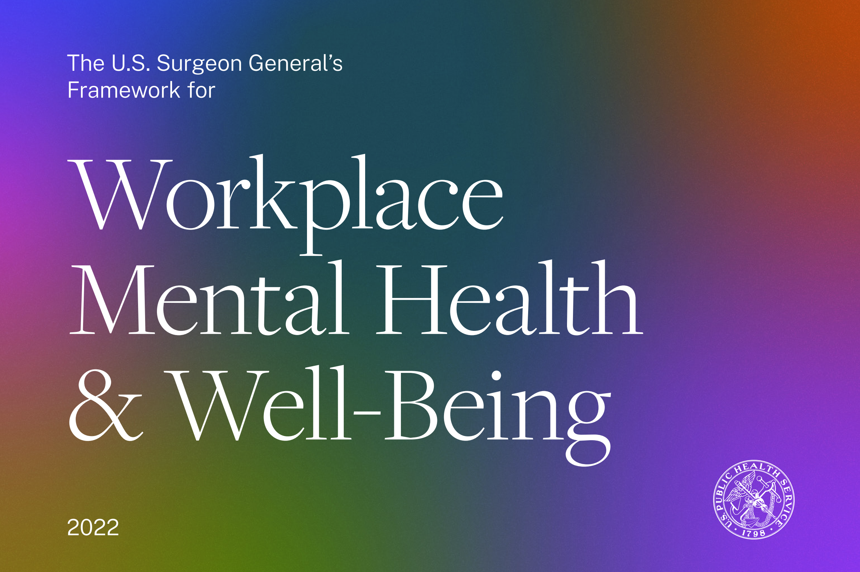
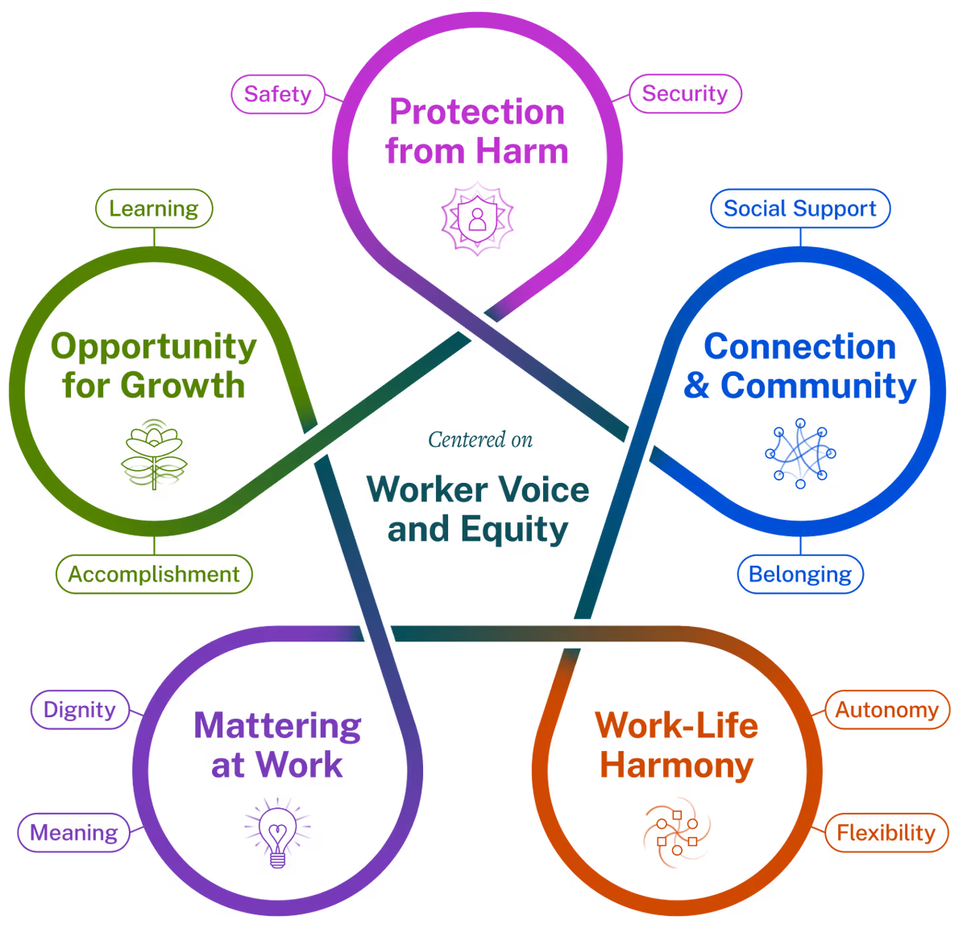
https://www.hhs.gov/surgeongeneral/priorities/workplace-well-being/index.html

Slide 21

Identifying “Best Practices” in Workplace Health Promotion: What Works?
Source: Goetzel RZ, Shechter D, Ozminkowski RJ, Reyes M, Marmet PF, Tabrizi M, Chung Roemer E. Critical success factors to employer health and productivity management efforts: Findings from a benchmarking study. Journal of Occupational and Environmental Medicine. (2007) February; 49:2, 111-130.

Slide 22
Kent et al., Best Practice Study

Slide 23









Case Studies – Companies That Do It “Right”

Slide 24


Organization-Wide Recommendation
Reinforce a culture of health and well-being that incorporates improved communications, transformative policies, and visible leadership support for health, wellbeing, and safety.
24

Slide 25

The Secret Sauce
Culture of health
Leadership commitment
Specific goals and expectations
Strategic communications
Employee engagement in program design and implementation
Best practice interventions
Effective screening and triage
Smart incentives
Effective implementation
Measurement and evaluation

Slide 26
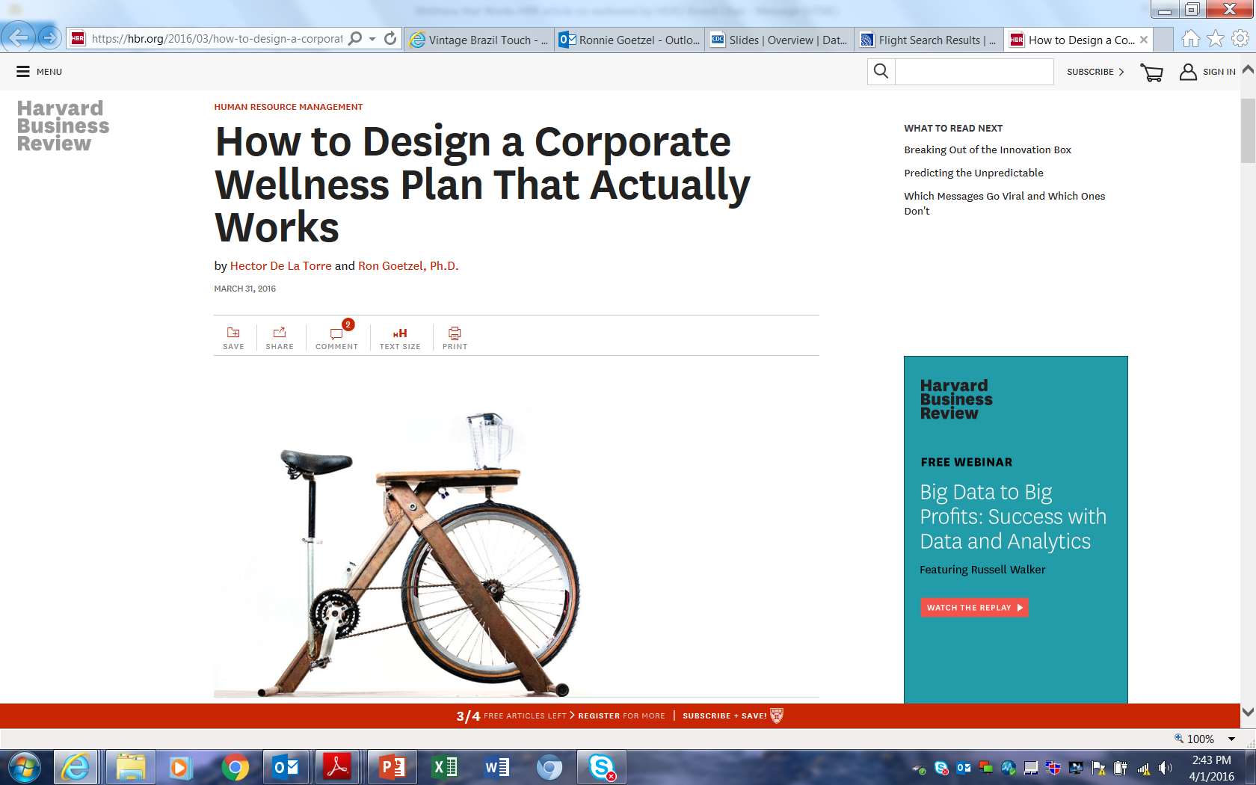
Harvard Business Review

Slide 27

27

Slide 28
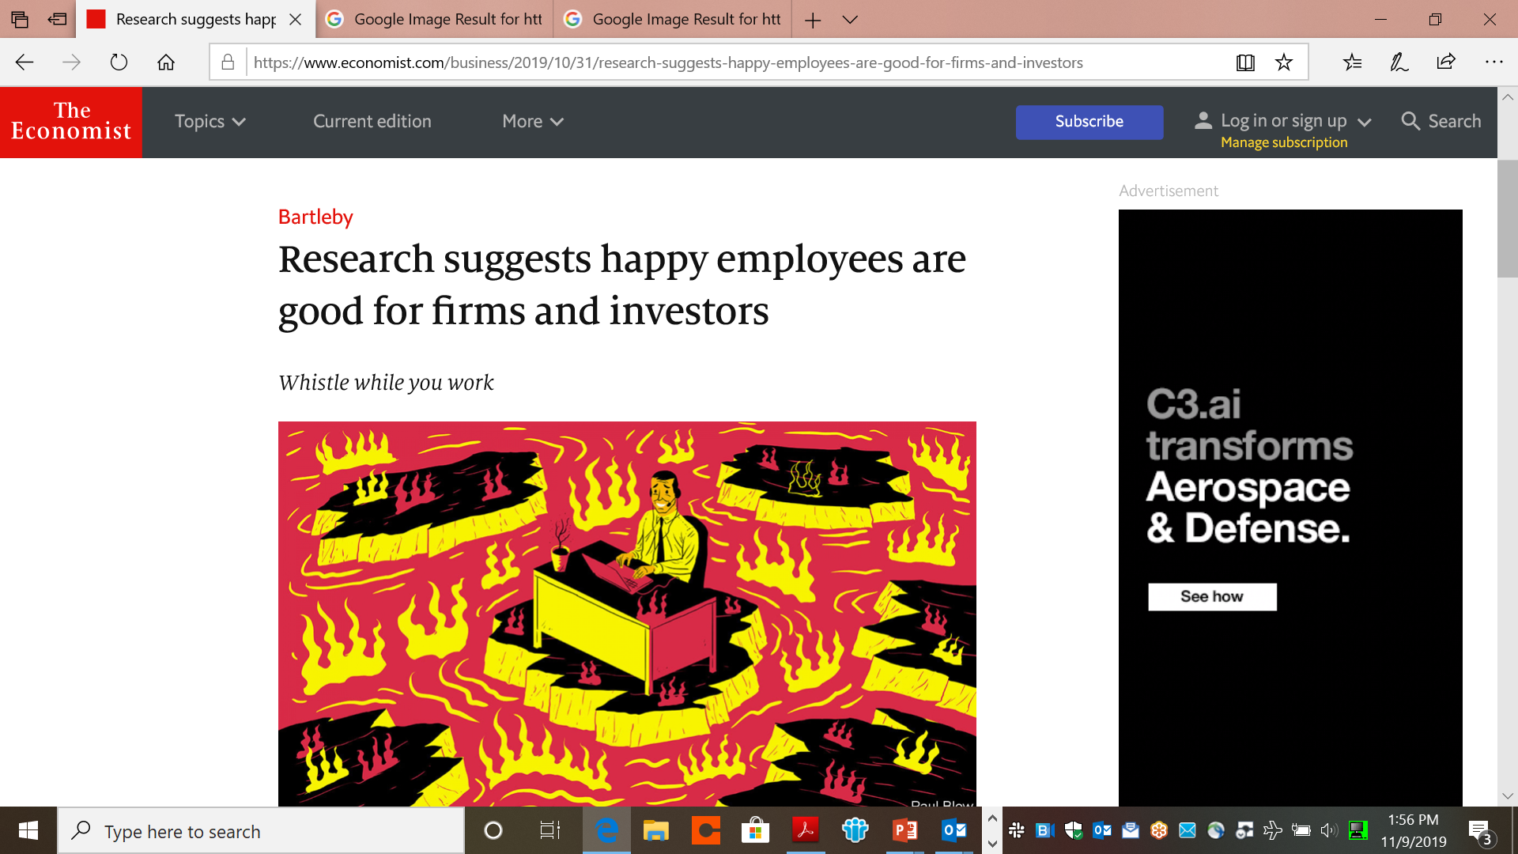
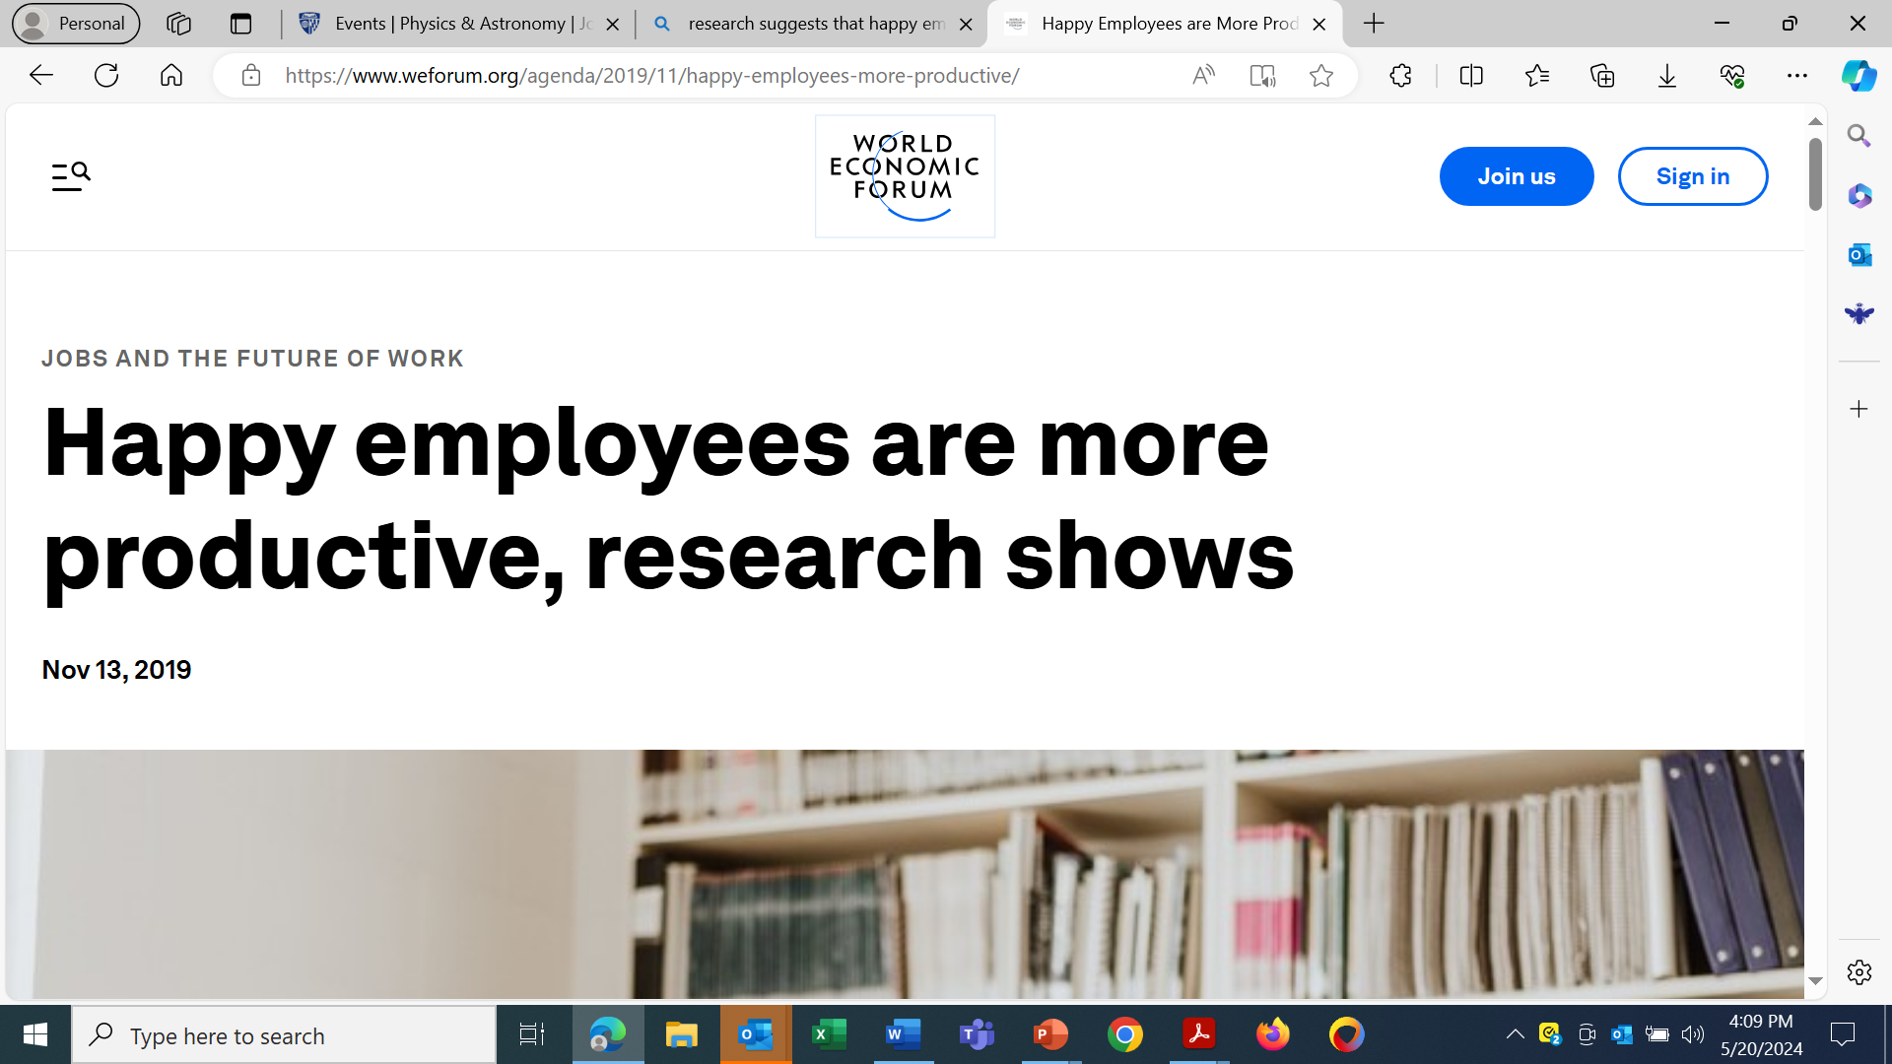
Happy employees… are productive employees!
Economist, October 31, 2019

Slide 29
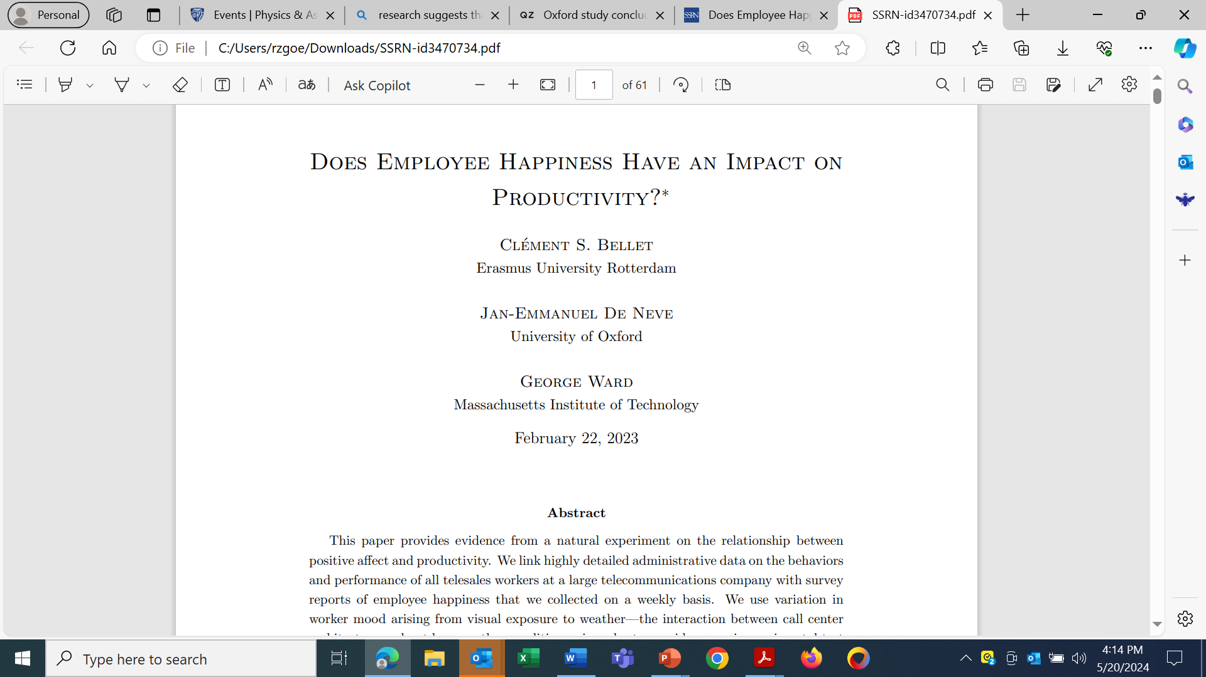
Corresponding author: George Ward, MIT Sloan, 100 Main Street, Cambridge MA. Email: wardg@mit.edu.

Slide 30

Wall Street Studies

Slide 31
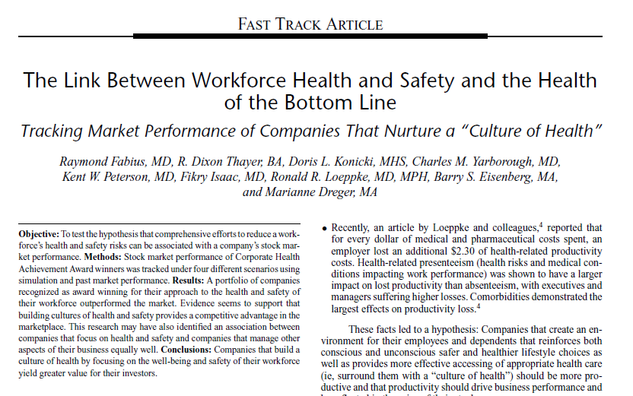

Slide 32
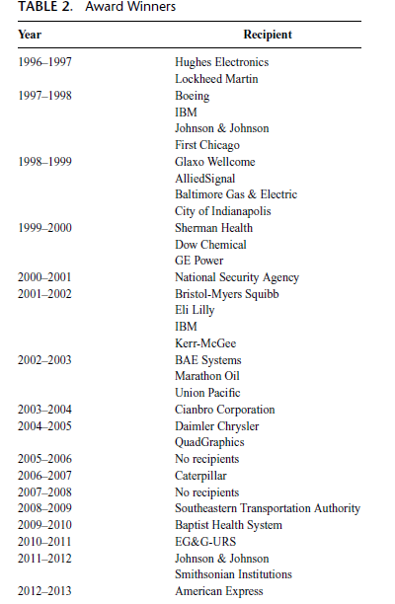
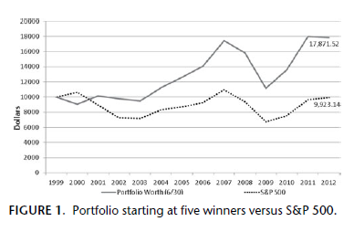
Corporate Health Achievement Award(CHAA) Winners

Slide 34
High Health and Safety Scores vs. S&P 500

Slide 35
Grossmeier et al., HERO S&P Study

Slide 36
HERO Study Results

Slide 37
Goetzel et al., Koop S&P Study

Slide 38













Some Winners of the Koop Award

Slide 39
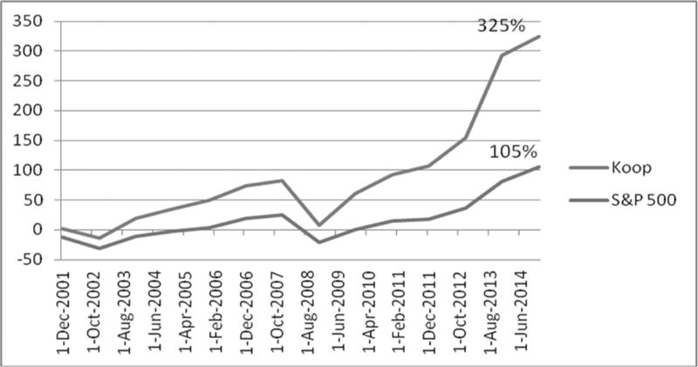

Koop Winners Outperformed the S&P 500 – 3:1
Cumulative Stock Performance (%) of Koop Award Winners Compared With the S&P 500 Index, 2001–2014

Slide 40
RWJF-Funded Study

Slide 41
HI COH INT Companies vs. the S&P 500
41

Slide 42
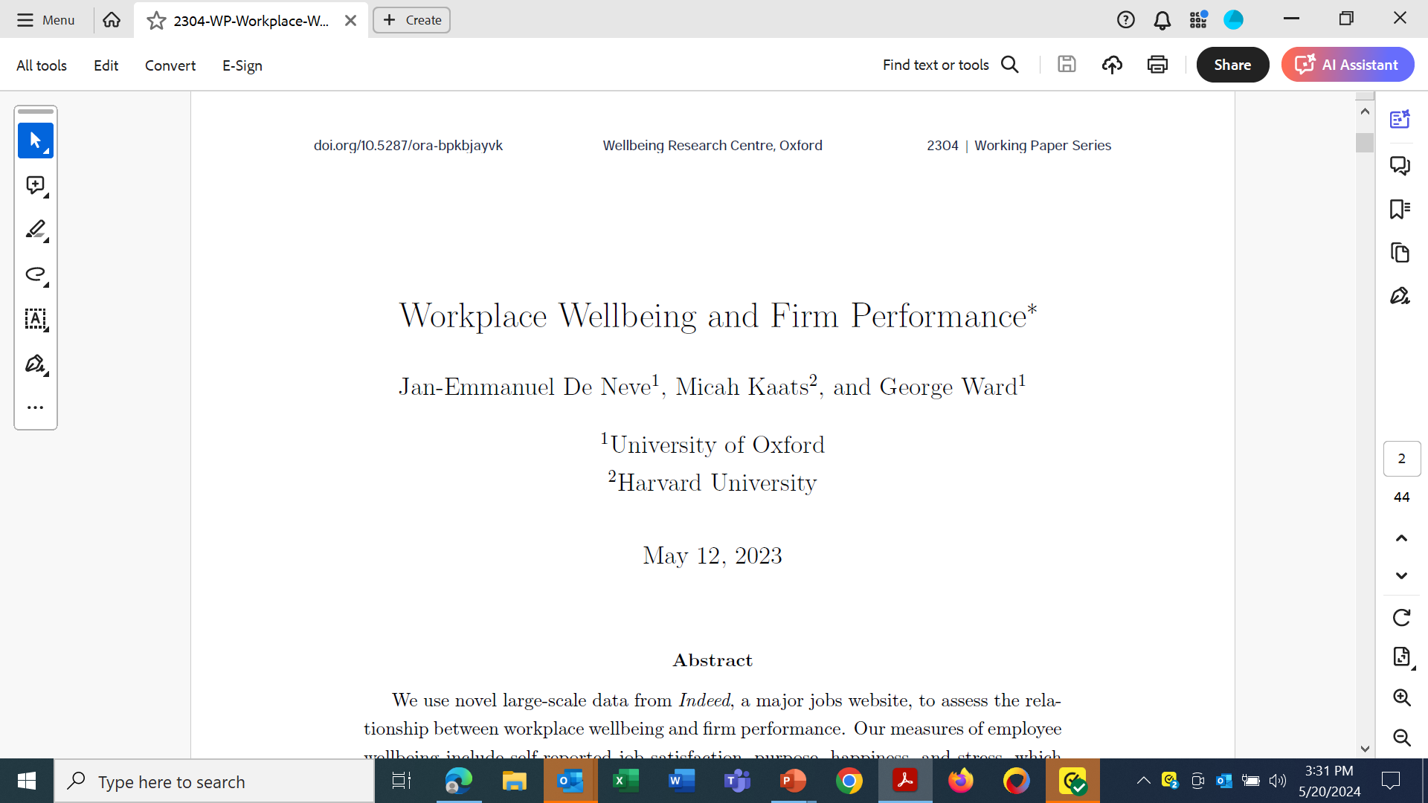
Indeed Study – Workplace Well-Being and Performance
De Neve, J-E., Kaats, M., Ward, G. (2023). Workplace Wellbeing and Firm
Performance.
University of Oxford Wellbeing Research Centre Working Paper 2304. doi.org/10.5287/ora-bpkbjayvk

Slide 43
Correlation of Happiness and Business Metrics

Slide 44
Top 100 “Happiest” Companies’ Stock Performance

Slide 45

Now What?

Slide 46

An Employer Recognition Program
The Carolyn C. Mattingly Award for Mental health in the Workplace recognizes and celebrates exemplary organizations that advance the mental health and well-being of their workforce, while also serving as role models for other employers.
https://theluvuproject.org/workplaceaward

Slide 47
Award Criteria
The award criteria are comprised of 10 categories
Endorsements of baseline practices
Culture
Mental health benefits
Mental health resources
Workplace policies and practices
Healthy work environment
Leadership support
Outcomes
Innovative approaches
Employee opinions

Slide 48
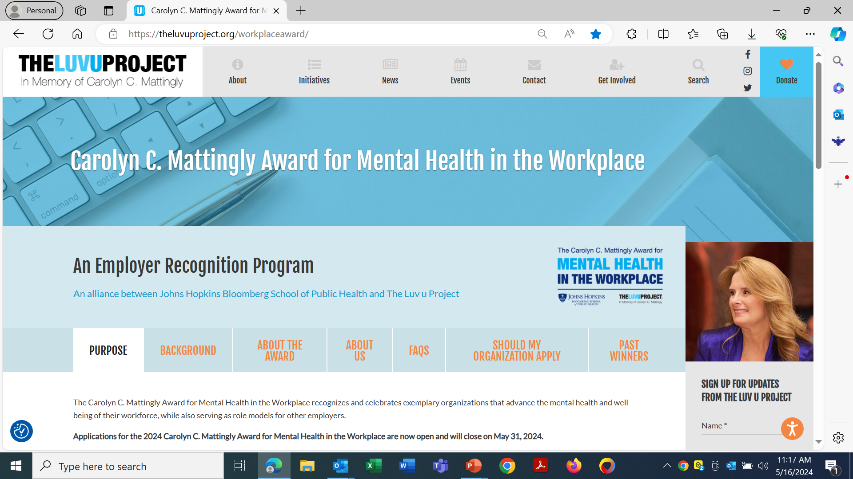

Slide 49
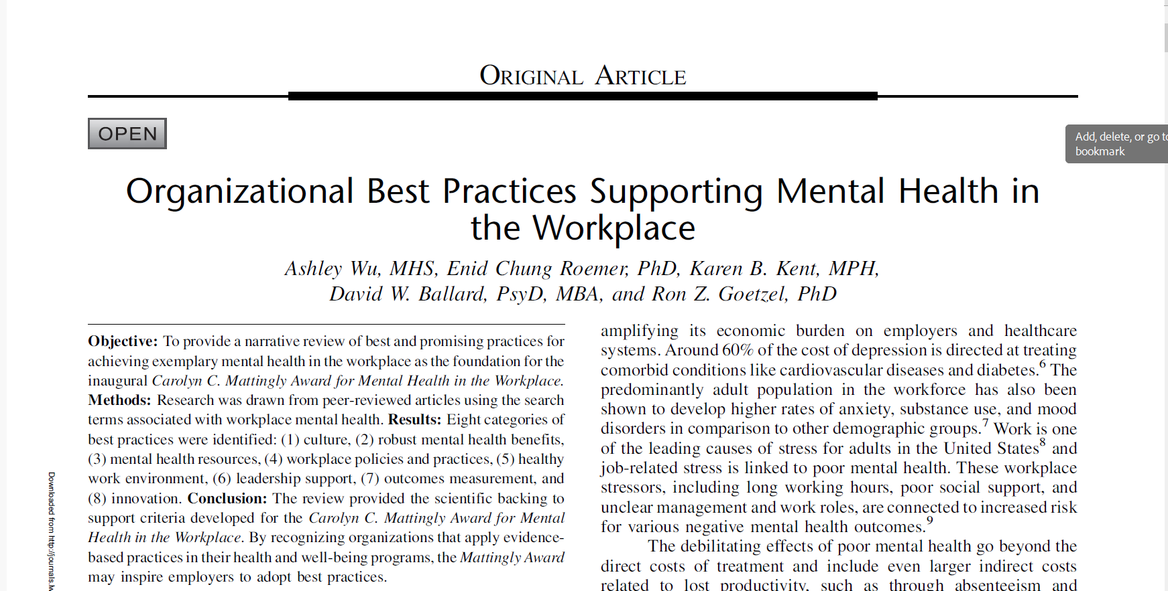
JOEM Volume 63, Number 12, December 2021

Slide 50
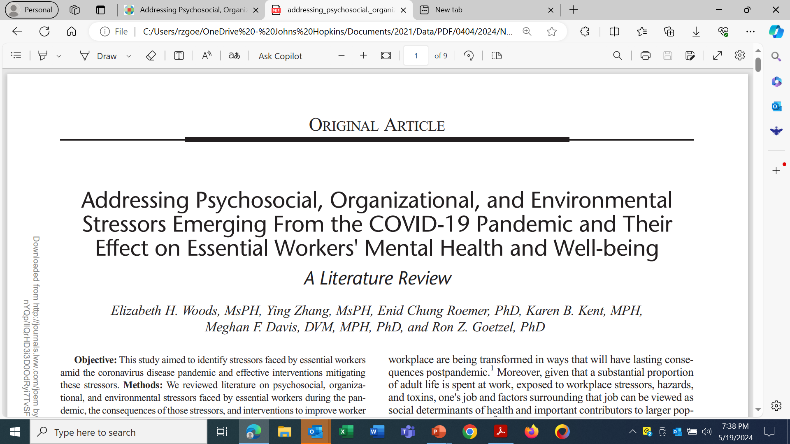
Published Evidence-Based Reviews

Slide 51

Recommended Strategies
Overarching Strategy
Create a culture of health and well-being, championed by leadership, and built on structures promoting engagement and social support
Psychosocial
Organizational
Environmental
Highlight self-care
Manage stress
Align purpose
Build resilience
Encourage connectedness and belonging
Address job demands and decision latitude
Allow for flexibility
Pay living wages
Design spaces to promote physical activity, social engagement, and “contemplation”
Reduce exposure to toxins and safety hazards

Slide 52
Some Ideas (Psychosocial Domain)
Make good use of your Employee Assistance Program (EAP).
Use creative marketing techniques, to tell personal stories, employees share their experience (without being named).
Provide simple tools, e.g., Calm, Headspace, meQuilibreum.
Organize support groups for employees (kids and work, home schooling, cooking groups, history workshops, language clubs).
Have casual check-in meetings, informal coffee groups and occasional group lunches to just hang out, chill, and/or share life stories.

Slide 53
Other Ideas (Psychosocial Domain)
Focus on basic needs: good nutrition, physical activity, rest, …
Avoid further harm (smoking, drinking excessively, drugs).
Keep calm: deep breathing, schedule quiet moments.
Set priorities: distinguish between what you can and can’t control.
Connect with others: reach out to friends and family.
Reinforce coping skills: how have you coped with difficult situations in the past -- use those techniques now.

Slide 54
More Ideas (Organizational Domain)
Follow the science – appoint a credible spokesperson as the “one source” of information.
Question and respond to misleading social media posts.
Highly encourage public health prevention measures.
Connect with your local public health department to work together on joint initiatives.

Slide 55
More Ideas: Organizational and Environmental Domains
Reinforce a culture of health and well-being encouraged by visible leadership support
Expand existing health and safety communications campaigns
Streamline and improve ease of access to information –
Create a one-stop-shop (a virtual or “live” concierge service) that offers advice and counseling on where/how to access resources and tailor communications to affinity and sub-groups.
Improve protocols/guidelines to encourage social engagement and reduce stressors.
Reinforce current management training on ways to support employees – lead by example.
Provide designated times for participation in health and wellbeing programs/activities.
Measure and Evaluate Progress

Slide 56

Measure Using a Balanced Scorecard Move from ROI to VOI
Financial Outcomes
Quality of Life and Productivity Outcomes
Health Outcomes
Return-on-Investment (ROI)
Medical costs
Absenteeism
Short term disability
Safety/Workers’ Comp
Presenteeism
Population Health
Adherence to evidence- based medicine
Behavior change, risk reduction, health improvement
Value-on-Investment (VOI)
Improved “functioning” and performance
Attraction/retention of talent
Employee engagement
Corporate social responsibility
Reputation

Slide 57

Thank You!
Ron Z. Goetzel, Ph.D.
Senior Scientist at the Johns Hopkins Bloomberg School of Public Health
rgoetze1@jh.edu
202-768-6236

