Slide 1

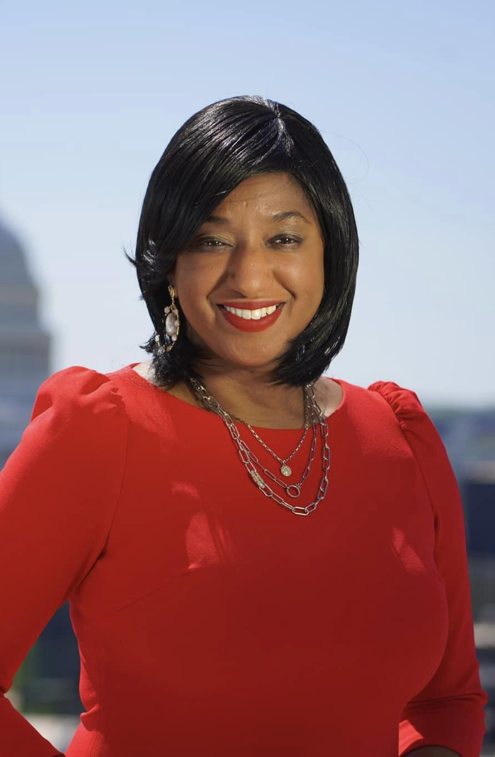
Widening the Pipeline CARESSE JACKMAN/INVESTIGATETV

Slide 2
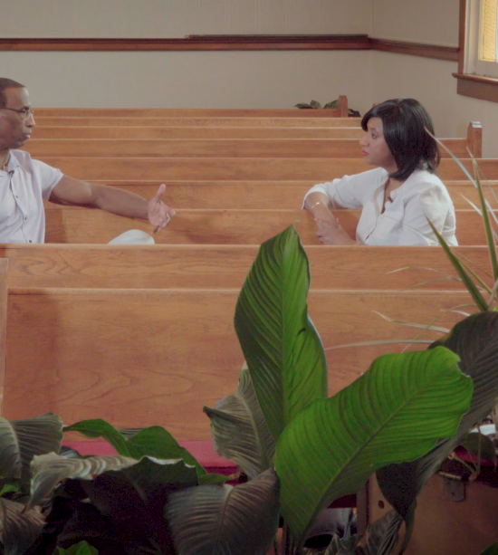
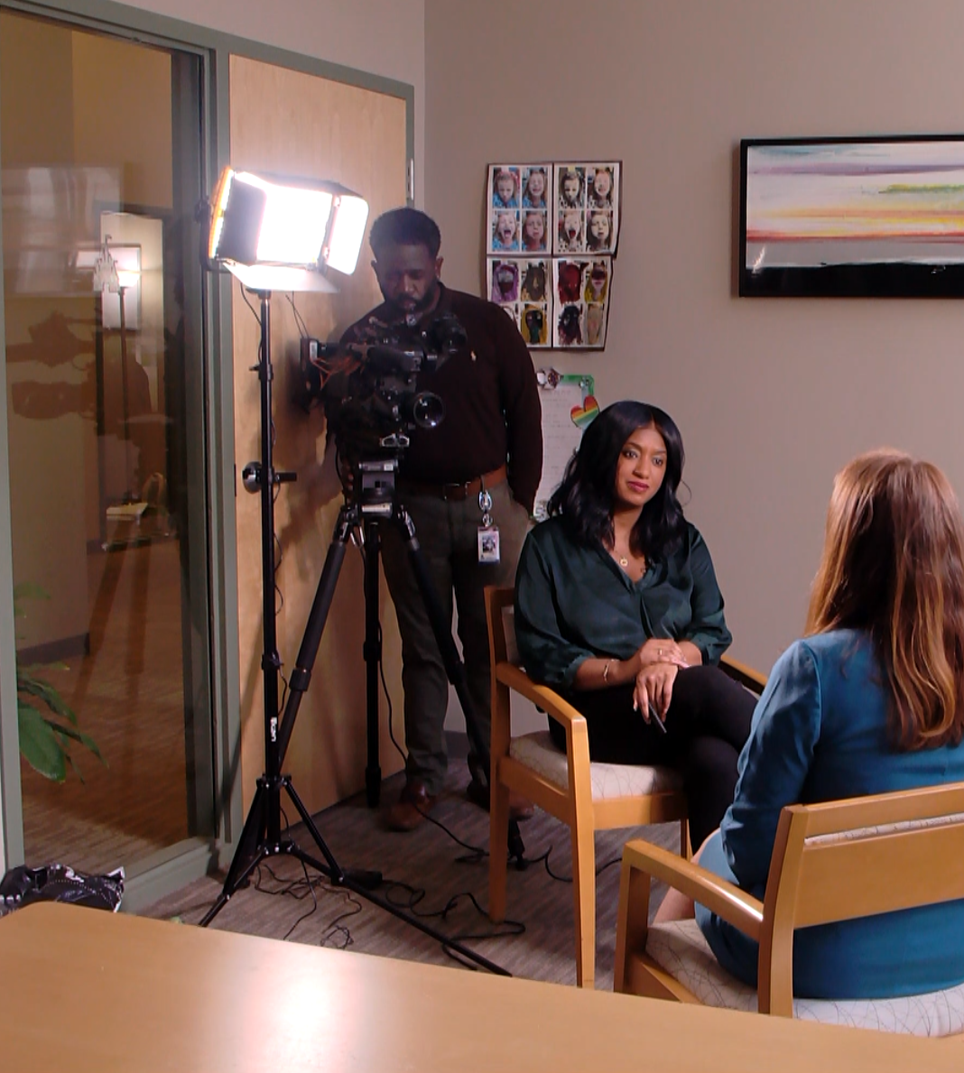
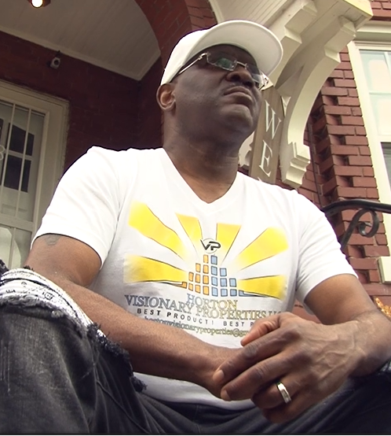
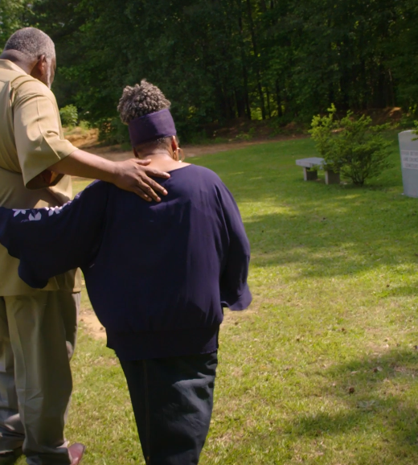
Today we’ll discuss
Pitching Investigative Stories with systemic issues
Storytelling and process
Showcase stories and outcome

Slide 3

When pitching a story impacting minorities…
Pitch it strategically: come prepared!
Have an idea of what type of story you want to tell from beginning to end. Know what types of open records requests you want to file. (you can even start doing a few to see what you receive. May make your pitch stronger.)
Do some digging on your project before you even begin it.
Conduct background calls/zooms with people so you can have an idea of what you want to talk about. Sometimes they’re more likely to agree to an interview.
Find ways to pivot when challenges come your way, because they will.
Being real: many of your managers will be white/male and have no concept of the issues we face. You have to give them an understanding of why these stories matter, why it’s important and how impactful this story can be.

Slide 4
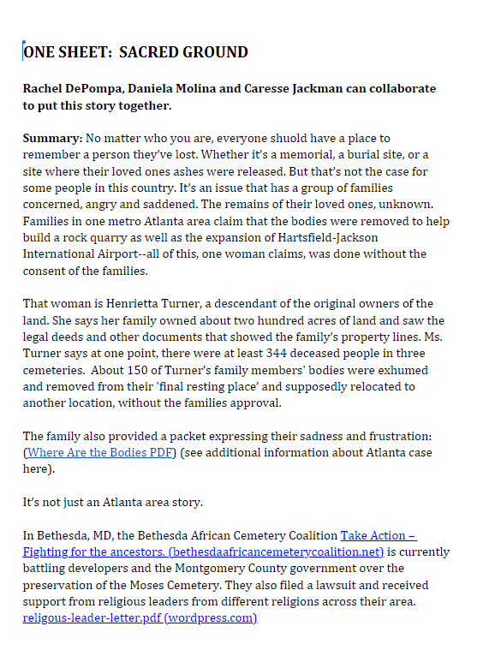
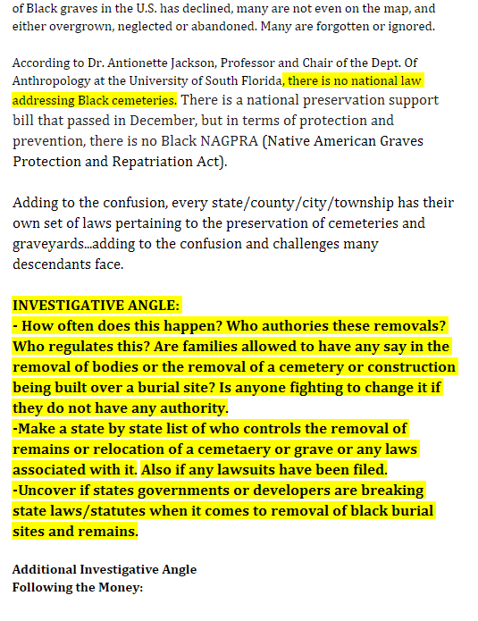
Pitch sheet- make it so good it’s hard for them to say no!

Slide 5
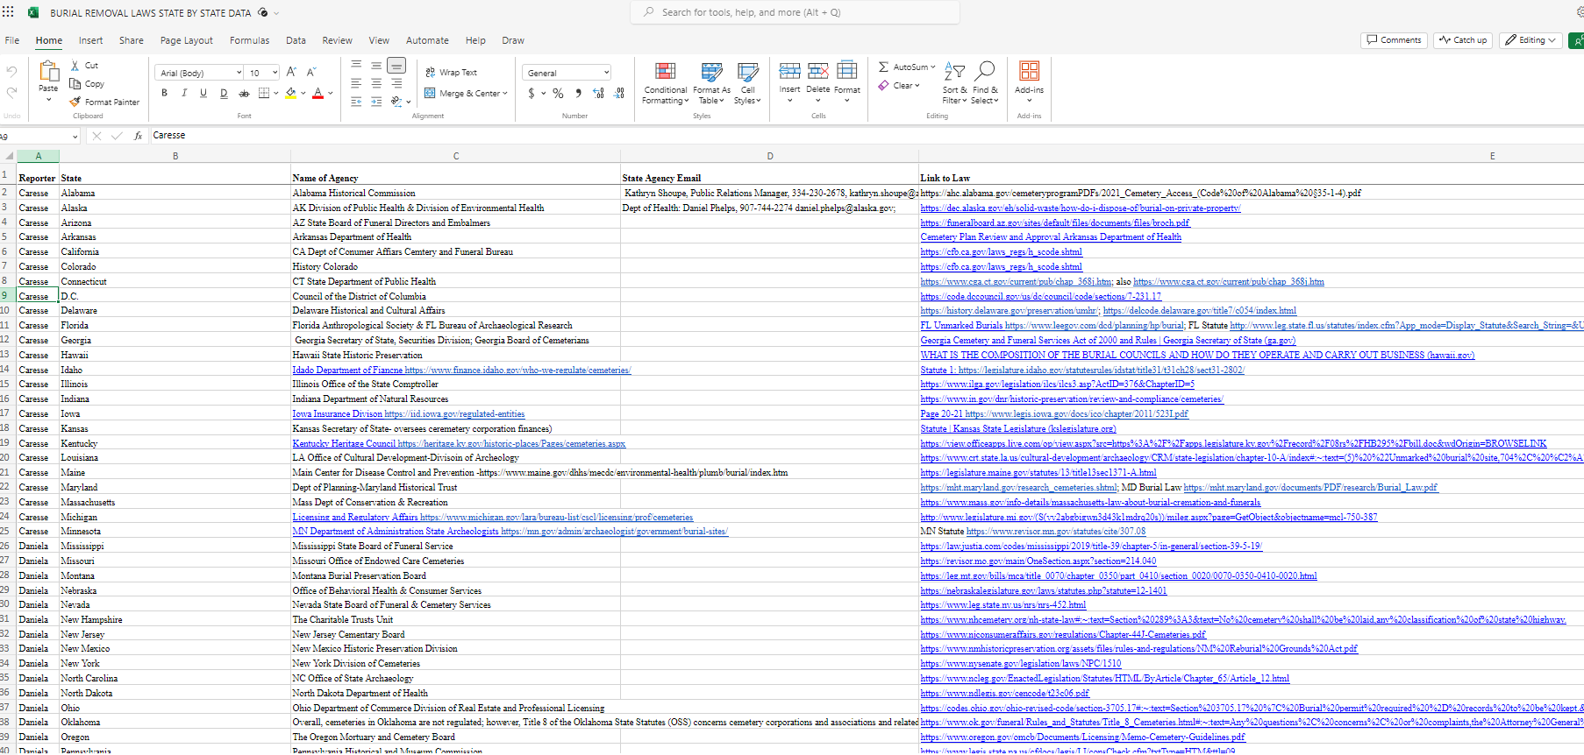
Once your story is given the green light…
Be prepared to create or catalogue your own data:
In so many cases, because our communities have been marginalized and disregarded for years, the data the may exists for other stories may not exist for these. So, create a database as you track and gather information. Example: excel spreadsheet.
Sometimes part of the investigation is exposing that the data does not exists, that there’s a lack of care when it comes to state and federal agencies, and that the problem is not being addressed.
Find creative ways to illustrate or visualize your story:
Always give context to stories impacting minority communities.
Peel the layer back and give that context to your readers/audience. Make people understand why systemic issues linger today because of laws put into place to keep communities of color behind. (sacred ground: how African Americans were buried; undervalued: redlining.

Slide 6
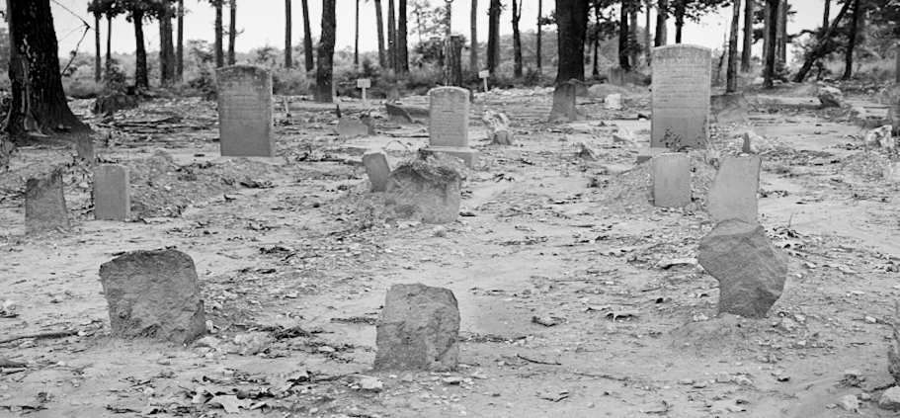
Sacred ground
Idea: Received a tip from someone in Georgia that remains were desecrated and moved from one location to another without the family’s consent.
Because I work on a national level, I needed to give the story a national scope, a national angle.
I wanted to dig deeper than just the surface level stories I’ve seen in the past. “Oh this cemetery is in bad shape..the end.”
Find an investigative angle.
Began looking into lawsuits and other cases currently happening nationwide.
Found that there were also two pending cases: Virginia and Maryland.

Slide 7
Investigative hook
Investigative angle: what’s being done to protect African American burial sites, how prevalent is this problem?
we asked each state for their permit process to remove remains. Wanted to know if there’s a record of them for black cemeteries. Asked states for their cemetery laws.
Discovered that a law was passed in congress to help fund and preserve African American burial sites, but zero dollars were allocated towards it. So that begs the question, were these laws just passed to appease people? Why is this not considered a priority? Why do states not know about black cemeteries, how many there are and if they have been built over or demolished.

Slide 8

Who you need to interview for investigative stories impacting people of color
Descendant communities (families and groups advocating for preservation, activists.)
Attorneys familiar with cemetery and remain being disturbed or desecrated
Lawmakers trying to create change.
Accountability: Developers and attorneys representing the companies allegedly building over black burial grounds/cemeteries

Slide 9
Sacred ground series
Sacred Ground: The fight African American families face protecting their ancestors’ final resting place – InvestigateTV
Sacred Ground: A families fight to identify the resting place of more than 300 African Americans – InvestigateTV
Sacred Ground: Burial program approved yet descendant families still waiting – InvestigateTV

Slide 10
UNDERVALUED: INVESTIGATING APPRAISAL BIAS
Undervalued: Black homeowners fight for unbiased appraisals – InvestigateTV

Slide 11
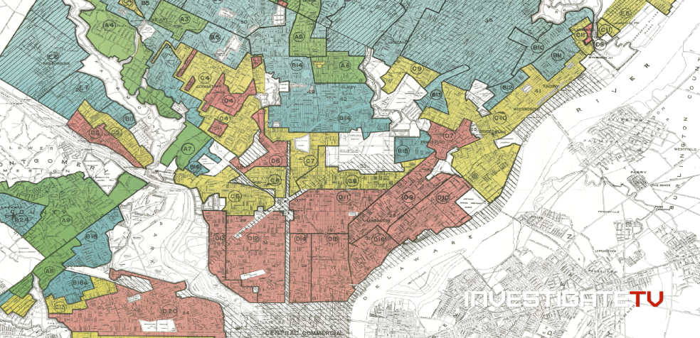
Behind the story: Undervalued
Idea: Started working on this story when I was an investigative reporter in Nashville, TN.
The idea of “White Washing” was done before, but I wanted to focus file open records request to see what issues are being reported to each state, as well as federal agencies tasked with investigating appraisal bias.
Wanted to know on a federal level, how they’re holding states and real estate appraisal boards accountable.
We found:
Most states aren’t doing much, except maybe the bare minimum.
Some states, like Texas, have collaborated with civil rights divisions. But for the most part, most states don’t even have a way of cataloguing appraisal bias complaints.
Also showcased how this issue is systemic…going back to redlining-and showing comparisons in language used then vs. now
Then: “infiltration of negroes.” Now: “black population above state average.”
Spoke with people from the “other side”- conservative think thank which does not believe undervaluation of homes is solely because of race.

Slide 12

So remember- when investigating
Look for patterns
Look for victims/people impacted
Look for experts
Look at loopholes in laws, state and federal policies
Expose the complexities and injustice taking place.
That’s how you dig deeper, uncover information and expose systemic problems- giving it an investigative lens
Ofcourse hold people and agencies accountable.
Follow up, be persistent. Do multiple stories and parts!

Slide 13
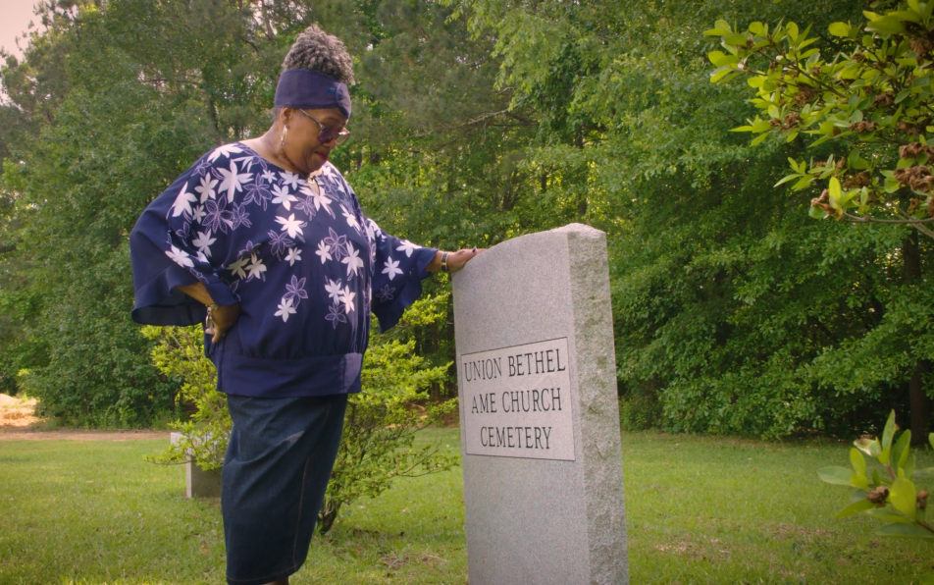
Thank You
Caresse.jackman@investigatetv.com
Twitter: @caresseJ

