Slide 1
Broadening the Lens on Investigative Reporting
Shreya Agrawal
Climate Journalist and Communicator
Newsroom Fellow at The Xylom

Slide 2
A (swift) trip down memory lane
Born in India near the Himalayas
Spent a bunch of time growing up in the SF Bay Area
Studied geology, English and journalism at USC
But didn’t really know what I wanted to do with any of it
Climate journalist and communicator
Found my a-ha moment in 2022 + founded Annenberg Media Earth
First existential crisis at age 5
When I first read about climate change

Slide 3
What do we do at The Xylom?
“Non-profit, student-led newsroom focusing on communities influencing and shaped by science.”
But what does that mean?

Slide 4
What do we do at The Xylom?
Centering perspectives of people of color
  All of our employees + most of our writers
Telling the stories that usually don’t get told
  Stories with international perspectives
  Hard to talk about topics –– endometriosis, greenwashing
Holding people in power accountable while focusing on community-building!

Slide 5

Perspective on menstruation from an Indian woman
We get writers from all around the world.
At a time when most newsrooms are grappling with DEI, The Xylom has always centered that in everything we do.

Slide 6
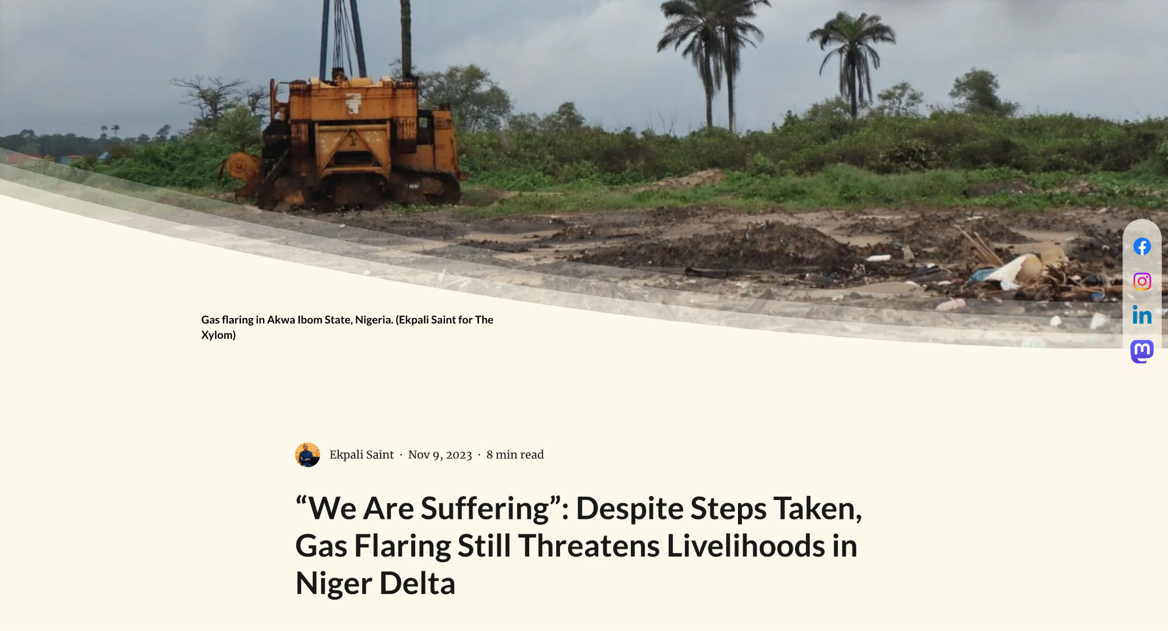
International stories need to be told nationally
Our editor-in-chief Alex Ip strongly believes in giving a voice to those who haven’t had one in the past.
We welcome all writers, even those with no experience.
Our job is to train, teach and help your stories get better!

Slide 7
I currently also work for:
USC Annenberg Center for Climate Journalism and Communication
Sojourners Magazine
one5c
Feet in 2 Worlds

Slide 8
I’ve previously written for:
Los Angeles Times
CalMatters
Malheur Enterprise
Planet Forward
Annenberg Media Earth (duh)
I’ve also been a guest on radio stations such as CapRadio, KQED, LAist and KCBS.

Slide 9
So, what do I do with the Xylom (and all the other jobs)?
Feels like everything!!!
Investigative and accountability reporting
Community reporting
Editing and fact-checking
Podcasting!
Planning journalism/comms events
Climate comms reports/surveys
My fav: being a rainmaker :)

Slide 10
Why am I here?
Mostly to tell you: YOU GOT THIS!!!

Slide 11
But let’s talk about investigative reporting for a sec…
Investigations are no different from other kinds of reporting, except:
You get lots of time to work on them
There is usually an accountability/harm aspect to those stories
You get to go as deep as possible (because of the time factor)

Slide 12
Where can I find investigative stories?
You probably already have a few right under your nose!
Think of stories you have done in the past. How can you expand on them?
Look at what is happening in your beat. Who is being harmed? Who needs to be held accountable?
Build good relationships with your sources beyond the daily grind –– that’s how I have gotten a bunch of my stories!

Slide 13
So, how can I get started?
It is totally possible to do investigations even when saddled with other hefty stories on your beat!
How?
Cultivate sources + become an authority on your beat
Think: “What are the big questions on my beat?”
If you can’t do a big project, think in terms of incremental stories
Try to find data/documents! Stories are often hidden in the fine print…

Slide 14
Some tips and helpful resources
Set up coffee chats with reporters you admire and learn from their process
Check out the Ida B. Wells Society –– they have great resources + bootcamps
If IRE and NICAR seem too intimidating, try going to other society conferences (NLGJA, NAHJ, AAJA, SEJ, etc.)
Read investigative stories and try to break them down to understand the process

Slide 15
The most important…
REDEFINE WHAT INVESTIGATIVE JOURNALISM IS FOR YOU!
Everyone’s process is different
You don’t have to look or act or be a certain way to be a good investigative journalist. You can be yourself and still shine!
If someone makes you feel like you can’t, be brave and prove them wrong
Don’t be afraid to try new things, take risks and make mistakes. That’s the ONLY way to learn.

Slide 16
Some stories I am working on:
The Xylom:
Impact of lithium mining in Imperial Valley
The state of fire insurance in rural California/Oregon
“Recycling” of synthetic turf

Slide 17
Other stories I am working on:
Redlining and environmental justice in Los Angeles
Eco-chaplaincy and how it can help us fight climate anxiety
And several other climate comms projects!

Slide 18
Journalism is hard…
Everyone has a different career path and no path worth walking on is straightforward.
Trust your own process.
Listen to everyone’s advice but remember, you don’t have to follow everything.
But you are here for a reason! Trust your gut!

Slide 19
Questions? Musings?
Want to debate?
(Now’s your chance!)

Slide 20
Other questions? Feel free to reach out!
Always happy to chat about:
Career path
All aspects of journalism
Nature/environment/climate change
Books, books, books
Thoughts on writing/storytelling
Anything else that you may fancy :)
theclimatecommunicator@gmail.com
213-551-3943

