Slide 1

Center for American Women and Politics
X: @CAWP_RU
Instagram: @womenandpolitics
cawp.rutgers.edu

Slide 2
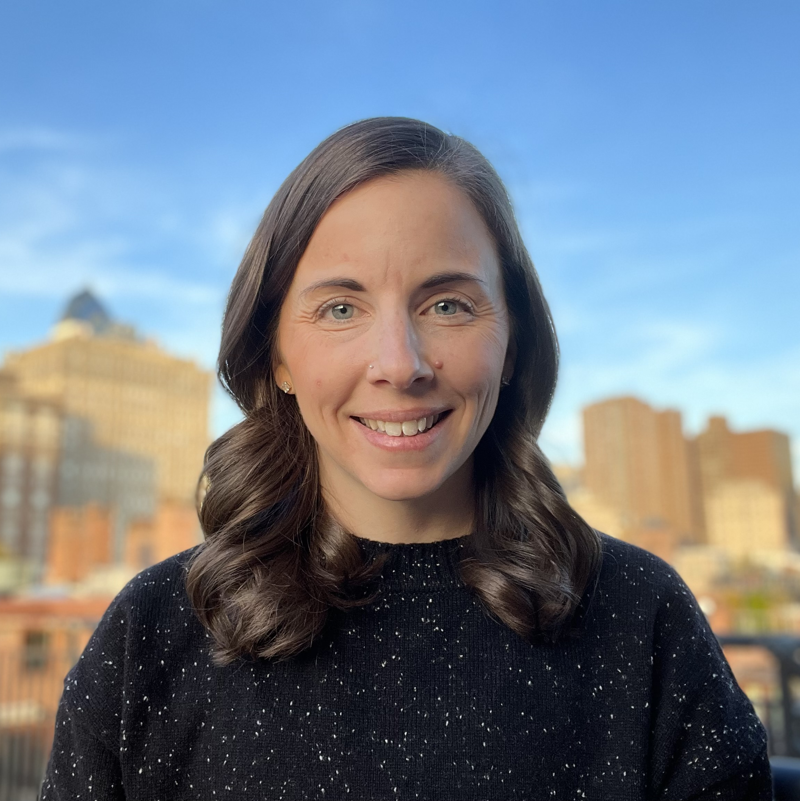
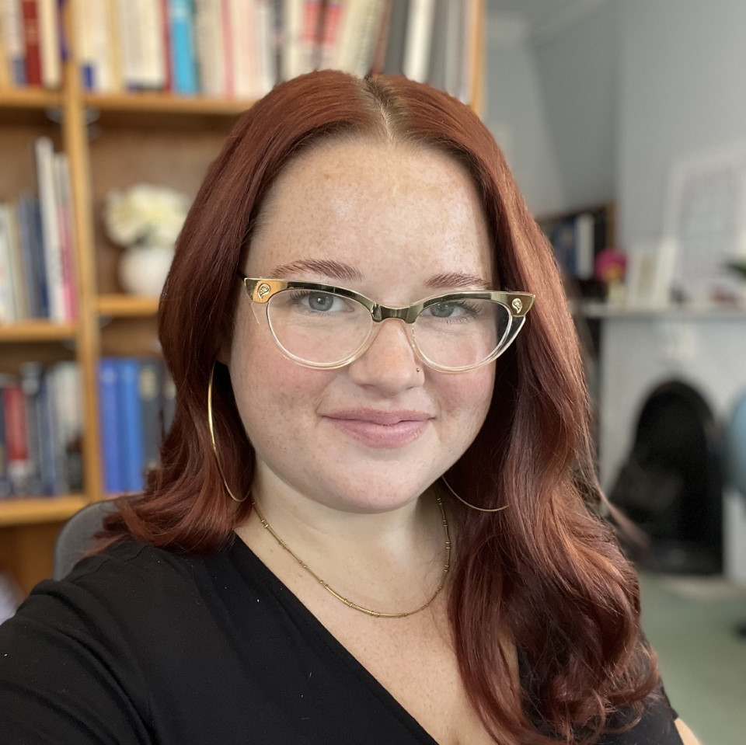
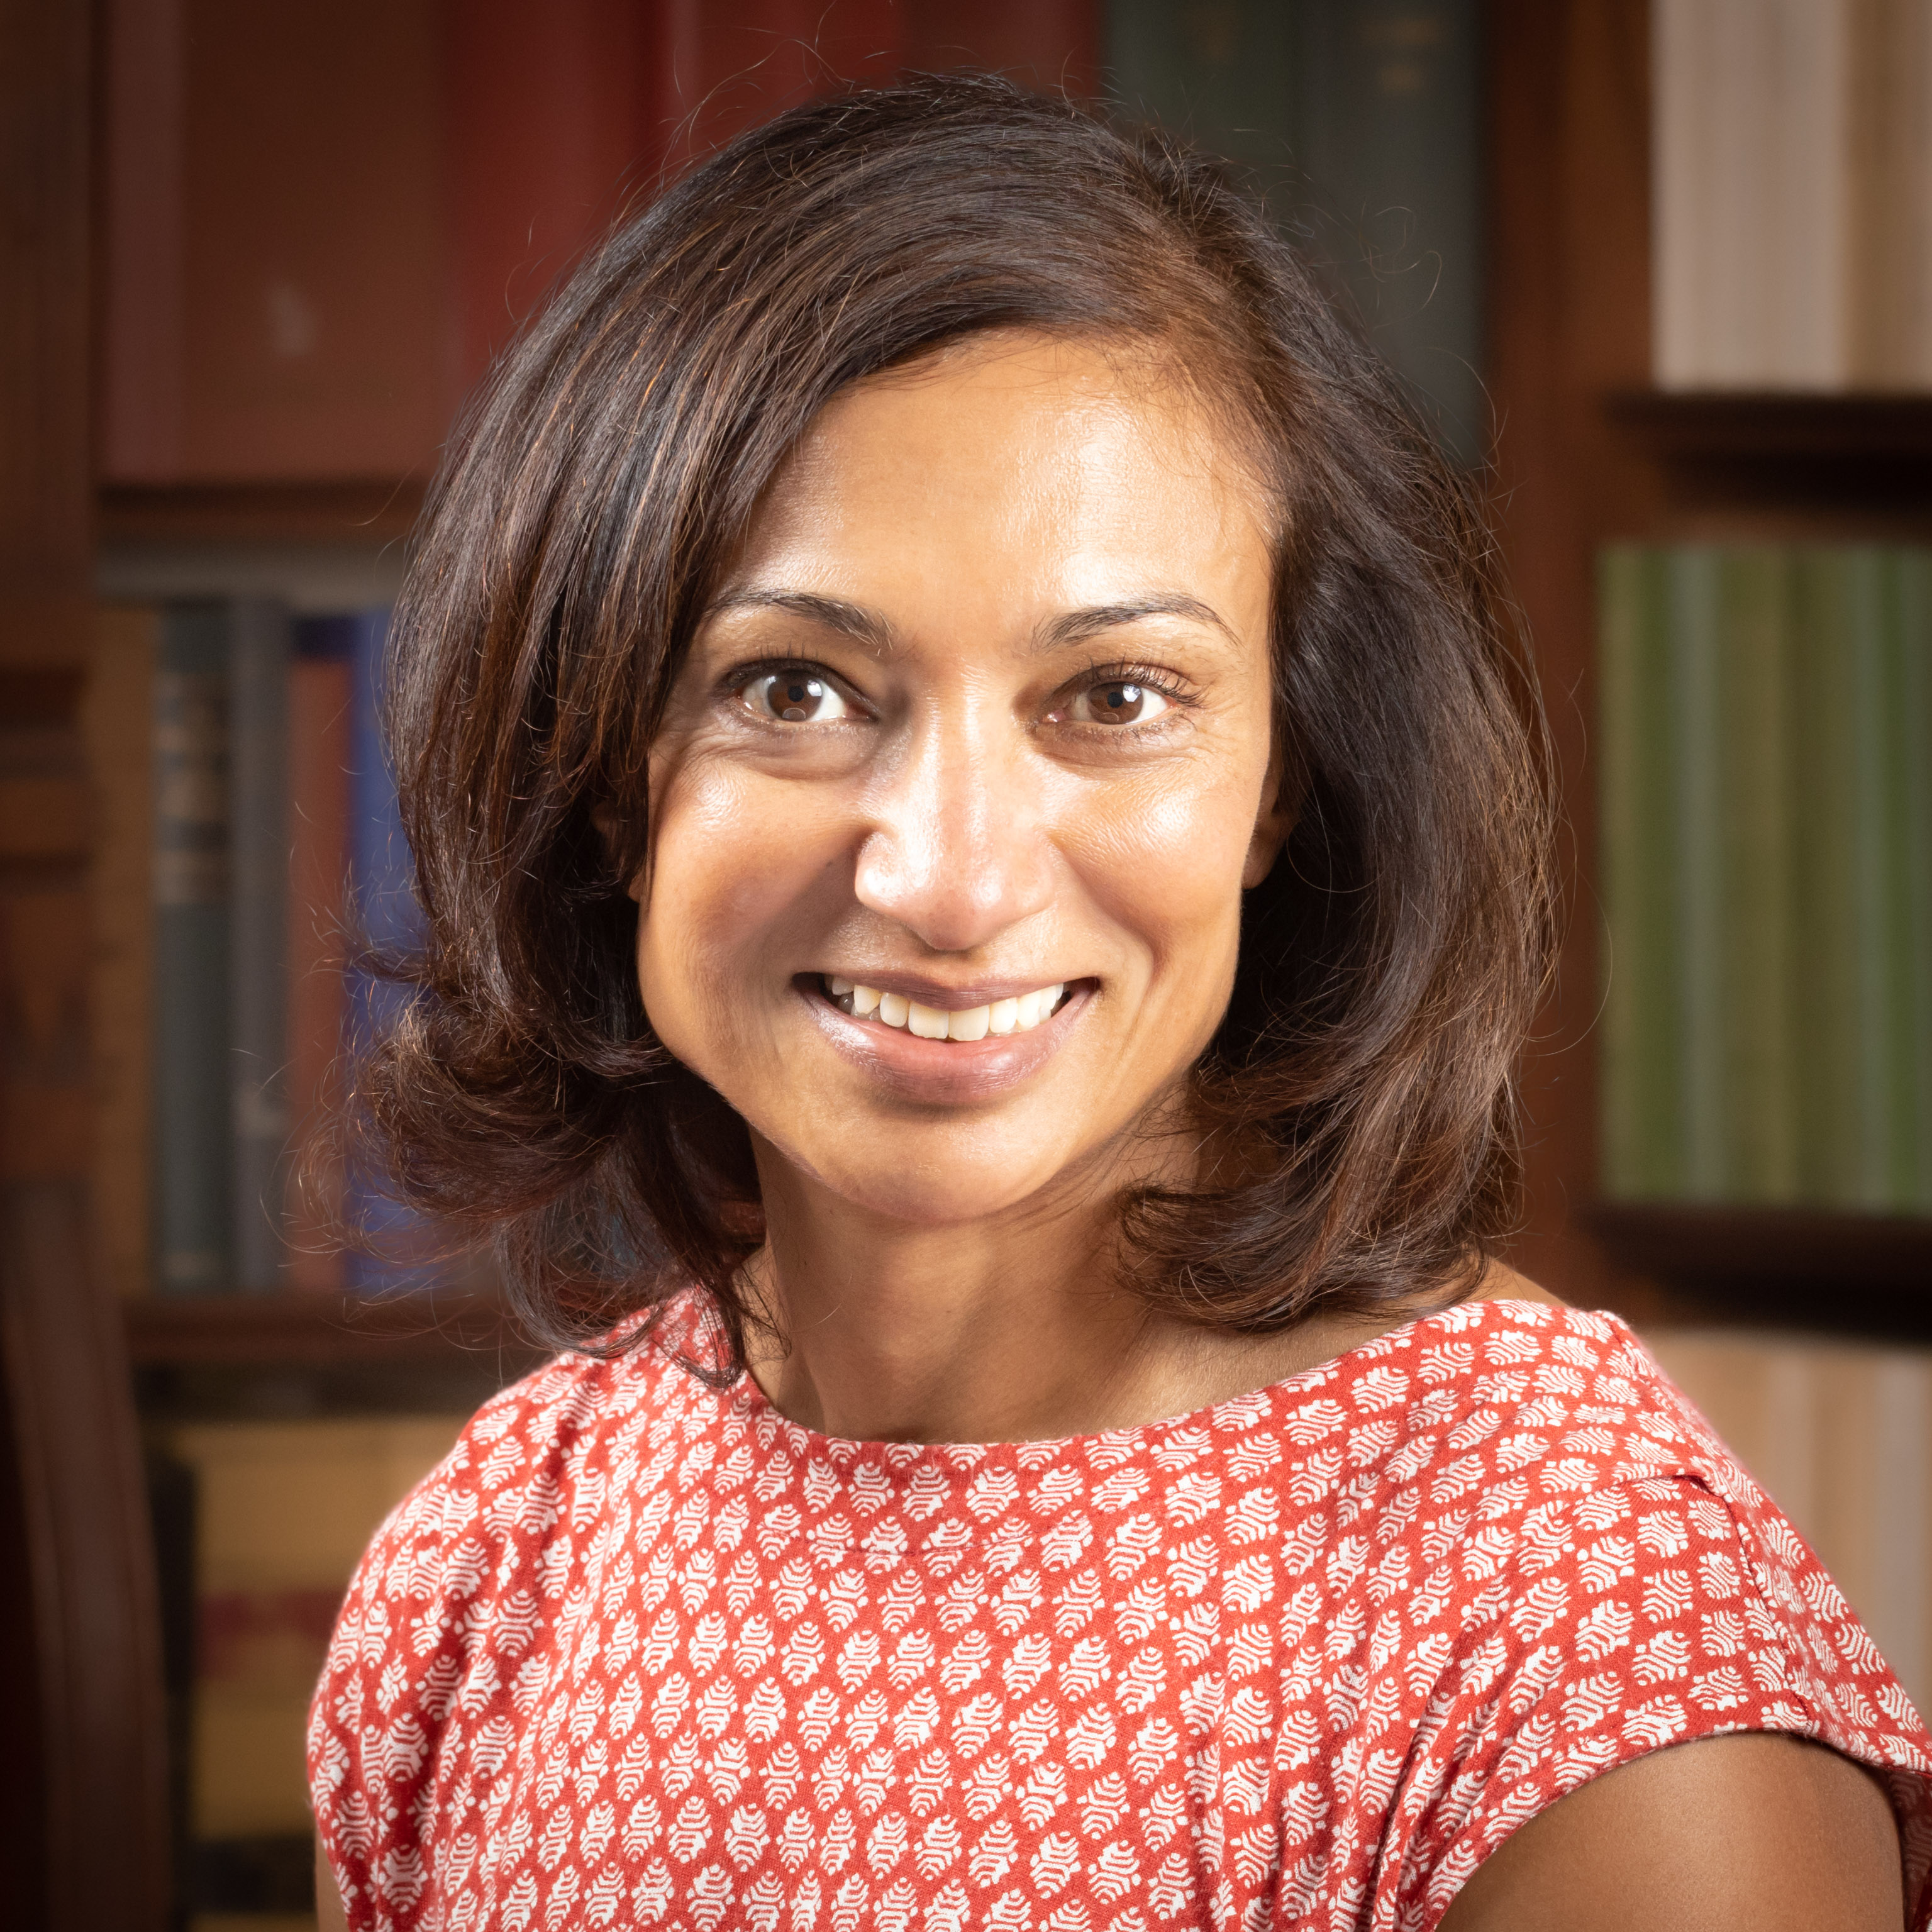
Kelly Dittmar
Director of Research; Associate Professor of Political Science
kdittmar@rutgers.edu
848-932-8314
Areas of expertise: Gender and intersectional dynamics in campaign strategy and candidate evaluation; masculinity and executive politics; trends in candidacy, nominations, and success by gender, race, and party.
CAWP Experts
Debbie Walsh
Director
walsh@eagleton.rutgers.edu
848-932-8799
Areas of expertise: Gender and electoral politics; women’s paths to office; historical milestones.
Chelsea Hill
Director of Data
chelsea.hill@eagleton.
rutgers.edu
848-932-8179
Areas of expertise: Current and historic data on women candidates and officeholders.
Jean Sinzdak
Associate Director
sinzdak@eagleton.rutgers.edu848-932-8781
Areas of expertise: Use of campaign funds for childcare; candidate training and recruitment; K-12 political leadership education; historical milestones.
Kimberly Peeler-Allen
Visiting Practitioner
Kimberly@peeler-allen.com
Areas of expertise: Black women in politics; fundraising; gender, race, and campaign strategy.
Kira Sanbonmatsu
Senior Scholar and Professor of Political Science
kira.sanbonmatsu@zoho.com
848-932-8798
Areas of expertise: Fundraising; women as political donors; women’s paths to office; gender, race, and state-level politics; “women of color” as an identity.
Paru Shah
Senior Scholar and Professor of Political Science
ps1372@polisci.rutgers.edu
(848) 932-8809
Areas of expertise: gender, race, and state/local politics; paths to office; descriptive and substantive representation

Slide 3

Rethinking Women’s Political Power
rethinkingpower.rutgers.edu

Slide 4
Purpose and Methods
State Political Ecosystems: The interconnected systems, networks of individuals and organizations, and overall environments in which both formal and informal politics occurs.
Interviews conducted with 192 political actors across five states – Georgia, Illinois, Nevada, Oklahoma, and Pennsylvania between November 2021 and June 2023.

Slide 5
Key Findings
Rethinking Political Power: To maximize women’s political voices and influence in their full diversity, it is necessary to rethink our definition and measures of political power.
Problem Definition: In order to address gender inequality within political ecosystems, women’s lack of political power must be defined as a problem in need of solution.
Building Support Infrastructure: Existing support infrastructures for women are helpful but insufficient to see gains in women’s political power across sites, groups (racial/ethnic, partisan, class), and stages of the political process.
Structural Barriers and Opportunities: Structural realities related to money, work/family responsibilities, white and male dominance, and party strength and influence offer both persistent barriers and opportunities for increasing women’s political power.
Social/Political Barriers and Opportunities: Social/political realities resulting from cultural evolution, critical moments in U.S. politics, and the expansion of women’s political leadership have offered opportunities for women’s political empowerment, while persistent sexism, racism, and heightened toxicity both inside and outside of political institutions present distinct hurdles to women in politics.

Slide 6
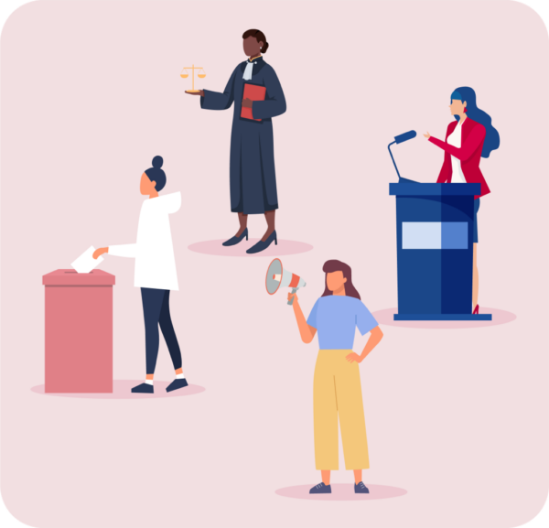
Rethinking Political Power
Reframe the conversation from numbers to power, from titles to influence and outcomes.
Expand:
Definitions of political power
Measures to evaluate women’s political power
Sites to increase women’s political power
Political power is not concentrated in any one role/position, including solely in elective positions, in state political ecosystems.
Holding elective office does not yield the same amount of political power and influence for all officeholders – including women.

Slide 7
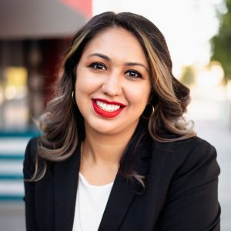
Rethinking Political Power
“There is this system of white male patriarchy in the legislature that permeates regardless of whether or not we’re the most diverse legislature.”
Selena Torres (D-NV)
State Assemblywoman

Slide 8
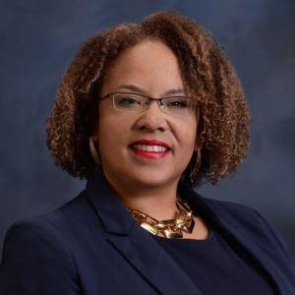
Rethinking Political Power
“There’s racism in the legislature. There’s racism within the lobbying groups where they’re like, ‘I don’t like that legislation.’ And you’re like, ‘How is it different that [a white woman is] carrying it? Is it less threatening?…We’re seen as it’s a threat to carry legislation that moves the needle for minority communities. And it’s insane that that can even be the case.”
Dina Neal (D-NV)
State Senator

Slide 9
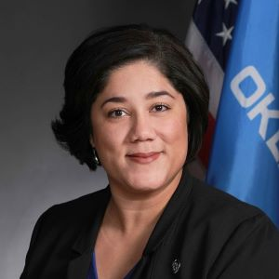
Rethinking Political Power
“To me at this point, as a Democrat and a woman in a huge supermajority legislature, it feels like martyrdom.”
Merleyn Bell (D-OK)
Former State Representative
Interview conducted in February 2022 before Bell left the legislature.

Slide 10
Rethinking Political Power
Appointed positions on public boards and commissions at local and statewide levels
Individuals in both appointed and high-level staff positions at state agencies and/or regulatory authorities
Legislative staff
Campaign and party staff and operatives
Political consultants
Registered lobbyists
Individual donors
Major industries, including their political action committees
Tribal governments and tribal community and industry
Voters
Grassroots advocates/activists
Unions
Civic institutions, including schools, churches, think tanks, non-profit organizations, and community foundations
Political parties, including party organizations, party campaign committees, and elected party leaders
Critical actors
Expand focus to unelected positions of political power.
Train women on how to exercise, not simply attain, power, and establish alternative sites for resources – money, votes, and vocal and coordinated support – that women leaders can rely on when they stand up against the status quo.

Slide 11

Problem Definition
Republicans are:
Less likely than Democrats to identify systemic and distinct barriers to women’s political representation and power within their states’ ecosystems;
More likely than Democrats to cite women’s doubts and/or preferences as the primary cause for their political underrepresentation;
Less likely to support and engage in targeted interventions to increase diversity among candidates and officeholders; and
More likely to doubt that nonpartisan or bipartisan efforts to increase women’s political power are meant for/helpful to them.

Slide 12
Problem Definition
Value proposition: The lack of gender parity in political leadership is undemocratic and yields inferior or unfair outcomes.
Electoral Proposition: The lack of gender diversity among candidates is bad for party optics and/or misses opportunities for electoral advantages.
Limits on political power
Relies on perceptions of electability
Context-dependent

Slide 13
Problem Definition
Think creatively about how to engage Republicans in work that will increase women's political power.
Less explicit focus on women-targeted messages and approaches
Pressure in non-targeted infrastructure to address barriers to women
Put more women and people of color in positions of political authority – including party leaders, chamber leaders, and leading practitioners – to increase likelihood that gender and intersectional disparities are problematized and addressed.

Slide 14

Building Support Infrastructure
Support infrastructures for women in politics are under-resourced and heavily reliant on volunteers, including women political practitioners doing this work alongside their full-time careers.
Infrastructure needs include mental health supports and financial assistance beyond campaign donations.

Slide 15
Building Support Infrastructure
Support infrastructures do not serve all women.
Dearth in supports for:
Officeholders
Unelected women
Republican women
Asian, Black, Latina, and Native women
Many women’s political organizations are led and/or resourced by white women.

Slide 16
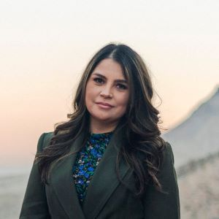
Building Support Infrastructure
When I look for gatekeepers…it’s white women. Your gatekeepers are white women. Look at every organization…any program that trains people how to run for office is run by white women. …It’s like we have to prove to the white women and not necessarily that they are holding office. They are running these spaces that become key when you want to run for office. …Going back to infrastructure, where will Latinas go? Where do we go? Anything Latino or Hispanic is run by Latino men and…[we] might as well go with the white women and give them the sense of the white savior. …And to them, sometimes it feels like we’re some sort of charity work to help a Latina that wants to run for office. …And then you walk into these spaces and [there’s a] disconnection. …They just don’t understand how the system works for us, Latinos and immigrants. …[It] goes back to what does [the] infrastructure look like for Latinas or for women of color? …It’s almost like I have to put up with [white-women-led organizations] if I want to run for office because they put it like ‘the sisterhood.’ We have each other’s back, we help each other. …So yes, they have a board that…looks diverse but it’s still white women teaching women of color how to be leaders in our community."
Cecia Alvarado (D-NV)
Democratic Political Consultant

Slide 17
Building Support Infrastructure
Invest in programs and organizations that serve women at specific intersections of race and gender.
Fostering racial/ethnic inclusion in existing women’s political organizations beyond increasing diversity of program participants or contributors; re-allocate power over organizational decision-making, planning, and resource distribution.
Engage in dialogue with diverse communities of women, especially those who feel underserved by the existing supports that target women and/or for whom gender-targeted support is not a priority.
Create coalitions that enhance reach, capacity, and coordination among organizations and individuals committed to increasing women’s political power.

Slide 18
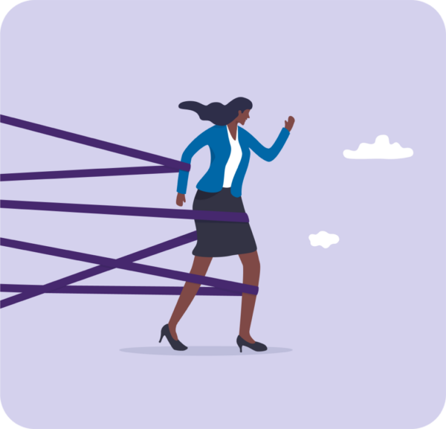
Barriers and Opportunities
Barriers
Financial challenges to candidates, officeholders, and practitioners
Work/family conflicts in campaigns and government
Gender and racial biases and beliefs within political institutions and society
Women’s beliefs and calculations
Party organizational strength and inclusivity
Opportunities
Party organizational strength and inclusivity
Gender and racial reckonings
Increase women as political donors
Institutional power redistribution (increasing women in positions of power)
Vacancies and appointments
Changes in electorates

Slide 19
Barriers and Opportunities
Invest in diverse and innovative approaches to closing the finance gaps that affect who can run for, win, or serve in elective office.
Provide compensation and benefits to campaign and legislative staff that promote feasibility and retention.
Promote more family-friendly political institutions.
Build political pipelines and engage in strategic planning and prioritization to capitalize on opportunities created by vacancies, demographic change, and appointed positions.
Increase attention to and amplification of the success and impact of women political leaders.
Promote cultural change within political institutions to ensure safety, reduce racism and sexism, and permit authenticity among all actors regardless of identity.
Create and capitalize on social/political opportunities to build women’s political power.

Slide 20
Rethinking Women’s Political Power
Briefing for Women’s Political Organizations
rethinkingpower.rutgers.edu

