Slide 1

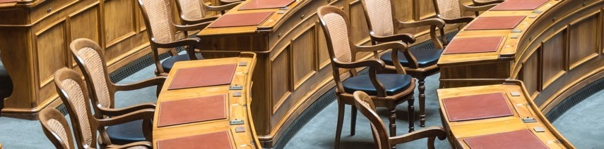
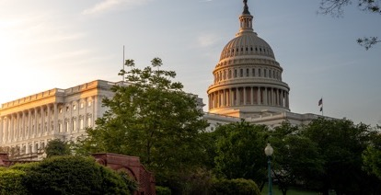
Women State Legislators: By the Numbers
Martha Saenz, Associate Director
Women’s Legislative Network

Slide 2
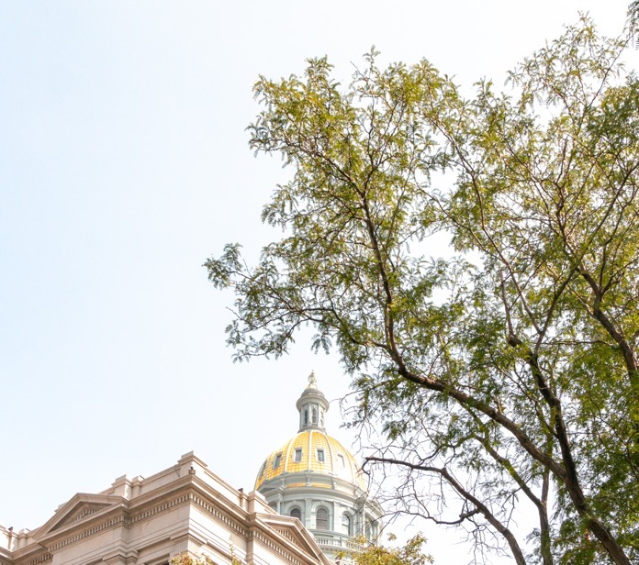
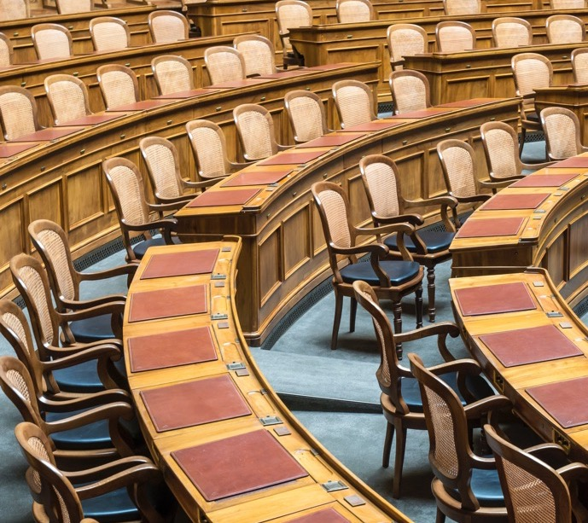
NCSL: Strengthening the Legislative Institution
Policy and Research
Trainings
Federal Voice for States
Connections

Slide 3
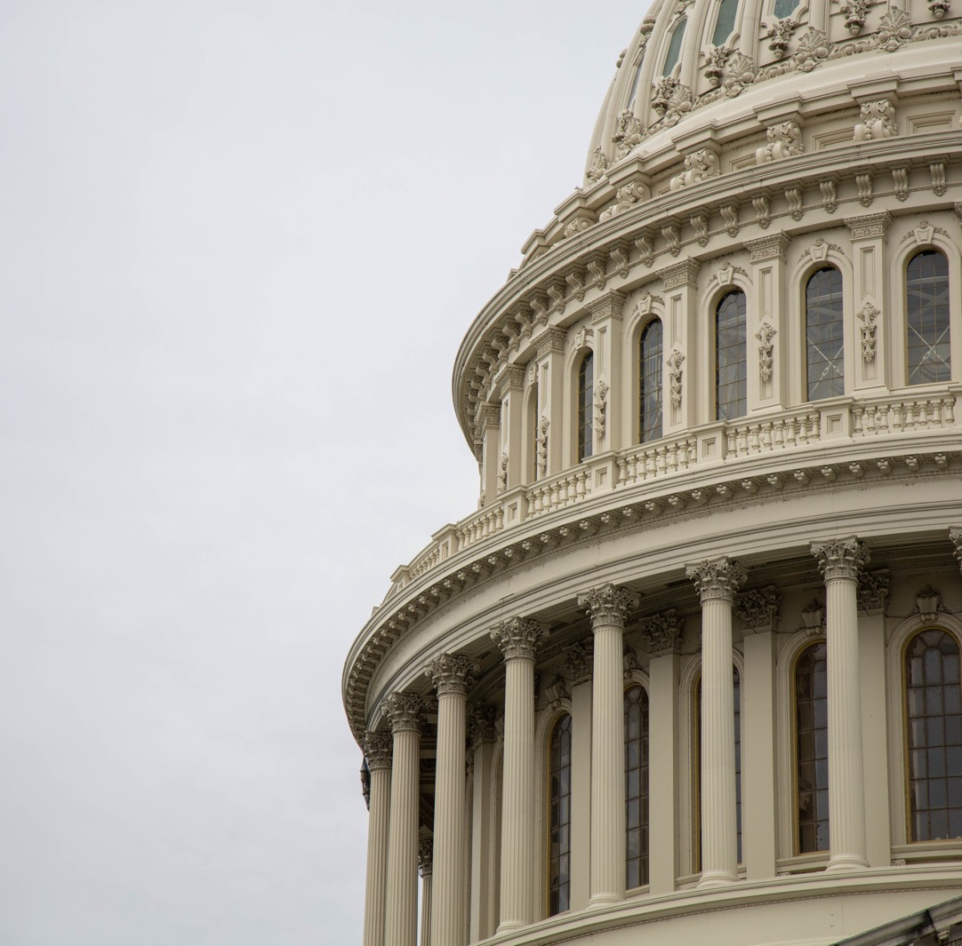
Overview of State Legislator Demographics
Includes U.S. Territories
Total Senate Seats: 2,069
Republican: 1,089
Democrat: 869
Other: 107
Total House Seats: 5,503
Republican: 2,936
Democrat: 2,426
Other: 107

Slide 4
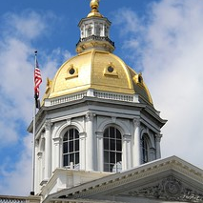
Which state has the most state representatives?
This Photo by Unknown Author is licensed under CC BY-NC

Slide 5
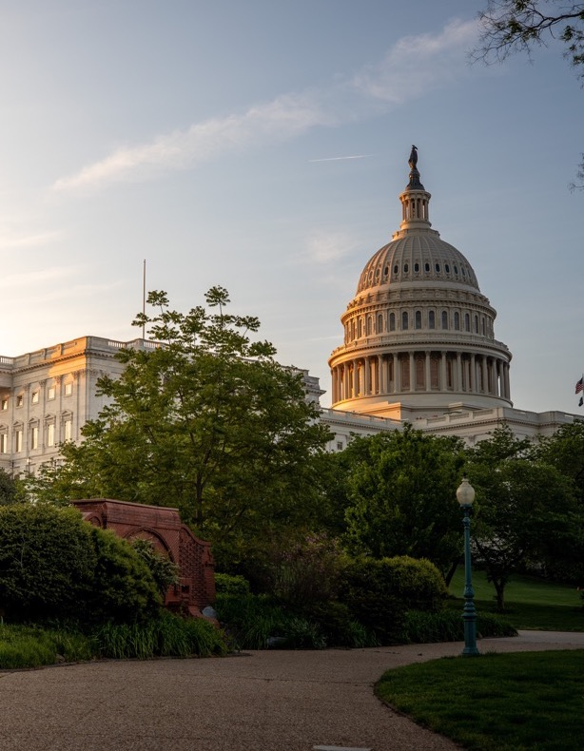
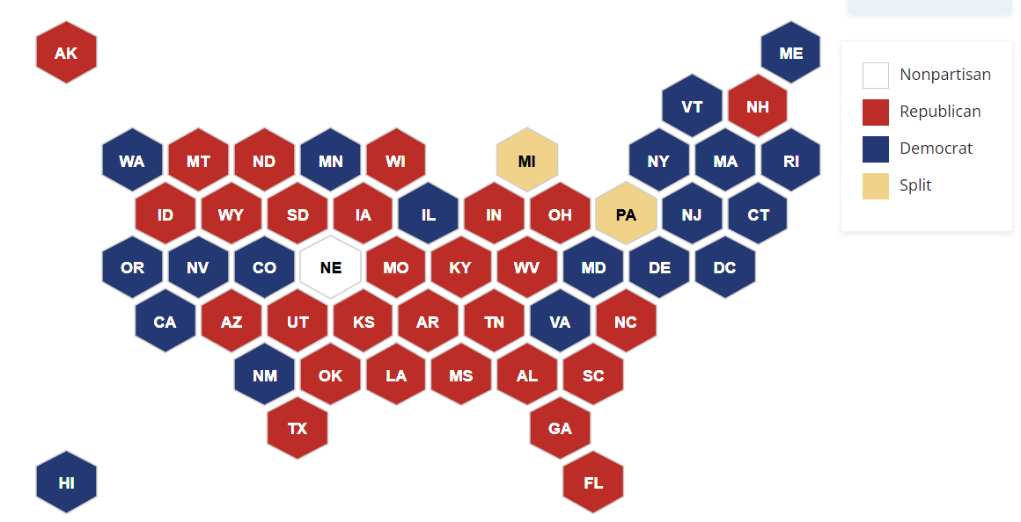
State Partisan Composition

Slide 6


Slide 7

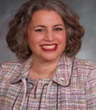
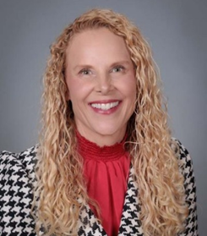
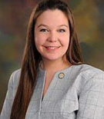
Women’s Legislative Network
Officers
NAME
NAME
NAME
NAME
Title | Location
Title | Location
Title | Location
Title | Location

Slide 8
Women Legislators Over Time
Where we’ve been…Milestones and Markers

Slide 9
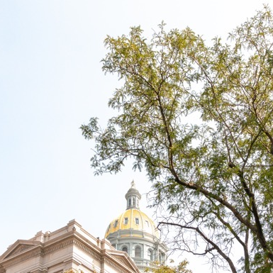
Where did the first women serve as state legislators?

Slide 10
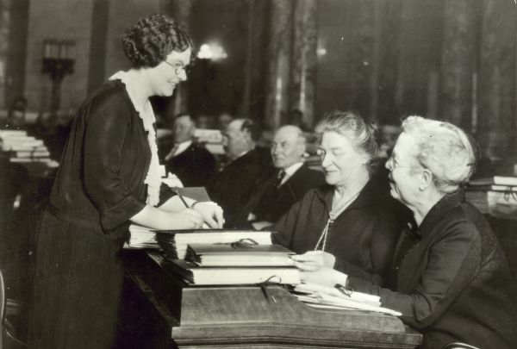
Photo courtesy of the Wisconsin Historical Society and Wisconsin Historic Images
Notes:
Mildred Barber stands to the left of Helen Thompson and Hellen Brooks. The three were the first women elected to the state Legislature in 1924. Barber, Thompson and Brooks served in the Wisconsin Assembly.
Today, 41 of the state Legislature’s 132 seats

Slide 11
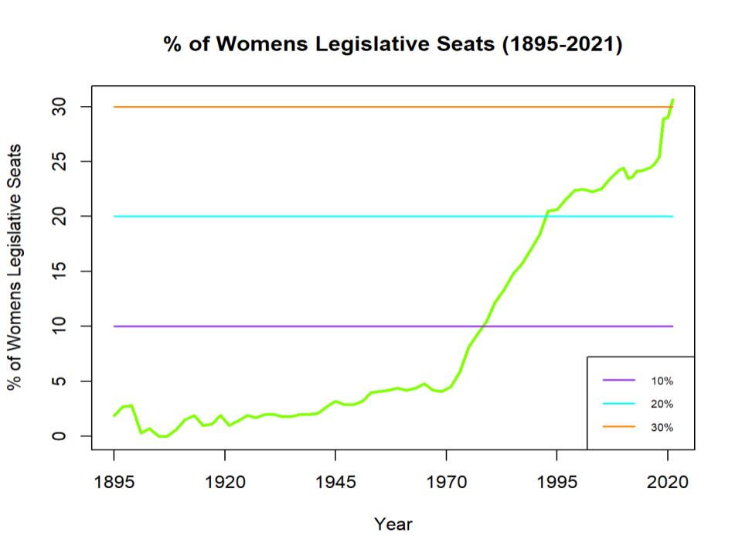
Notes:
Note the milestones here
And the decades in which major growth occurred
Ask the audience: Anybody know which state had the first women legislators?
The 10, 20, 30 percent milestone for women. Stayed under 10 percent until 1970s. Over the next 2 deacdes the number would double to 20% in the 1990s where it platued for a bit and stayed until recently, when it hit 30%.

Slide 12
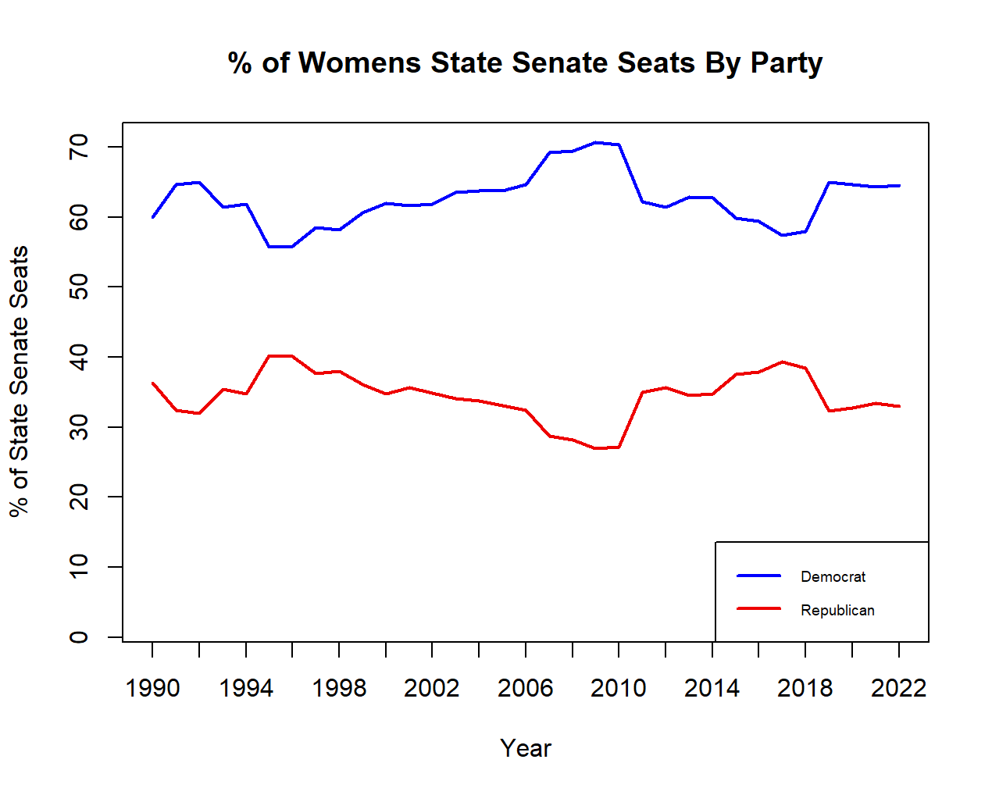

Slide 13
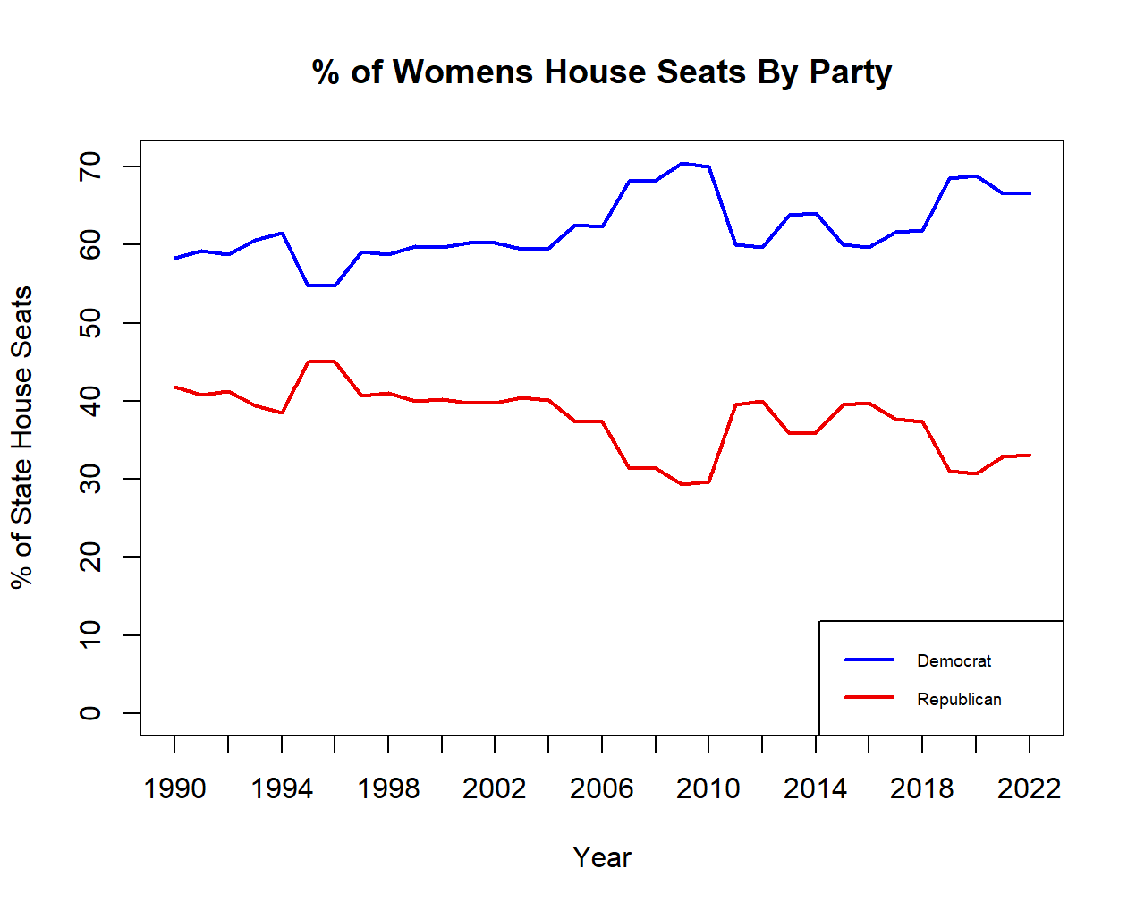

Slide 14
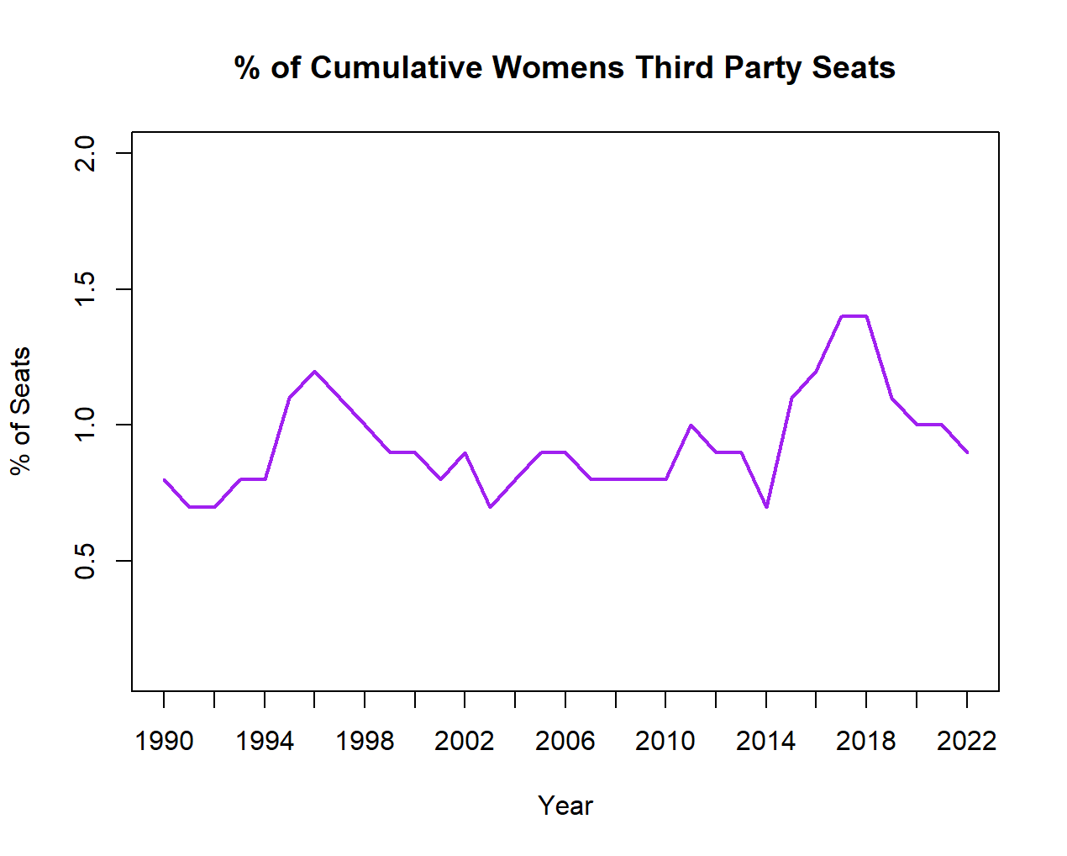

Slide 15
Where we are now…

Slide 16
Women Representation in States
Total Percentage by State
ME
AK
VT
NH
WA
MT
ND
MN
WI
MI
NY
MA
RI
ID
WY
SD
IA
IL
IN
OH
PA
NJ
CT
OR
NV
CO
NE
MO
KY
WV
VA
DC
DE
HI
CA
UT
NM
KS
AR
TN
NC
SC
MD
AZ
OK
LA
MS
AL
GA
10-25%
Over 50%
TX
FL
26-35%
AS
GU
MP
PR
VI
36-49%

Slide 17
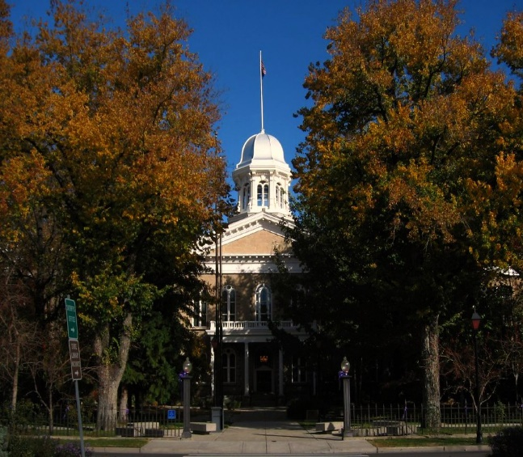
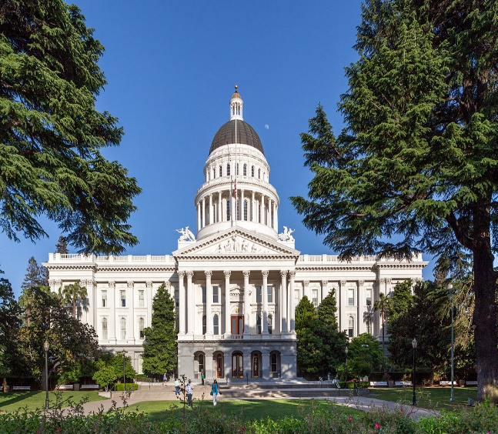
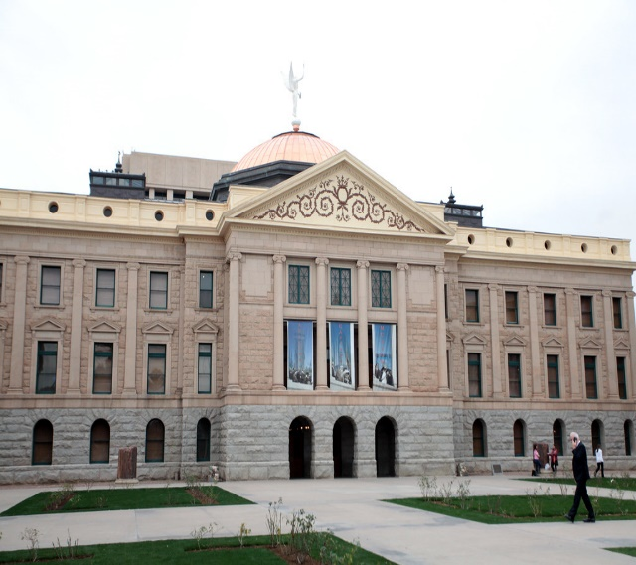
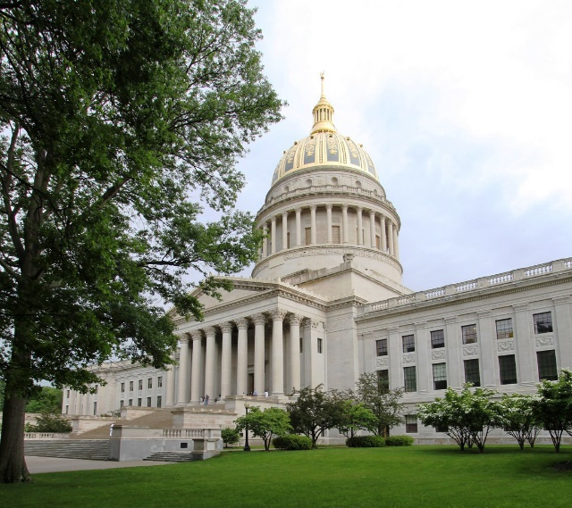
Highlights
Nevada
California
Highest representation of women
Hit milestone in 2018
Convenes in Odd years Only
Expected to see continued growth
Currently at 41, but will be at least 46% after November
10% jump since 2020
Arizona
West Virginia
Reached 50% in 2024
16 out of 30 Senators are Women
29 out of 60 are Representatives
Most are Democrats
11.7% Women
16 out of 134
Highest reached in 2011: 17.9%

Slide 18
Current Women in Legislative Leadership
Speaker of the House, Senate President/Senate President Pro Tem
ME
AK
VT
NH
WA
MT
ND
MN
WI
MI
NY
MA
RI
ID
WY
SD
IA
IL
IN
OH
PA
NJ
CT
OR
NV
CO
NE
MO
KY
WV
VA
DC
DE
HI
CA
UT
NM
KS
AR
TN
NC
SC
MD
AZ
OK
LA
MS
AL
GA
TX
FL
AS
GU
MP
PR
VI

Slide 19
Women in State Legislatures
Top Legislative leaders
ME
ME
AK
VT
NH
AK
VT
NH
WA
MT
ND
MN
WI
MI
NY
MA
RI
WA
MT
ND
MN
WI
MI
NY
MA
RI
ID
WY
SD
IA
IL
IN
OH
PA
NJ
CT
ID
WY
SD
IA
IL
IN
OH
PA
NJ
CT
OR
NV
CO
NE
MO
KY
WV
VA
DC
DE
OR
NV
CO
NE
MO
KY
WV
VA
DC
DE
HI
CA
UT
NM
KS
AR
TN
NC
SC
MD
HI
CA
UT
NM
KS
AR
TN
NC
SC
MD
AZ
OK
LA
MS
AL
GA
AZ
OK
LA
MS
AL
GA
TX
FL
TX
FL
AS
GU
MP
PR
VI
AS
GU
MP
PR
VI

Slide 20

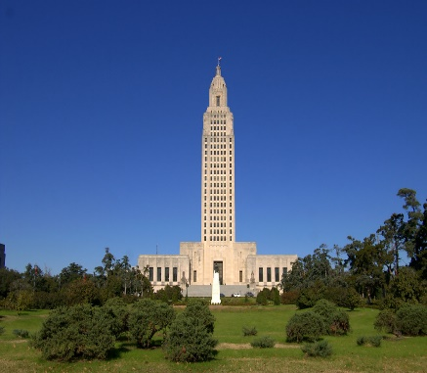
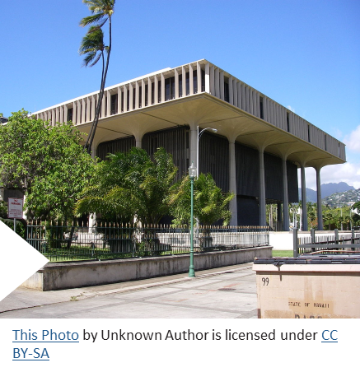
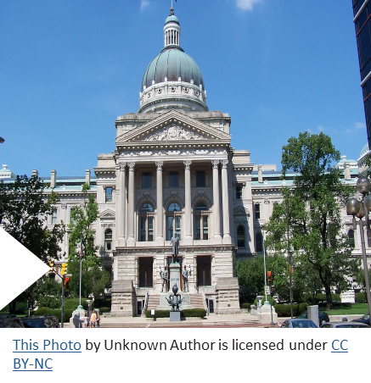
Caucus and Networks
Formal, Informal, Social and Political
More than 30 states have some form of state legislative women’s caucus.
Louisiana
Hawaii
Indiana

Slide 21
Women Legislators of Color
319/ 12%
100/4%
210/8.5%
36/1.4%
African American
Latina
Asian/Pacific Islander
Native American/Alaska Native/Native Hawaiian

Slide 22


Slide 23
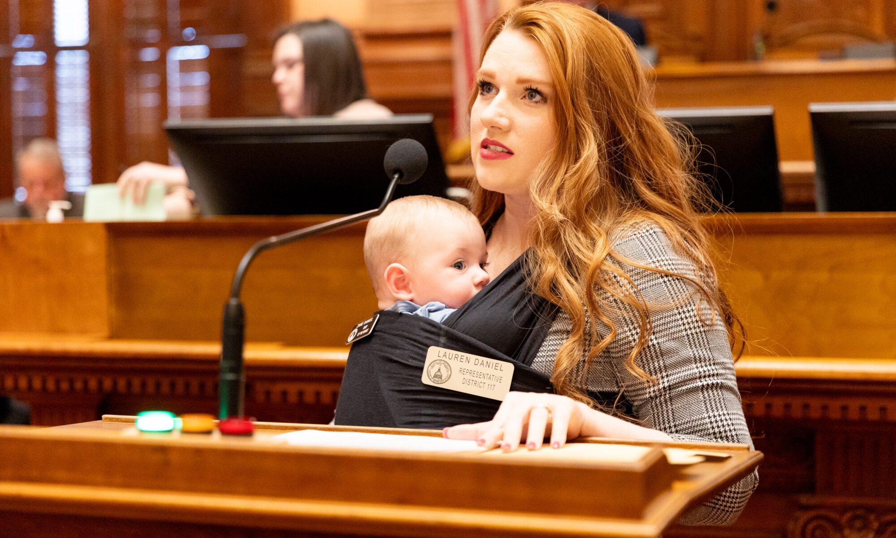
Where we’re going….
Photo Courtesy of Georgia House Media Services

Slide 24

Stay Connected
Learn about NCSL training
Subscribe to policy newsletters
Read State Legislatures magazine
Listen to an NCSL podcast
Watch recorded policy webinars and training sessions
Attend a meeting or training
Follow @NCSLorg on social media
24

Slide 26
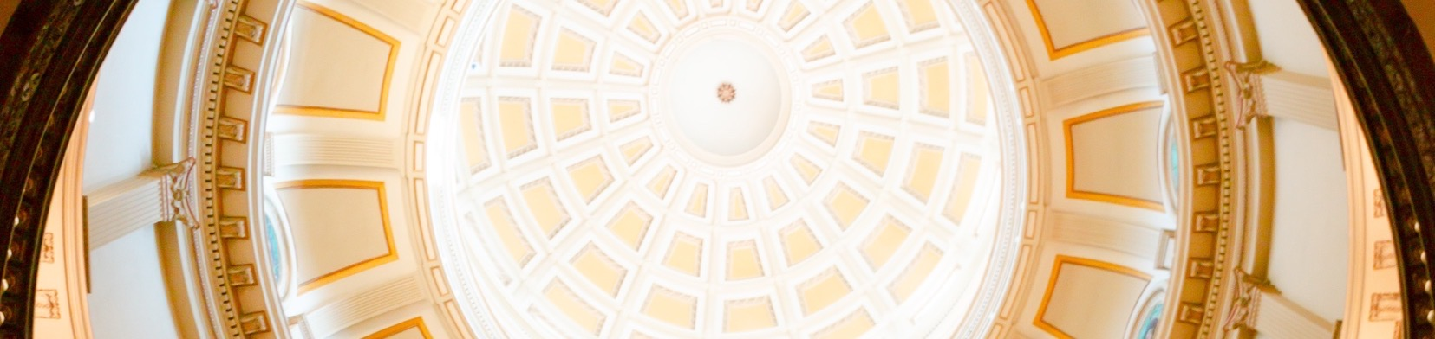
Thank you for joining today!
Martha Saenz
Associate Director
Martha.Saenz@ncsl.org
303.501.9579
www.ncsl.org
@NCSLorg
Denver 7700 East First Place, Denver CO 80230
Washington D.C.
444 North Capitol Street, N.W. Suite 515, Washington, D.C. 20001

