Slide 1
Covering The Next America
The Best Story of Our Lives
Bobbi Bowman, National Press Foundation, Feb. 14, 2024

Slide 2
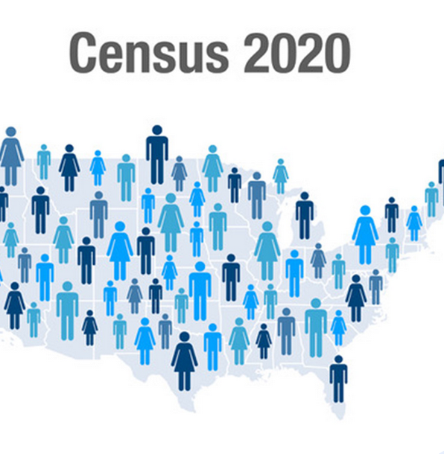

Why Do We Take A Census?
Article I, Section 2 of The U.S. Constitution

Slide 3
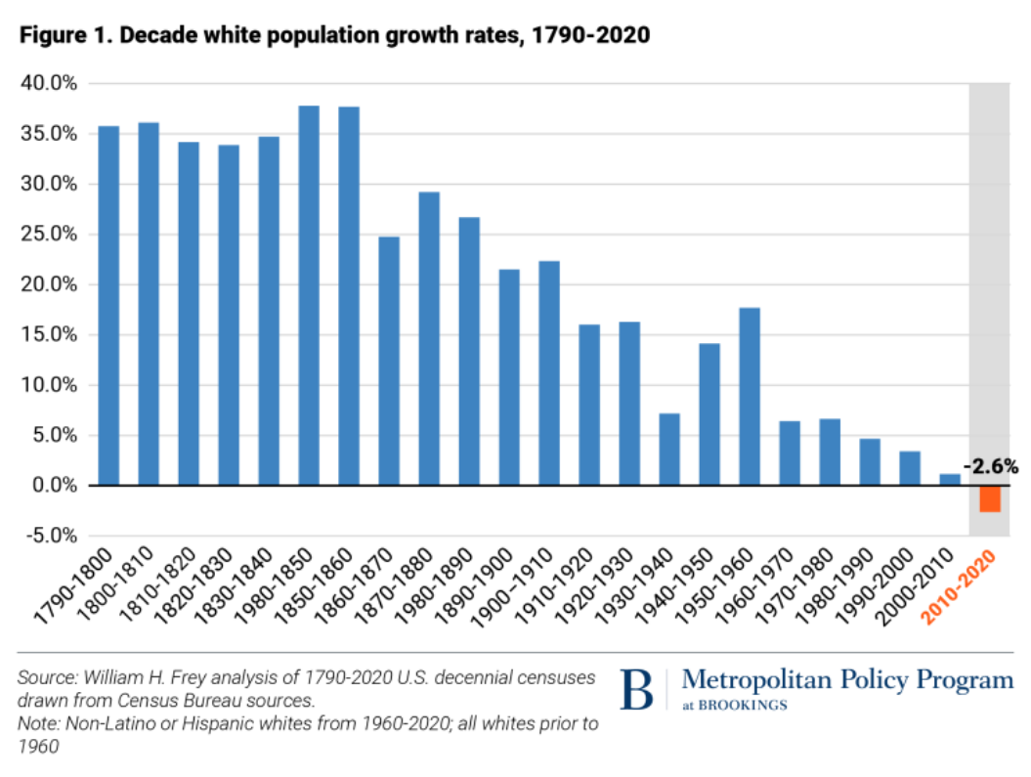

Slide 4
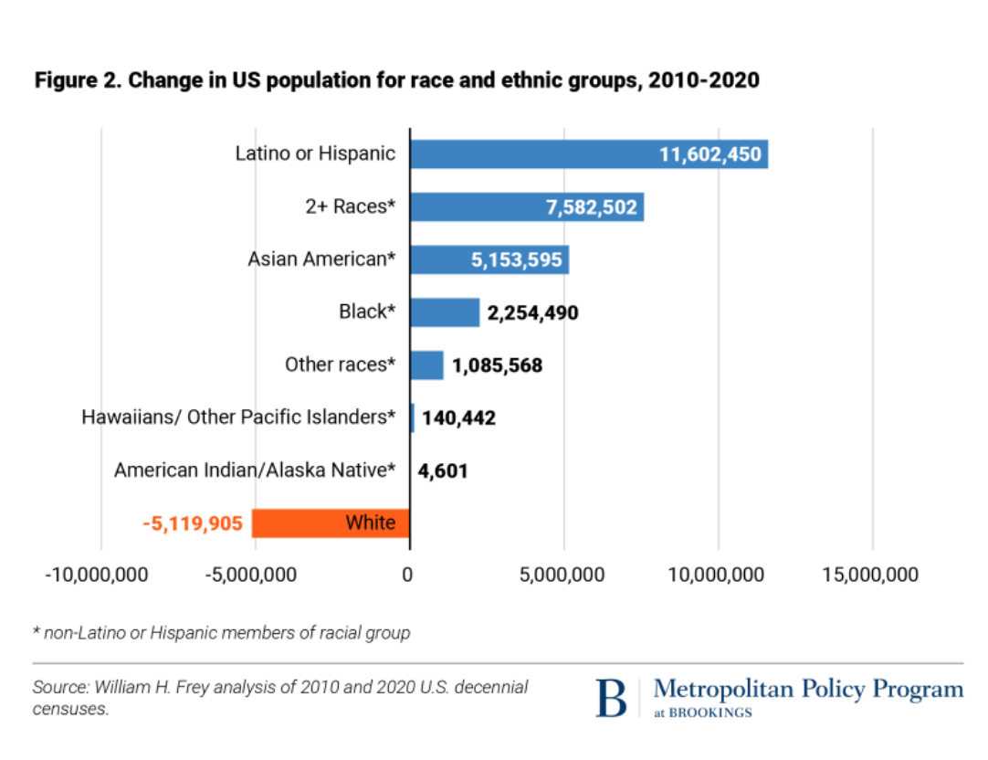
U.S. Population Growth 2010-2020

Slide 5
Source:U.S. Census

Slide 6
Percent of Voter Turnout by Race 2000-2020
 | 2000 | 2010 | 2020
White* | 76 | 72 | 71
Hispanic | 7 | 10 | 11
Black | 12 | 12 | 12
Asian | 2 | 4 | 4
Others | 2 | 2 | 2
*White Not Hispanic
Source: U.S. Census Bureau

