Slide 1
COVERING JUVENILE COURT
Promoting collaboration between courts and media for accurate and responsible reporting
Presented by:
Hon. Ranord J. Darensburg
Judge, Orleans Parish Juvenile Court, Section F
RTDNA/National Press Foundation
Crime Coverage Summit
January 17-20, 2024
Notes:
Media coverage plays a crucial role in shaping the public perception and understanding of the justice system. The influence of the media extends to all aspects of the justice system, including juvenile justice, where it has the power either to perpetuate negative stereotypes or foster positive change. The media’s ability to collaborate with the courts can lead to better outcomes for court involved youth and families, as well as create safer communities.
As people who work in and report news, including on the court system, the question before you are, how do you use the information, resources, and tools to deliver responsible, accurate and complete information to the public.
Juvenile Court proceedings face a unique challenge when it comes to media involvement. Due to the age of the defendant, special considerations need to be taken to protect their privacy and ensure rehabilitation. The media’s portrayal of juvenile offenders can have long-lasting effects on their reintegration into the community. In these cases, it is important for the media to strike a balance between transparency and sensitivity.
In today’s fast-paced world, where news is disseminated at lightning speed through various media outlets, accountability, accuracy, and transparency in the reporting have become essential. The role of the media as a fourth state cannot be understated, as it served as a watchdog, ensuring that those in power are held accountable for their actions. This is where the use of collaborative efforts and data-driven information comes into play, providing effective solutions to combat any challenges.

Slide 2


Media and the juvenile justice system
LEARING OBJECIVES
1. Understanding of the impact of media on the fairness of the trial process in juvenile court.
2. Appreciation of the balancing of media scrutiny and the ability to protect defendants
3. Review of root causes of juvenile delinquency
4. Promotion of collaboration between courts and media for accurate reporting
Notes:
My objective today is to give you a perspective from the bench. Journalists obtain some of their best information from the legal process. Judges, prosecutors, and defense counsel have a vested interest in seeing their work portrayed accurately in the media. Apart from the implications negative media coverage could have on their career, legal stakeholders have a sincere interest in upholding the public’s confidence in the justice system.
In the time we have together, I hope to give you an…
1. Understanding of the impact of media on the fairness of the trial process in juvenile court.
2. Appreciation of the balancing of media scrutiny and the ability to protect defendants
3. Review of Juvenile Delinquency and root causes.
4. Promotion of collaboration between courts and media for accurate reporting

Slide 3
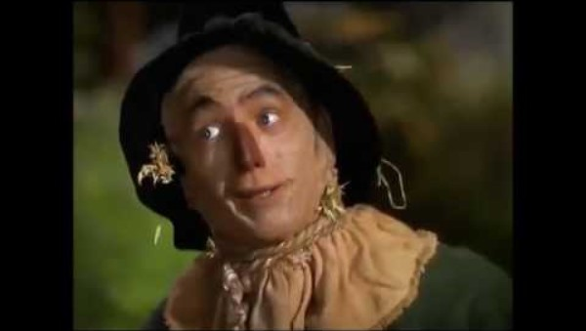
The media is on the telephone….
Notes:
So why then, does a disconnect exist between the press and the courts? And more importantly, what can be done to bridge the gap?
For the media, the answer may be partly due to time constraints, and they may be learning by doing, with little training in covering courts as a part of their journalism studies. Also, in the Juvenile Court, legal protections limit access to information.
Like many, the courts have a suspicion that because of the interest in telling/selling the best story, journalists and the media always have an ulterior motive.
As such there is sometimes a belief that the objective of the press and the court are mismatched.
VIDEO- I believe that this video. In the classic movie Wizard of Oz, as Dorthy, the Tin Man, and the Scarecrow make their way down the yellow brick road, they become afraid and begin chanting. This is the feeling in the courts when call comes in from the Media.

Slide 4

The media are not the enemy
Should Judges and court professionals consider the media a nemesis or a resource that can be used to assist the court in delivering its message?
What is the best way for judges and court professionals to interact with the media?
With new forms of media including social media and websites, how does the interaction need to change?
Notes:
Question for Us.
With the introduction of new forms of media, including social media websites, how does the interaction need to change?
How do we use new media methods and technology to enhance communication between the media and the courts?
Today there are fewer newspapers but more people calling themselves reporters.
Technology has not just changed the way information is gathered and disseminated; it has changed who is doing the gathering a disseminating.
ALL OF THIS CAN HAVE PROFOUND AFFECT ON

Slide 5
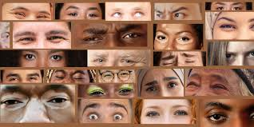
IMPACT OF MEDIA ON THE FAIRNESS OF THE TRIAL PROCESS
PUBLIC PERCEPTION
PORTRAYAL OF JUVENILE OFFENDERS
1966
U.S. Supreme Court
Shepard v. Maxwell
1963
U.S. Supreme Courrt
Rideau v. Louisiana
1976
U.S. Supreme Court
U.S. v. Haldeman
Notes:
SHEPPARD v. MAXWELL (In 1966 the U.S. Supreme Court weighed in on how the media can affect court proceedings.)
In 1954 (Cleveland, Ohio), Dr. Sam Sheppard was accused of bludgeoning and murdering his pregnant wife. It was sensationalized in the media with constant coverage and comments. (Jurors photos on front page, their addresses available media. Sheppard was convicted. He appealed.
The court said that publicity (carnival atmosphere) surrounding trial resulted in defendant’s right to a fair trial being denied.
The case examined the rights of freedom of the press as outlined in the 1st Amendment of the constitution when weighed against a defendant’s right to a fair trial as required by the 6th Amendment.
OPINION – Justice Clark – The Court concluded that it was obvious that the prejudice that spread thought the community, as a result of the intense media coverage of the case, negatively affected the trial and nullified the first trial.
The massive, pervasive, and prejudicial publicity attending petitioner’s prosecution prevented him from receiving a fair trial consistent with the Due Process Clause of the 14th Amendment.
He ultimately won a new trial and was acquitted. (THE FUGITIVE)

Slide 6

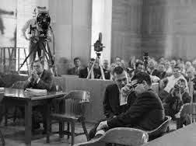
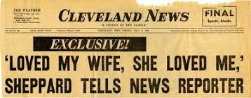
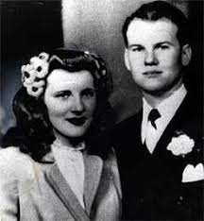
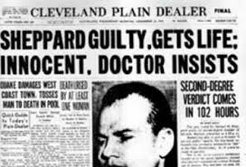
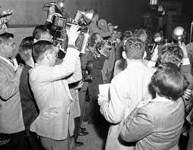

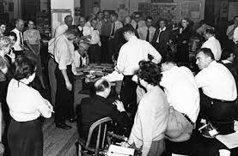
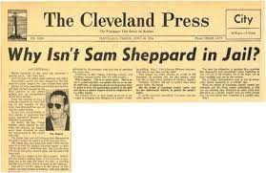
Shepard V. MAXWELL, 384 u.s. 333 (1966)
Notes:
SHEPPARD v. MAXWELL (In 1966 the U.S. Supreme Court weighed in on how the media can affect court proceedings.)
In 1954 (Cleveland, Ohio), Dr. Sam Sheppard was accused of bludgeoning and murdering his pregnant wife. It was sensationalized in the media with constant coverage and comments. (Jurors photos on front page, their addresses available media. Sheppard was convicted. He appealed.
The court said that publicity (carnival atmosphere) surrounding trial resulted in defendant’s right to a fair trial being denied.
The case examined the rights of freedom of the press as outlined in the 1st Amendment of the constitution when weighed against a defendant’s right to a fair trial as required by the 6th Amendment.
OPINION – Justice Clark – The Court concluded that it was obvious that the prejudice that spread thought the community, as a result of the intense media coverage of the case, negatively affected the trial and nullified the first trial.
The massive, pervasive, and prejudicial publicity attending petitioner’s prosecution prevented him from receiving a fair trial consistent with the Due Process Clause of the 14th Amendment.
He ultimately won a new trial and was acquitted. (THE FUGITIVE)

Slide 7
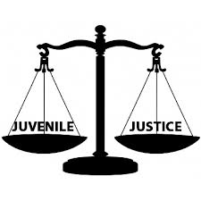
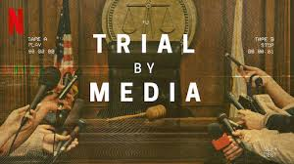
Balancing media scrutiny and the ability of the court to protect defendants
Challenges of Media Intrusion
Preserving Confidentiality
Mitigation of Harmful Effects
Notes:
MITIGATION OF HARMFUL EFFECTS
Courts can employ various strategies to mitigate the harmful effects of media scrutiny in juvenile court cases.
One approach is to limit information access to only that which is provided by law. This can help maintain the privacy of the juveniles while still allowing for transparency and accountability in this process.
Courts can establish strong partnerships with relevant stakeholders and media organizations to develop guidelines and protocols that strike a balance between transparency and the protection of juvenile rights.
Regular reviews and updates of these protocols can ensure that they remain effective and relevant in the face of evolving media landscapes and technologies.

Slide 8
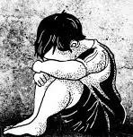

juvenile delinquency… Understanding the root causes
Theories of Juvenile Justice- What is Juvenile Delinquency?
Impact of poverty and socioeconomic factors on juvenile crime rates.
Juvenile Court… Need for comprehensive approach that addresses underlying issues.

Slide 9
Promoting collaboration between courts and media
TRUTH IS OUR BEST GUIDANCE
Importance of data-driven reporting in debunking myths and stereotypes
Role of media in shedding light on systemic issues within the juvenile justice system
Encouraging open dialogue and partnerships between court and medial outlets
Notes:
Historically, courts and media outlets have maintained a strained relationship due to concerns about confidentiality sensationalism, and the potential impact on ongoing cases. However, fostering open dialogue between these entities can bridge this gap and allow for constructive collaboration.
Create the media. Courts should actively engage with media outlets to provide accurate information about the juvenile justice Systems processes and challenges.
Regular training sessions about court processes and the juvenile justice process can enhance media literacy on issues specific to the juvenile justice system.
Sharing success. By highlighting successful cases where court-involved youth and families have been rehabilitated and reintegrated into society, media outlets are able to challenge negative stereotypes and demonstrate the potential for positive outcomes within the system. These success stories not only inspire hope but also contribute to shifting public perception and reducing stigma surrounding court involved youth.
Raising awareness of rehabilitation programs. Media platforms can play a crucial role in promoting awareness and understanding of rehabilitation programs available within the community. By showcasing successful initiatives that prioritize rehabilitation over punishment media outlets can encourage public support and potential funding for community-based rehabilitation programs.

Slide 10
AND ALL THAT IS TO SAY…
Media and Courts must appreciate and
Honor the profound impact they together
have on public perceptions.
Juvenile Delinquency is complex and
responsible reporting requires the inclusion of all relevant information.
Courts and media must work together to
provide community with accurate stories.
Data driven practices in reporting provides the reason why, the accountability and the most profound impact.
Notes:
Media and courts must appreciate and honor the profound impact they together have on public perceptions. Juvenile delinquency is complex and responsible reporting requires the inclusion of all relevant information. Courts and media must work together to provide community with accurate stories. Data driven practices in reporting provides the reason why, the accountability, and the most profound impact.

Slide 11
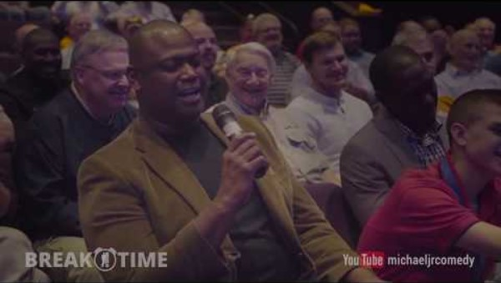
Know your why!

Slide 12

Thank you
RANORD J. DARENSBURG
JUDGE
ORLEANS PARISH JUVENILE COURT
SECTON F
1100-B MILTON STREET
NEW ORLEANS, LA 70122
(504) 658-9539
RJDARESNBURG@NOLA.GOG

