Slide 1

Mental Health in the Newsroom
Gretchen Schmelzer, PhD
January 10, 2024
Crime Coverage Summit
RTDNA/National Press Foundation

Slide 2
“Mental health is a state of mind characterized by emotional well-being, good behavioral adjustment, relative freedom from anxiety and disabling symptoms, and a capacity to establish constructive relationships and cope with the ordinary demands and stresses of life”
American Psychological Association

Slide 3
Mental Health in the Newsroom is highly impacted by Trauma
Journalists have reported rates of anxiety and depression that are 4 X the average population
60% of journalists have reported symptoms of anxiety, depression, or PTSD
80 to 100% of journalists have been exposed to work-related traumatic events.

Slide 4
‘Often, people begin recognizing the effect of trauma exposure when they realize they are behaving in ways they never would have when they first started working in their field.’
Lipsky & Burk, Trauma Stewardship

Slide 5
How Can Newsrooms Support the Mental Health of Journalists?
Train and educate people to understand trauma
Offer various means of support from peer support to professional support to time off
Train leaders and managers to talk about trauma
Naseem Miller, The Journalist’s Resource
Harvard Kennedy School

Slide 6
Trauma is a workplace and leadership issue
We don’t tend to think of the workplace as a place where we need to overtly work with trauma. We believe that trauma belongs in the domain of mental health. It belongs to your therapist, and not conversations with your boss, teams, journalists, or staff.
But here’s the truth: adults spend most of their time at work. We are at work more than we are with our loved ones, in our leisure activities or our civic activities.
Workplaces need to become places where we not only grow and develop—they also need to be places where we can heal and repair what has been hurt.
And as the workplace has gotten more stressful– our work and homelife have become inextricably linked. To not address trauma and stress is to impact both work and home life.

Slide 7
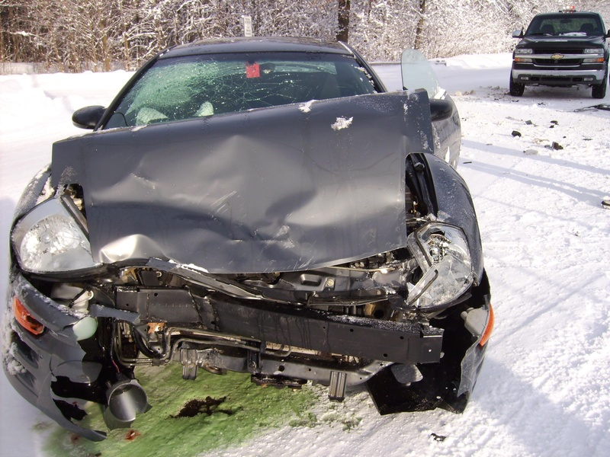
Trauma is an experience or event that overwhelms your capacity to defend or protect yourself

Slide 8
Emotional Intelligence (E.Q.)
Self Awareness
Social Awareness
Self Management
Relationship Management
Emotional Self-Awareness
Empathy
Organizational Awareness
Emotional Self-Control
Adaptability
Positive Outlook
Achievement Orientation
Teamwork
Inspirational Leadership
Conflict Management
Influence
Coaching/Developing Others
Goleman, Daniel. (2005). Emotional Intelligence. New York, Bantam

Slide 9
Acute Stress = Fight | Flight | Freeze
Stress primes our body with energy
This energy narrows our focus, increases our blood flow and directs all available energy to ‘the problem’
This method of stress response was designed with a ‘physical’ action-oriented problem in mind
Notes:
increase blood pressure
increase heart rate
Blood goes to skeletal muscles
increase oxygen consumption
pupils widen

Slide 11

REPEATED TRAUMA IS REALLY 3 FORMS OF TRAUMA
What did happen
What you did to survive: your protections
What didn’t happen
Schmelzer, G. (2018). Journey Through Trauma. NY: Avery.
Notes:
What are the biggest impacts that you see in your work or life from repeated trauma?

Slide 12
How stress/trauma impacts (E.Q.)
Self Awareness
Social Awareness
Self Management
Relationship Management
Numbing
Hyper-vigilance
Trauma impacts capacity for attention and focus
Low self-awareness makes it hard to understand others
Stress narrows focus--makes it hard to see big picture
Lack of understanding or trust in others
Hyper-arousal Fight/Flight/Freeze
Narrows the window of tolerance
Creates a fear of Emotions
Foreshortened future
Rigid defenses/All or Nothing Behavior
Lack of trust/empathy impedes teamwork
“I have to do it myself”
Lower self-management impacts influence
Fear of negative emotions impedes conflict management
Goleman, Daniel. (2005). Emotional Intelligence. New York, Bantam; Schmelzer, G. 2023.

Slide 13
Trauma impacts the way we think and communicate
Attention
Adrenaline narrows focus
Memory
Blood is routed away from the hippocampus and language center of the brain.
Memories can be stored as sensations, images, sounds and not as a coherent narrative.
Trauma impacts the way you take in information, the way you store information and the way you retrieve information.
Time
Time orientation shifts with trauma: time can get reordered in a desire for control, and time is foreshortened.

Slide 14




Vicarious Trauma
When you hear about firsthand trauma
Vicarious trauma is another form of repeated trauma where chronic exposure accumulates over time.
When you read about accounts of trauma
When you witness suffering
Vicarious trauma is the transformation of the inner experiences of a person that comes about as a result of empathic engagement with the traumatic material of another.
—Pearlman and Saakvitne, 1996, p. 31
© 2023 Gretchen Schmelzer, PhD | 14

Slide 15
Signs and Symptoms of Vicarious Trauma
hopelessness
inability to embrace complexity
anger
cynicism
sleeplessness
exhaustion
guilt
intrusive thoughts
nightmares
burnout

Slide 16
Warning signs of vicarious trauma
Hypervigilance | Excessive alertness of threat/danger outside of work
Poor boundaries | Difficulty leaving work/taking it personally, stepping in too much
Avoidant | Coping with stress by shutting down and disconnecting
Inability to empathize/numbing | Inability to stay emotionally connected
Addictions | Seeking distractions
Chronic exhaustion | Using fatigue to soothe
Minimizing | Trivializing the impact of the trauma
Anger and cynicism | Using anger and cynicism to manage emotions
Professional inadequacy | Becoming unsure of yourself despite professional competence
© 2023 Gretchen Schmelzer, PhD | 16

Slide 17


Moral injury
When you engage in, fail to prevent, or witness acts that conflict with your values or beliefs
These events do not necessarily involve a threat to life, but threaten one’s deeply held beliefs.
When you have to make decisions that affect the survival of others, or where all options will lead to a negative outcome
When you have to make decisions that affect the survival of others, or where all options will lead to a negative outcome
© 2023 Gretchen Schmelzer, PhD | 17

Slide 18

Functional repeated trauma system
So rather than post-traumatic stress disorder, you actually live with a “Functional Repeated Trauma System” — where you create a system of managing the ongoing repeated trauma and vicarious trauma and learn to maintain a balance of responsiveness and protectiveness.
This dynamic system is designed to allow you to adjust and adapt to the ongoing sustain stressor of trauma. It’s not dysfunctional or a disorder—it’s an adaptive dynamic system.
© 2023 Gretchen Schmelzer, PhD | 18

Slide 19
Roller Coaster of Extreme Stress
Hyperarousal
High adrenaline
Hypervigilant
High energy
Overstimulated
Anxious / panic
Angry
Hypo arousal
Exhausted
Numb
Apathetic
Boredom
Gilmartin, K. (2002). Emotional Survival for Law Enforcement: A guide for officers and their families. Tuscon, AZ: E-S Press.
Notes:
Working in environments that deal with trauma directly (first responders, social services)
Working in environments that feel traumatic to you (racism, sexism, heteronormative / hostile to difference)
Therapy / coaching – starting to explore the trauma or issues that came out of the trauma (ie: what didn’t happen / grief)
Being stressed out by overworking / too many demands at home / spiking into hyperarousal for too long in any circumstance
Toxic political environment
Relaxing

Slide 20

Cultivating the “Window of Tolerance”
Window of Tolerance: the place where I can respond appropriately to stress and call on resilience
Hyperarousal
High adrenaline
Hypervigilant
High energy
Overstimulated
Anxious/panic
Angry
What you need: Soothing
Window of Tolerance
the place where I can respond appropriately to stress and call on resilience
Hypo arousal
Exhausted
Numb
Apathetic
Boredom
What you need: Connect with your body/feelings
Siegel, D. 2010 Mindsight, New York: Bantam

Slide 21

Own the Roller Coaster
Own the roller coaster. Be aware of the impact on your body and brain - you have choices about what actions you can take.
Plan your transitions: create a ritual that helps you connect with people and previous aspects of yourself.
Avoid television, things that make you more likely to sit in ‘numb’ for too long.
Attend to your body. Above the line, things that ‘soothe’ you. Below the line, things that bring you back into a feeling state.
Notes:
Original Text
You have to own the roller coaster. By being aware of the impact on your body and brain you have some choices about what actions you can take to bring yourself into the best possible state.
Plan your transitions between work and home: create a ritual that helps you connect with people, and previous aspects of yourself (favorite music, something nourishing).
Avoid television, or things that make you more likely to sit in ‘numb’ for too long.
Attend to your body. Above the line, you want to do things that ‘soothe’ you. Below the line you want to do things that bring you back into a feeling state.

Slide 22
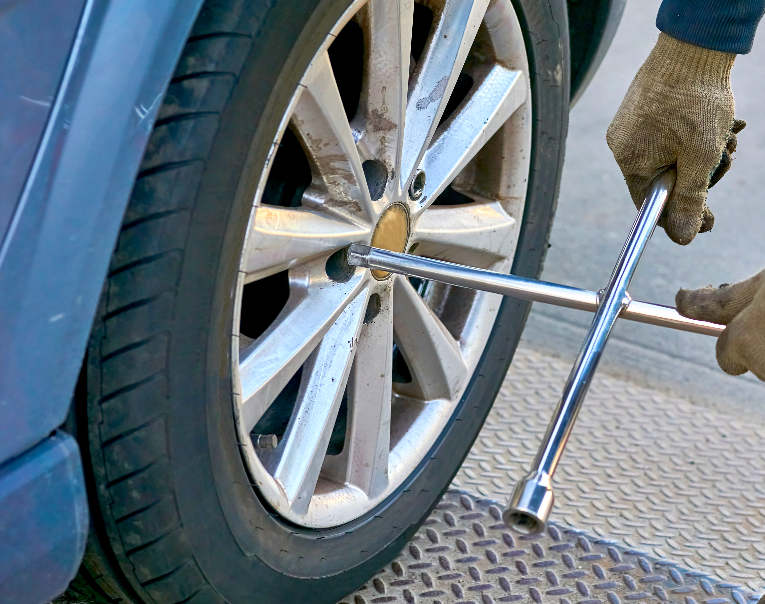
Let’s Talk about Resilience
Resilience is defined as the ability to both adapt and flex with major life stressors, and if knocked down or moved off-course—the ability to bounce or spring back.
(Vaillant, 1993)
Notes:
The definition of resilience is defined as the ability to both adapt and flex with major life stressors and if knocked down or moved off course the ability to bounce or spring back. I like to define resilience as your reserve well not the well that you need to survive but the one that's the spare sometimes I like to describe it as your spare tire right a spare tire allows you to be resilient on a trip because even if you get a flat tire you can keep going. We treat resilience as some something that we should be relying on all the time and that's not the case resilience should be there if we need it but we shouldn't be using it as our main energy source in the same way that we should be driving on our spare tire or the donut all the time. if we are constantly tapping into resilience or taking all the water out of our reserve well there's nothing left for emergencies.

Slide 23

Three forms of resilience
Within me
Connected to my relationships
Connected to something bigger than myself: my belief system and/or faith

Slide 24
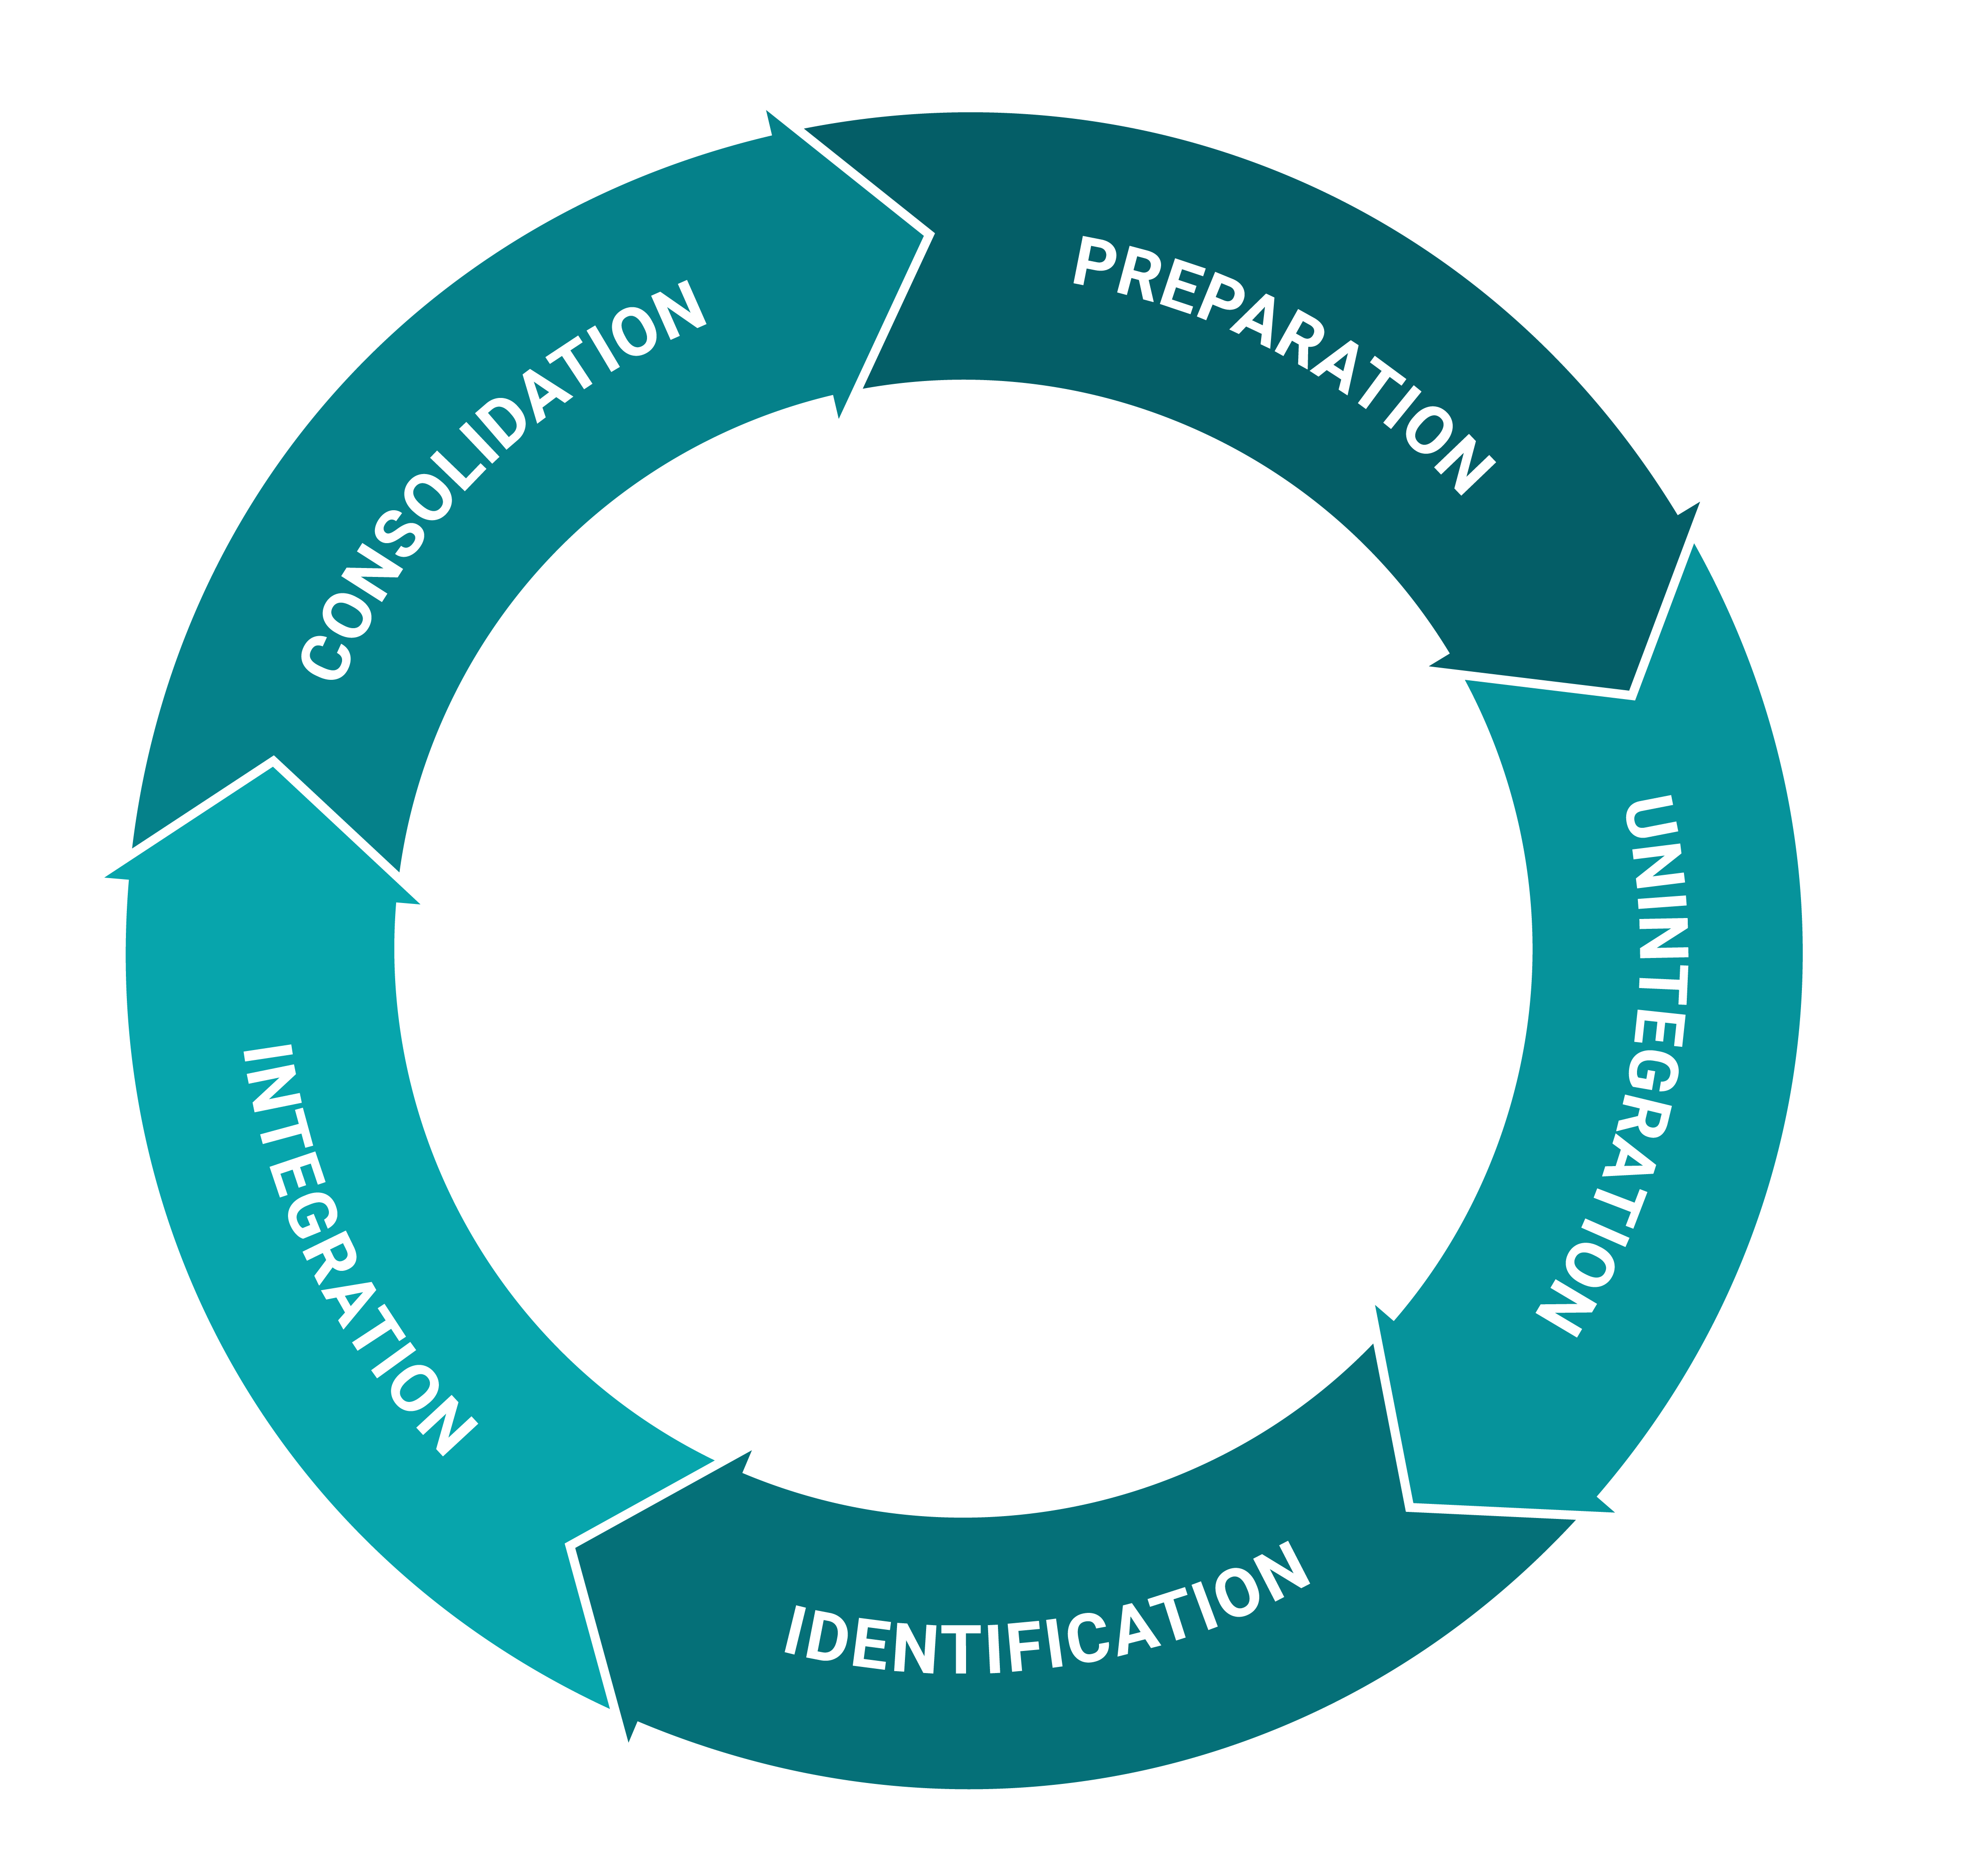
5-Phase Cycle of Healing Repeated Trauma
How do individuals, teams and communities recover from trauma?
Schmelzer, G. (2018). Journey Through Trauma. NY: Avery.

Slide 25
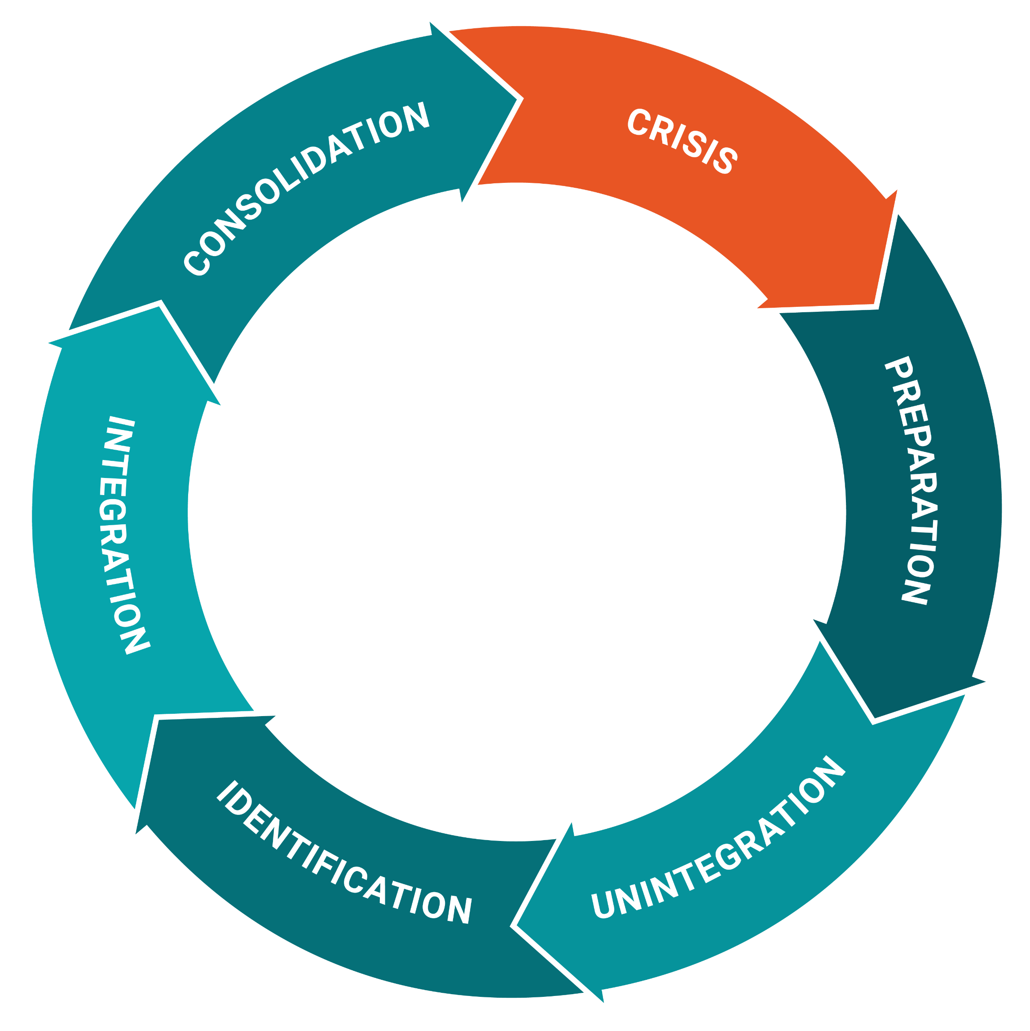
Crisis
Unintegration/ Disintegration
Stabilization
When a crisis occurs (at any phase), return to Preparation
Schmelzer, G. (2018). Journey Through Trauma. NY: Avery.

Slide 26
So how can leaders and managers talk about trauma?

Slide 27
There must be those among whom we can sit down and weep and still be counted as warriors.
Adrienne Rich

Slide 28
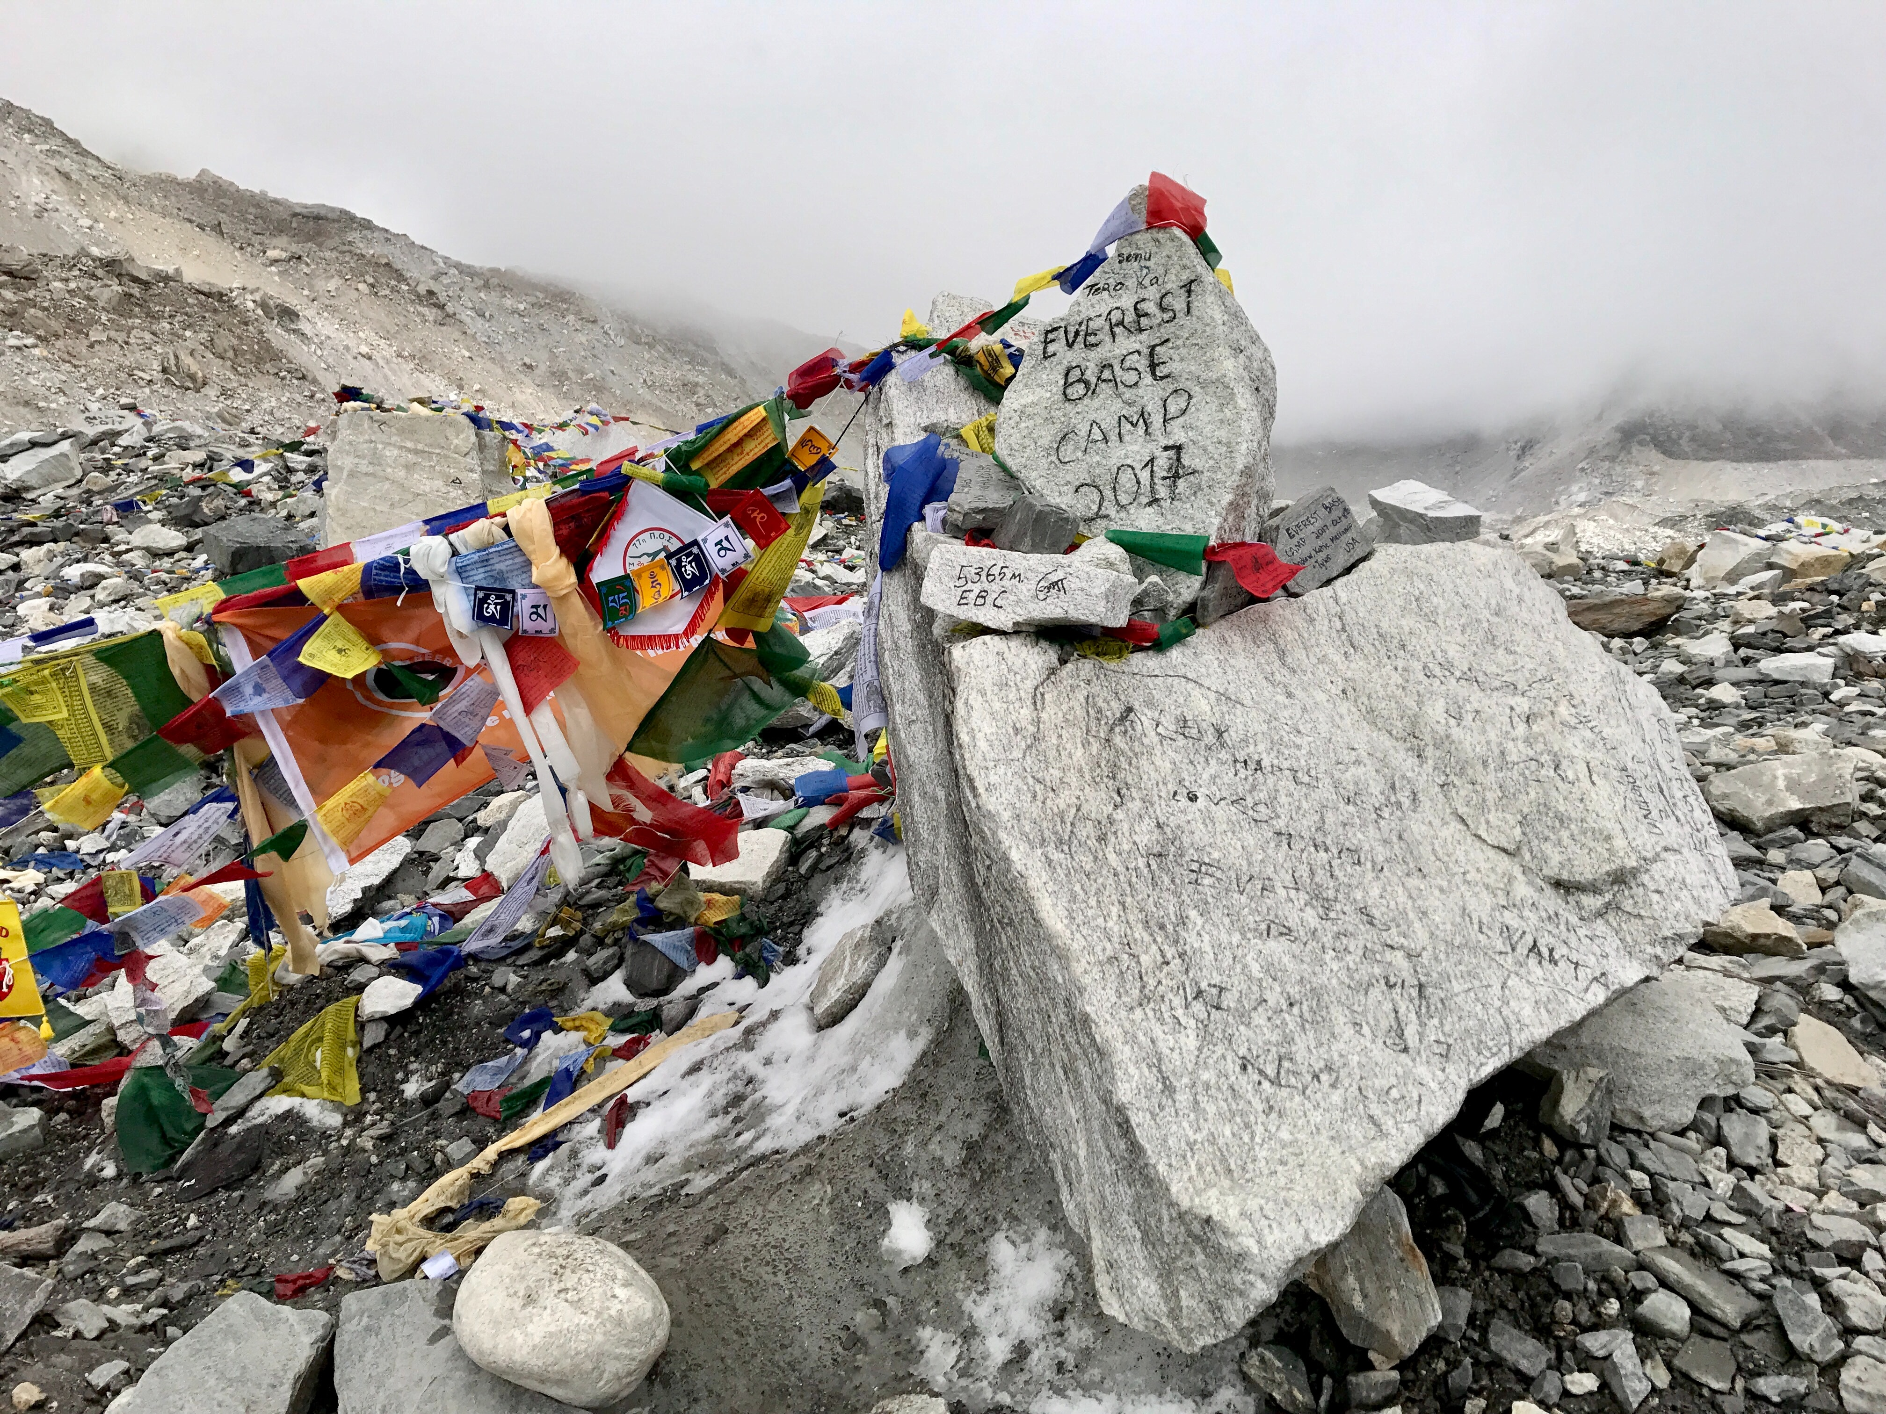
Leaders Establish Base Camp for Stressful Times
Base Camp: a main encampment providing resources, shelter, and communications that serves as a starting and staging area for a larger activity, for example in mountaineering
Schmelzer, G. (2018). Journey Through Trauma. NY: Avery.

Slide 29
Questions to support Base Camp for Ourselves and our Teams
What are some of my strengths I (we) can rely on?
What are some routines that can support me (us)?
Who is on my (our) ‘team?’ and can offer support? How can I communicate with them more effectively?
What are some practices/activities that help me (us) feel grounded or more effective?
How do I know it is time to slow down and return to Base Camp? (How will we know..)
Schmelzer, G. (2018). Journey Through Trauma. NY: Avery.

Slide 30
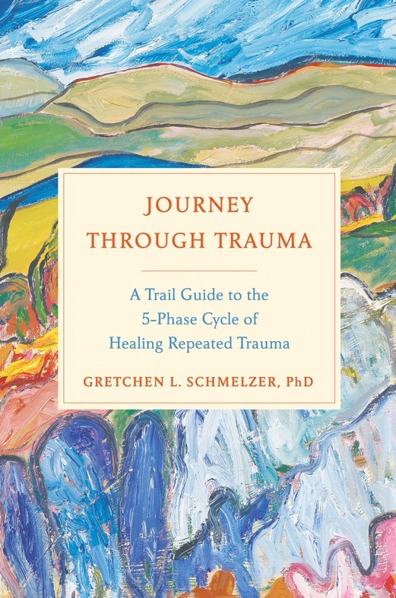
THANK YOU!
Gretchen Schmelzer, PhD
gretchen@gretchenschmelzer.com
https://gretchenschmelzer.com/
https://www.centerfortraumaandleadership.com/
Twitter: @TheTrailGuide
Facebook: @DrGretchenSchmelzer
Instagram: @gretchen_schmelzer

Slide 31
Works Consulted
Bracken, P. J., & Petty, C. (Ed.). (1998). Rethinking the Trauma of War. New York, NY: Free Associations Books Ltd.
Boyatsis, R., Mckee, A., & Johnston, F. (2008). Becoming a Resonant Leader. Boston: Harvard Business School Press.
Brayne, M. (Eds). (2007). Trauma and Journalism: A Guide for Journalists, Editors and Managers. Dart Centre for Journalism and Trauma.
Brock, R., & Lettini, G. (2012). Soul repair: Recovering from moral injury after war. Boston, MA: Beacon Press.
Clay, R. (2020). Journalists as vicarious first responders. American Psychological Association. https://www.apa.org/topics/covid-19/journalists-first-responders
Cuellar, R., Hendricks, A., Clarke, M., Sprang, G., & the NCTSN Secondary Traumatic Stress Collaborative Group. (2021). Secondary Traumatic Stress: Understanding the Impact on Professionals in Trauma-Exposed Workplaces. Los Angeles, CA, and Durham, NC: National Center for Child Traumatic Stress.
Gilmartin, K. (2002). Emotional survival for law enforcement: A guide for officers and their families. Tuscon, AZ: ES Press.
Goleman, Daniel. (2005). Emotional Intelligence. New York, Bantam
Herman, Judith. (1992). Trauma and Recovery: The Aftermath of Violence- from Domestic Abuse to Political Terror. New York, NY: Basic Books.
Hoge, Charles W. (2010). Once and Warrior Always a Warrior: Navigating the Transition from Combat to Home Including Combat Stress, PTSD, and mTBI. Guilford, CT: Globe Pequot Press.
Levine, P. (1997). Waking the tiger: Healing trauma. Berkeley, CA: North Atlantic Books.
McMahon, C., & Lyall, K. (2019). Leading Resilience: A Guide for Editors and News Managers: Working with Freelancers Exposed to Trauma. Dart Centre Asia Pacific.
Perry, B. (2007). Stress, Trauma, and Post-traumatic Stress in Children. www.Childtrauma.org
Substance Abuse and Mental Health Services Administration. SAMHSA’s Concept of Trauma and Guidance for a Trauma-Informed Approach. HHS Publication No. (SMA) 14-4884. Rockville, MD: Substance Abuse and Mental Health Services Administration, 2014.
Schmelzer, G. (2018). Journey Through Trauma: A Trail Guide to the 5-Phase Cycle of Healing Repeated Trauma. New York: Avery.
Siegel, Daniel J. (2010). Mindsight: The New Science of Personal Transformation. New York, NY: Bantam Books.
Solomon, M. F., & Siegel, D. F. (Ed.). (2003). Healing Trauma: Attachment, Mind, Body, and Brain. New York, NY: W. W. Norton & Company.
Terr, Lenore. (1990). Too Scared to Cry. New York, NY: Basic Books.
Tick, Edward. (2005). War and the Soul: Healing Our Nation’s Veterans from Post-traumatic Stress Disorder. Wheaton, IL: Quest.
van der Kolk, B. (2014). The body keeps score. NY: Penguin.
Willis, D. (2014). Bulletproof Spirit: The first responder’s essential resource for protecting and healing mind and heart. Novato, CA: New World Library.

Slide 32
What can leaders do?
Help your direct reports and colleagues understand and own the impact of stress and trauma.
Normalize it and encourage conversation and coping.
Make sure that the mental health resources are easily available, easy to find and widely distributed.
Establish base camp for yourself and the individuals and teams who work for you.
Be brave and risk conversations with your people. They may be awkward—that’s okay. And they will need to be repeated.

Slide 33
Conversations for support during a crisis or transition:
What do you like/dislike about working from home and this current crisis or transition?
What strengths are you leaning on?
What are your biggest sources of stress?
What are your signs of stress?
How will I know that you need help?
What can I do to support you at this time?

