Slide 1



Slide 2




About Freedom House
Inform
Mobilize
Support
Inform the public about key trends and emerging threats
Mobilize decision-makers to respond to threats and protect democracy
Directly support local activists and organizations working for human rights

Slide 3
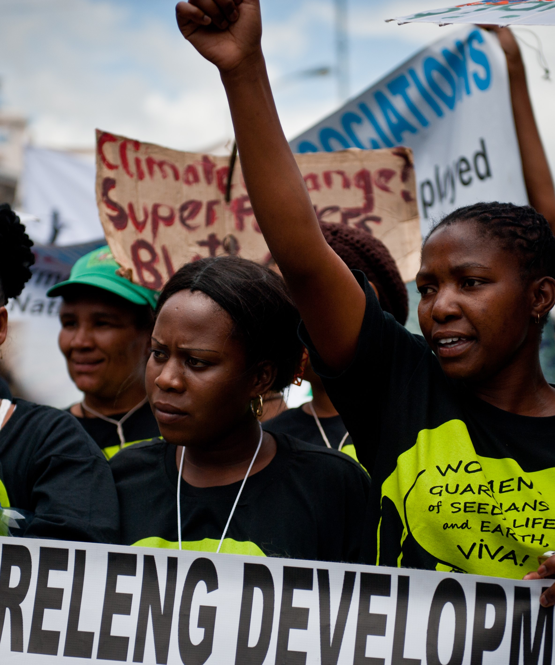
Freedom in the World
Political Rights
Civil Liberties
Electoral Process
Political Pluralism and Participation
Functioning of Government
Freedom of Expression and Belief
Association and Organizational Rights
Rule of Law
Personal Autonomy and Individual Rights

Slide 4
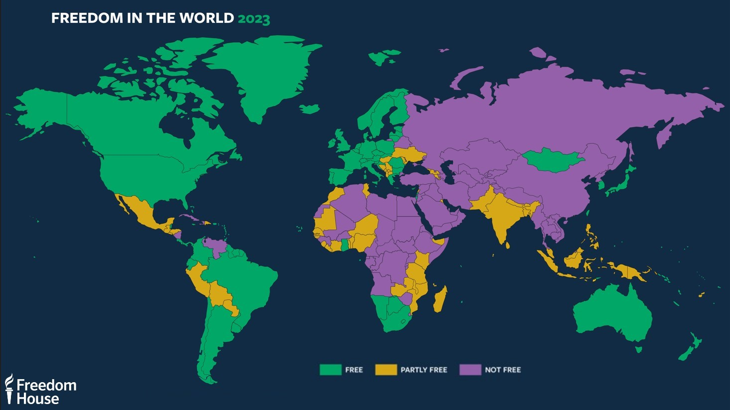

Slide 5
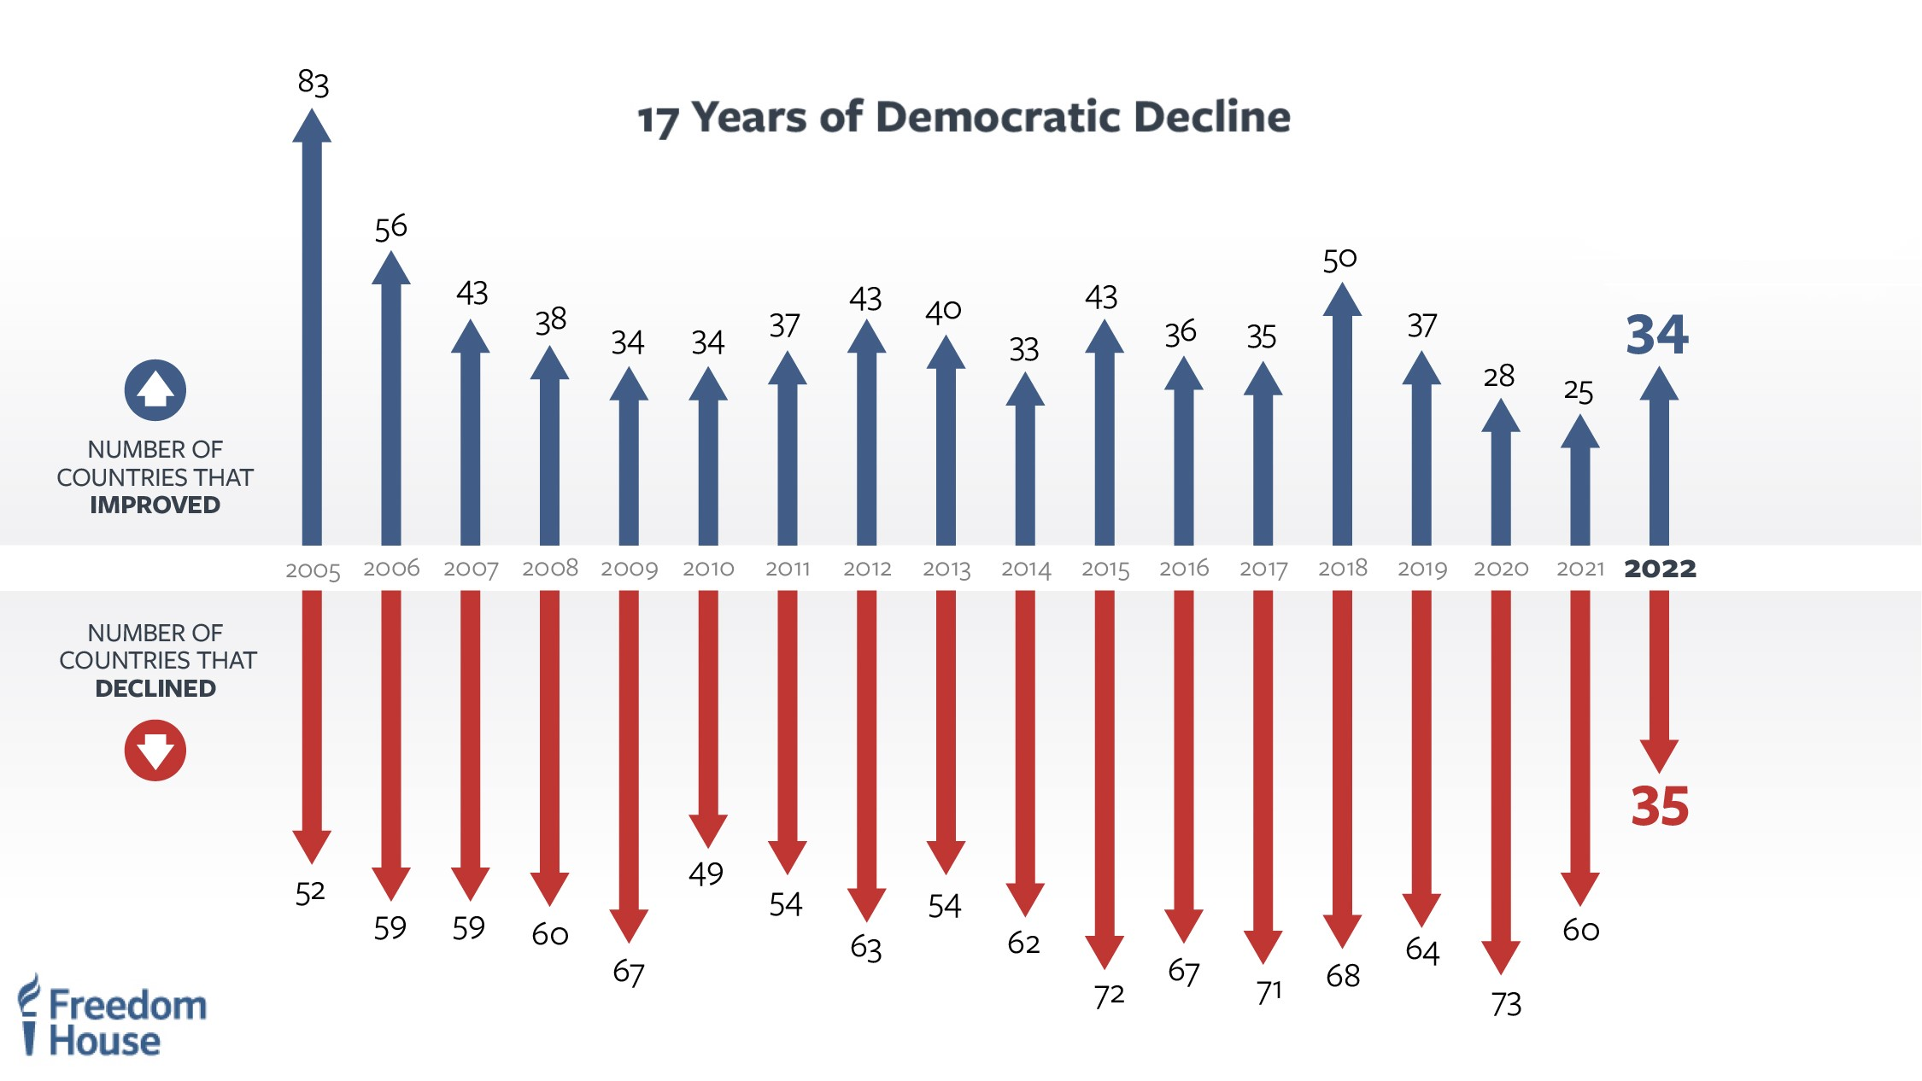

Slide 6

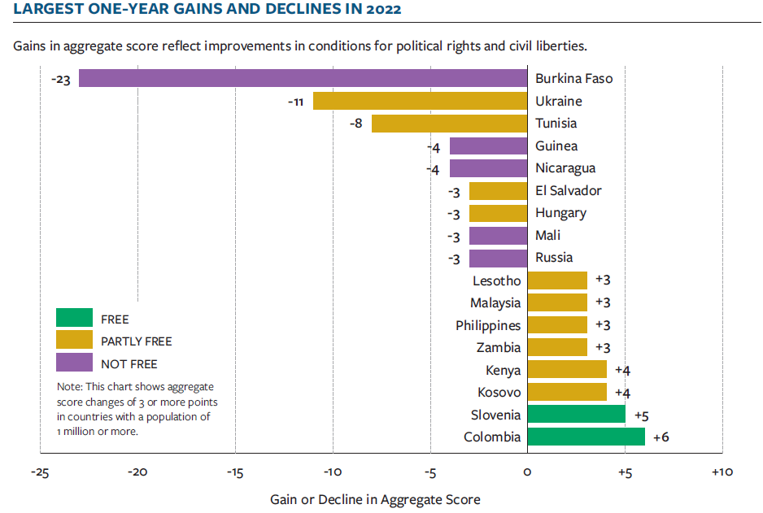

LARGEST ONE-YEAR GAINS AND DECLINES

Slide 7
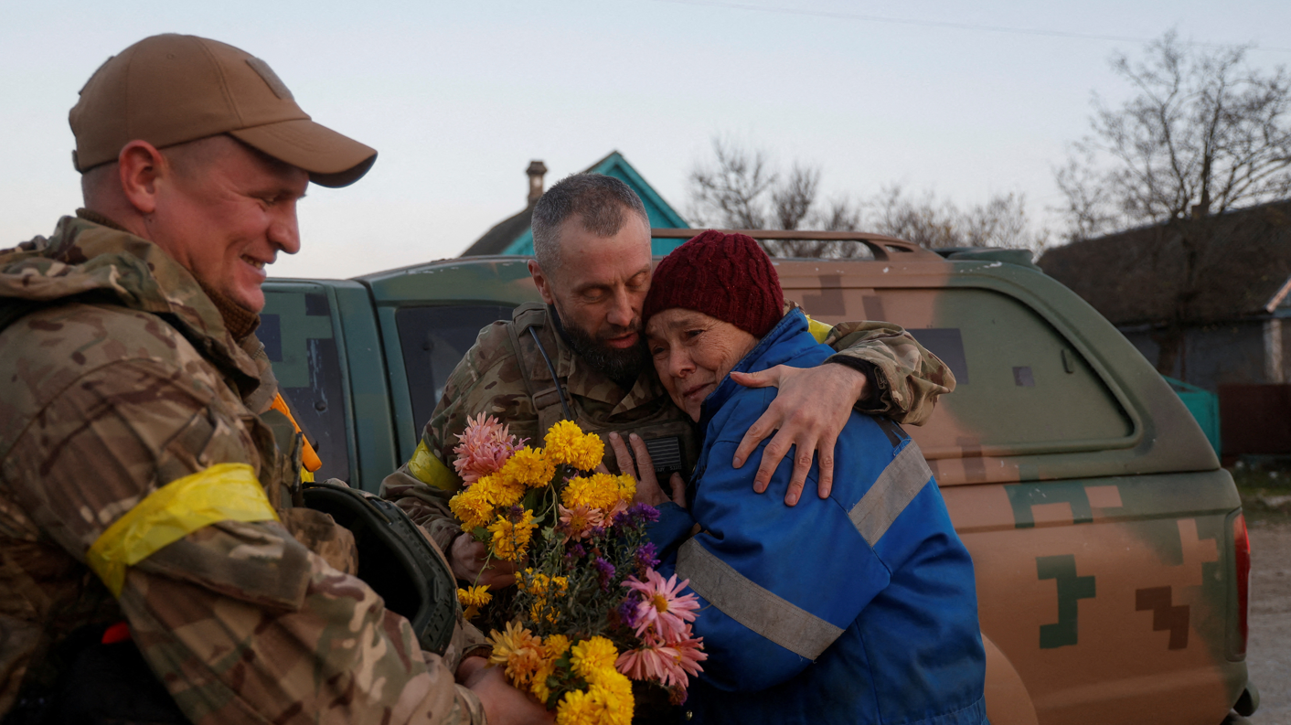
Russia’s full-scale invasion of Ukraine led to the second-largest score decline in the world.

Slide 8
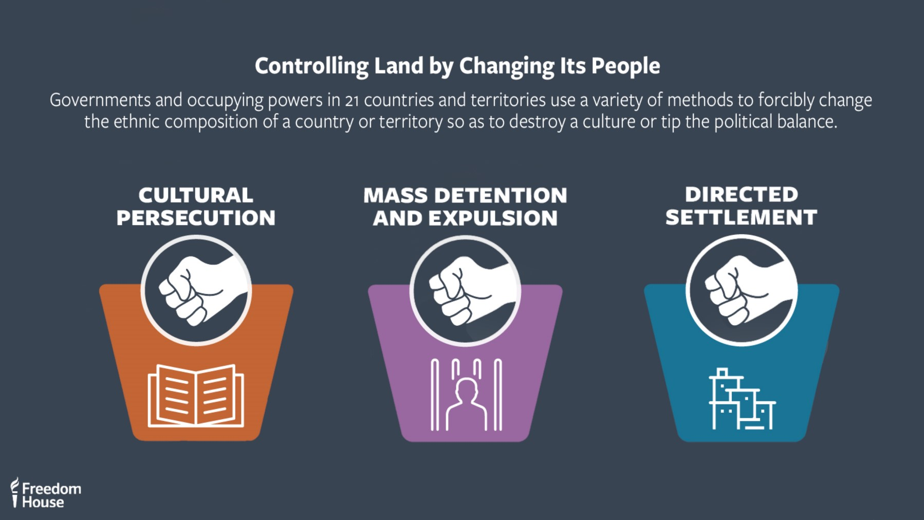

Slide 9
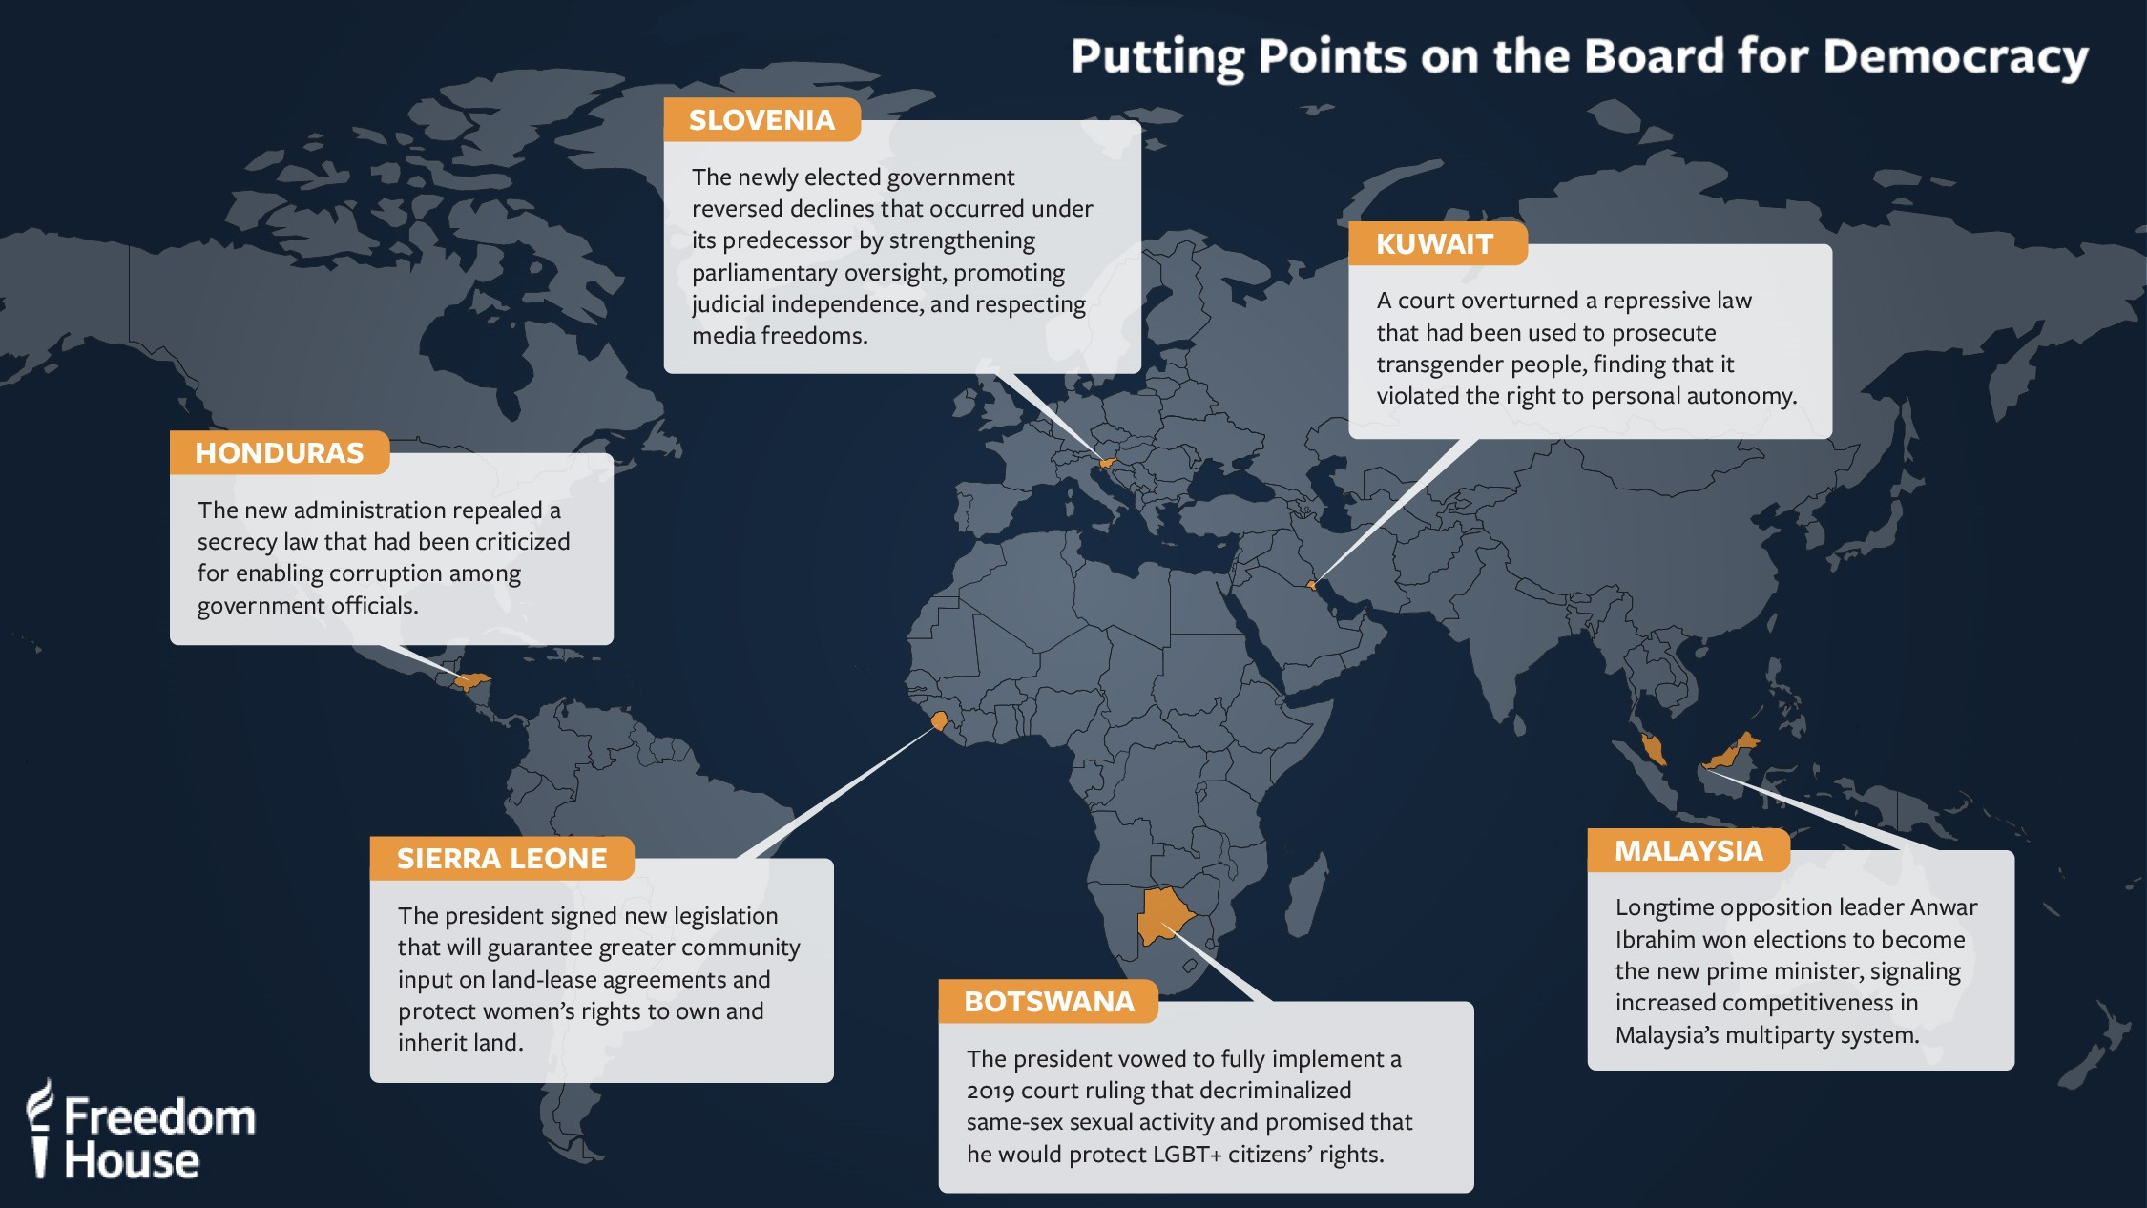

Slide 10

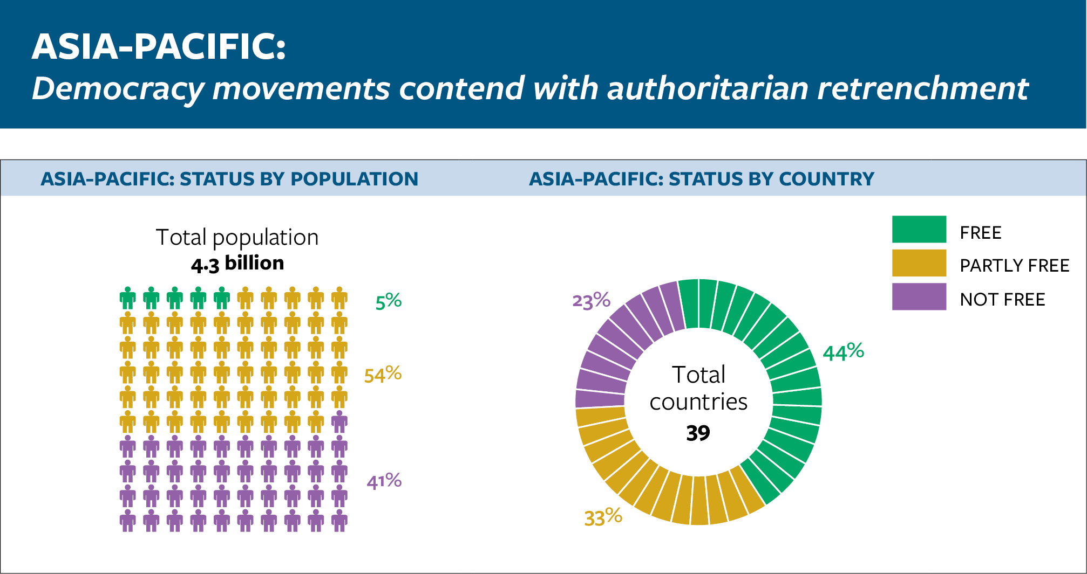
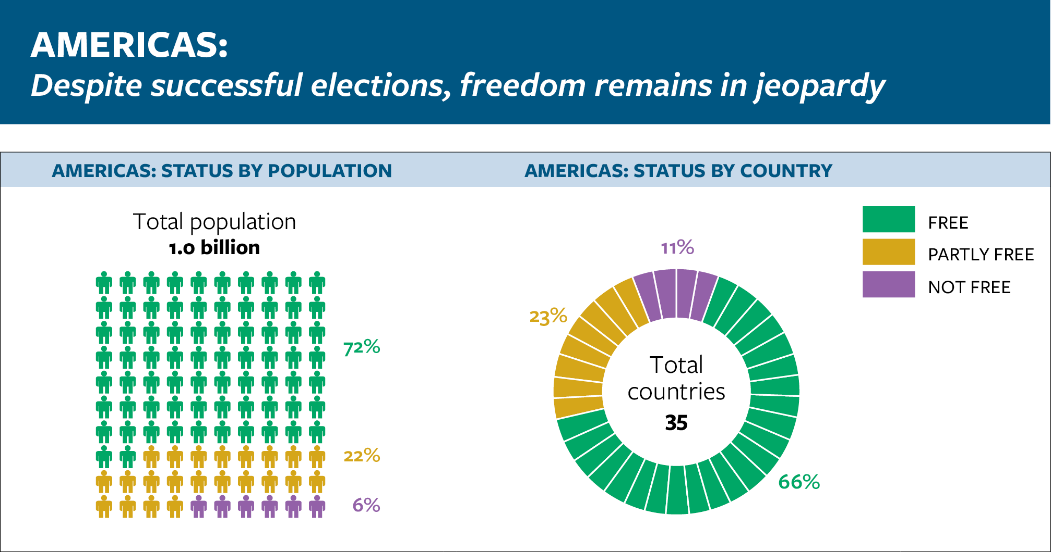
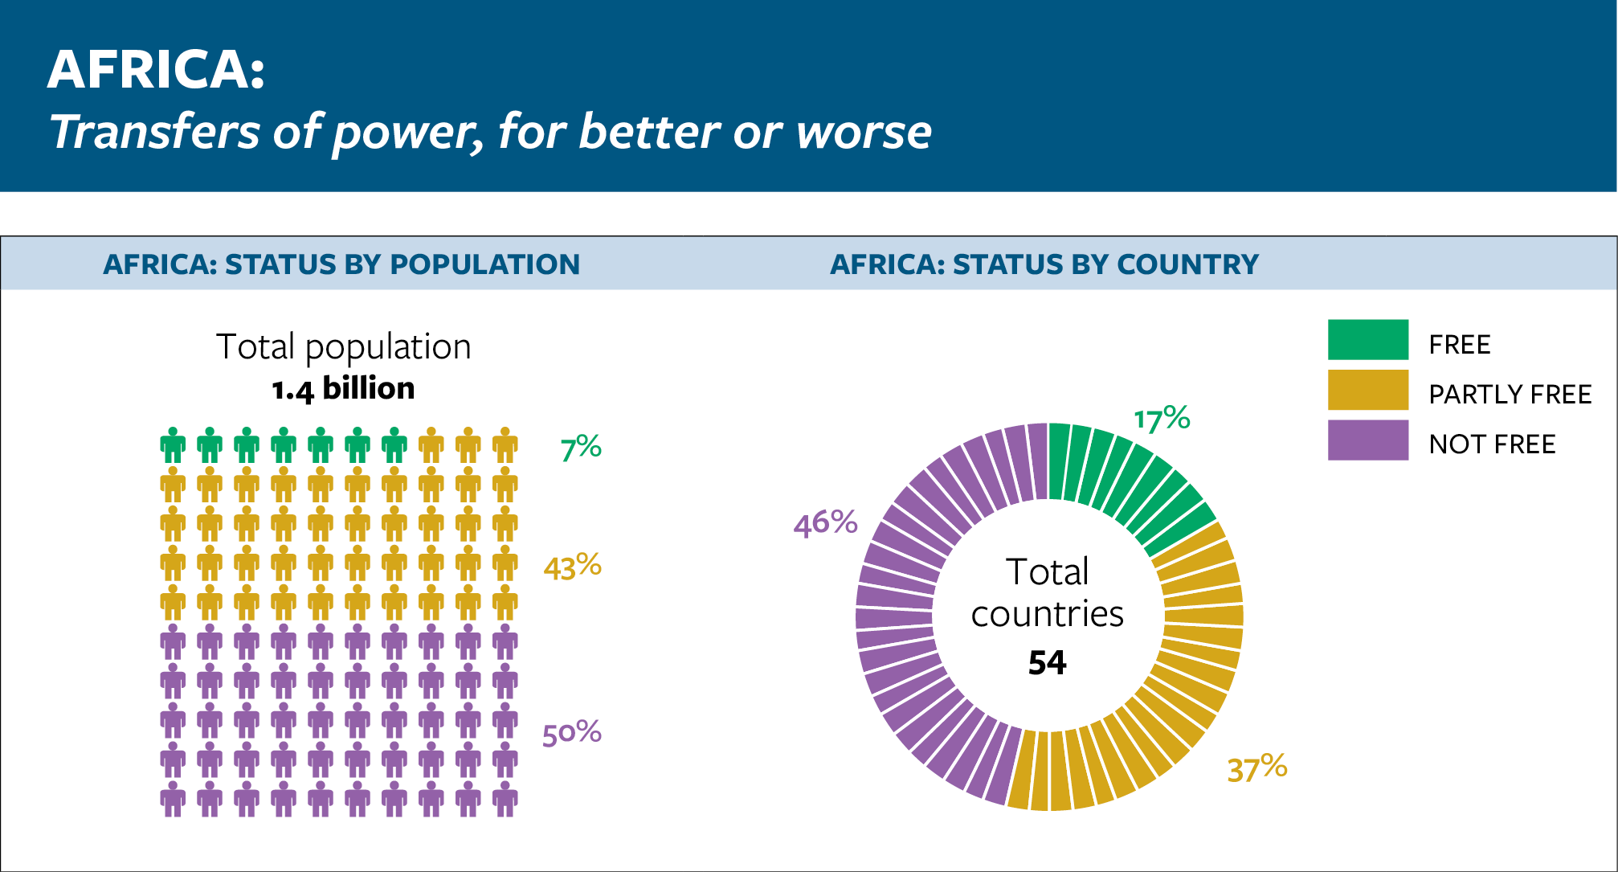
Regional Snapshots
Africa, the Americas, and Asia-Pacific

Slide 11
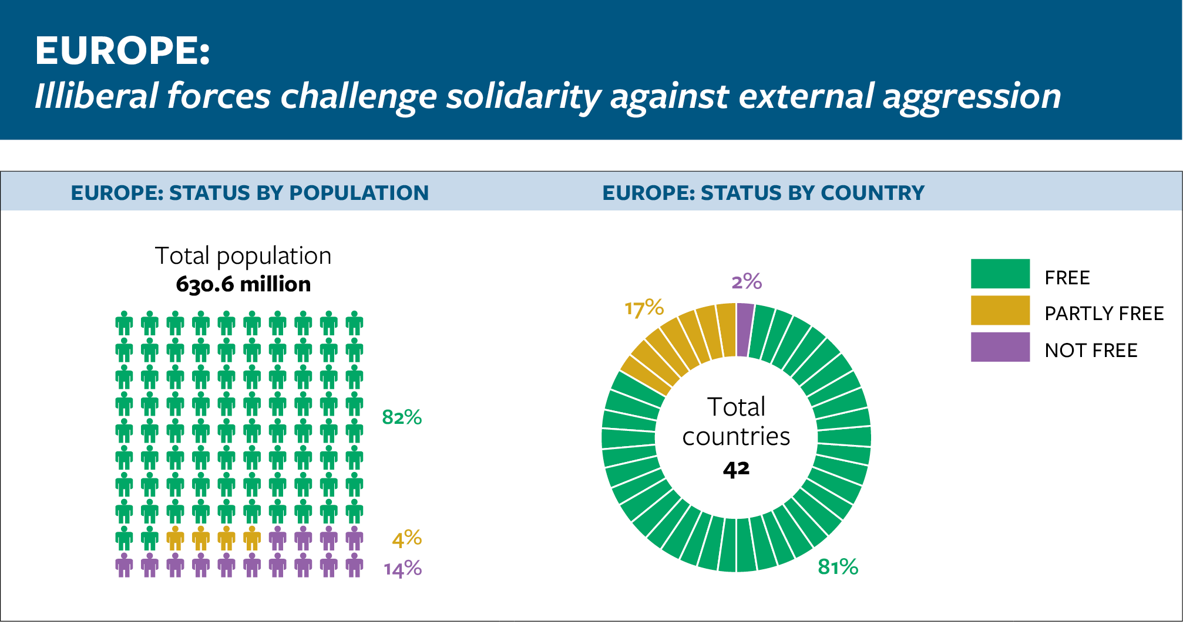
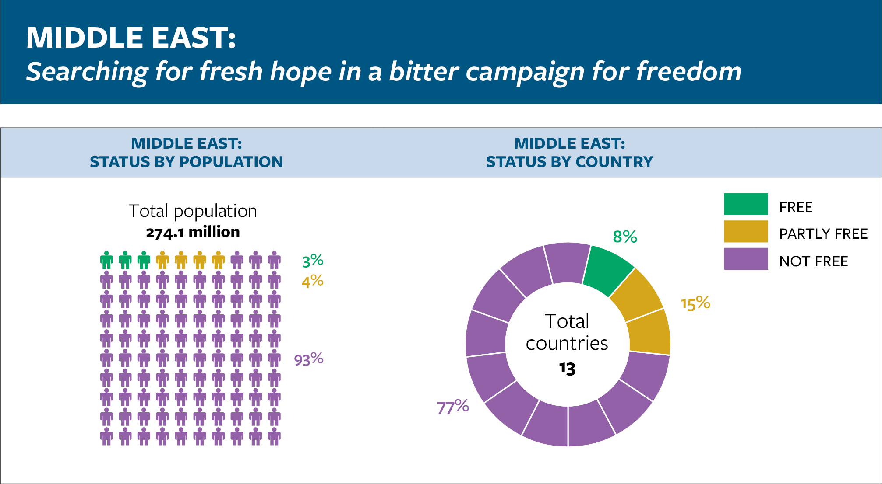
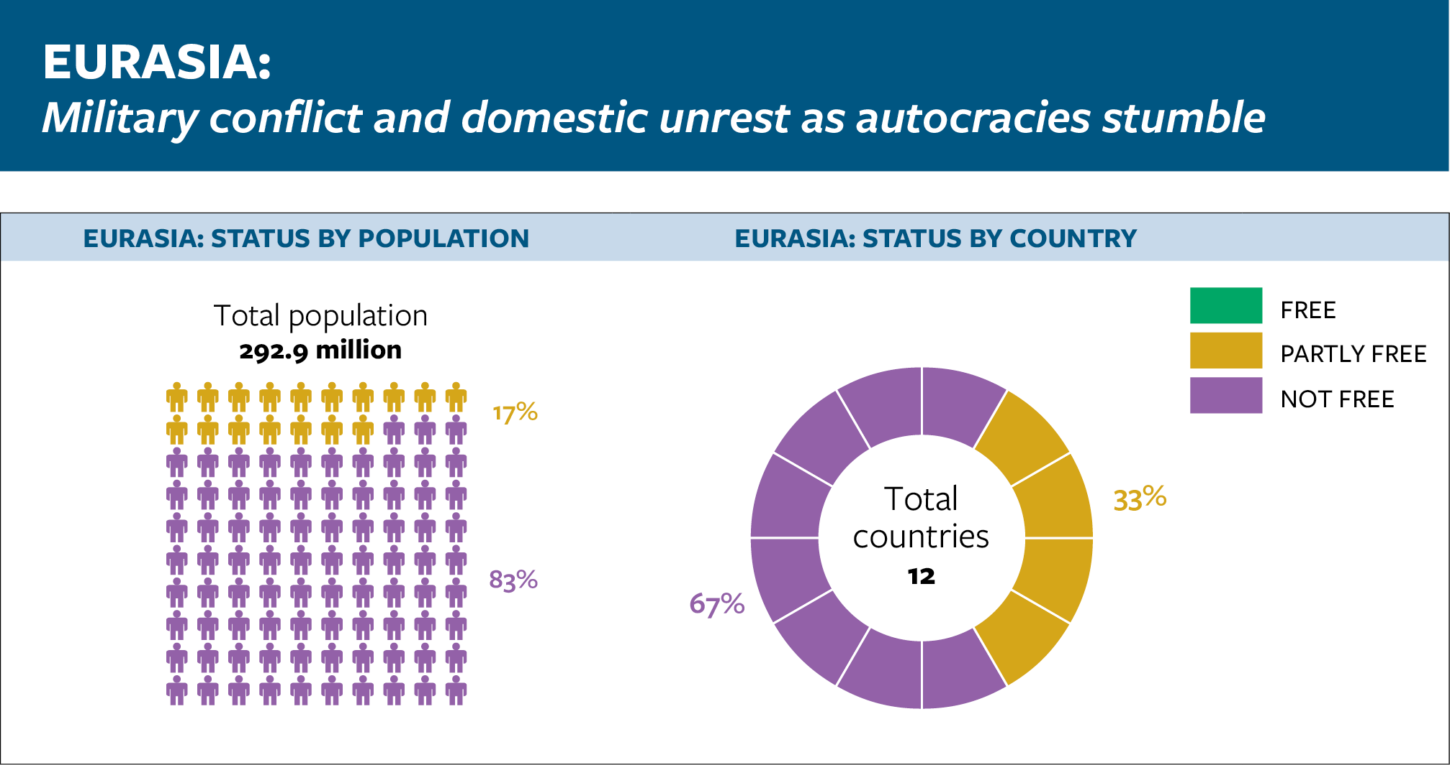
Regional Snapshots
Europe, Eurasia, and the Middle East

Slide 12
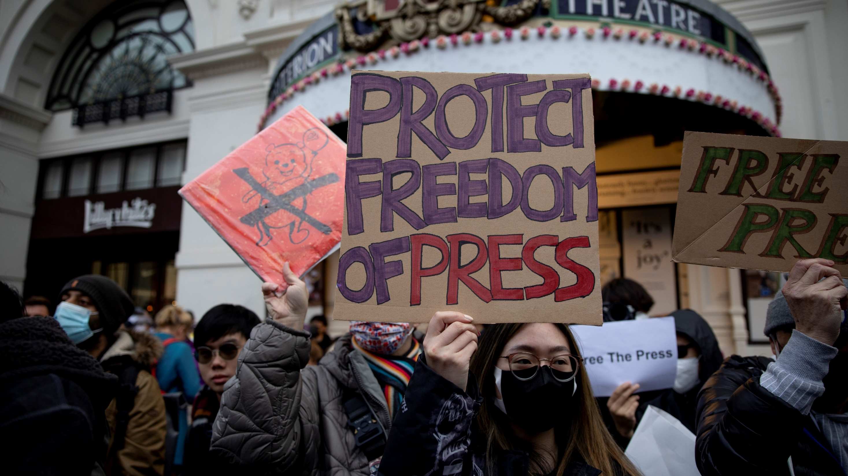

Slide 13


Slide 14
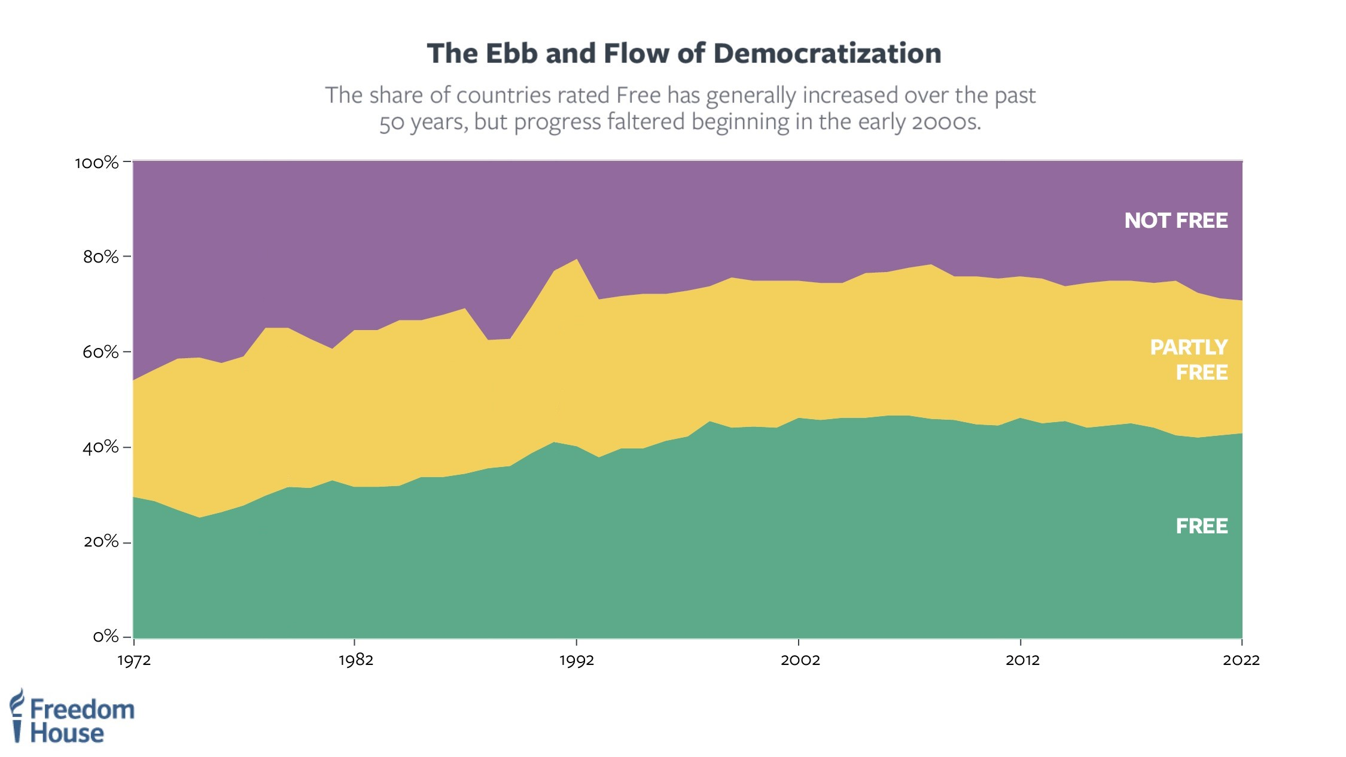

Slide 15
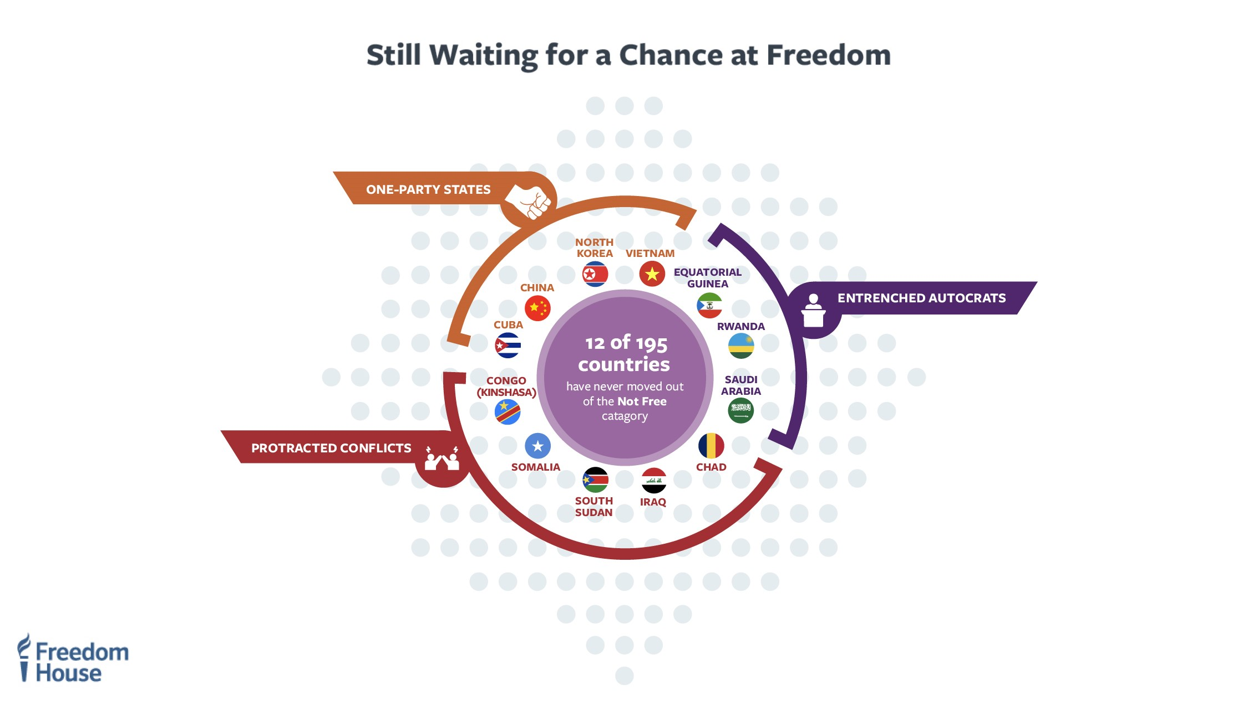

Slide 16
Thank you
Adrian Shahbaz
Vice President, Research and Analysis
Shahbaz@FreedomHouse.org

