Slide 1

Compassion Fatigue and Secondary Traumatic Stress
Melissa Kaiser, LBSW MelKai Consulting, LLC

Slide 2
Melissa Kaiser
Licensed social worker in ND
From Linton, ND, currently living in Clearwater, FL
Consulting and training on human trafficking/CSEC, MDTs, person-centered and trauma-informed approaches, and secondary traumatic stress
First Human Trafficking Navigator in ND
First Victim/Witness Specialist with the BCI
History of working in psychiatric and addiction, treatment foster care, youth homelessness, domestic violence, and prevention education

Slide 3

Normalize the Problem
“The expectation that we can be immersed in suffering and loss daily and not be touched by it is as unrealistic as expecting to be able to walk through water without getting wet.”
Rachel Naomi Remen,
Kitchen Table Wisdom, 1996
Slide courtesy of Françoise Mathieu, 2019
Notes:
We get it because we CARE
We will all experience compassion fatigue and secondary trauma, it’s about our awareness of it that makes the difference.
Give examples
The reality is…
Deeply compromised system
Ongoing challenges & cutbacks
Difficult stories
Losses

Slide 4
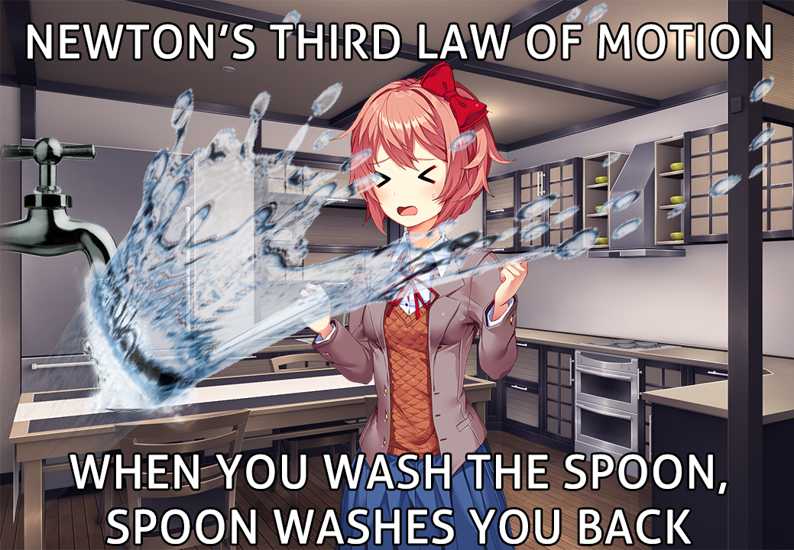
“For every action there is an equal and opposite reaction”
We are constantly at high stress levels (survival during work), and we go home assuming we return to ‘normal’. However we actually go through depression, addiction, etc. to cope/adapt.
When our actions/daily experiences at work expose us to trauma, we have to assume there is going to be a reaction/result that impacts us, day after day.
We are stuck on high or low.
Notes:
Newton’s Law
Addiction, depression, hypervigilance, suicide, etc…
The latter is derived from Dr. Kevin Gilmartin’s book and course on Emotional Survival for LE, in a nutshell that we have this thought that we in LE (applicable to other professions in this realm too) remain at high stress levels for survival reasons during work and we just assume we go home and return to normal, however research has shown we actually go well below normal to cope/adapt (almost depressionesque), hence the equal and opposite aspect Clayton Platt

Slide 5
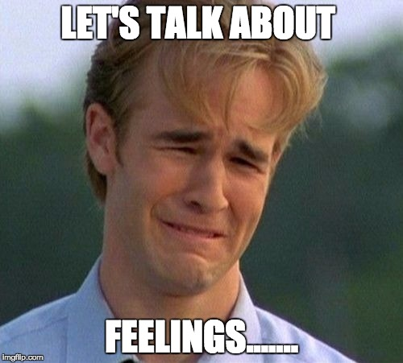

Let’s chat…
How has this work changed you?
How has this work changed your views on the world?
What happens to the stories you hear at work?
Were you trained for this?
Notes:
Derek-Share
Offer small group discussion about these questions or if doing virtually ask people to chat (5 min)
Give examples : softball tournament, Sarah/baby, Quinn/’she could die if I don’t do anything;, lack of trust for men, Emily-changing baby diaper
Needing to see the doorway

Slide 6
Terms to Understand
Secondary Traumatic Stress
Vicarious Trauma
Burn Out
Compassion Fatigue
PTSD
Moral Suffering

Slide 7
Definitions
Burn Out
PTSD
Can happen at any job
High workload, low pay
Loss of purpose
Increase in frustration
Poor working conditions
Mental health diagnosis
Impacts daily functioning
Flashbacks
Avoidance
Recurrent stress/anxiety

Slide 8
Definitions
Compassion Fatigue
Secondary Trauma
Predetermination
Impatient and irritable
“Eyeroll” mentality
Extreme self sacrifice
Loss in empathy
Indirect exposure causing second-hand trauma
Listening to heart-wrenching or disturbing stories
Seeing people in physical or emotional distress
Witnessing others’ graphic injuries
Similar symptoms to victims w/ trauma

Slide 9
Definitions
Vicarious Trauma
Moral Suffering
Worldview Shift
Intrusive thoughts
Difficult, repeated exposure
Impacts sense of self
Similar symptoms to victims w/ trauma
Moral Injury is the damage done to one’s conscience or moral compass when that person perpetrates, witnesses, or fails to prevent acts that transgress one’s own moral beliefs, values, or ethical codes of conduct (military)
Moral Distress is being constrained to act in an ethical manner due to rules, regulations, procedures (healthcare)

Slide 10

“I miss feeling my emotions” “I am mean to my kids”
“I am married to my job”
“I have a hard time relaxing” “Gory scenes in movies do not phase me”
“Nobody’s redeemable”
“I had empathy when I first started this job”
“It is what it is, I’m good”
“Throw them into the wolves, that’s how I had to learn”
“We all have to just pull ourselves up by our bootstraps and get over it”
Personal Impact How do you relate?
Notes:
Donut story, pregnant client, jail staff/no emotions, McQuades
Relating to Lisa: How does this cause STS? How can you relate? Why is it triggersome? How can you debrief with your team?
There is potential for compassion fatigue or secondary trauma to surface for first responders and VSPs working on this case based on personal vulnerabilities/factors and details of Lisa's story.
Dynamics of Lisa's story could be triggersome for VSPs and first responders, or remind them of a family member, another case, their personal life, etc... Her story can be relatable to those helping her which may have an impact on the VSP/first responder, and hinder/change the services they are providing to her.
Considerations and awareness prior to discussing this case (debriefing, venting, etc) with colleagues.
-Trusting men and dating

Slide 11

What are we even doing, anyways?
Journalism…
Can feel defeating and discouraging
Little reward or acknowledgement
Taking blame and putting ourselves in danger
Things that matter vs. things you can control
Lack of utilization of mental health services
Notes:
BCA wellness program
ICAC has a full-time therapist

Slide 12
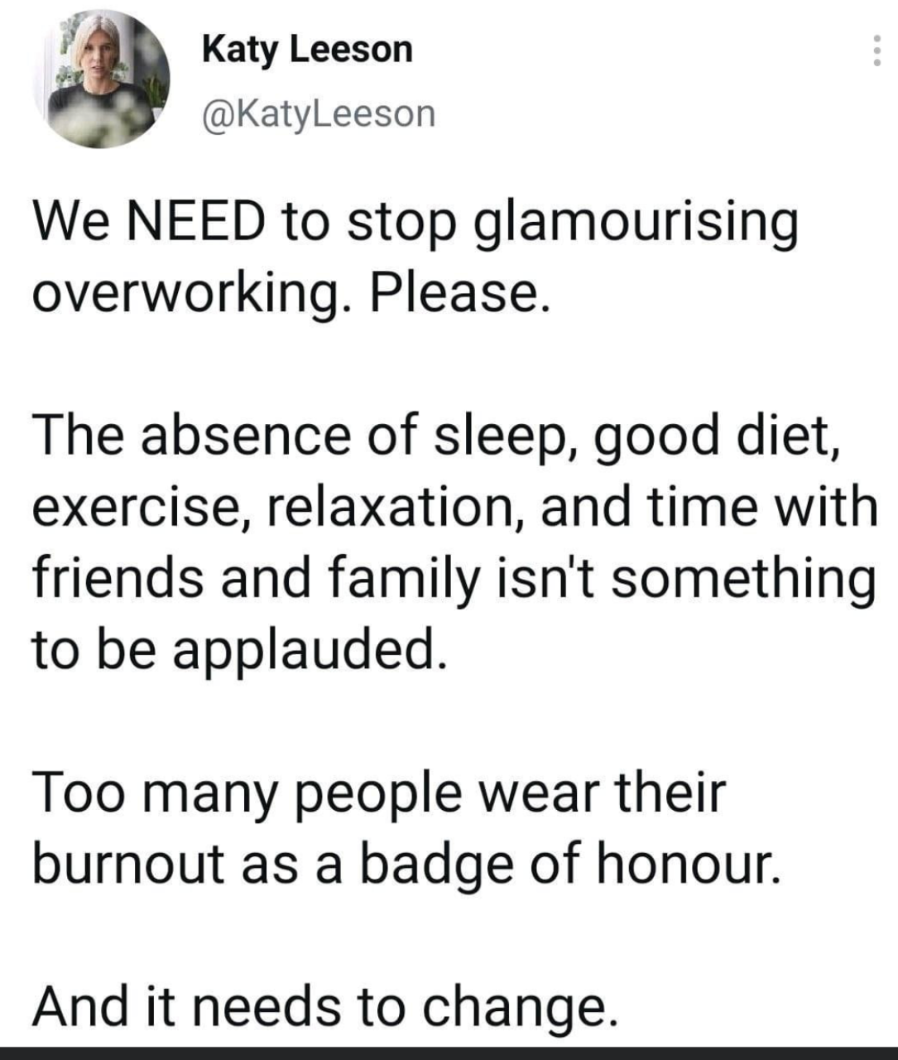
Notes:
“It kills us”

Slide 13

Absent vs. Present?
Absenteeism
Missing work often
Not available
Not mentally “there”
Presenteeism
At work too often/no breaks
No use of vacation or sick time
Always available
Notes:
Conflicts with MH and sick days, relief worker PTO

Slide 14
6 Causes of Burnout The Burnout Epidemic, Jennifer Moss
Workload
Perceived lack of control
Lack of reward or recognition
Poor relationships
Lack of fairness
Values mismatch

Slide 15
Beliefs
Results
Thoughts
Behaviors
Feelings
Notes:
55,000 thoughts a day, 80% are negative
National Science Foundation
Push of numbers/lack of quality, lack of victim rapport
Results/lack of relationship, offender focused
Exhaustion, discouragement, confusion, anger, annoyance
Rushed, miss details, lack of rapport building/authenticity, lack of reward
Rushed, missing details, no victim-involvement, overwhelmed
Number vs quality

Slide 16

Slide source TEND ACADEMY LTD
INDIVIDUAL RISK FACTORS
Personal Vulnerabilities
Work-related Traumatic Grief/Loss
Direct Exposure
Indirect Trauma
Working conditions
Systems Failure
Socio-Cultural Context
Image courtesy of Dr. Leslie Anne Ross, UCLA
Notes:
Understand Multiple Points of Exposure
Personal Vulnerabilities – personal history of trauma, high stress home life, personal history of medical and MH conditions
Work-Related Traumatic Grief and Loss – impact or loss of colleagues, death of clients
Direct Exposures to Traumatic Events – witness fire, accident, death, violence
Indirect Exposure – the stories we hear
Empathic Strains - difficult having empathy, starting to not care
Systems Failures – when the system doesn’t work as we believe it should, a kid is returned back to abuse, not guilty
Working Conditions – long hours, no breaks, under pay, hostile work environment, lack of variety of responsibilities
Socio-Cultural Contexts – current cultural, social, political climate for instance in 2020 we have faced a health crisis, the reality of systematic racism
ALL can lead to greater rates of stress.
Over time, these multiple points of exposure can contribute to Empathetic Strain and related symptoms.
Pause: ask them to note down their personal vulnerabilities

Slide 17







PROTECTIVE FACTORS
Balanced and reasonable caseload
Supervision and support at work
Time away from high stress work
Social support outside of work
Adequate training
Diversifying responsibilities
Notes:
Empathetic Strain & vicarious trauma affects the most caring. Research has shown us the factors that help protect individuals in high stress and trauma exposed environments
Percentage of traumatic cases on caseload - the more traumatic the work, the higher the incidence of VT
Full time vs Part time – amount of time exposed to trauma
Social support is a protective factor
Adequate training – in both your position and in building resiliency is also a protective factor -
Having supervision and support at work to process and debrief
Diversify responsibilities so not all trauma content, like part of the job is training and outreach

Slide 18

MAKING A CHANGE
Assess where you are at
Understand your warning signs
Learn strategies
Develop an intervention plan
Slide courtesy of Françoise Mathieu, 2019
Notes:
How one makes a change
Understanding what is happening to you - is it burnout, empathic strain/compassion fatigue, or secondary traumatic stress?
Understanding the warning signs
Learn strategies to protect yourself and respond to stress
Developing an early intervention plan

Slide 19

First Thing’s First…
Avoidance Creates Burnout
We have to be willing to experience negative emotions!

Slide 20

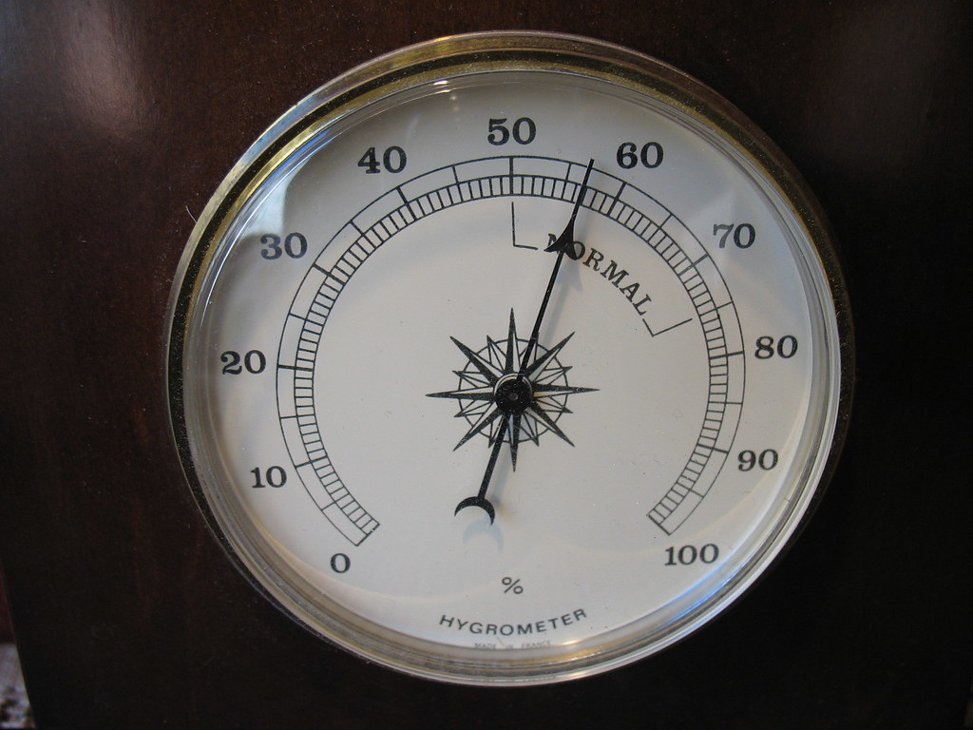
Self Assessments
PRoQol app
Compassion Fatigue and Vicarious Trauma - Signs and Symptoms
What’s Draining You?
Notes:
We are doing a disservice to our clients:
Can sense burnout/loss of interest
Re-traumatization
Blame/shame and judgement
Lack of response
Inability to actively listen
Lose faith in the system
Forget why we are here in the first place

Slide 21
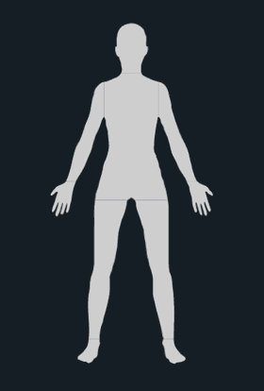
Self Assessment: What does stress feel like?
Jaw tension, grinding of teeth
Increase or decrease in appetite
Frequent urination, GI issues
What level of stress can you put up with?
Have you become accustomed to a certain level of stress?
How does that affect your responsiveness to it?
Exhaustion
High heartrate and blood pressure
Migraines and/or headaches
Tension, aches/pains and muscle soreness
Skin irritation (Rashes, hives, acne, etc)
Weak immune system/sick often
Numbness and/or tingling

Slide 22
Self Assessment: Understanding your warning signs
What is the worst part of my job? How do I avoid (or delay) it? What are the feeling(s) I am avoiding by avoiding this task or responsibility?
© Françoise Mathieu, 2019
Notes:
There are physical, emotional, and behavioral signs of empathic strain. Creating a warning system can help you monitor your levels of empathic strain so you’re able to implement strategies to resolve empathic strain in a more timely manner.
Give an examples of signs:
Green Zone - healthy eating, exercise, time with loved ones
Yellow Zone – no time to exercise, increased irritability
Red Zone – no time to eat, work-out, reacting irritable, angry,
Ask people around you what each of those looks like for you, and what is it like to be around you in each zone?
Family-doesn’t have it that bad/compare, eating, emotions/irritable and impatient Sarah story

Slide 23
HOME LIFE
If you are a trauma-exposed professional, have you asked your loved ones/friends what it’s like to live/hang out with you when you are in the yellow zone?
What would they say about how you transition from work to home?
What would they say about the impact hard stories and cases have on you? On them?
Have you developed a keen self-awareness about your warning signs and when it’s time to take stock and reset yourself?

Slide 24
What is my before-work narrative?
What is the narrative in my mind before going to work?
What feelings are associated with this?
What do I want it to be?
…even in the most stressful moments?

Slide 25
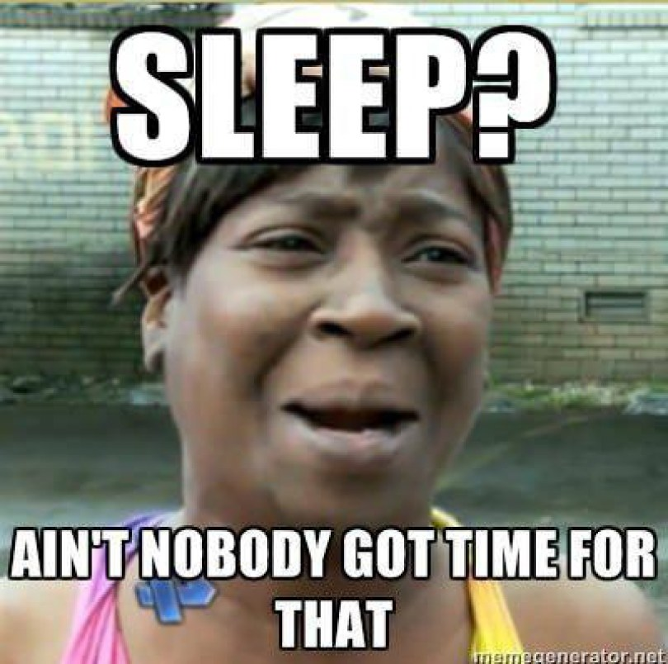
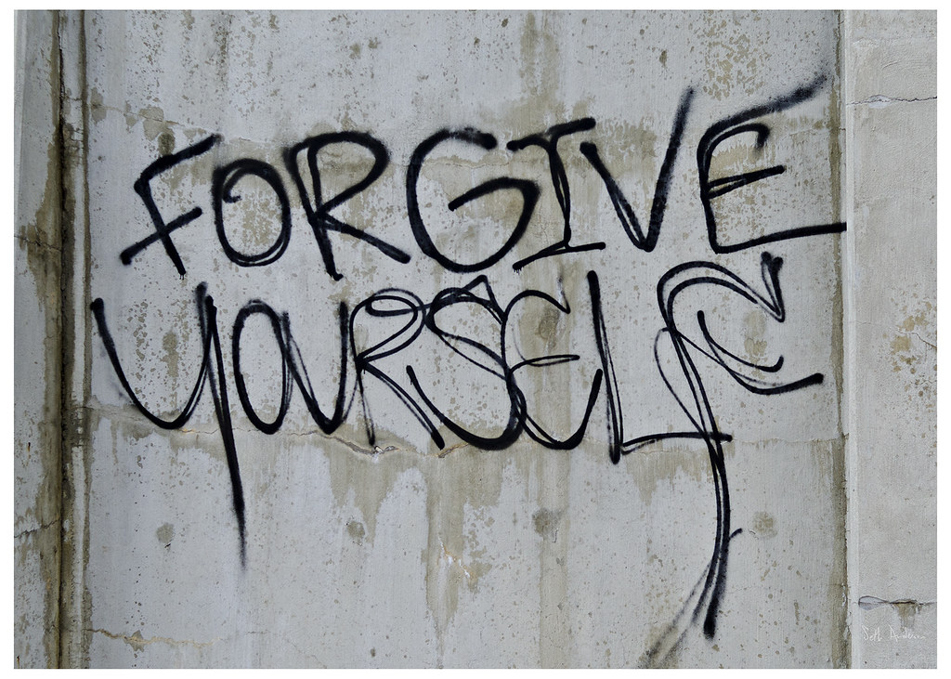
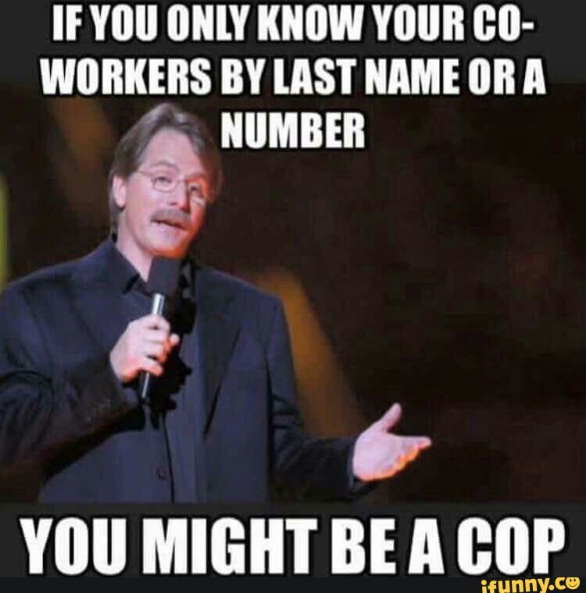
STRATEGIES
True self-care:
Sleep
Time management
Spirituality
Health and wellness
Fun and laughter
Motivation
Self compassion
Notes:
Selfcare is not just bubble baths, shopping, wine, etc.. It’s discipline

Slide 26
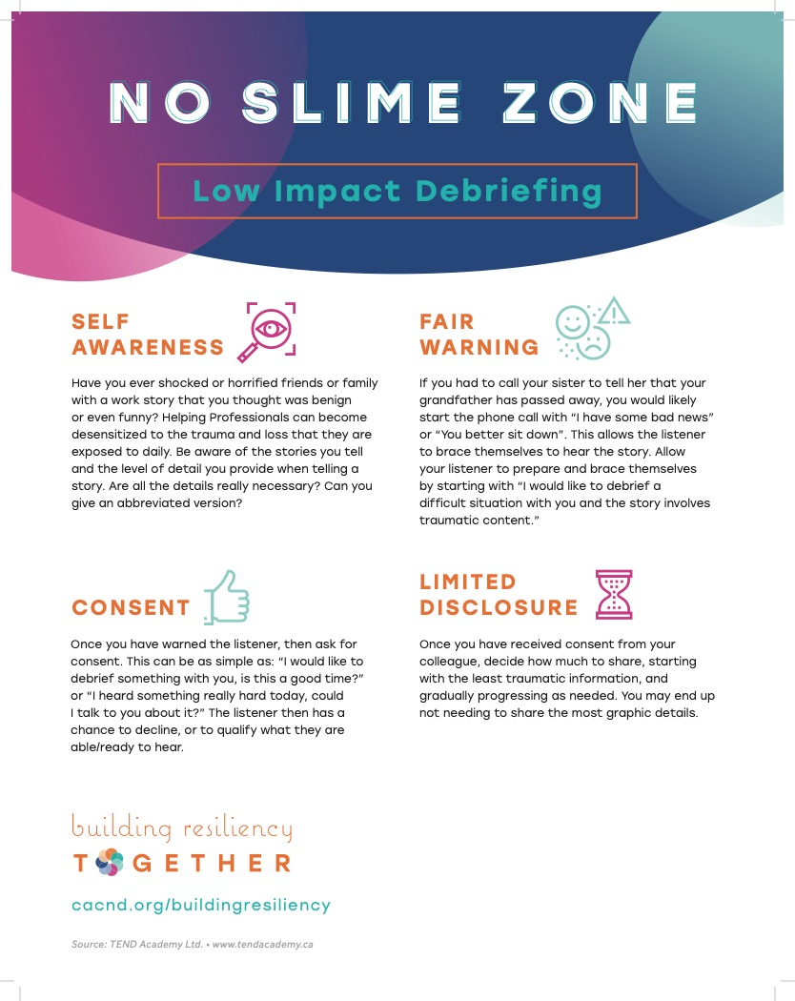
STRATEGIES
© Françoise Mathieu, 2019
Notes:
LOW IMPACT DEBRIEFING
Self Awareness: be aware of the stories you tell and the level of detail you tell them, in. Are all the details necessary? Can you give an abbreviated version.
Give the person fair warning: allow the listener to prepare and brace for impact by saying “ I would like to debrief a difficult situation with you and the story involves some traumatic content.”
Get consent: ask for permission, “Is now a good time to debrief? “Could I talk about something hard that happened today?
Use limited disclosure: decide how much to share and start with the least traumatic information and see if that is sufficient.

Slide 27

Home Life
Relationships are our greatest safety net!
Keep a routine/rituals
Communication and connection
Regular updates
Understand the barriers
Compromise and balance, mutual empathy
Over food and drink
Notes:
Divorce rate is the same as the average, but increase in:
Affairs
Stay in bad relationships
Up at work, down at home – spouse or family want engagement but you feel annoyed, nagged, or not enough = bad
Cyndi Doyle

Slide 28
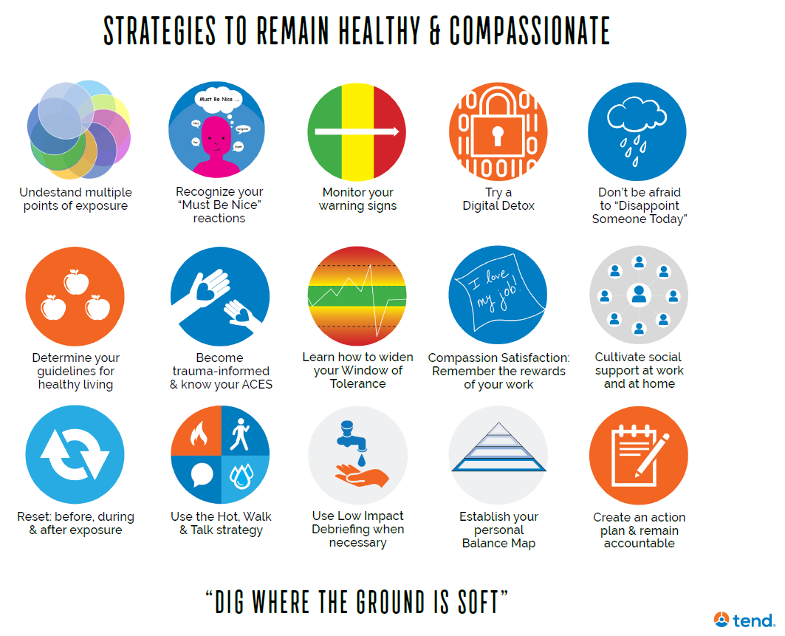
www.cacnd.org/buildingresiliency
Notes:
Posters and website for more

Slide 29

Organizational Considerations

Slide 30
But wait, who’s responsibility is it?
Employee
Organization

Slide 31

What are the benefits?
Resilience and less turnover
Recognition and normalization
Cost Savings
Positivity
Support
Healthy boundaries
Increased individual wellbeing
Community success

Slide 32

Organizational Intervention Planning
What are first steps your organization can take? How can you advocate for change?
Who are the champions/influencers/partners?
Who has passion and agency buy-in?
What are easy ways to start changing culture?
What can I do when I leave here today?
What barriers can I expect?
This Photo by Unknown Author is licensed under CC BY-SA-NC

Slide 33

Acknowledgement
Employee of the week/month
Recognition board
Fun!
Data and updates
Feedback from the community
Online presence
National Journalism Day
Training and feedback from the communities

Slide 34

So, now what?

Slide 35

Last but not least….
Why am I here?
What makes me want to be here?
Gratitude
Motivation
Goal
Symbolism
Reminders
Notes:
Set an office trend, normalize

Slide 36

Why did you sign up for this work?
What do you love about your job?
Whose lives have you touched?
What do you bring to the work?
Remember the rewards of the work
Notes:
Derek
Pick on a few to answer
Pause and write what you get as a reward from this work
Ask for 2 volunteers to share
GIVEAWAYS

Slide 37


Questions?
Melissa Kaiser (701) 321-0689
melkaiconsulting@gmail.com
www.swsecrets.net
www.linkedin.com/in/kaisermel/

Slide 38
References and Resources
Office for Victims of Crime *Search compassion fatigue Home | Office for Victims of Crime (ojp.gov)
Secondary Traumatic Stress | The Administration for Children and Families (hhs.gov)
SHIFT Nursing Home | SHIFT (shiftnursing.com)
Code4Couples www.code4couples.com
The Journey 2 Well theJourney2well.com
Mark DiBona Protecting the Guardian
John Kelley Sometimes Heroes Need Help Book: Surviving Self-Inflicted Wounds
Dakota Children’s Advocacy Center https://www.cacnd.org/building-resiliency/
TEND Academy https://www.tendacademy.ca/
North Dakota Human Trafficking Task Force https://www.ndhttf.org/
Office of Juvenile Justice and Delinquency Prevention/NTTAC Working for Youth Justice and Safety | Office of Juvenile Justice and Delinquency Prevention (ojp.gov)
Administration for Children and Families Secondary Traumatic Stress | The Administration for Children and Families (hhs.gov)

