Slide 1


COVERING RACE
Racial Bias, Reporting, and the Criminal Legal System

Slide 2


(Race) Conscious
Reporting
A holistic approach to reporting wherein a journalist acknowledges, and articulates in their work, the fact that the criminal legal system is inherently biased against people of color and the poor

Slide 3
CRIME REPORTING IS RACIALLY DISCRIMINATORY
It focuses on individual incidents of mostly violent crime, and does not do any critical analysis of the criminal legal system.

Slide 4

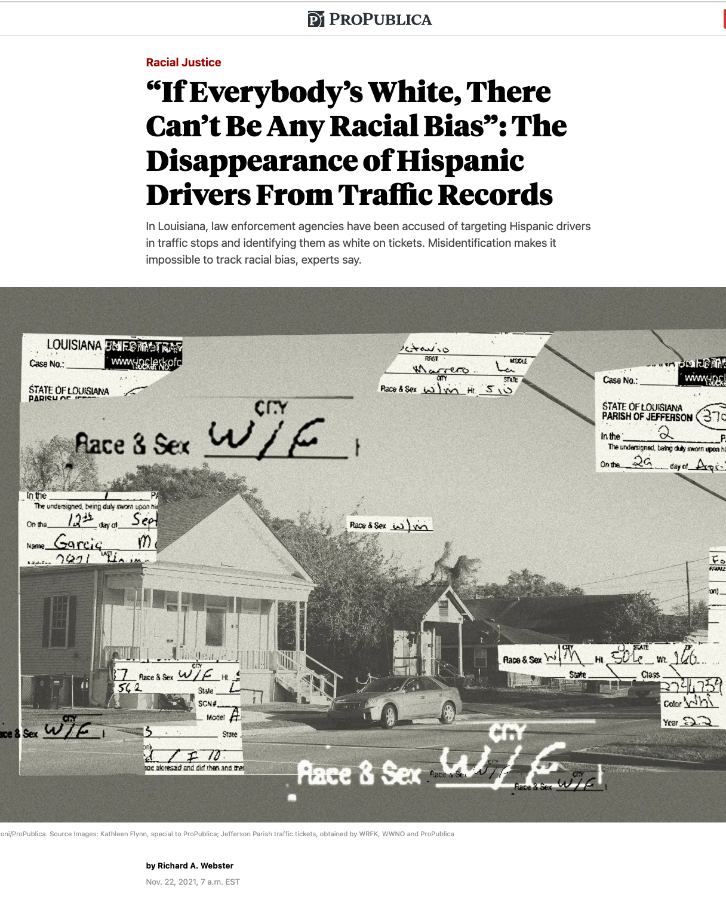


RICHARD A. WEBSTER
Webster was hired to live in New Orleans and cover police misconduct in Jefferson Parish. He immediately connected with the ACLU of Louisiana.

Slide 5
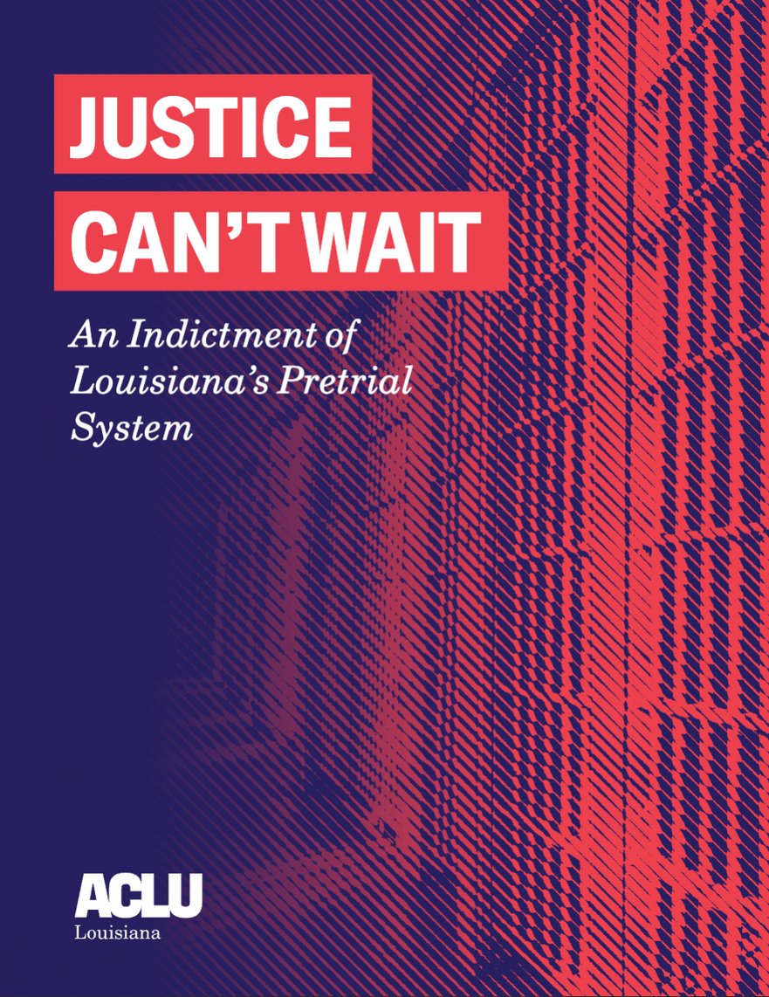
JUSTICE CAN’T WAIT
REPORT
Louisiana has long been the incarceration capitol of the world, home to notorious sprawling state prisons and an extensive network of jails. Although much is known about the state prison population, there has been very little statewide analysis of who Louisiana incarcerates pretrial, people who are considered innocent in the eyes of the law as they await trial.

Slide 6
BLACK BOYS AND MEN AGED 15-24 ARE 5 TIMES MORE LIKELY TO BE JAILED FOLLOWING ARREST THAN WHITE BOYS AND MEN OF THE SAME AGE.

Slide 7
BLACK LOUISIANIANS ARE MORE THAN TWICE AS LIKELY TO BE JAILED FOLLOWING ARREST THAN WHITE LOUISIANIANS
Black Louisianians in our sample speng 36% more time in jail.

Slide 8
EXCESSIVE BAIL IS AT THE ROOT OF PRETRIAL INJUSTICE.
The median bail set for people in jail is $24,000. The median annual income in Louisiana is $27,027.

Slide 9
PEOPLE JAILED PRETRIAL ARE MORE LIKELY TO PLEAD GUILTY, EVEN WHEN THEY ARE INNOCENT JUST SO THEY CAN BE RELEASED.

Slide 10
UNCONSTITUTIONAL POLICING IS A MAJOR CONTRIBUTING FACTOR TO THE INJUSTICE IN THE CRIMINAL LEGAL SYSTEM
Prosecutorial Discretion, Draconian Sentencing, Legal Financial Obligations, and Barriers to Re-Entry are also key contributing factors

Slide 11

JUSTICE LAB:
PUTTING RACIST
POLICING ON TRIAL
This intensive litigation and storytelling effort by the ACLU of Louisiana and partnering law firms challenges racially discriminatory policing practices and combats police violence against people of color.

Slide 12
JUSTICE LAB CASES SHOW THAT BLACK PEOPLE ARE POLICED FOR EVERY DAY ACTIVITIES
These activities include driving home from work, owning a motorcycle, performing their work duties, and looking for a lost dog

Slide 13
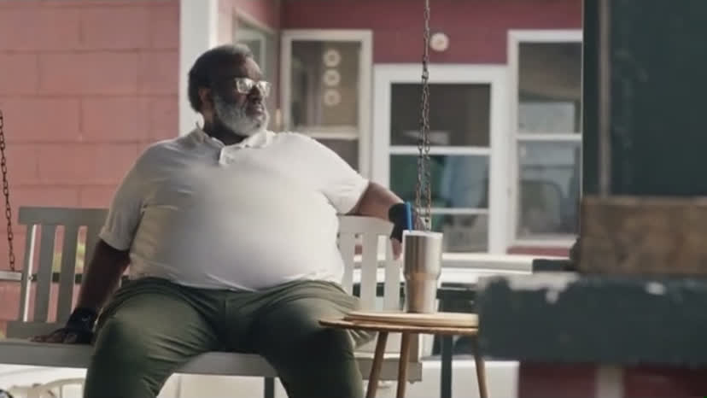

Slide 14
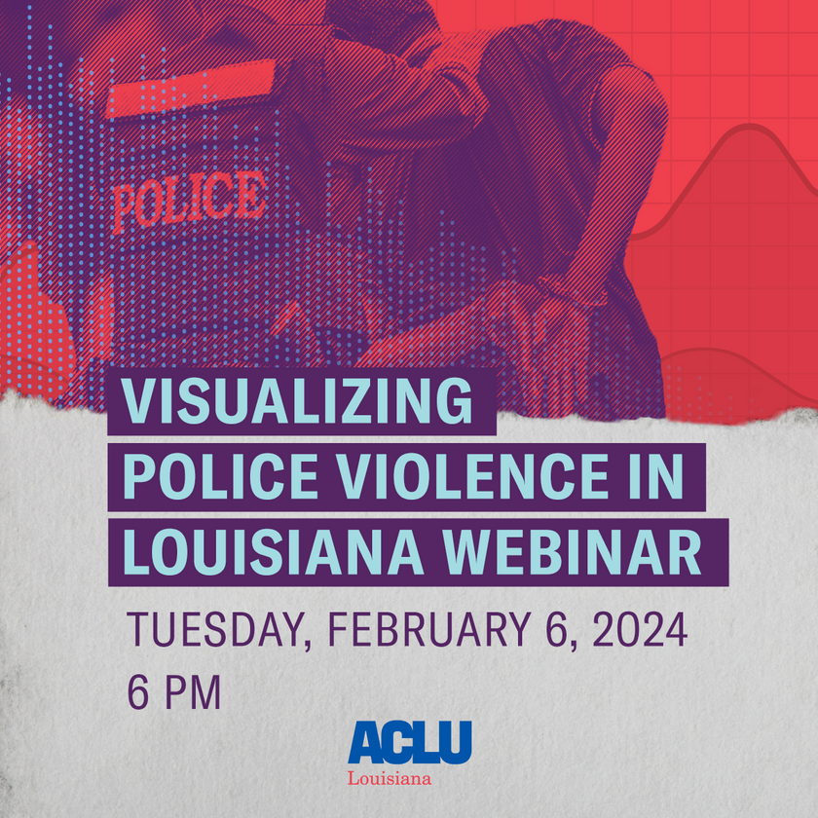
THE IMPORTANCE
OF DATA
Anecdotal evidence is not a complete story. The ACLU of Louisiana’s forthcoming police violence dashboard showcases the need for more data and reporting by police agencies on misconduct.
The dashboard goes live on January 29th: www.aclujusticelab/dashboard

Slide 15


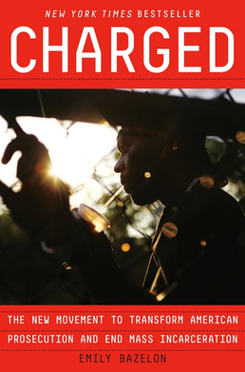
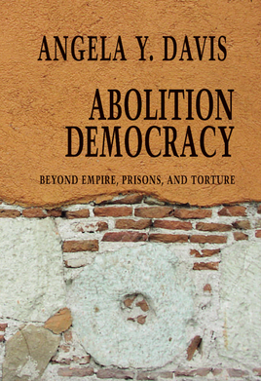

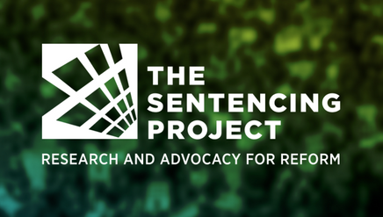

RESOURCE RECOMMENDATIONS FOR RACE-CONSCIOUS REPORTING
Reach out to Your local ACLU and other non-profit organizations to learn more about the issues
Read authors Michelle Alexander, Bryan Stevenson, Emily Bazelon and Angela Davis

Slide 16
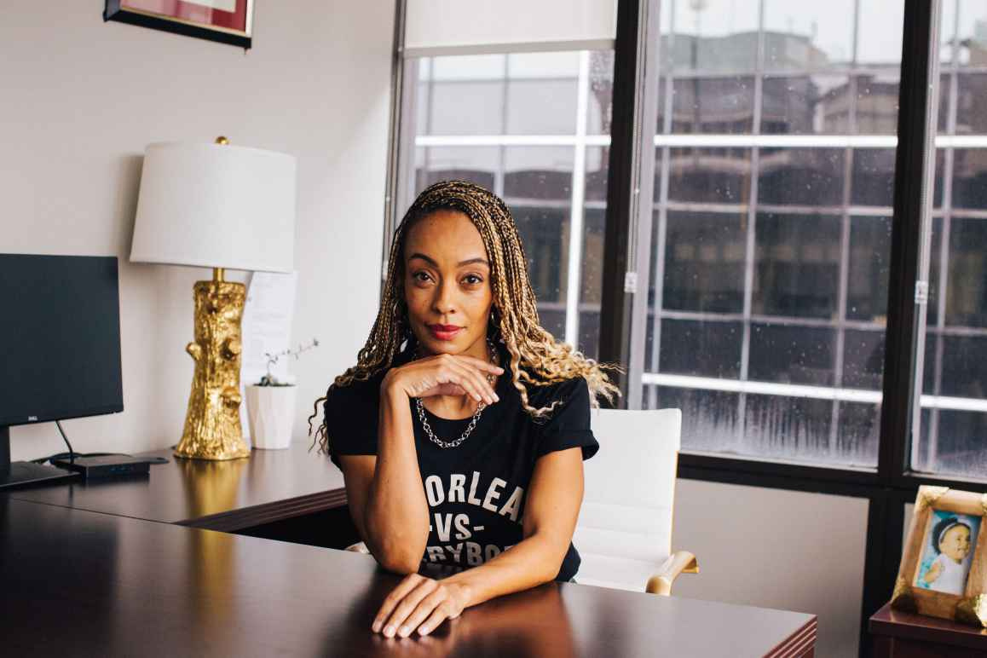



ALANAH ODOMS
Executive Director, ACLU of Louisiana
Media Inbox: media@laaclu.org
in
ACLU of Louisiana

