Slide 1
Covering Gun Violence
Chip Brownlee, The Trace

Slide 2
There are more than 48,000 gun deaths each year

Slide 3
A major barrier to public understanding of gun violence is misinformation

Slide 4
MYTH: Background checks are conducted with all sales
REALITY: Nearly a quarter of guns are sold without a background check
MYTH: Background checks catch all dangerous behavior
REALITY: NICS background checks do not capture all mental health history, violent threats, social media activity, extremism, nor criminal charges that don’t result in convictions
MYTH: Handgun registration is common in the U.S.
REALITY: Just four states and D.C. have registration requirements
MYTH: You have to prove you can shoot a gun to carry it in public
REALITY: Only 16 states require live-fire training for concealed carry permits
Notes:
One of the major barriers to public understanding of gun violence is misinformation. People think our gun laws are stronger than they actually are.
• Slide #1: We don’t have background checks on all sales. This is perhaps the biggest misconception I come across. The 1993 Brady bill, which established federal gun background checks, only requires background checks on guns sold by federally licensed dealers. Only 21 states (and D.C.) have passed additional laws requiring background checks on sales that don’t go through licensed dealers. So if you live in the other 29 states, you can buy a gun from a friend, or someone you meet online, or at a yard sale or a gun show, and there’s no record of it. It's estimated that 22% of gun sales in the U.S. happen with no background check.
• Slide #2: We don’t have handgun registration. I hear this a lot on TV shows and in movies, how people get in trouble for not having registered handguns. That’s a myth. Only California, Hawaii, Oregon, D.C. and New York require guns to be registered with local authorities.
• Slide #3: There’s no mandatory training to carry a gun. Only 18 states require range training to obtain a concealed carry permit. 25 states are permitless, which means they require no permit or training at all.
• Slide #4: Not all convicted felons are banned from having guns. Under federal law, you can still own a gun if you’re convicted of a felony punishable by less than a year of prison time. For misdemeanors, a gun ban only kicks in if your crime is punishable by more than two years of prison time, or if it’s a domestic violence offense.

Slide 5
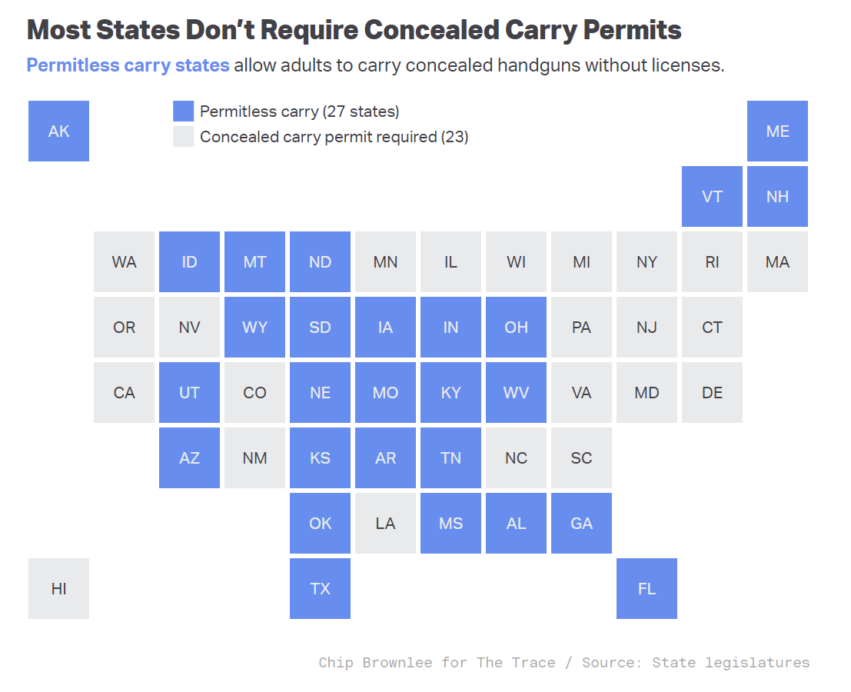


Slide 6
More gun laws people think we have but don’t
Handgun ban for people under 21
Federal law prohibits handgun sales to minors and 18-to-20-year-olds — but only through federally licensed dealers. Private sales are allowed
Digital crime gun tracing
A 1986 federal law bans the digitizing of gun sales records, so agents at the ATF’s gun tracing center must thumb through paper documents by hand
Assault weapon purchasing ban for people under 21
Only 10 states require buyers of semiautomatic rifles to be 21

Slide 7
Another barrier is lack of data

Slide 8
What we don’t know
Exactly how many guns are sold in the U.S. every year
Exactly how many Americans own guns
How many people are wounded by firearms each year
A reliable national incidence of violent crime
All of a gun’s previous owners
But we do have estimates
Notes:
Another barrier to public understanding of gun violence is lack of data. Many of these gaps are intentional, enacted by the NRA’s surrogates in Congress. Here’s what we don’t know:
• Slide #1: How many guns are sold in the U.S. every year: That’s because they’re not required to be registered. Other countries have these figures, but we don’t. We have estimates based on monthly background check figures from the FBI, but they’re not exact.
• Slide #2: How many guns Americans own: For the same reasons, we don’t know how many guns are currently in civilian hands. The closest estimate we have is the Small Arms Survey, a Swiss group that only releases estimates every few years. The last report, from 4 years ago, pegs U.S. guns at 393 million. The gun industry pegs the figure at 423 million, but they’re a biased source.
• Slide #3: How many people are wounded each year by guns: While we have CDC gun death figures, which are derived from death certificates, we don’t have reliable numbers on the hundreds of thousands of people wounded by guns every year. But that’s changing, as my co-panelists will probably tell you.
• Slide #4: National incidence of violent crime: Only 62% of the nation’s city, county, state, tribal, college, university, and federal law enforcement agencies reported crime data to the FBI in 2021. Reporting crime to the federal government is voluntary, so that’s a stat we may never know.
• Slide #5: All of a gun’s previous owners: Because we don’t have mandatory gun registration, we don’t always know where a gun goes once it’s resold. If it’s transferred through a federally licensed dealer, it will have a background check. But if it’s sold to a friend or someone at a yard sale, it probably won’t. That is a big hindrance during crime gun tracing, when authorities are trying to figure out who bought a gun used in a shooting.

Slide 9
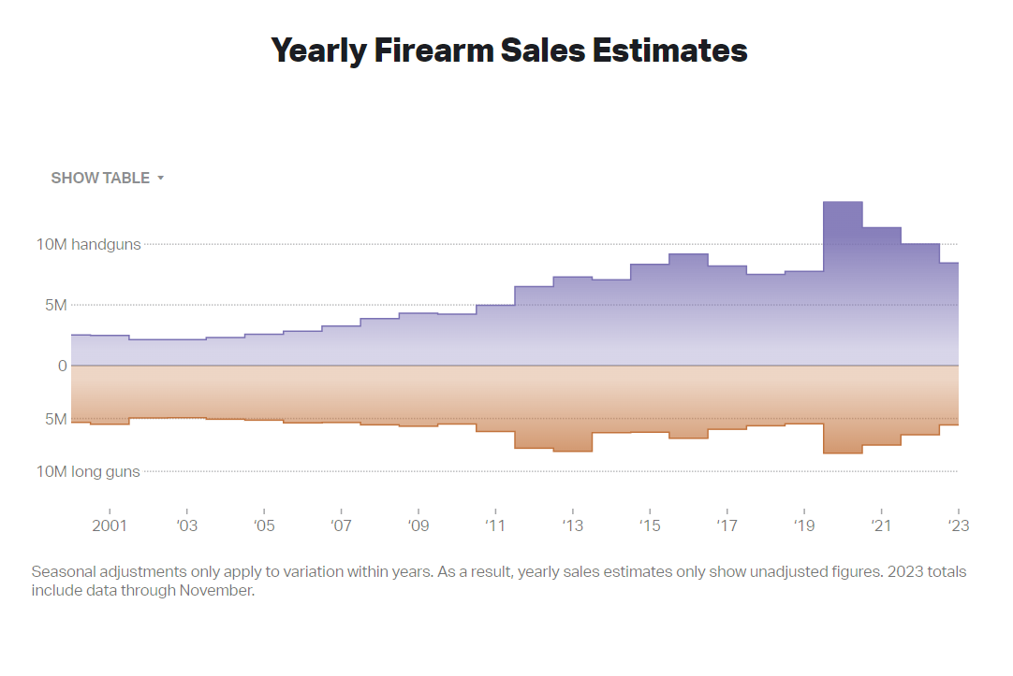


Slide 10
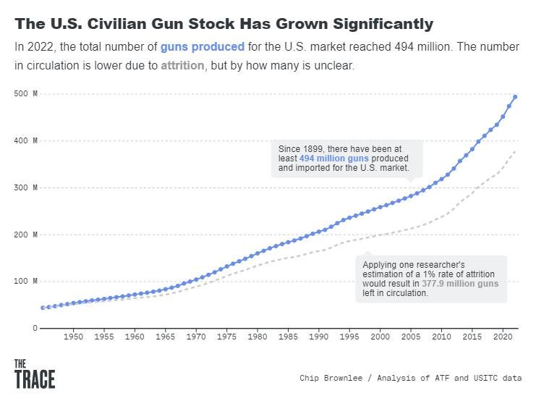


Slide 11
So, what do we know?

Slide 12
Most Americans don’t own guns

Slide 13
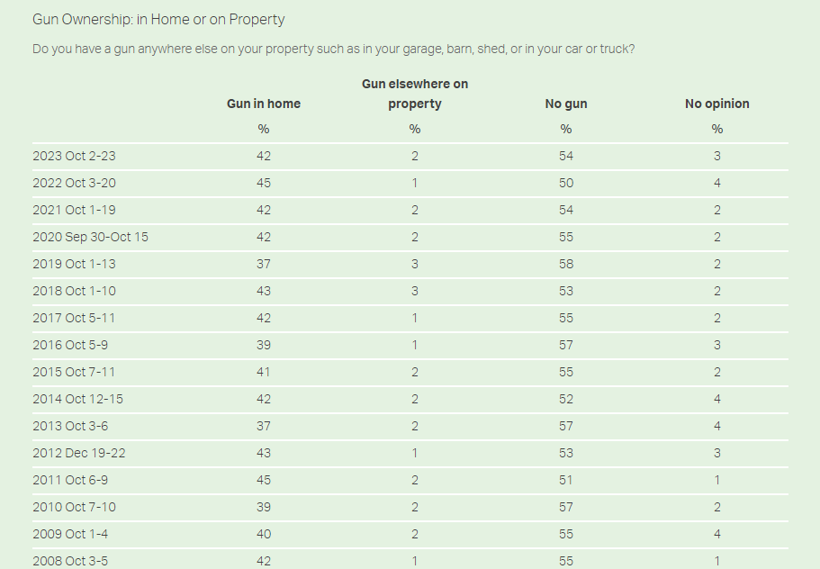
Gallup
Notes:
54% of Americans say they don’t own a gun, according to Gallup polling, which is more or less the same as it was 10 years ago. So a vocal minority has an outsize influence on gun policy in the U.S., which is a public safety issue.

Slide 14
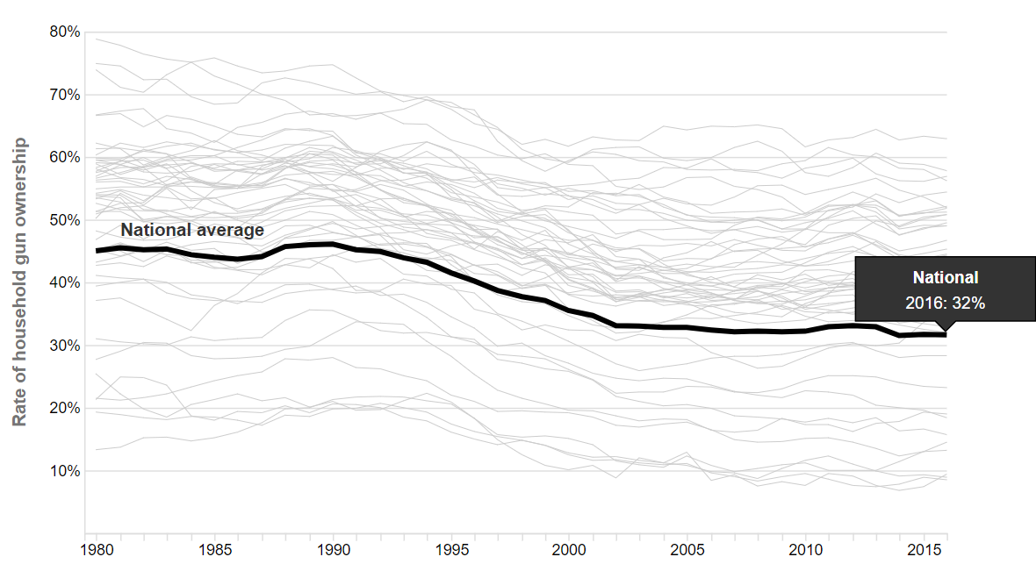
RAND

Slide 15
The vast majority of shootings in America are not mass shootings*
* Includes incidents in which four or more people, not including the suspect, are shot

Slide 16
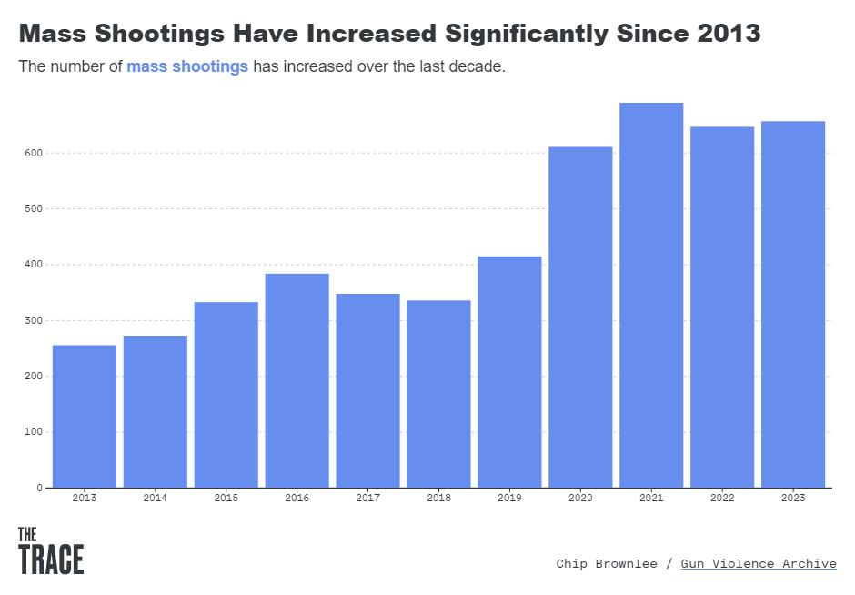


Slide 17

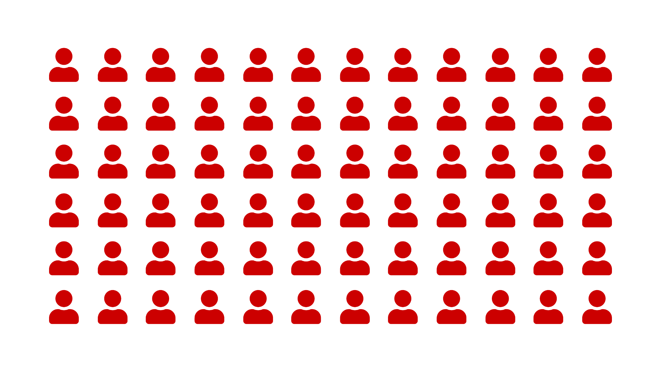
In 2023, 712 people were killed and 2,692 people were injured in mass shootings = 10 people killed
Notes:
In 2023, 712 people were killed in more than 650 mass shootings, defined as 4 or more people shot in a single incident, not including the perpetrator.

Slide 18
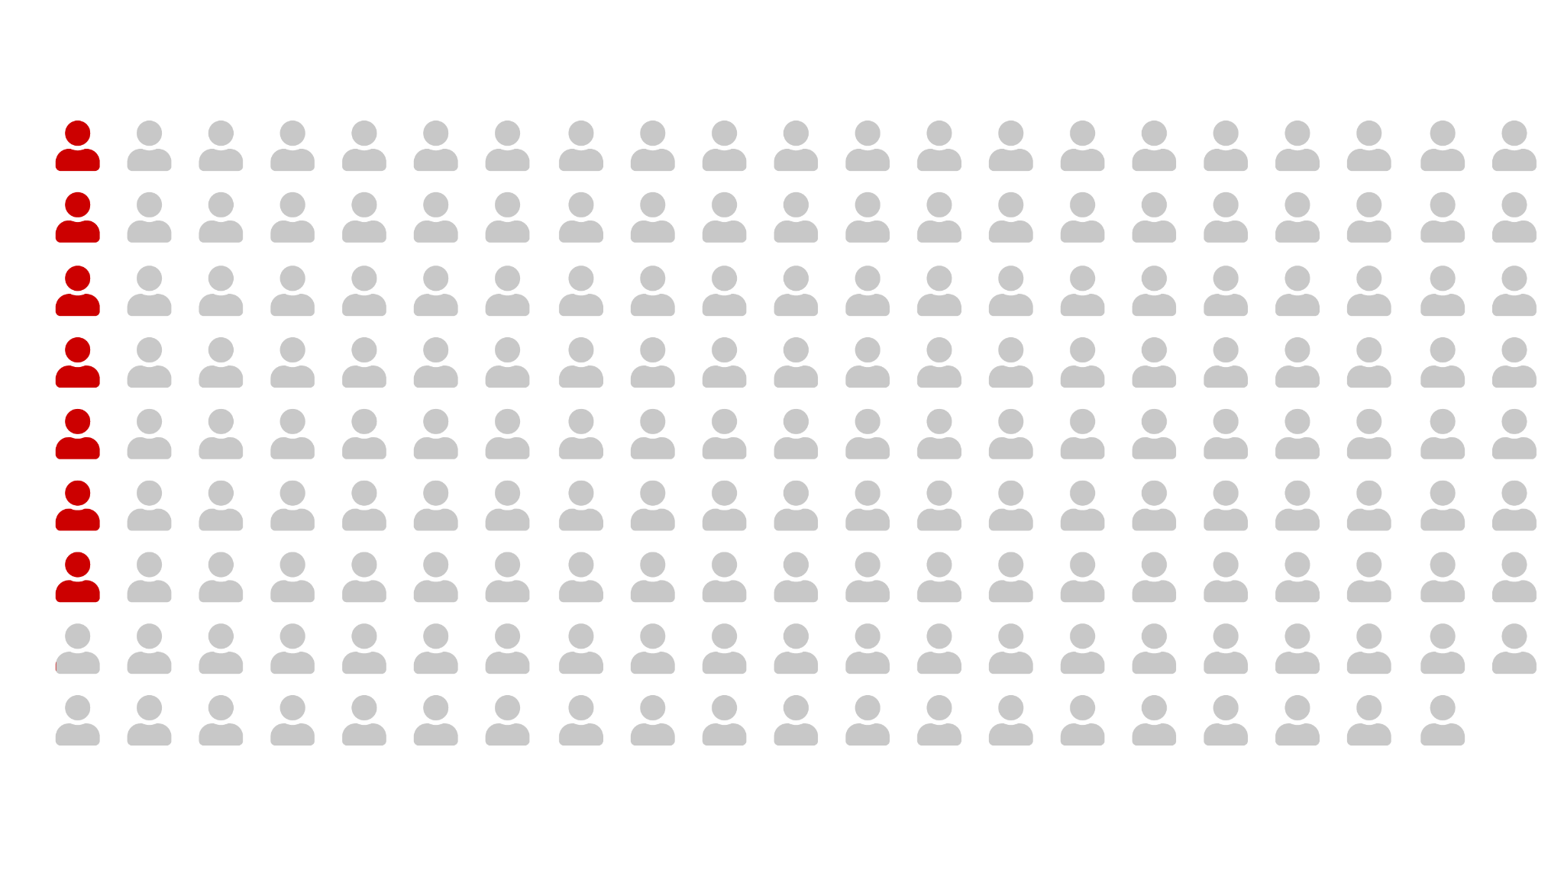
That accounts for 3.7 percent of the more than 18,800 gun homicides in the U.S. last year = 100
Notes:
That accounts for only 3.7% of the more than 18,800 gun homicides in 2023.

Slide 19
There were 48,830 gun deaths in 2021

Slide 20
The vast majority of these gun deaths were suicides

Slide 21
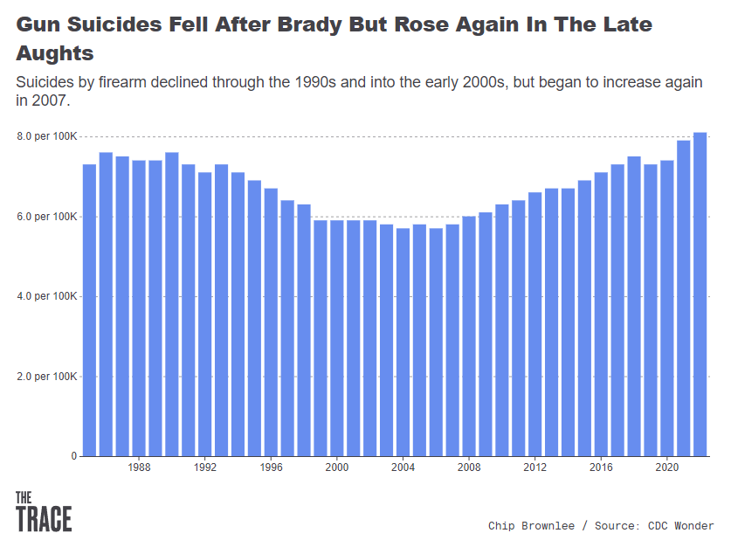


Slide 22
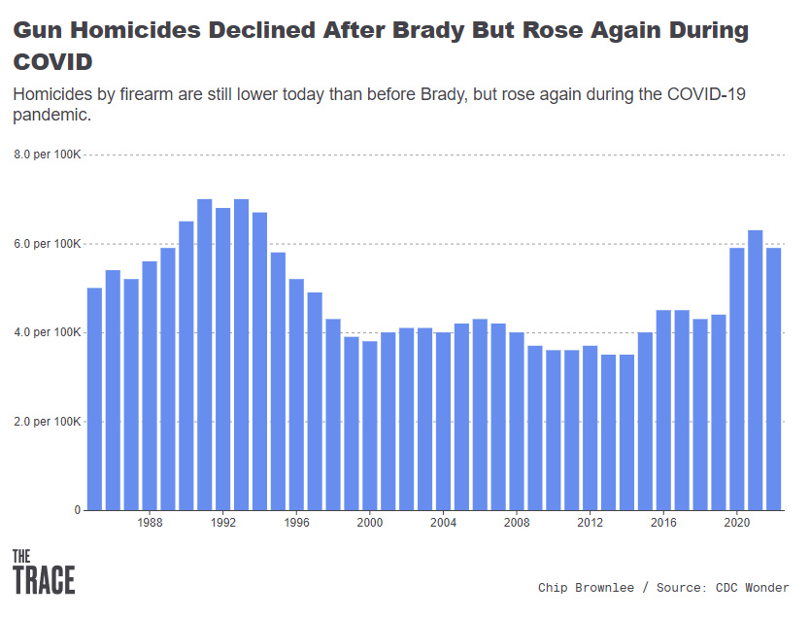

Slide 23
Gun homicides
don’t just happen in big cities

Slide 24
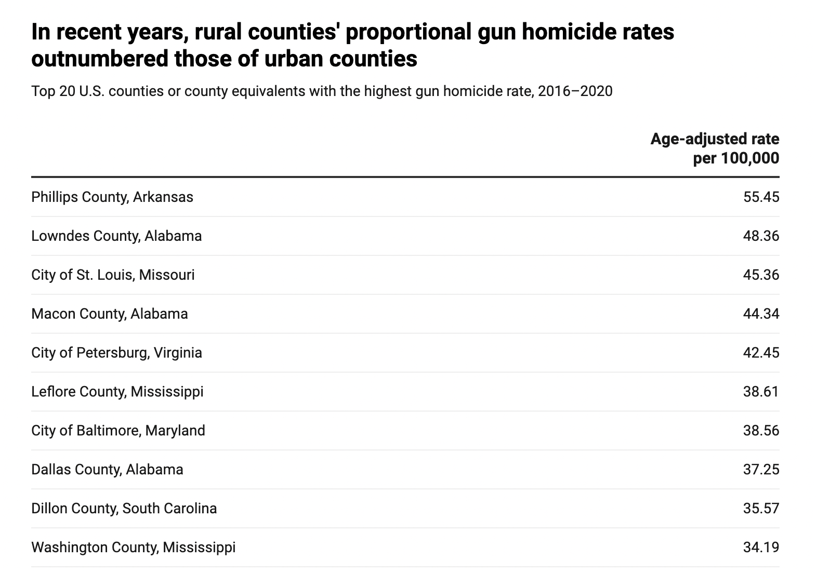
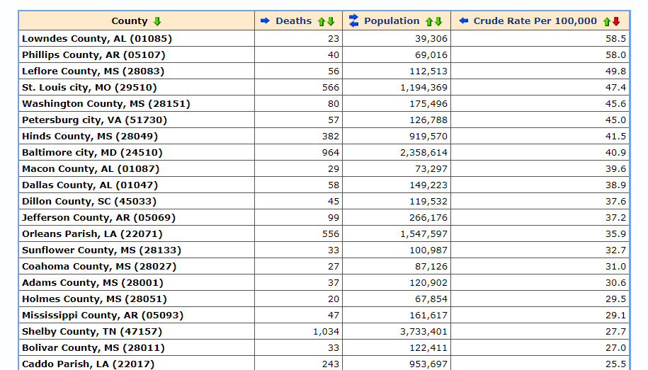
CDC
Notes:
The headlines we see are “shootings in Chicago, Philadelphia, and Los Angeles,” but according to data released last month by Center for American Progress, rural counties took 13 of the top 20 spots on the list of highest per capita gun homicides between 2016 and 2020. Cook County, where Chicago is located, ranked 79th in firearm homicide rates; Philadelphia County ranked 38th; and L.A. County ranked 316th.

Slide 25
100 to 300 people are shot each day and survive
Notes:
Firearm injuries likely outweigh gun deaths three-to-one. These numbers aren’t exact because non-fatal shooting data isn’t great, and it depends on whether you include self-inflicted injuries.

Slide 26
Firearms are the leading cause of death for children and teens, as is gun homicide for Black men ages 0 to 44
Notes:
In 2020, for the first time ever, gunshot wounds overtook car crashes as the number one cause of death for children in America aged 1 to 19. But for Black children, specifically, gun violence has been the leading cause of death since 2006. Black Americans are 10 times more likely than White Americans to die from gun homicide.

Slide 27
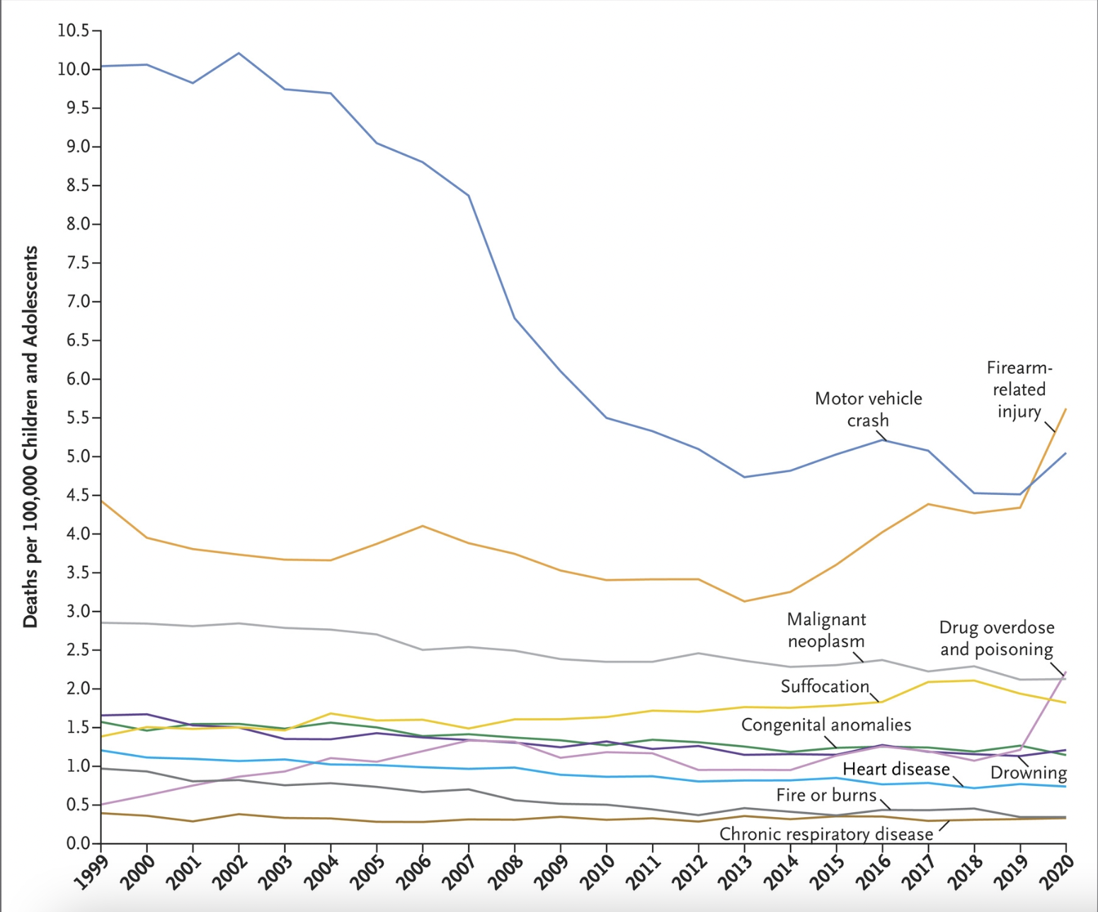

Notes:
And the rate is accelerating: From 2019 to 2020, gun deaths among children and adolescents rose 30% — more than twice as high as the relative increase in the general population.

Slide 28
What else we know
80 percent of homicides in the U.S. are perpetrated with guns
Almost every shooting involves a handgun. Very few involve long guns like semiautomatic rifles or shotguns
Neighborhoods that have suffered disinvestment, racism, and marginalization experience a disproportionate share of gun violence
Children are far more likely to be shot at home in a domestic incident than at school
Gun death rates tend to be highest in states with loose gun laws
Notes:
Here’s what else we know:
• 80% of homicides in America are perpetrated with guns: More than ever before. When we first launched in 2015, it was 73%. Homicide in America is largely a gun problem.
• It also disproportionately affects people of color: Homicide is the leading cause of death for Black men aged 0-40.
• Almost every shooting involves a handgun. A fractional percentage involve semiautomatic rifles. AR-15s rifles get a lot of attention, though, because they've been used in some of the deadliest mass shootings on record.
• Most shootings are the result of neighborhood disputes and interpersonal disputes.
• Children are far more likely to be shot in a domestic incident than at school. That's according to a story we're about to publish, so I can't share the data yet.
• Gun death rates are highest in states with loose gun laws. … NEXT SLIDE

Slide 29


Slide 30
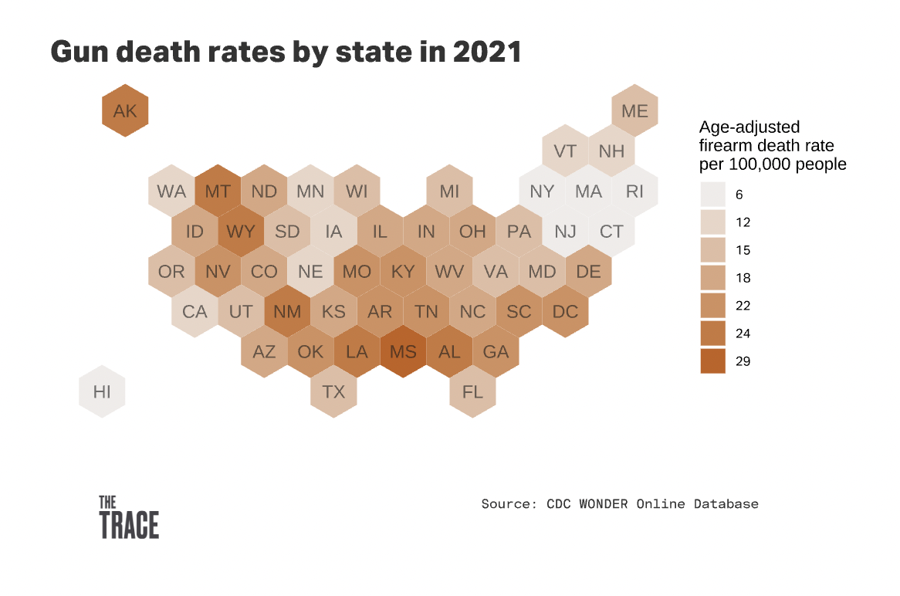
Notes:
When you look at this chart of gun death rates by state, the regional variations are apparent. The same states that have loose gun laws tend to have the highest rates of gun death. That includes the gulf states, the southeast, and the mountain west.

Slide 31
Gun violence appears to be falling from pandemic highs

Slide 32
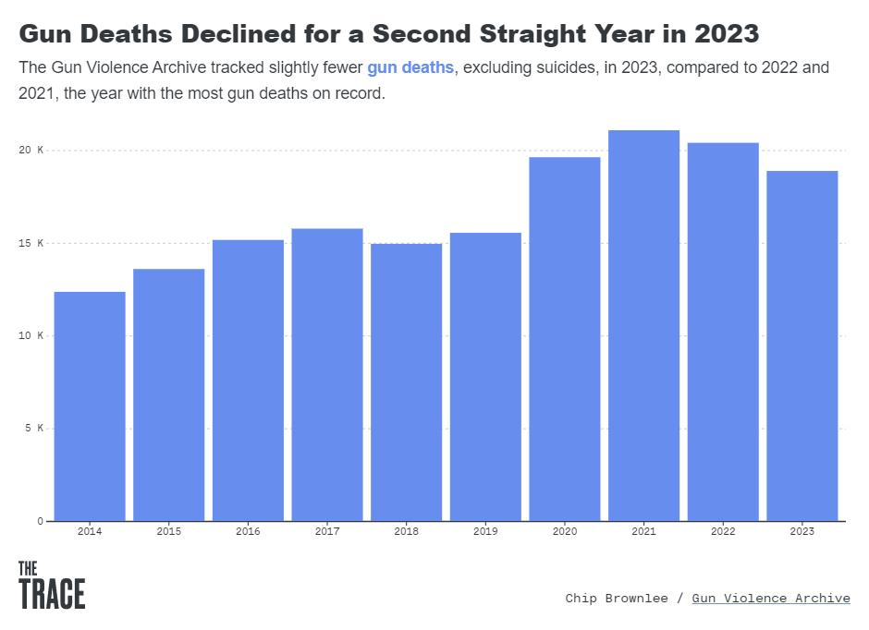

Slide 33
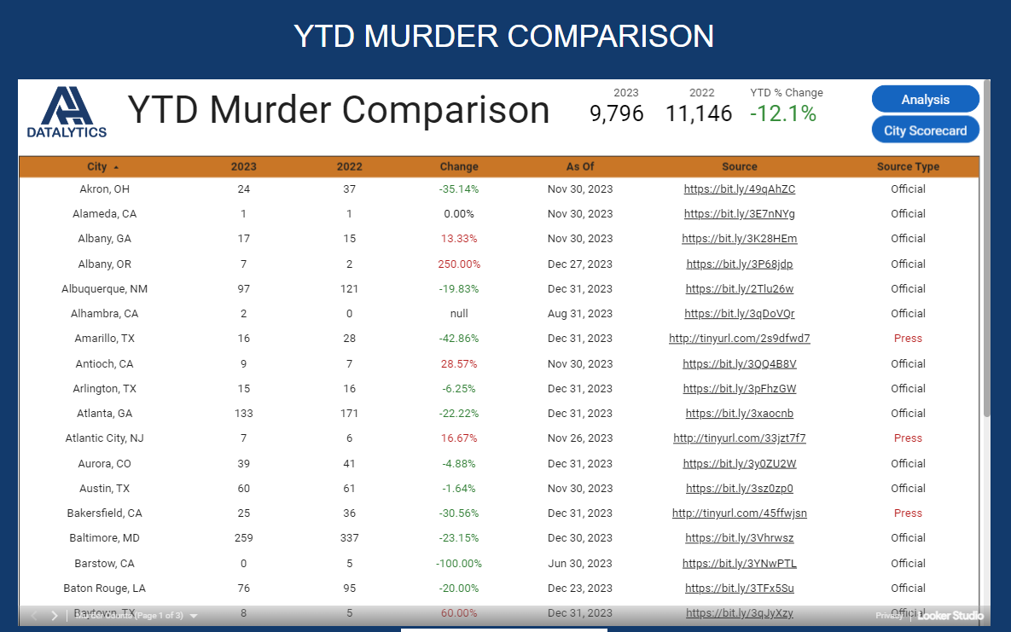


Slide 34




How can we do better?
Notes:
Because there’s so much misinformation out there, it’s up to the media to correct the record. But this is a nuanced issue, and it’s easy to simplify and generalize. Here are some common misconceptions.

Slide 35
Consider letting survivors tell their own stories, in their own words

Slide 36



Slide 37


Slide 38
There are community-driven solutions that don’t rely solely on police

Slide 39
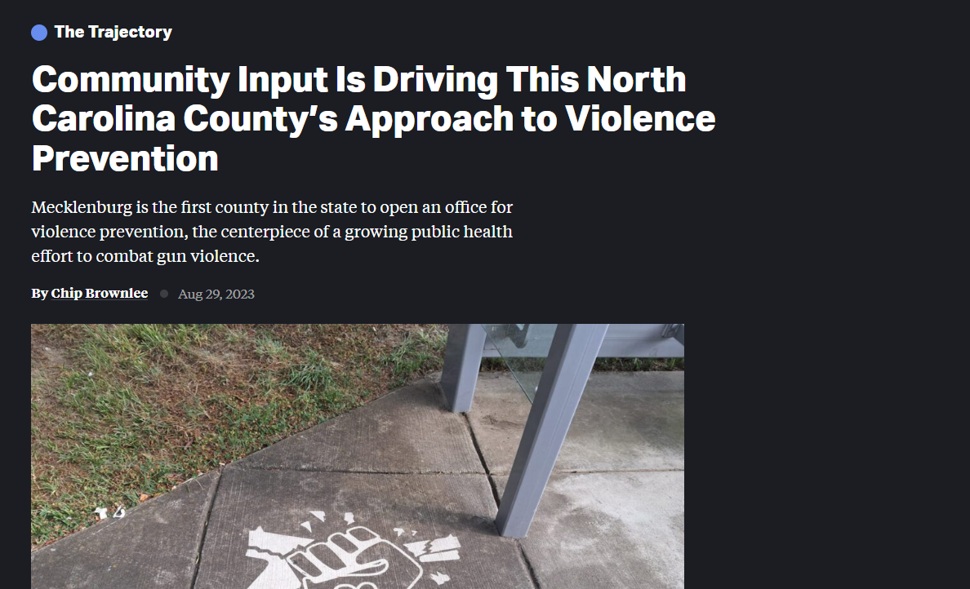
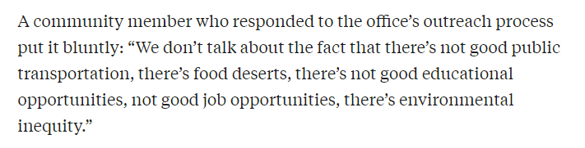

Slide 40

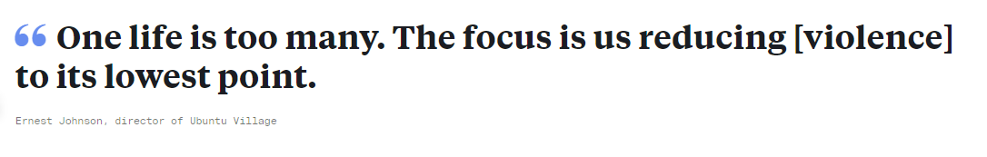

Slide 41



Slide 42


Slide 43
But community-driven solutions are often underfunded and overextended

Slide 44

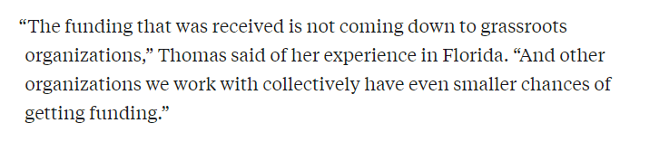

Slide 45
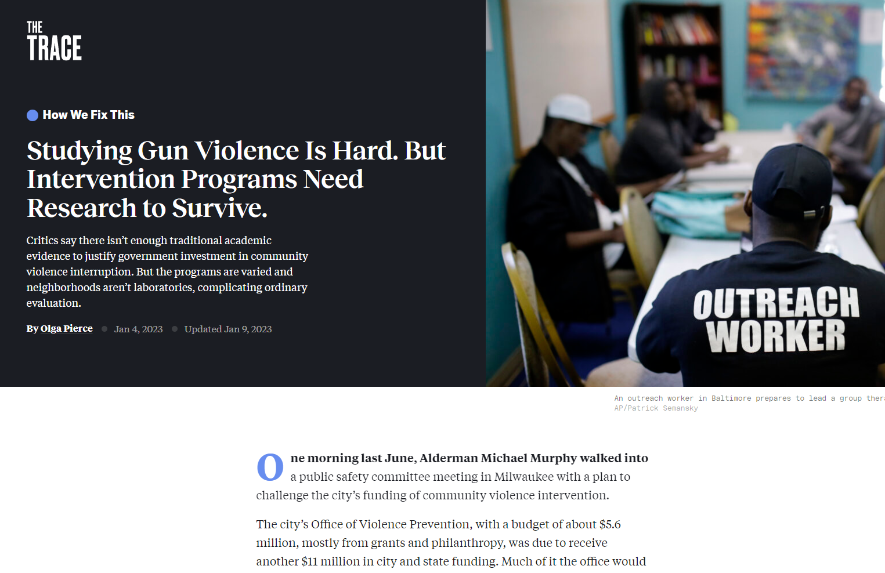

Slide 46

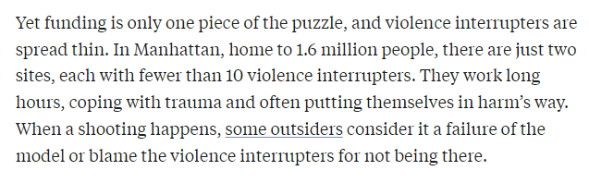

Slide 47
Victim and perpetrator is a false binary

Slide 48
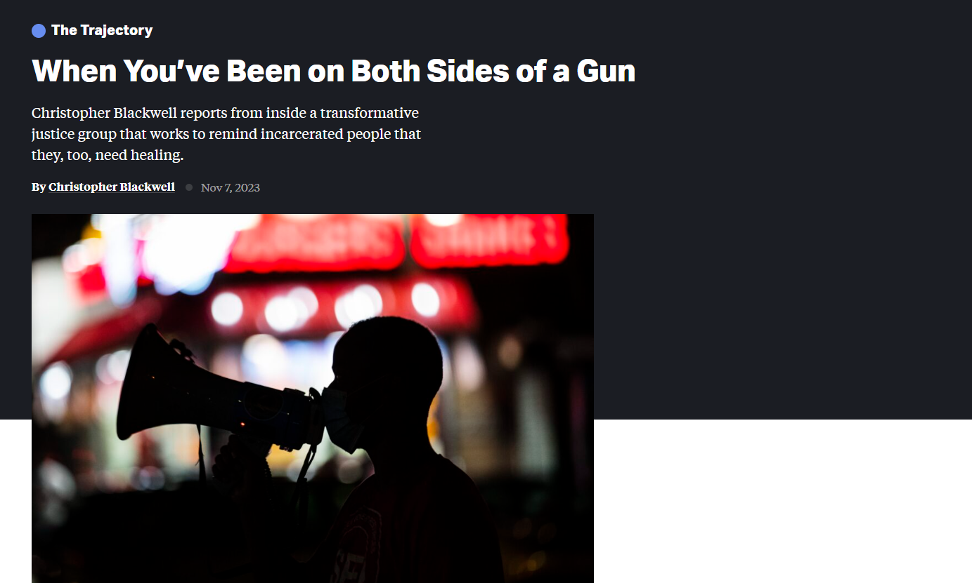
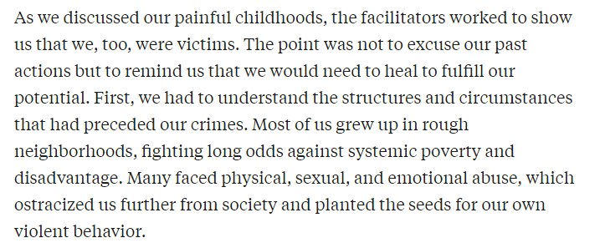

Slide 49
Not all “solutions” are effective

Slide 50
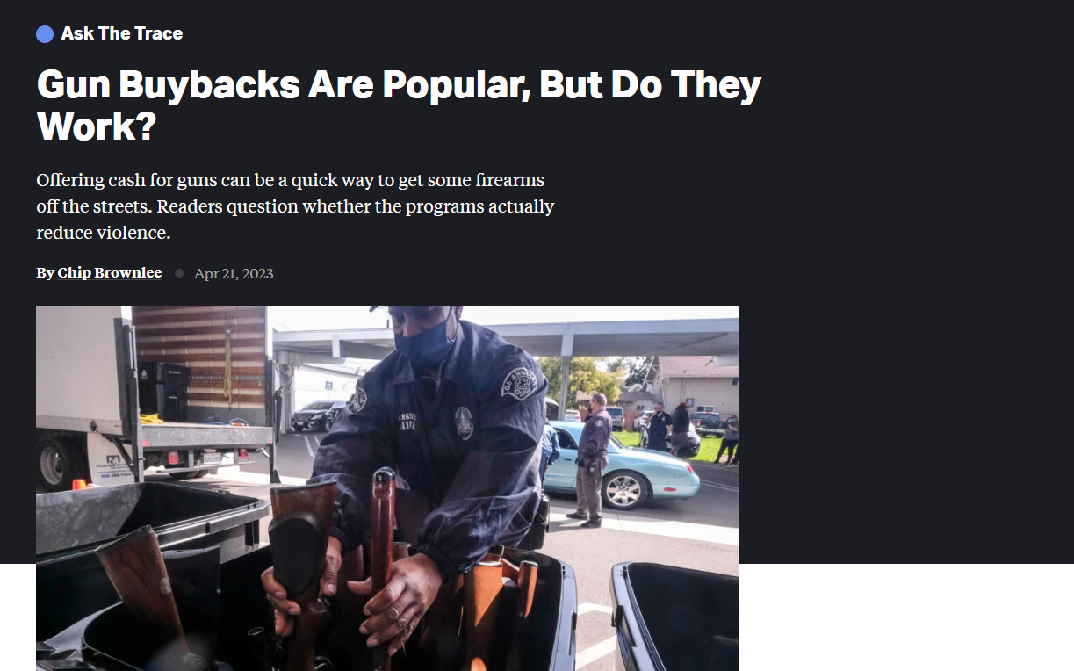
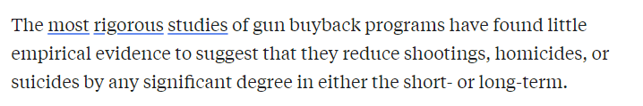

Slide 51

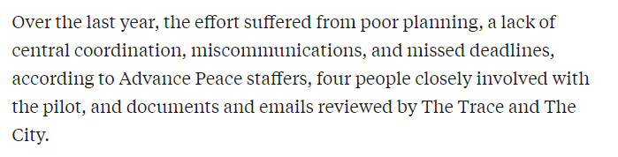

Slide 52
Where can we get good data?

Slide 53
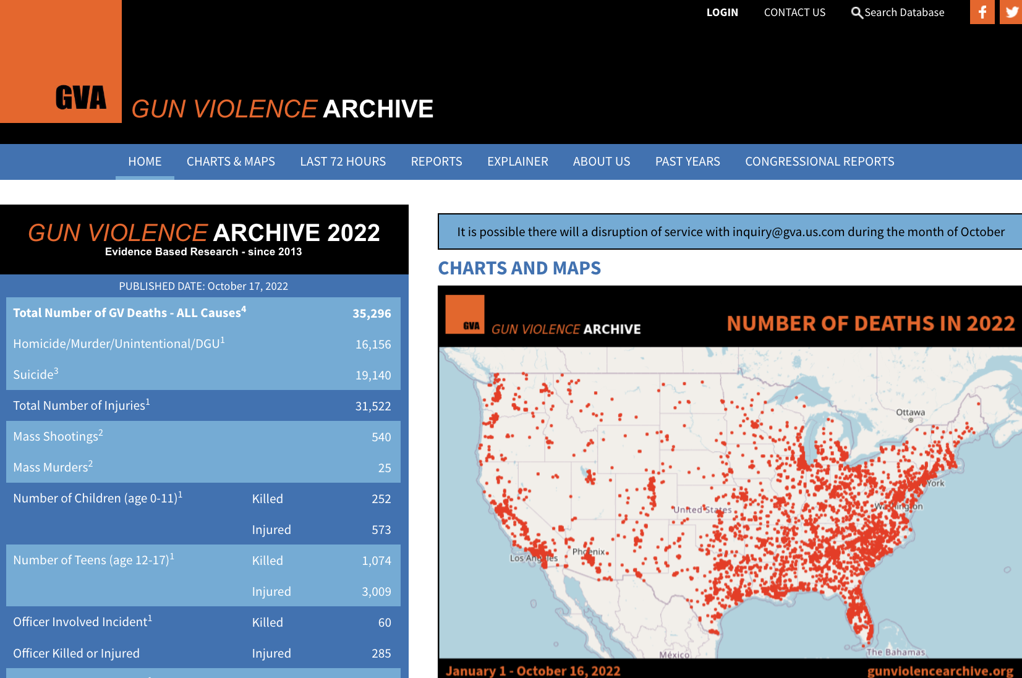
Gun Violence Archive
gunviolencearchive.org
Notes:
Gun Violence Archive is a nonpartisan, nonprofit outfit that tracks shootings in near-real time from hundreds of news and law enforcement sources.

Slide 54
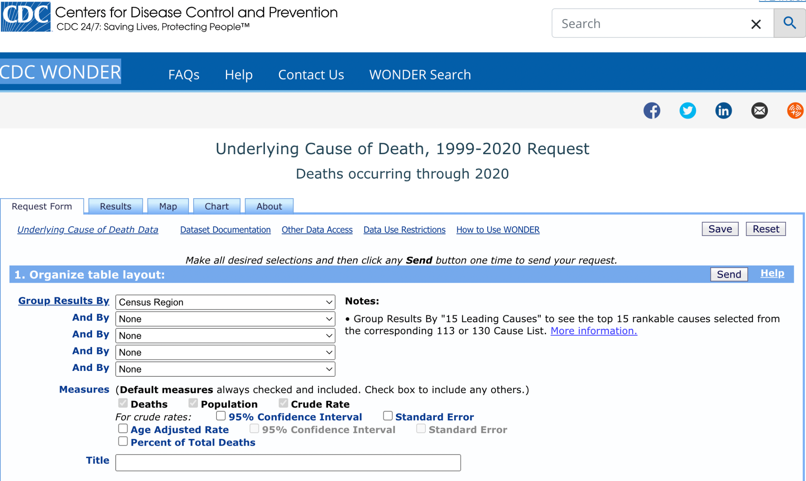
CDC WONDER
wonder.cdc.gov
Notes:
For that you can turn to the CDC, which collects data on gun deaths, sourced from death certificates. You can break down data by region, state, age, year, gender, race, day of the week, intent (homicide, suicide, accidental).

Slide 55
Other sources of data
CDC WISQARS: wisqars.cdc.gov
AHDatalytics: ahdatalytics.com
Your state Department of Public Health
American Violence: americanviolence.org
The Trace’s gun sales tracker: thetrace.org/gun-sales-estimates
RAND Corporation: rand.org/research/gun-policy.html

Slide 56
Questions?
cbrownlee@thetrace.org

