Slide 1

National Press Foundation’s
Future of the American Child
Janet Singerman
Child Care Resources Inc.
January 24, 2024

Slide 2

Child Care Resources Inc.
works with families and
communities to ensure that
all children have access to
high-quality, affordable
early learning and school-age opportunities and experiences that enable
them to succeed
in school and in life.

Slide 3









CHILD CARE RESOURCE & REFERRAL
A set of services delivered by a community-based agency designed to make the early care and education and school-age child care systems work better.
Core Customers
Core Functions
  Consumer education
  Subsidy administration
  Early learning quality advancement
  Data collection, analysis, reporting
  Community education/planning
  Advocacy
  Special initiatives
  Parents
  Early childhood professionals
  Employers
  Government
  Funders
  Community collaborators

Slide 4
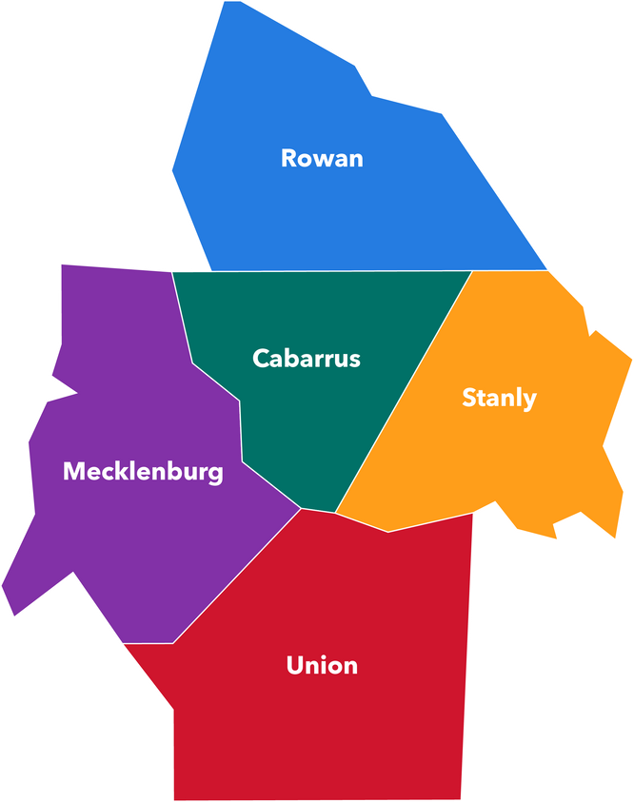
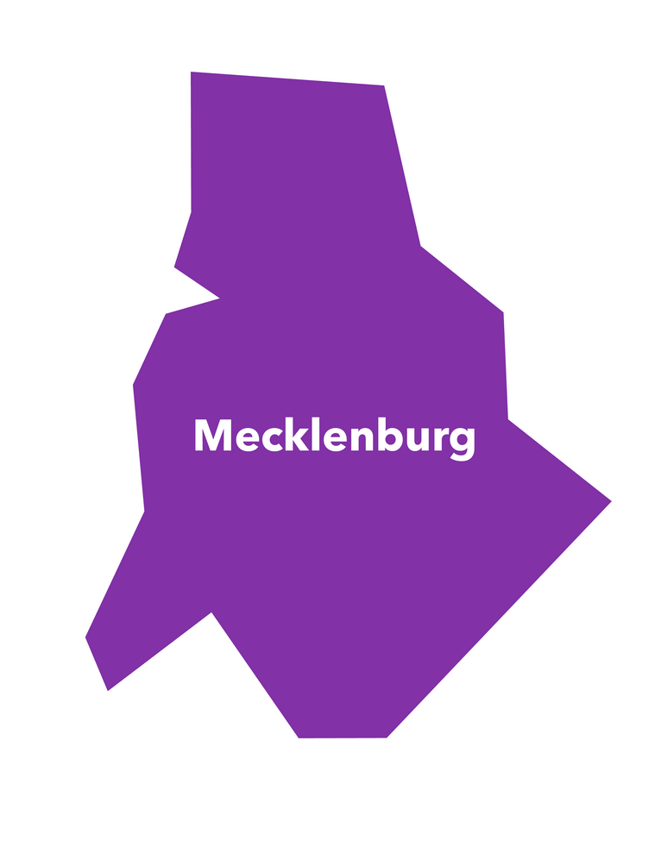

CCRI’S FOOTPRINT
Local
Statewide
Regional
Budgeted staff: 112 | Operating budget: $19M+ (excluding subsidy funds)

Slide 5
DEMOGRAPHIC DASHBOARD

Slide 6
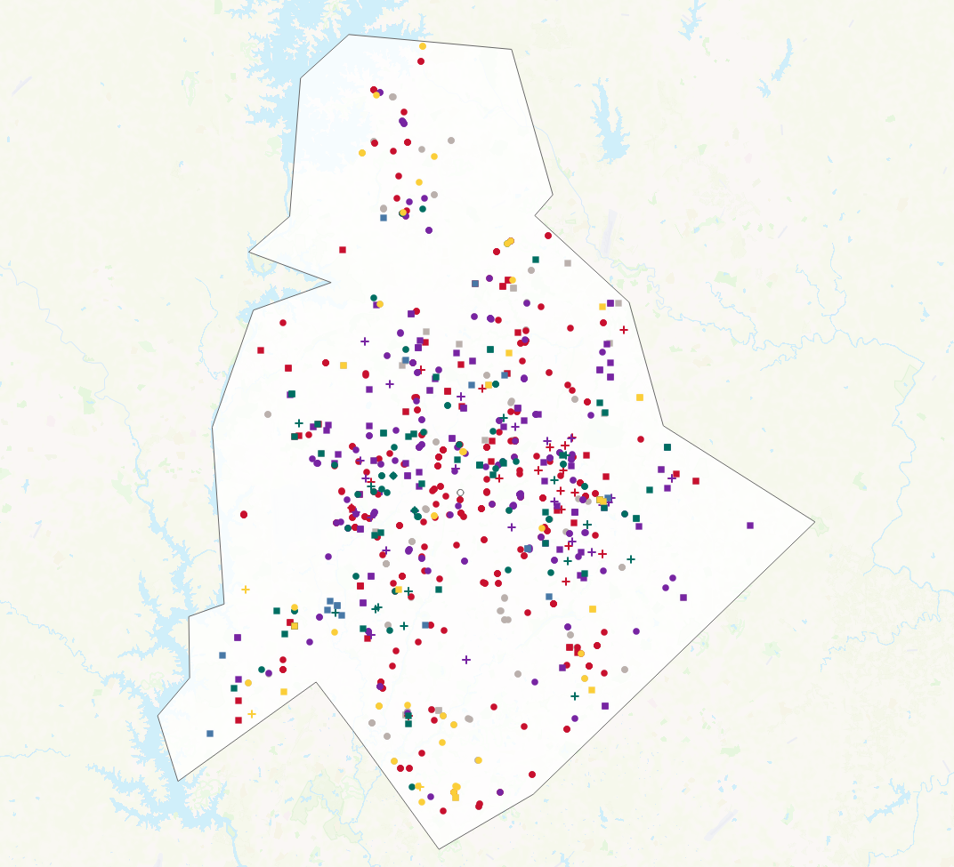
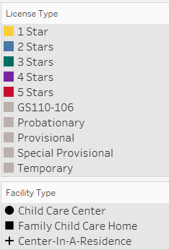
CHILD CARE IN MECKLENBURG COUNTY
Centers = 433
FCCHs = 112
Spaces = 49,703

Slide 7
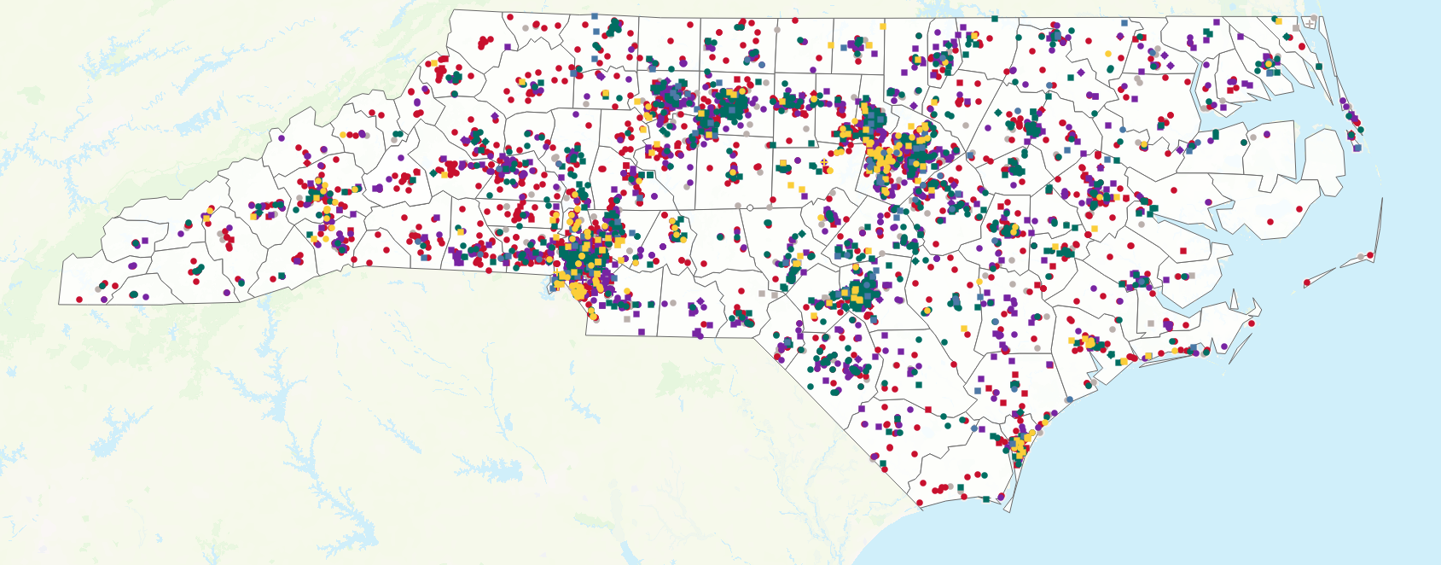
CHILD CARE IN NORTH CAROLINA
Centers = 4,250
FCCHs = 1,172
Spaces = 371,077

Slide 8
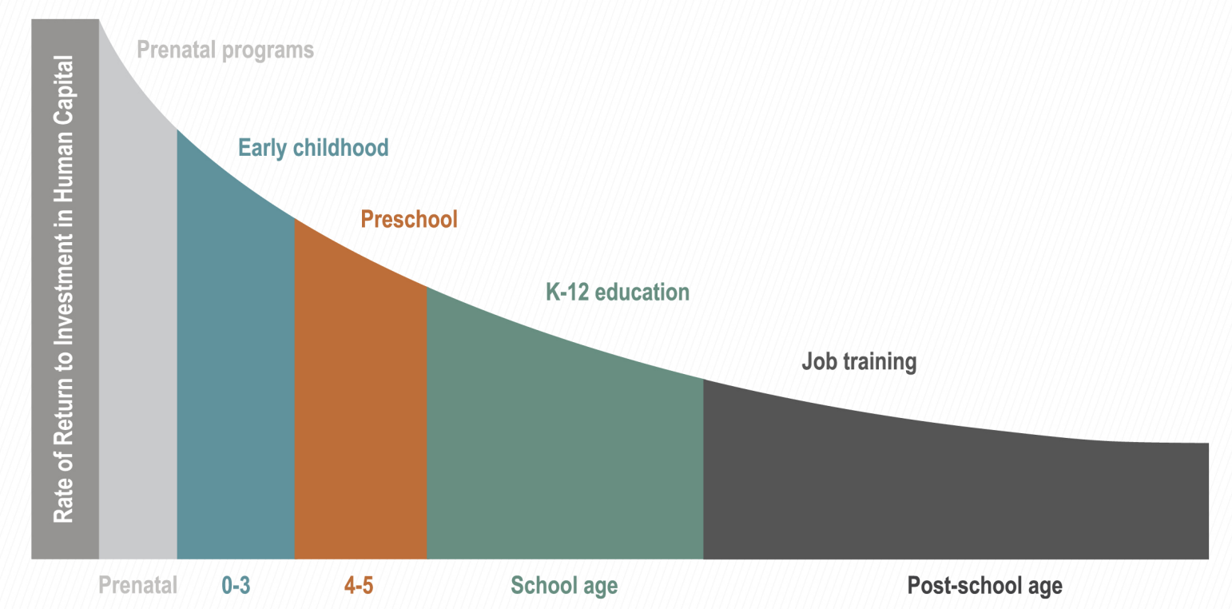
A SMART INVESTMENT
Nobel Laureate Economist James Heckman’s research makes the economic case for early childhood investments starting before birth.
https://heckmanequation.org/the-heckman-equation/

Slide 9
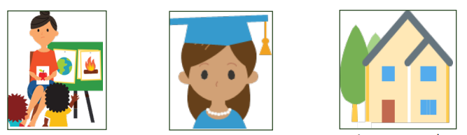
MECKLENBURG CO. COST COMPARISON
Center-based
infant care
Mecklenburg: $15,825
NC: $12,263
Public four-year university tuition
$7,214 per year
Average annual mortgage payments
$19,428
*NC CCR&R Council December 2023

Slide 10
AVERAGE CHILD CARE FEE AS % OF MEDIAN HOUSEHOLD INCOME

Slide 11
WHO PAYS FOR CHILD CARE IN NC?
State and Federal Subsidy
32%
Parent
Fees
68%

Slide 12
DRIVING THE SHORTFALL

Slide 13
HOW IS NC INVESTING?

Slide 14
FEDERAL PANDEMIC CHILD CARE FUNDING IN NC
  CARES Funding: $118,135,976
  CRRSA Funding: $335,912,393
  ARPA Funding: $1,308,545,248 (72.24% of total)
    ARPA from CCDF: $502,777,789
    ARPA from Stabilization: $805,767,459.00
  TOTAL: $1,762,593,617 ($170.02 per capita)

Slide 15
NC & MECKLENBURG STABILIZATION GRANTS
NC Total Stabilization Grant Payments: $965,154,891
  Early Care and Learning Programs: 4,492
  Centers: $906,711,211/ 3,275
  Family Child Care Homes: $58,391,572/1,217
  Staff Impacted: 45,730
  Total Spaces Impacted: 396,626
Mecklenburg County Total Stabilization Grant Payments: $122,399,344
  Early Care and Learning Programs:
  Centers: $116,731,072
  Family Child Care Homes: $5,668,262
  Staff Impacted: 5,608
  Total Spaces Impacted: 53,332
NC DCDEE website

Slide 16
CURRENT SUPPLY COMPARED TO PRE-PANDEMIC
(Excludes School-age Only Programs)
 | Feb 2020 | Dec 2023 | Number Change | Percent Change
NC Programs | 5,242 | 5,039 | -203 (-5 Centers, -198 FCCH) | -4%
NC Enrollment | 215,050 | 203,580 | -11,470 | -5%
Mecklenburg County Programs | 474 | 466 | -8 (+11 Centers, -19 FCCH) | -2%
Mecklenburg County Enrollment | 29,583 | 22,734 | -3,862 | -13%
NC CCR&R Council December 2023

Slide 17
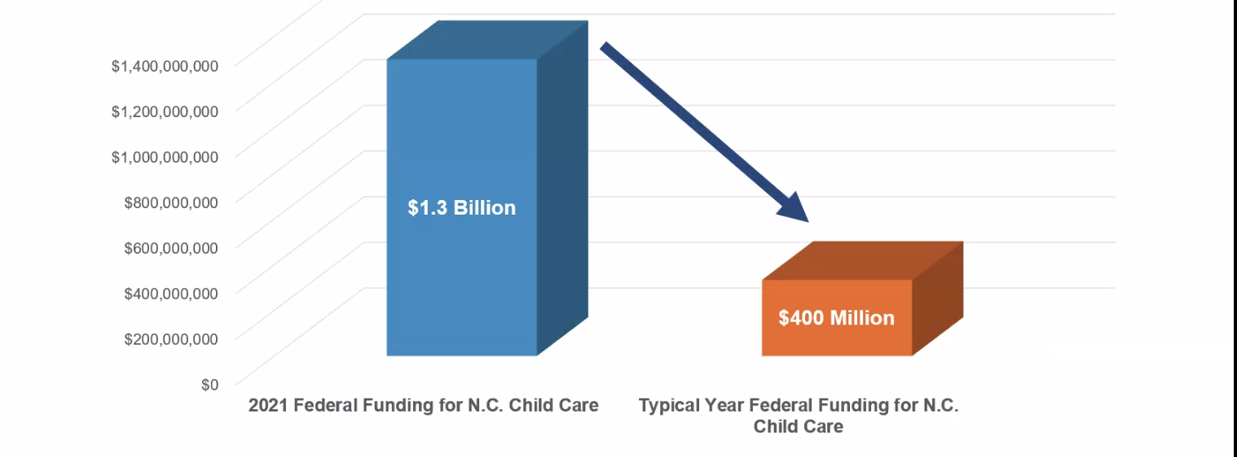
2024 NC PANDEMIC RELIEF FUNDING CLIFF
Scale of ARPA Funding
NC DCDEE

Slide 18
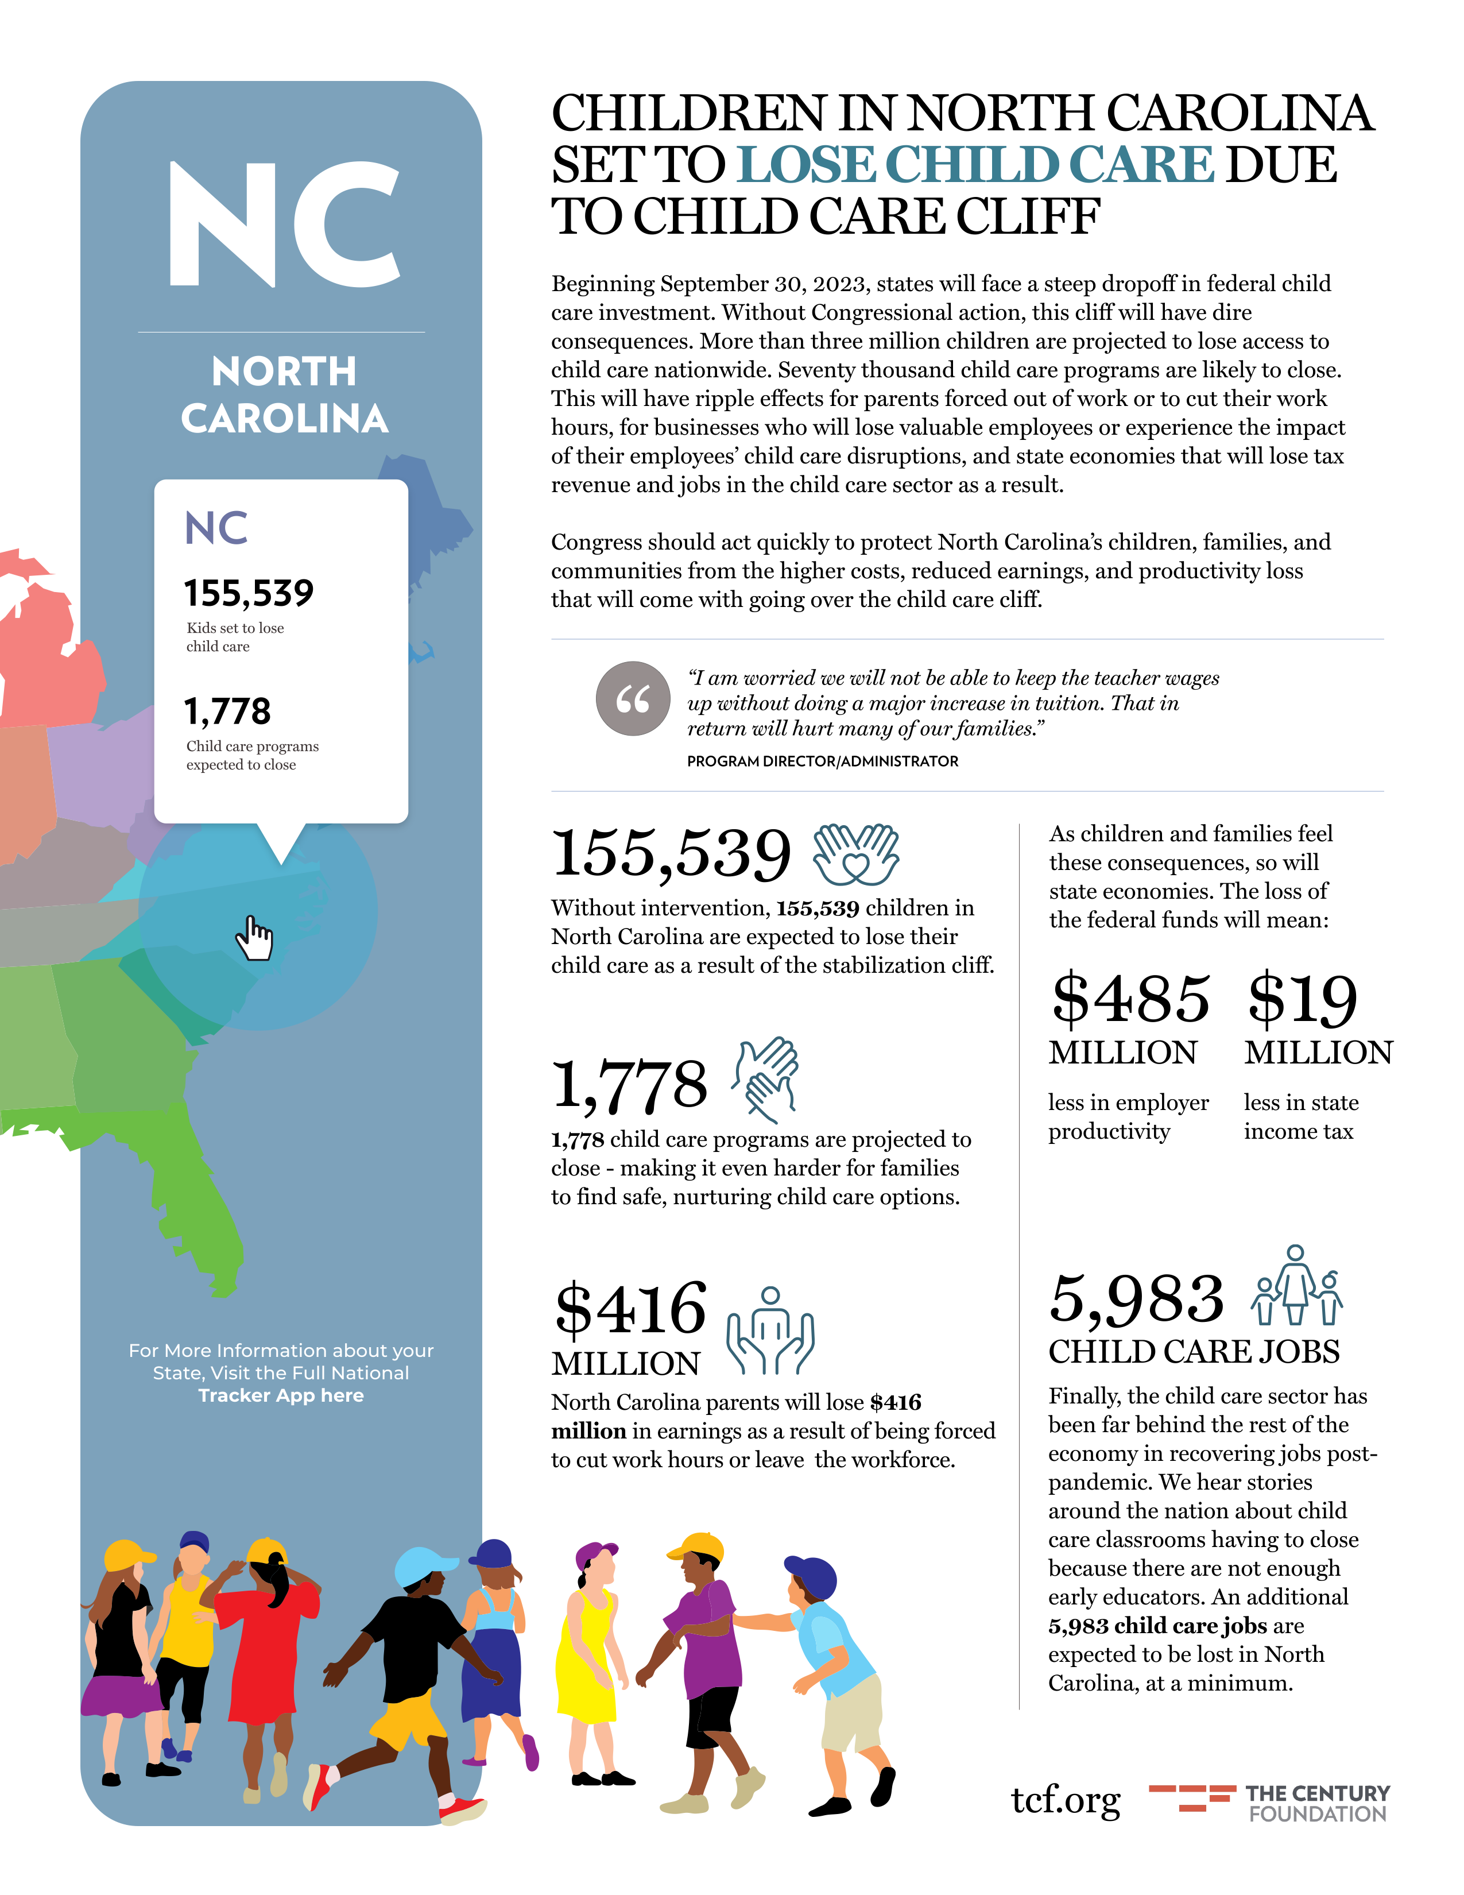
CHILD
CARE
FACT
SHEET
The Century Foundation

Slide 19
HOW WE BUILD A RESILIENT STATE
NC has so much to be proud of – historically and now
We are building the workforce through innovation and infrastructure
Without sustained investments, we will not be able to maintain or grow the ECE workforce and our economy will suffer.
SO, WHAT HAPPENS NEXT?

