Slide 1
Charlotte
A national childcare crisis, locally
Ely Portillo
Interim News Director, WFAE 90.7

Slide 2
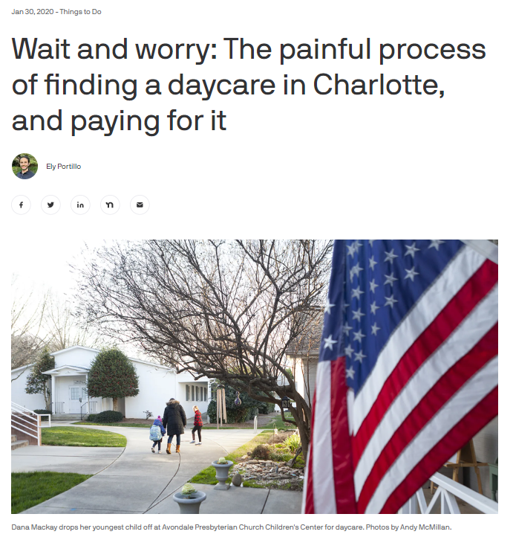
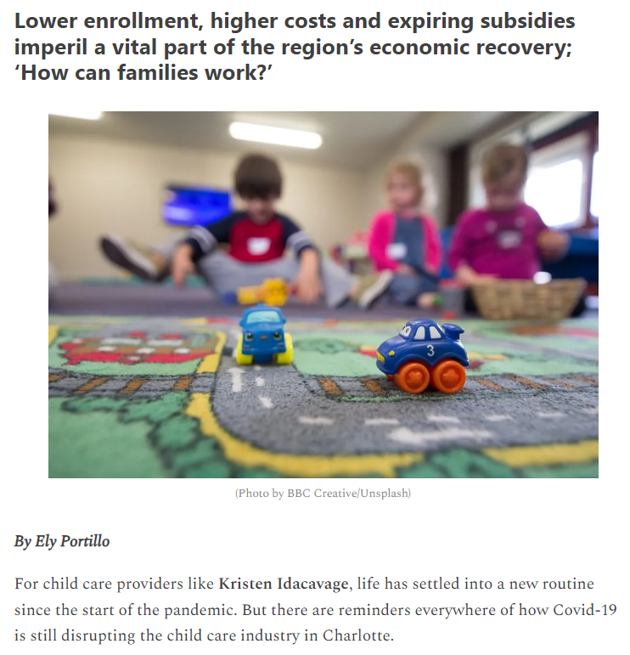
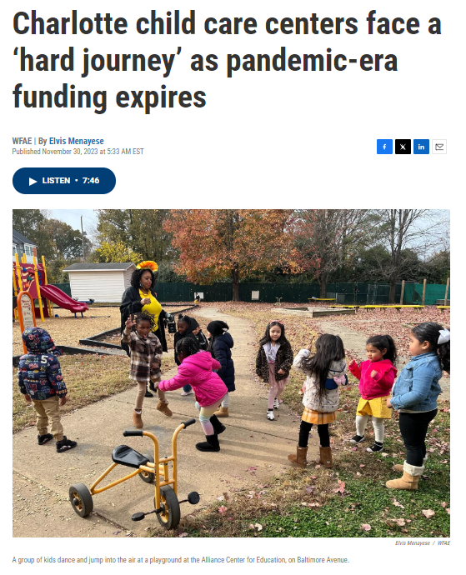

Slide 3
Childcare is a story about…

Slide 4
Childcare is a story about…
The same old, same old.

Slide 5
Childcare is a story about…
Economic development.

Slide 6
Childcare is a story about…
“NCECF estimates that 400,000 working parents across the state are constrained by child care needs. This can affect the choices they make about whether to pursue postsecondary education, participate in the workforce, or even pay for things like food and housing.
These constraints were evident in NCECF’s survey findings: 45% of parents with young children were dropping out of college/training or declined training.”
North Carolina Early Childhood Foundation

Slide 7
Childcare is a story about…
Equity — racial, gender and socioeconomic.

Slide 8
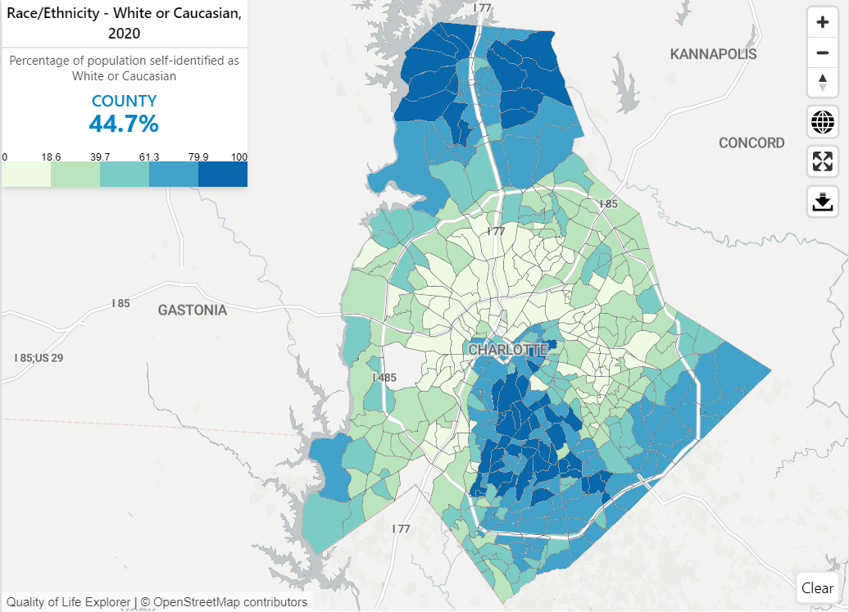
Race

Slide 9
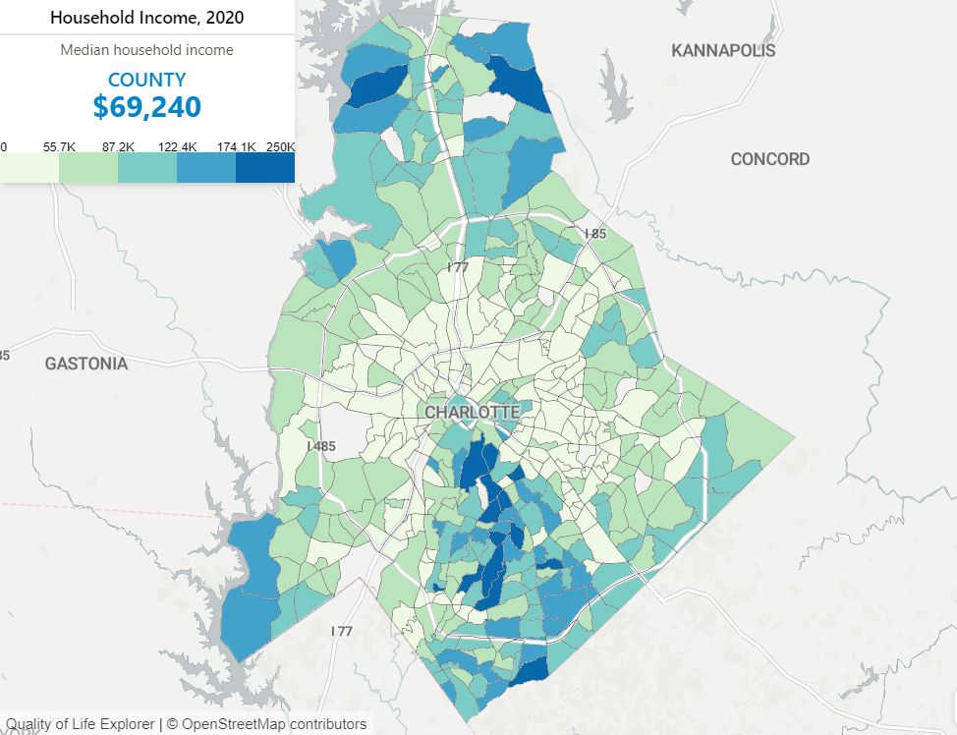
Wealth
9.9% of Mecklenburg households are in poverty, including 13.6% of children.
Their geographic distribution follows the traditional “crescent/arc” and “wedge” dynamics we’ve grown accustomed to.

Slide 10
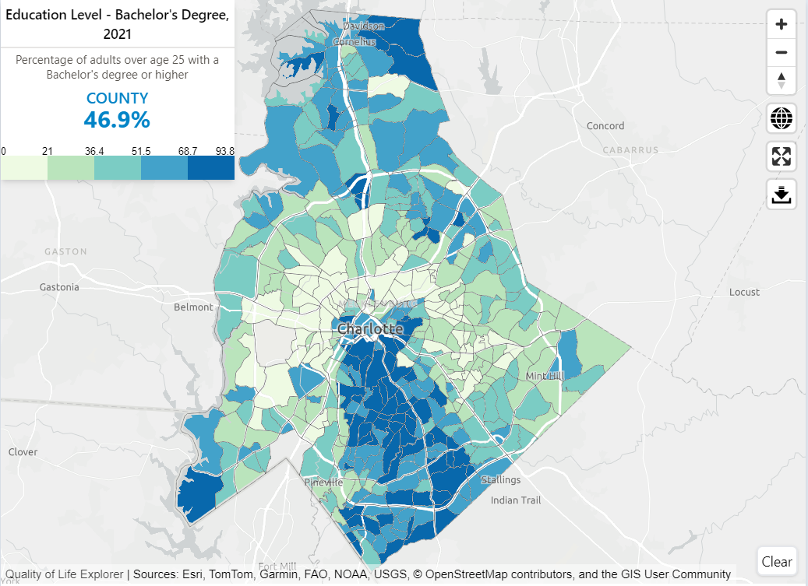
Education

Slide 11
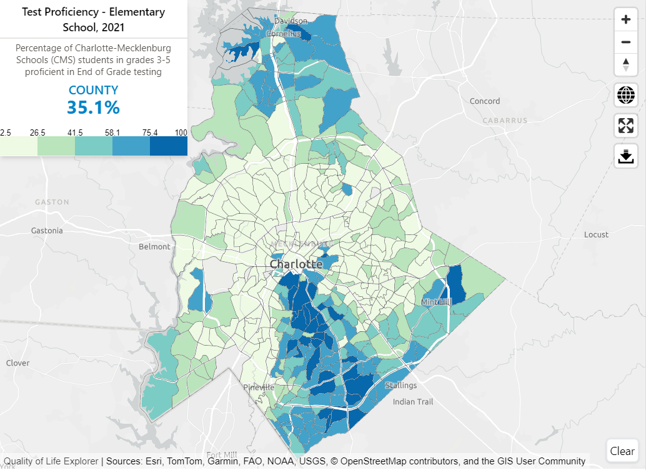
Education

Slide 12
Childcare is a story about…
The workforce and workers’ rights.

Slide 13
Childcare is a story about…
“But, despite the integral role that early childhood educators play, they are compensated with low to poverty wages for their work. Child care workers remain nearly at the bottom of all U.S. occupations when ranked by annual pay, and they struggle to make ends meet—frequently relying upon public income support programs.”
Center for American Progress, 2022

Slide 14
Thanks!
Follow me on X, if that’s your thing (@esportillo)
Or email me at eportillo@wfae.org

