Slide 1


Slide 2
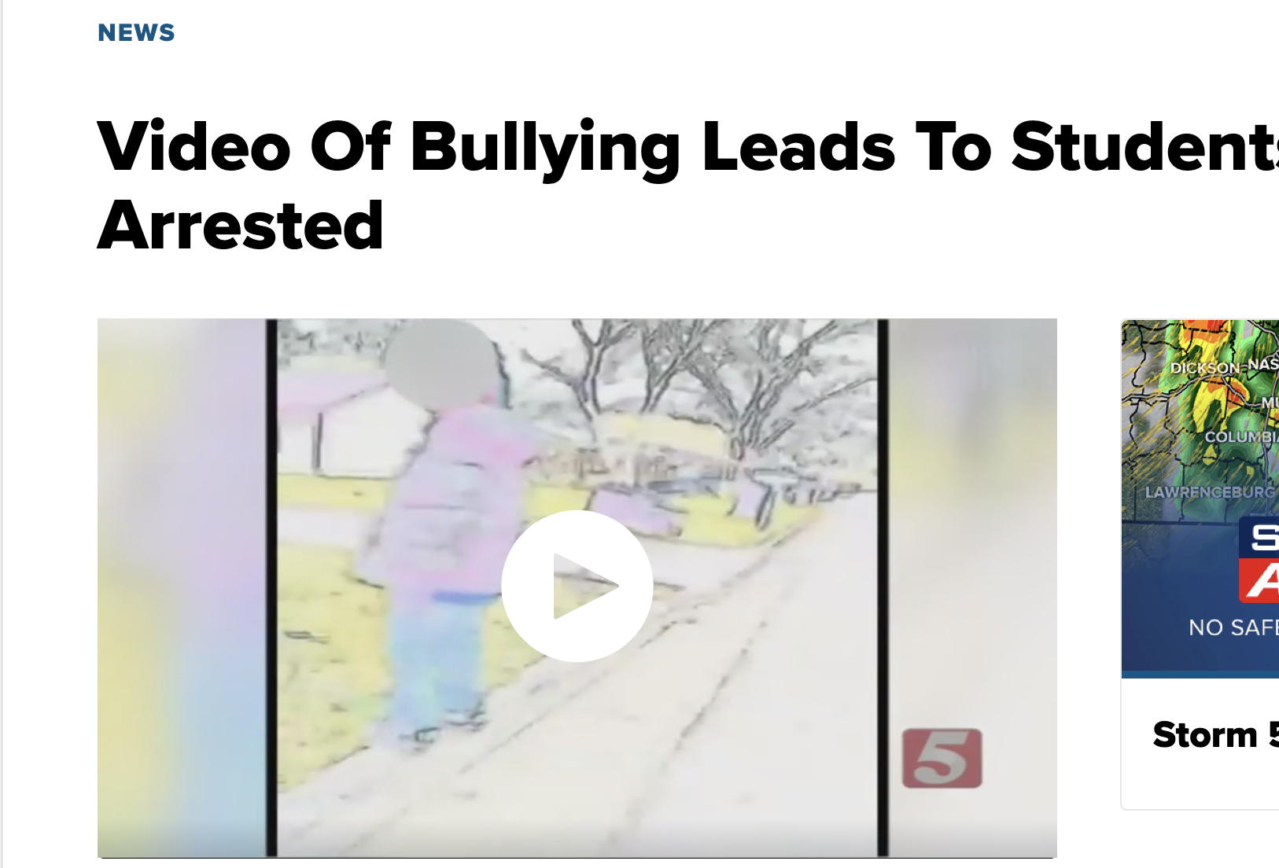
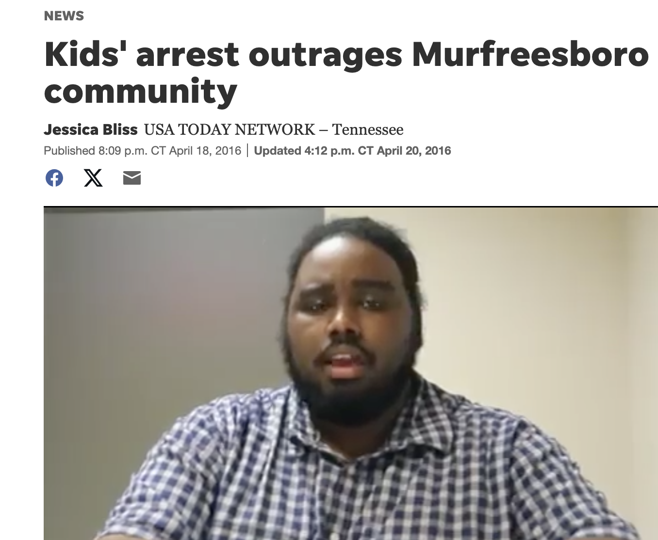
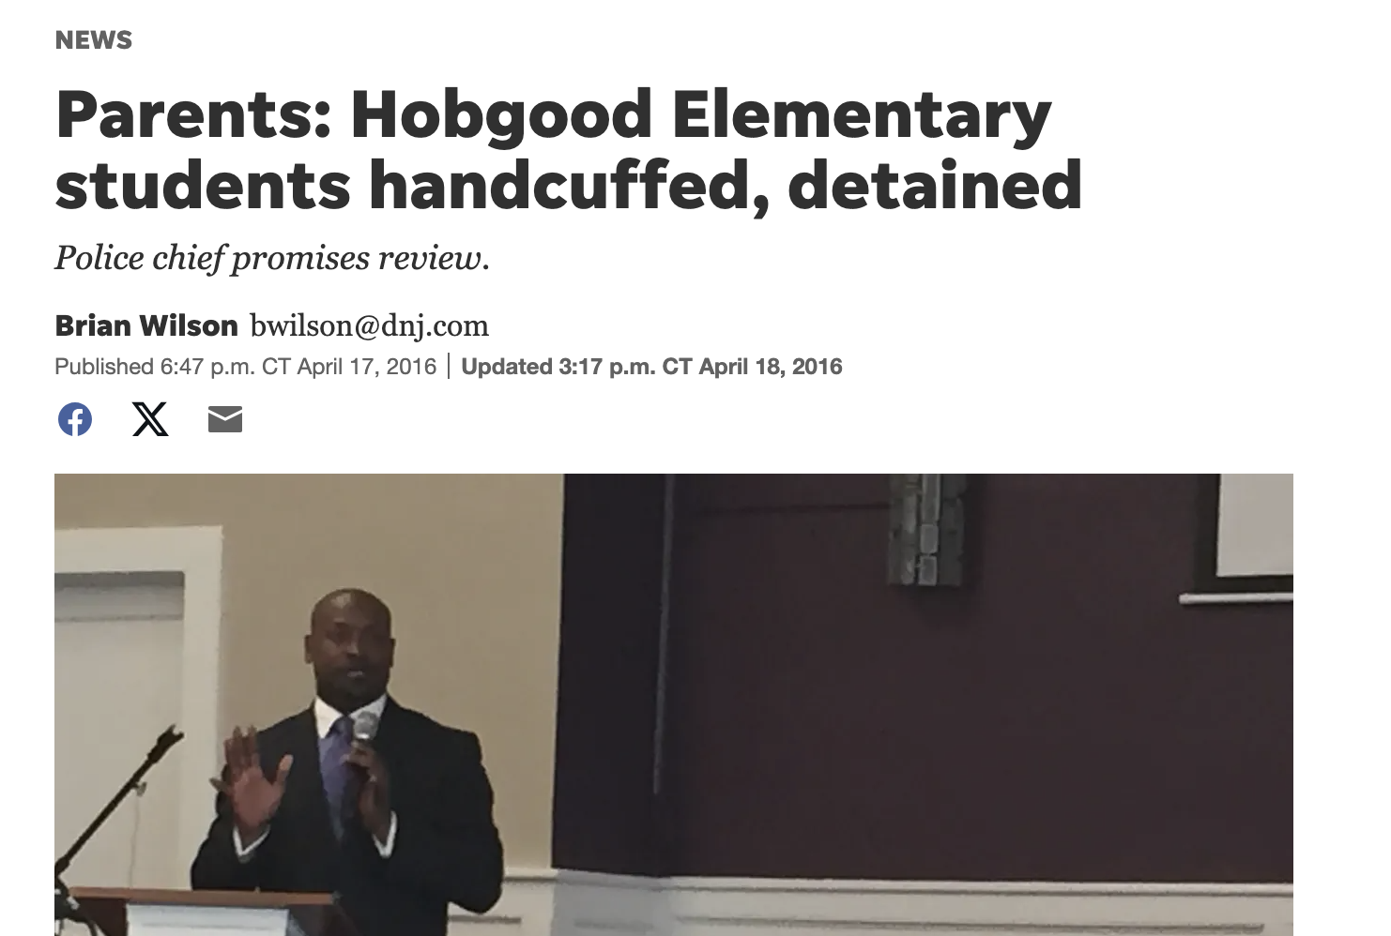
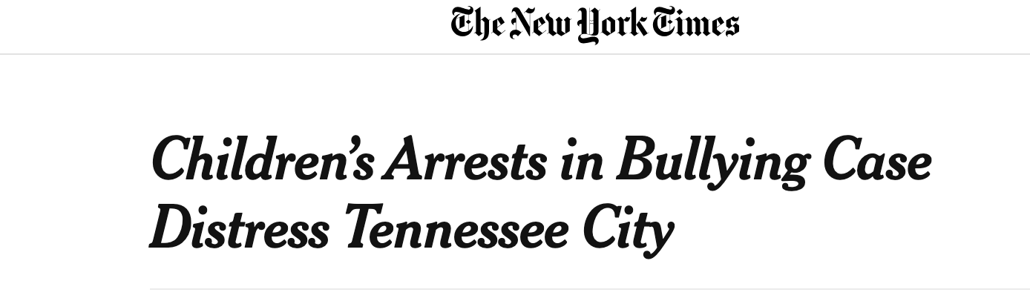
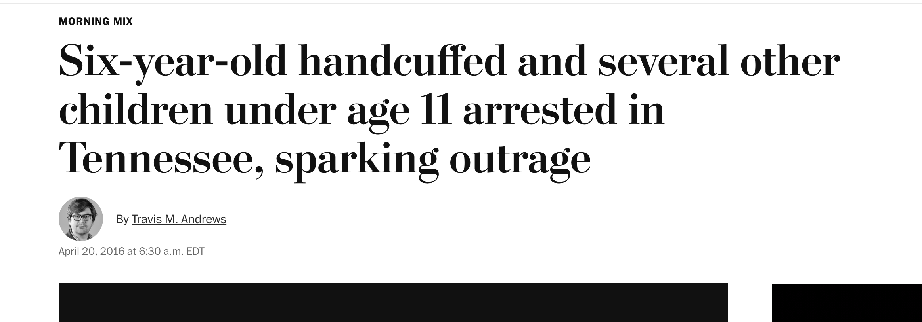

Slide 3
Every story starts with a question….
Why are children being arrested for such minor offenses?

Slide 4
Juvenile court is private
Juvenile records are sealed
Most court proceedings are private

Slide 5
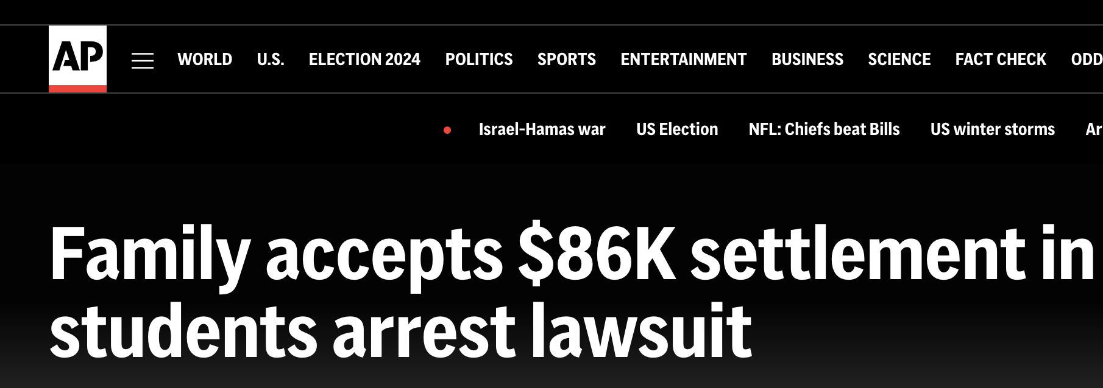
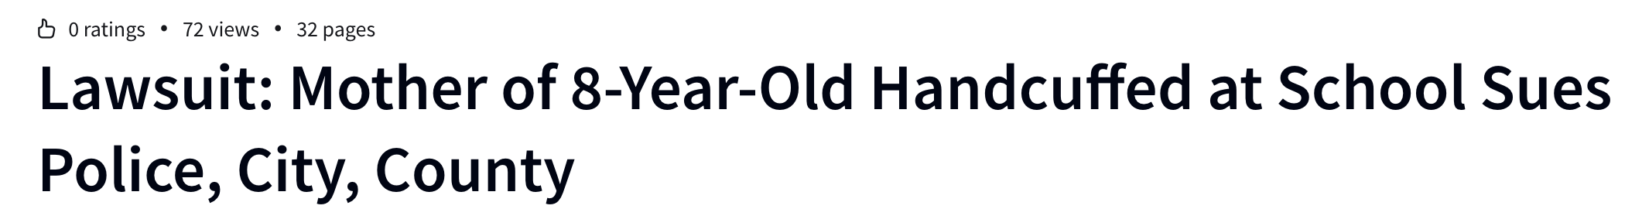


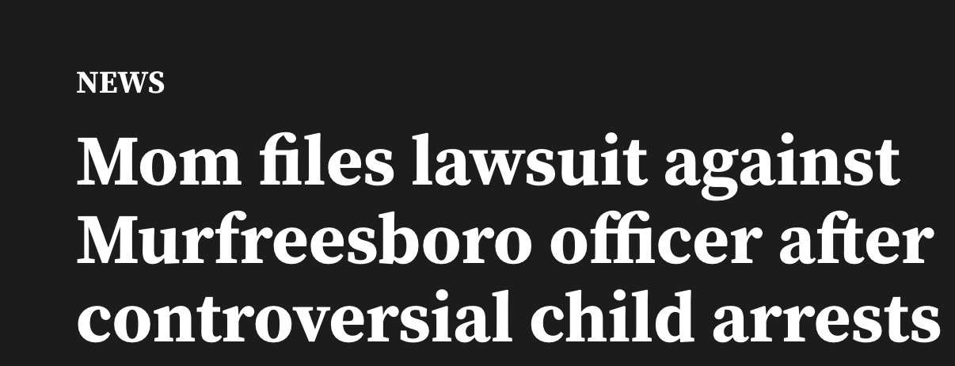

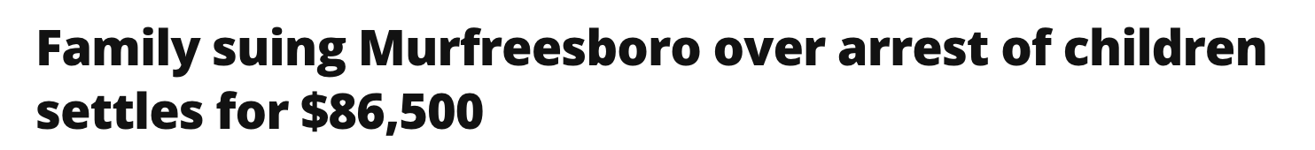

Slide 6
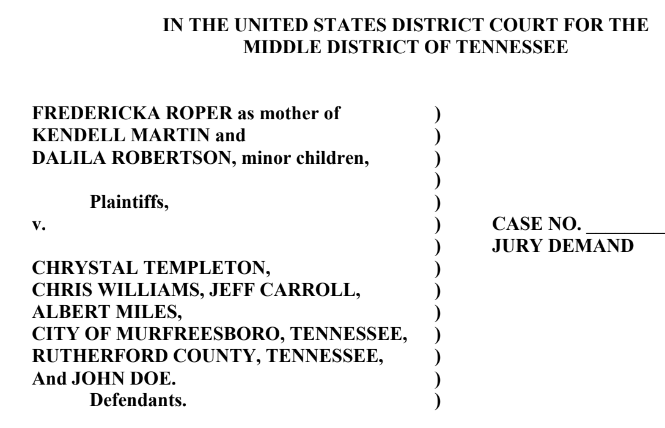
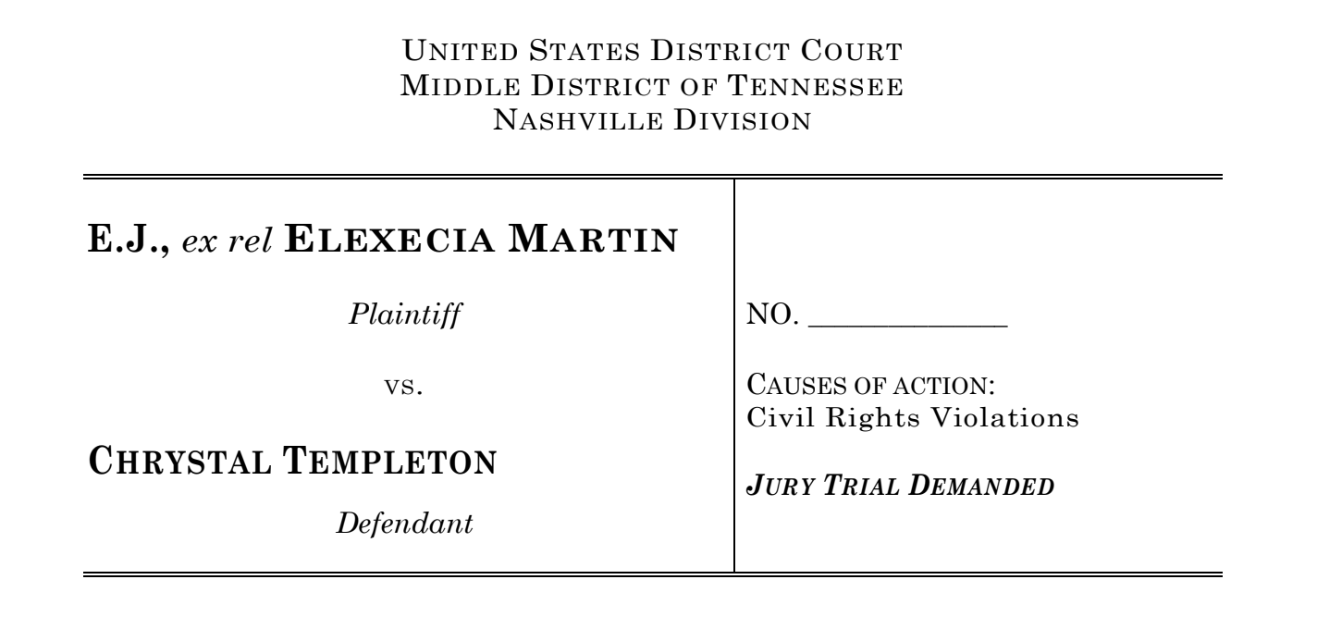
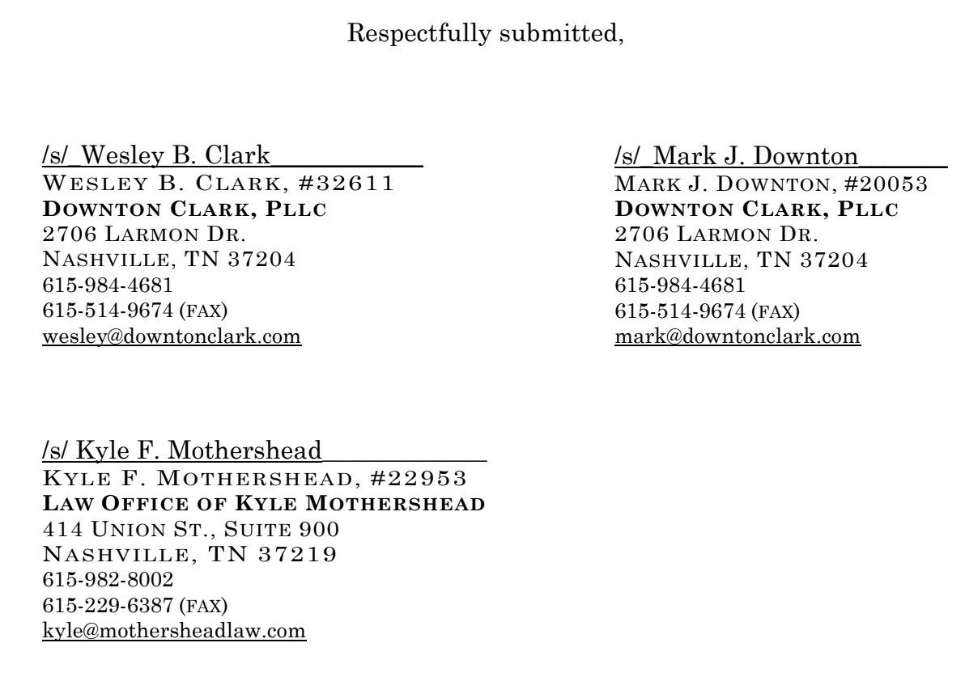
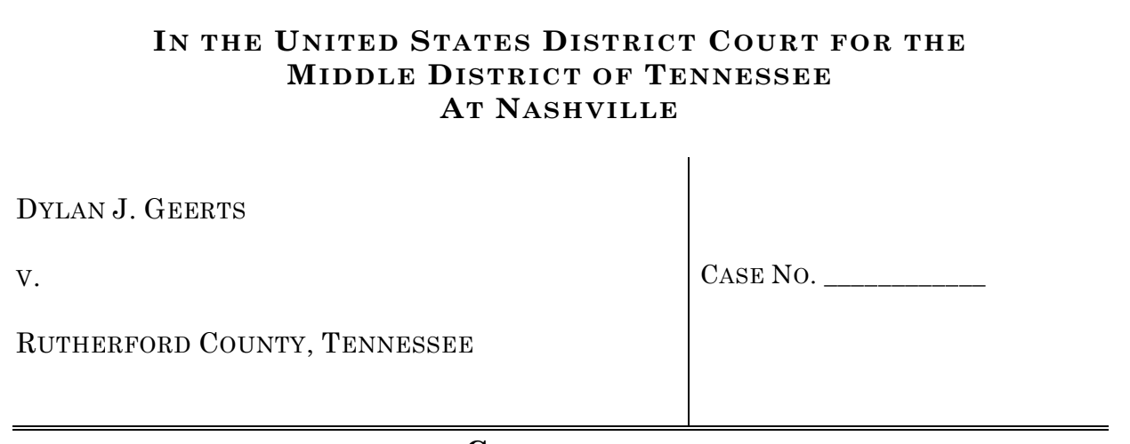

Slide 7
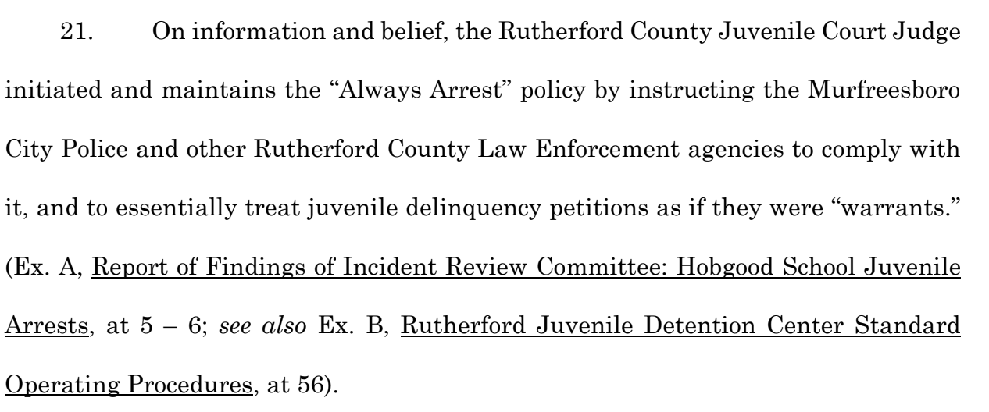
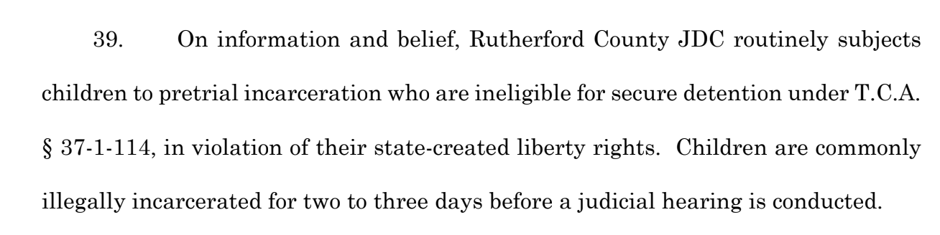
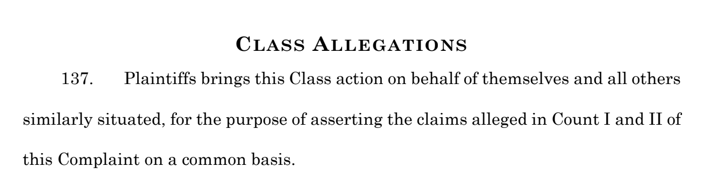


Slide 8
So, what was our question?
Why are children being arrested
for such minor offenses?

Slide 9


Slide 10
The judge is still the judge…
The jailer is still the jailer…
This is where the accountability reporting gets its HUMPH!

Slide 11

Now it’s time to hunt for proof:
Documents
Official records
Evidence
Sources
anything I can get my hands on!

Slide 12
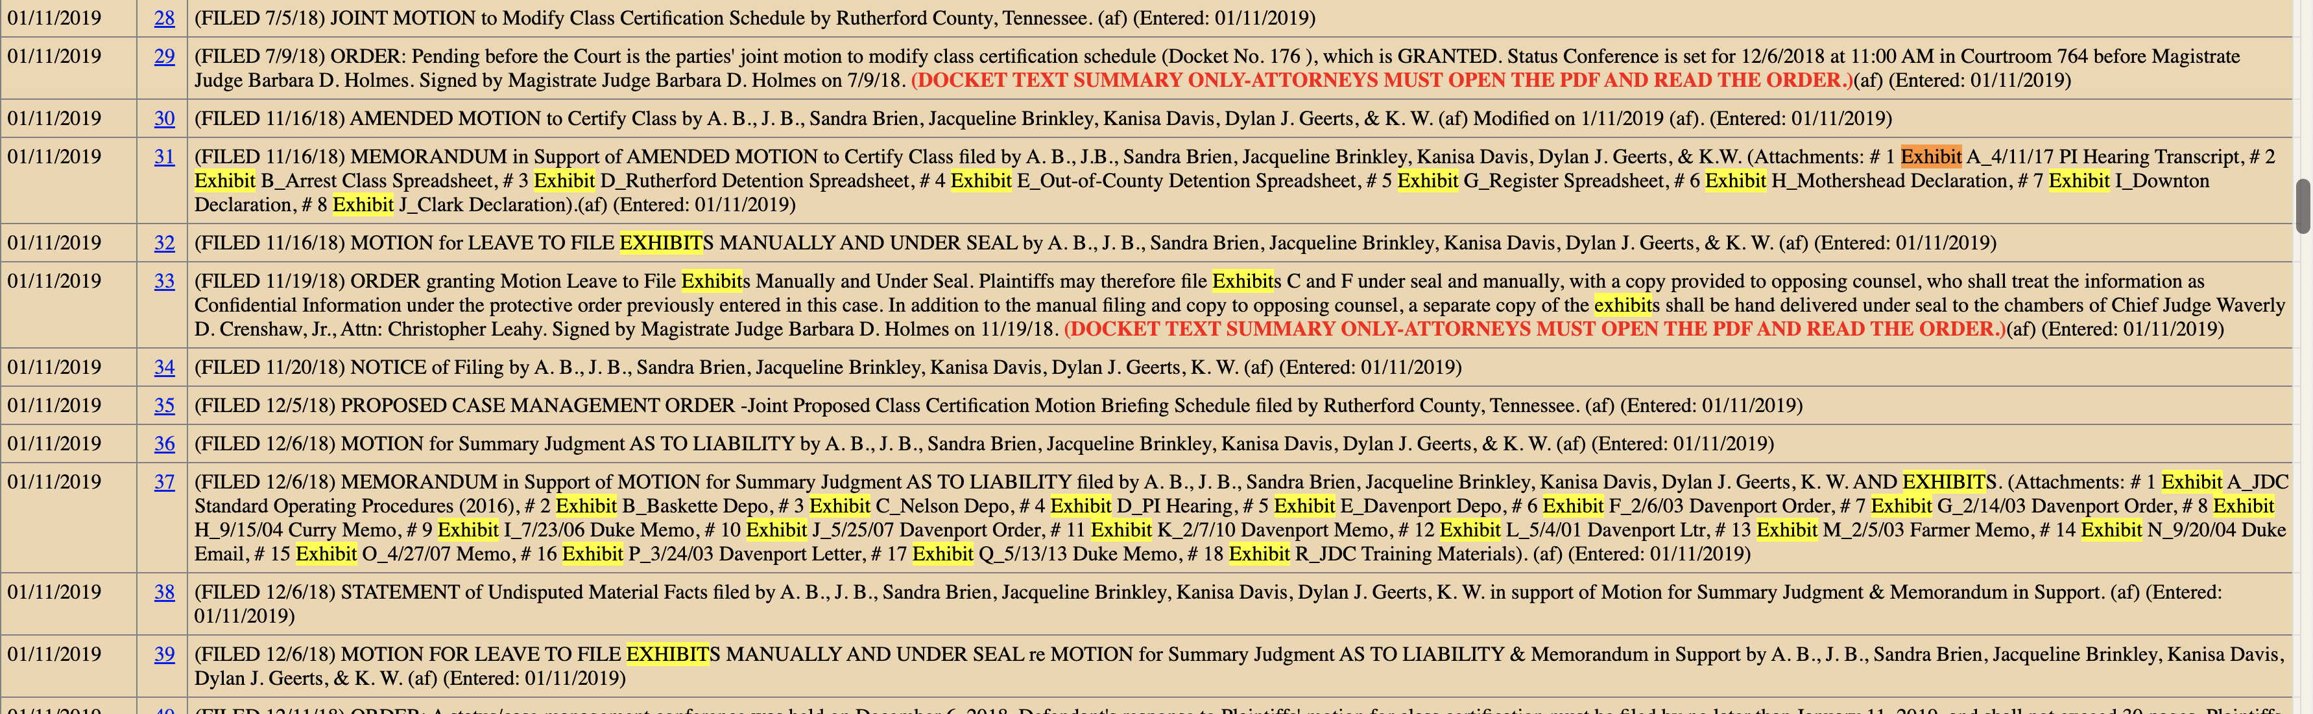

Slide 13

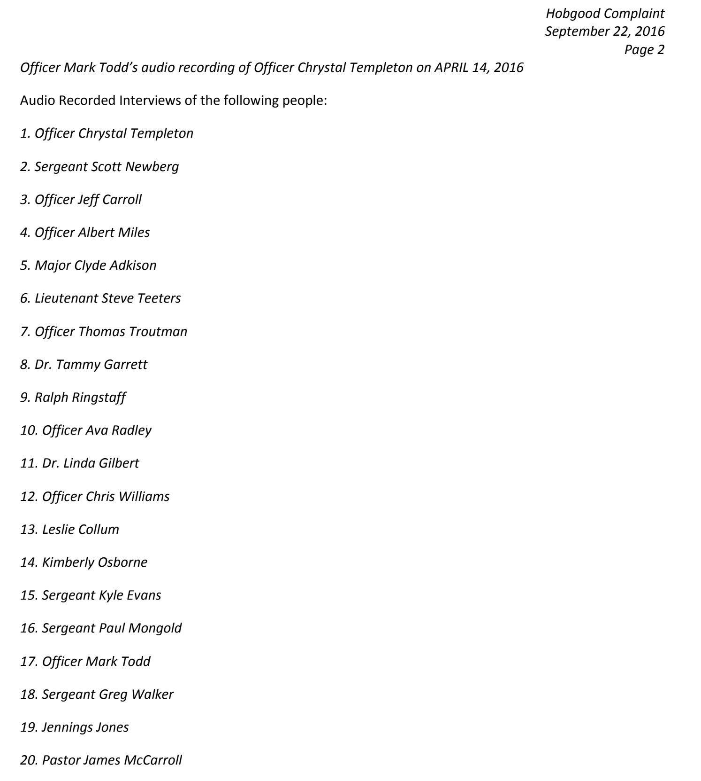

Slide 14
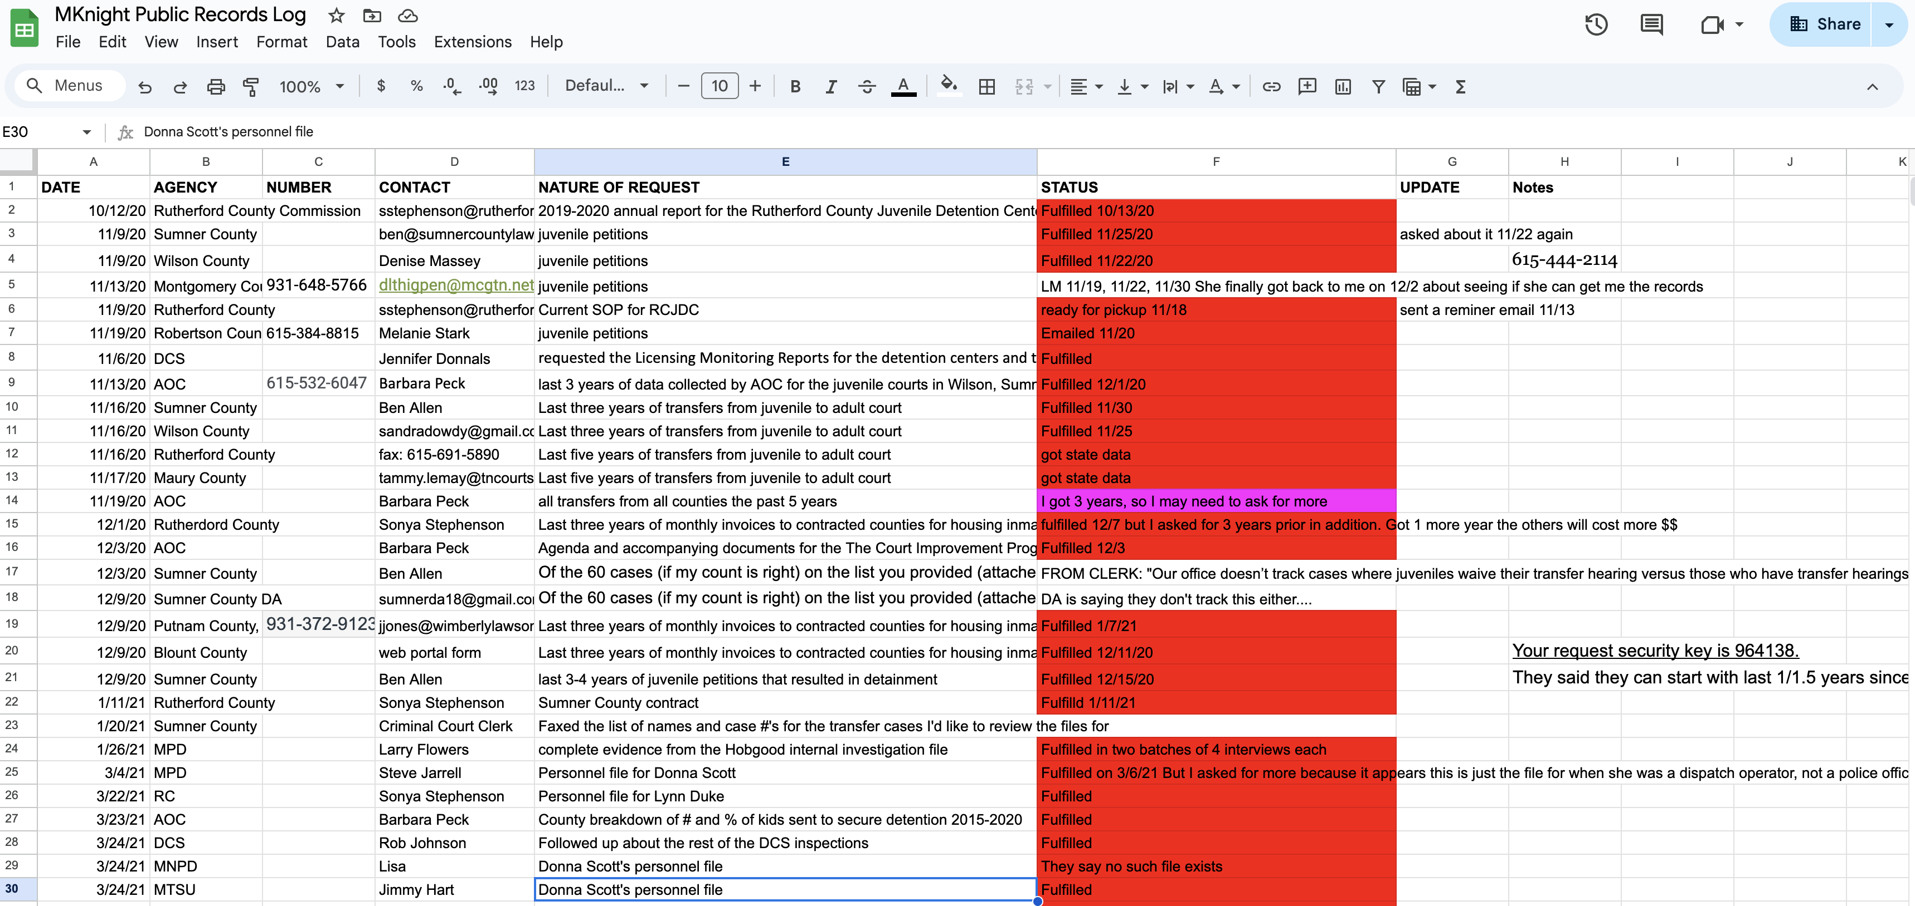

Slide 15
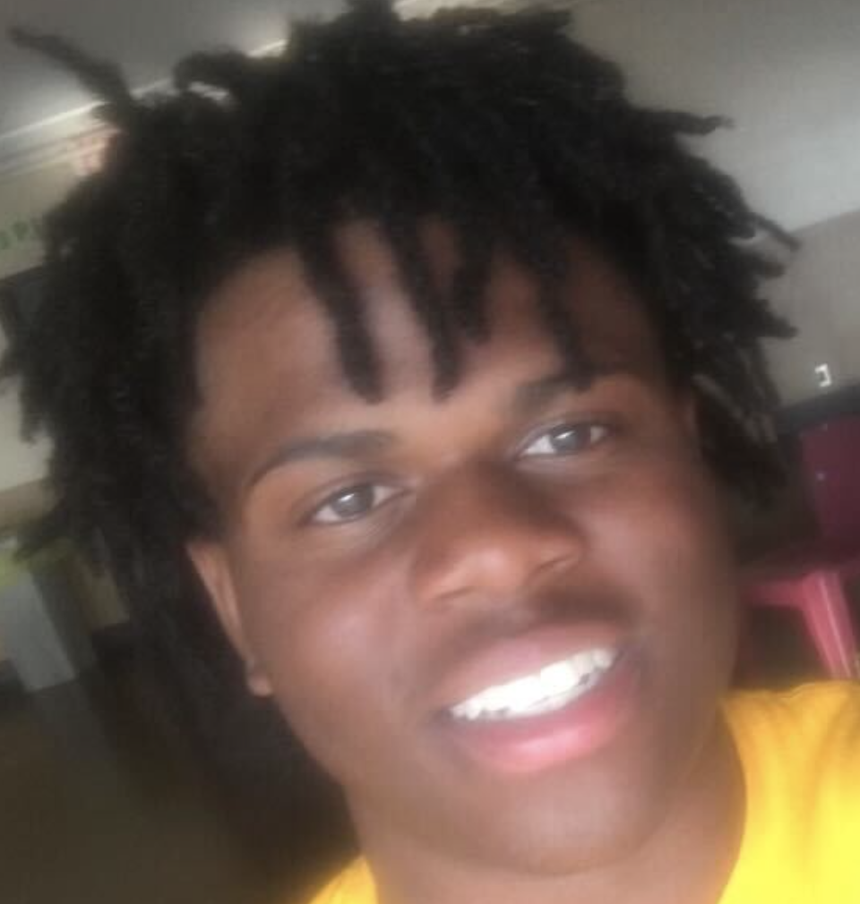

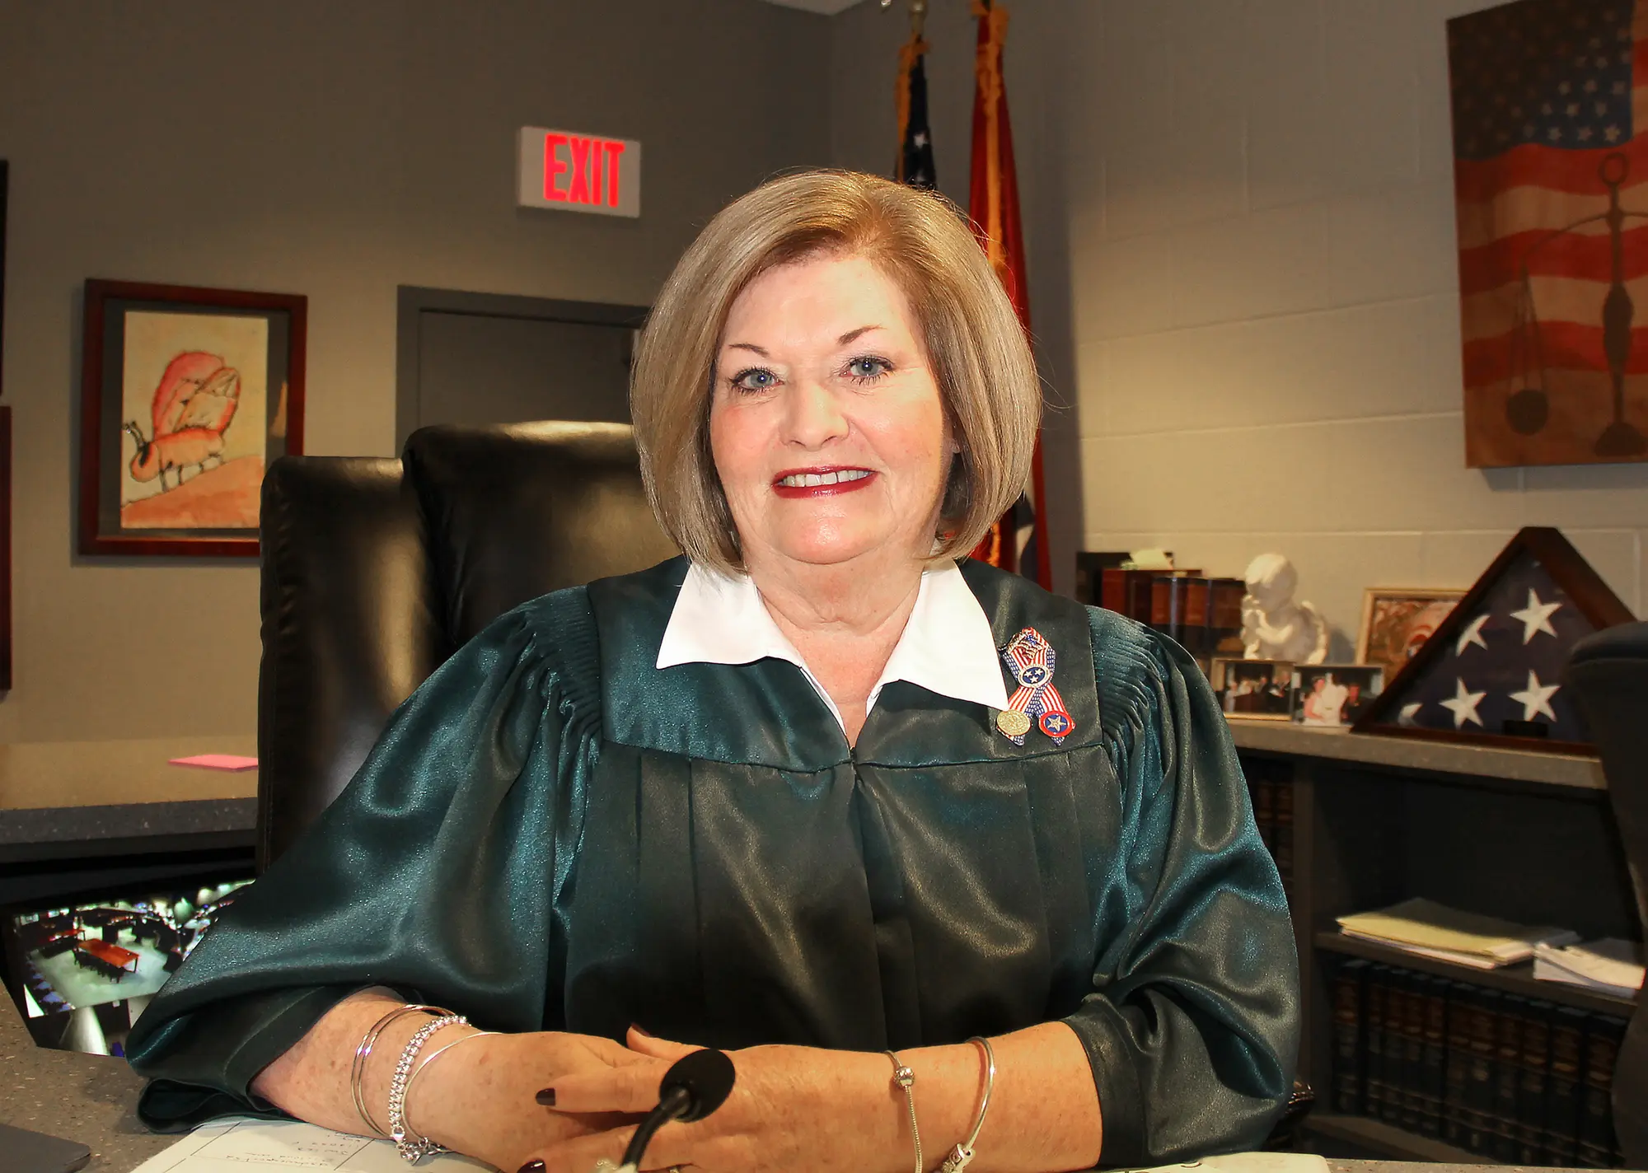
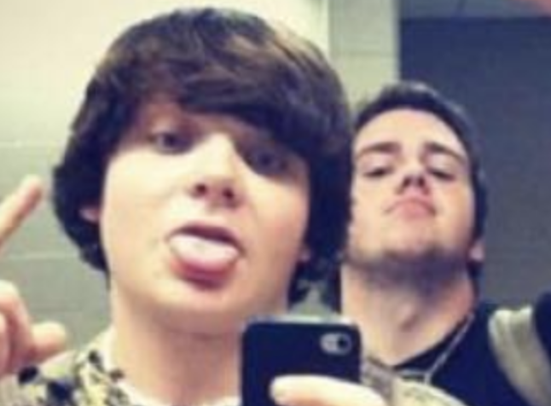
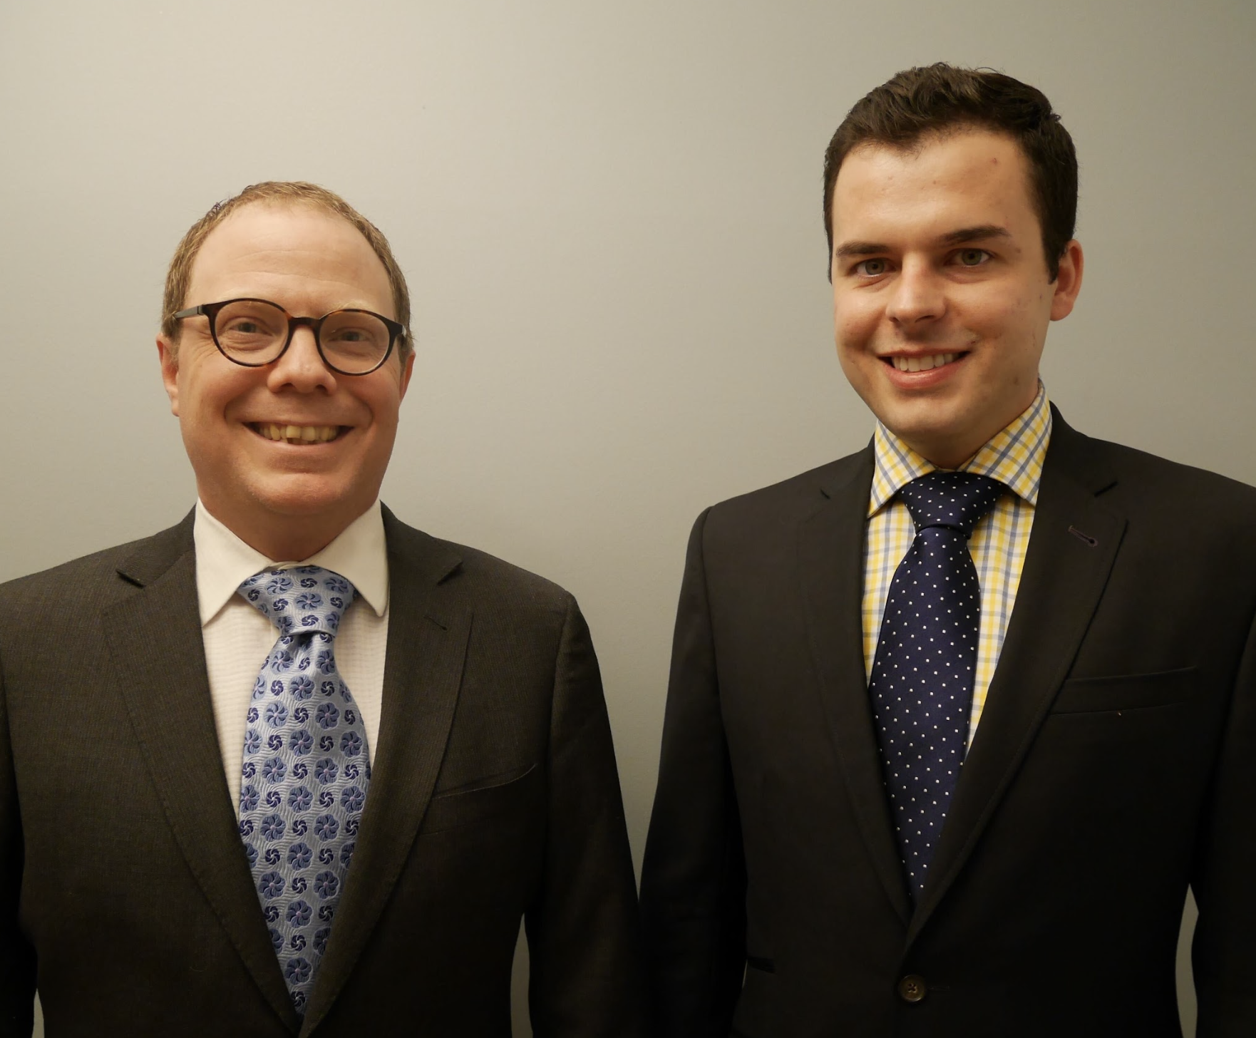

Slide 16
What do you do when the people in your story won’t talk to you?

Slide 17
7 lawsuits
More than 2 dozen young people spoke
Hours of interviews with lawyers, county employees, county officials, childhood friends of judge
70 hours or radio show
Community meetings (12 years’ worth)
Thousands of pages of court filings
  Depositions
  Jail and court documents/policies
  Internal memos/PAC
More than 60 FOIA requests
  State, county data and documents
  Personnel files
  Disciplinary records for county employees

Slide 18

Wes and Mark decide to sue over solitary
Wes and Mark team up and complain
Hobgood Arrests, 2016
Lawyers discover policies
arrest and jail
Wes arrives at court 2014
Expand lawsuit and file class action
Settle lawsuit
Reporters journey takes over

Slide 19
A shift….from reconstruction to real time

Slide 20
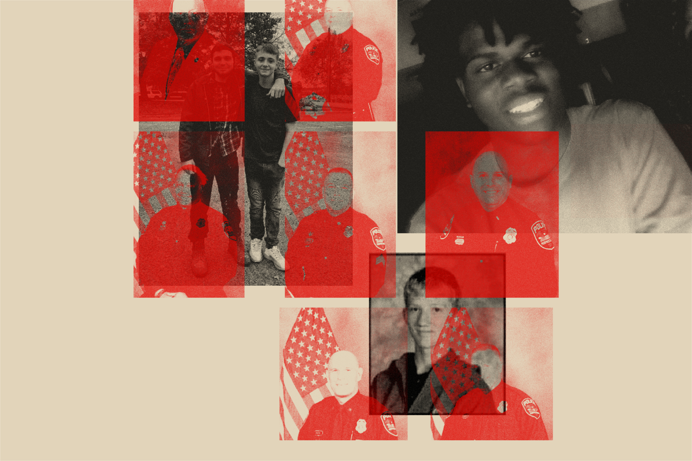

Slide 21
Questions!

