Slide 1
The Promise and Potential of the Child Tax Credit (CTC)
January 23rd, 2023

Slide 2
A sampling of NCCP’s areas of focus nccp.org
Early Childhood:
Early intervention for infant and early childhood mental health and Medicaid
Expulsion prevention interventions
Impacts of direct cash transfers on homeless youth
Improving participation of foster children in high-quality EC
Family Economic Security:
Promoting the economic well-being of immigrant families
State-by-state social safety-net policy analysis
Supporting Paid Family Medical Leave legislation
Family resource simulators and benefit cliff analysis
Notes:
NCCP has completed a broad range of projects and studies in support of children. Please feel free to reach out to us about anything….
Focus on deep poverty, relationships of economic security with family stress and mental health of adults and children.

Slide 3
What led up to the Expansion of the CTC?
Right from the start of the pandemic, those who could least afford it were hit more quickly and harder. Employment loss was one measure of this.
Notes:
Kochhar, R., & Sechopoulos, S. (2022). COVID-19 Pandemic Pinches Finances of America's Lower-and Middle-Income Families..
The onset of the pandemic was an historic event, an anomaly.
Researchers like to look at the impact of such events, as well as of programs and policies, as they affect different groups – by income, by race, by family structure – because they both reveal structural inequities and point to solutions.

Slide 4
Similarly, low-income, Black, and Latino families began to experience disproportionate levels of material hardship as soon as March and April of 2020
 | Share whose families cut back spending on food
All parents | 31.0%
By family income
Above 250% FPL | 20.5%
Below 250% FPL | 41.4%
By race/ethnicity
Non-Hispanic white | 24.4%
Non-Hispanic black | 36.4%
Hispanic | 45.9%
Notes:
Karpman, M., Gonzalez, D., & Kenney, G. M. (2020). Parents are struggling to provide for their families during the pandemic. Washington, DC: Urban Institute.
Immediately (in March and April), disparities in material hardship began to appear:
100% FPL was $21,720 for a family of 3 in 2020 throughout most of the US
250% FPL was $54,300 for a family of 3 in 2020 throughout most of the US

Slide 5
Challenges particularly challenged single parents right from the start of the pandemic, and those challenges continued
Related challenges continued for these parents throughout the pandemic:
In April 2020, one in four single parents was unemployed.
Unemployment rates recovered more slowly for single parents throughout 2021, perhaps in part due to their unequal exposure to school and childcare closures.
Levels of worrying among single parents continued to worsen throughout 2021.
Notes:
Parolin, Z., & Lee, E. K. (2022). Economic precarity among single parents in the United States during the COVID-19 pandemic. The ANNALS of the American Academy of Political and Social Science, 702(1), 206-223.
These challenges, and their cascading effects, their ongoing nature, created conditions for what some viewed as an intervention, almost an experiment, to provide steady, unconditional cash to parents.

Slide 6
Provisions of the Expanded Child Tax Credit (within the American Rescue Plan)
Under the provisions of the ARP:
Beginning in July 2021 and through December for 2021, parents of children from 0 to 6 received $300/month, or $1800/per young child per month, even those earning no income.
Parents of children from 7 to 17 received $250/month, or $1500/per older child.
In tax season in early 2022, parents who filed their taxes and claimed it would receive an additional “lump sum” amount of $1800/child or $1500/child, depending on the age of their children.
There was no income requirement to receive the credit, although there were caps on families with higher incomes.*
The total CTC was “fully refundable.” Parents could claim all of the credit even if they didn’t owe any taxes, no matter what their income level.
Notes:
https://www.congress.gov/bill/117th-congress/house-bill/1319/text
ARPA passed on March 11, 2021.
*Families with AGIs below $150,000 for joint filers and $112,500 for single filers. Above these thresholds, the credit phased out at a rate of 5 percent per dollar of AGI until reaching the credit value families were eligible for under prior law.
Important: ITIN holders (without SSNs) were allowed to receive the credit. Families were entitled for each child born in the US. A “non-filer portal” was created to facilitate such claims.

Slide 7
Expanded Child Tax Credit had many positive effects for low-income children
The monthly cash benefits were responsible for moving more than three million children out of poverty across the country.
Later analysis of transactional data from bank accounts and credit cards from several partner financial institutions during that time showed that recipients of the CTC:
          Increased spending on groceries, education, and healthcare;
          Spent more money reducing debt, and incurred fewer overdraft fees;
          Were not significantly likely to leave the workforce.
          In fact, some studies found that the CTC supported work participation by paying for childcare.
Notes:
Lens, V., Arriaga, A., Pisciotta, C., Bushman-Copp, L., Spencer, K., & Kronenfeld, S. (2022). Spotlight on child tax credit: Transforming the lives of families. City University of New York, and Columbia University, https://static1. squarespace. com/static/610831a16c95260dbd68934a, 623.
Lourie, B., Shanthikumar, D.M., Shevlin, T.J., & C. Zhu (2022) Effects of the 2021 Expanded Child Tax Credit. SSRN. http://dx.doi.org/10.2139/ssrn.3990385.
Improved food security, many other measures.
Parents reported spending CTC monthly payments mostly on food, essential bills (like utilities), clothing, and rent or mortgage payments. But also, it is important that we have research with data from banks supports this conscientious spending by most parents.

Slide 8
The Expanded CTC made a bigger difference in some states than in others
Reductions in child poverty were greatest in states with relatively lower costs of living and higher pre-tax and transfer poverty rates. Examples:
Without the CTC, Louisiana’s child poverty rate would have been 15.7% in 2021; with it, it was 6.9%, reflecting a 56.2% decrease.
Without the CTC, Michigan’s child poverty rate would have been 11.8% in 2021; with it, it was 6.3%, reflecting a 46.9% decrease.
Without the CTC, Alaska’s child poverty rate would have been 9.9% in 2021; with it, it was 6.1%, reflecting a 37.8% decrease.
Notes:
Collyer, S., Hardy, B., & Wimer, C. (2023). The antipoverty effects of the expanded Child Tax Credit across states: Where were the historic reductions felt?

Slide 9
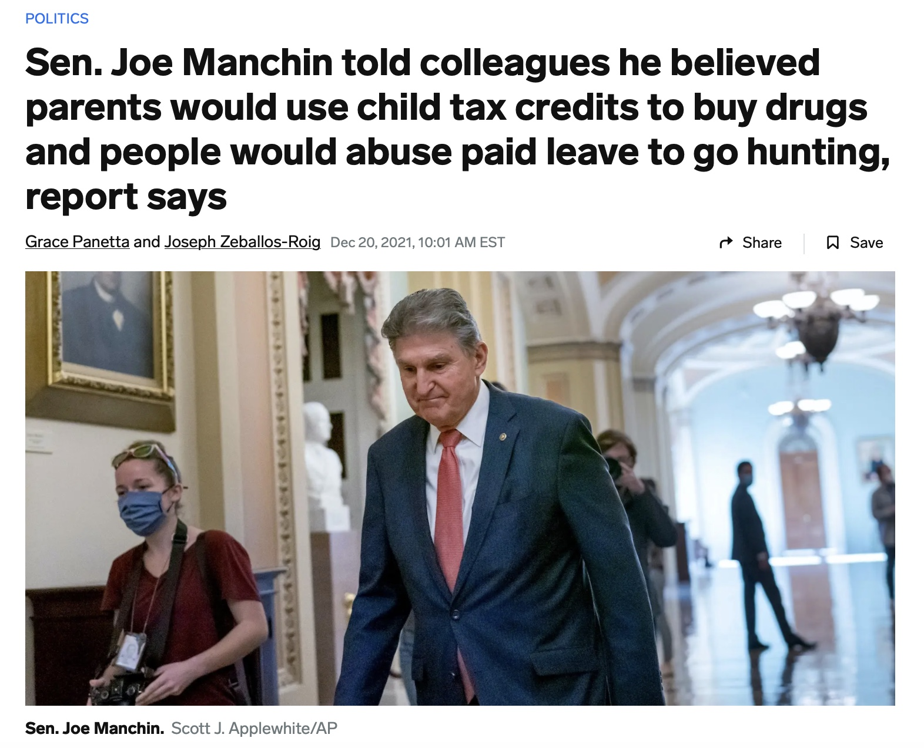
Why was the Expansion not renewed?
Senator Manchin of WV was central to discussions around not continuing the CTC. Framing included:
      Concerns around inflation, work participation, drug abuse;
      Claims (that were false) that grandparents who were caregivers for their children could not receive the CTC.
In late summer, 2022, the Inflation Reduction Act was passed instead of Build Back Better, and it precluded continuation of the Expansion of the CTC.
Notes:
Marr, C., Cox, K., & Sherman, A. (2021). Build Back Better’s Child Tax Credit Changes Would Protect Millions From Poverty–Permanently. Center on Budget and Policy Priorities, November, 11.
Build Back Better legislation in late 2021 attempted to reduce child poverty by more than 40%.
The CTC Expansion proposed in Build Back Better included a plan for full refundability and expanding the maximum credit to $3,600 for children under age 6 and $3,000 for children aged 6-17 (from the $2,000/child in the Tax Cuts and Jobs Act).
Full refundability accounted for 87% of this projected anti-poverty impact. Again, full refundability means that all families receive the same benefit no matter their income.
https://www.businessinsider.com/manchin-thinks-people-will-misuse-child-tax-credits-paid-leave-report-2021-12
Included in the bill. as a federal increase to the minimum wage, which would more than double it from $7.25 to $15/hour.
Surveys indicated that public support was behind this: https://economicsecurityproject.org/wp-content/uploads/2022/10/Lake-ESP-CTC-slides-Sep2022.pdf

Slide 10
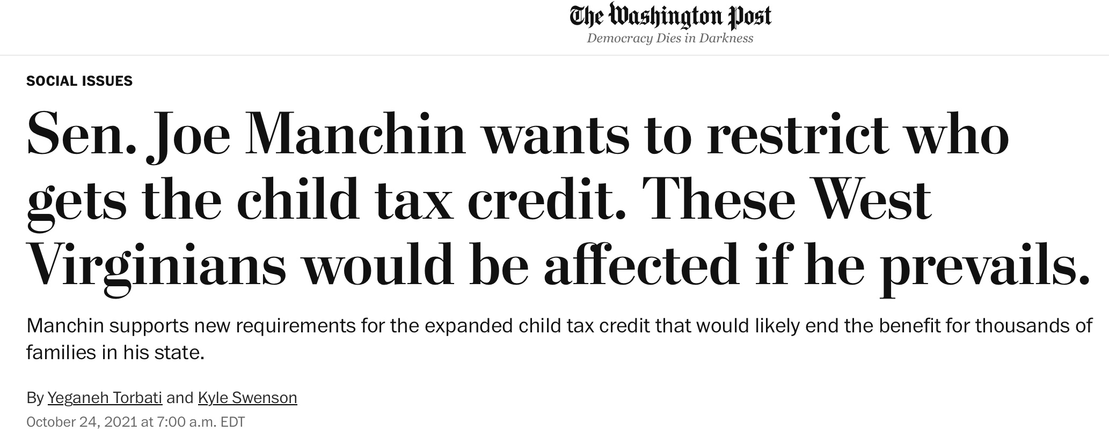
Some reporters documented the losses families would experience without the continued Expansion using the words of caregivers.
Included the story of caregiver-grandparents who were able to claim the credit.
Emphasized how the Expansion supported stay-at-home parenting for some.
Stressed, how, with inflation, it was hard for even the “upper-class poor” to make ends meet.
Quoted Manchin on why he opposed the Expansion: “There’s no work requirements ….there’s no education requirements … for better skill sets. Don’t you think, if we’re going to help the children, that the people should make some effort?”
This piece in the Washington Post from October, 2021 by Yeganeh Torbati and Kyle Swenson highlighted the CTC Expansion’s value beautifully through stories about real parents (and their words).
Notes:
https://www.washingtonpost.com/dc-md-va/2021/10/24/west-virginia-manchin-child-tax-credit/
Highlights that caregivers of children were sometimes unable to access the funds (grandparents), the genuine struggles that parents were encountering in providing basic needs for their families. Gold star!

Slide 11
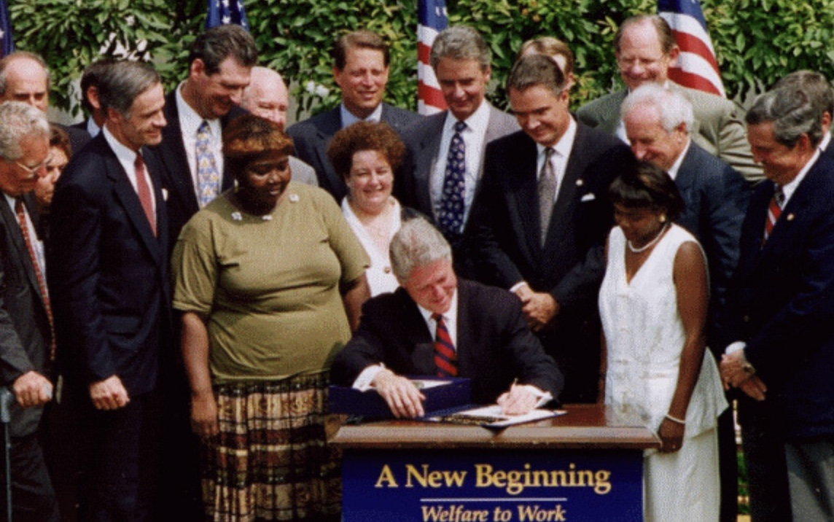
The federal Child Tax Credit had not been constructed to serve as an anti-poverty policy
The CTC program was established in 1997, with just $500/child available to families earning more than $10,000, and it was not at all refundable – meaning that if the value of the credit for a family’s income and size exceeded their tax liability, they did not receive a refund for the difference.
Notes:
The year is important – it’s the year after the Personal Responsibility and Work Opportunity Act “ended welfare as we know it,” removing the entitlement for children to cash assistance through the Aid to Families with Dependent Children program and replacing it with the Temporary Aid to Needy Families (TANF) program. The federal government designed TANF to be administered by states who define what a “needy family” looks like and sets standards of need and other provisions.
The CTC was not created as an anti-poverty measure; the contrary it’s part of a very different structure, the US tax code.
The people who need help the most do not receive this credit, because they needed to earn at least $10,000. It was intended only as an aid to parents in lightening their tax bills. No portion of it, originally, was refundable. It was no way similar to policies in other developed countries that support families’ economic security, which are called “child allowance” benefits.

Slide 12
Revisions of the federal Child Tax Credit
Economic Growth and Tax Relief Reconciliation Act of 2001 (EGTRRA) increased the maximum amount of the CTC to $1,000/child and made the credit partially refundable. This meant that if the value of the credit (for a family’s income and size) exceeded their tax liability, they could receive a partial refund for the remaining value at tax time. The refund was capped at 15 percent of their earned income above the earnings requirement of $10,000 – so this clearly benefited higher-earner parents far more than low-earning parents.
American Recovery and Reinvestment Act (ARRA) of 2009. Families needed to earn only $3,000, and could receive a refund that was capped at 15% of their earnings above $3,000.
Notes:
You need to earn more and more with each child in order to obtain the full benefit.
As the income limit was extended downward, to $3,000, those who earning just above that limit, and need it the most, don’t receive as much as families earning more. Let’s say in 2010 I scrape together an income of $4,000 – the highest credit I’m going to receive is 15% of 1,000, or $150/child, while families earning more can receive more.
Universal vs. targeted benefits.

Slide 13
Pre-pandemic provisions of the federal Child Tax Credit
Tax Cuts and Jobs Act (TCJA) of 2017.
To qualify, families had to earn at least $2,500 (decreased from $3,000).
The maximum credit was increased from $1,000 to $2,000 per child.
The refundable part of the credit was set to a maximum value of $1,400 per child.*
Eligibility was expanded to families with higher incomes by increasing the credit’s phase-out thresholds to $200,000 for single filers and $400,000 for joint filers, compared to the prior laws’ thresholds of $75,000 for single filers and $110,000 for joint filers.
The new law required that qualifying children have a Social Security number (under previous law, children with an Individual Tax Identification Number (ITIN) were eligible for the credit) – implications for children of immigrants.
Notes:
This is important because this is basically the same CTC we have today.
Absent further legislative action, the TCJA’s changes to the CTC expire in 2025.
#3 “the refundable part of the credit” -> this is not fully refundable
#4 Extended to benefit more middle-class or affluent families…
*$1,400 has since been extended to $1,600, but this is basically the shape of the current CTC.

Slide 14
In its current form, the amount of a CTC that a family can receive is determined by family size and family earnings
In 2020, roughly one in three children were ineligible for the full CTC because of its dependence on family income: 11% were completely ineligible, and 22% were eligible for only a portion of the full credit.
Two adults working full time at the federal minimum wage take home $25,375 in earnings and therefore would not qualify for the full refund at any family size.
A two-parent, two-child family needs to earn more than $36,000 to qualify for the full refund (<$2,000/child).
If they added a third child to the family, they would need close to 20% more in earnings to continue receiving the full CTC refund, and a family with four children would need to earn even more.
Notes:
(Collyer, Harris, and Wimer 2019b; Goldin and Michelmore 2022). (Curran and Collyer 2020).
This slide and the next few, illustrating the important theme of how many and which children are left out of the CTC as it functioned before the pandemic and does again now, include analyses based on numbers from 2019 or 2020, but they are largely reflective of current provision (in 2024).

Slide 15
Which children were ineligible for child tax credits, or eligible for only a partial credit?
Notes:
Collyer, S., Curran, M. A., Garfinkel, I., Harris, D., Parolin, Z., Waldfogel, J., & Wimer, C. (2023). The Child Tax Credit and family well-being: An overview of reforms and impacts. The ANNALS of the American Academy of Political and Social Science, 706(1), 224-255.

Slide 16
Which children were ineligible for child tax credits, or eligible for only a partial credit?
Notes:
Collyer, S., Curran, M. A., Garfinkel, I., Harris, D., Parolin, Z., Waldfogel, J., & Wimer, C. (2023). The Child Tax Credit and family well-being: An overview of reforms and impacts. The ANNALS of the American Academy of Political and Social Science, 706(1), 224-255.

Slide 17
Which children were ineligible for child tax credits, or eligible for only a partial credit?
Notes:
Collyer, S., Curran, M. A., Garfinkel, I., Harris, D., Parolin, Z., Waldfogel, J., & Wimer, C. (2023). The Child Tax Credit and family well-being: An overview of reforms and impacts. The ANNALS of the American Academy of Political and Social Science, 706(1), 224-255.

Slide 18
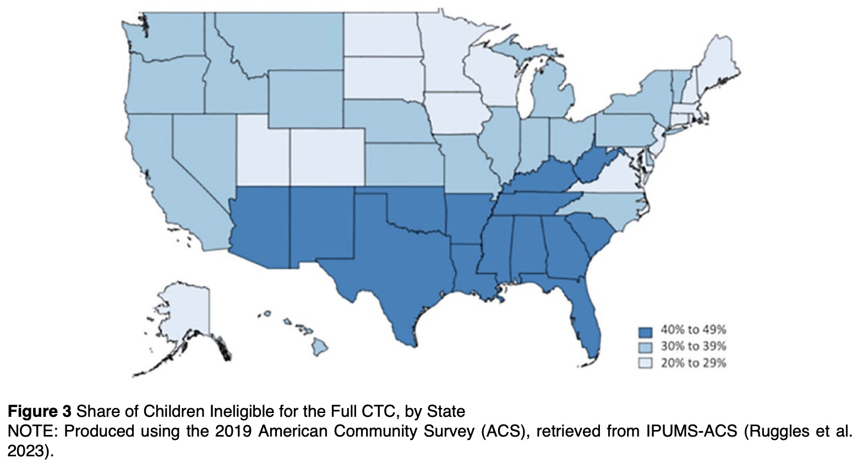
Where are children ineligible for the full CTC most likely to live?
Notes:
Collyer, S., Curran, M. A., Garfinkel, I., Harris, D., Parolin, Z., Waldfogel, J., & Wimer, C. (2023). The Child Tax Credit and family well-being: An overview of reforms and impacts. The ANNALS of the American Academy of Political and Social Science, 706(1), 224-255.
“The five states with the highest levels of nonreceipt include Mississippi (47 percent), New Mexico (46 percent), Louisiana (43 percent), Arkansas (44 percent), and Alabama (43 percent)—all states with child poverty rates above the national average.”

Slide 19
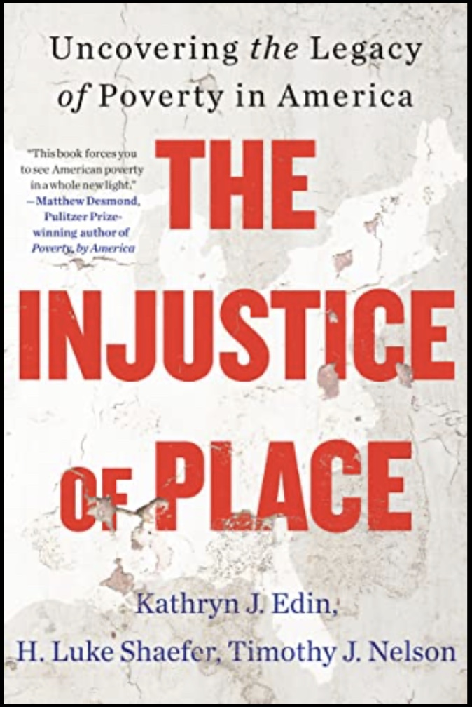
New(ish) book on the “poverty of place”
Really helpful book identifying areas of the country where poverty – not just child poverty – is particularly challenging to overcome, and where economic mobility is especially limited.
It features exploration of historical context for areas the authors identify as particularly “disadvantaged” including Appalachia, South Texas, the ”Cotton Belt” and many (not all) predominantly Native American communities.

Slide 20
After the 2021 Expansion: back to normal
Once again, regulations around the CTC mean the amount a family can claim depends on their income and family size. The maximum tax credit is again set at $2,000 per child per year. Only families earning more than $2,500 could claim the credit. Families can now receive up to $1,600 per child as a cash refund at tax time (if the tax they owe is less than that and they earn enough to obtain the “refundable portion”).
As a result, roughly one in three children is again ineligible for the full CTC because their families had low or moderate incomes.
Predictably, there was a significant increase in child poverty in 2022, from from 5.2% in 2021 to 12.4% a year later.
Notes:
Collyer, S., Curran, M. A., Garfinkel, I., Harris, D., Parolin, Z., Waldfogel, J., & Wimer, C. (2023). The Child Tax Credit and family well-being: An overview of reforms and impacts. The ANNALS of the American Academy of Political and Social Science, 706(1), 224-255.
.

Slide 21
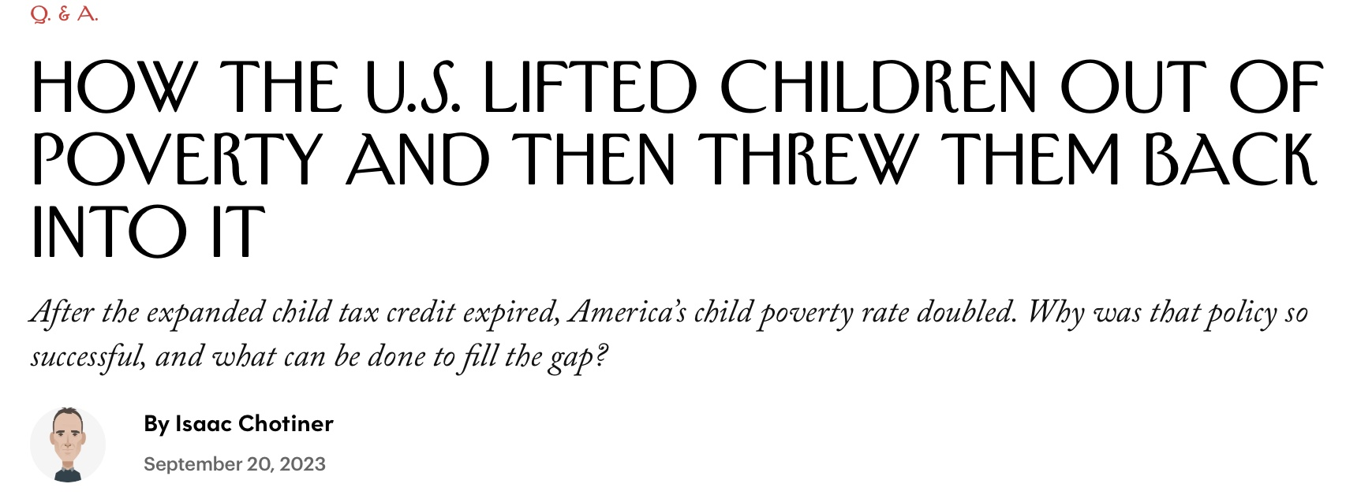
Notes:
https://www.newyorker.com/news/q-and-a/how-the-us-lifted-children-out-of-poverty-and-then-threw-them-back-into-it
Gold star for their continual examination of these questions: Center on Poverty and Social Policy at Columbia University, Director Chris Wimer, who was interviewed for this piece.
The Expansion included ”Three social policy experiments” – Expanded provision, monthly provision, and the cessation of the Expansion: when families lost the support.

Slide 22
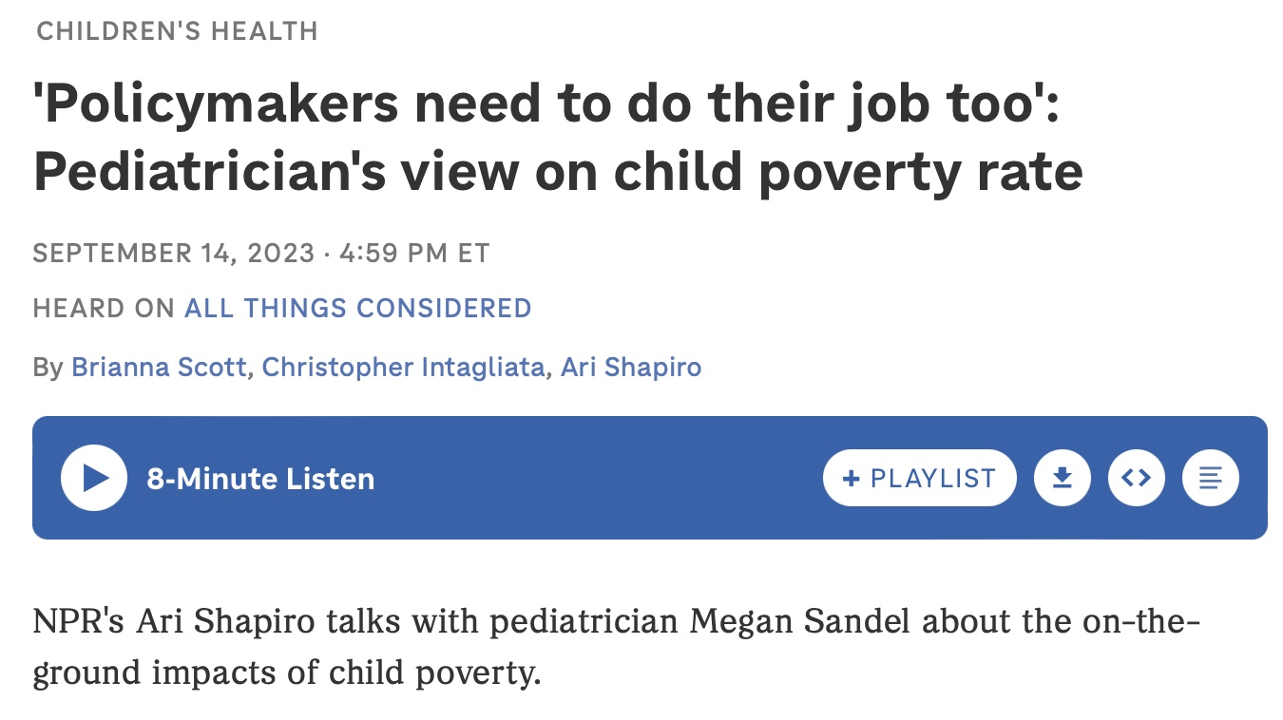
Excellent news stories last fall illustrated the reality of the Expanded CTC’s expiration.
“As a doctor, can you tell us specifically what you tend to see more of when families struggle to meet kids' basic needs?” - Ari Shapiro of NPR
“….What we're starting to see is kids flatlining, kids who should be growing, should be gaining weight, should be, frankly, growing the brain that they need for the rest of their lives. And we're seeing kids not grow. We're seeing kids lose weight, which when you're 3 or 4 years old, that is a medical emergency. What's going on? And a lot of times when we really dig deeper, it's simply because people can't afford enough food and are stretching beyond what they can deal with.”
– Megan Sandel, pediatrician
Notes:
https://www.npr.org/2023/09/14/1199584554/policymakers-need-to-do-their-job-too-pediatricians-view-on-child-poverty-rate#:~:text=And%20so%20I%20want%20to,to%20help%20kids%20grow%2C%20too.
.

Slide 23
After the Expanded Child Tax Credit some effects on NYC families: SHARP Impact Study
The Settlement House American Reconciliation Plan Impact Study. A mixed-method study of 1,000 parents who were program participants and/or staff members at NYC settlement houses. Included two waves – first was during 2021 and the second began in late 2022, after the CTC expansion expired. Interviews for the second wave continued into 2023.
We asked questions about families’ material hardship, food security, housing security, employment, debt, and, importantly, whether they received the CTC and how they used it. With about 50 participants in each wave, we conducted hour-long interviews in which interviewers asked questions about many of these topics and invited more expansive responses, using the native language of the participants.

Slide 24
After the Expanded Child Tax Credit some effects on NYC families in need: SHARP Impact Study
Many of the participants in the Study had never before been eligible to receive the Child Tax Credit, but they were all eligible to receive the Expanded Child Tax Credit (i.e., they had children under 17 who were born in the US.
Some characteristics of the sample of parents in wave 2:
57.7% had been born outside of the U.S. (with at least one child born in the U.S.)
47.4% reported income < $25,000 /year
24.4% had not completed high school
40.7% participated the Study in either Spanish or Mandarin
57.5% had at least one child under 6 years old
More than one in four (26.4%) families of parents surveyed included at least one family member with a disability, including over 20% with disabled children.

Slide 25
Findings in the second wave revealed increased levels of material hardship, food and housing insecurity, and related rates of anxiety and depression
In late 2022, almost 1/4 of respondents (23.0%) reported at least three hardships out of six included in the survey (food, housing, utilities, childcare, healthcare, and “other”).
Almost one in three (32.8%) parents had visited a food bank in the last seven days, and almost three in four (71.4%) provided a positive response to at least one question measuring food insecurity.
More than two in five respondents (42.3%) reported owing back rent.
Almost one in three (30%) of parents reported higher levels of debt than a year ago.
Almost 1/5 (18.5%) of parents screened positive for at least moderate anxiety and/or depression, and this outcome was strongly related to the number of material hardships they reported. It was especially high for parents of very young children.

Slide 26
After the Expanded Child Tax Credit
Some effects on NYC families in need: SHARP Impact Study
Many parents spoke of the challenges of budgeting money for basic needs after the Expanded CTC in a time of inflation:
“If we could have that CTC money every month again, it would be a really big help to our family. But there is no money, so you have to save on groceries. But we don’t have much, so we have to eat only a couple of things, and usually just steam or boil them. This is partly due to the desire to save on gas costs.”
- Mei, mother of two living with three-generation family on one income
Notes:
Mixed-method study of 1,000 parents who were program participants at NYC settlement houses, and staff. Two waves – first was during 2021 and the second began in late 2022, after the CTC, and interviews continued into 2023.

Slide 27
After the Expanded Child Tax Credit
Some effects on NYC families in need: SHARP Impact Study
Some parents reported working multiple jobs to make ends meet, but were still unable to afford basic needs:
“It’s like no matter how hard you work or how much you make, you can never catch up. I literally work four jobs to feed my kids. I’m a delivery person, I’m a security guard, I’m a part-time cook, and I’m schedule coordinator for a moving company. Just to be able to manage.”
- Shelley, mother of one, living with her children “doubled up” with relatives after losing her home in the first year of the pandemic

Slide 28
After the Expanded Child Tax Credit
Some effects on NYC families in need: SHARP Impact Study
Quite a few parents who were interviewed spoke of using whatever money they earned to pay for rent and medical bills while visiting multiple food pantries every week to acquire food for their families:
“It’s not embarrassing. It’s more embarrassing that they could catch me stealing than to go to a pantry. But if I go to pantry twice, they don’t give me anything. They tell me, ‘No.’ They tell me, ‘You have to wait until it’s your turn again.’”
- Isabella, mother of two disabled teens

Slide 29
Generous provisions in state-level CTCs across the country would reduce poverty dramatically
“In almost all states, a refundable state Child Tax Credit of $2,000 or less – with a 20% credit boost for young children under 6 – would achieve a 25% reduction (or more) in the child poverty rate. Most states would see a child poverty reduction of 25 percent with a base credit value between $1,200 and $1,800.”
“To cut child poverty rates by half, the majority of states would require a base credit value of between $3,000 and $4,500 per child plus a 20 percent boost for young children. If the federal Child Tax Credit expansion is reinstated, the same goals could be achieved through smaller state credits.”
Notes:
Collyeri, S., Currani, M., Davisii, A., Harrisi, D., & Wimeri, C. (2022). State Child Tax Credits and Child Poverty: A 50-State Analysis. Center on Poverty & Social Policy at Columbia University, Institute on Taxation and Economic Policy, and Children’s Research and Education Institute.
On this slide are two of the main points of a presentation by a 2022 brief from the Institute on Taxation and Economic Policy and the Center on Poverty and Social Policy at Columbia.
The brief provides cost projections of both the 25% and the 50% reductions in child poverty:
“A twenty-five percent child poverty reduction in each state would collectively cost states 2.6 percent of total nationwide state and local revenue under the more universal Child Tax Credit. Under a more targeted approach, the overall cost to all states would be 1.7% of total state and local revenue.”
“Fifty percent child poverty reduction in each state would collectively cost states 7.0% of total nationwide state and local revenue under a more universal Child Tax Credit option that extends higher up the income scale and is available to more middle-class families.”

Slide 30
State-level CTCs are now seen as an answer to child poverty by many
Fourteen states now provide permanent Child Tax Credits:
  The eleven states with fully refundable Child Tax Credits in 2024 are California, Colorado, Maine, Maryland, Massachusetts, Minnesota, New Jersey, New Mexico, New York, Oregon, and Vermont.
  Idaho, Oklahoma, and Utah offer nonrefundable credits.
  Three of these states created their new CTC programs in 2023: Minnesota, Oregon, and Utah.
Notes:
Davis, A., & Butkus, N. States are Boosting Economic Security with Child Tax Credits in 2023.
https://itep.org/states-are-boosting-economic-security-with-child-tax-credits-in-2023/
In 2023, lawmakers in Minnesota, Oregon, and Utah created new Child Tax Credits while lawmakers in seven states expanded existing credits.
.

Slide 31
Legislative provisions of Child Tax Credits that are critical to reducing poverty levels
This provision: | Means that:
Fully refundable | The full amount of the credit can be refunded to families who do not have tax liabilities, regardless of their income.
Available without minimum income requirement | Families with low income, or no income, are eligible to receive the credit. (Requires full refundability.)
Size of the credit | More generous credits are more effective in reducing child poverty.
Maximum credit amount per child rather than per household | Support larger families equitably.
Advance payments | Smaller monthly cash payments; very helpful in meeting basic needs and alleviating family stress.
Notes:
Additional options:
Schedule recurring increases to tax credit amounts, tied to inflation.
Setting the maximum income: setting this lower and providing the credit to fewer middle-class families can support greater generosity of low-income households. (universal vs. targeted)

Slide 32
Legislative provisions of Minnesota’s new Child Tax Credit
This provision: | Under Minnesota’s CTC:
Fully refundable | The full amount of the credit can be refunded to all families who do not have tax liabilities, regardless of their income.
Available without minimum income requirement | No minimum income requirements. (The credit phases out if income is over $29,500, or $35,000 for Married Filing Jointly).
Size of the credit | $1,750 per child.
A maximum amount per child rather than per household | Available for every dependent child in the family who is under 18.
Advanced payments | No, although state administrators hope to begin providing these in another year.
Notes:
https://www.mprnews.org/story/2023/06/13/minnesota-bets-on-child-tax-credit-to-cut-poverty-will-it-work
Gold star: Minnesota also makes this credit available to families filing with an ITIN, enabling access for immigrant families.
Almost 300,000 households — including 513,000 children — are projected to benefit from this new CTC. Projected reduction to poverty up to 33%, with reservations.

Slide 33
Legislative provisions of Oregon’s new Child Tax Credit
This provision: | Under Oregon’s CTC:
Fully refundable | Yes.
Available without minimum income requirement | Yes. (Above a modified AGI of $25,000 the credit is reduced and is completely phased out ($0) at a modified AGI of $30,000.)
Size of the credit | $1,000 per child
A maximum amount per child rather than per household | Available for every child in the family who is from 0-5 years of age, for up to five dependent children.
Advanced payments | No.
Notes:
https://www.oregonlegislature.gov/senatedemocrats/Documents/230625%20Child%20Tax%20Credit.pdf

Slide 34
Legislative provisions of Utah’s new Child Tax Credit
This provision: | Under Utah’s CTC:
Fully refundable | No. It can only be used to reduce the family’s taxes.
Available without minimum income requirement | No. Since the credit is non-refundable, families must earn income. (The credit available phases out with income above $43,000, or $53,00 for a couple.)
Size of the credit | $1,000 per child.
A maximum amount per child rather than per household | Available for every dependent child in the family who is from 1-3 years of age.
Advanced payments | n/a
Notes:
https://le.utah.gov/~2023/bills/static/HB0170.html
Analysis from ITEP: 1.4% of households in Utah will benefit from the state CTC.
Among those eligible, the average annual tax savings will be around $400.
4.3% of children will benefit from the CTC.
No family will receive the full $1,000 per child.

Slide 35
What stories do we need to move forward with poverty reduction through Child Tax Credit(s)?
Policy details matter a lot:
Is it fully refundable?
Are there minimum income requirements?
Will families with young children receive help?
Will families with more children receive more help?
How many low-income parents and children will receive help, and by how much will the poverty rate will be reduced through this program?
Notes:
Reach out to the experts for comment.
All of the nuts and bolts were there.

Slide 36
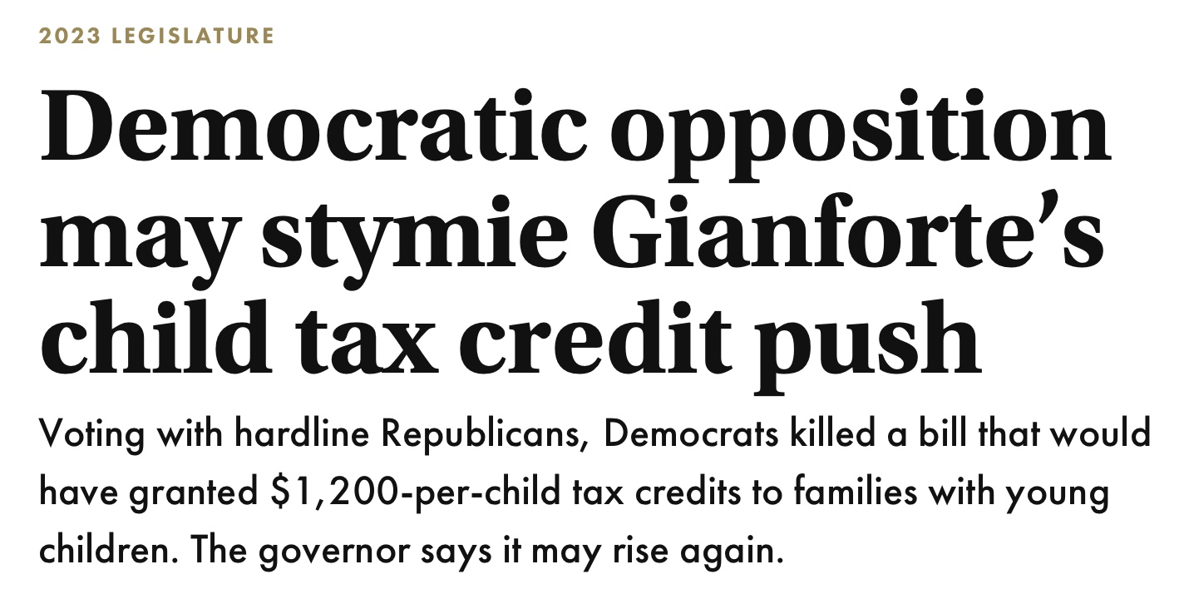
Montana’s failed CTC from last year.
In an interesting case last year, Democrats in the state legislature in Montana did not support a CTC proposed by the Governor.
This article quoted one Democrat mentioning that an income was required for families to gain the credit, and that this provision was a stumbling block.
Notes:
https://montanafreepress.org/2023/04/06/democratic-opposition-may-stymie-gianfortes-child-tax-credit-push/
Article offered that a “work requirement” may have killed the bill.
https://leg.mt.gov/bills/2023/billhtml/HB0268.htm

Slide 37
A CTC-related story idea
At tax time: talk to families living in poverty who are in Minnesota, for example, and to similar families in South Dakota and North Dakota (which have no state-level CTC). When families living in states with generous CTC programs get a “lump sum” refund, even if they have very little or no income, it is an important time for them, and could be contrasted to great effect with the same time in other states.
Notes:
What they do with that money – and what it means to them and their children – will tell much of the story that needs to be told about the CTC.
Hint: be sure and pick families across both states with income low enough that they will not receive the federal CTC.
Arizona and California provide another good comparison.

Slide 38
A CTC-related story idea
There is a new bill now in Congress to bring provisions from the Expansion to the existing federal CTC.
It could be valuable to hear from:
Parents, asking them “If you received the CTC monthly payments again today, what would they spend them on?”
Legislators or their staffers, especially those who voted against BBB, to ask them “In view of research substantiating how low-income parents spent their monthly payments in 2021, are you likely to review your position on this policy?”
Notes:
https://gop-waysandmeans.house.gov/wp-content/uploads/2024/01/BILLS-118hr7024ih.pdf
.

Slide 39
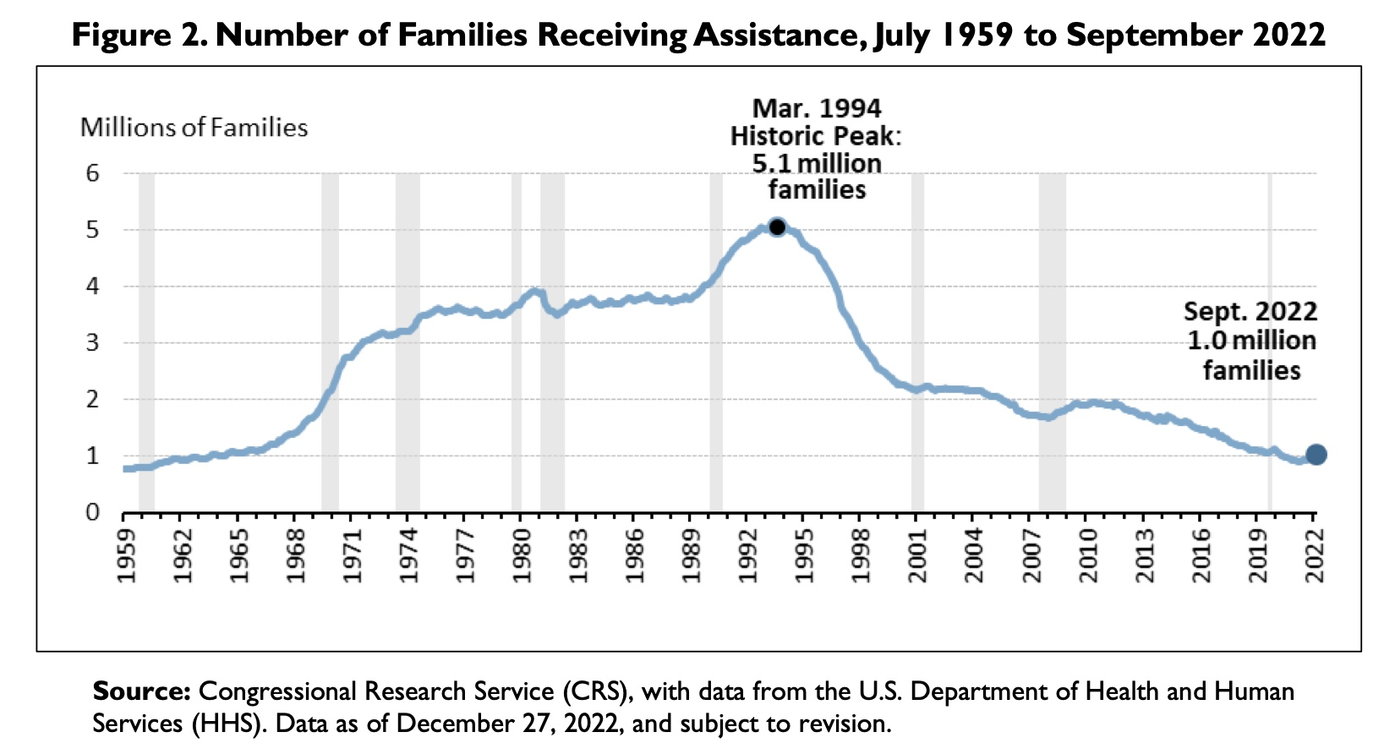
More about stories to move us forward.
Notes:
We need to look back as well, and think of how we arrived where we are. This graph shows an important development that has led to the necessity of looking at a provision that was part of the tax code to address childhood poverty.
It would be helpful to shift our public perception of low-income parents.
As caveat to state-level CTC as the path forward, 27 states have no state-level CTC yet. And of those, NINE states have no state income tax.
Alaska, Florida, Nevada, New Hampshire, South Dakota, Tennessee, Texas, Washington, and Wyoming do not levy a state income tax (making it difficult to envision state-level CTC’s in these states).
Are many policies to protect the rights of families better? Or should the plan be simple? We’ve seen that a Child Tax Credit can be altered to provide radical help, and then be altered again.

Slide 40
What stories do we need to move forward with poverty reduction?
Any story that emphasizes the dignity of low-income parents*:
What is it like for a parent to access the social safety net today in their state? Do they have the benefits to which they are entitled, and if not why not?
How much debt are they carrying today, and do they have an emergency fund or savings right now?
Is the family able to maintain a checking or savings account?
How much money do they have left at the end of each month? What bills are going unpaid right now?
For families who are not extremely food-insecure: What does having enough to eat look like these days for their children? For themselves? What strategies do they use right now to feed everyone in the family?
* In the context of any policy.
Notes:
We need more light shining on the subject of how inequitable the US social safety net is from state to state.
After the pandemic, we saw a big increase in debt among low-income parents. And debt predicts anxiety in parents.
Banks charge fees that reinforce structural inequities. This condition + payday lending can add to family challenges.
We know the economic recovery is unevenly distributed. Material hardship predicts anxiety in parents.
Food insecurity has not been resolved in the time since the pandemic, and it is a hard topic for parents to open up about.

Slide 41
Thank you for listening, and thank you for the work you do.
Karen Chatfield, Director of Family Economic Security
kchatfield@bankstreet.edu

