Slide 1


Transforming a Child Welfare System
Charles Bradley, MSW
Child, Family, and Adult Services (CFAS)
Youth and Family Services Director
January 22, 2024

Slide 2
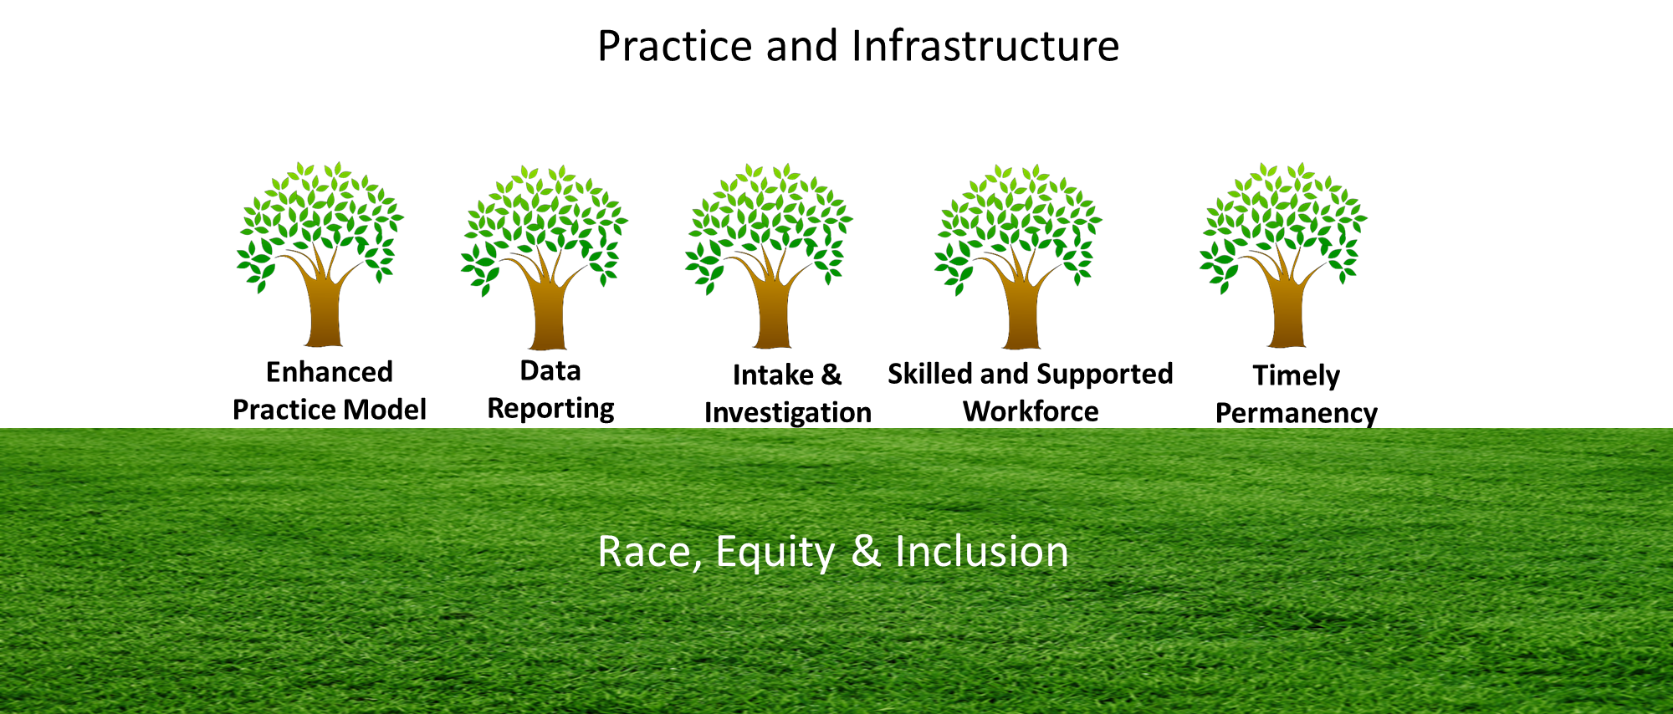

YFS focused its efforts on improving practice and enhancing its infrastructure

Slide 3
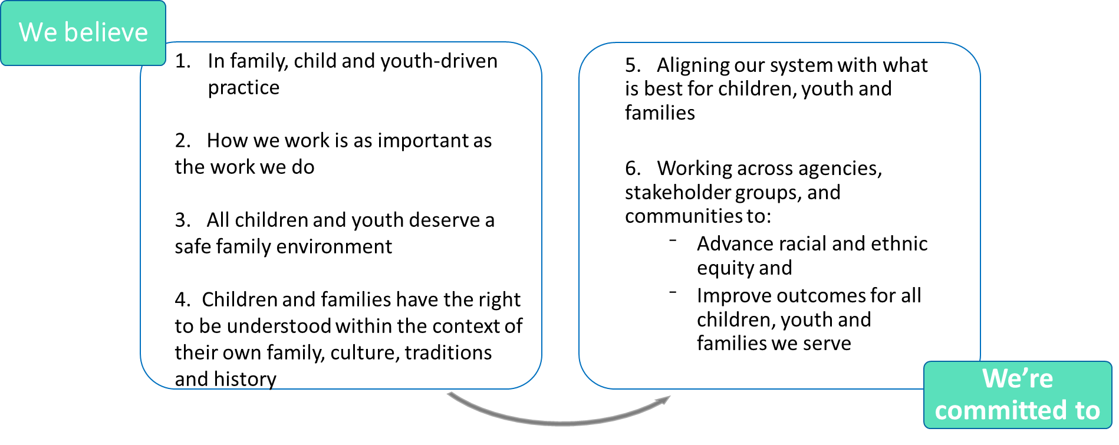
Mecklenburg County YFS Values and Beliefs

Slide 4
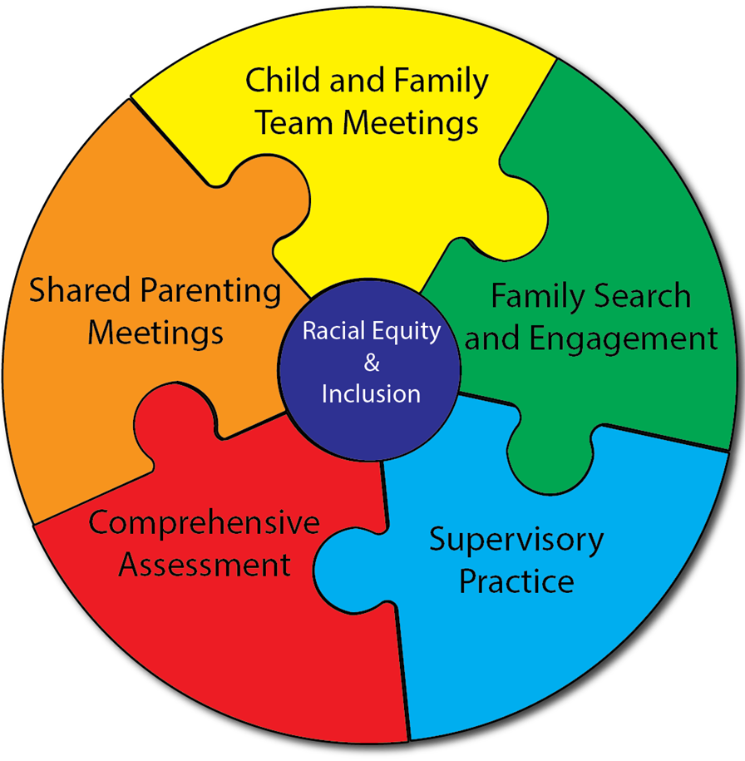
YFS Practice Interventions

Slide 5
Practice Model Outcomes
Decrease number and rate of entries into out of home care.
Reduce the number and rate of repeat maltreatment.
Increase placement stability/reduced placement moves.
Decrease LOS for youth in OOH care.
Increase % of children and older youth placed with kin.
Increase % of youth with timely adoptions.
Improve equitable outcomes for all children of color.

