Slide 1
Home-School Nation
A Washington Post series

Slide 2
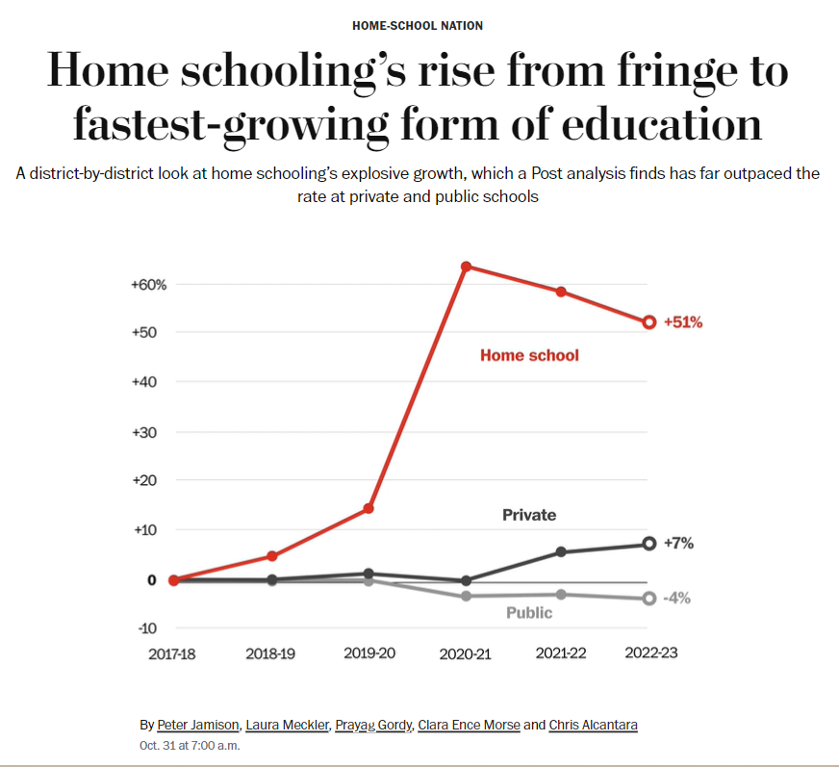
National data analysis

Slide 3
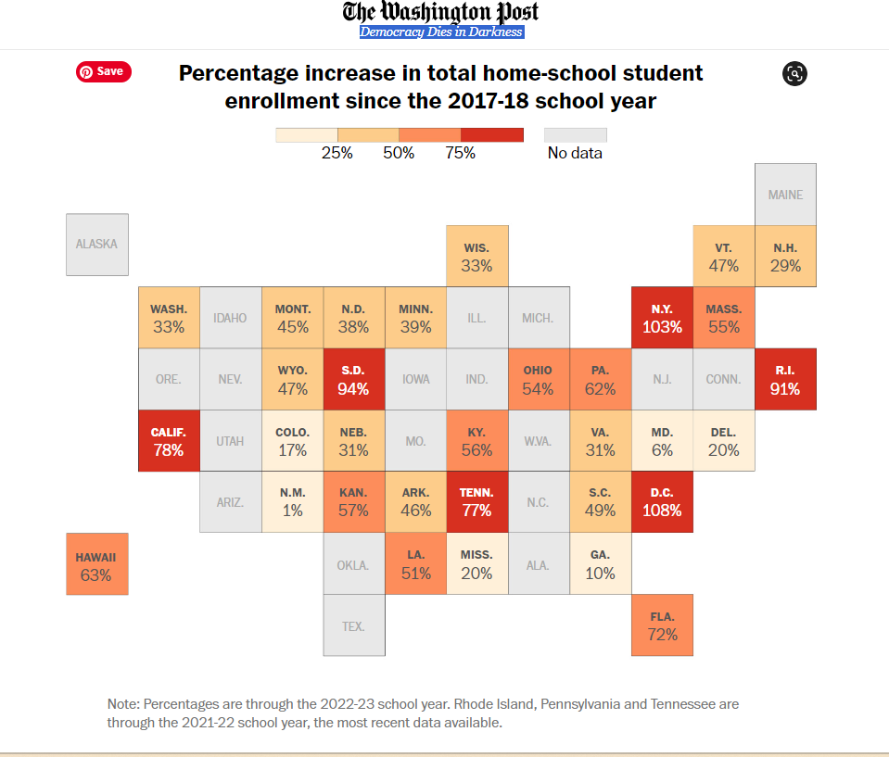
Percentage increase in home-schooling by state
(Link)

Slide 4
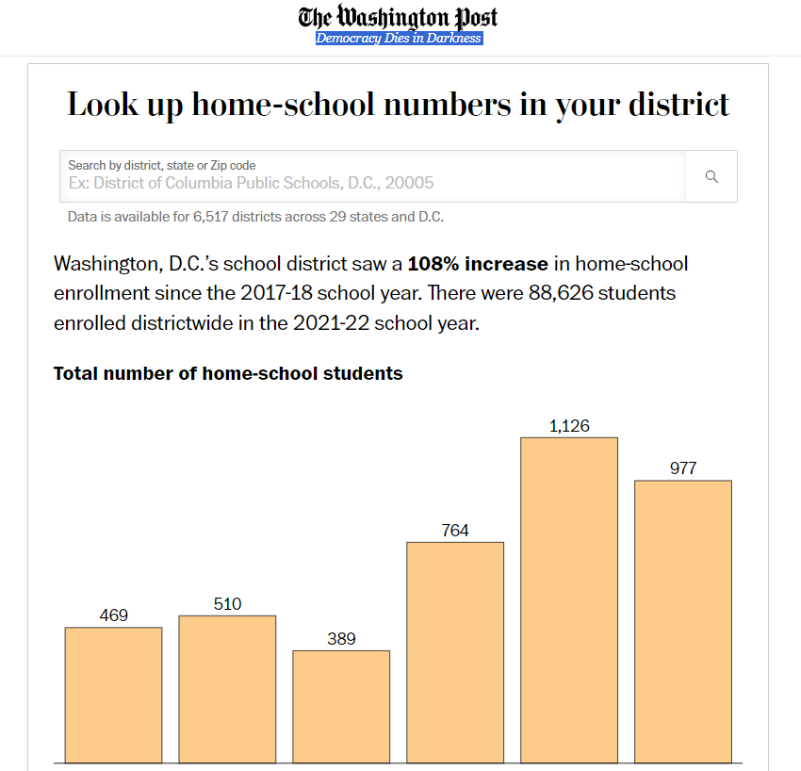
Look-up tool for local districts

Slide 5
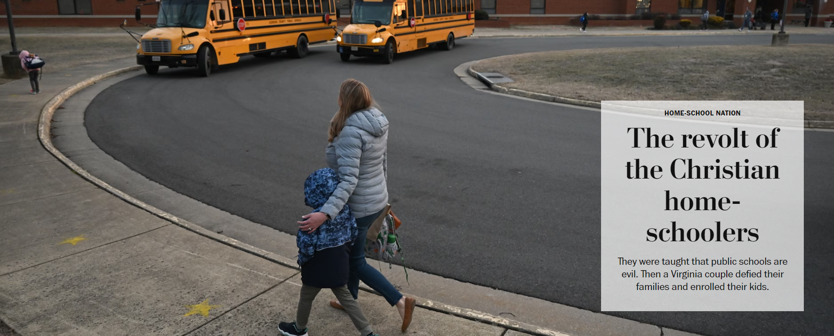
First story in the series

Slide 6
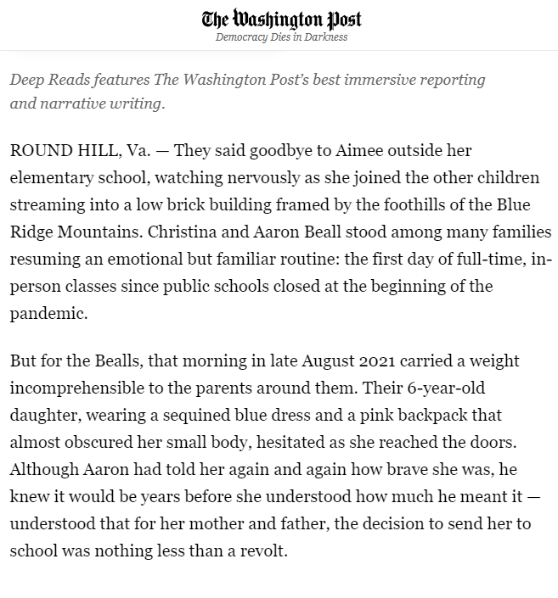

Slide 7
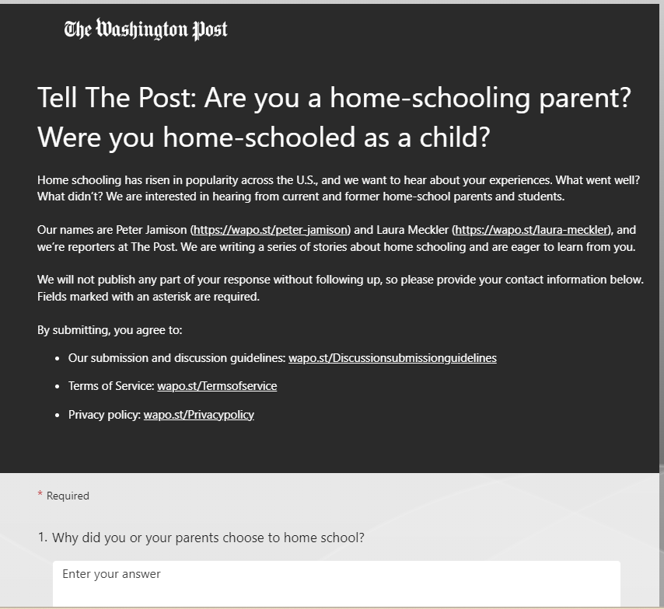
About 1,200 responses to our reader call-out

Slide 8
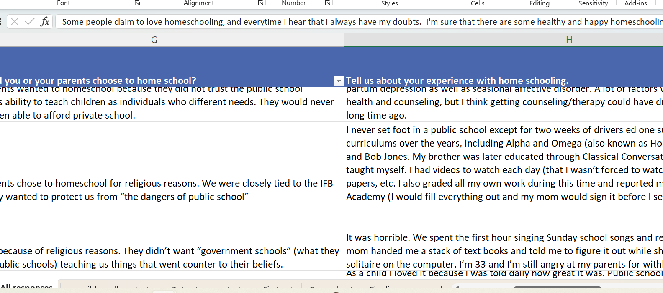
Kept track of responses via spreadsheet

Slide 9
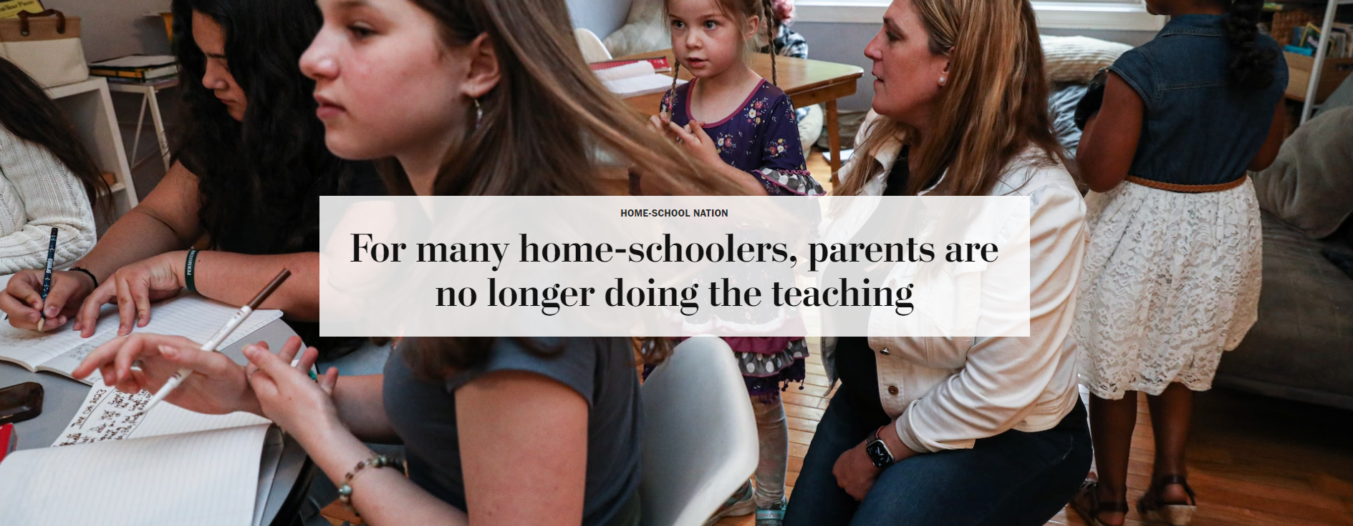
Rise of the microschool … and more

Slide 10
An explosion of new options (Link)
For many years, home schooling has conjured images of parents and children working together at the kitchen table. The new world of home schooling often looks very different: pods, co-ops, microschools and hybrid schools, often outside the home, as well as real-time and recorded virtual instruction. For a growing number of students, education now exists somewhere on a continuum between school and home, in person and online, professional and amateur.

Slide 11
[N]ew financial and ideological forces have revolutionized the broader home-school landscape.
The most powerful may be government. About a dozen states allow families to use taxpayer funds for home-school expenses. Education Savings Accounts, or ESAs, direct thousands of dollars to families that opt out of public school, whether the destination is a private school or their own homes.
Support comes, too, from the nonprofit sector. School-choice advocates are directing millions of dollars in charitable giving toward home-school organizations — a convergence of two powerful but traditionally separate movements.
And venture capitalists have invested tens of millions of dollars in new businesses to serve what they see as a potentially huge market.

Slide 12
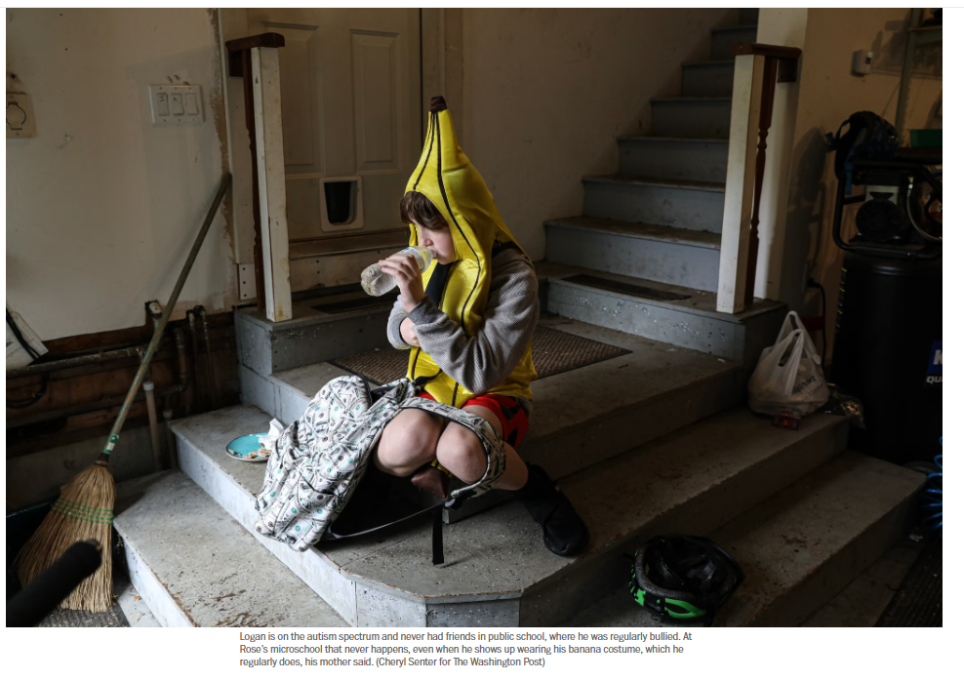

Slide 13
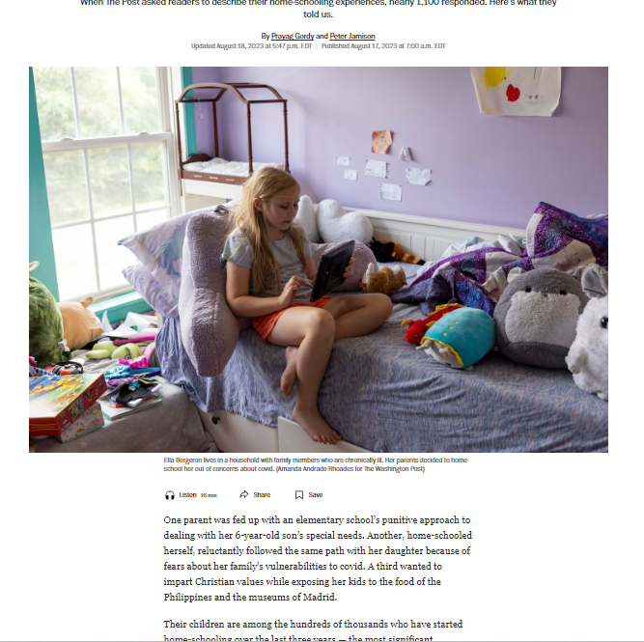
Voices of home-school families
(Link)

Slide 14
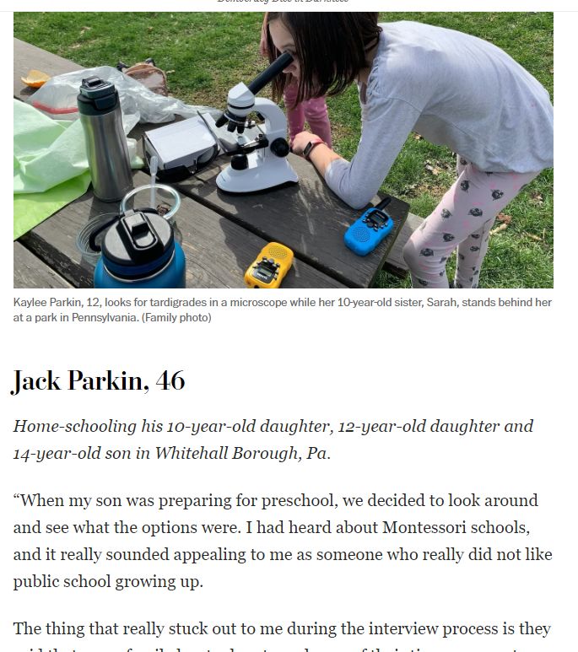
Five sketches- of home-school families

Slide 15

Examination of Michael Farris and today’s politics
(Link)

Slide 16
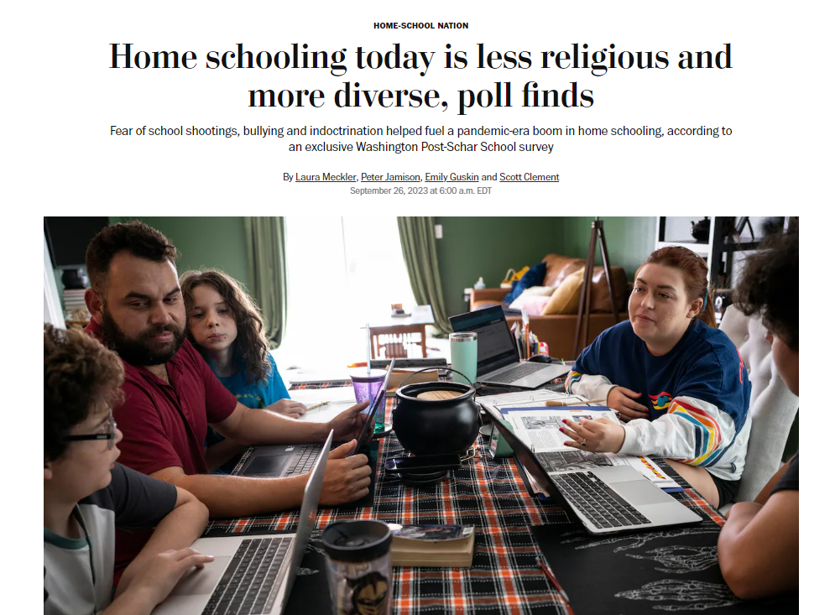
A Washington Post poll, partnering with the Schar School
(Link)

Slide 17
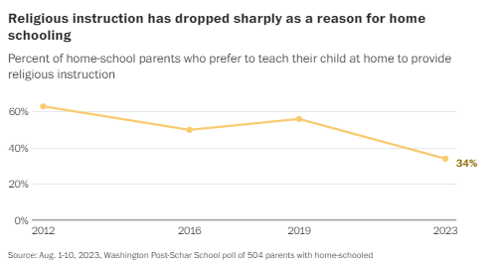

Slide 18
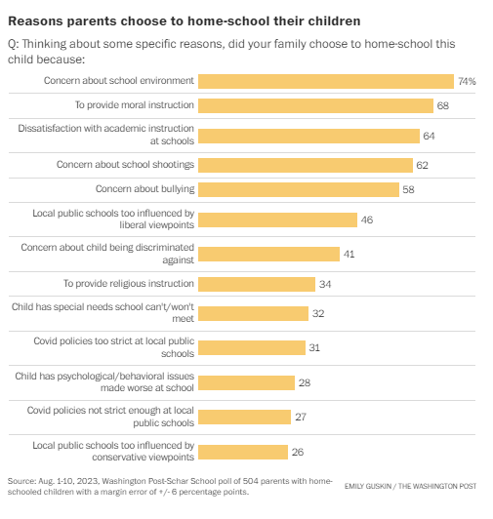

Slide 19
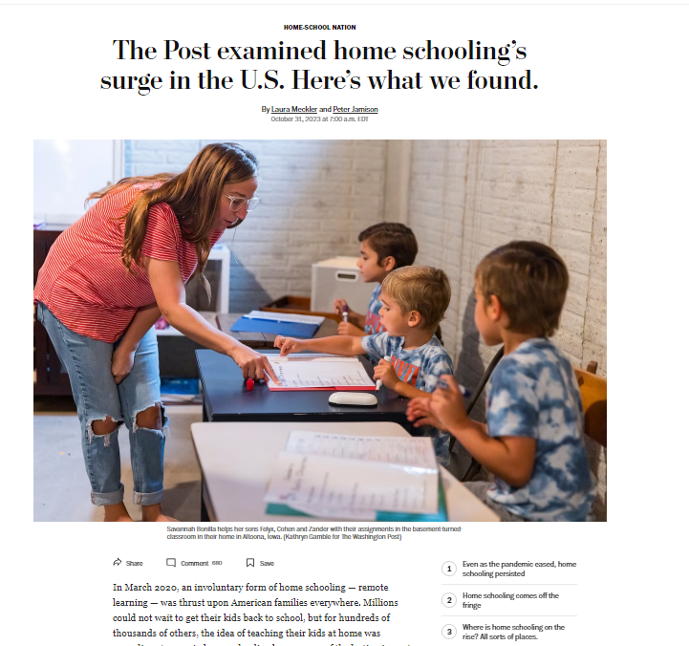
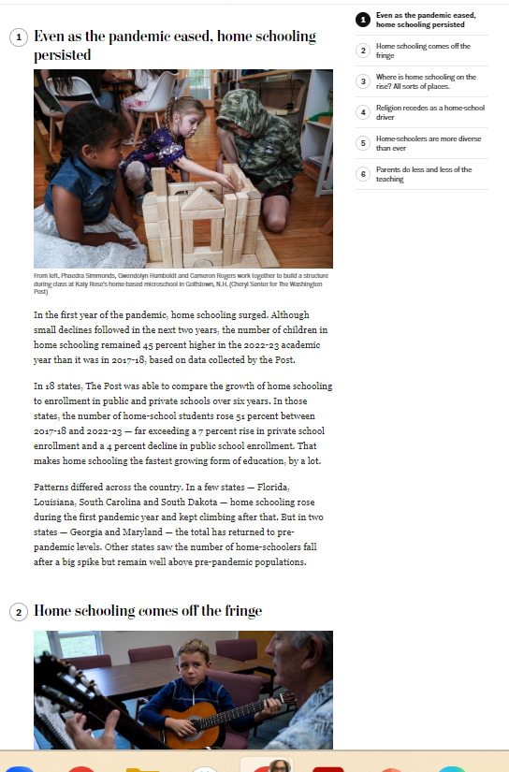
Takeaways pulled together findings from data story and poll (Link)

Slide 20
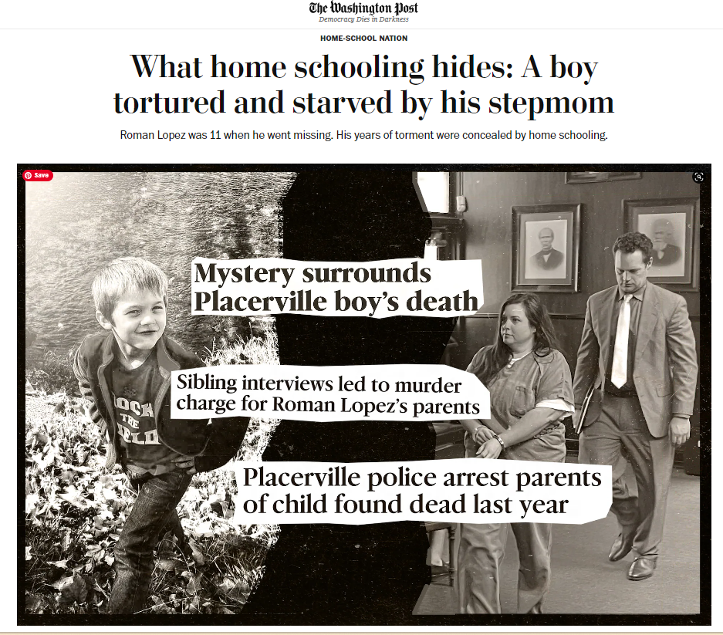
A harrowing story of child torture and murder
(Link)

Slide 21
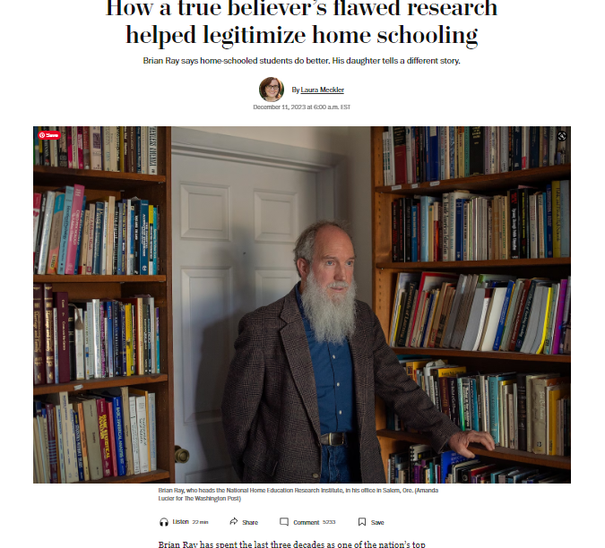
How do home-schooled children fare academically?
(Link)

Slide 22
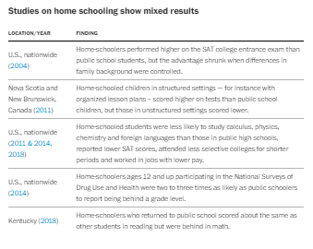
Research results were best summarized like this

Slide 23
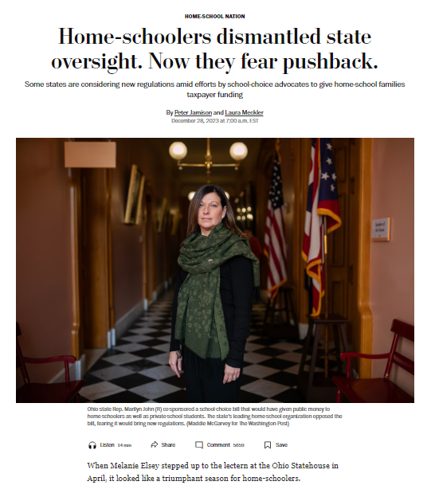
The dismantling of home-school regulations… and a new frontier
(Link)

Slide 24
Story ideas to consider
Data from your area: Has home-schooling increased and where?
State regulations: Do they exist?
Local enforcement: Is there any real scrutiny?
New flavors: microschools, pods and more formal co-ops
Impact on local public schools
Possible abuse cases
Local outcomes data

Slide 25
Questions?
Feel free to contact us with questions:
Laura.Meckler@washpost.com
Peter.Jamison@washpost.com

