Slide 1
Covering the Police
Tony Plohetski
Associate Editor, Austin American-Statesman
Senior Reporter, KVUE-TV

Slide 2
A little about my background and why good police coverage is so important
I’ve always enjoyed breaking news (adrenaline junkie).
I have always valued of “true crime” coverage, but it is complicated.
My work has transitioned to more “accountability reporting” in recent years which, as a journalist, I believe is a particularly important responsibility.

Slide 3
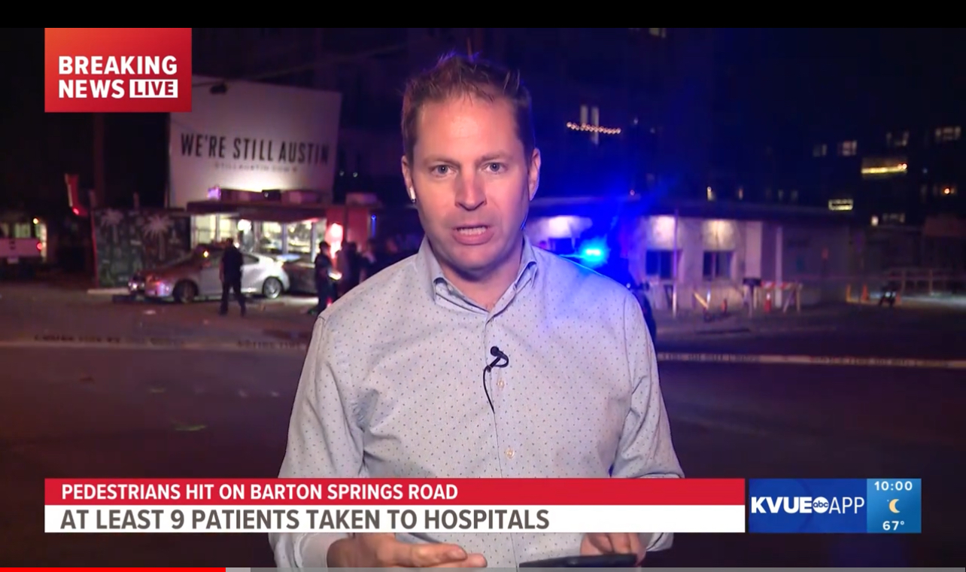
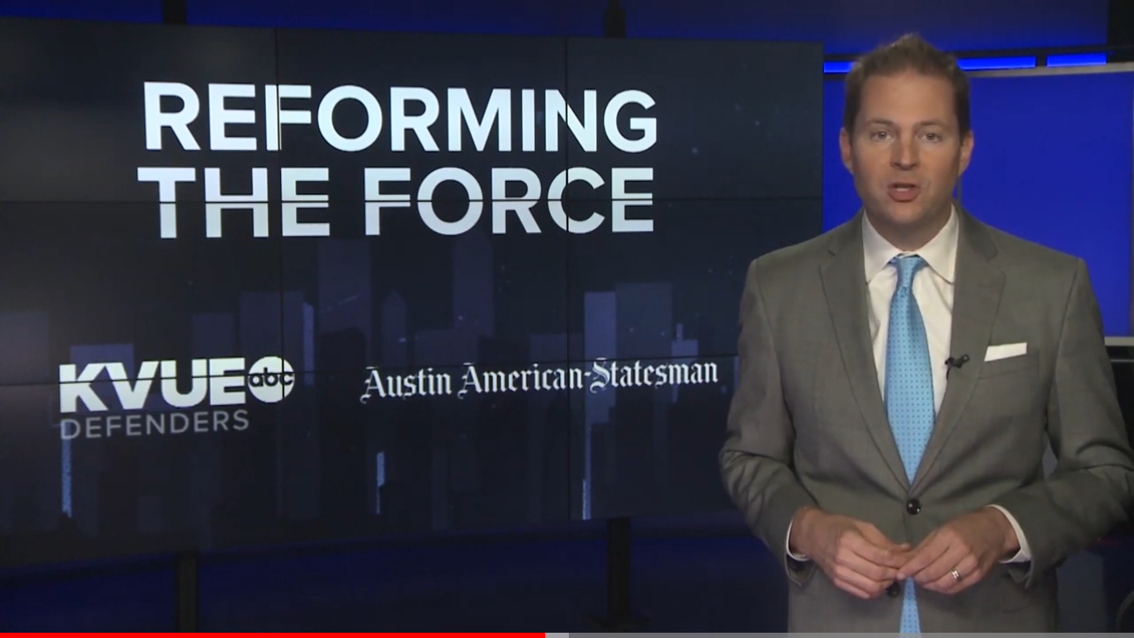
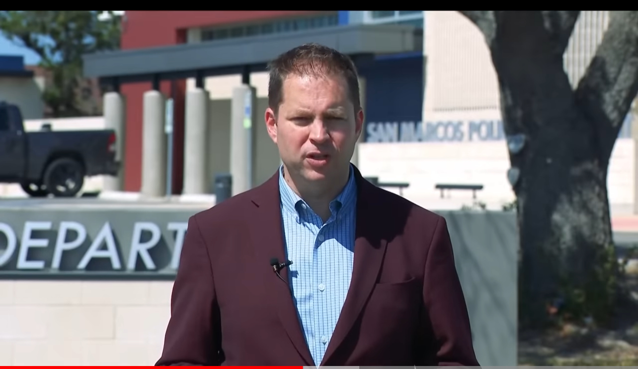
Types of police coverage
Breaking news
Community-based enterprise
Investigative reporting

Slide 4
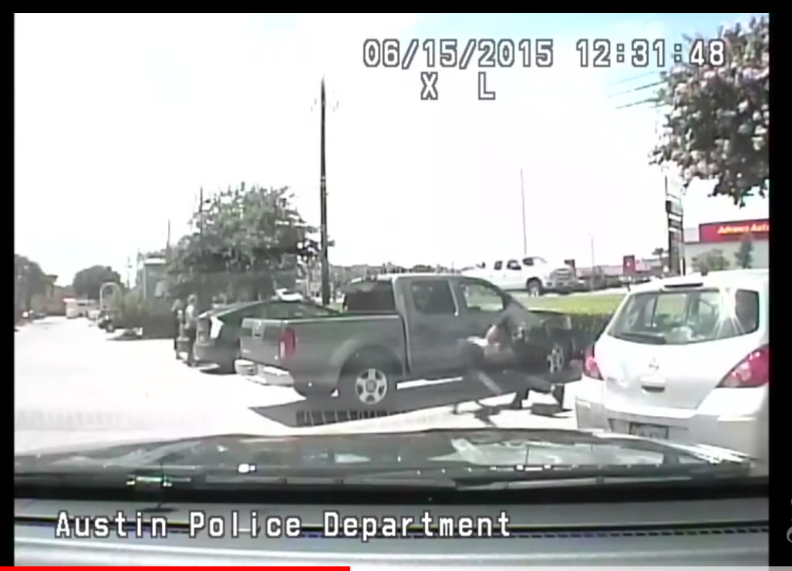
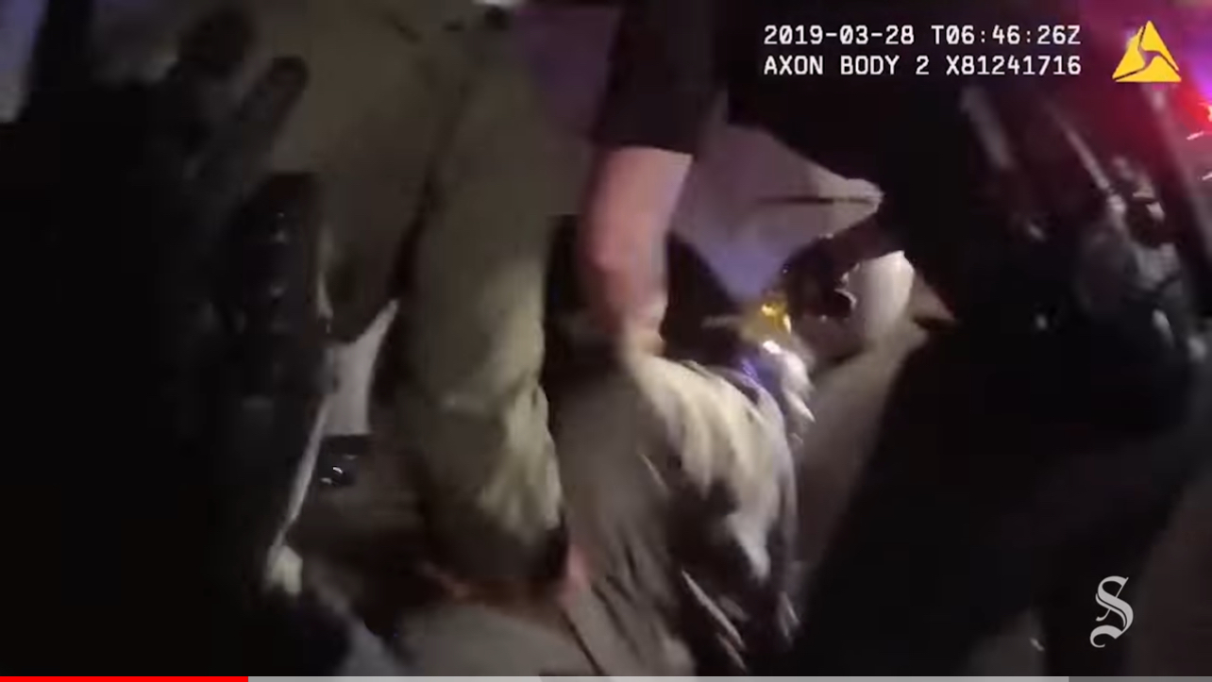
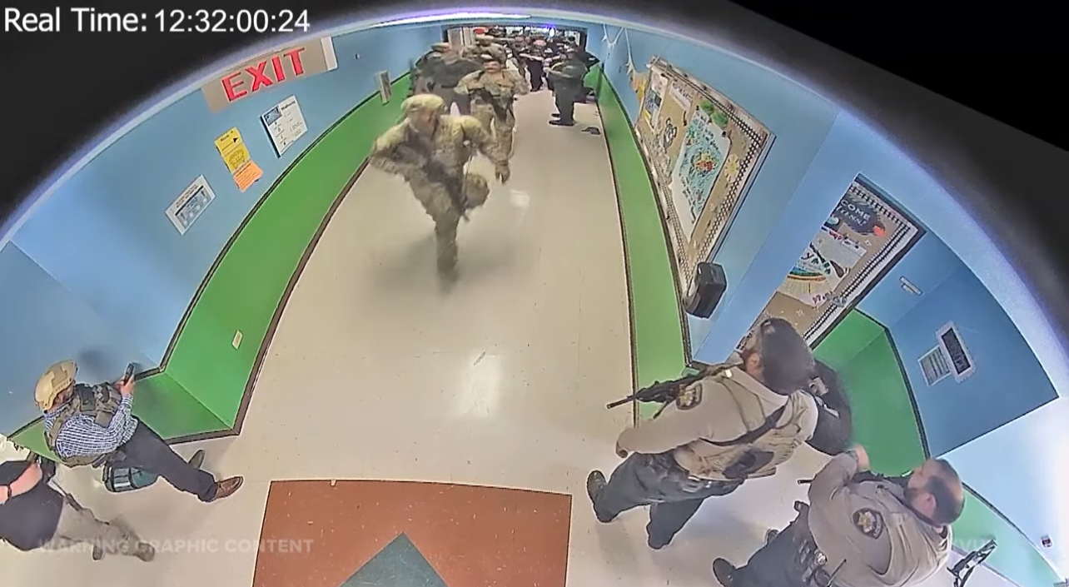
Examples in recent years of accountability reporting
Breaion King, 2016
Javier Ambler & Williamson County Sheriff’s Office, 2020
Uvalde Mass Shooting, 2022

Slide 5
How do you find stories covering the police?
Good sourcing often comes from within an agency. Through reporting on day-turn stories, keep your eye out for people who seem particularly conversational and open to a relationship. Invite them to coffee. Hear what they have to say.
Police union leaders can make for good sourcing
But there are many other potential good sources for covering the police: there are reformists and activists, police monitor/civilian oversight, prosecutors, victims’ advocacy groups, defense attorneys and civilian attorneys, the community at large.
Make sure your news managers are giving you time for this. Ask for at least a couple of workdays a month to purely work on building relationship, establishing sources.
The payoff is not always immediate, but it will be.

Slide 6
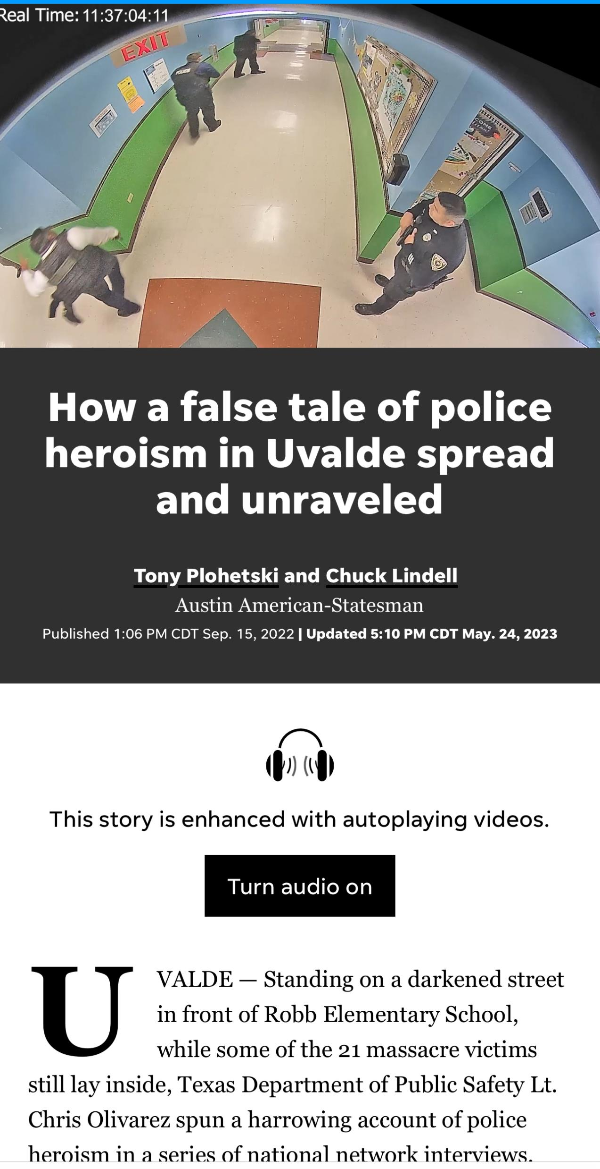
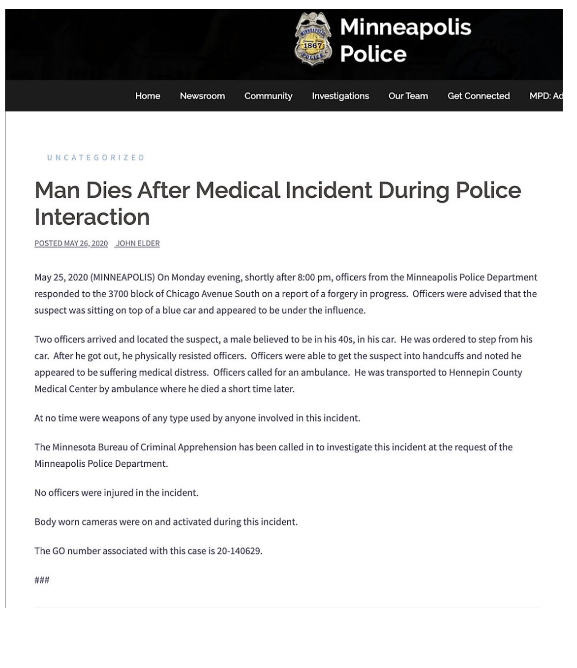
Police as the ‘official narrator’
George Floyd
Uvalde
Always listen, but then do your due diligence

Slide 7


Questions?
@tplohetski

