Slide 1


Slide 2


Slide 3
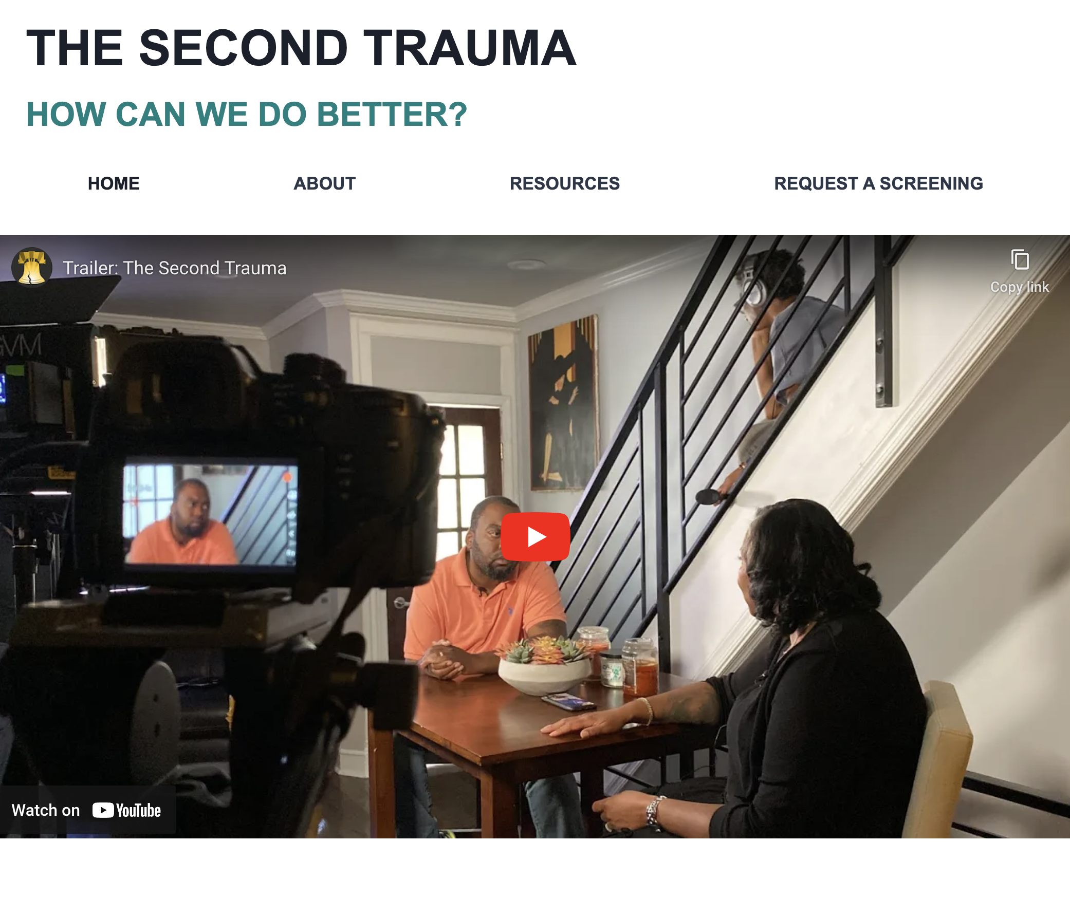

Slide 4
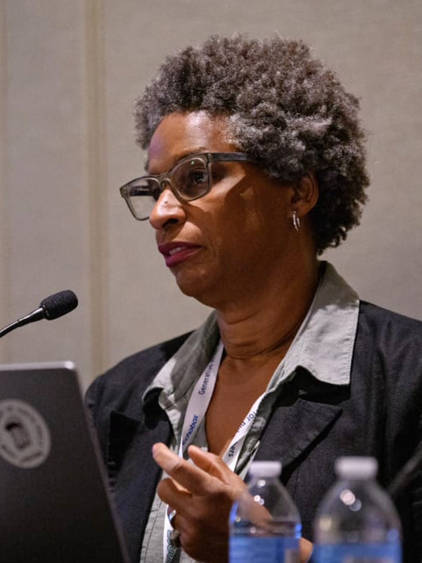
PROF. YVONNE LATTY
Director, Logan Center for Urban Investigative Reporting
Klein College
Temple University
Journalism Education Advisor, Philadelphia Center for Gun Violence Reporting

Slide 5
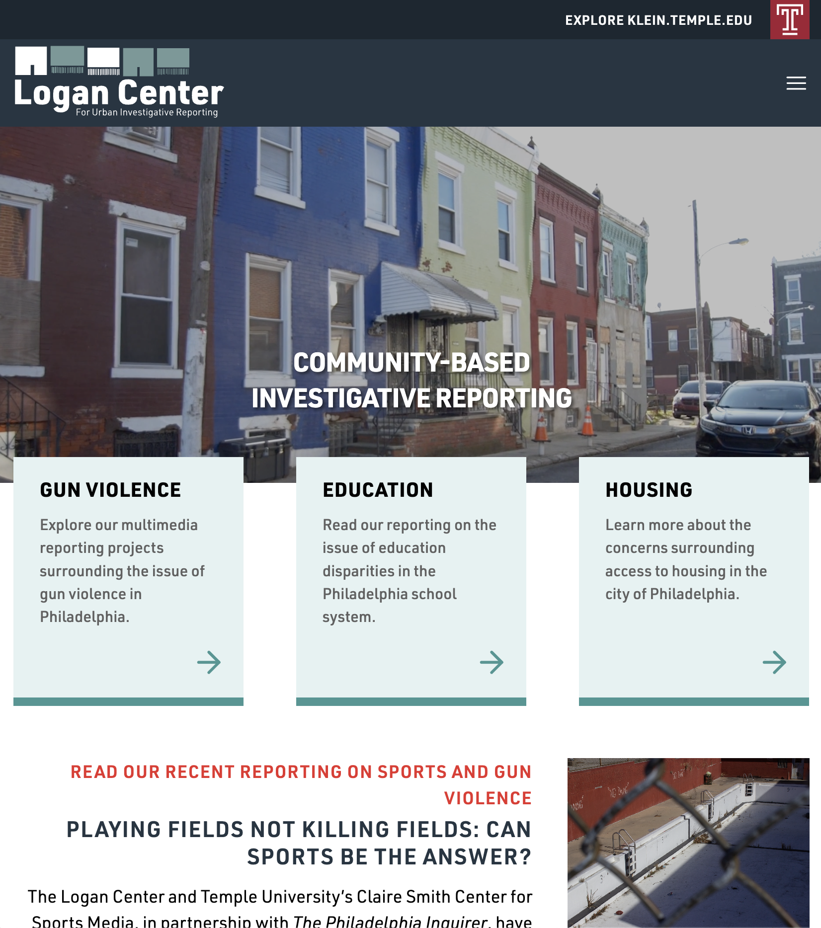

Slide 6
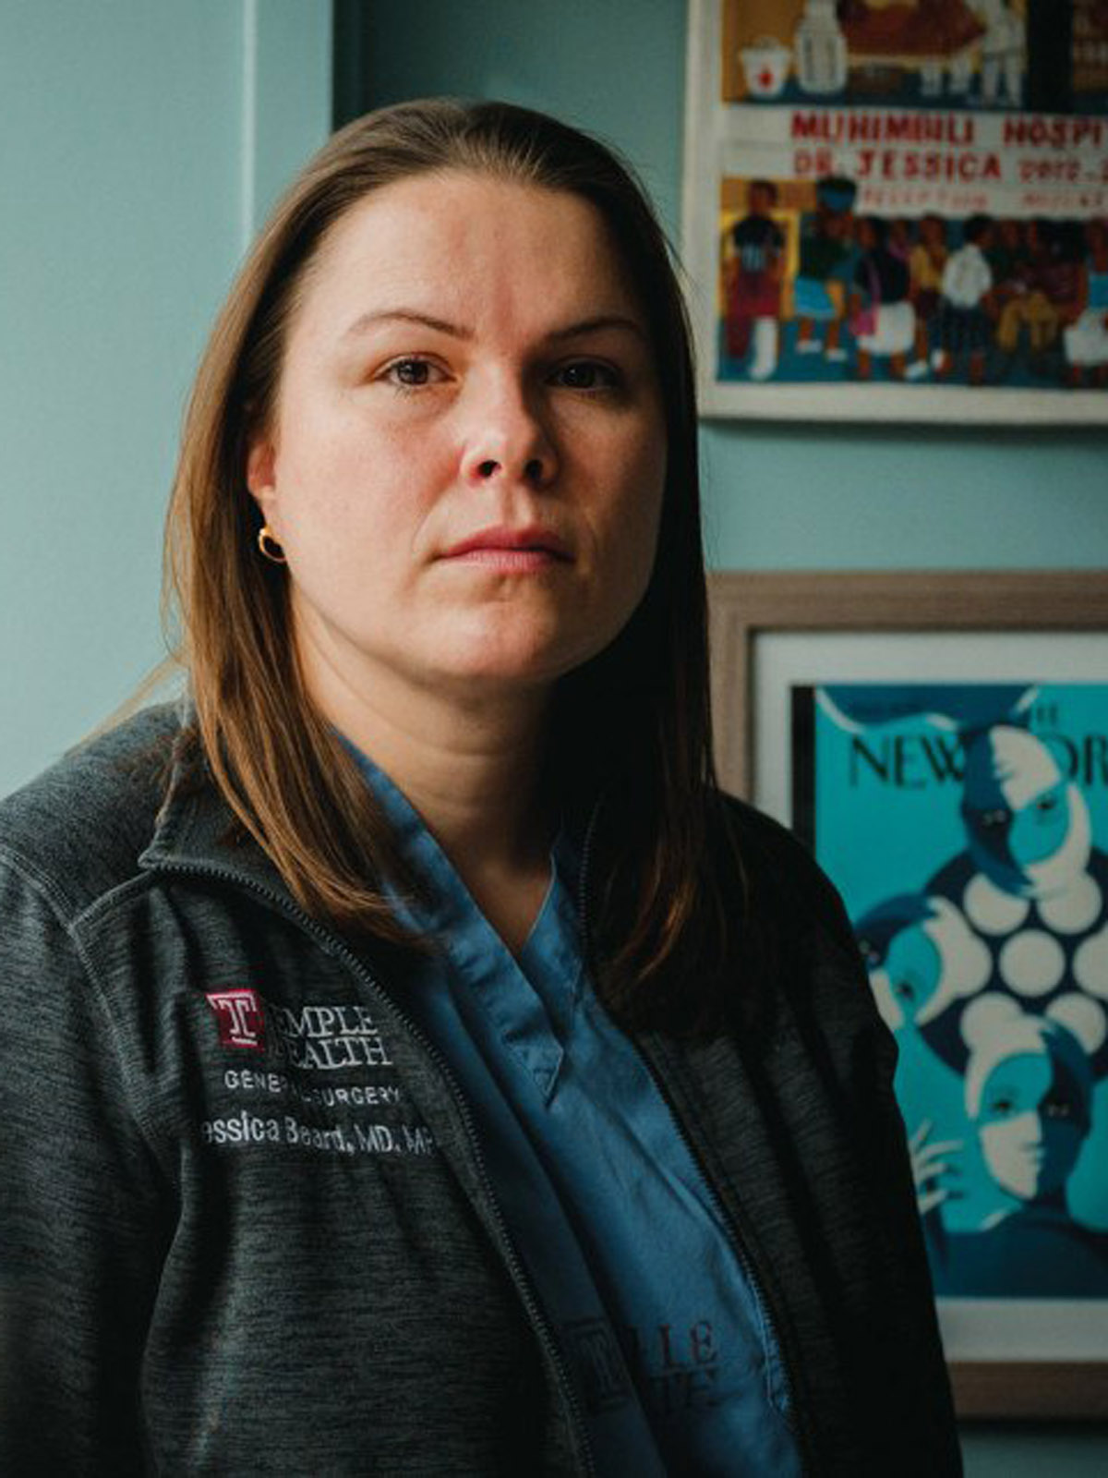
DR. JESSICA BEARD
Trauma Surgeon, Temple Trauma
Director of Research, Philadelphia Center for Gun Violence Reporting
Stoneleigh Foundation Fellow

Slide 7
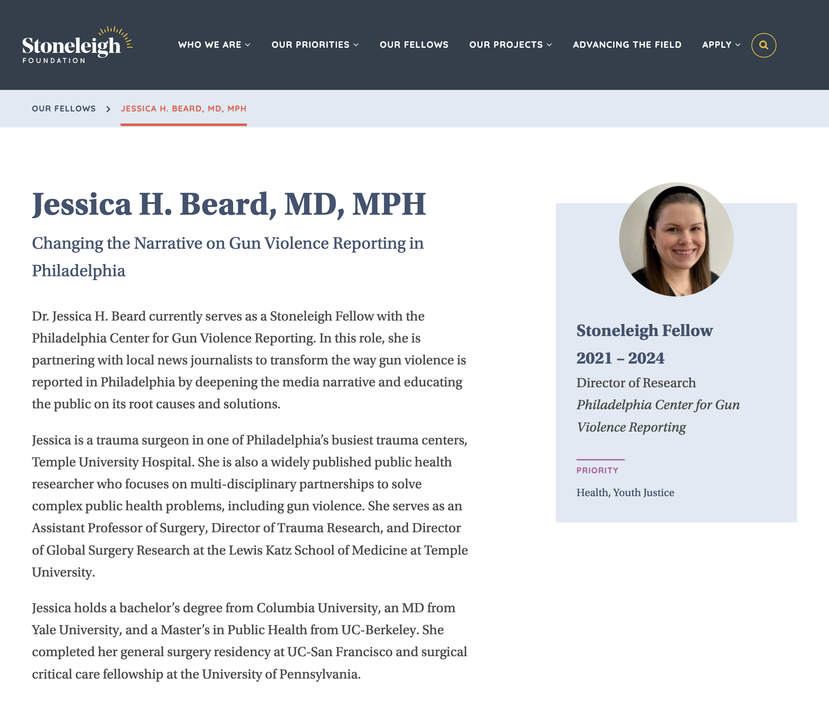

Slide 8
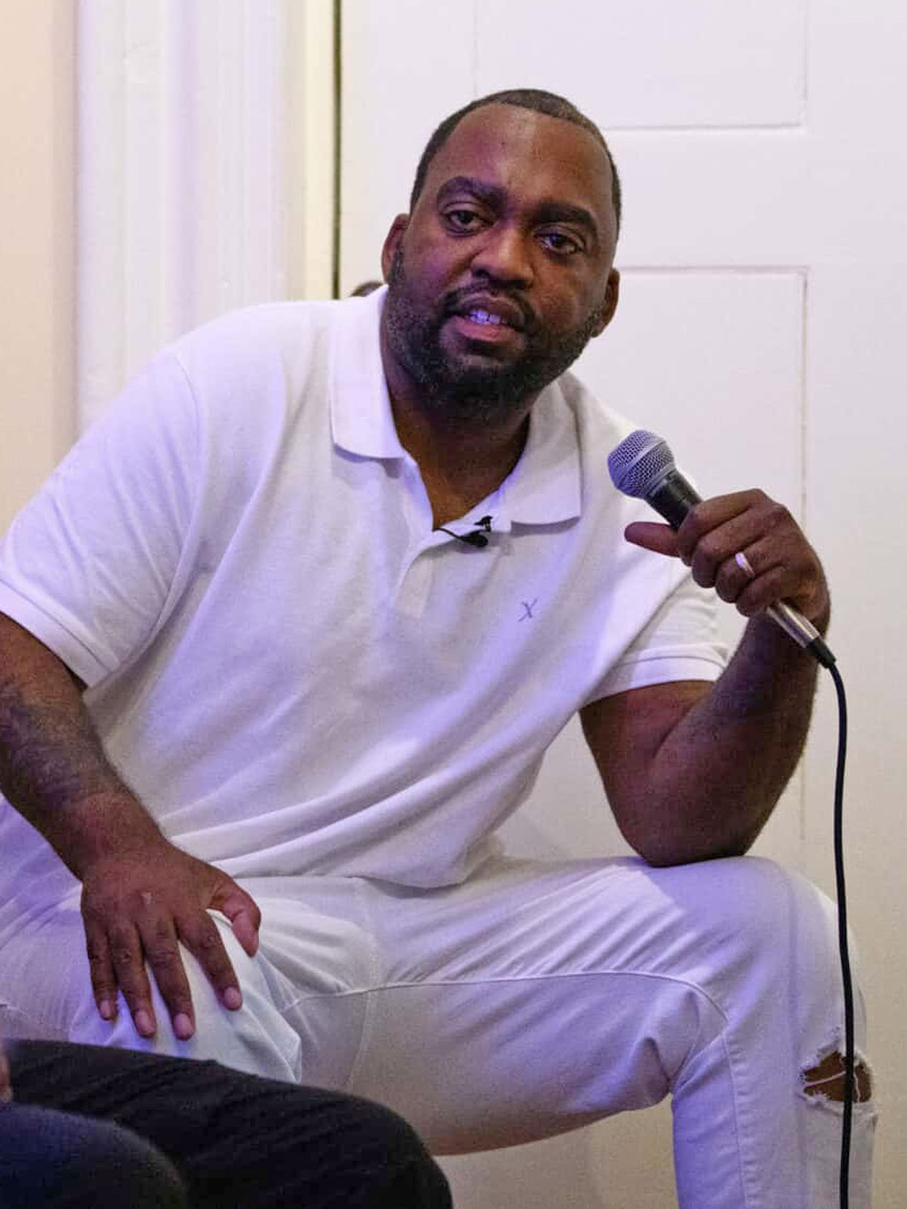
ORONDE MCCLAIN
Newsroom Liaison, Philadelphia Center for Gun Violence Reporting
Emerging Leader Fellow
The Stoneleigh Foundation

Slide 9
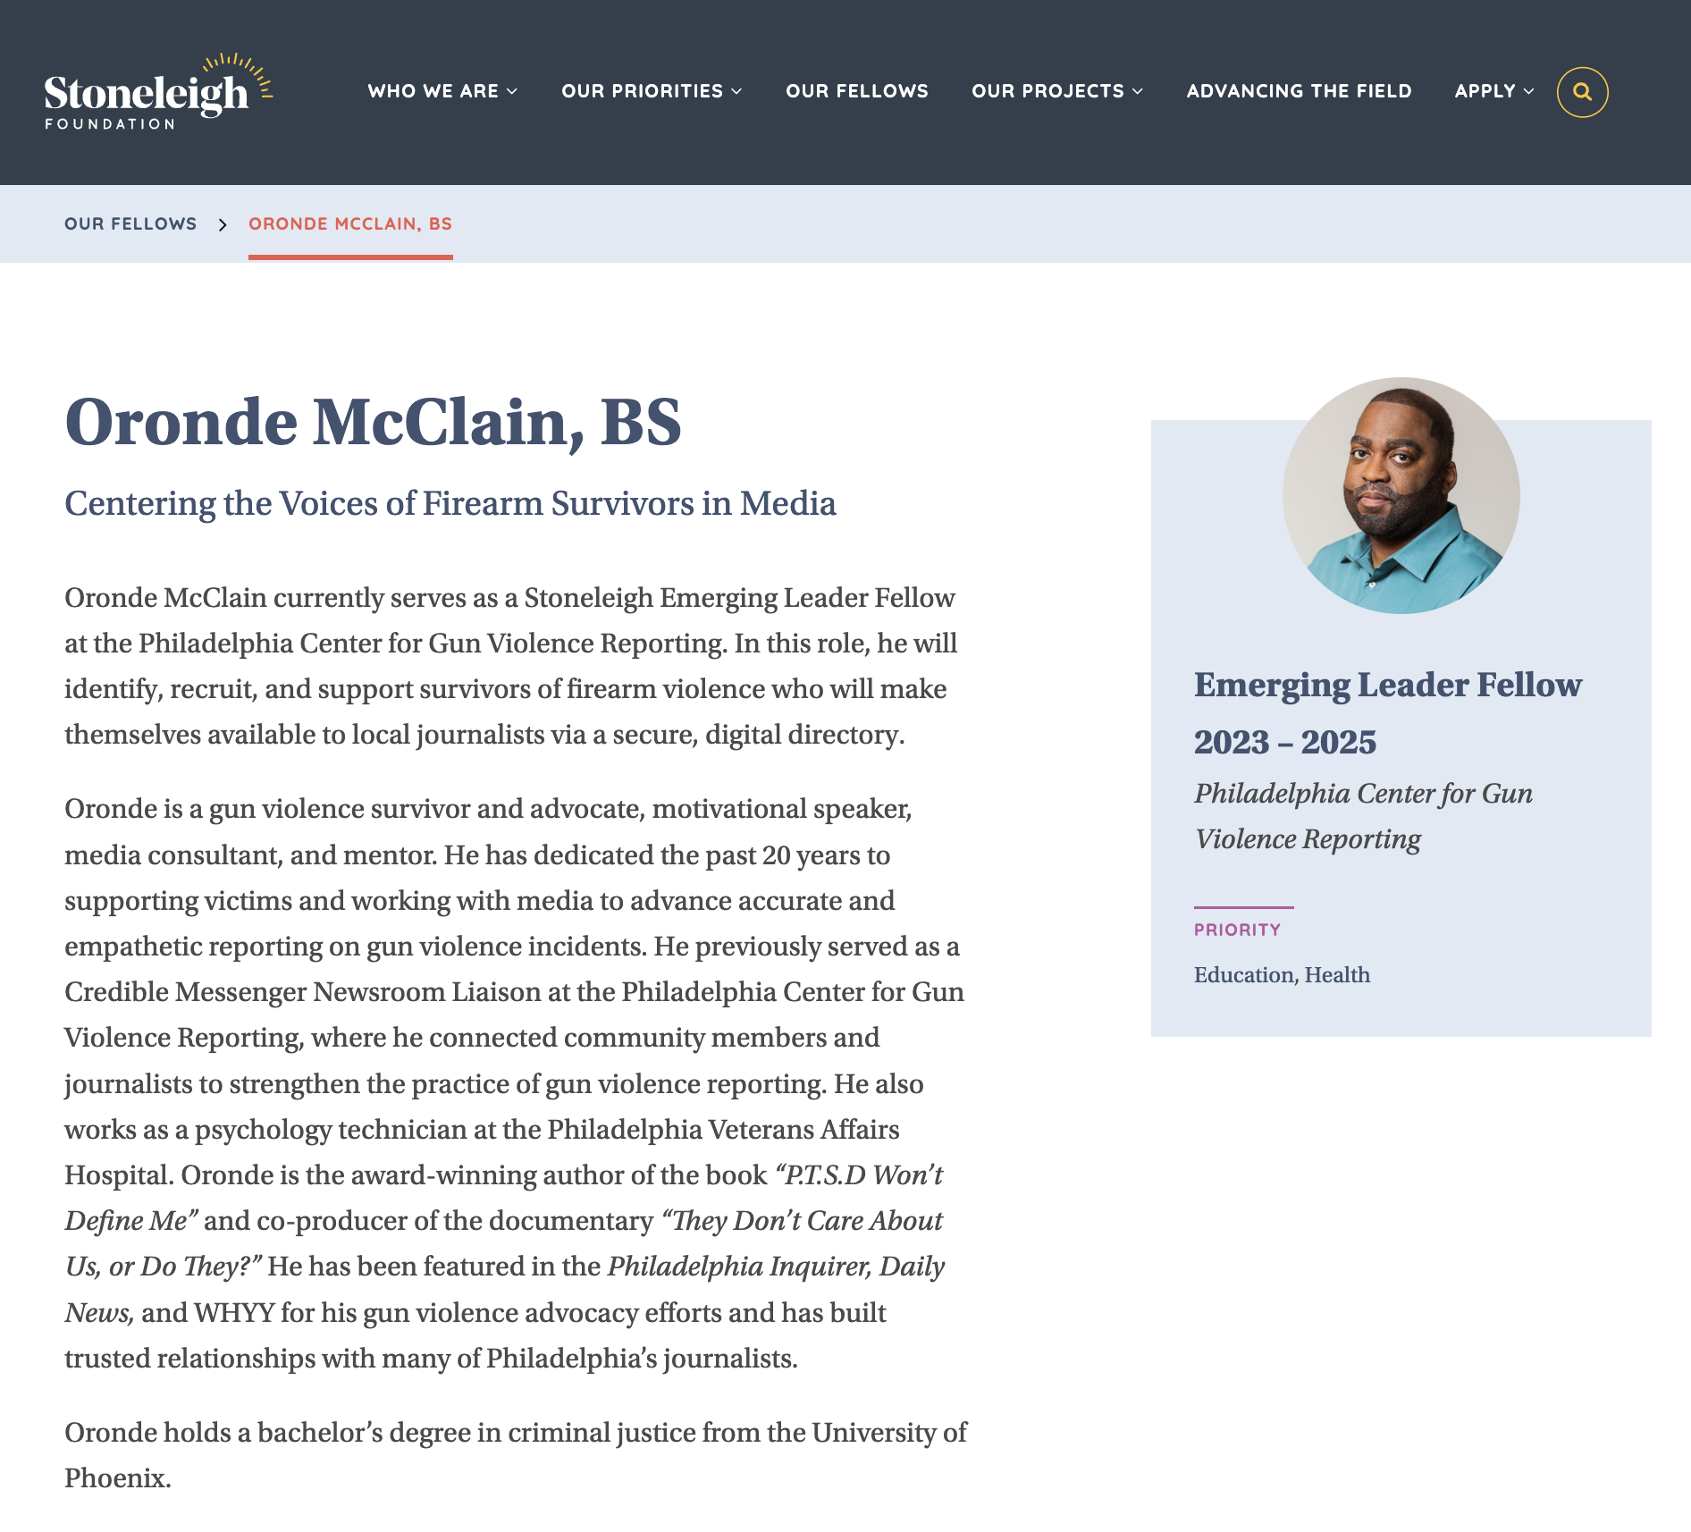

Slide 10
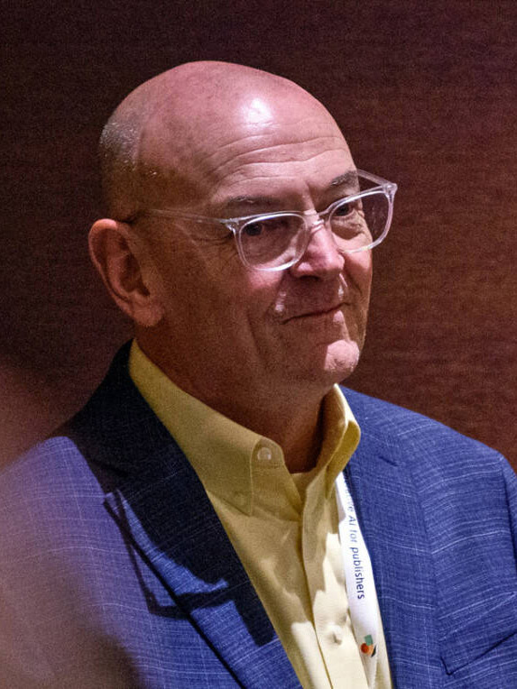
JIM MACMILLAN
Founder and Director, Philadelphia Center for Gun Violence Reporting
Assistant Director, Logan Center for Urban Investigative Reporting
Klein College
Temple University

Slide 11


Slide 12
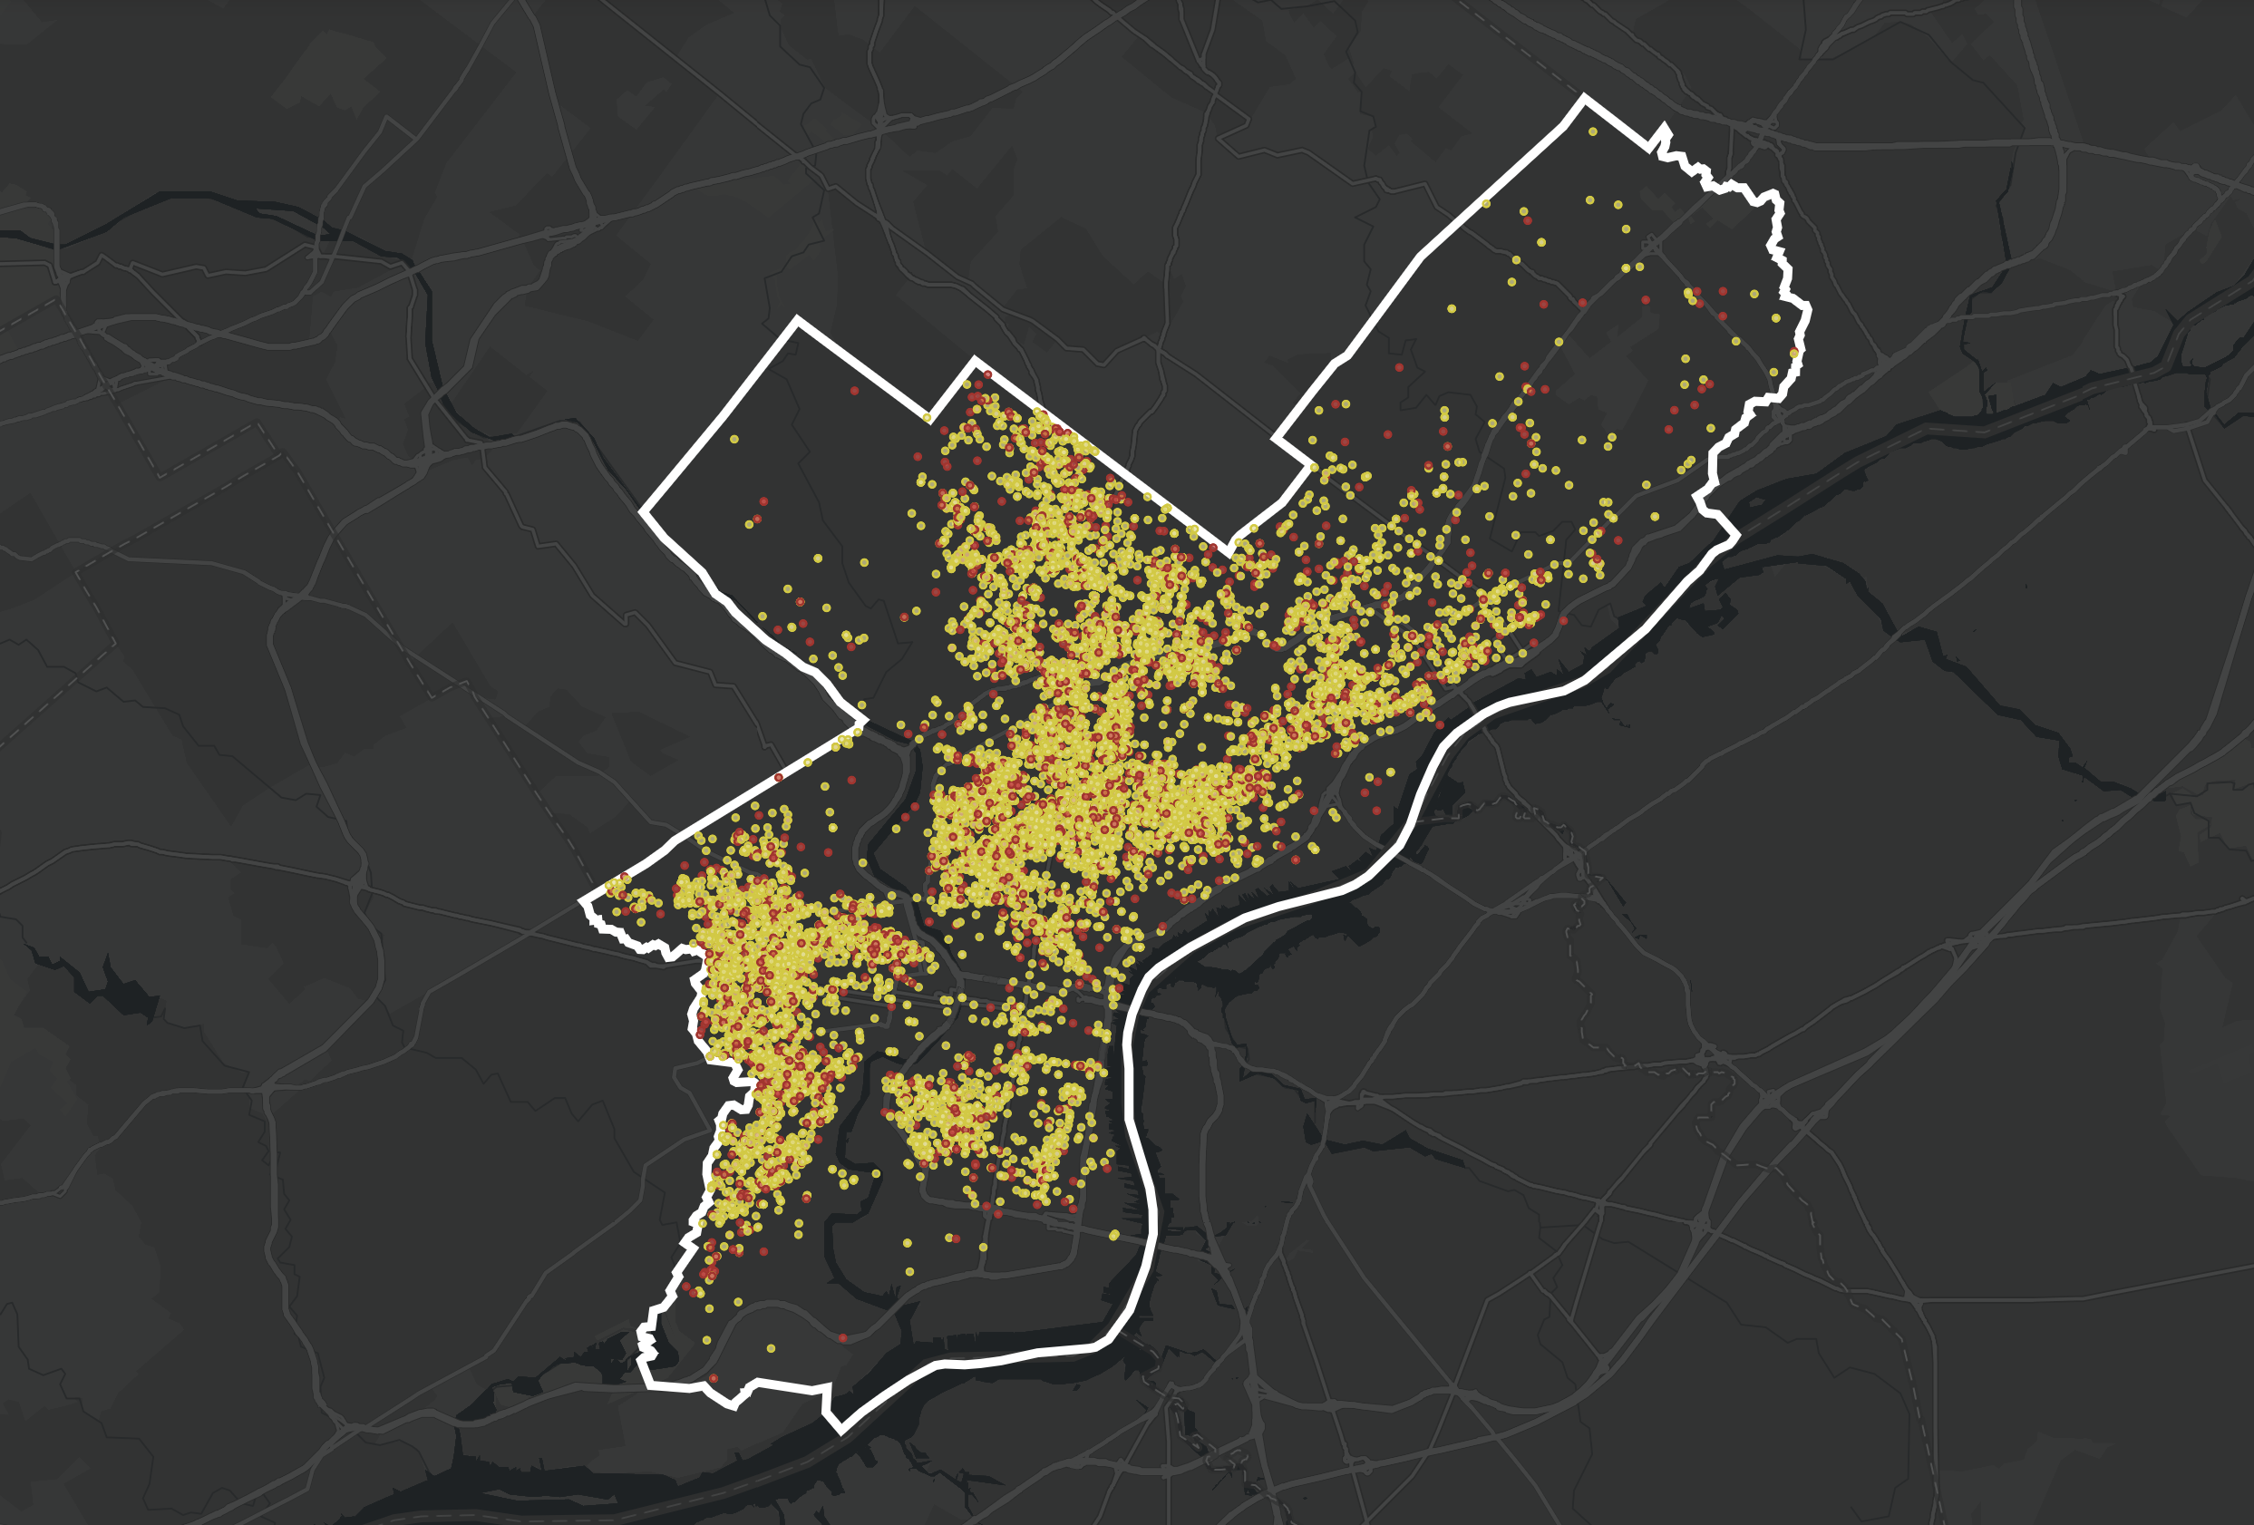

Slide 13
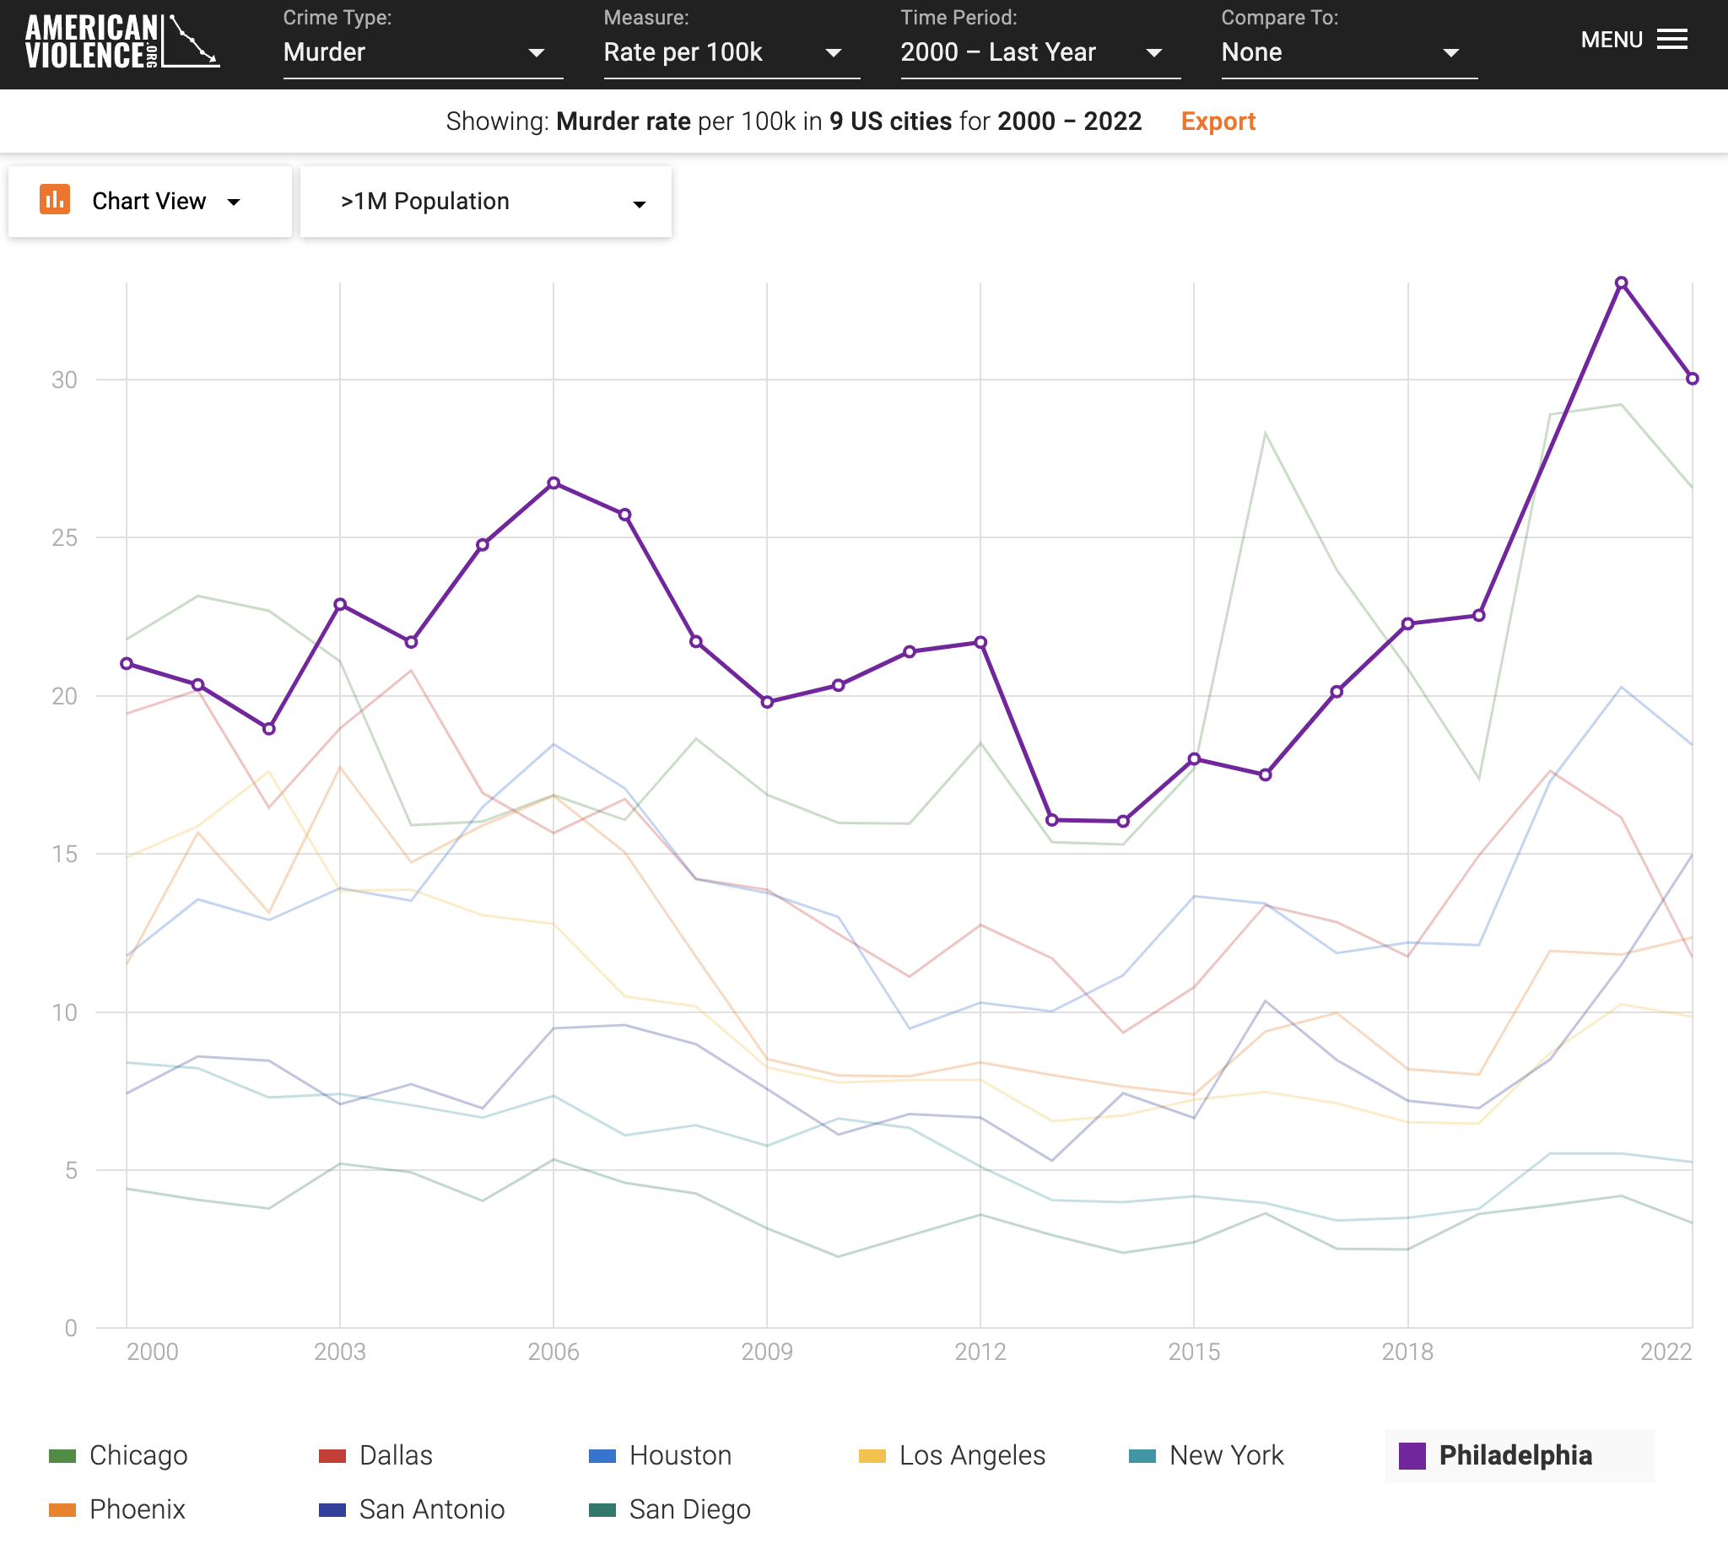

Slide 14
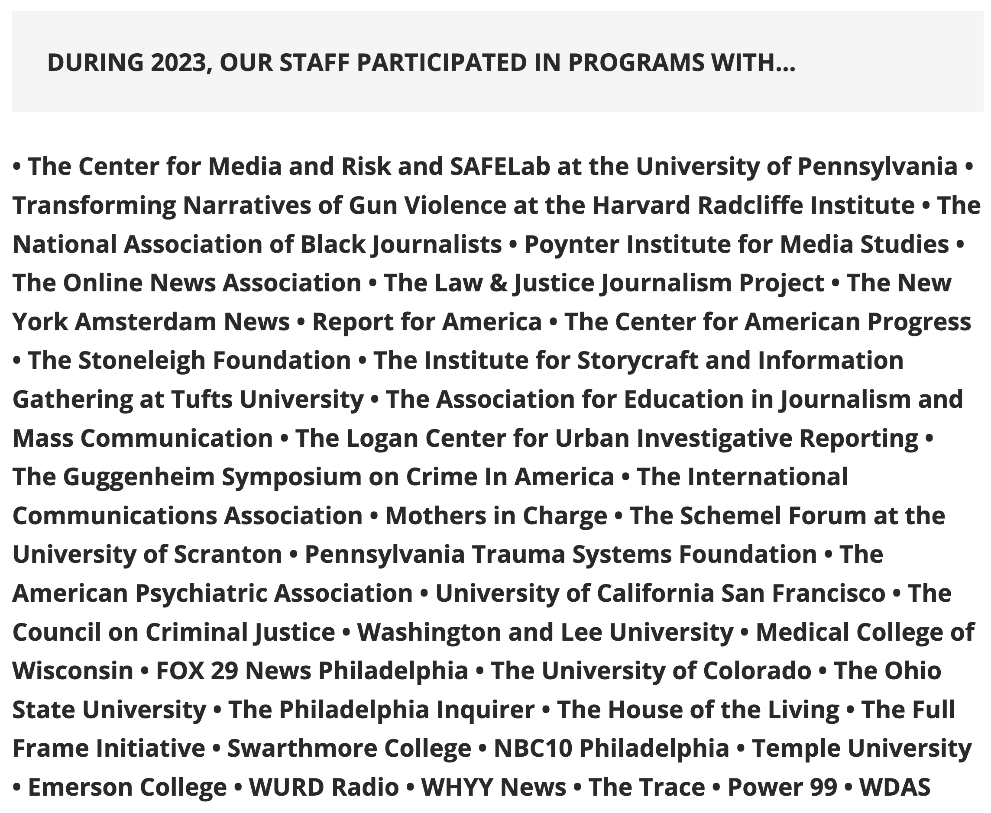

Slide 15
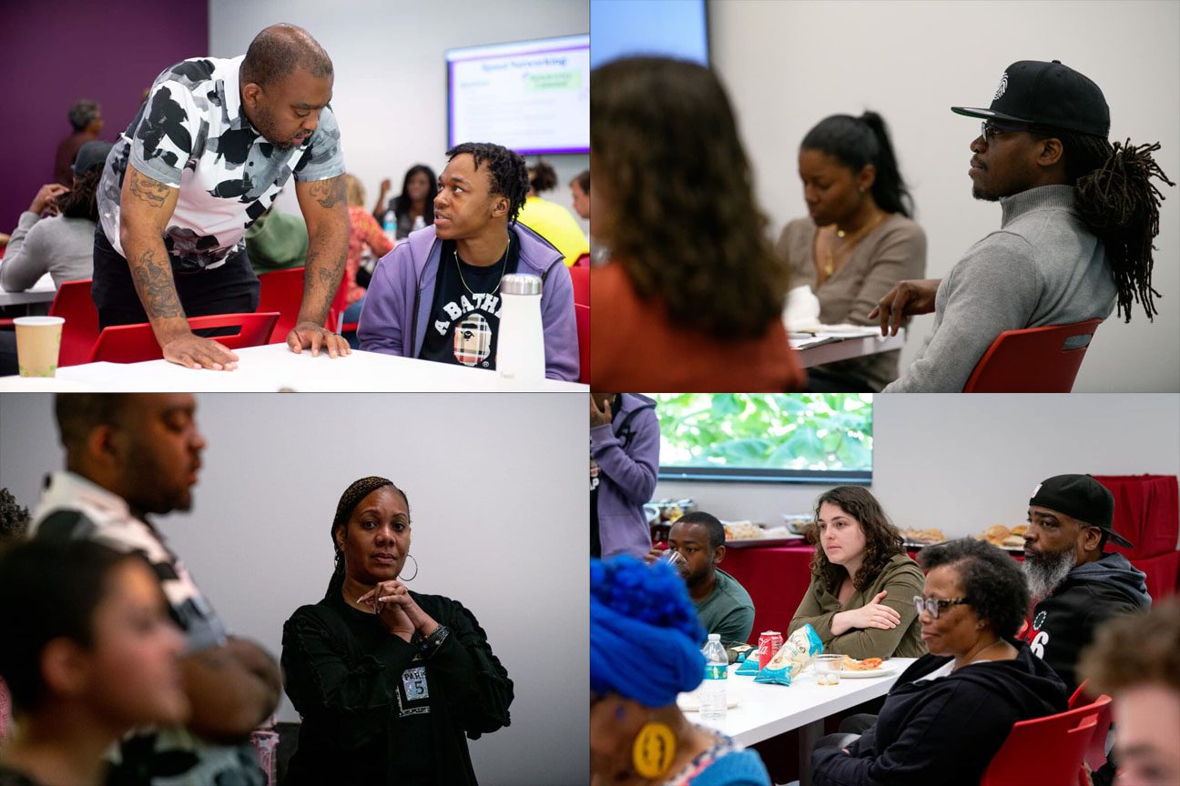

Slide 16
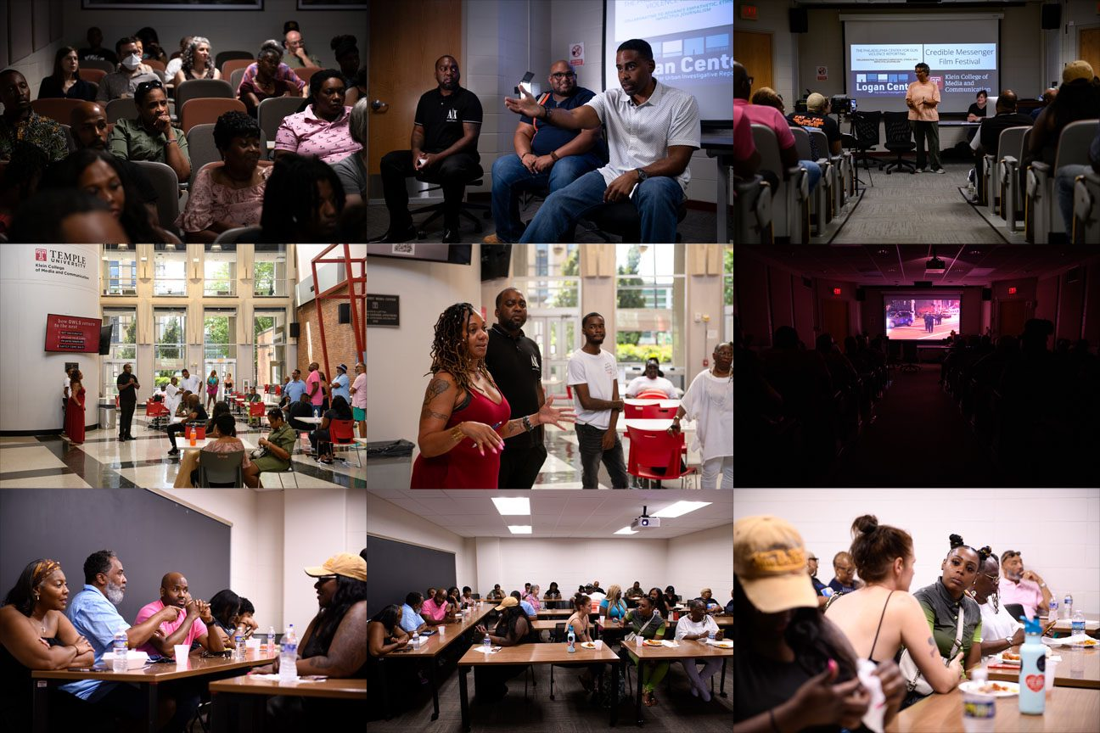

Slide 17
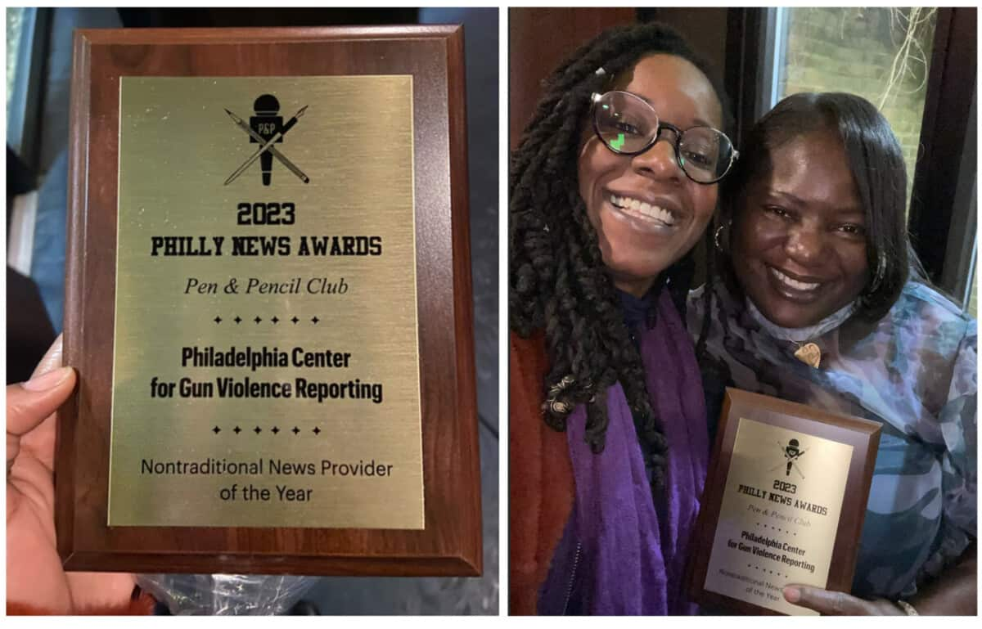

Slide 18
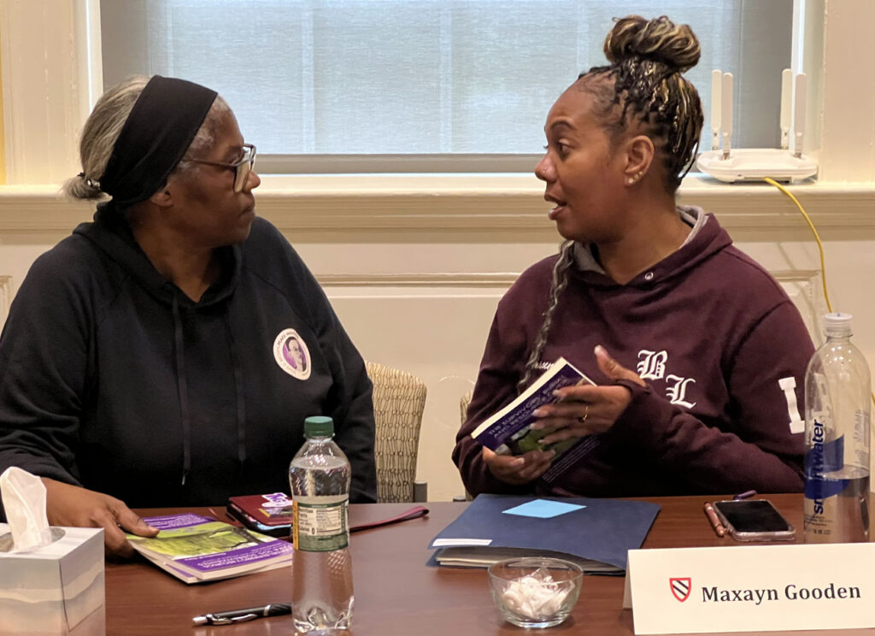

Slide 19
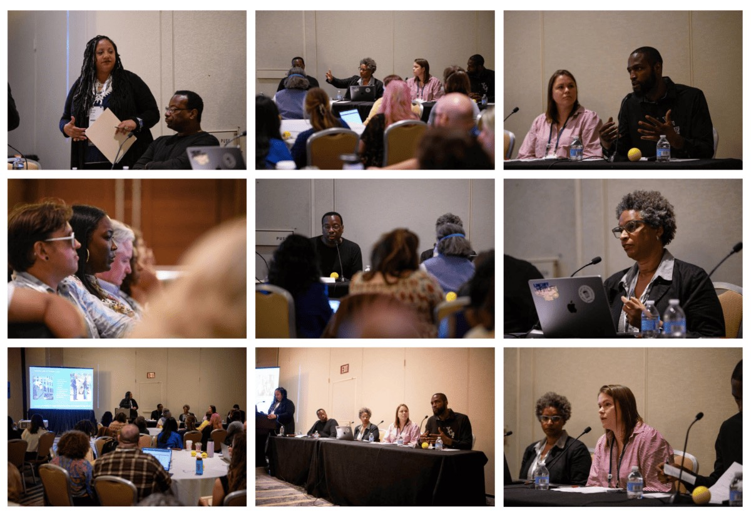

Slide 20
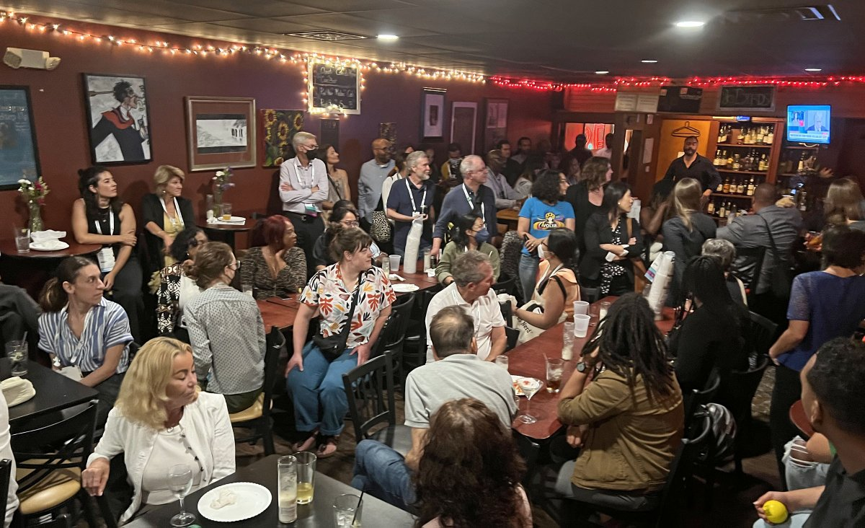

Slide 21
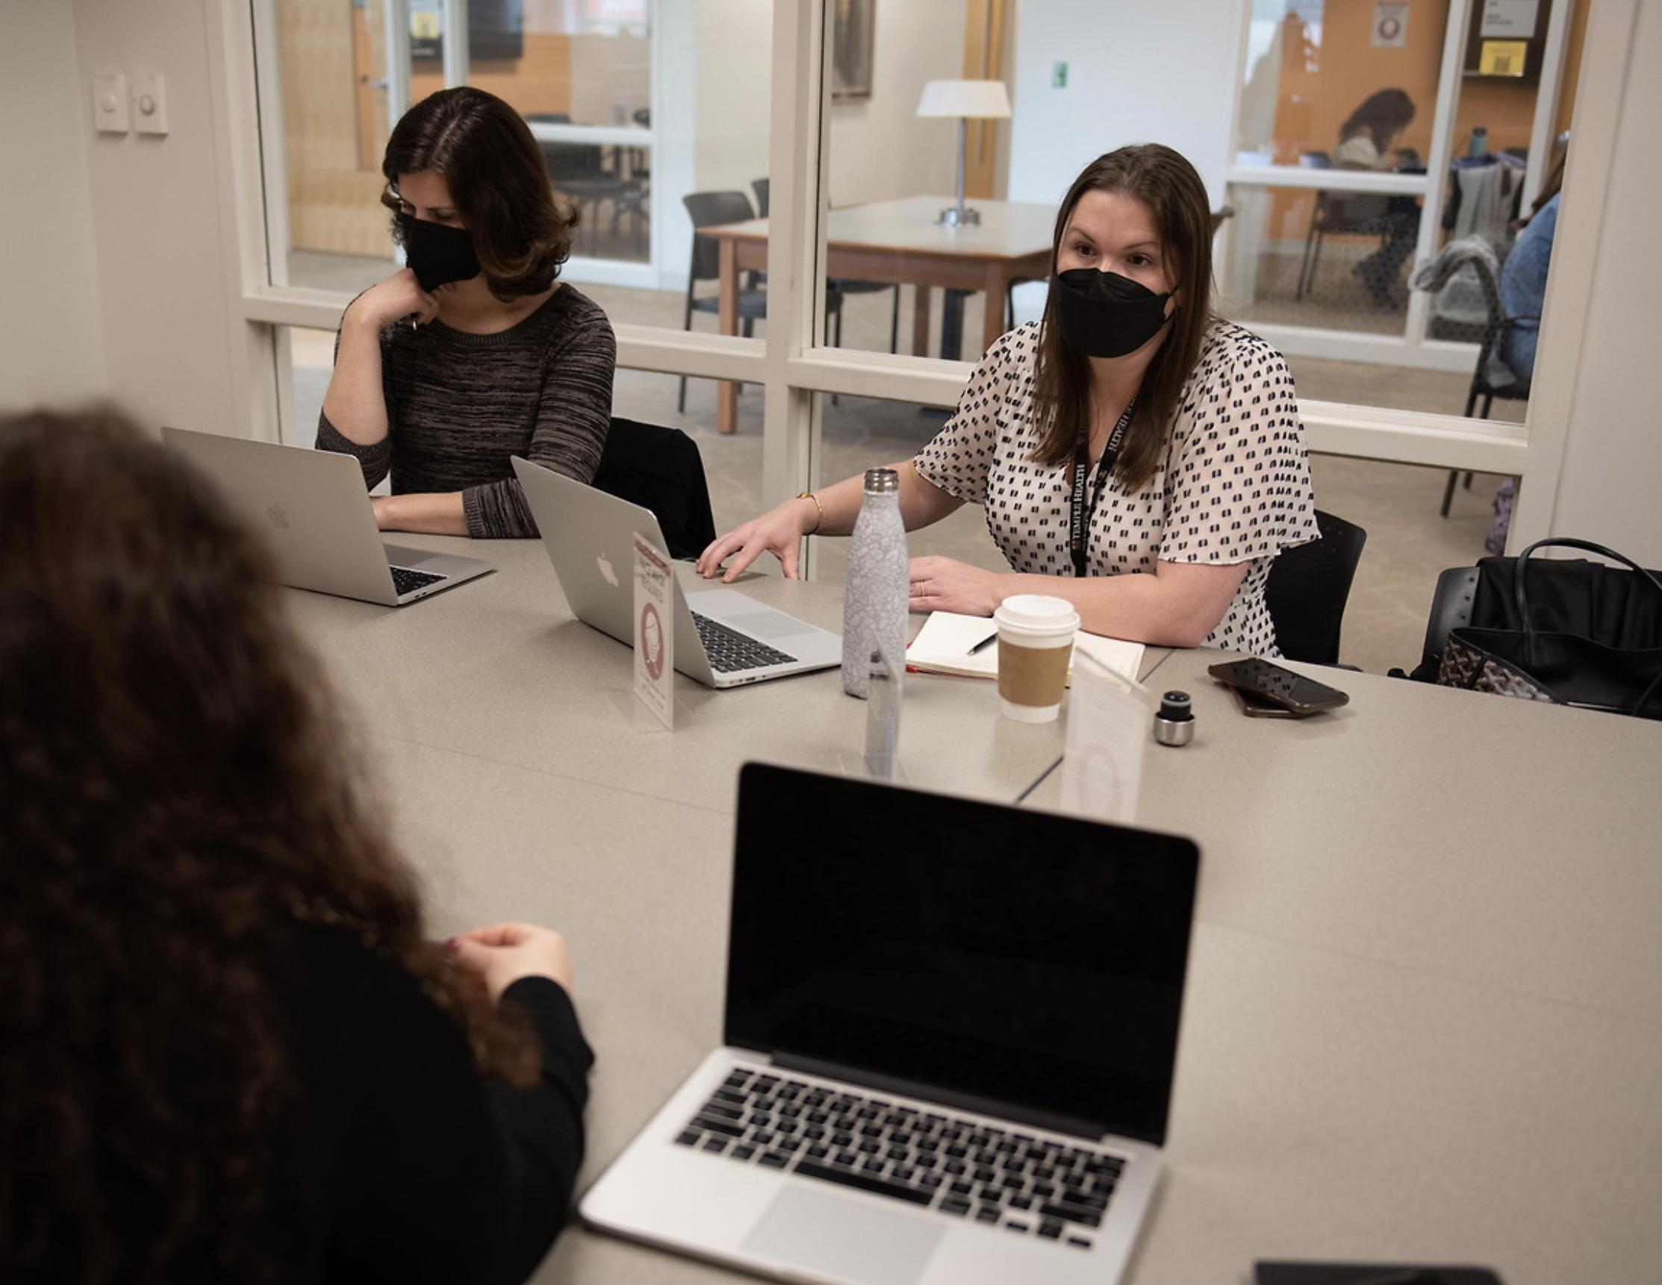

Slide 22
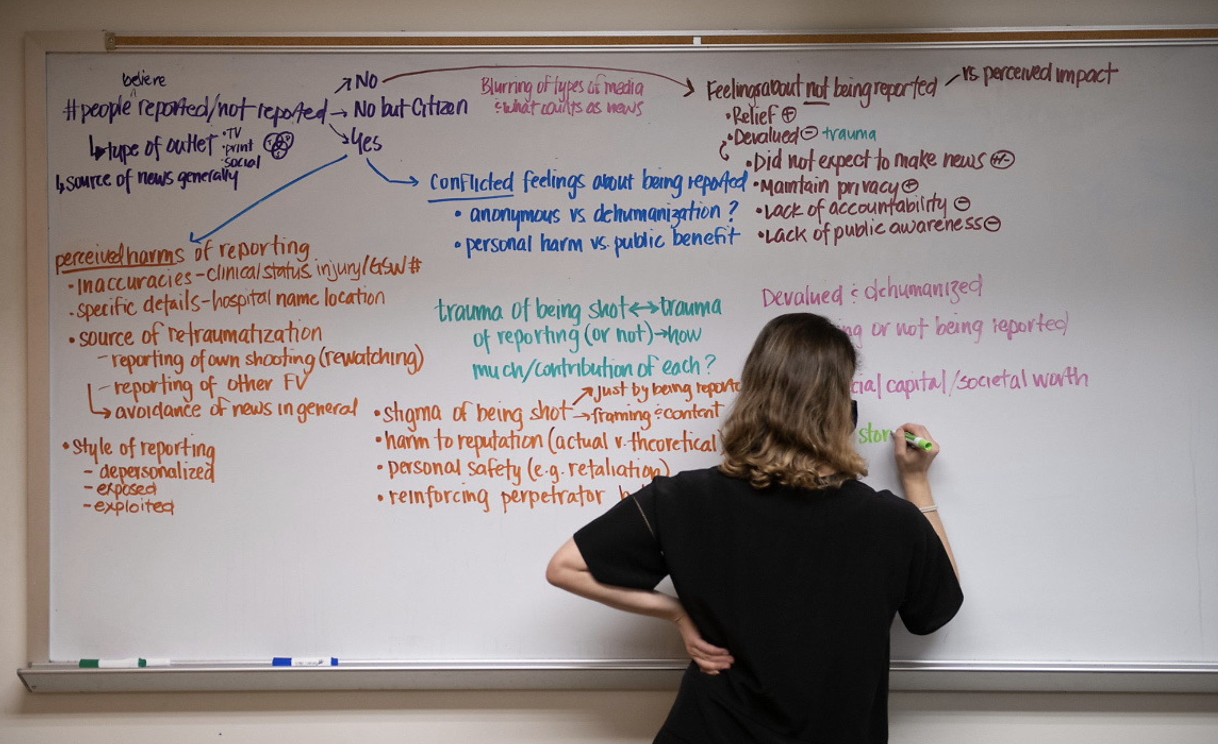

Slide 23
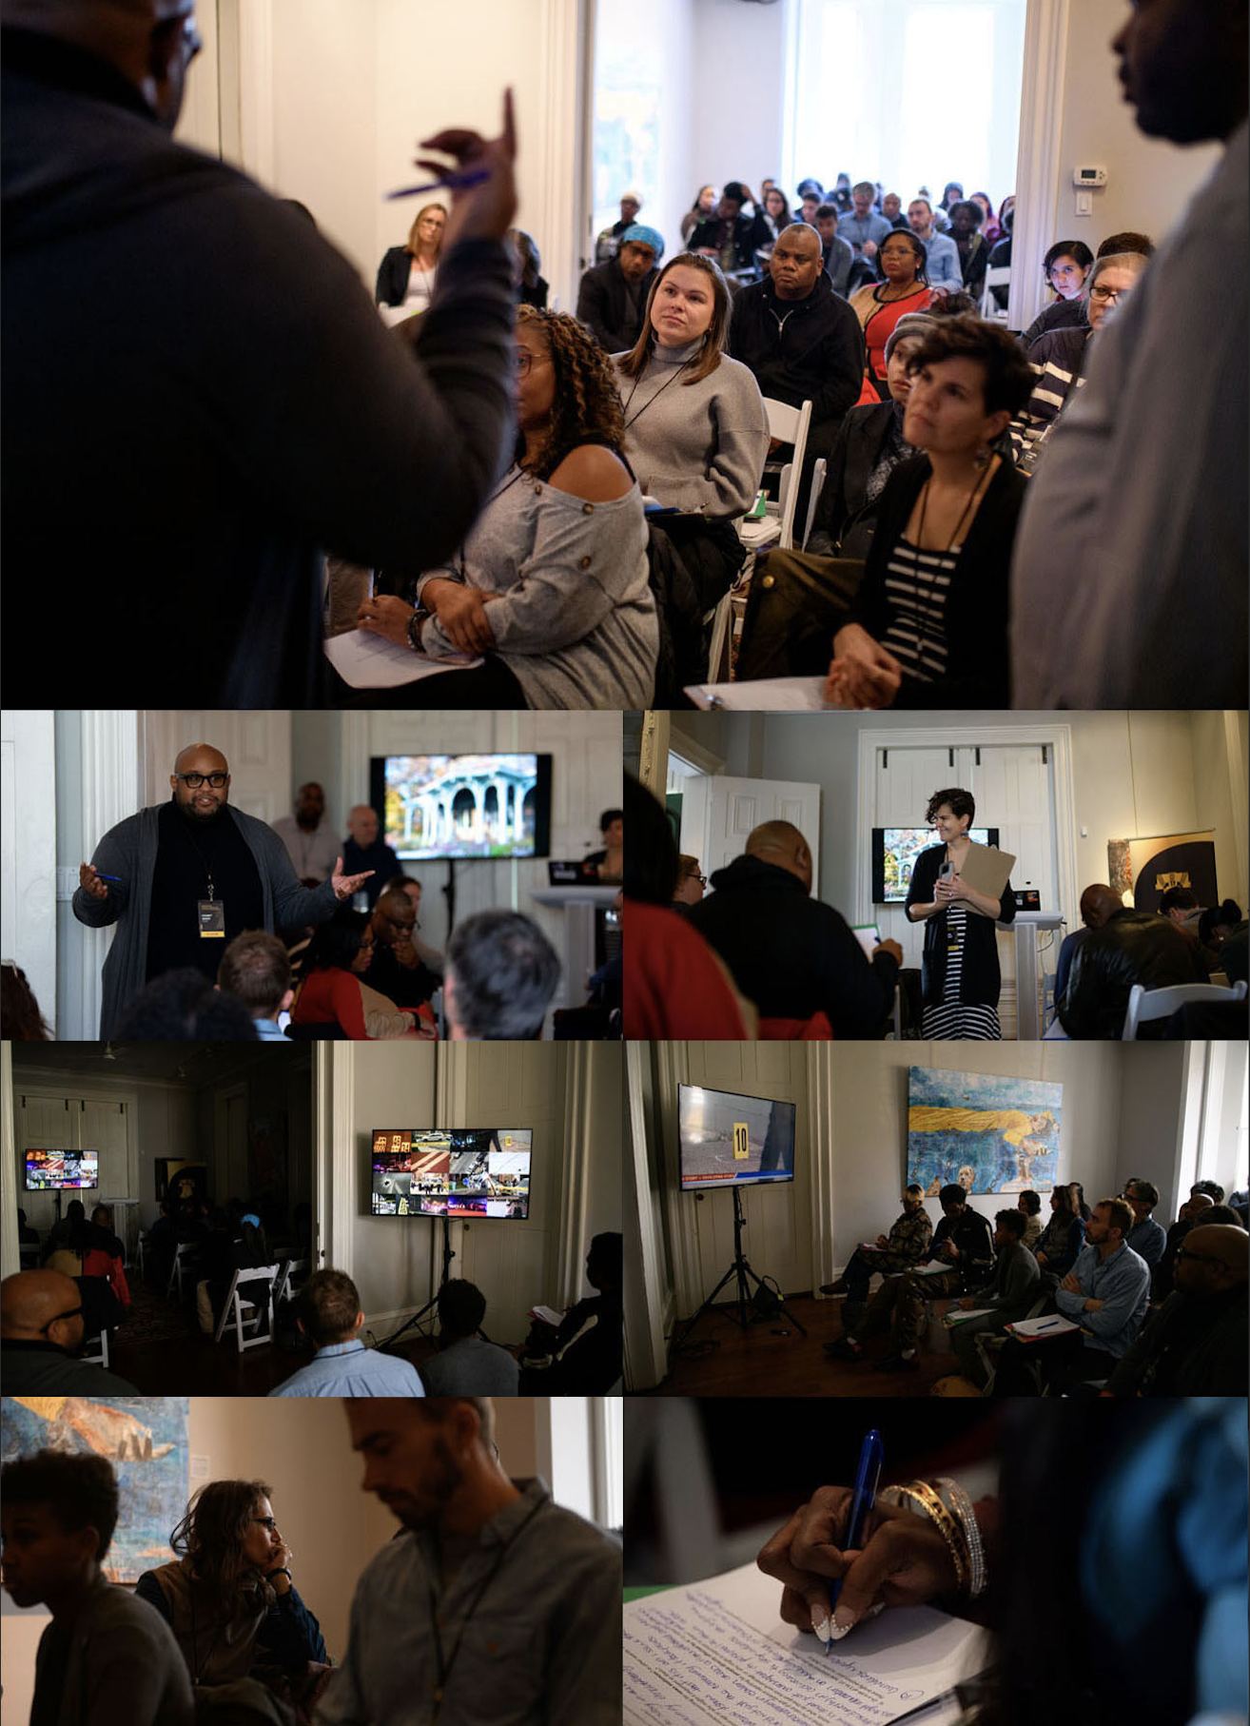

Slide 24


Slide 25
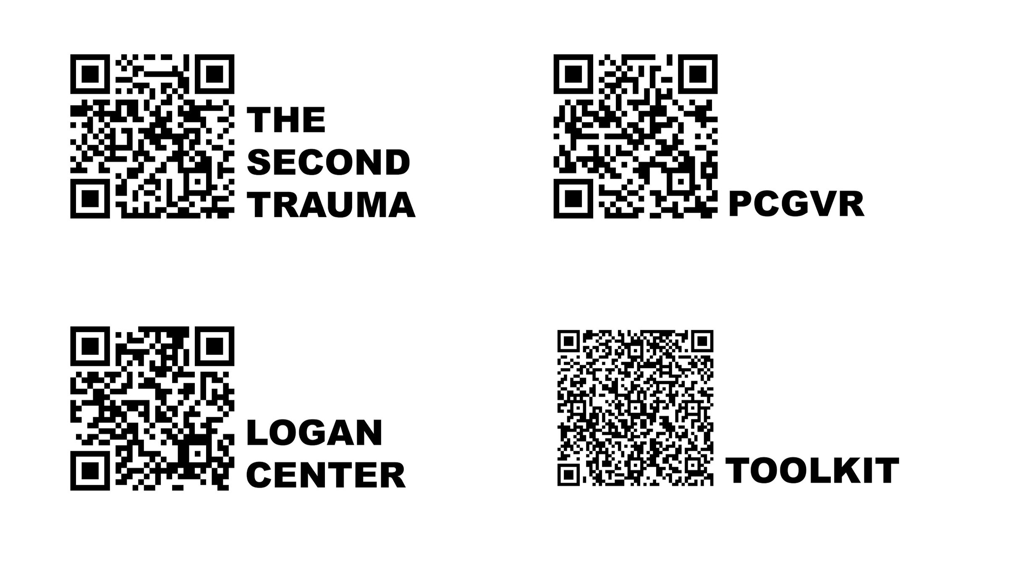

Slide 26
PROF. YVONNE LATTY
Director, Logan Center for Urban Investigative Reporting
Klein College
Temple University
Journalism Education Advisor, Philadelphia Center for Gun Violence Reporting

Slide 27
DR. JESSICA BEARD
Trauma Surgeon, Temple Trauma
Director of Research, Philadelphia Center for Gun Violence Reporting
Stoneleigh Foundation Fellow

Slide 28
ORONDE MCCLAIN
Newsroom Liaison, Philadelphia Center for Gun Violence Reporting
Emerging Leader Fellow
The Stoneleigh Foundation

Slide 29
JIM MACMILLAN
Founder and Director, Philadelphia Center for Gun Violence Reporting
Assistant Director, Logan Center for Urban Investigative Reporting
Klein College
Temple University

