Slide 1
Gene Therapy and
Genome Editing Technology
Peter Marks, MD, PhD
National Press Foundation
November 17, 2023

Slide 2
Outline
Status of gene therapy and genome editing
Regulatory considerations for genome editing
Regulatory guidance for genome editing
Facilitating product development

Slide 3
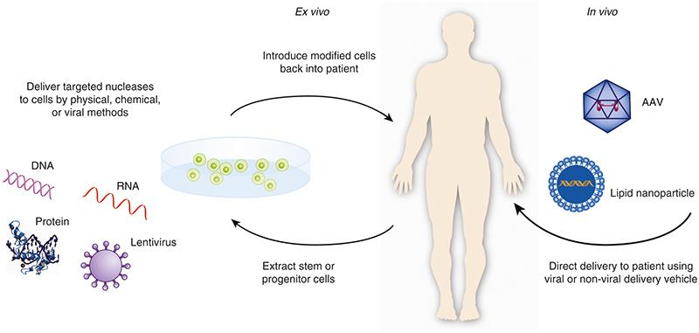
Delivering Gene Therapy

Slide 4
Describing Gene Therapy
Cell-based or directly administered
Hematopoietic stem Cell, T cell
Viral or non-viral vectored
Lentiviral, adeno-associated virus (AAV) vectors
Lipid nanoparticles
Genome edited
TALENs, Meganucleases
CRISPR-Cas9 (CRISPR = Clustered Regularly Interspaced Short Palindromic Repeats), base editors, prime editors

Slide 5
U.S. Approved Gene Therapies
Kymriah (2017)
Yescarta (2017)
Luxturna (2017)
Zolgensma (2019)
Tecartus (2020)
Breyanzi (2021)
Abecma (2021)
Carvykti (2022)
Zynteglo (2022)
Skysona (2022)
Hemgenix (2022)
Adstiladrin (2022)
Vyjuvek (2023)
Elevidys (2023)
Roctavian (2023)
Stem cell
T cell
Directly administered

Slide 6
Human Genome Editing in the Clinic
Biologics License Application pending for what could be the 1st approved genome edited product
Ex vivo genome-edited gene therapy for sickle cell disease (Exa-cel, formerly CTX001)
Involves interrupting the gene that normally switches off fetal hemoglobin production in adults
Fetal hemoglobin expressed at high levels counteracts the effect of sickle hemoglobin

Slide 7
Authority Over Gene Therapy – U.S.
FDA regulates gene therapy including somatic and germline gene modifications in humans
Includes modification of cells prior to administration and use of directly administered gene therapy vectors
Only somatic cell gene therapy (non-heritable) is currently permitted in humans in the United States
Congressional appropriations rider prohibits creation of heritable genetic modifications in humans

Slide 8
Regulatory Considerations
Nature of editing
Ex vivo, in vivo
Inactivation, insertion, modification
Safety considerations
Percentage of cleavage at on- and off-target sites
Evaluation of the profile of insertions and deletions and types of mutations generated
Benefit-risk analysis
Monitoring after treatment

Slide 9
Relevant Recent Guidance
Human Gene Therapy Products Incorporating Human Genome Editing; Draft Guidance for Industry
Considerations for product development
General recommendations
Manufacturing considerations
Considerations for preclinical studies
Considerations for clinical studies
Human Gene Therapy Products Incorporating Human Genome Editing | FDA

Slide 10
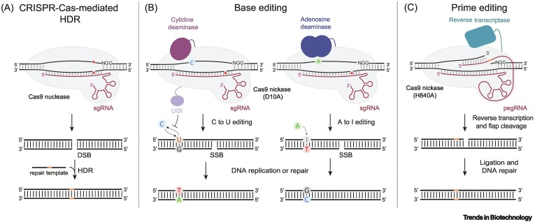
CRISPR-Cas Mediated Genome Editing
From: Zhou et al. Trends in Biotechnology. 2023; 41:1000-1012

Slide 11
Platform Technologies
Gene insert or guide RNA
Vector
Originator Product
Offshoot Product 1
Offshoot Product 2
Offshoot Product 3
Premise
In appropriate situations, non-clinical data and manufacturing information from one product may be able to be leveraged to another

Slide 12
Omnibus Appropriations Act of 2023
Section 2503. Platform Technologies
Requires FDA to create a designation program for “platform technologies” which are defined as technologies that have the potential to be incorporated in or used by more than one drug or biological product and are reasonably likely to make the drug development or manufacturing process and the review process more efficient.
Requires FDA to issue guidance relating to the program.

Slide 13
Section 2503. Platform Technologies
Sponsors may also “reference or rely upon data and information” from a previous application for a drug or biological product that incorporates or uses the same platform technology
Data must be submitted by the same sponsor or the sponsor relying on the data received permission from the sponsor who originally submitted the data

Slide 14
Current Challenges
Gene therapy is now at a critical juncture due to a combination of factors
Manufacturing challenges
Clinical development timelines
Different global regulatory requirements

Slide 15
Actions at Center for Biologics
Advancing manufacturing technologies for cell and gene therapy through research
Work to more clearly define the use of accelerated approval for gene therapy
Exploring concurrent submission and product review with other regulatory authorities
Operation Warp Speed for Rare Diseases communication pilot

Slide 16
Criteria for Accelerated Approval
Serious or life-threatening disease or condition
Substantial evidence of effectiveness based on:
Effect on a surrogate endpoint that is reasonably likely to predict clinical benefit, or
Clinical endpoint that can be measured earlier than irreversible morbidity or mortality, that is reasonably likely to predict an effect on irreversible morbidity or mortality or other clinical benefit
Taking into account severity, rarity, or prevalence of the condition and the availability or lack of alternative treatments
Also takes into account residual uncertainty
Section 506 (c) of the Food Drug and Cosmetic Act (21 U.S.C. 356(c))

Slide 17
Confirmatory Trials
Post-marketing trials are routinely required to verify and describe clinical benefit when using accelerated approval
By assessing clinical benefit, the goal of the confirmatory trial is to address the remaining uncertainty of the surrogate endpoint’s relation to clinical benefit
Because accelerated approval is inherently associated with greater residual uncertainty, some trials may not confirm clinical benefit

Slide 18
Connecting Biomarkers with Gene Therapy Clinical Outcomes
Animal Models
Disease model reflects aspects of human pathology
Administration of therapy associated with achievement of a specific protein level ameliorates disease
Human Observations
Disease state is associated with protein levels above or below a certain range
Certain protein levels are associated with disease absence or minimal disease
Demonstrate that equivalent protein levels can be achieved in humans affected by the disease

Slide 19
Global Cooperation
Produce document on potential regulatory framework for cell and gene therapies for low- and middle-income countries (ongoing at WHO)
Convergence of regulatory approach in high income countries (? harmonization in the future)
Discussion of concurrent collaborative review process for gene therapy (Project ORBIS model)

Slide 20
Support for clinical Trials Advancing Rare disease Therapeutics (START) Pilot
Goal is to further accelerate pace of development for products intended to address unmet medical needs in rare diseases or conditions likely to lead to significant disability or death in the first decade of life
Three eligible products in the initial iteration to receive enhanced communications when selected for the pilot
An initial meeting to review features of the pilot program
Additional ad hoc interactions via email or teleconference on a scheduled and/or as needed basis as agreed upon by the sponsor and FDA

Slide 21
START Pilot Timelines
Federal Register Notice published September 29, 2023
Additional details:
Federal Register :: Support for Clinical Trials Advancing Rare Disease Therapeutics Pilot Program; Program Announcement
Requests to participate: January 2 to March 1, 2024
FDA will acknowledge receipt of requests within 14 days of receipt of request to participate in pilot
FDA will notify sponsors of acceptance by May 30, 2024

Slide 22
Expedited Development Programs
Fast Track
Priority Review
Accelerated Approval
Breakthrough Therapy
Regenerative Medicine Advanced Therapy
These programs may be applicable to drugs or biologics intended to treat serious conditions

Slide 23
Regenerative Medicine Advanced Therapy Designation (RMAT)
Products must be intended for serious or life-threatening diseases or conditions
Preliminary clinical evidence must indicate potential to address unmet medical needs
Designated products are eligible as appropriate for priority review and accelerated approval
Expanded options for fulfilling post approval commitments with accelerated approval

Slide 24
INTERACT Program
INitial Targeted Engagement for Regulatory Advice on CBER producTs
To further encourage early interaction with sponsors and replace the pre-pre-IND meeting process across the Center regarding preclinical, manufacturing and, clinical development plans
https://www.fda.gov/BiologicsBloodVaccines/ResourcesforYou/Industry/ucm611501.htm

Slide 25
CATT Meetings
CBER Advanced Technology Team
Provides an interactive mechanism for discussion of advanced technologies or platforms needed for the development of CBER-regulated biologics products
CATT allows access to early and ongoing interactions with CBER before filing of a regulatory submission
https://www.fda.gov/vaccines-blood-biologics/industry-biologics/cber-advanced-technologies-team-catt

Slide 26
Summary
FDA is committed to working with the community interested in developing therapies using genome editing and will engage with sponsors throughout the development lifecycle from concept through postmarket surveillance

