Slide 1
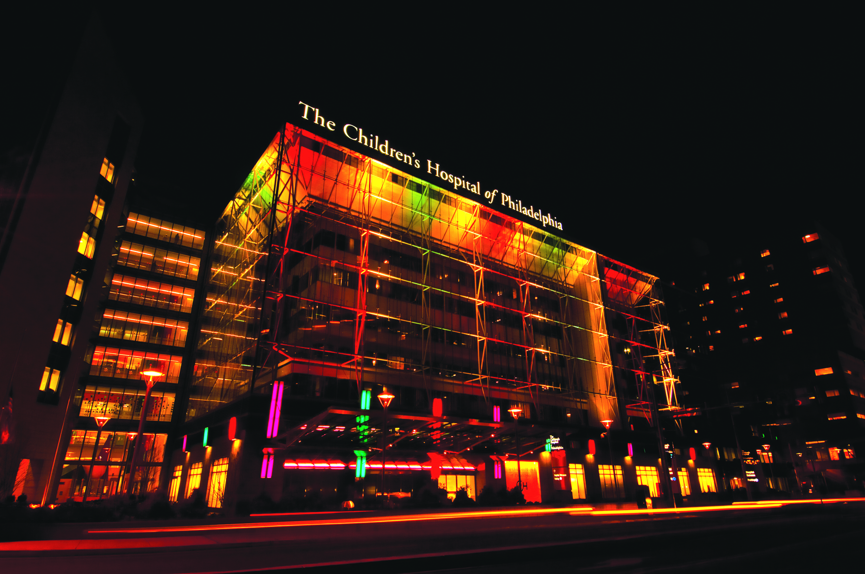
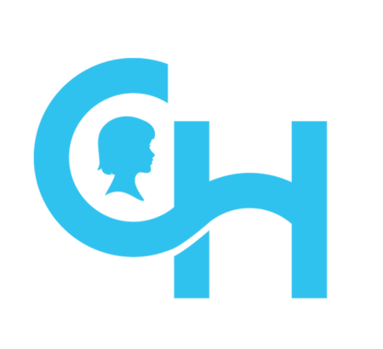

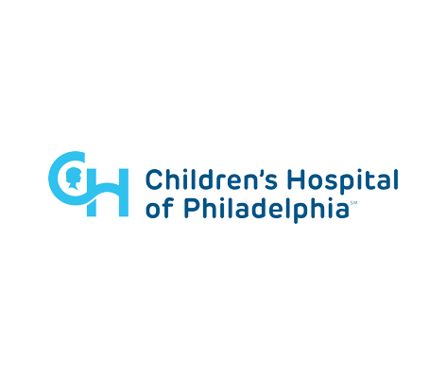


Sickle Cell Research: On the Cutting Edge of Rare Disease Treatment Innovation
Stefano Rivella, PhD
Kwame Ohene-Frempong Chair on Sickle Cell Anemia
Scientific Director of The Sickle Cell and Red Cell Disorders Curative Therapy Center (CuRED)
Frontier Program

Slide 2
Disclosures
Research Grants
R01DK090554-NIH-NIDDK
R01 DK095112-NIH-NIDDK
Commonwealth Universal Research Enhancement (C.U.R.E.)-Dept. of Health-PA
ITMAT-Upenn
HCRI-HRB
Frontier Program-CHOP
Sanofi-iAwards
CuRED-Frontier Program-CHOP
SAB
IONIS Pharmaceuticals
Meira GTx
Disc Medicine
Consultant (last 5 years)
Incyte, GSK, Cambridge Healthcare Res, Celgene Corporation, Catenion, First Manhattan Co., FORMA Therapeutics, Ghost Tree Capital, Keros Therapeutics, Noble insight, Protagonist Therapeutics, Sanofi Aventis U.S., Slingshot Insight, Spexis AG, Techspert.io and BVF Partners L.P., Rallybio, LLC, venBio Select LLC.

Slide 3
My Background
Stefano Rivella, Ph.D.
Professor of Pediatrics - Children’s Hospital of Philadelphia
Kwame Ohene-Frempong Chair on Sickle Cell Anemia
Leader of the RNA Gene Therapeutics Group - Penn Institute for RNA Innovation
Scientific Director of CuRED

Slide 4

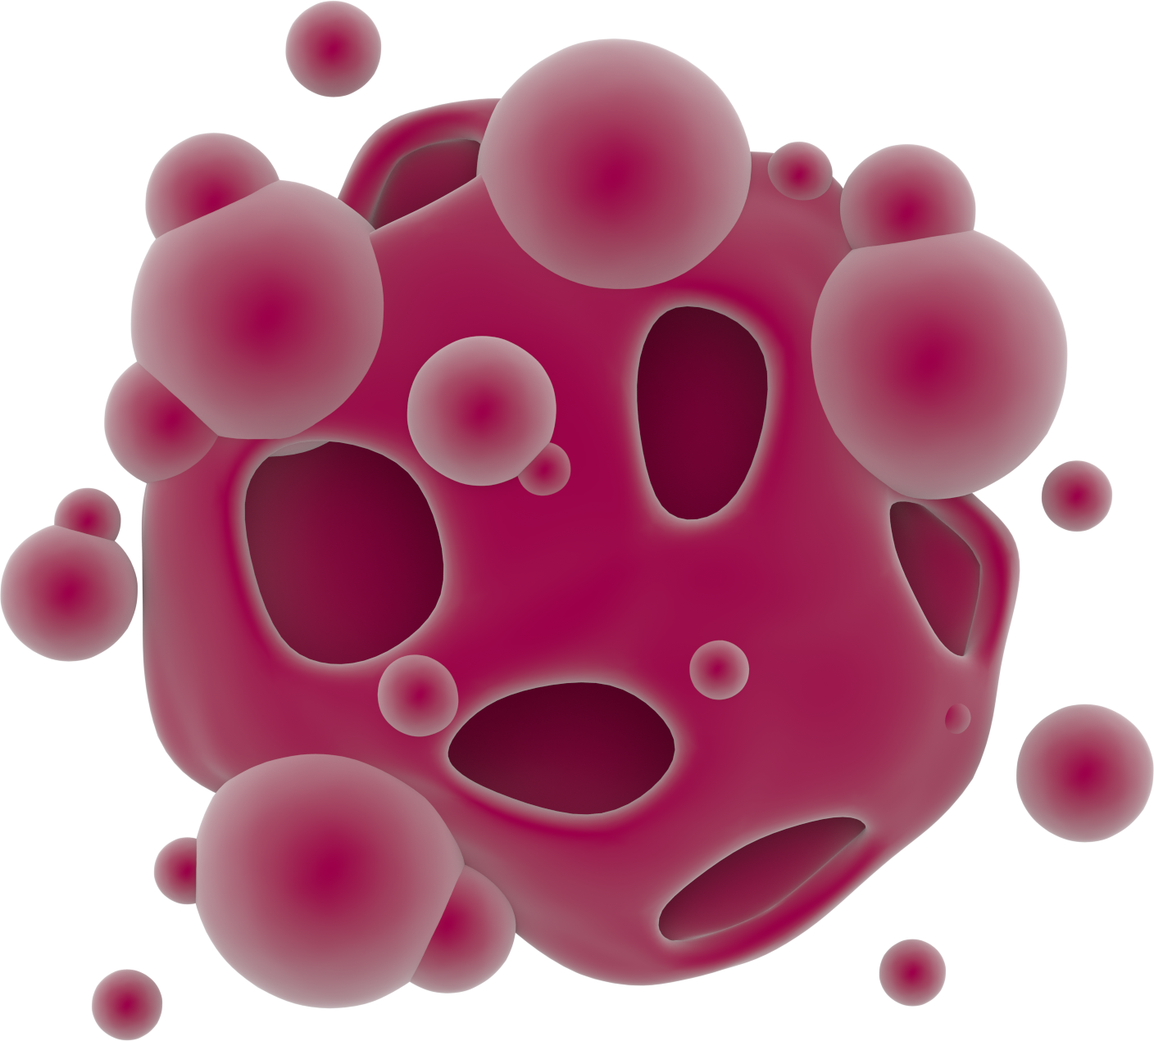

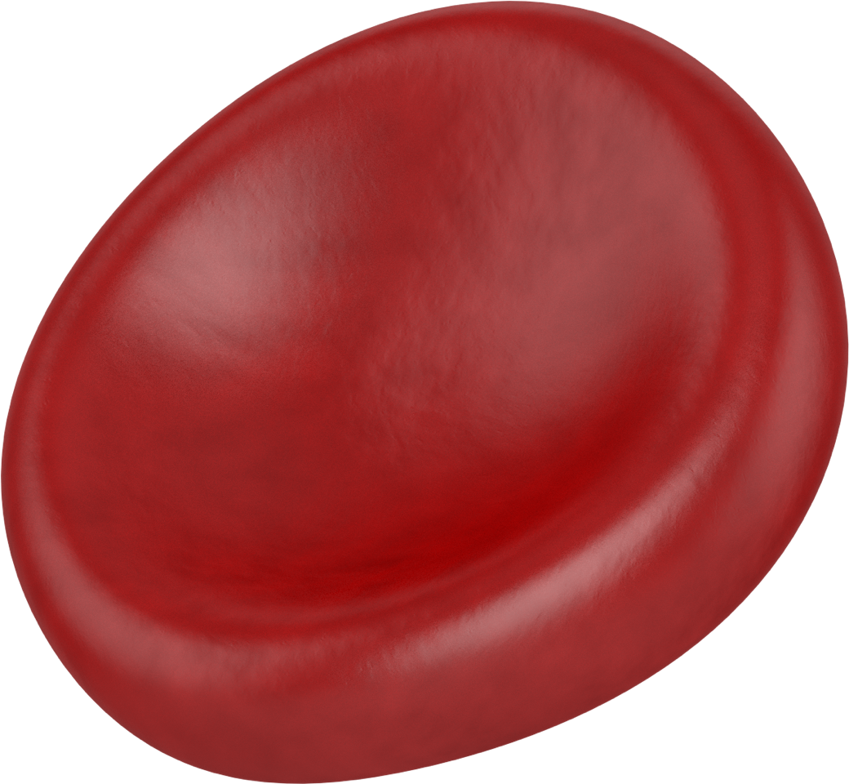


Hemoglobinopathies
Mutations that alter the structure
(Glutamic acid to Valine at position 6)
SCD
Sickling Hb
and red cells
Mutations in the ß-globin gene
Mutations that reduce the synthesis
α
ß-thalassemia
α-chain/heme aggregates or hemichromes
Adult Hemoglobin
α
α
Heme
α
α
Heme
β
β
Mutations in the α-globin gene
Mutations that reduce the synthesis
ß
ß
α-thalassemia
HbH
Heme
ß
ß
Notes:
In my lab we have been focusing for several years on hemoglobinopathies, which are diseases characterized by mutations that impair the structure or the abundance of the beta or alpha globin chains.
The most representative of the hemoglobinopathies associated with an altered globin protein structure is SCD, which is due to a single point mutation in codon 6 of the BGG, leading to Vaso occlusive crisis, inflammation, hemolysis, and anemia.
In contrast, both beta and alpha-thal are associated with many different mutations, whose common denominator is the reduction in the expression of one of the two globin chains, leading to a relative excess of the partner protein. This leads to abnormal erythropoiesis, anemia, and, eventually, iron overload.
For all the severe forms of these diseases, chronic blood TX and IC are required. The only definitive cure is allogeneic BMT which, however, is limited by finding a compatible BM donor and may be associated by GF/GR or GVHD.
GT can avoid some of these limitation and potential side effects, as this approach is based on the engraftment of autologous HSC genetically modified by techniques defined as GA, when a lentiviral vector includes an additional copy of a therapeutic gene to the genome of the patient BM cells, or by GE, when tools such as CRISPR/Cas9 modify the genome of HSC to restore the expression of a thereputic gene.
In BT, the mechanism that leads to the anemia is characterized by more studies than in AT for a variety of reasons, including the relative abundance of mouse models that mimic well the human disease. The mechanism leading to the anemia and increased iron absorption in BT is indicated as IE, which we can define as a large expansion in the number of erythroid progenitors which, however, are inefficient in making normal enucleated RBC. The same progenitor cells and abnormal RBC are also responsible, directly and indirectly, for the increased iron absorption observed in this disease.

Slide 5
Current estimates suggest that more than 300,000 children are born each year with hemoglobinopathies (250 million people worldwide carry mutations in globin genes; ~5 million of patients).
Hemoglobinopathies: frequency and geographical distribution
From WHO
Weatherall, Blood Reviews, 2011; ASH; CDC
Notes:
I believe I do not need to stress to this audience the importance of finding curative therapies for these diseases, as many patients are affected world-wide by hemoglobinopathies, and more than 300,000 children are born every year with one of these diseases.
For many years allogeneic BMT has been the only curative options for these patients, but more recently…

Slide 6
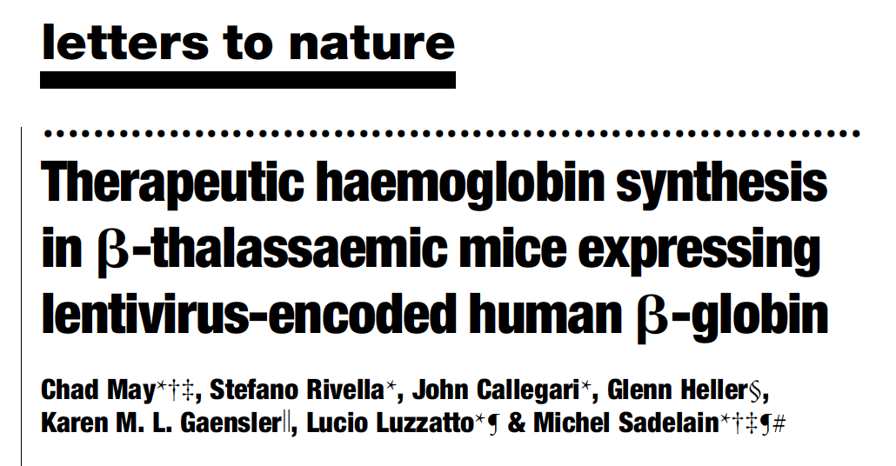
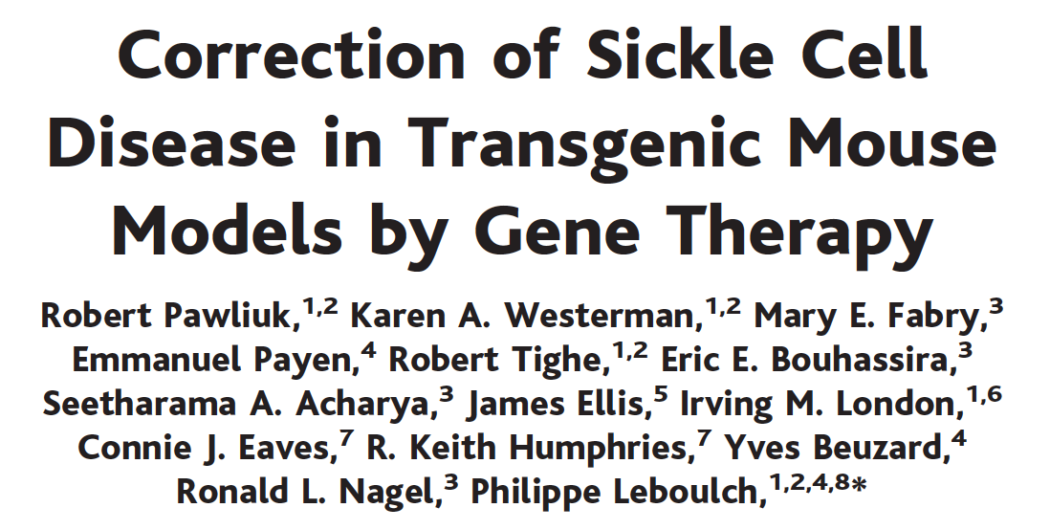
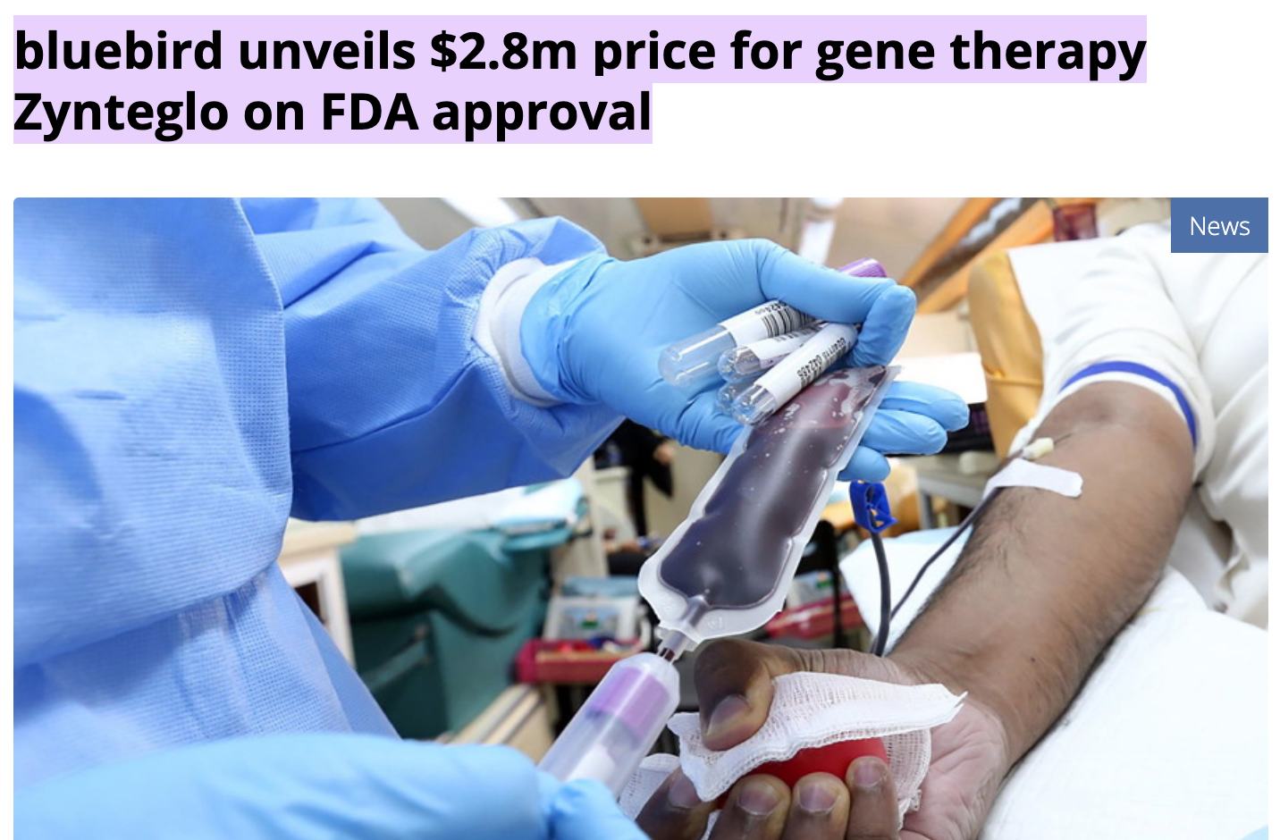
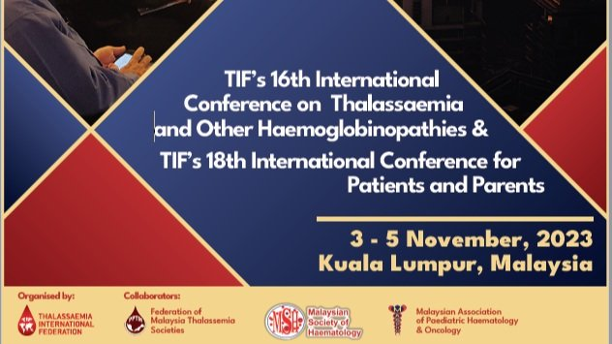
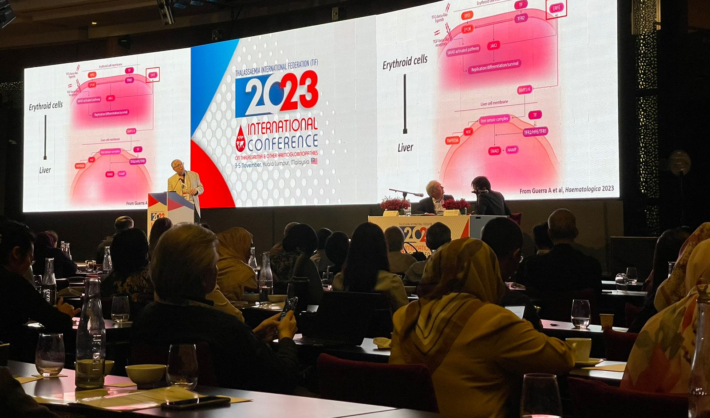
2000
2001
2022
2023

Slide 7
From Pavia to New York (1997)

Slide 8
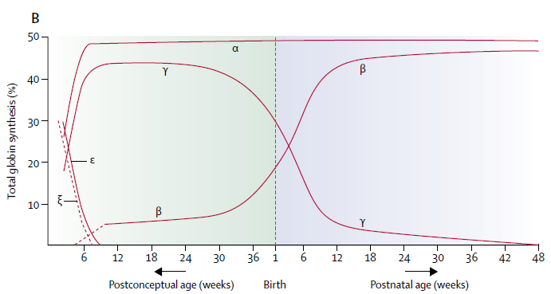
Globin gene organization and expression
Human
^{G}γ
LCR
ε
^{A}γ
δ
β
β
HS-40
ζ
α2
α1
α
5 Kb
The γ-globin and ß-globin genes are on chromosome 11
γ-globin is expressed from early on in development and switched off after birth, when ß-globin is activated
There are two genes coding for α-globin on human chromosome 16
Between homologous chromosomes there are four copies of the α-globin gene
α-globin is expressed from early on in development (following cessation of ζ-globin production)
Taher et al. 2017
Notes:
“Thalassaemia.” 2018. The Lancet 391 (10116): 155–67. https://doi.org/10.1016/S0140-6736(17)31822-6.

Slide 9
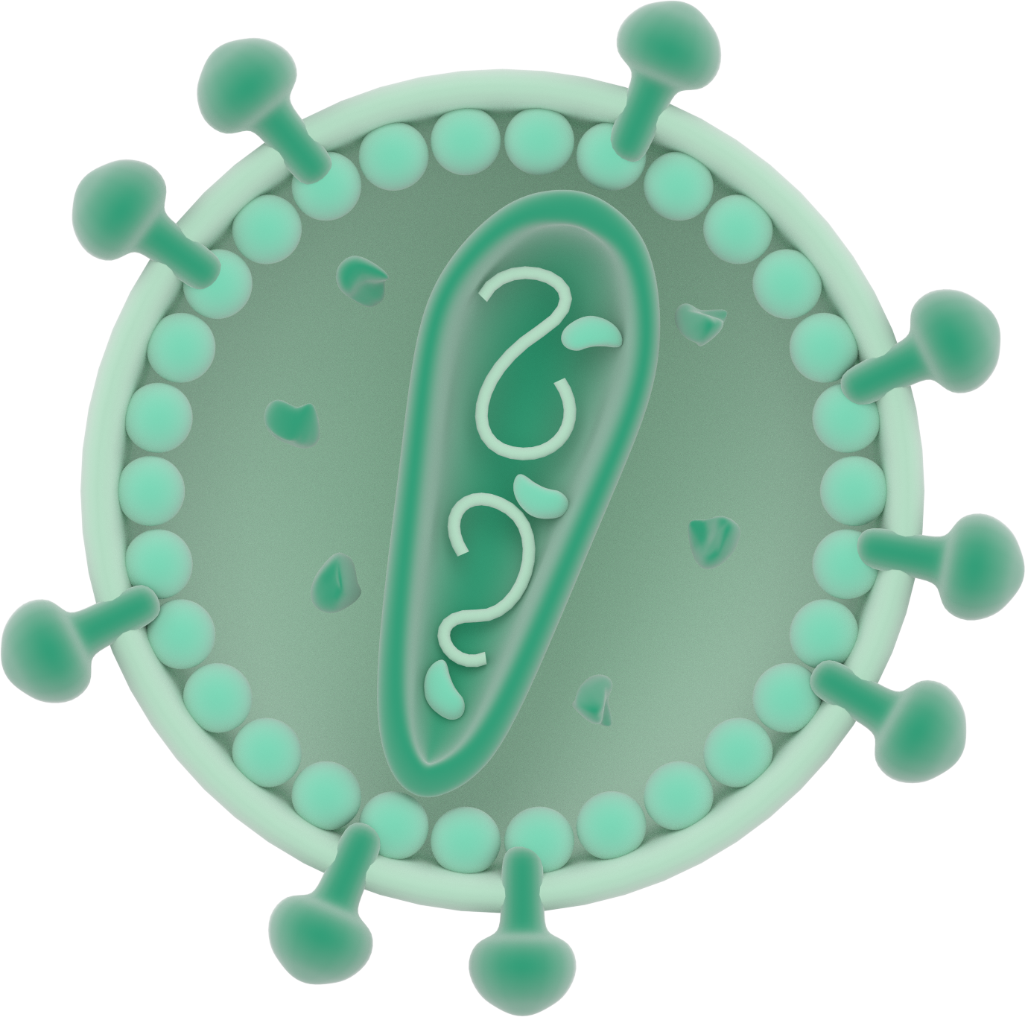
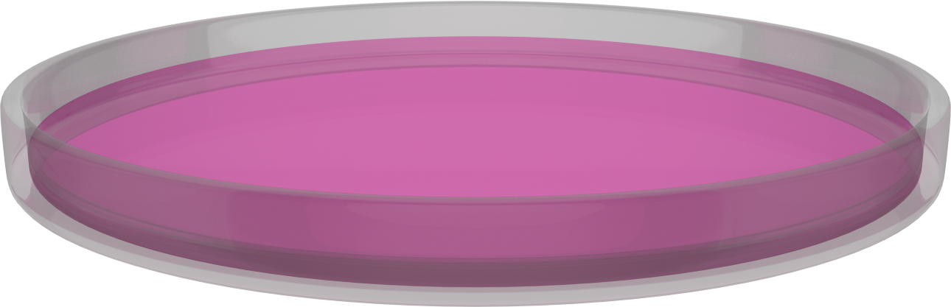

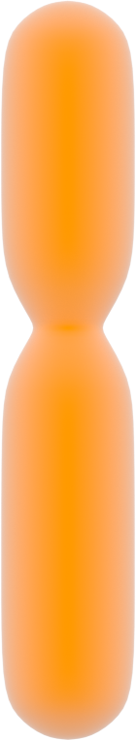

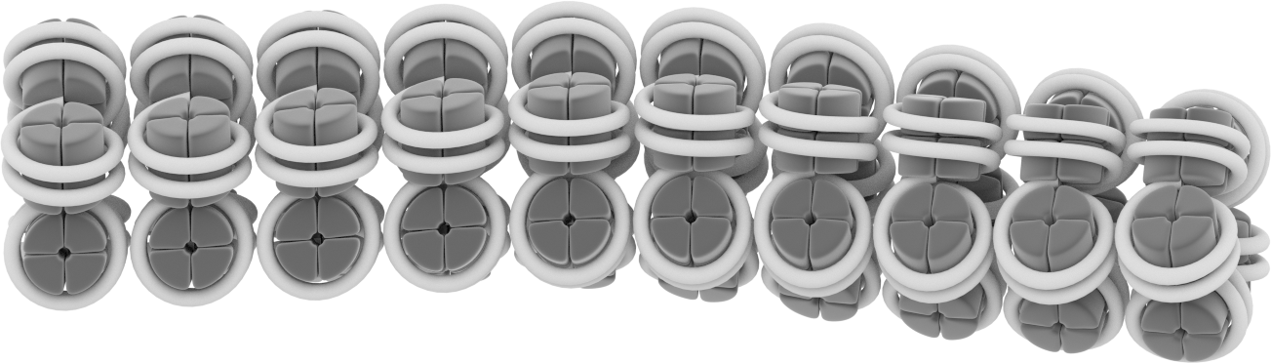
Gene therapy of hemoglobinopathies: gene addition
Gene addition
Transgene
Transgene
Gene X
Gene Y
Heterochromatin
Transgene
Pros
Independent from mutations
Overexpression, if required
Cons
Random integration
Level of expression may require high VCN
  Increased chance of genome toxicity
Ge- -ne X
Notes:
For question of time, today I will not discuss gene editing techniques or trials, which are very efficient and promising, but I will focus on GA, which is the technology we are presently using in the attempt to cure both BT and AT. GA is mediated by viral vector, primarily lentiVs, that integrate randomly in the genome. The pros of this approach are that the transgene introduced can be curative independently of the underlying mutation. In addition, this approach may allow for overexpression, which may be desirable in some conditions. A potential limitation of GA is the random integration, that could lead to variability in the level of transgene expression and, more problematically, in genome toxicity. CLICK
These are papers associated to clinical trials using lentivaral vectors that carry the beta globin gene, as in the case of the trial by BBB led by Dr Cavazzana or the trial by Tiget led by Dr. Ferrari. The third paper describes a lentiV which, instead, delivers a therapeutic gamma globin gene, used by Dr. Malik at Cincinnati CH

Slide 10
Human ß-globin gene
5
4
3
2
1
Locus Control Region
ε
^{G}γ
^{A}γ
ß
δ
ß
5 kb
e⁺
pA
e⁺
Promoter/5’ UTR
Ex1
IVS1
Ex2
IVS2
Ex3
3’ UTR
91
110
222
849
128
1605

Slide 11

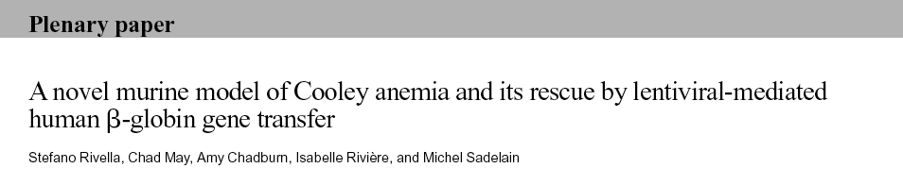

Therapeutic levels of Hb in mice affected by β-thalassemia major or Cooley’s anemia
Hb 13-15g/dL
Transfusion independent
5’LTR
ß-globin
LCR
3´LTR
TNS9
Hb 2-4g/dL
WT
th3/th3
th3/th3 + TNS9
2003

Slide 12
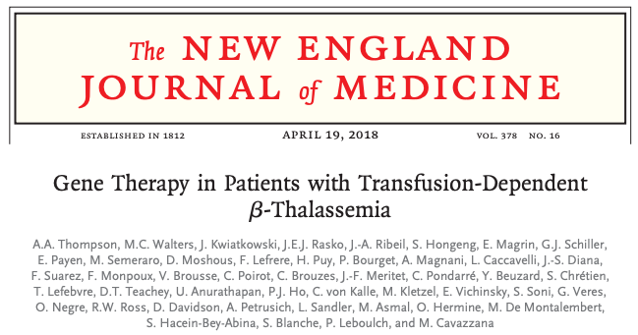
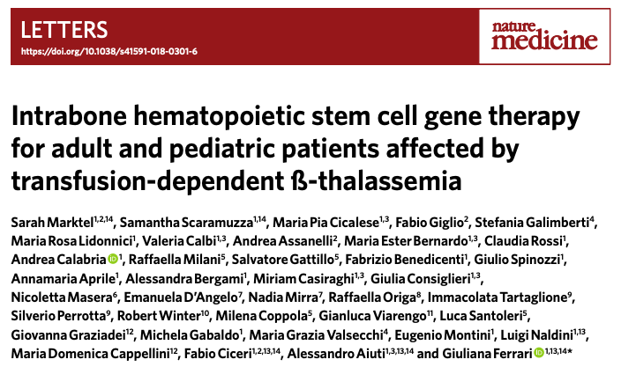
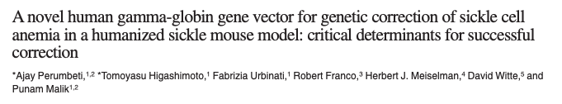
Gene therapy of hemoglobinopathies: gene addition
Zynteglo/bluebird was approved in Aug 2022 for patients with Beta-Thalassemia who require regular blood transfusions ($2.8 million)
Gene addition
April 2019
Transgene
Transgene
Gene X
Gene Y
Heterochromatin
February 2019
Transgene
Ge- -ne X
Pros
Independent from mutations
Overexpression, if required
Cons
Random integration
Level of expression may require high VCN
  Increased chance of genome toxicity
August 2019
Notes:
For question of time, today I will not discuss gene editing techniques or trials, which are very efficient and promising, but I will focus on GA, which is the technology we are presently using in the attempt to cure both BT and AT. GA is mediated by viral vector, primarily lentiVs, that integrate randomly in the genome. The pros of this approach are that the transgene introduced can be curative independently of the underlying mutation. In addition, this approach may allow for overexpression, which may be desirable in some conditions. A potential limitation of GA is the random integration, that could lead to variability in the level of transgene expression and, more problematically, in genome toxicity. CLICK
These are papers associated to clinical trials using lentivaral vectors that carry the beta globin gene, as in the case of the trial by BBB led by Dr Cavazzana or the trial by Tiget led by Dr. Ferrari. The third paper describes a lentiV which, instead, delivers a therapeutic gamma globin gene, used by Dr. Malik at Cincinnati CH

Slide 13
From New York to Philadelphia (2015)

Slide 14
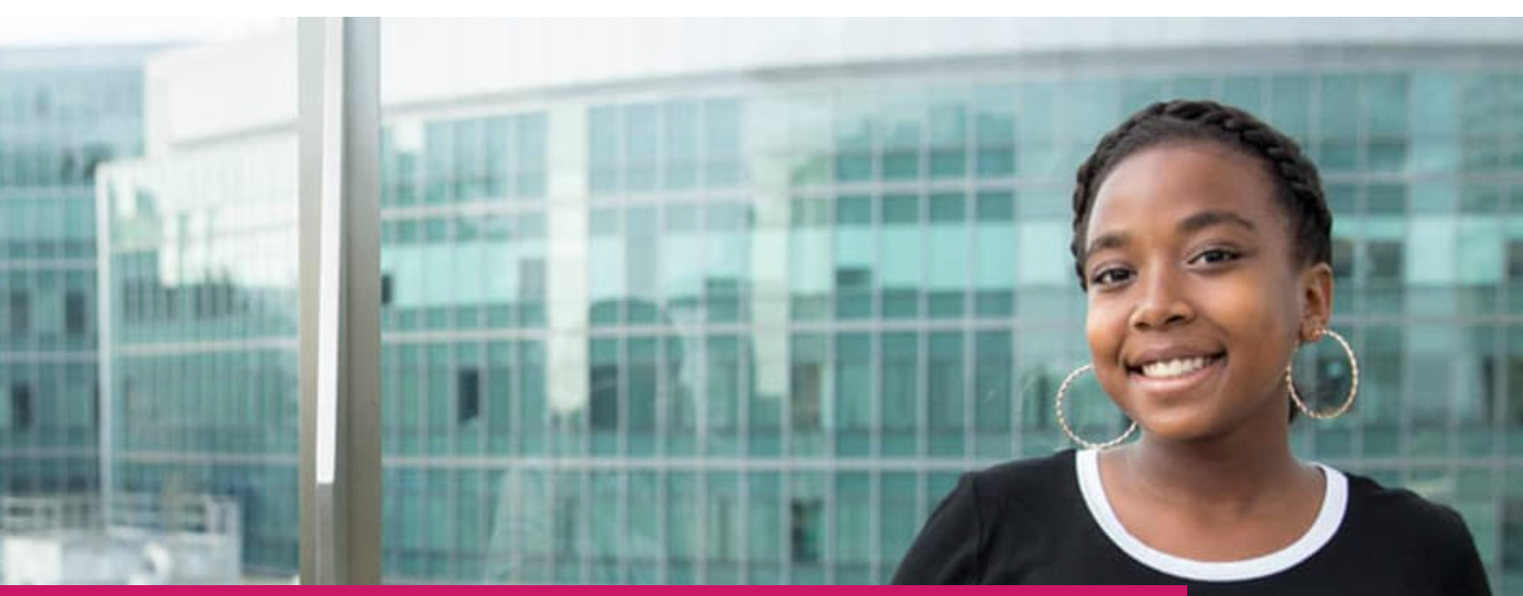

CuRED
Comprehensive Center for the CUre of Sickle Cell Disease and other Red Cell Disorders
https://www.chop.edu/centers-programs/sickle-cell-and-red-cell-disorders-curative-therapy-center-cured
Laura Breda
Naoto Tanaka
Lucas Tricoli
Carlo Castruccio Castracani
Osheiza Abdulmalik
Max Chappell
Caitlyin McFadden
Alice Li
Tom Privette
Camille Jolly Tornetta
Simone Temporal
Janet Kwiatkowski
Alexis Thompson
Catherine Hamilton
Tim Olson
Steve Grupp
Yonping Wang
The path of the patient to the cure
Pre-Treatment
Treatment
Post-Treatment
Gene Therapy Trial
HSCT
Gene Therapy
New Drugs
Notes:
Before I’ll show you my last slide, I’d like to introduce the new Comprehensive Center for the CUre of Sickle Cell Disease and other Red Cell Disorders where patients affected by hemoglobinopathies are currently treated at CHOP.
This center aims to provide the best treatments to the patients and offer them curative therapies, including allogeneic BMT or gene therapies, such as gene addition or gene editing.
I’m the scientific direction of this center, while JK is the clinical director. If possible, we hope to offer our new vector and additional therapies to the patients through the CuRED center at CHOP.

