Slide 1

Insights into the Barriers to Care Experienced by the Rare Disease Community
November 15, 2023
Notes:
Good morning, my name is Debbie Drell and I am NORD’s Senior Director of Membership. My pronouns are she/her, and I am a second generation Mexican-American. I have been working at NORD for more than 6 years directly with 1,200 nonprofit organizations and hundreds leaders to support their mission-critical work. Prior to NORD, I worked for 13 and a half years at the Pulmonary Hypertension Association. For the last 22 years, I am a caregiver to my sister who was diagnosed with a rare, life-threatening heart and lung disease.
I’m here to discuss the preliminary findings of the Rare Disease Diversity Survey. The development and implementation of the survey was made possible through funding from Rare Disease Diversity Coalition, a program of the Black Women’s Health Imperative (BWHI).
October 13, 2022— the Rare Disease Diversity Coalition (RDDC), the nation’s leading voice for alleviating the disproportionate burden of rare diseases on communities of color, and the National Organization for Rare Disorders (NORD), the leading rare disease advocacy organization, announced plans to conduct a first-ever national survey of underrepresented rare disease patients and caregivers to better understand their unique perspectives and experiences in accessing and affording health care. The research was made possible through a grant from the Black Women’s Health Imperative.
NORD brings together rare disease patients, caregivers, leaders, researchers, clinicians, regulators, advocates, and industry to better understand and fight for diversity, equity, and inclusion within the rare disease community. Earlier this year, NORD launched several dynamic resources to educate leaders, advocates, and nonprofit organizations on how a lack of DEI is affecting marginalized groups within the rare disease community.

Slide 2

RARE DISEASES BARRIERS
Isolation
Health systems are not set up properly to diagnose and care for rare diseases
Within rare, environments and socioeconomic factors have a significant impact on health outcomes
Stigma
95% lack treatment
Scarce expertise & information
Scattered populations
Diagnosis delays
Notes:
Those living with rare diseases face a number of barriers — including isolation, stigma, discrimination, and social marginalization. Due to the rarity of each individual disease and scattered populations, expertise and information is scarce. What’s more, health and support systems are designed for common conditions and are not set up to properly diagnose and provide care and treatment for rare diseases.
Public health researchers have shown that environments and socioeconomic factors also have a significant impact on health outcomes. These factors may affect individuals’ ability to seek and secure the resources needed for problems that arise due to health.
Preliminary data suggest that individuals with a rare disease who are also members of marginalized populations face additional challenges and barriers.

Slide 3
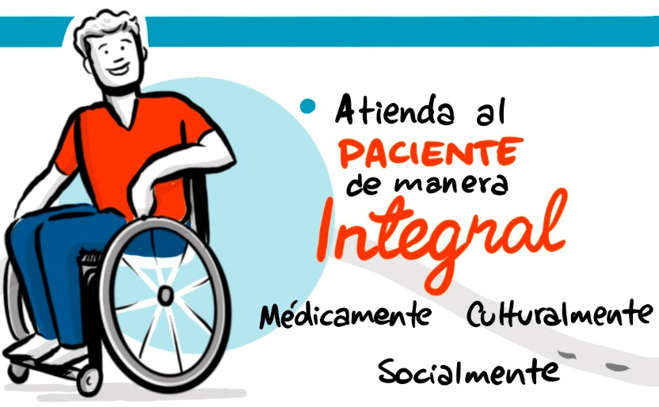
RD DIVERSITY SURVEY OBJECTIVE
Listen to and learn from underrepresented communities
To better understand the experiences of individuals living with a rare disease and investigate whether differences are observed across populations
Barriers to diagnosis, care, treatment access
Tend to the patient in a comprehensive way: medically, culturally, & socially
Notes:
The objective of the Rare Disease Diversity Survey was to collect information from a diverse sample of individuals with a rare disease and those who care for them, to better understand the experiences of individuals and investigate whether differences are observed across populations. We wanted to learn from these communities within rare disease who experience additional barriers to diagnosis, care, and treatment access.

Slide 4
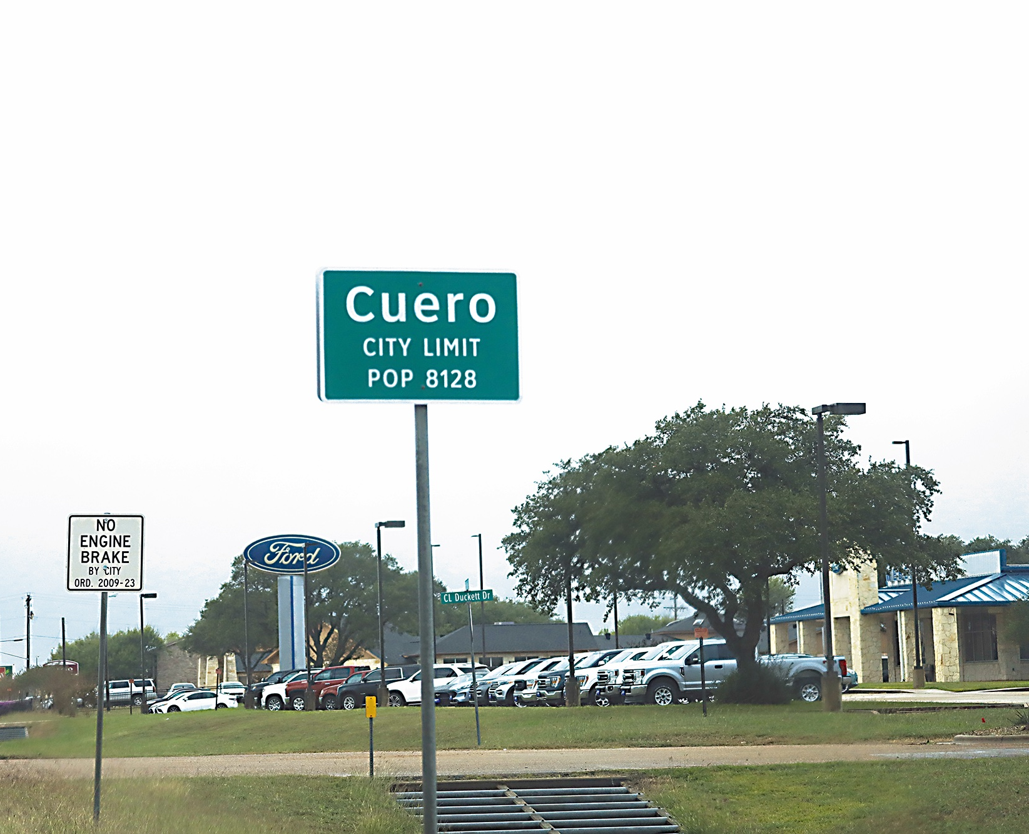
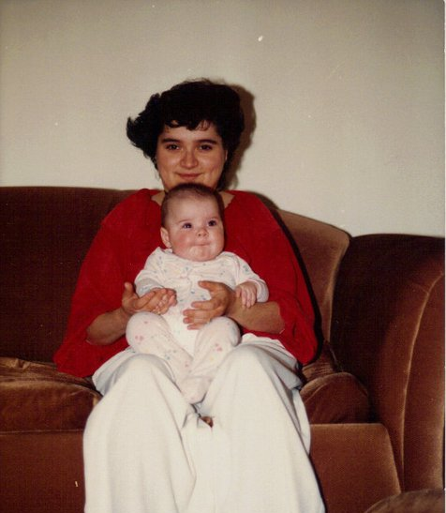
Notes:
The year was 1998 and I was 28 years old living in a small rural town in Texas and I had just given birth to my third daughter.
As a young mother of three toddlers, I didn’t think anything about being short of breath and always tired. I was practically a single mother, with my girl‘s father leaving for military duty nearly 8-9 month out of the year.
That summer, I was so tired all the time. I couldn’t move around the house like I used to. Being exhausted, the house got messy and my husband thought I was lazy and faking being sick. My sister Debbie – who visits once a year for her one week of vacation – would plead with me to get off the couch and take advantage of her time in town. Over a couple of weeks, I didn’t have energy to even eat and started to lose weight.
Something happened to me that year that I couldn’t explain. Out of the blue, my heart started to feel like it was beating out of my chest with very little exertion – I would walk slowly across the room and feel these palpitations. I had little energy, and I could barely get out of bed.

Slide 5
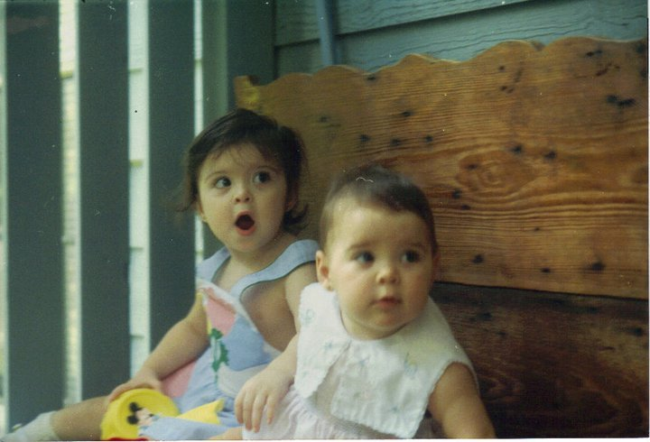
Notes:
This was incredibly difficult because I not only had a baby to take care of but my other two daughters running around the house in need to get dressed, fed and out the door for school.
I was living in a high-poverty, rural town in Texas with a population of 4,000. I’m not sure if it was because I was poor, or because I was a Mexican-American in a very white town, or I was a young woman, but I was dismissed almost a dozen times by my doctors when I showed up to the doctor’s office time and again with worsening symptoms.

Slide 6
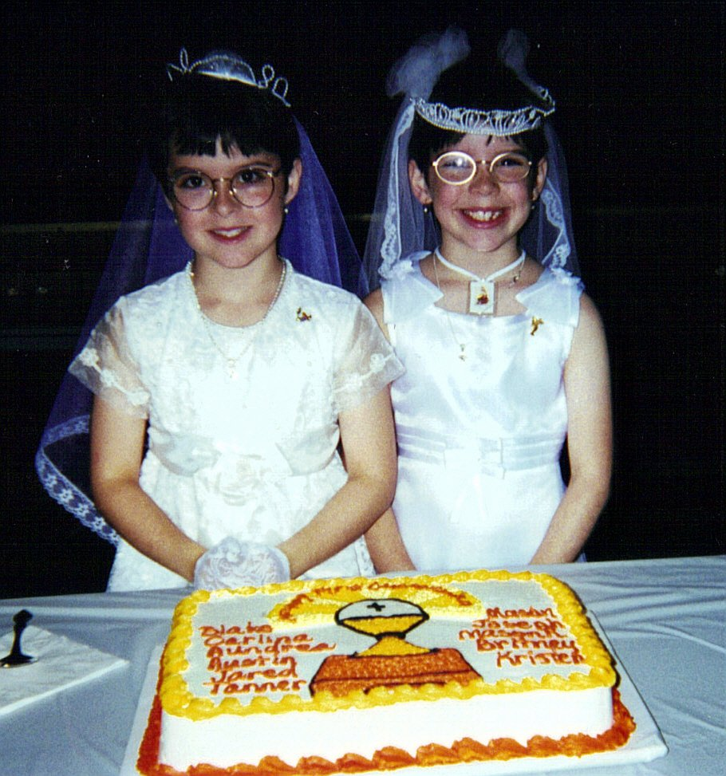
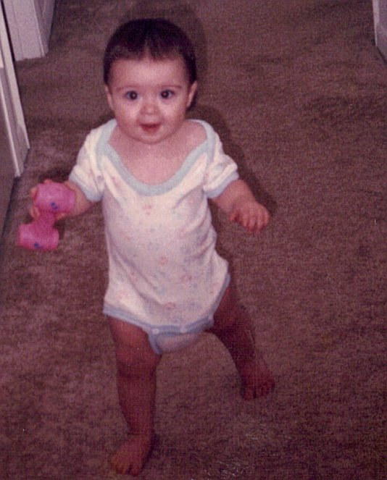
Notes:
I was 28 years old and they told me I wouldn’t live to see my 30th birthday.
My doctor told me that if I had waited any longer they might have diagnosed me in autopsy. I knew I was dying and it took years of misdiagnoses as the disease slowly killed my heart and my ability to breathe. had i waited any longer, I would have been dead in 6 month.
They gave me 2 years to live when I was diagnosed. My life sentence was given, and I had 2 years to live my best life with my babies.
I wouldn’t live to see my baby girls go to prom. I wouldn’t live to see their quinceaneras.
Aundrea, Carlena, and Luzy would not have the love and care of their mother watch them graduate high school. I wouldn’t live to see them get married. I wouldn’t see them have babies of their own. I wouldn’t live long enough to be a grandmother.

Slide 7
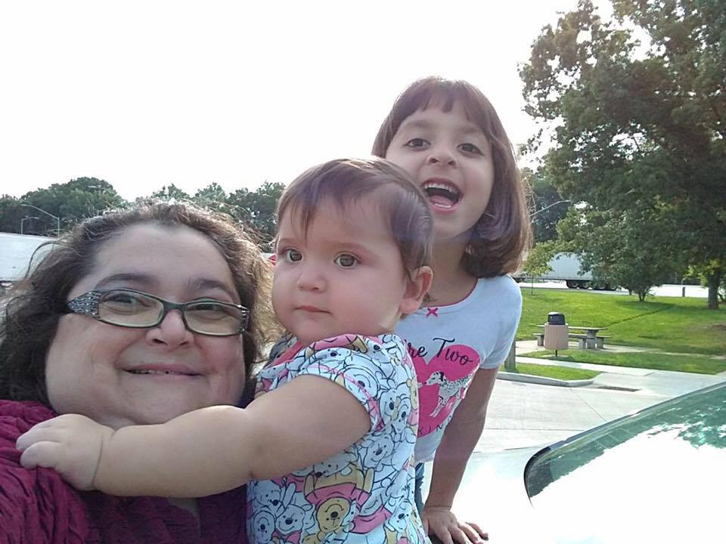
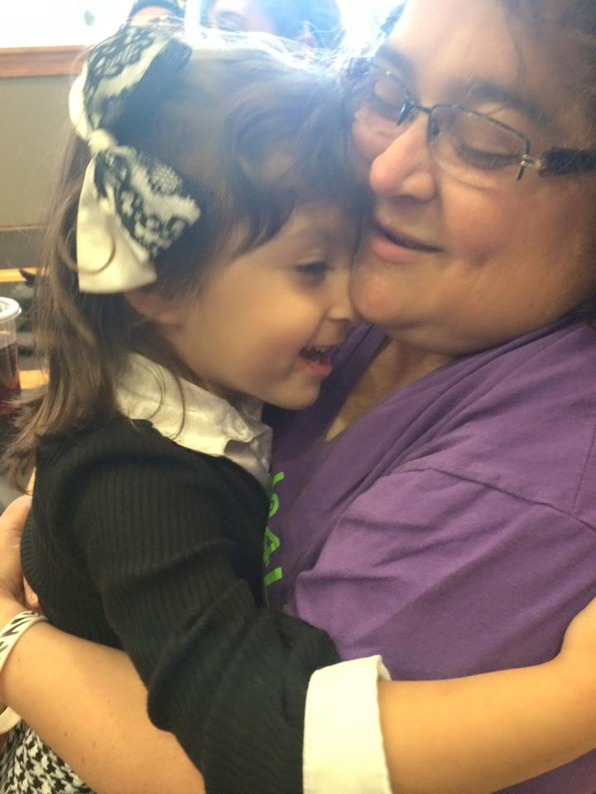
Notes:
The doctors were wrong in their predictions. I am standing here before you, a grandmother to Ellie and Stevie, mom to Aundrea, Carlena and Luzy, because the Orphan Drug Act had created the incentive for drug developers to develop the drug that saved my life!

Slide 8
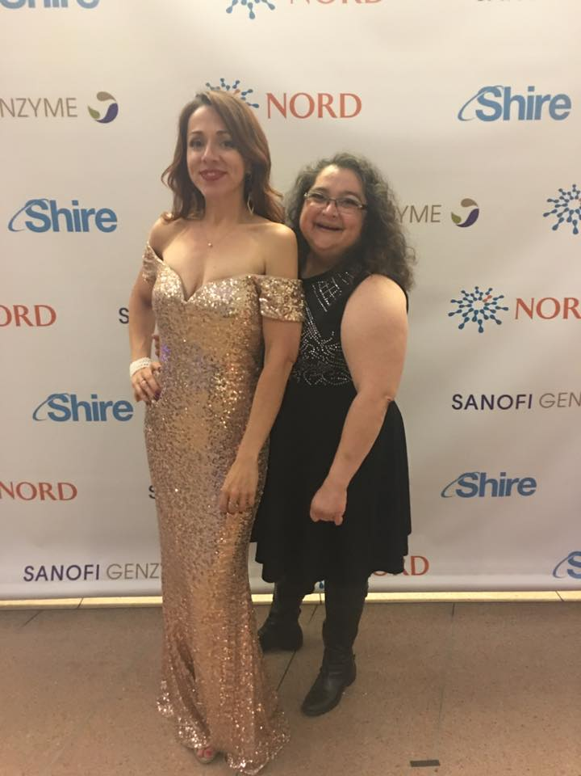
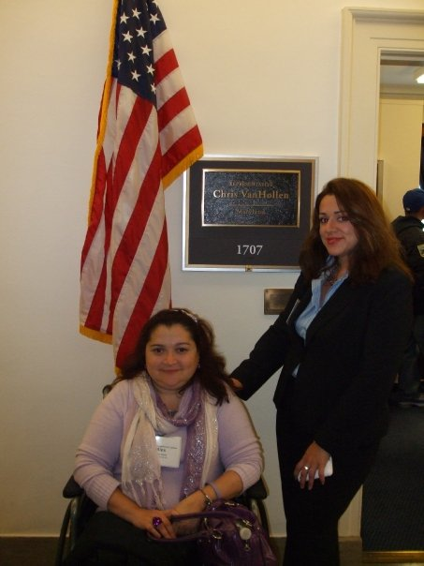
GRATEFUL FOR ODA, BUT ALSO TO NORD
Notes:
There are now almost 20 treatments for pulmonary hypertension, and we’re still fighting for a cure.
Now about NORD’s 40th anniversary… I will say this. NORD is also the reason I am alive. The orphan drug act incentivized drug companies to research rare diseases. But NORD made patient involvement in drug development a reality… and this combination of the two saved me and so many like me

Slide 9
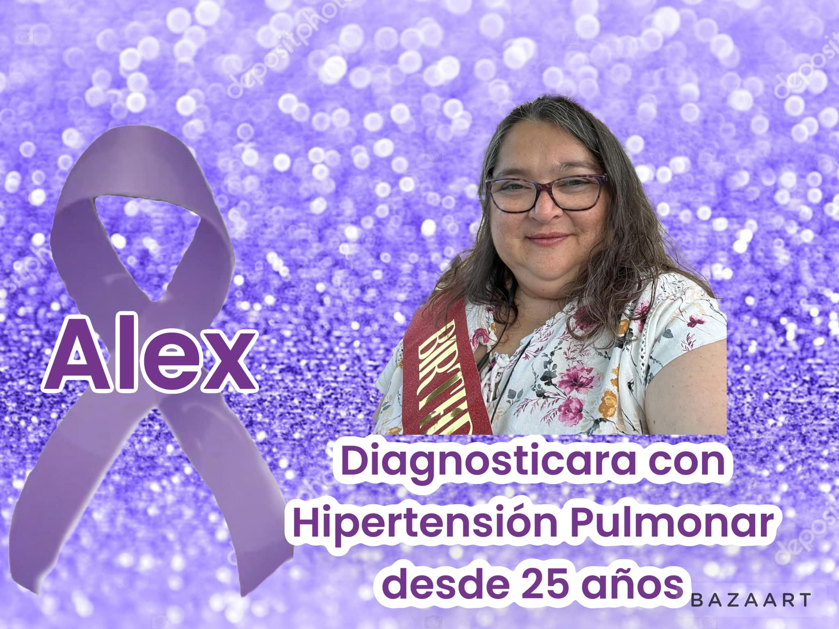
Notes:
If it wasn’t for the Orphan Drug Act, there would not likely be the first treatment.
Without the Orphan Drug Act, I would not be here today.
At 28 years of age, the doctors in Texas told me that I would not likely live to see my 30th birthday. I’m 53 years old and thriving!
The doctors told me I would not live to see my daughters have children of their own. I not only have two granddaughters, but I currently have enough energy to help raise one of them.
Raising my seven year old granddaughter has been a huge challenge for me, but I do it with all my heart. She’s awesome! Loving, caring and helpful and kind. She is very popular in the first grade, and has tons of friends.
I’m an advocate, an artist, a support group leader, a mentor, mother, and a grandmother. I am all of these things, and I am alive and here to tell you that without the Orphan Drug Act, none of this would be true.
Thank you.

Slide 10
DATA COLLECTION
Conducting a first-of-its-kind national survey of underrepresented individuals with rare disease and caregivers
Collected via SurveyMonkey from February 14 – June 15, 2023
Survey available in English and Spanish
Data collected anonymously
Topics covered
Demographics
Rare disease attributes
Diagnostic journey
Health insurance
Health care utilization
Health care experiences
Emotional Health
Inclusion Criteria
Individuals with a rare disease
Individuals currently undiagnosed but suspected to have a rare disease
Current and former caregivers of individuals with or suspected to have a rare disease
Notes:
In specific response to addressing inequities in underrepresented communities, NORD formed a partnership with the Rare Disease Diversity Coalition (RDDC) and we conducted a first-ever national survey of underrepresented RD patients and caregivers – across all 7,000 rare diseases.
Data was collected via SurveyMonkey on Valentine’s day of this year and continued through early Summer – a total of four months. The survey was available in English and Spanish and all data was collected anonymously to ensure safe participation and to remove any barriers of privacy concerns with the data collection. Our inclusion criteria were (1) individuals diagnosed with rare diseases or (2) undiagnosed and suspected of having a rare disease. (3) As well as their caregivers. (4) Caregivers who lost their loved ones were also asked to participate. We covered a range of topics as you can see above, but most importantly, we wanted to learn of their specific barriers to care.
We had branch logic across four subtypes of respondents
Patients
Caregivers currently actively taking care of patients
Caregivers who once took care of their loved one but is no longer because their loved one passed away
Caregivers, who no longer take care of their loved one, but their loved one is alive and wither caring for themselves or are receiving care in another way
We had the demographics you would expect: age, ethnicity, gender identity, income, marital status, educational level, work status, zip code, language spoken at home.
Section 2: Questions about your Rare Disease
Section 3: Some information about your diagnosis (if and how you were screened and/or received a genetic test)
Section 4: Some questions about your health insurance (if they are covered, type of insurance, secondary insurance, cost per month, type of clinical access offered by their insurance,
Section 5: Questions about your use of health care (if they see a RD expert, received a referral for an expert in their disease, # of hospitalizations, checkups, ER or urgent care visits, visits with traditional healers, mental health providers; transportation to RD doctor,)
Section 6: Experiences with health care (barriers question!)

Slide 11
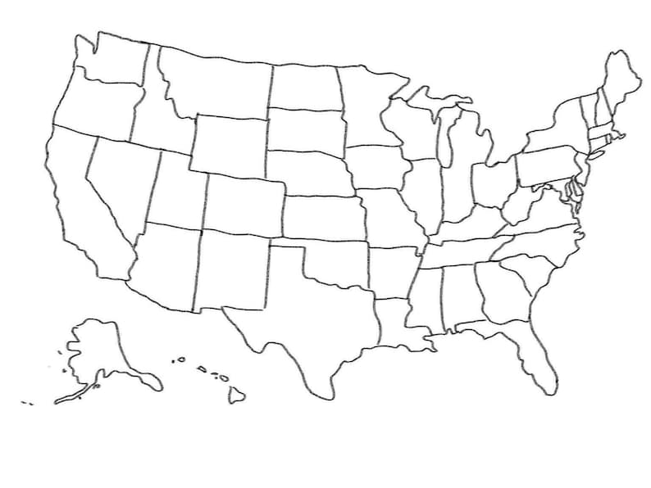


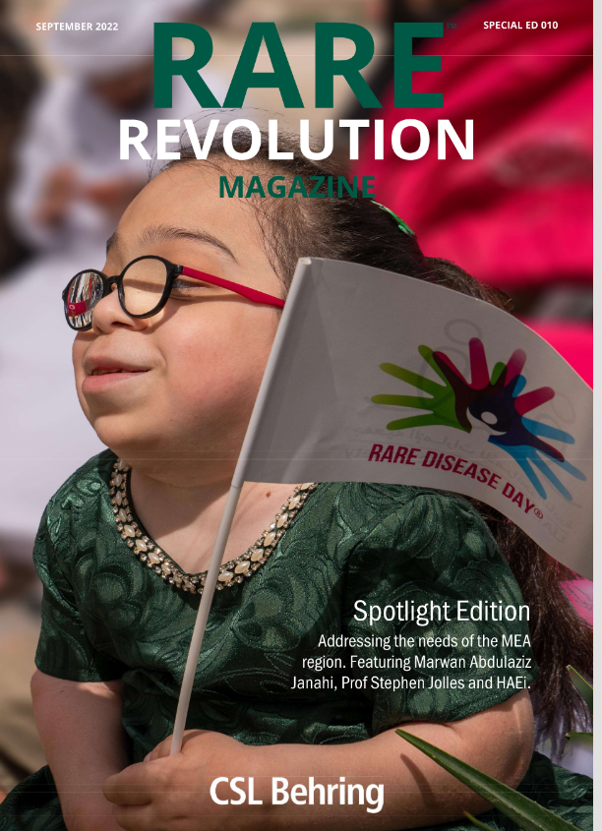
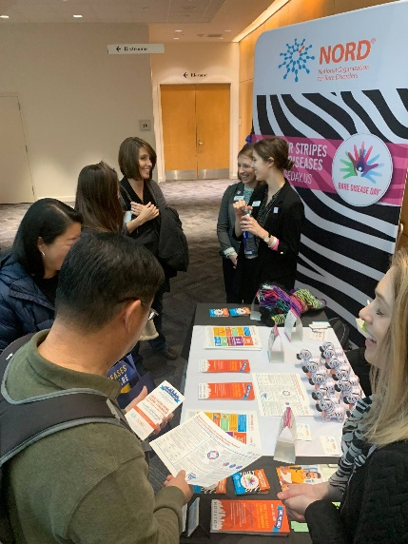
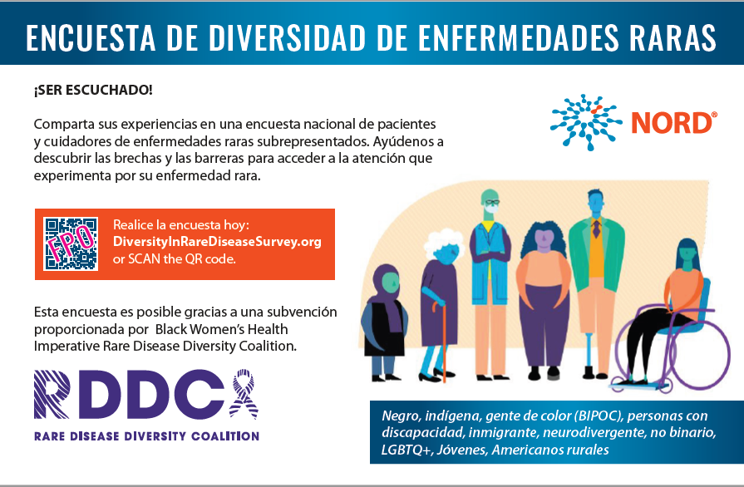
RECRUITMENT STRATEGIES
All messaging in English y Espanol
Survey in both languages
E-mail distribution to RDDC/NORD networks of tens of thousands
Ethnic based advocacy groups
Postcard promotion at exhibits at health conferences and grassroots community health fairs nationwide
Promotion to 100,000s via multi-stakeholder social media channels
Paid Google ads
Virtually: CA, PA, NY, KY, IA
Notes:
All messaging in our recruitment was in English and Spanish
we developed a printed postcard with English on one side and Spanish on the other which were distributed to thousands of people across the United States at 34 rare disease conferences, state and regional health fairs, local community events and community health centers. Ethnic based advocacy groups distributed the postcard at events and also send virtual communications int heir e-newsletters and social media.
The RDDC and NORD have hundreds of thousands of followers on our social media accounts; NORD is a coalition of 340 non-profit rare disease organizations and worked to disseminate the promotion of this survey through our members, as well as our Rare Action Network Ambassadors, our 40 RD Centers of Excellence, and our industry partners. The RDDC also circulated across their coalition of ethnic and diverse partnerships.
We worked with nearly a dozen media partners, and ran ads in media outlets. We identified a list of rare diseases for targeted communication, and these included rare diseases that disproportionately impact communities of color. We rolled out additional ads targeting these specific disease communities across Google, YouTube, and Google's display network (which follow users throughout the web reading relevant topics) to direct rare disease patients and caregivers of color to take the Rare Disease Diversity Survey between June 1 – June 15, 2023. These ads were viewed 405,436 times and clicked 2,587 times, resulting in more than 2,500 visits to the Survey form.
Given the high bar of taking a 20-minute survey, and the small amount of text we were able to provide users to guide them from the articles they were reading to the survey, this is a very strong result.

Slide 12


Notes:
The Creative team at RDDC/BWHI put together a 10 second digital billboard that was wrapped around a building in NYC's Time Square. The billboard Screen is slightly wrapped so the info is on both sides when you review the video.
Video has the wording twice because it was wrapped around a building from two sides.

Slide 13
PRELIMINARY RESULTS

Slide 14
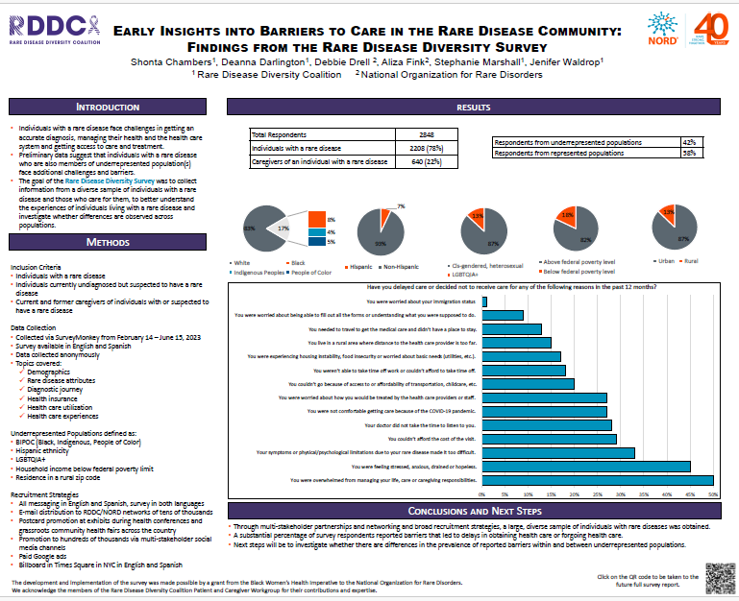

Slide 15
RESULTS
Total Respondents | 2848
Individuals living with a rare disease | 2,208 (78%)
Caregivers | 640 (22%)
Underrepresented Groups
BIPOC (Black, Indigenous, POC) | Hispanic ethnicity
Household income below federal poverty limit | Residence in a rural zip code
Notes:
Our goal was 2,000 respondents and 60% underrepresented. We reached nearly 3,000 respondents.

Slide 16
SURVEY QUESTIONS
Beliefs and attitudes towards their health care providers
Patient/provider interaction and communications
Patient understanding of and attitudes towards
genetic testing and genetic counselling
clinical trials and research
Patient travel time and distance to medical appts (actual barriers)
Perceived barriers to accessing care
Visual, hearing, ability, language, citizenship, psycho-social, SES (quantitative)
Open-ended responses (qualitative)
Notes:
It took an average of 20 minutes to complete the survey.

Slide 17
BARRIERS QUESTION
Have you delayed care or decided not to receive care for any of the following reasons in the past 12 months?

Slide 18
You were overwhelmed from managing your life, care or caregiving responsibilities. | 50%
You were feeling stressed, anxious, drained or hopeless. | 45%
You couldn’t afford the cost of the visit. | 29%
Your doctor did not take the time to listen to you. | 28%
You were worried about how you would be treated by the health care providers or staff. | 27%
You weren’t able to take time off work or couldn’t afford to take time off. | 18%
You were experiencing housing instability, food insecurity or worried about basic needs (utilities, etc.). | 17%
You were worried about being able to fill out all the forms or understanding what you were supposed to do. | 9%
Goal: to collect information from a diverse sample of individuals with a rare disease and those who care for them, to better understand the experiences of individuals living with a rare disease and investigate whether differences are observed across populations.

Slide 19
OVERALL FINDINGS AND NEXT STEPS
Through multi-stakeholder partnerships and networking and broad recruitment strategies, a large, diverse sample of individuals with rare diseases was obtained.
A substantial percentage of survey respondents reported barriers that led to delays in obtaining health care or forgoing health care.
Next steps will be to investigate whether there are differences in the prevalence of reported barriers within and between underrepresented populations.
Notes:
The survey findings will elevate and empower the entire rare disease field to better understand and combat the significant health barriers rare disease patients and their caregivers face daily, as well as build a more equitable future for the over 25 million Americans currently living with a rare disease.
The survey will also help inform future efforts by RDDC to bring rare disease experts, health and diversity advocates, and industry leaders together to identify solutions to overcome barriers faced by rare disease patients and their families and to help amplify diverse and marginalized perspectives in rare disease advocacy and research.
We are working to bring together rare disease patients, caregivers, advocates, leaders, researchers, clinicians, regulators, and industry to better understand and fight for diversity, equity, and inclusion within the rare disease community.
If you or someone you love is diagnosed with a rare disease, or if someone you cared for succumbed to a rare disease, we want to hear your journey. To take the survey, please visit www.RareDiseaseDiversitySurvey.org
In 2022, we also launched several dynamic resources to educate leaders, advocates, and nonprofit organizations on how a lack of DEI is affecting marginalized groups within the rare disease community. Some of these resources include DEI toolkits and webinars that include materials in both English and Spanish.
When people ask how they can help to address these inequities, we encourage them to participate in Rare Disease Day by holding or participating in an event, helping secure media attention when possible and even reaching out to policy makers.

Slide 20
MORE TO COME…
Amish communities and PFDDs
Latinos and Rare Community Listening Sessions
DEI for rare disease nonprofits

Slide 21

THANK YOU!
We acknowledge the members of the Rare Disease Diversity Coalition Patient and Caregiver Workgroup for their contributions and expertise.
Notes:
- The development and implementation of the survey was made possible through funding from Rare Disease Diversity Coalition, a program of the Black Women’s Health Imperative (BWHI).

