Slide 1
The Orphan Drug Act at 40
Karin Hoelzer, DVM, PhD
Director, Policy and Regulatory Affairs

Slide 3

THE ODA AT 40: ALONE WE ARE RARE. TOGETHER WE ARE STRONG.®
“We look back on this adventure with a great sense of accomplishment and relief. It was an opportunity for patients with rare diseases to empower themselves. I doubt if we would have [had] such an effective and cohesive group if we had not faced opposition at every turn.”
- Abbey Meyers

Slide 4
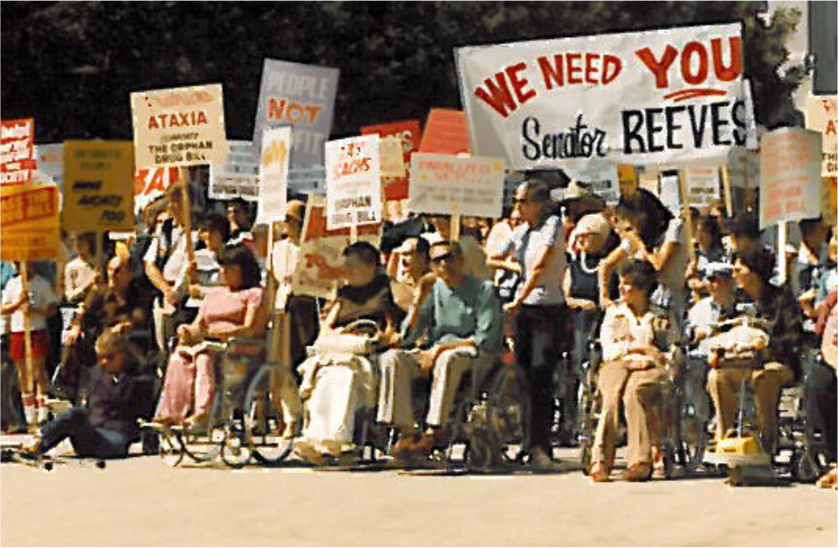
THE ODA AT 40: INCENTIVES & MODEST INVESTMENTS CAN CHANGE THE WORLD
Research grant funding
Tax credits
Exemption from FDA user fees
Orphan Drug Exclusivity (ODE)

Slide 5

THE ODA AT 40: GOOD HEALTH POLICY SAVES LIVES & TRANSFORMS COMMUNITIES
Source: Orphan Drugs in the United States: Rare Disease Innovation and Cost Trends Through 2019; available at https://rarediseases.org/advocate/rareinsights/

Slide 6
THE ODA AT 40: WE HAVE COME FAR, BUT WE HAVE A LONG WAY TO GO
Most rare disease patients STILL have NO FDA-APPROVED TREATMENTS and NO CURES
Many rare diseases have a GENETIC component and lead to PREMATURE DEATH in CHILDHOOD
Most rare diseases have heterogenous DISEASE MANIFESTATIONS and PROGRESSIONS
Cell & gene therapies are the only hope for a cure for many RARE DISEASE PATIENTS
Effective treatments have completely changed the DISEASE TRAJECTORY for patients and families

Slide 7
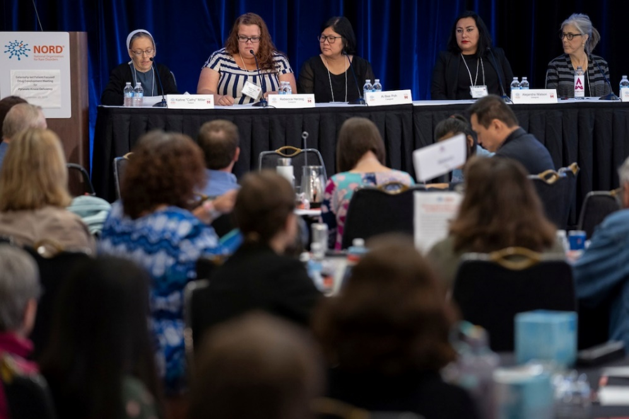
THE ODA AT 40: PATIENTS PLAY A KEY ROLE AT EVERY STEP OF DRUG DEVELOPMENT
Raising awareness & attracting funding
Collecting data & research
Shaping research tools
Informing & participating in clinical trials
Patient-focused drug development (PFDD) meetings & Patient Listening Sessions
FDA Advisory committee meetings
…………….

Slide 8
THE ODA AT 40: IF WE WANT TO GO FAR, WE HAVE TO GO TOGETHER
Global harmonization is key
Clinical trials & data must become truly global
Diversity, Equity & Inclusion is not optional
Approval does not equal access

Slide 9
THANK YOU
Karin Hoelzer, DVM, PhD
Director, Policy and Regulatory Affairs
National Organization for Rare Disorders (NORD)
Email: khoelzer@rarediseases.org
Phone: 607-339-6561

