Slide 1
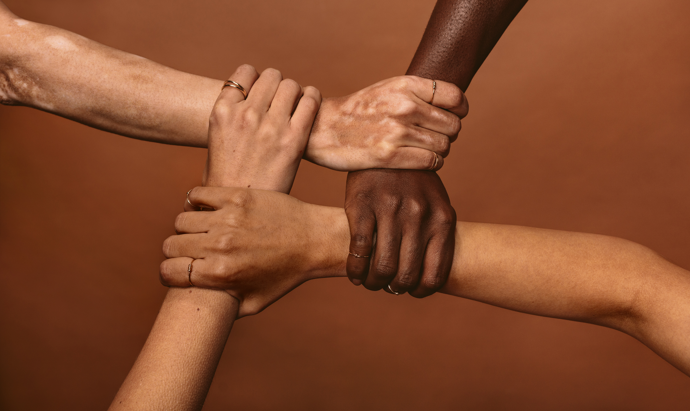
Inequities in rare disease an overview
James Levine MD PhD, Foundation Ipsen

Slide 2
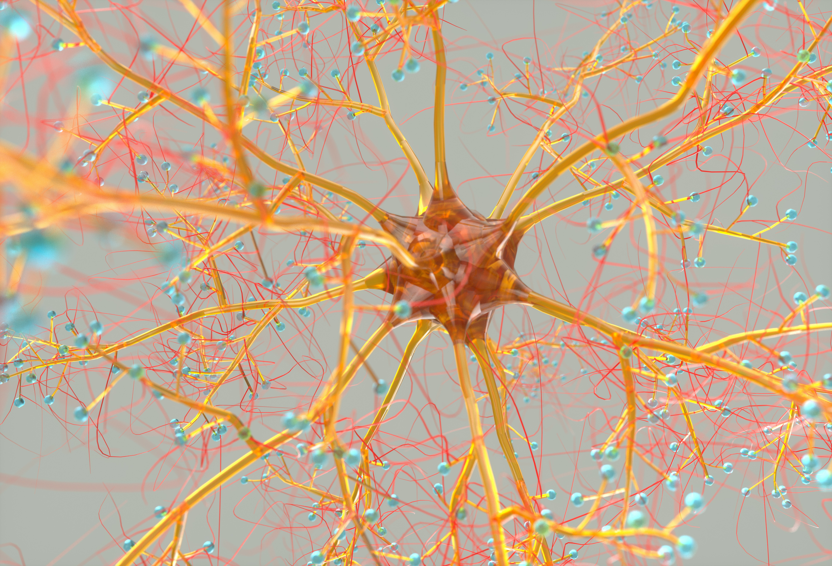
1. Research Gaps
Publications: https://pubmed.ncbi.nlm.nih.gov/
163,145 Immunotherapy in cancer
131,733 Type 2 diabetes therapy
5,163 Familial Mediterranean Fever
2,200 Niemann-Pick type C disease
Rare diseases typically receive less research funding and attention compared to more common diseases. This can lead to a lack of understanding of the disease, its causes, and potential treatments.

Slide 3

2. Delayed Diagnosis
Difficult to diagnose
Healthcare professionals unfamiliar
Healthcare systems
Access to testing
“On average, it takes more than 6 years and nearly 17 doctor visits, hospitalizations, and other health-related trips, to receive a rare disease diagnosis after symptoms begin.”
Benito-Lozano J. PMID: 35682039

Slide 4

3. Limited Access to Expertise
Patients with rare diseases struggle to find healthcare professionals with expertise in their specific condition. This can result in suboptimal care and a lack of specialized knowledge.
“…unfortunately, health professionals have a low level of knowledge regarding the impacts of Rare Diseases on the social, psychological, and economic spheres of the patients and their families; hence, RD management is inadequate, consistently empirical, and precarious.”
Flores A, PMID: 36457581

Slide 5

4(a). Lack of Treatment Options
95% rare diseases - no treatment
  limited research
  limited pharmaceutical interest
  Even when treatments do exist, they may be expensive, inaccessible, or ineffective
Han Q. PMID: 36313320

Slide 6
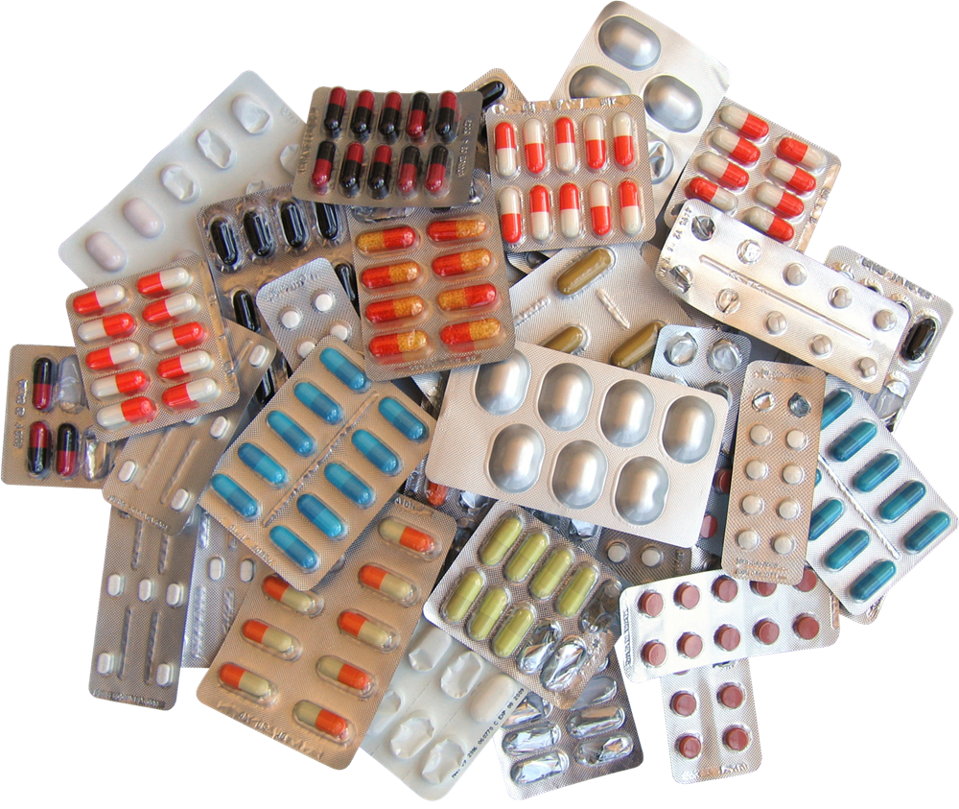
4(b). Lack of Orphan Drug Development
Orphan drugs are medications developed specifically for rare diseases.
high cost of developing
small patient populations
High risk
-> Limited treatment options
  “Orphan drugs, however, are rare and patients often struggle to utilize them and expensive medications during treatment”
Han Q. PMID: 36313320

Slide 7

5. Isolation and Support
“The diagnosis itself is isolating, but when you consider that there may be few similar cases in the world, fewer physicians who recognize it, and fewer organizations for support, individuals with rare diseases face unique obstacles.”
Lack of community and social support
Few others with the same condition
Difficult to find others who can relate to their experiences
https://globalgenes.org/blog/how-isolation-impacts-those-suffering-with-rare-disease/

Slide 8

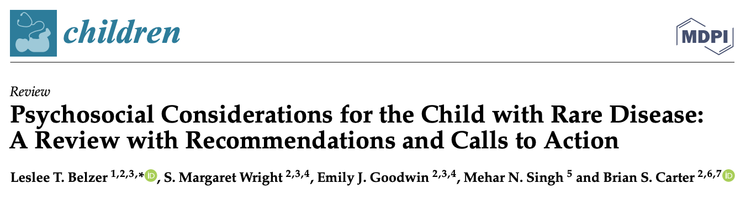
6. Stigma and Misunderstanding
Patients with rare diseases may experience stigma and discrimination due to a lack of public awareness and understanding about their conditions. This can lead to isolation and psychological distress.

Slide 9

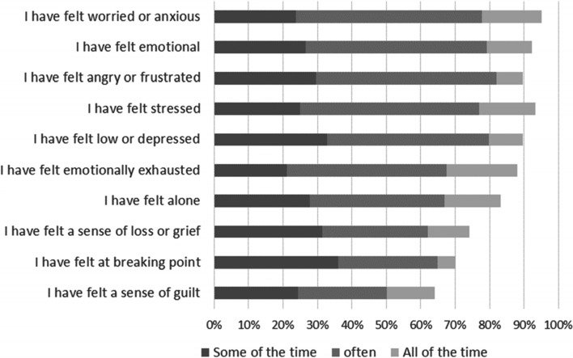
7. Psychological
1231 patients and 564 carers.
“Living with a rare disease substantially impacts mental health. Many of the drivers of poor mental health reflect issues specific to managing rare conditions.”
https://pubmed.ncbi.nlm.nih.gov/35568910/

Slide 10

8. Financial Burden
The cost of managing a rare disease, including medical bills, specialized care, travel and medications, can be exorbitant. Many patients and their families face financial hardship as a result.
Delaye J, PMID: 35754469

Slide 11

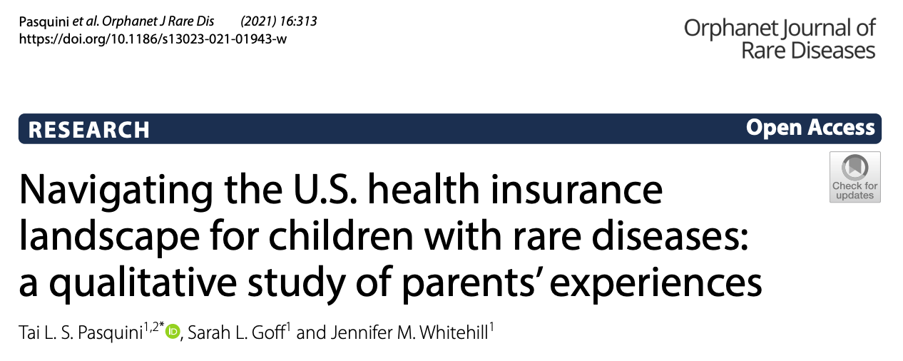
9. Inadequate Insurance Coverage
Suboptimal coverage :
Rare disease treatments
Medical expenses
Care expenses
Lost income
Significant financial
burden.

Slide 12
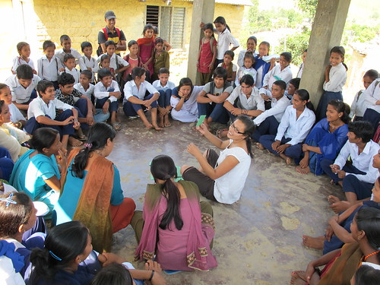
10. Advocacy and Awareness
Rare disease communities often struggle to raise awareness and advocate for their needs, as they lack the visibility and numbers that more common diseases enjoy.
Halley MC, Rare Disease, Advocacy and Justice: Intersecting Disparities in Research and Clinical Care. Am J Bioeth. 2023 Jul;23(7):17-26. PMID: 37204146.

Slide 13

Conclusions
Efforts to address these inequities.
  Advocacy groups, patient organizations, and rare disease researchers work to increase awareness, funding, and support for people living with rare diseases.
  Government initiatives and policies
  Rare disease patients must receive the care, cure and support they need.
  PLEASE HELP US

