Slide 1

Case study: Assistive Technology to Help Seniors with Dementia Stay Connected with Family

Slide 2
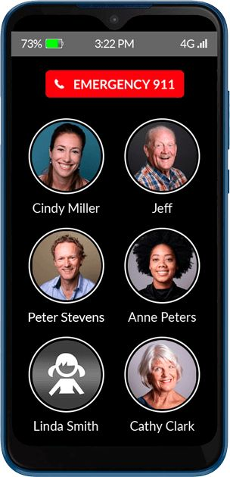
The Problems – dementia and aging in place
RAZ Mobility
6.7 million Americans 65 and older are living with Alzheimer’s dementia. This represents 1 in 9 seniors.
33.3% of people aged 85 and older have dementia.
More than 11 million family members provided an estimated 18 billion hours of care to people with Alzheimer’s or other dementia in 2022.
The lifetime risk for Alzheimer’s dementia for a 45-year-old woman is 20% and for a man it is 10%.
88% of adults aged 50 to 80 feel it is very important for them to age in place. The American Medical Association believes that aging in place is also beneficial to those with dementia.

Slide 3
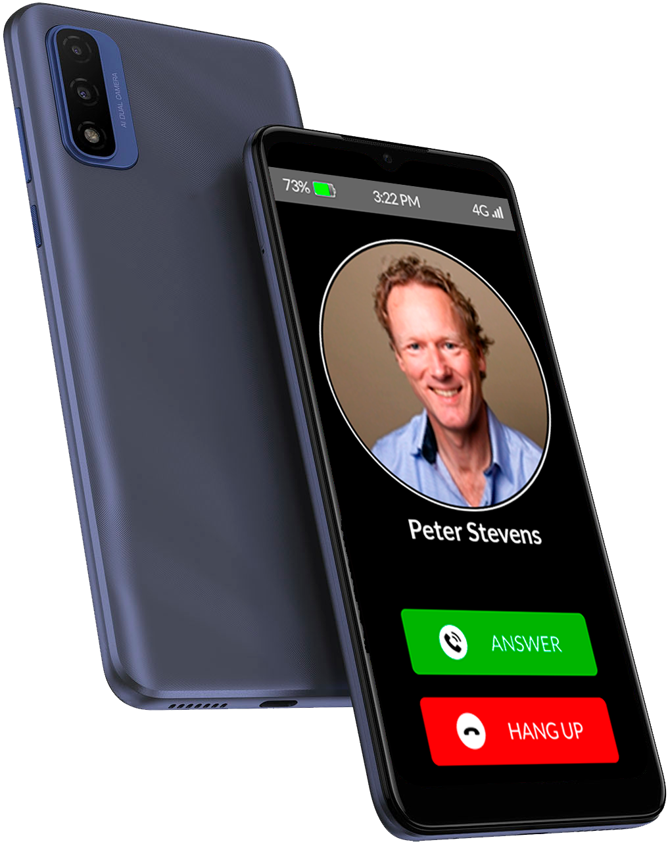
Loneliness – a cause and effect of dementia
Social isolation is associated with a 50% increased risk of dementia.
Social isolation significantly increases a person’s risk of premature death from all causes, on an order of magnitude similar to smoking, obesity, and physical inactivity.
Monday in JAMA Neurology: People who are lonely have a 37% greater likelihood of being diagnosed with Parkinson’s. The authors concluded that “[t]his study adds evidence on the detrimental health impact of loneliness and supports recent calls for the protective and healing effects of personally meaningful social connection.”
There is little data on loneliness experienced by people with dementia. But the University of Michigan National Poll on Healthy Aging reports that social isolation is experienced by 7 in 10 seniors with fair or poor mental health and more than half of those with fair or poor physical health.
Nearly 25% of adults aged 65 and older are socially isolated.

Slide 4
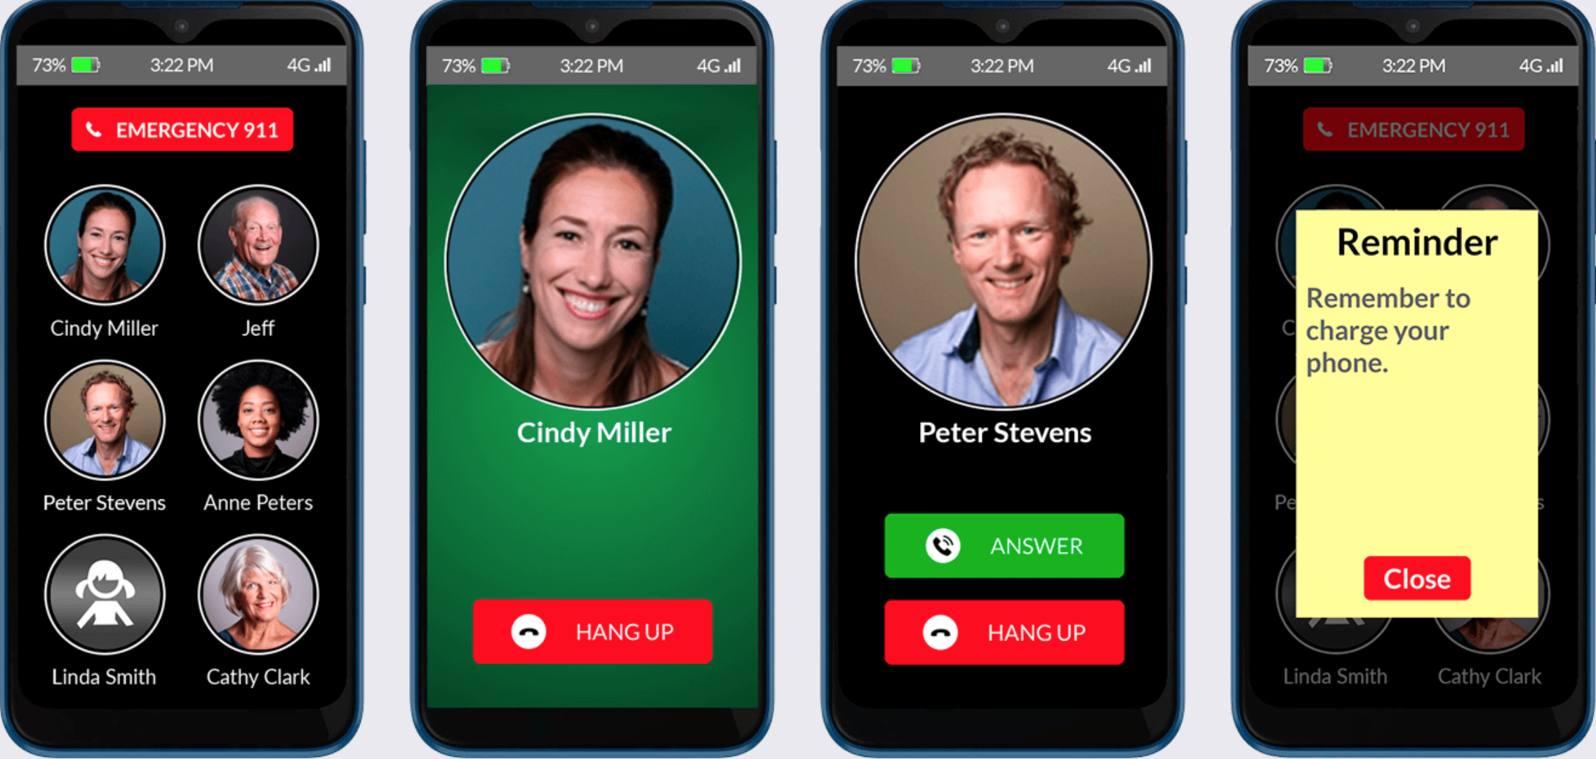
Cell phones for seniors
Other than the RAZ Memory Cell Phone, there are no cell phones designed for seniors with dementia.
Lively phones sold by Best Buy.
Assistive Access just introduced in iOS 17.

Slide 5
RAZ Memory Cell Phone
Designed for people with cognitive decline, especially dementia.
The phone follows certain principles: 1) simplicity, 2) everything is customizable, and 3) remote manage.
Solves unique problems experienced by those with dementia so that this population can use a phone for longer and stay connected with family:
Remembering to Charge
Vulnerability to fraud
Repetitive calling to 911
Calling in the middle of the night
Lock screen
Power button
Simple experience for the senior, including low vision and hand tremor mode.

Slide 6
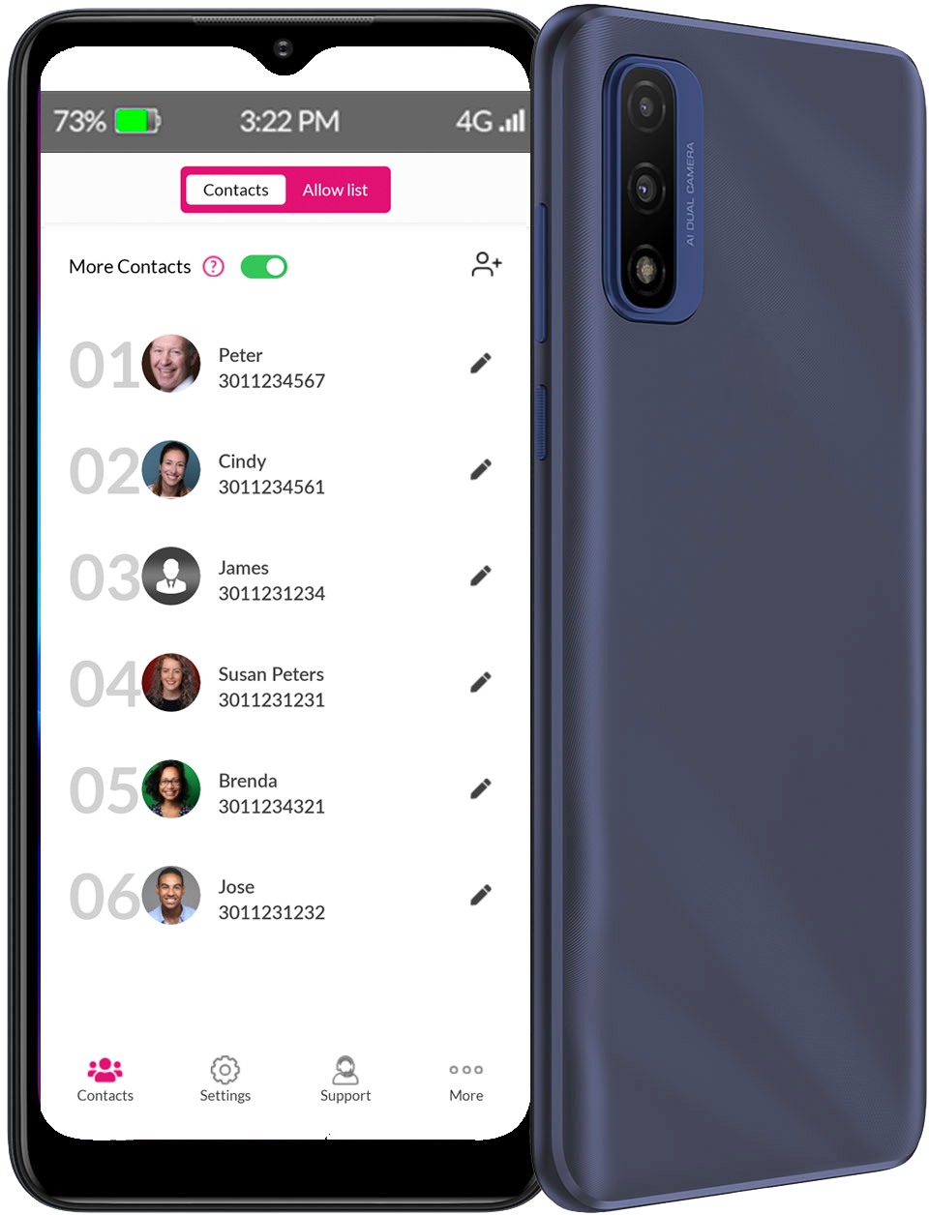
RAZ Memory Cell Phone – continued
RAZ Memory Cell Phone from perspective of the caregiver.
RAZ Care app
Video calls
Contacts
Safety – 911 notification, telephone fraud, GPS location
and tracking
Auto answer
Reminders
Power button
Interesting stats showing mission accomplished:
14% of customers have never used a cell phone before
25% of customers are over 90
50% of customers are using at home, supporting aging in
place.
Future development and initiatives.
Voiceitt
Loneliness alert
Offer additional features, such as text messaging and a photo album, in a dementia friendly way.

Slide 7
Presentation by Robert Felgar, CEO, robert@razmobility.com Nermin Selimic, COO, nermin.selimic@razmobility.com

