Slide 1

SCORECARDS & BOTTOM LINES
5 Story Ideas Worth Considering
Sarita Mohanty, MD, MPH President and CEO, The SCAN Foundation October 4, 2023 | Washington, D.C.

Slide 2
About The SCAN Foundation
VISION
We envision a society where all of us can age well with purpose
MISSION
We pursue this vision by igniting bold and equitable changes in how older adults age in both home and community

Slide 3
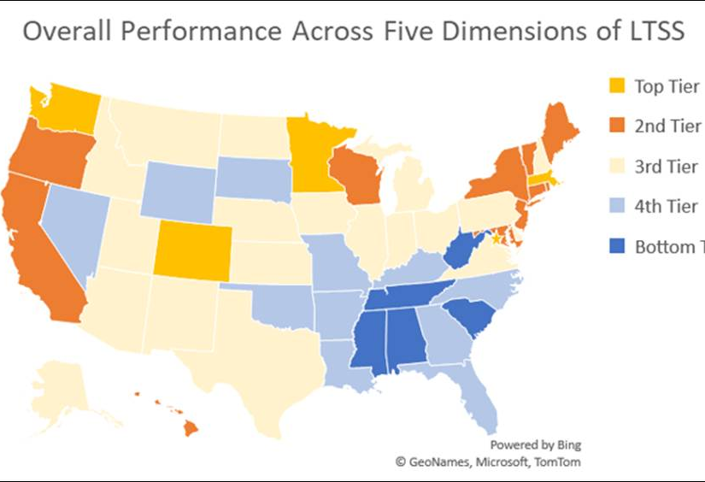

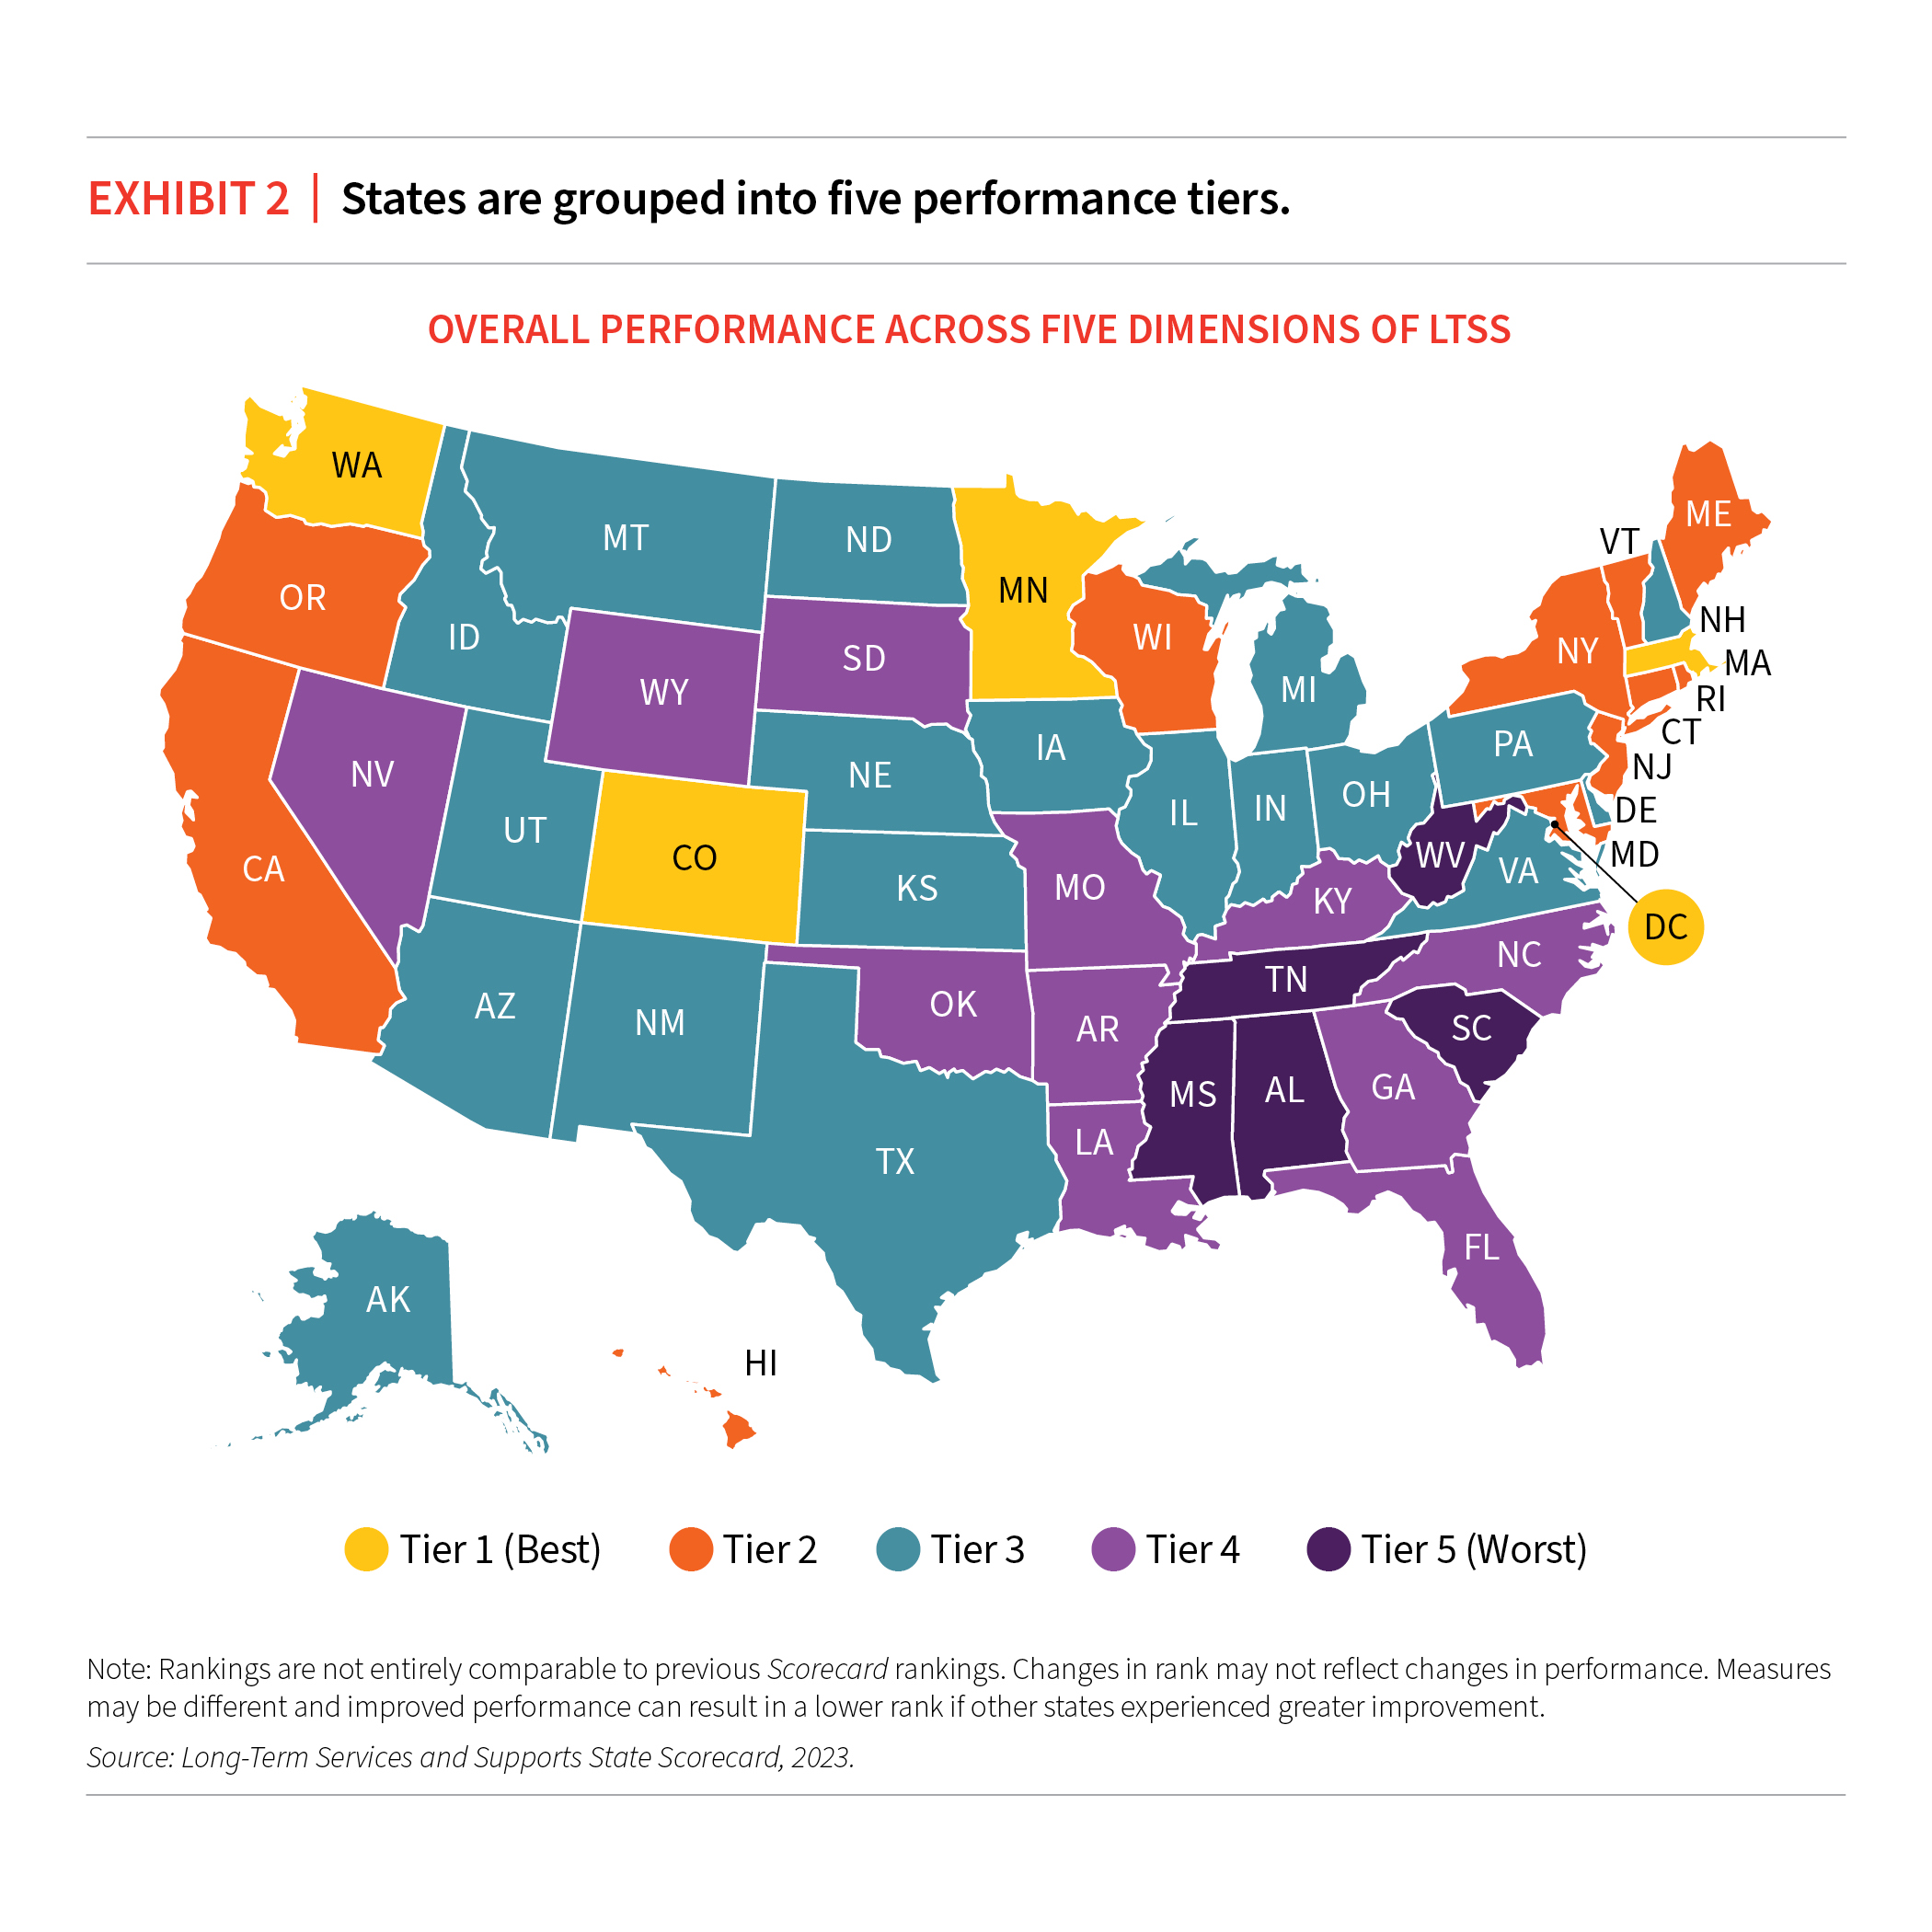
1. AARP SCORECARD SHOWS DISPARITIES
Nursing home care & staffing
Home & Community-Based Services
Resources for family caregivers

Slide 4


2. INCREDIBLE DEMAND FOR HOME-BASED CARE
Increasing population
‘Aging in place’ is desirable
but unaffordable
Long HCBS wait lists
Workforce shortages
Family caregivers

Slide 5







3. FAMILY CAREGIVERS NEED RELIEF
ONE IN FIVE PEOPLE IN AMERICA IS A FAMILY CAREGIVER
NO training
NO reimbursement
NO paid time off
NO employment protections

Slide 6

4. COMMUNITY MEMBERS ARE LEADING EFFORTS TO IMPROVE HEALTH EQUITY
OLDER ADULTS LEFT OUT OF DECISION-MAKING
Advancing Health Equity in Aging Initiative
Engaging older adults from underserved communities
People of color
Low-income
Geographically underserved
Identifying issues
Informing solutions

Slide 7

5. EMERGING POWER & POTENTIAL OF SOCIAL IMPACT INVESTMENT
Focusing investments on social good
Driven by health equity
Informed by social determinants, pandemic
Philanthropy and private sector increasingly investing in community health
Representation in data collection and analysis
Technology and other solutions impacting equity

