Slide 1




SUPPORTING CAREGIVERS THROUGH POLICY AND TRAINING
Clare Ansberry
Columnist
The Wall Street Journal
Debbie Witchey
EVP & COO
Healthcare Leadership Council

Slide 2
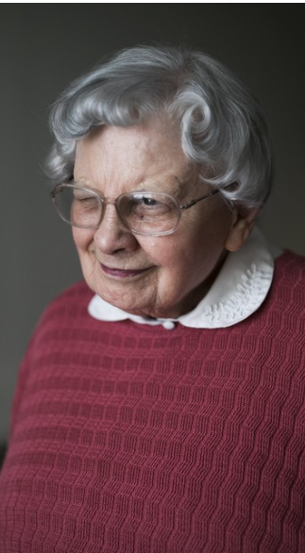
Running out of Caregivers
What: The U.S. is running out of traditional caregivers just when we need them most.
Why: Gap between supply and demand. Aging population and fewer family caregivers. Private options inadequate: Demand for private home care expected to exceed supply by more than 3 million in next decade.
Who is most affected: long distance caregivers; smaller families; elder orphans – about 14% of frail older adults are without children and the number is expected to double in next two decades.
What is happening as result: patchwork network – childhood friends, extended family, ex- spouses, nonprofits and volunteers.
Why that matters: offers glimpse of what future may hold for those who are not currently family caregivers, as well as public and private programs expected to offer support.

Slide 3


Total cost of long-term care is more than families expect. Few are prepared.
The numbers:
Median net worth of people 75 and older is $254,800, which is about the same it would take to cover the cost of 14 months of 24/7 in-home care.
Median cost of a home health aide increased 12.5% between 2020 and 2021.
Only one in five adults between the ages of 50 and 80 is “very confident” that they would afford to pay for in-home help.
Those 85 to 99 among fastest growing age segment, but not necessarily healthier.
$1.3 million: what one family paid to care for their mother at home. “If you would have asked me if I thought we would spend $1 million, I would have said, ‘No Way.’”

Slide 4
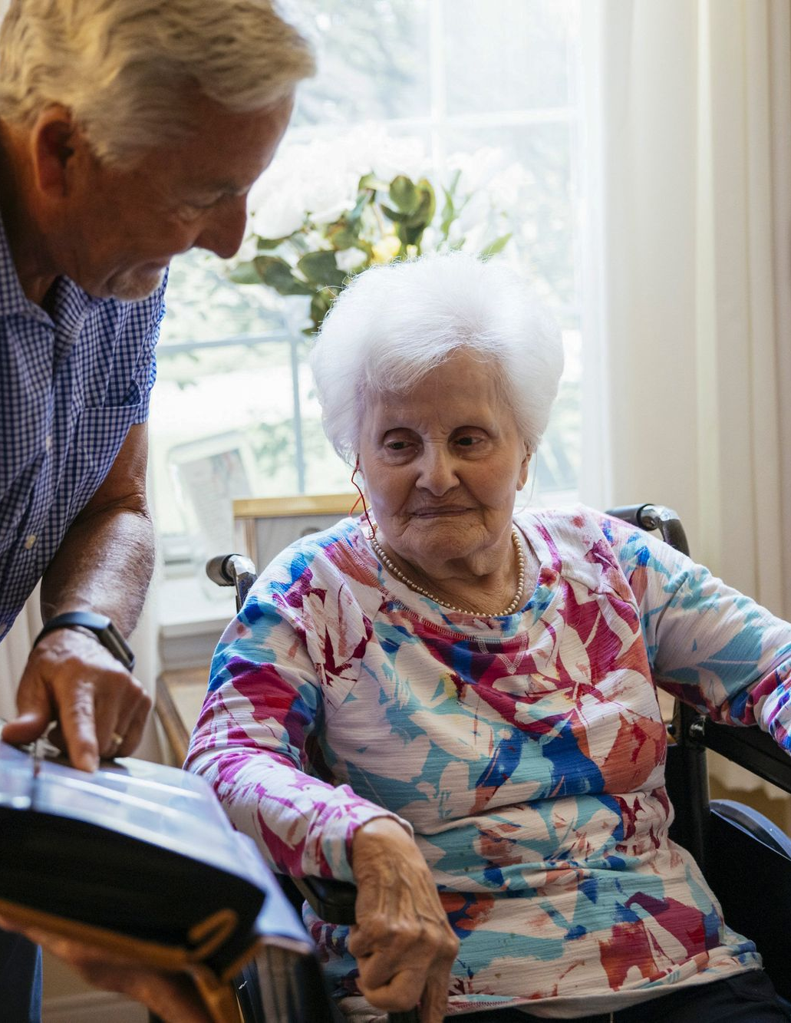
Inflation, long term care and impact on families.
Long term care providers, seeing their own costs increase, are passing along to residents.
New daily fees, added charges for previously free amenities, higher rates—in some cases three times previous annual increases. Families are required to hire additional private caregivers if a parent is a fall risk.
Those families who can’t afford the higher costs and fees have to move frail elderly relatives to a cheaper facility if available or absorb the higher costs.
In a decade, more than 11 million middle income older adults might not be able to afford assisted living and won’t qualify for Medicaid.
“A huge wake up call for our generation.”

Slide 5


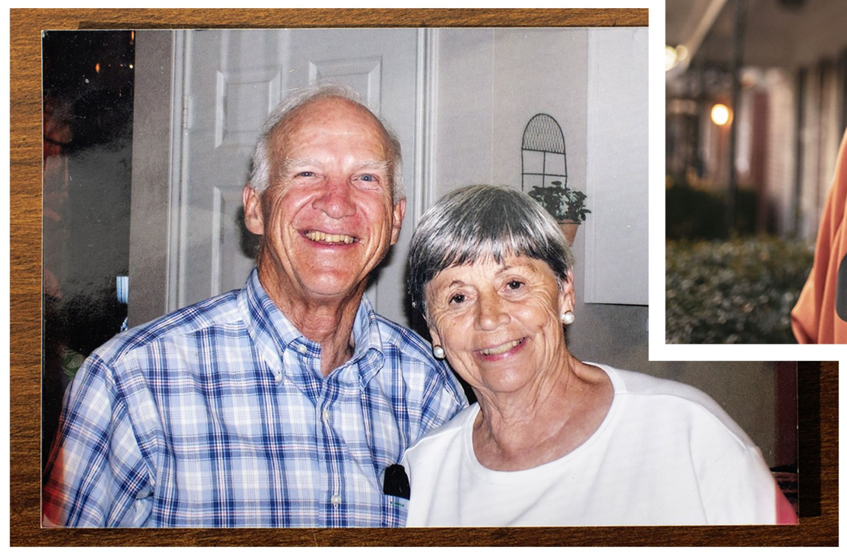
Pandemic put older adults at increased risk of elder abuse.
Staff shortages due to Covid: Temporary caregiver on probation for a felony robbery conviction brought in to fill a staff shortage at a long-term care facility. Stole engagement ring and credit cards and made charges at a Wendy’s hours after the 86-year-old woman died.
Fraud: virtual real estate transactions common during pandemic take advantage of older adults. The number of elder-fraud victims increased 55% between 2019 and 2020,
Physical abuse: Pandemic kept family members from regular visits to monitor care and caregiver. More than one in five older adults living in homes or apartments, as opposed to facilities, reported abuse in April and May 2020, when all states had stay at home orders – an 83.6% increase over pre-pandemic prevalence estimates.
Post pandemic: cases expected to continue to rise due to aging population and shortage of trained and licensed caregivers and continued isolation.

Slide 6

















































Who is HLC?

Slide 7
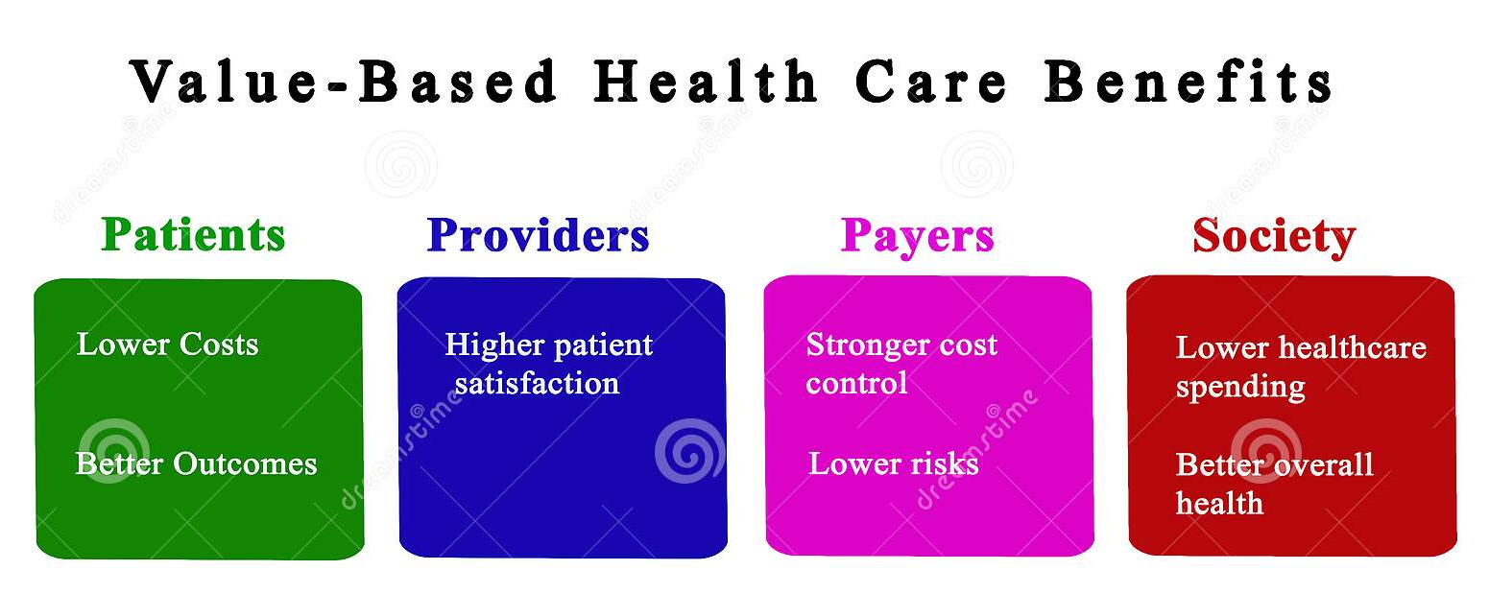
Why are Healthcare Industry Executives Interested in Caregiving?
Focused on outcomes and value-based healthcare delivery
SDOH and variations in care delivery
30% less likely to use the emergency department
50% less hospitalizations
13-day shorter hospital stays
Chronic conditions better managed for patients with caregivers, per CDC
Workforce Shortages/home health
1 million new aides next 10 years
Aides most vacancies
25% in home health and personal aides
Notes:
https://press.aarp.org/2023-03-08-New-Report-Highlights-Increasing-Cost-of-Family-Caregiving-in-the-US
https://www.aarp.org/content/dam/aarp/work/employers/2018/11/AARP-NEBGH-EmployerCaregivingToolkit_Practical-Guide-102517.pdf

Slide 8



Caregivers in the Workplace
Focused on outcomes and value-based healthcare delivery
20-25% are caregivers to a friend or relative (BLS 2021)
Average more than 20 hours a week providing some kind of care
25% are millennials
Spend $7,000 per year on out-of-pocket caregiving expenses
Notes:
https://press.aarp.org/2023-03-08-New-Report-Highlights-Increasing-Cost-of-Family-Caregiving-in-the-US
https://www.aarp.org/content/dam/aarp/work/employers/2018/11/AARP-NEBGH-EmployerCaregivingToolkit_Practical-Guide-102517.pdf

Slide 9

Why Does the Business Community Care About Family Caregiving?
Health insurance costs
Lost productivity & workday interruptions (69% change hours)
Increased absenteeism
61% change in employment
Notes:
https://press.aarp.org/2023-03-08-New-Report-Highlights-Increasing-Cost-of-Family-Caregiving-in-the-US
https://www.aarp.org/content/dam/aarp/work/employers/2018/11/AARP-NEBGH-EmployerCaregivingToolkit_Practical-Guide-102517.pdf

Slide 10

What is the Business Community Doing to Support Family Caregivers?
Long term care benefits
20% > 500 eldercare referral
15% > eldercare leave
Emergency eldercare, subsidized eldercare center,and…
Needed most: navigation & flexibility
Notes:
https://press.aarp.org/2023-03-08-New-Report-Highlights-Increasing-Cost-of-Family-Caregiving-in-the-US
https://www.aarp.org/content/dam/aarp/work/employers/2018/11/AARP-NEBGH-EmployerCaregivingToolkit_Practical-Guide-102517.pdf

Slide 11

Legislative Actions to address caregiver Needs
H.R. 2505/S. 3321, Credit for Caring Act
Provides a tax credit of up to $5,000 for 30% of the cost of long-term care expenses that exceed $2,000 in a taxable year to help defray the costs of caring for a loved one.
Available to caregivers of persons across the lifespan.
H.R. 1637/S. 56, Comprehensive Care for Alzheimer’s Act
Provides coordinated care.
Ensures caregiver support and training.
Requires outreach to potential beneficiaries.
Notes:
https://press.aarp.org/2023-03-08-New-Report-Highlights-Increasing-Cost-of-Family-Caregiving-in-the-US
https://www.aarp.org/content/dam/aarp/work/employers/2018/11/AARP-NEBGH-EmployerCaregivingToolkit_Practical-Guide-102517.pdf

Slide 12


Regulatory actions to Improve long-term healthcare services
Executive Order on Increasing Access to High-Quality Care and Supporting Caregivers
Improves access to home-based care for veterans
Mental health support for family caregivers
Other actions (e.g., dementia care proposal)
CMS 2024 Physician Fee Schedule Proposed Rule:
Pays Medicare providers to train family caregivers
Pays for a social needs assessment and care navigation for people with certain conditions
Creates an integrated care model for people with dementia and their families
Notes:
https://press.aarp.org/2023-03-08-New-Report-Highlights-Increasing-Cost-of-Family-Caregiving-in-the-US
https://www.aarp.org/content/dam/aarp/work/employers/2018/11/AARP-NEBGH-EmployerCaregivingToolkit_Practical-Guide-102517.pdf

Slide 13



Regulatory actions to Improve long-term healthcare services
The Guiding an Improved Dementia Experience Model:
New voluntary model launching July 2024
Focuses on dementia care management and aims to improve quality of life for people living with dementia
Reduces strain on their unpaid caregivers
Enables people living with dementia to remain in their homes and communities
CMS Hospital at Home Waiver
CMS Telehealth Waivers
Notes:
https://press.aarp.org/2023-03-08-New-Report-Highlights-Increasing-Cost-of-Family-Caregiving-in-the-US
https://www.aarp.org/content/dam/aarp/work/employers/2018/11/AARP-NEBGH-EmployerCaregivingToolkit_Practical-Guide-102517.pdf

Slide 14

Questions, comments, discussion

