Slide 1


THE CONSEQUENCES OF CAREGIVING
National Alliance for Caregiving
October 2023

Slide 2

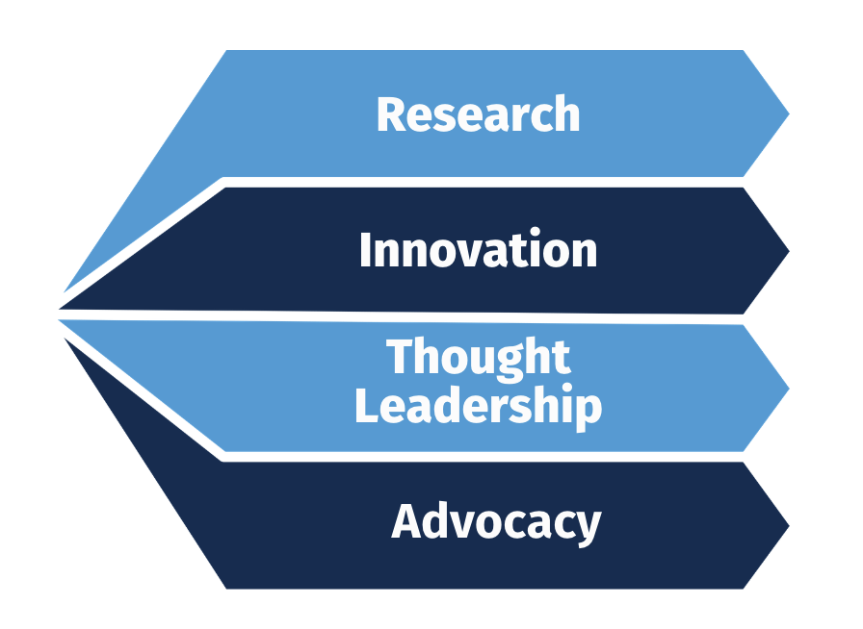
ABOUT US
Established in 1996, the National Alliance for Caregiving (NAC) is a membership-based organization catalyzing system change to build health, wealth, and equity for America’s 53 million family caregivers.

Slide 3
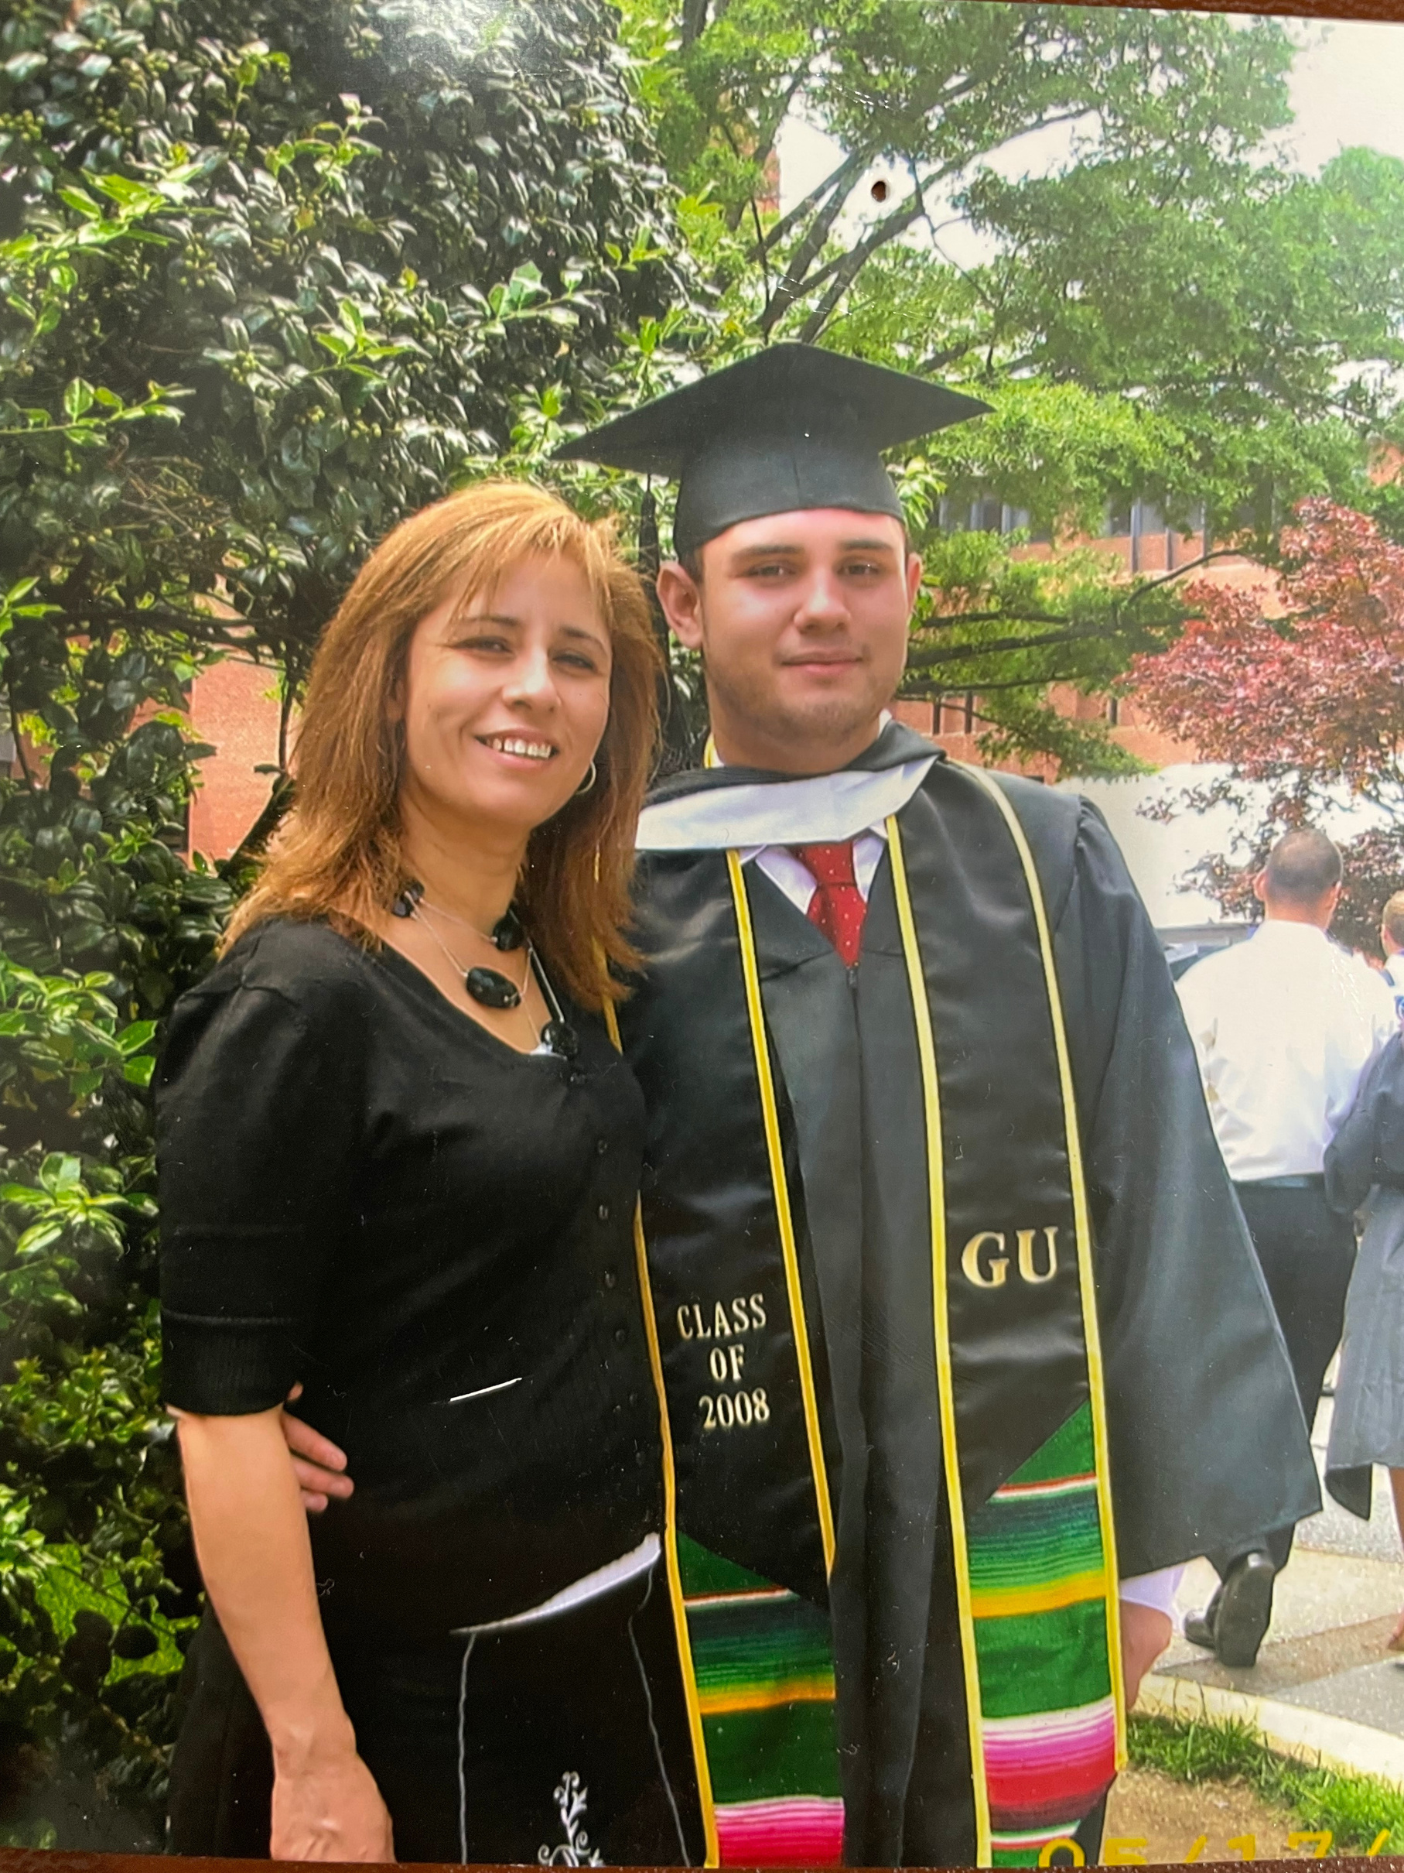
CAREGIVING CONNECTS US ALL

Slide 4
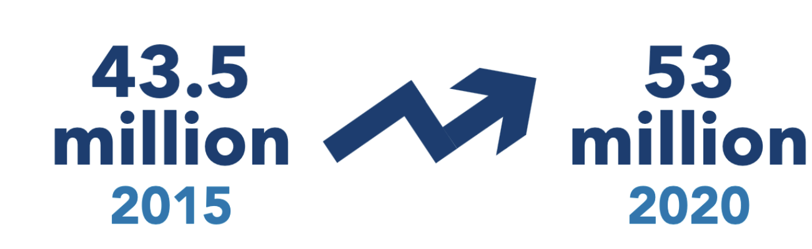
GROWING COMMUNITY
The number of Americans providing unpaid care has increased over the last five years
Caregiving in the U.S. 2020, National Alliance for Caregiving and AARP, 2020

Slide 5
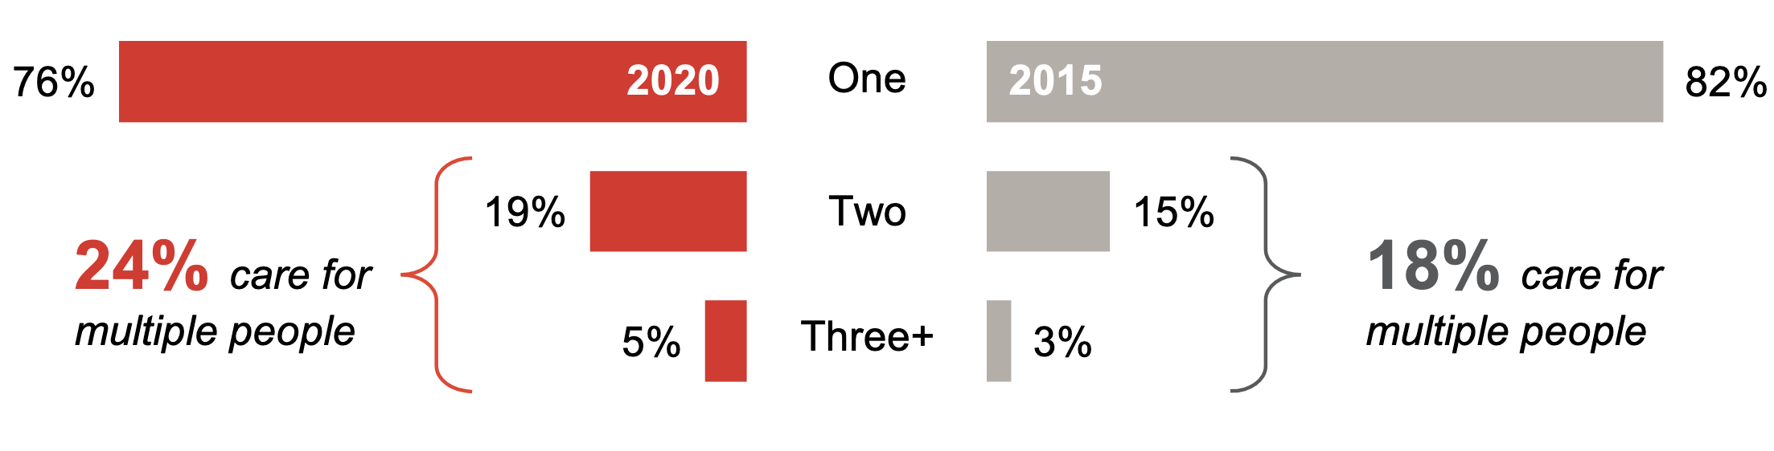
CARE RESPONSBILITIES
More family caregivers are caring for more people
Caregiving in the U.S. 2020, National Alliance for Caregiving and AARP, 2020

Slide 6
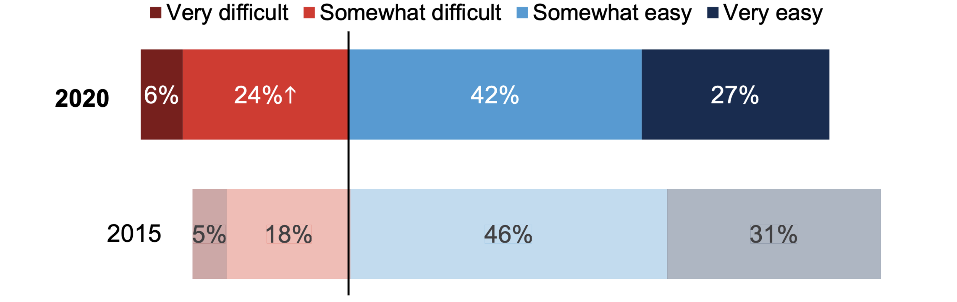
CARE COORDINATION
More family caregivers are finding it difficult to coordinate care for their loved ones
Caregiving in the U.S. 2020, National Alliance for Caregiving and AARP, 2020

Slide 7
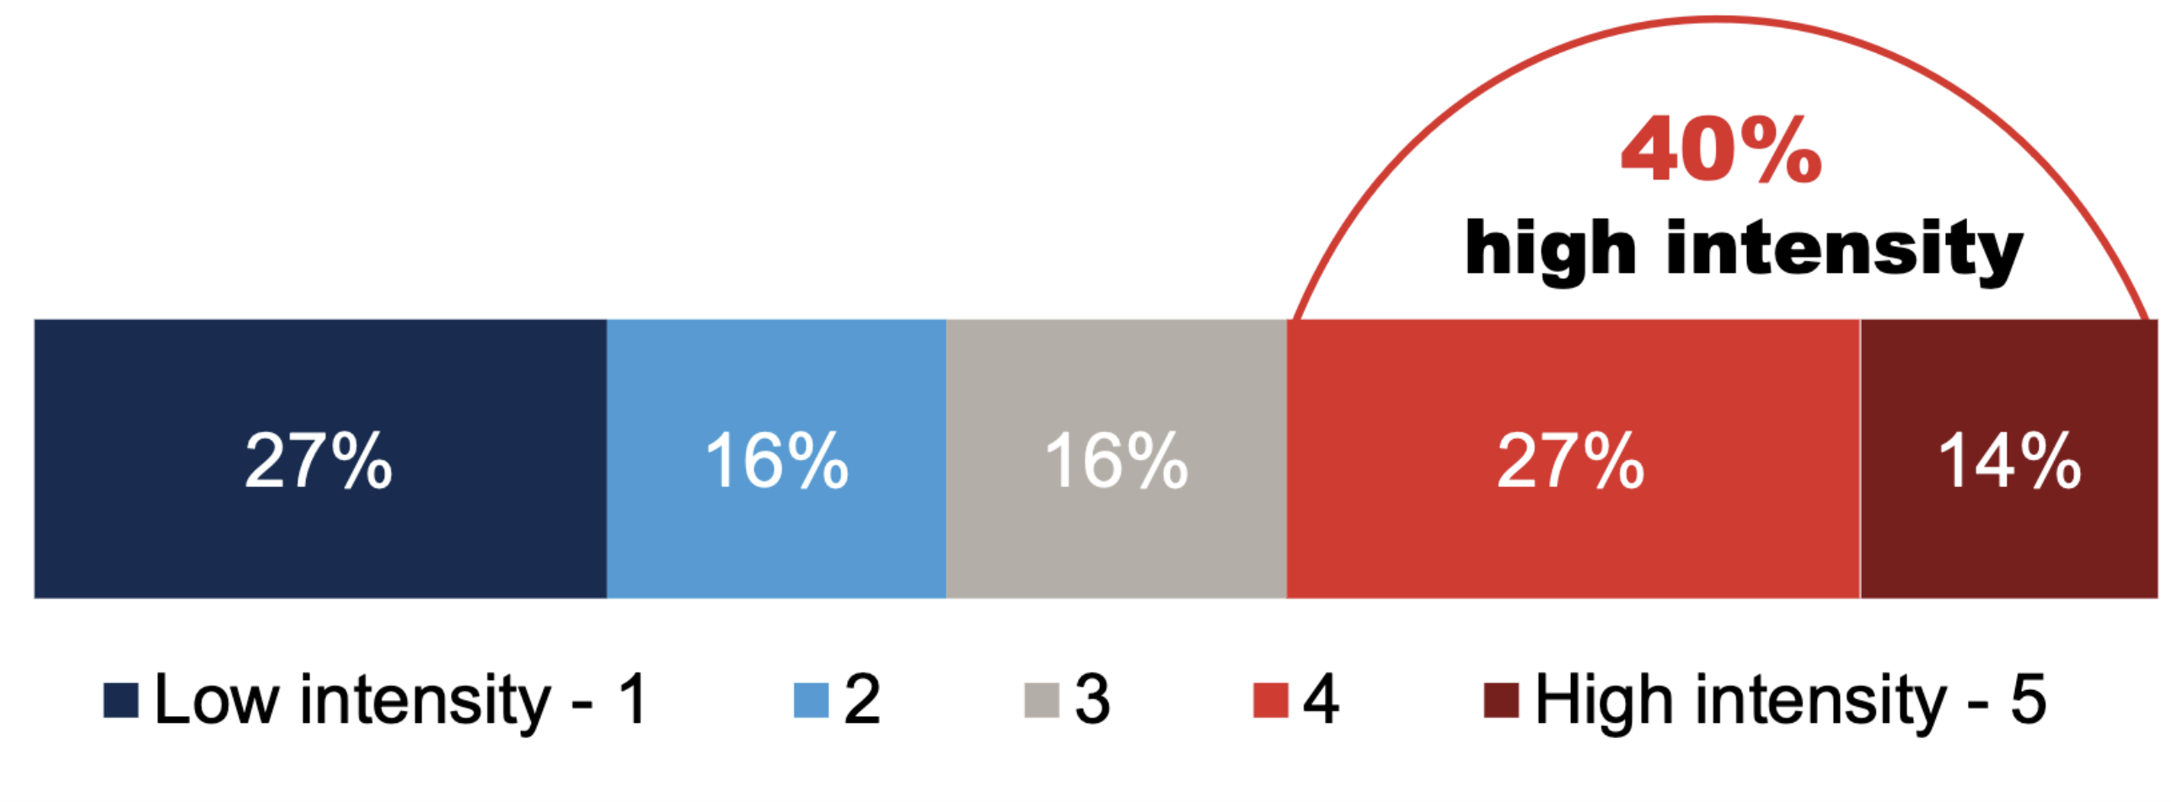
INTENSITY OF CAREGIVING
4 in 10 family caregivers are in high-intensity situations
Caregiving in the U.S. 2020, National Alliance for Caregiving and AARP, 2020

Slide 8

CAREGIVING IS BECOMING
More...

Slide 9
CAREGIVING IS BECOMING
More...
prevalent

Slide 10
CAREGIVING IS BECOMING
More...
prevalent
complex

Slide 11
CAREGIVING IS BECOMING
More...
prevalent
complex
intense

Slide 12
CAREGIVING IS BECOMING
More...
prevalent
complex
intense
inequitable

Slide 13

CAREGIVING HAS CONSEQUENCES

Slide 14
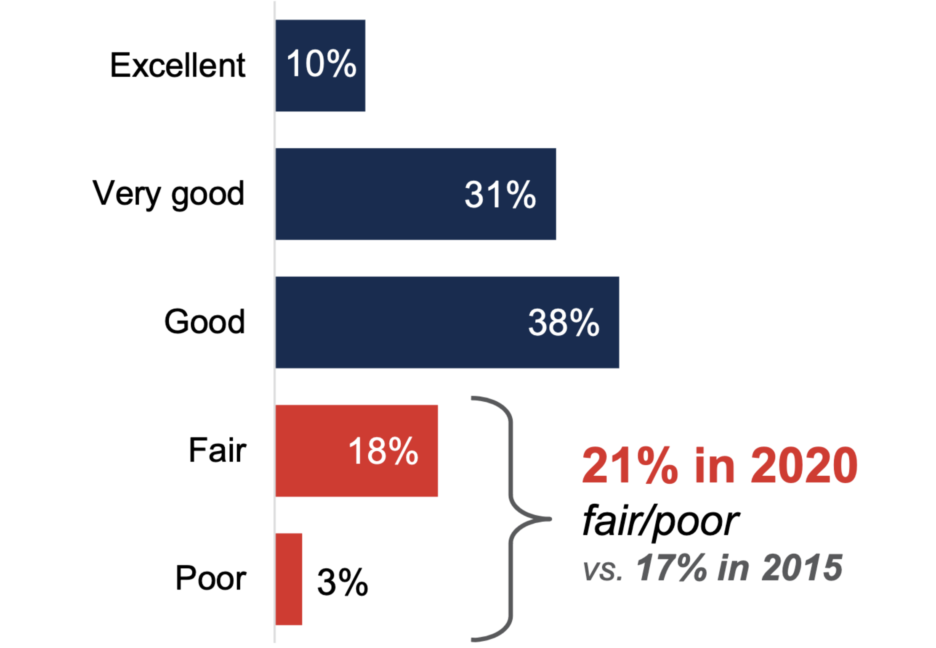
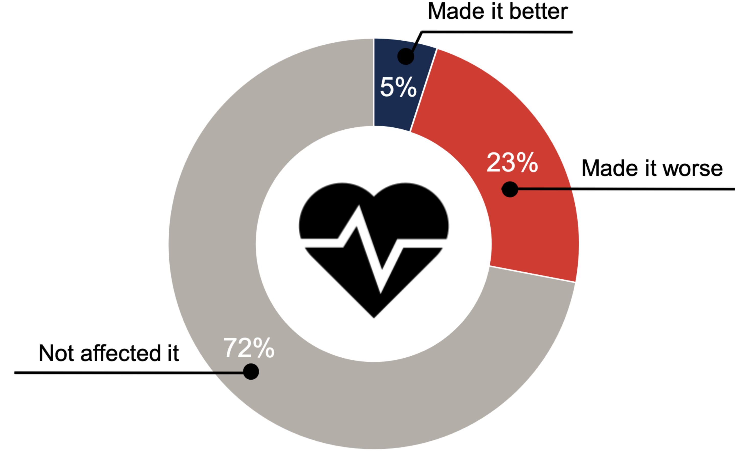
HEALTHCARE CONSEQUENCES
1 in 5 family report worse health due to caregiving
Caregiver Self Rated Health
Caregiver Health Changes
12 million
Caregiving in the U.S. 2020, National Alliance for Caregiving and AARP, 2020

Slide 15
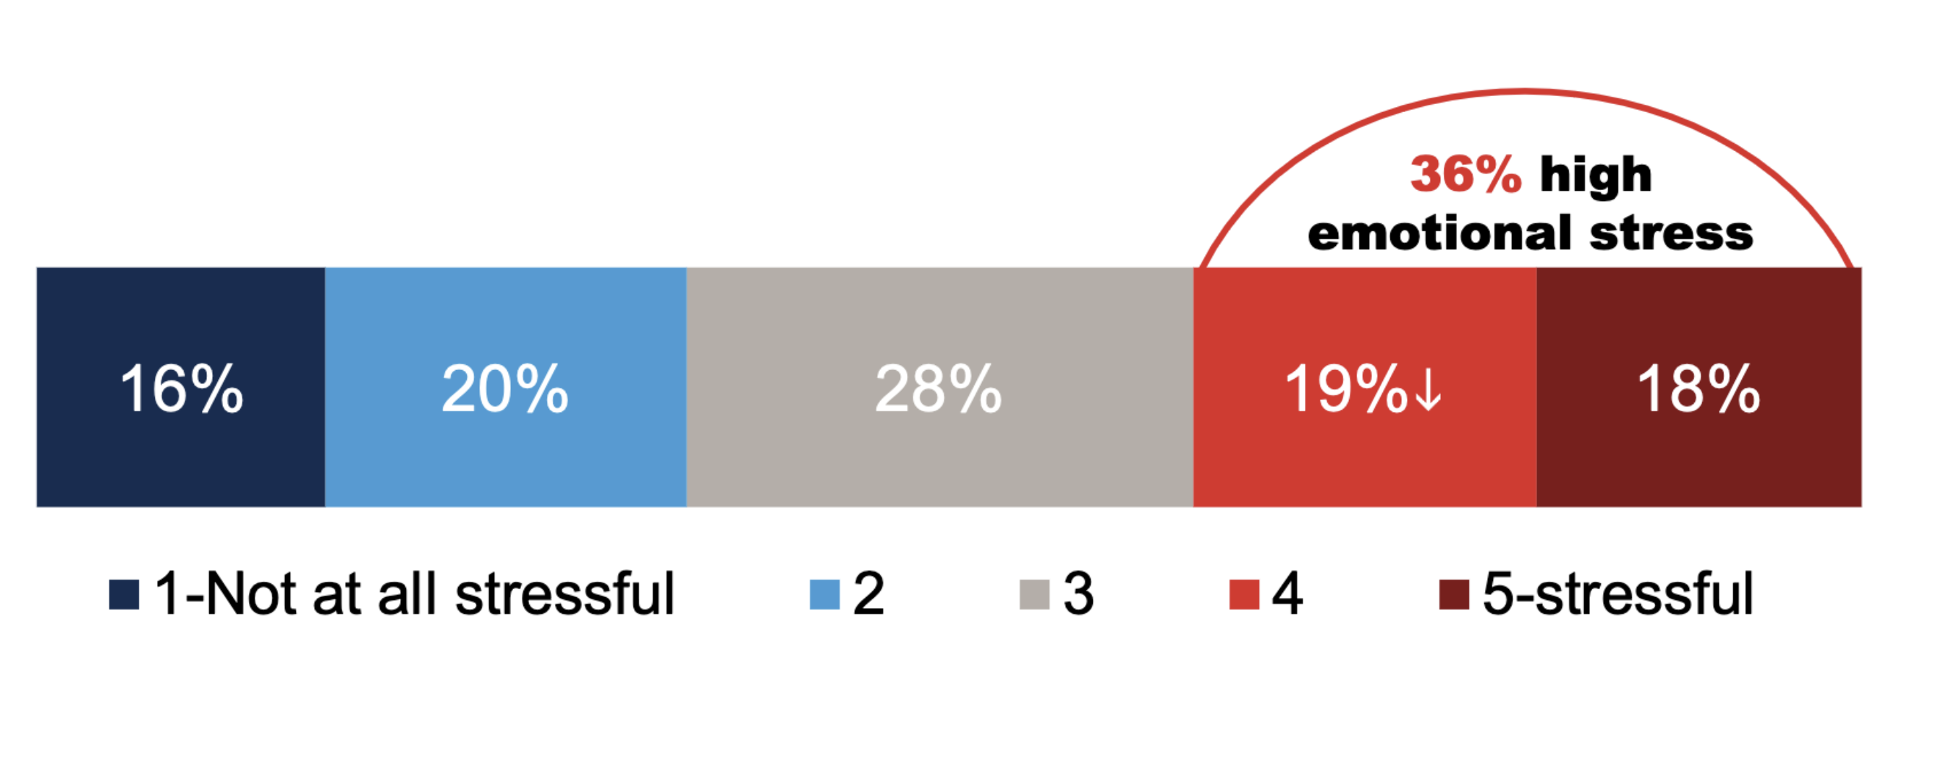
MENTAL HEALTH CONSEQUENCES
Nearly 4 in 10 family caregivers experience high emotional strain
Caregiving in the U.S. 2020, National Alliance for Caregiving and AARP, 2020

Slide 16
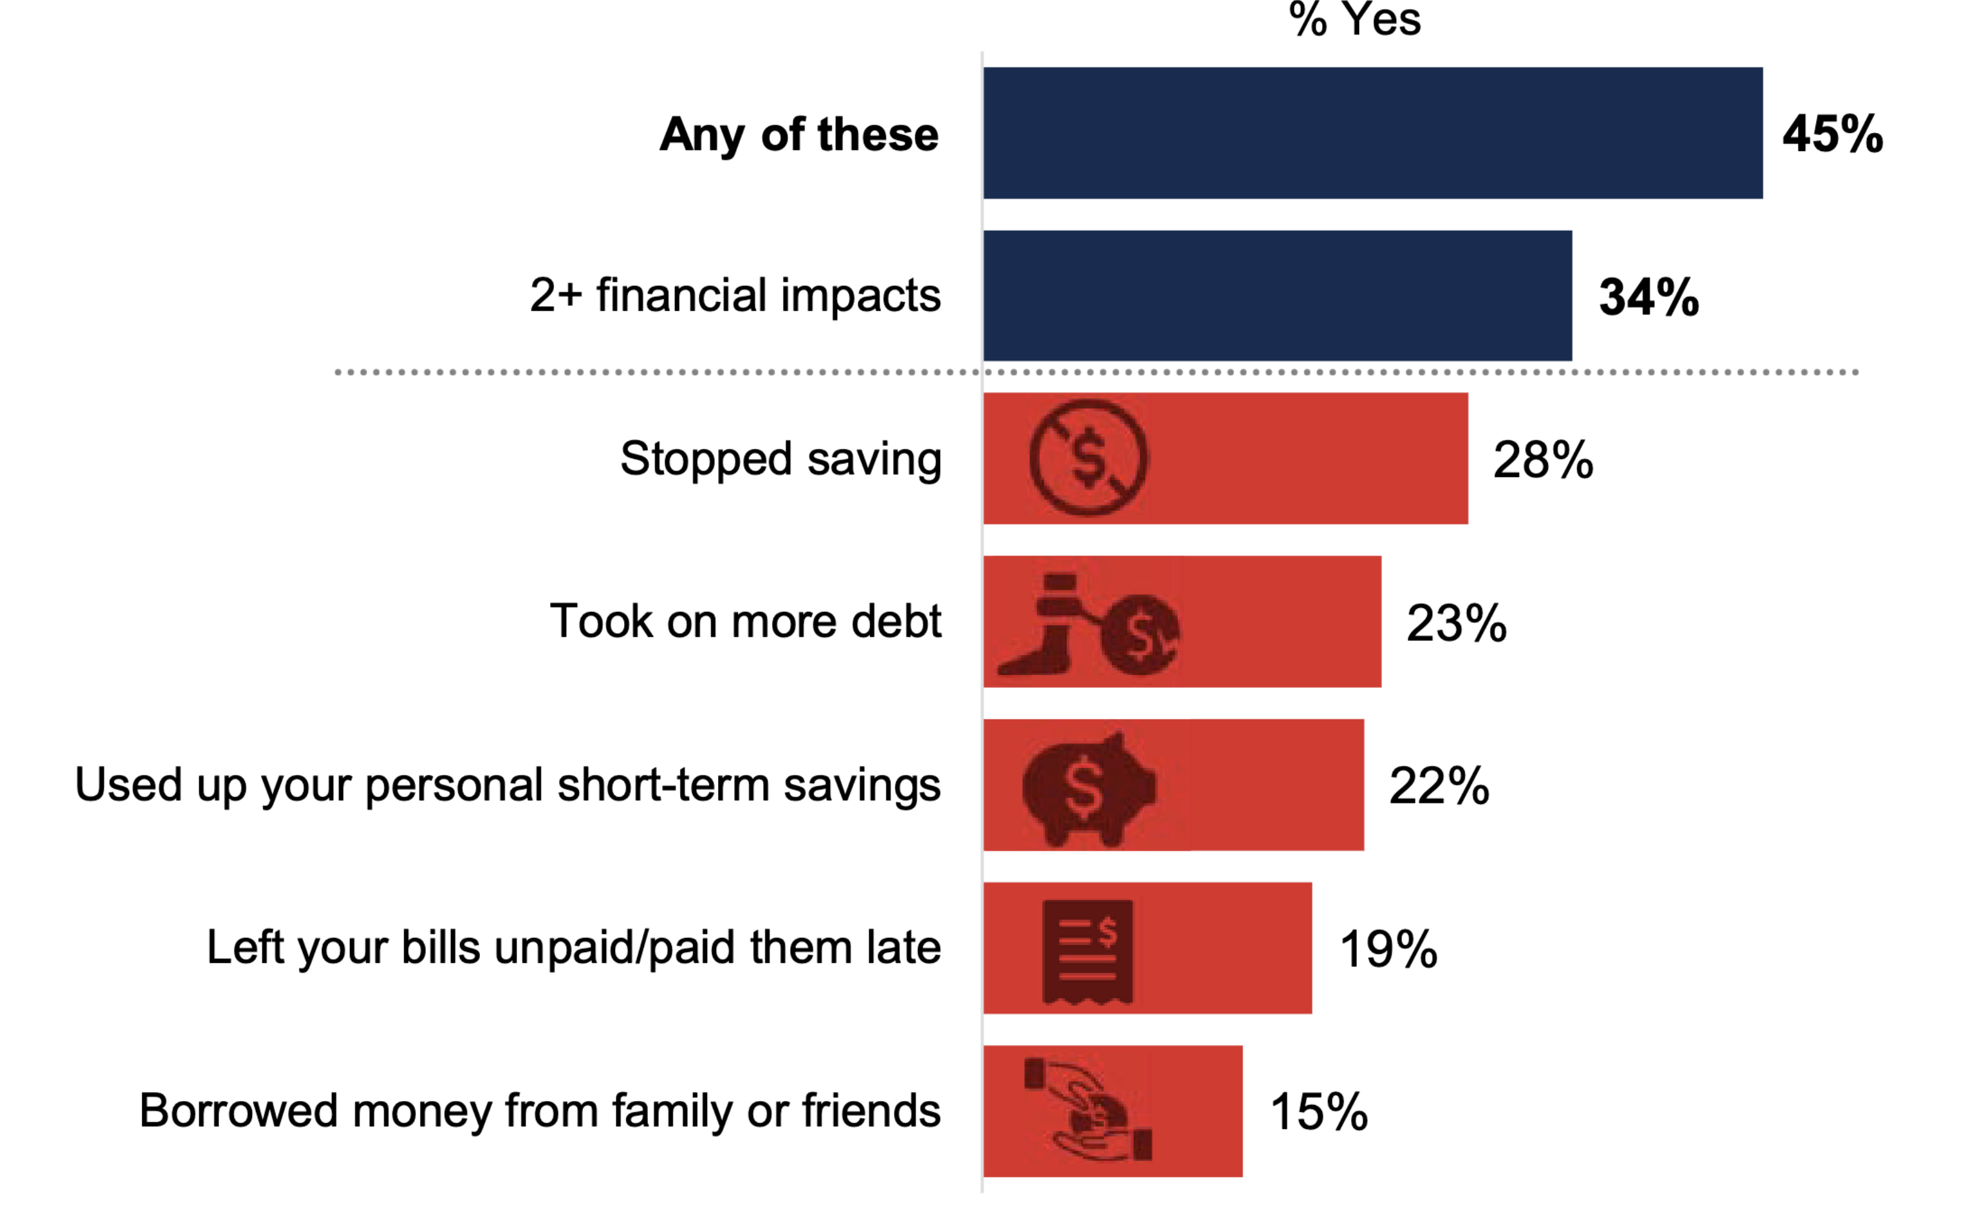
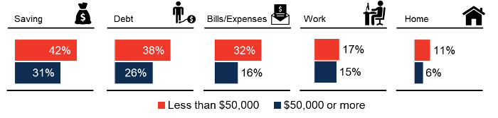
FINANCIAL CONSEQUENCES
4 in 10 family caregivers experience at least one financial impact due to caregiving
Top Financial Impacts
Financial impacts by household income
Caregiving in the U.S. 2020, National Alliance for Caregiving and AARP, 2020

Slide 17
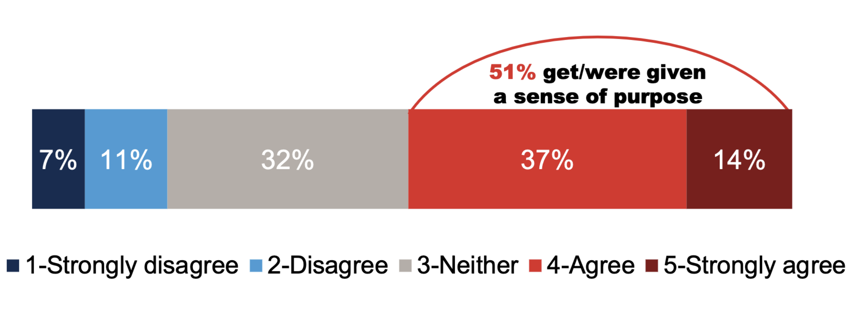
CAREGIVER FULFILLMENT
More than half of caregivers report caregiving gives them a sense of purpose
Caregiving in the U.S. 2020, National Alliance for Caregiving and AARP, 2020

Slide 18
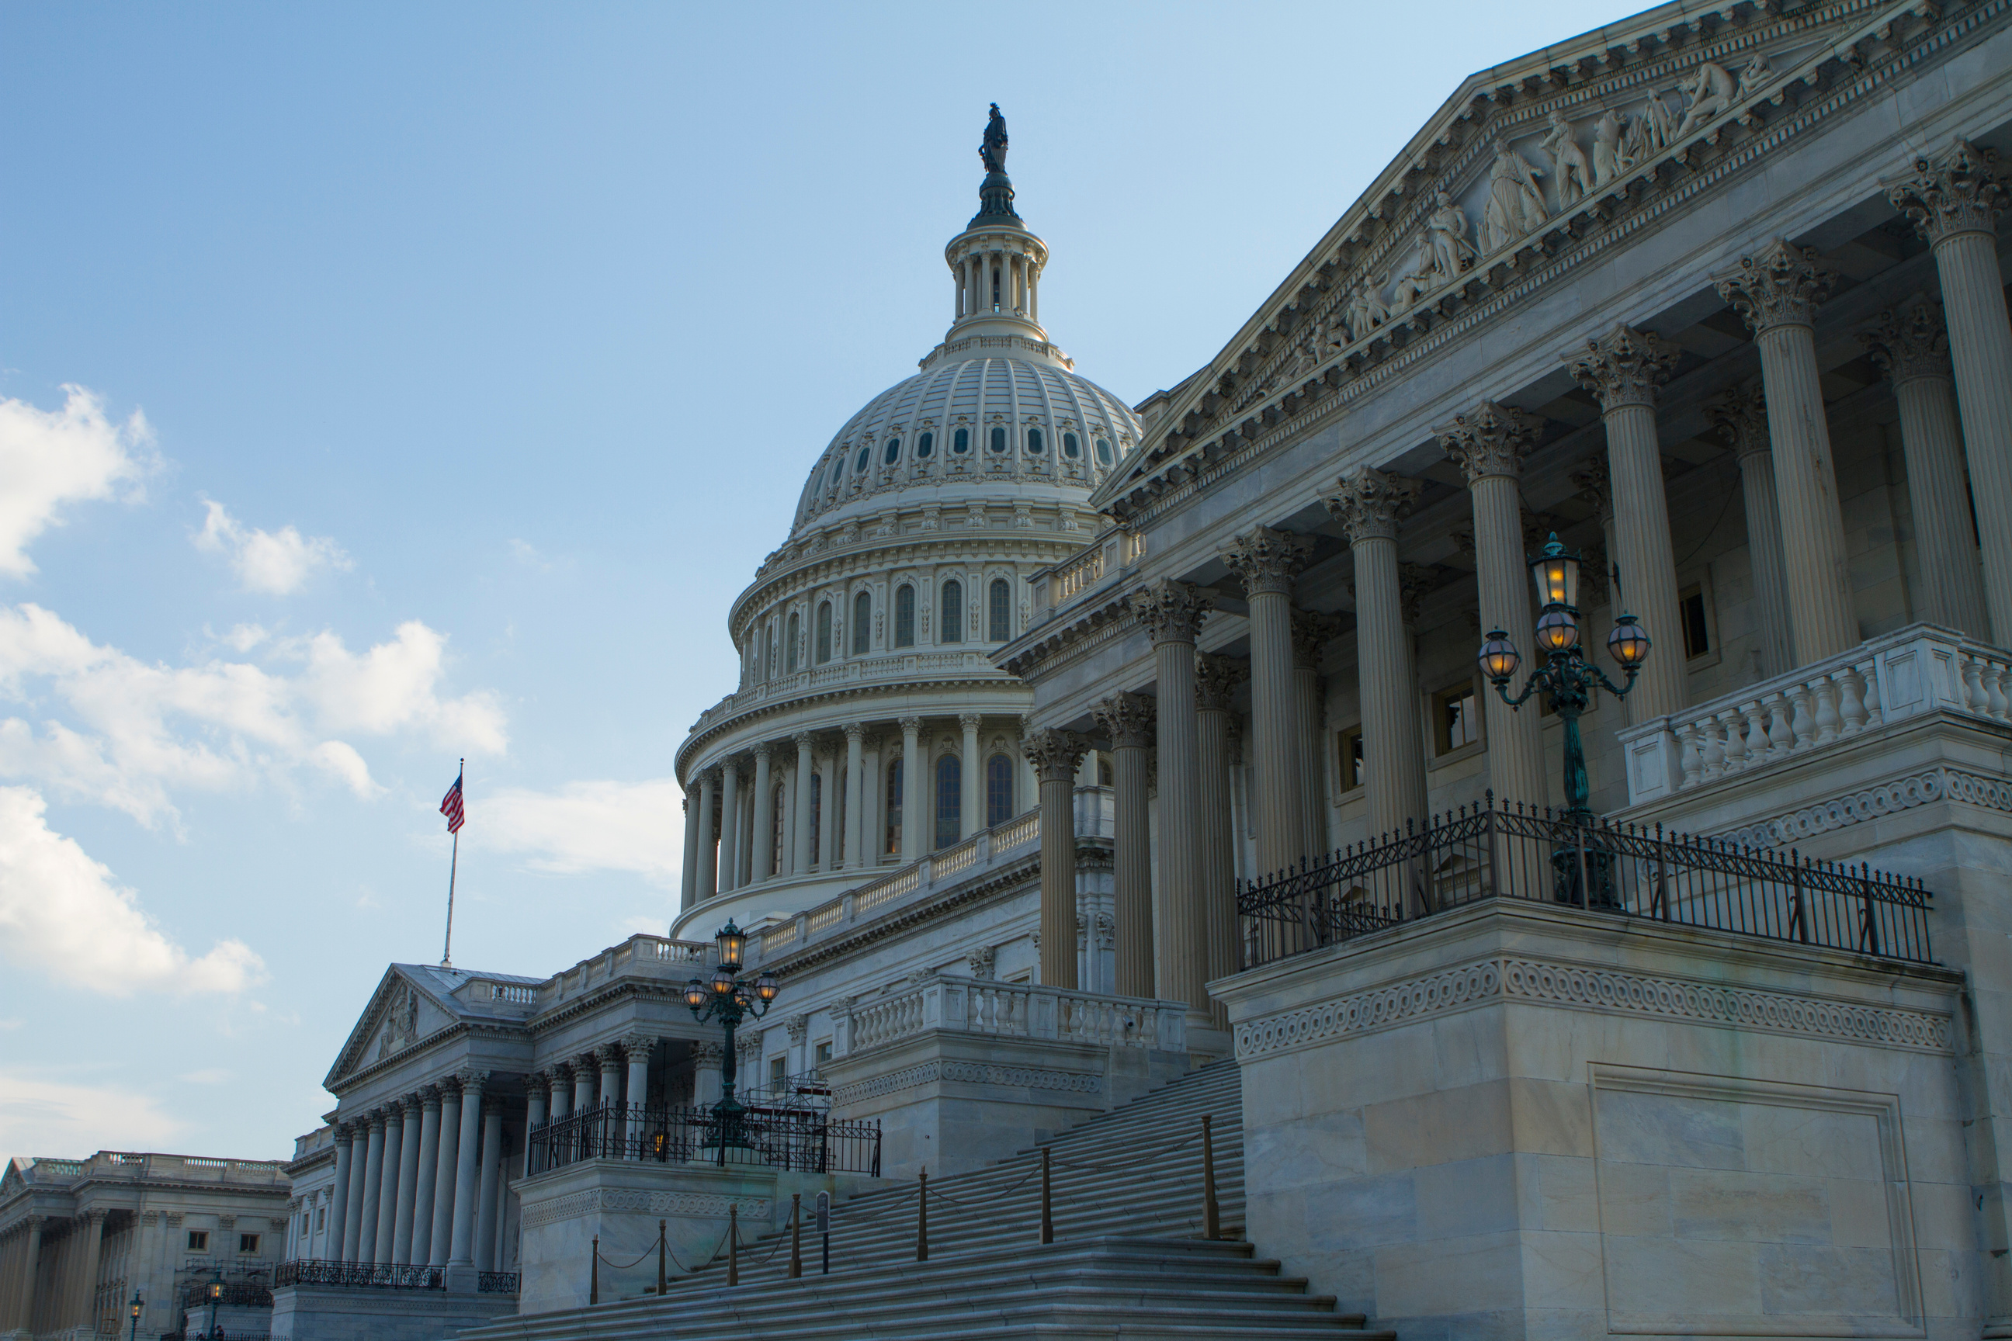
INVESTING IN INFRASTRUCTURE TO MAKE CAREGIVING MORE...
Sustainable
Dignified
Equitable

Slide 19
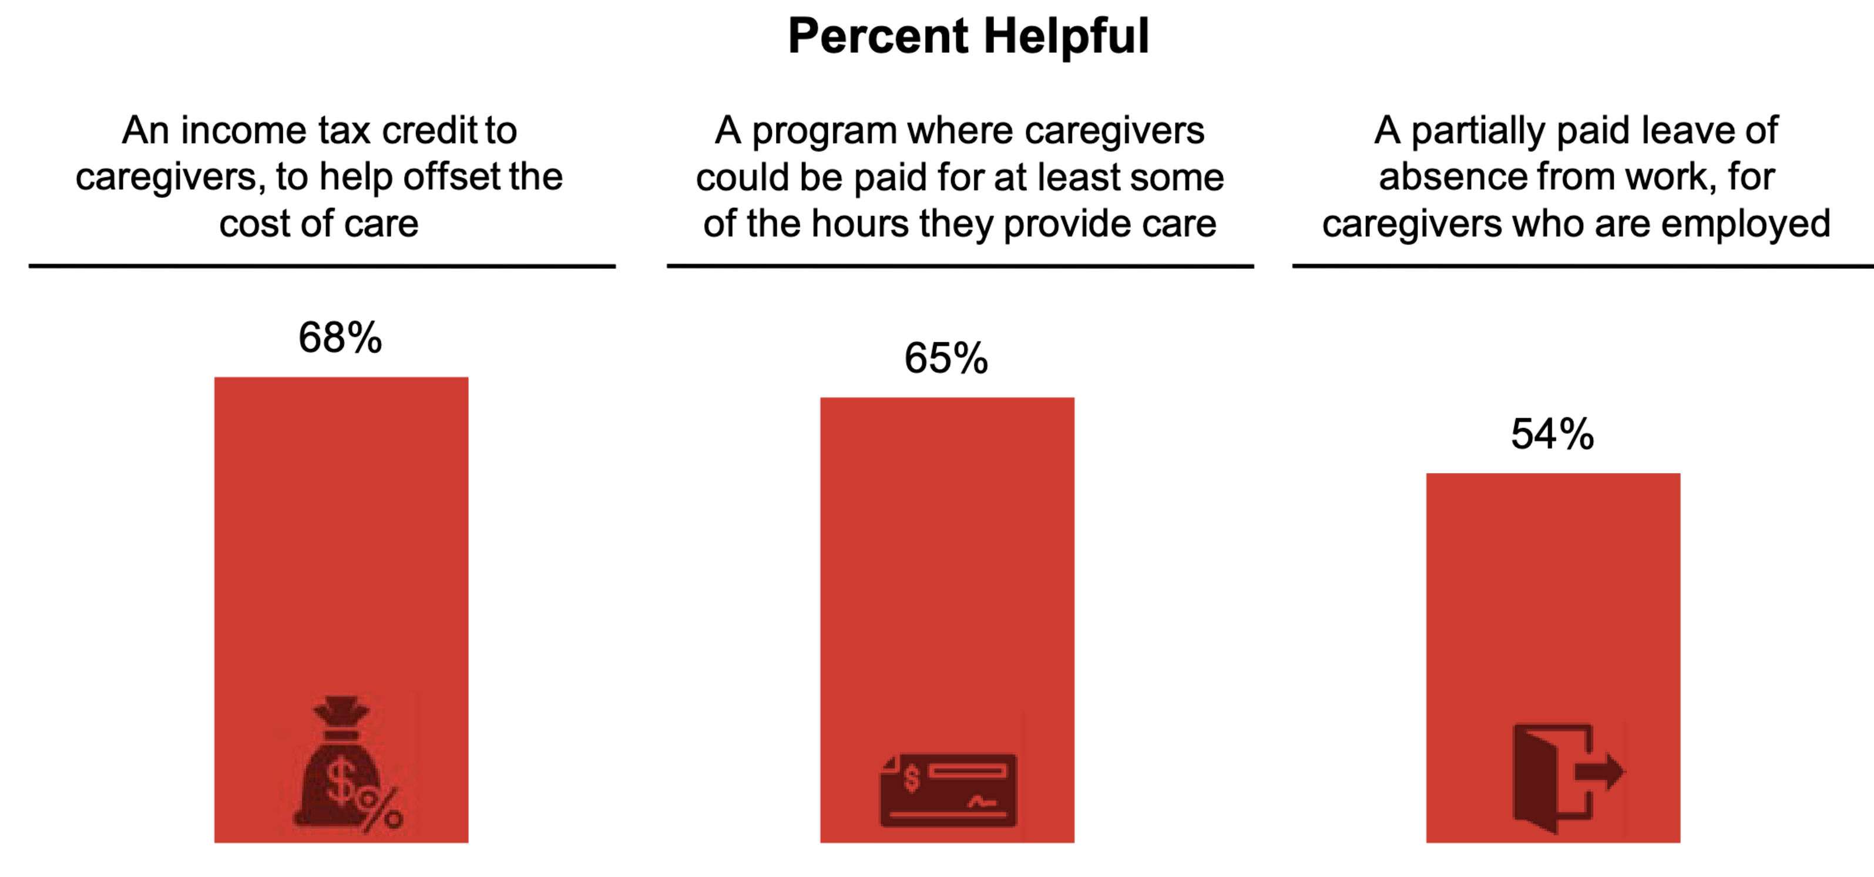
ECONOMIC SUPPORT IS KEY
Most family caregivers want financial incentives to support caregiving
Caregiving in the U.S. 2020, National Alliance for Caregiving and AARP, 2020

Slide 20
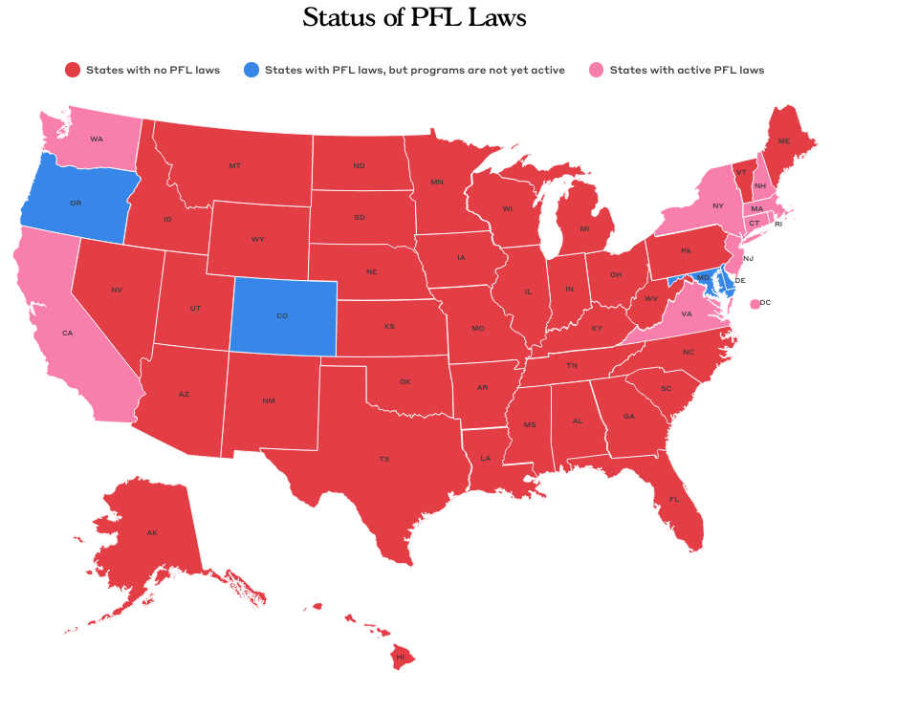
PAID FAMILY & MEDICAL LEAVE
Evidence suggests that state paid leave policies have increased resilience*
Increased ability to provide family caregiving
Increased labor attachment among probable caregivers
Improved earnings for women caregivers
Paid family leave ---> better economic security and potential to improve security in later life for caregivers
Bipartisan Policy Center, 2023
*Dao and Van Houtven, “Economic Impact of State Paid Family Leave Policies on Caregivers with Older and Disabled Adults” Working Paper, 2023

Slide 21
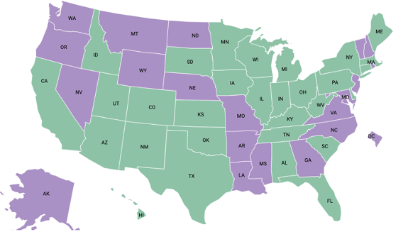
STATE INNOVATION
30 are utilizing ARPA funds to invest in family caregivers
17 states: training and education programs
12 states: respite care programs
7 states: direct payments to family caregivers
While this funding is significant, it is short-term and must be spent by the end of calendar year 2024.
American Rescue Plan Act (ARPA) Plans that Include Caregiving
National Association of State Health Professionals

Slide 22


FEDERAL COORDINATION & CAPACITY
First-ever national strategy to support family caregivers released in 2022
5 Goals
Increase awareness of and outreach
Advance partnership and engagement
Strengthen services and supports
Ensure financial and workplace security
Expand data, research, and evidence-based practices
350 federal actions
150 state and private sector actions
17 federal agencies engaged

Slide 23






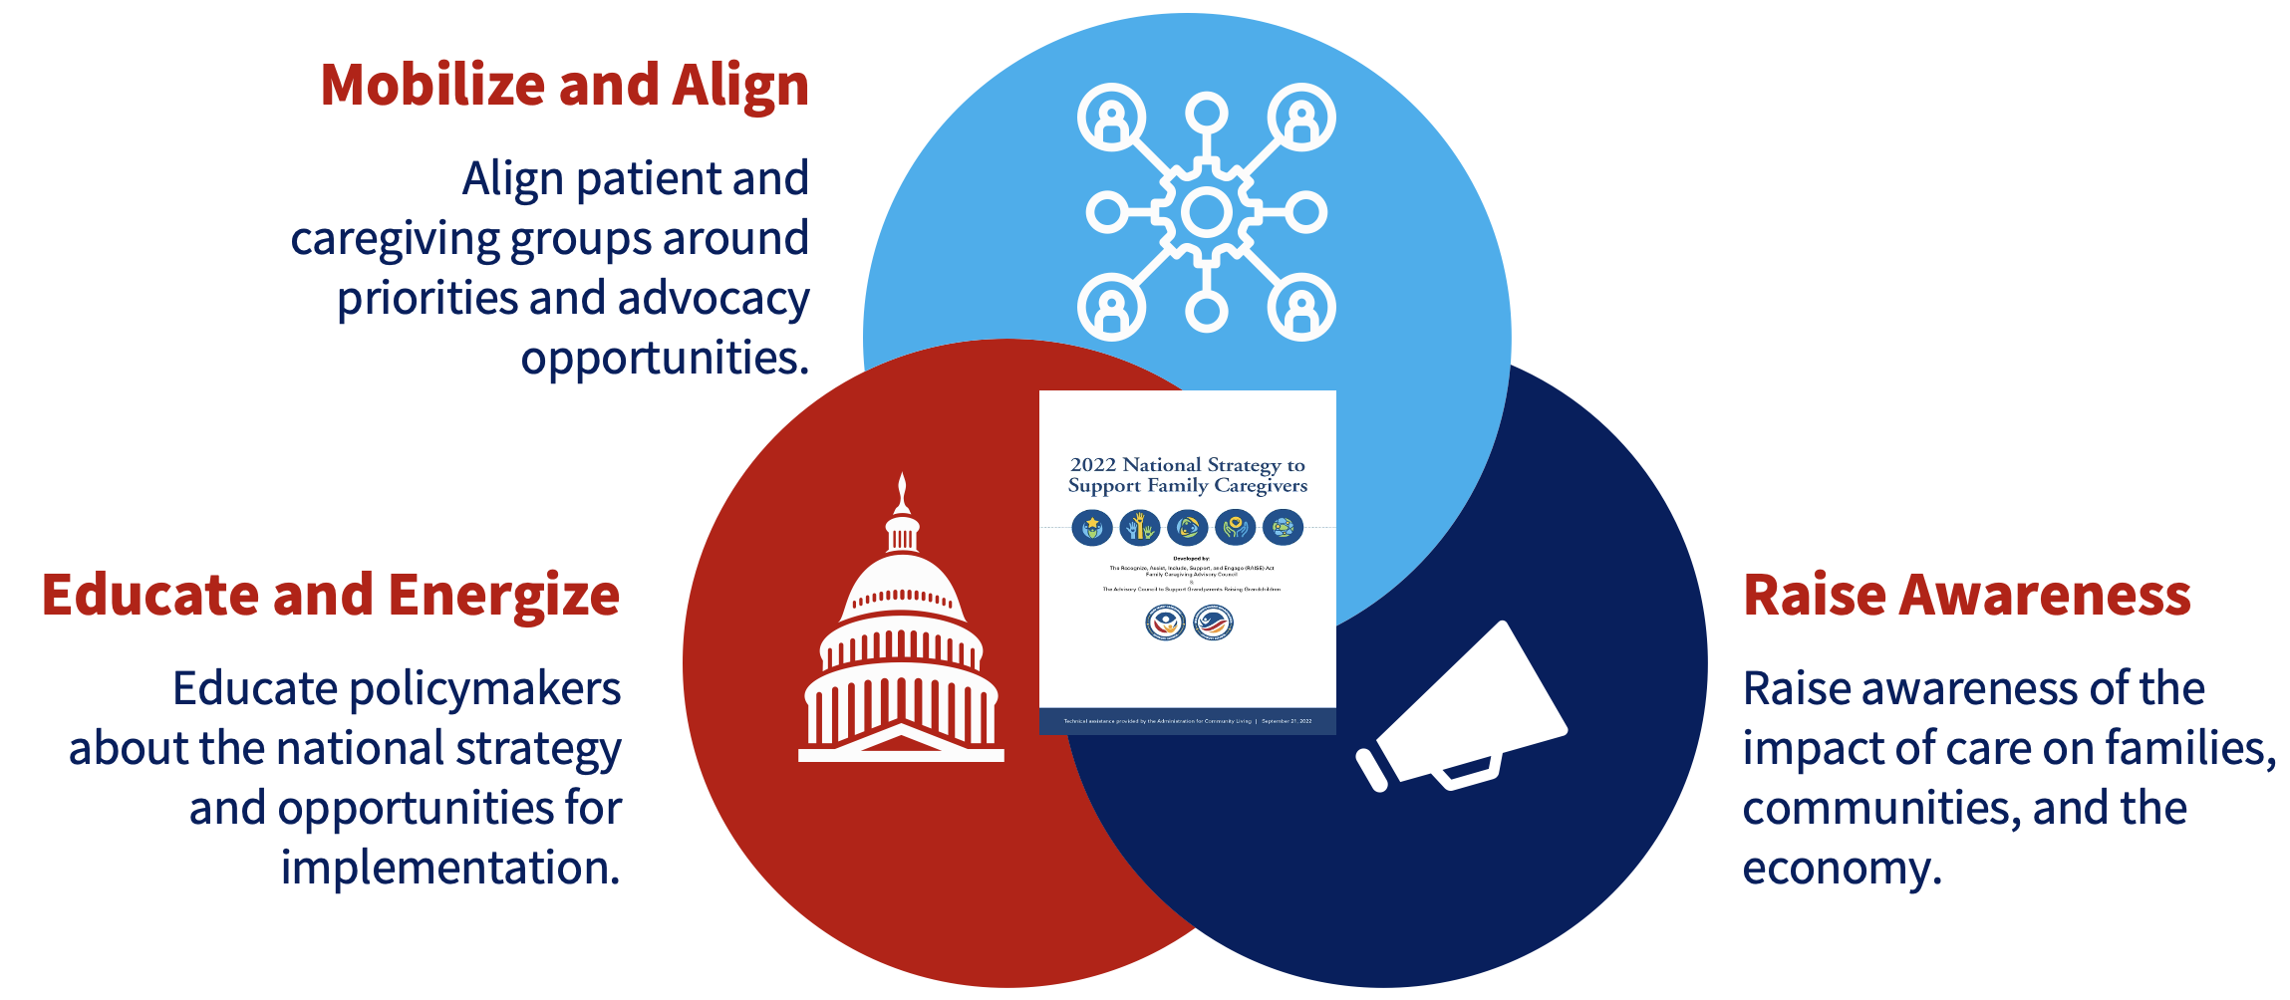






DRIVING IMPLEMENTATION
With support from The John A. Hartford Foundation

Slide 24
GROWING MOMENTUM
New Leadership
New RAISE Council Announced
CMS Proposed Rule on HCBS Access
New Rulemaking
CMS Proposed Rule on Caregiver Training
Executive Action
Executive Order on Caregiving
$20 million from ACL / HHS
New Resources
$100 million leveraged by philanthropy

Slide 25




THANK YOU!
Email Address
jason.resendez@caregiving.org
Website
www.caregiving.org

