Slide 1

Reporting on State Fiscal Health Melissa Maynard, Senior Officer, The Pew Charitable Trusts
Liz Farmer, Freelance Fiscal Policy Writer
September 21, 2023

Slide 2

Fiscal 50 indicators
Creative Considerations
ECONOMY AND
PEOPLE
LONG-TERM COSTS
REVENUE
SPENDING
FISCAL POLICY
Tax Revenue
Tax Revenue Volatility
Federal Share of
State Revenue
State Medicaid
Spending
Population Change
Debt and Unfunded
Retirement Costs
Reserves and Balances
Fiscal Balance
Fiscal 50: A 50-state lens for better understanding your state’s fiscal position

Slide 3
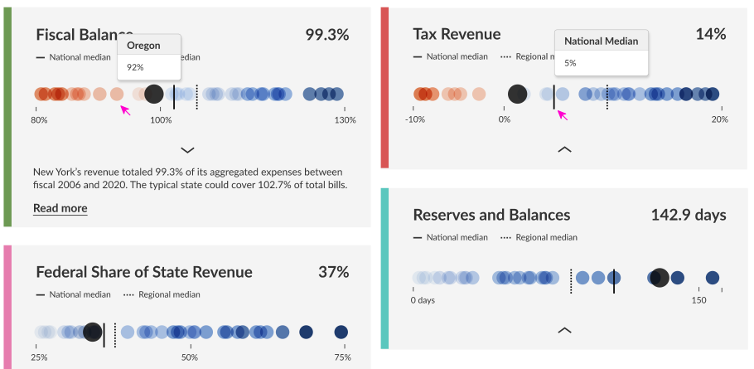
A preview of the new Fiscal 50
(Not real data!)
Creative Considerations
Fiscal 50: A 50-state lens for better understanding your state’s fiscal position

Slide 4
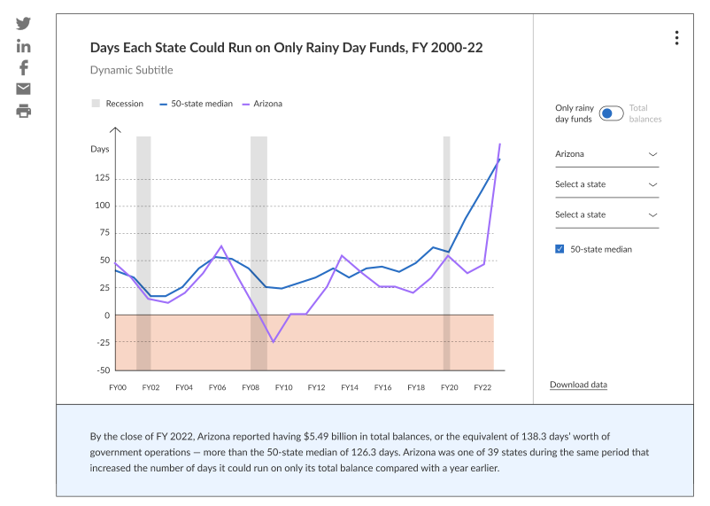
Creative Considerations
A preview of the new Fiscal 50
(Not real data!)
Fiscal 50: A 50-state lens for better understanding your state’s fiscal position

Slide 5
Temporary factors have driven recent state fiscal highs
Higher-than-expected tax revenue
Federal pandemic aid to individuals and businesses
Temporary, pandemic-driven shift in consumer spending patterns
Federal pandemic aid to state governments
More than $800 billion to states
Examples: Added Medicaid dollars, flexible ARPA funds
Conservative forecasting
High level of fiscal and economic uncertainties spurred cautious forecasts

Slide 6
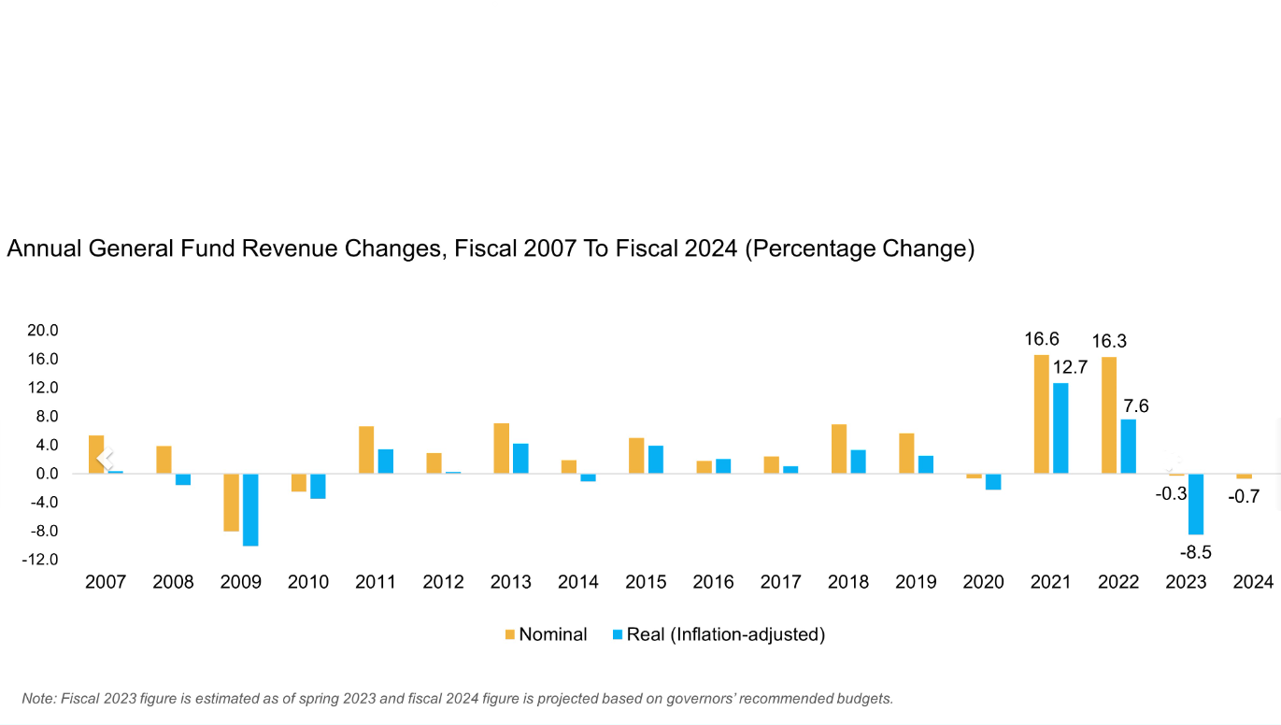
“These last few years have been very unique—it’s unprecedented to see double-digit revenue growth for two straight years. Some of that was economic strength, and some of it was due to the federal funding flowing to states and households. States weren’t assuming that level of growth would continue.”
-Brian Sigritz, director of state fiscal studies for the National Association of State Budget Officers (NASBO)

Slide 7
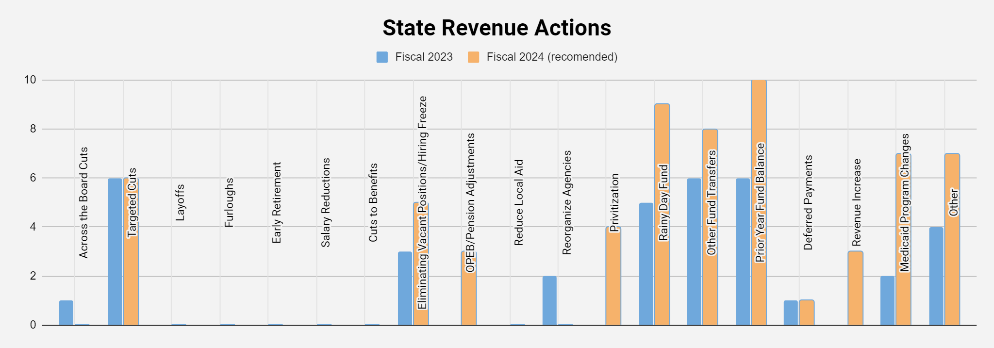
Source: National Association of State Budget Officers

Slide 8
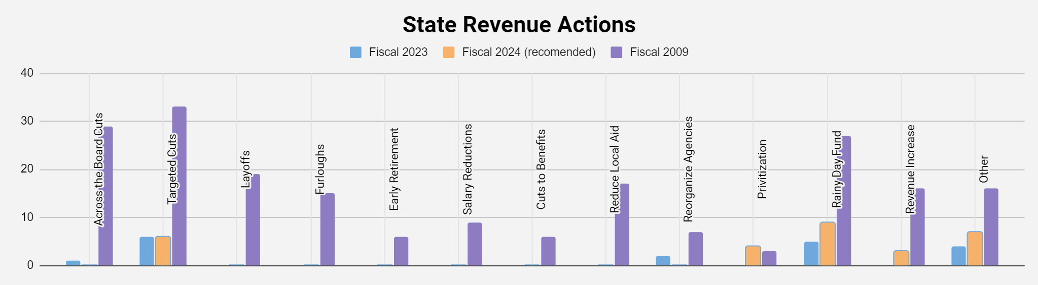
Source: National Association of State Budget Officers
Not specifically tracked in 2009: Other fund transfers, prior year ending balance, deferred payments, pension/OPEB adjustments, Medicaid program changes, hiring freezes.

Slide 9
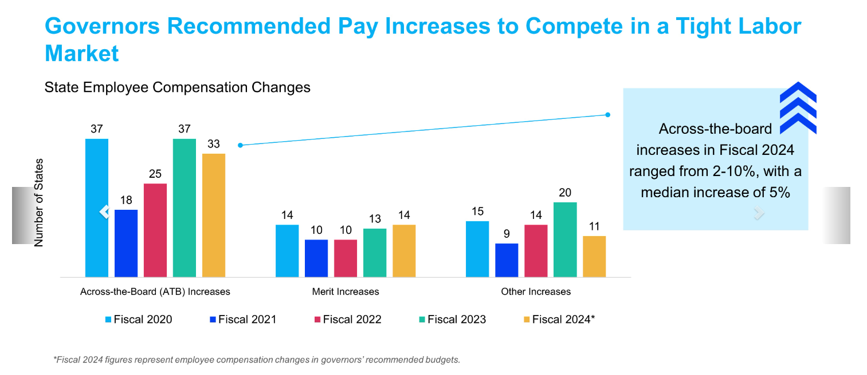

Slide 10

"If I’m looking at a situation where the same things are happening pre- and post-recession, then it’s a significant problem.”
Municipal analyst Tom Kozlik

Slide 11
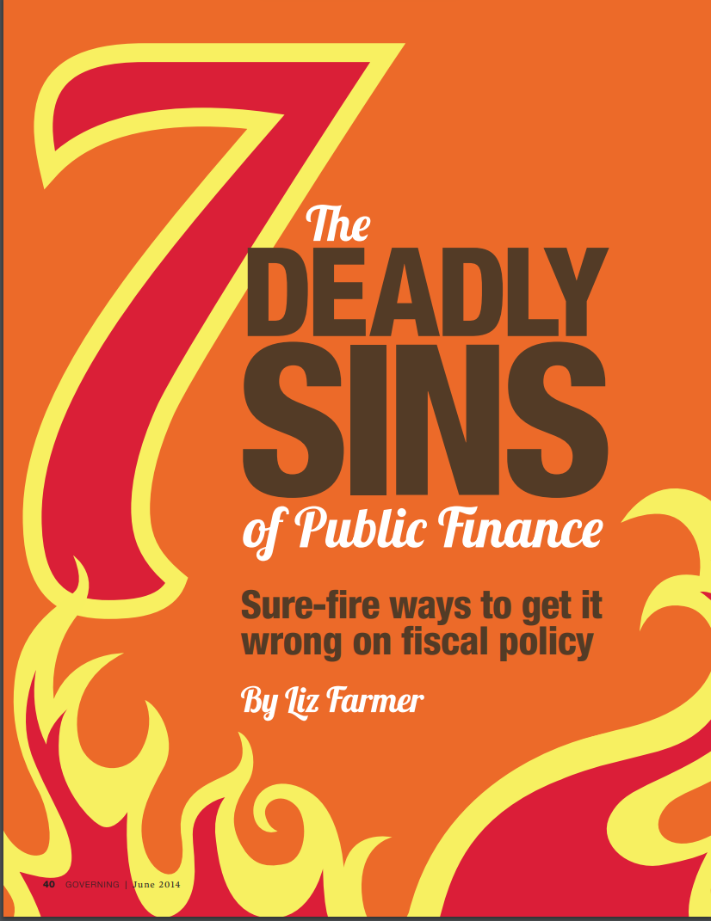

Misapplying a temporary windfall
California, IOUs, Prop. 2
Retroactive benefits
Ignoring financial checks and balances
Get to know your state auditor
S.C.'s $3.5 billion accounting error
Unrealistic projections
Tax cuts/revenue growth
The Kansas Experiment
Pensions (returns, lifespan, etc)

Slide 12


The Annual Comprehensive Financial Report (ACFR) is the real measure of a government’s overall health. It’s the full body scan, physical, and medical history...
...while the budget is the diet and exercise plan you come up with after.
Profile: history, demographics, economy, top employers, policy priorities
Revenue: taxes and other sources, recent trends
Expenses: totals and top categories
Net position: including capital assets​
Fund balance and reserve policy​
Outstanding debt and credit rating​
Capital improvements​

Slide 13
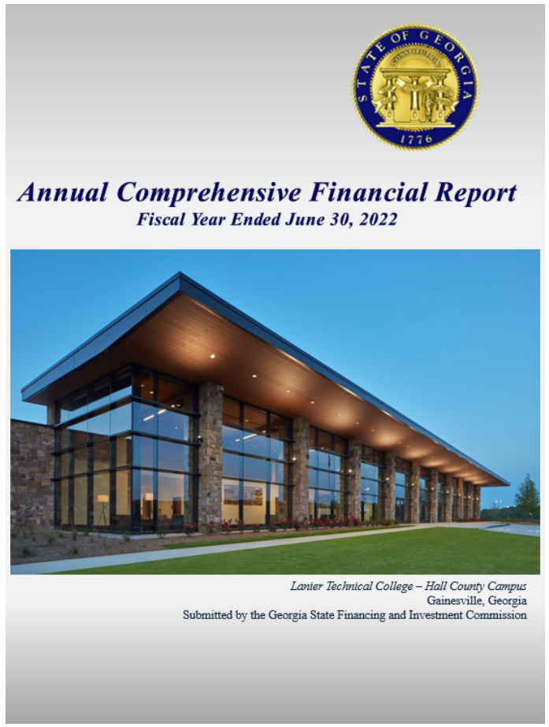

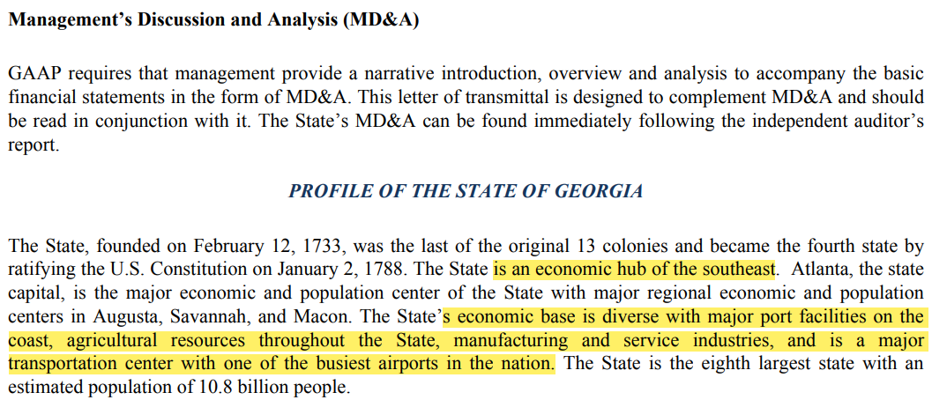
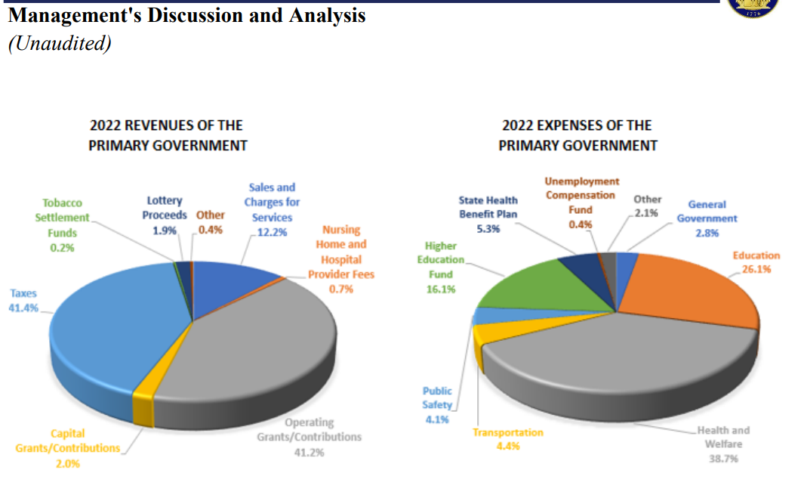

Slide 14
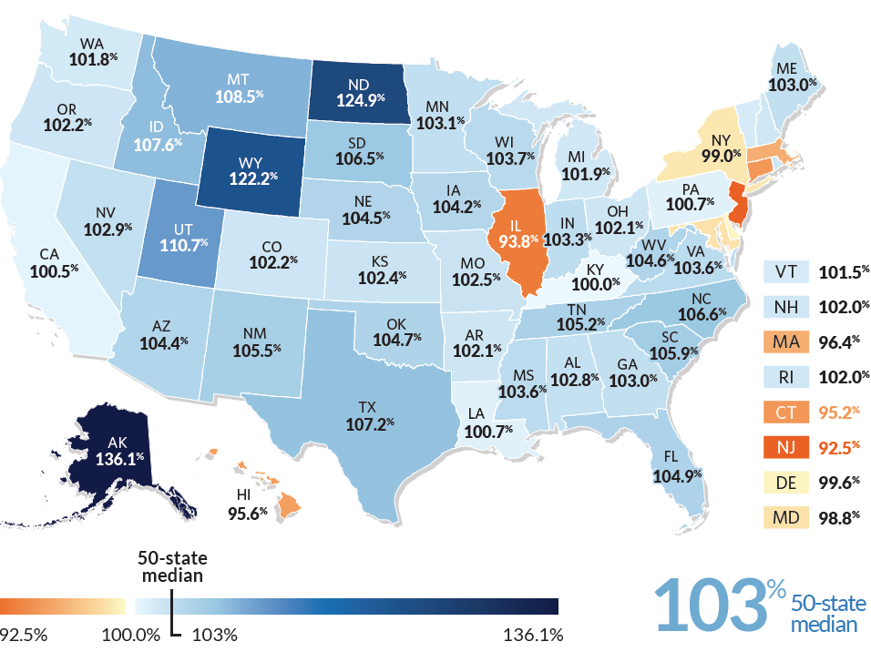
Long-Term Revenue Fell Short of Spending in 8 States
Creative Considerations
Total revenue as a share of total expenses, by state FY 2007-2021
Fiscal 50: A 50-state lens for better understanding your state’s fiscal position

Slide 15
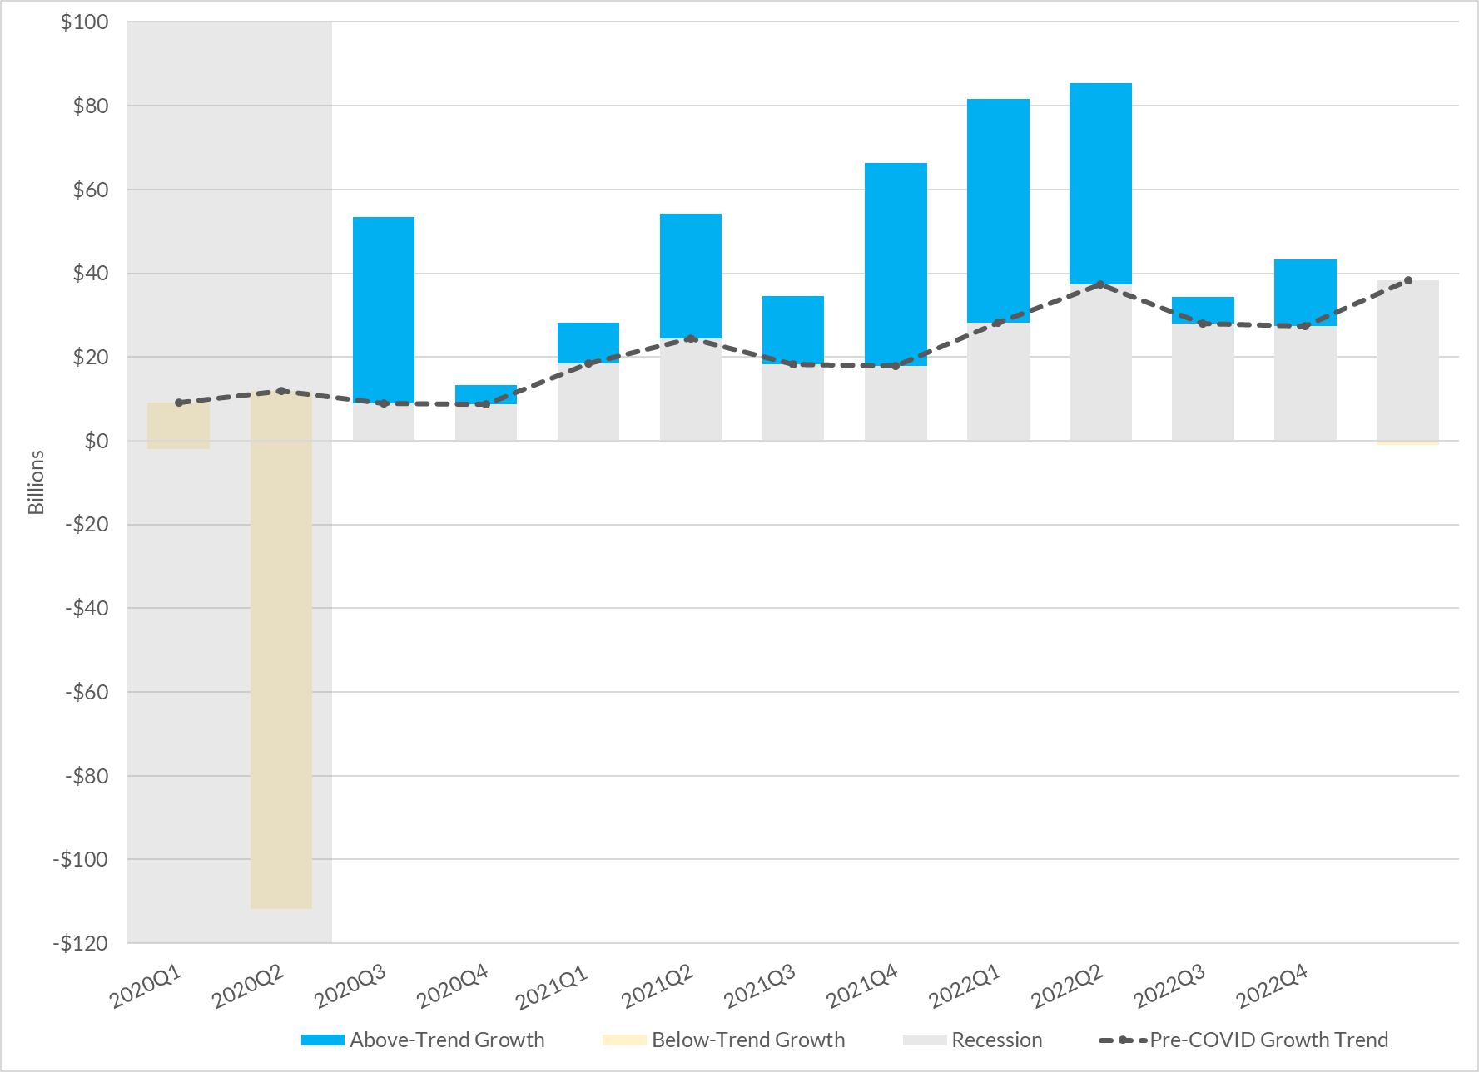
Roughly One-Third of New Tax Revenue Growth Exceeded Pre-COVID Trends
Actual 50-state tax growth compared with its 5-year pre-pandemic growth trend, inflation-adjusted.
Fiscal 50: A 50-state lens for better understanding your state’s fiscal position

Slide 16
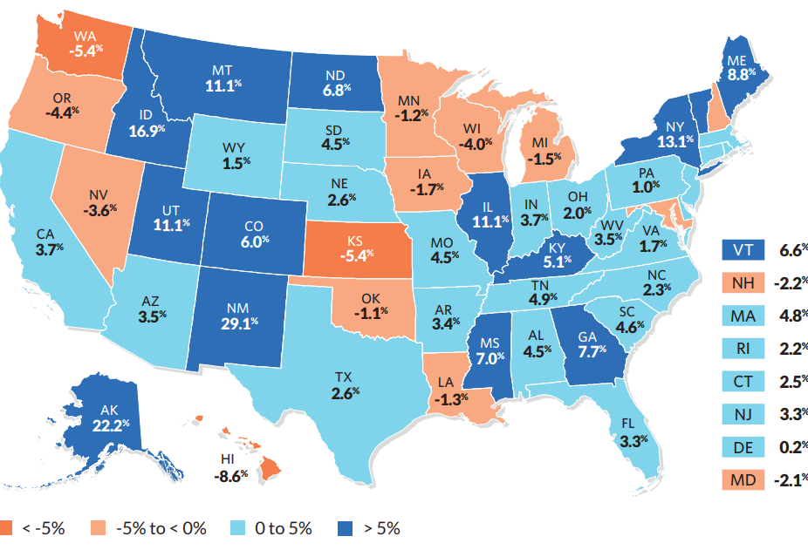
Tax Revenue in Most States Outperformed Pre-Pandemic Trends
Collections relative to estimated totals based on pre-COVID growth trajectories, Q1 2020 to Q1 2023, inflation adjusted
Creative Considerations
Fiscal 50: A 50-state lens for better understanding your state’s fiscal position

Slide 17
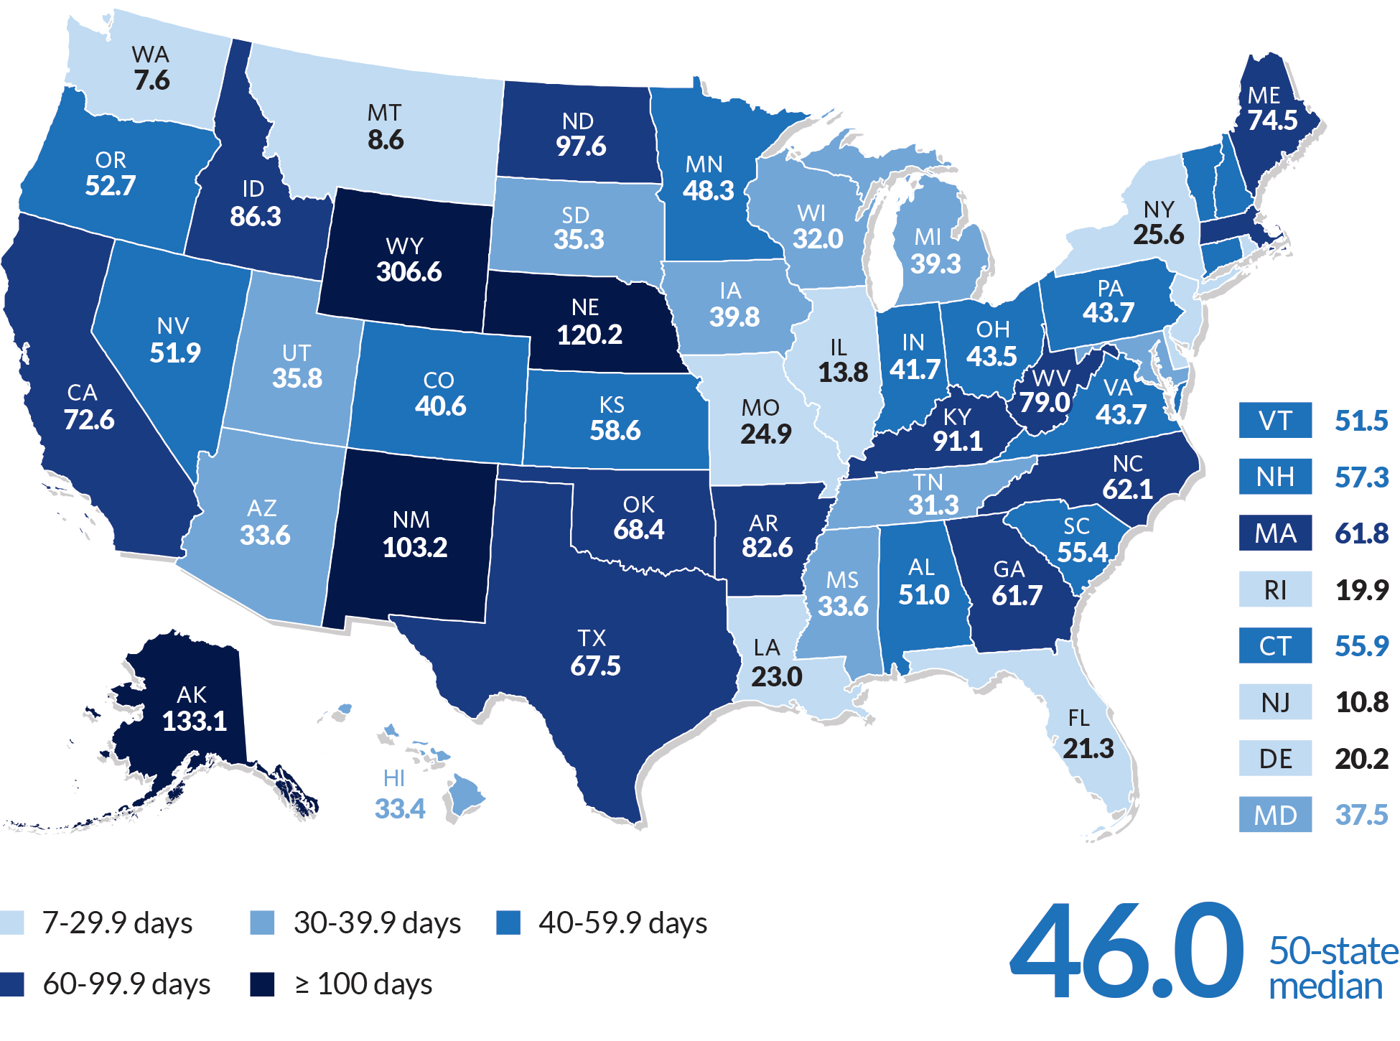
Strength of Rainy Day Funds Varies Widely by State
Creative Considerations
Number of days each state could run on savings,
FY 2023 estimated
Note: Colorado and Illinois do not have a rainy day fund as defined by Pew, despite balances reported within NASBO’s surveys.
Fiscal 50: A 50-state lens for better understanding your state’s fiscal position

Slide 18
States face looming threats to long-term fiscal stability
Declining tax revenue
Slowing economic growth
Return to pre-pandemic consumer spending patterns
Impacts of historic tax cuts
Transition away from federal pandemic aid
Added Medicaid dollars phaseout Dec. 2023
Next milestone: ARPA funds must be obligated by Dec. 2024
High degree of economic uncertainty
Still-elevated inflation

Slide 19
Thank you!
Creative Considerations
Melissa Maynard
mmaynard@pewtrusts.org 202-525-9246
www.pewtrusts.org/fiscal50
Liz Farmer
farmersfieldonline@gmail.com
650-759-8625
https://lizfarmer.substack.com
Fiscal 50: A 50-state lens for better understanding your state’s fiscal position

Slide 20
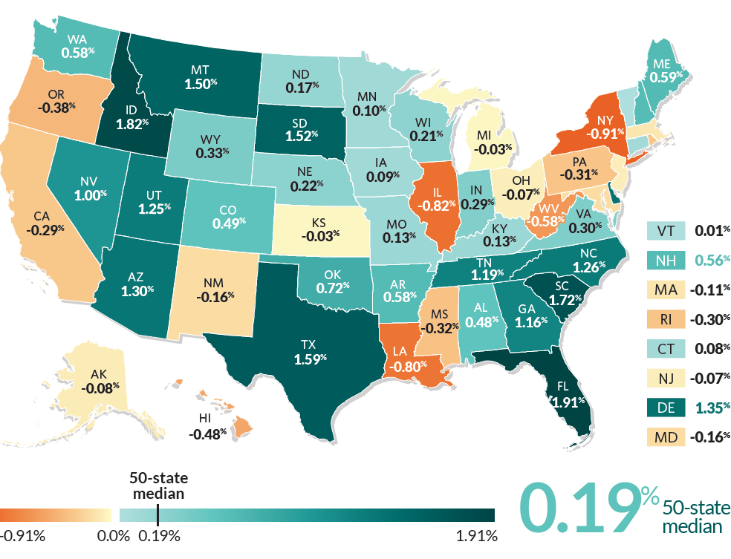
18 States Lost
Population Over the Past Year
Creative Considerations
Percentage change in state population, July 2021-July 22
Fiscal 50: A 50-state lens for better understanding your state’s fiscal position

Slide 21
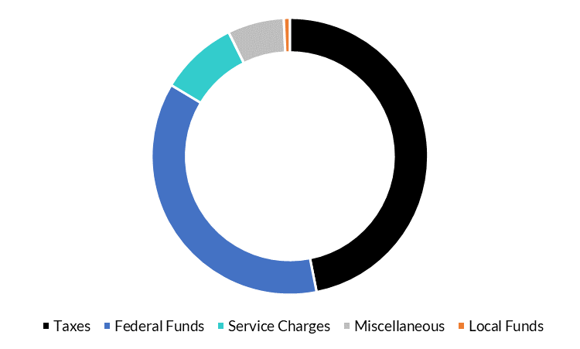
Where do states get their money?
6.6%
.7%
Creative Considerations
9.1%
50-State Total
46.9%
State Revenue by
Major Categories, FY 2021
36.7%
Fiscal 50: A 50-state lens for better understanding your state’s fiscal position

Slide 22
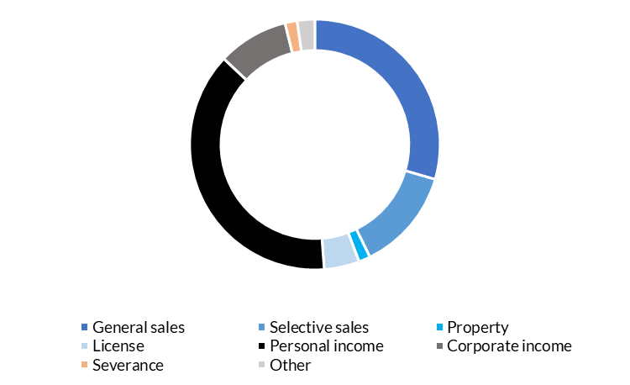
9.1%
How do states raise their tax dollars?
Creative Considerations
29.5%
50-State Total
38.2%
Mix of Tax Sources by State, FY 2022
13.3%
Fiscal 50: A 50-state lens for better understanding your state’s fiscal position

