Slide 1
Redistricting: 10 Things Reporters need to Know
September 20, 2023
wendy underhill

Slide 2
1. The Census Matters – A Lot
Gained two
Gained one
Lost one
Source: U.S. Census Bureau
AS
VI
PR
GU
MP

Slide 3
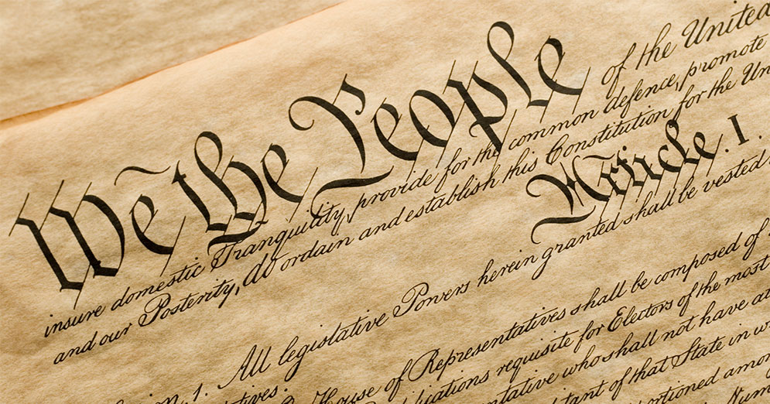
2. States are in charge of redistricting

Slide 4

3. Equal population is the first principle

Slide 5
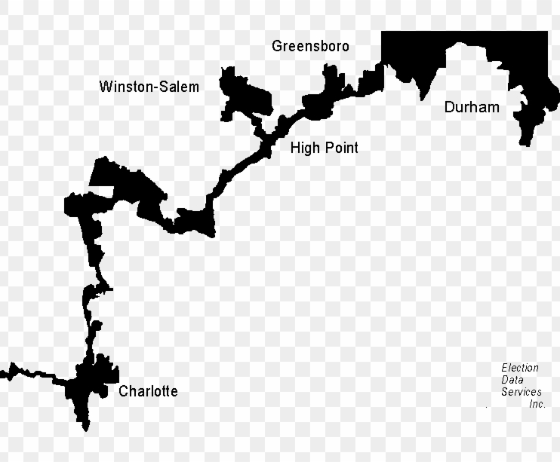


4. States must balance competing race principles

Slide 6
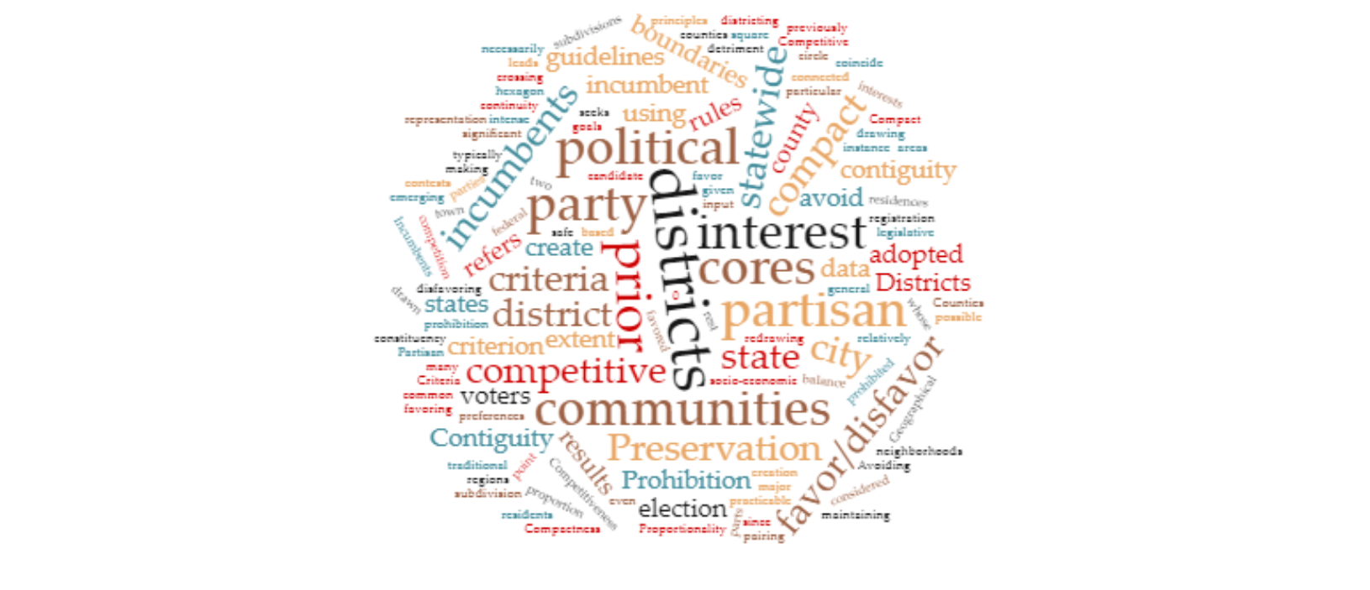
5. The rules of redistricting are not static

Slide 7
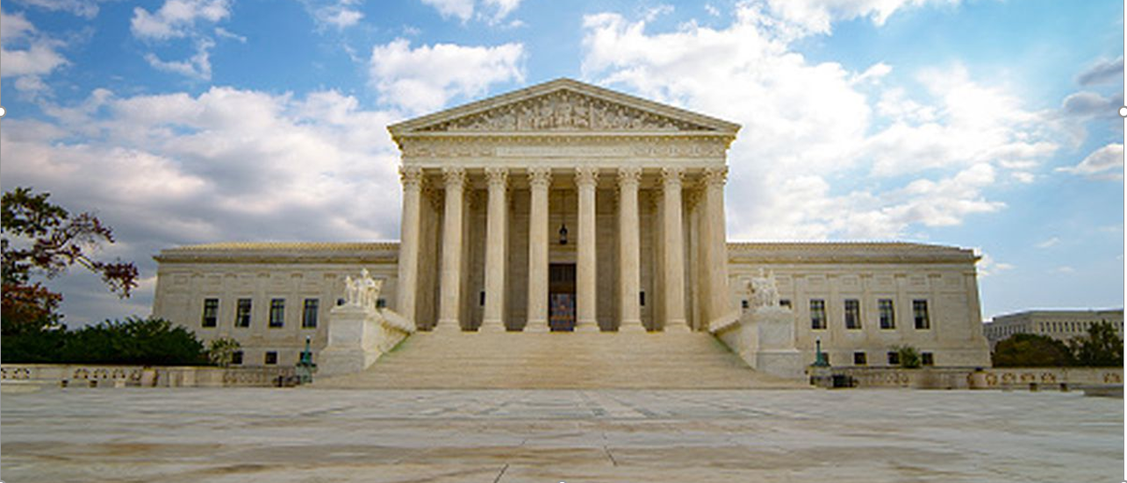
6. Courts are always busy with redistricting

Slide 8

7. Data matters

Slide 9
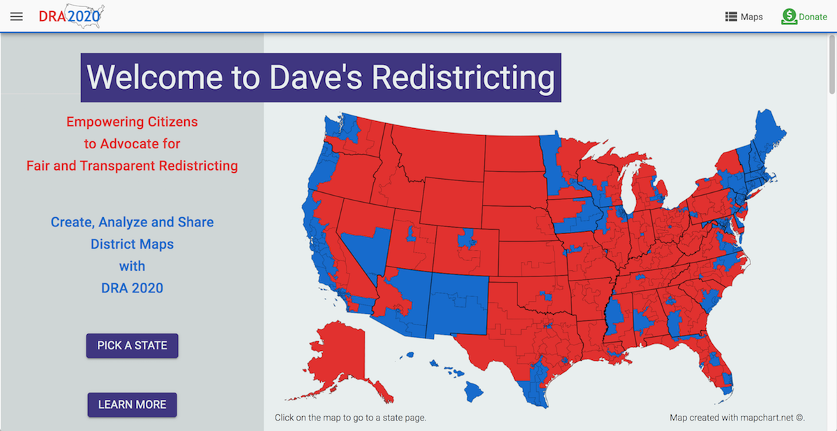

8. The Public may want to participate

Slide 10
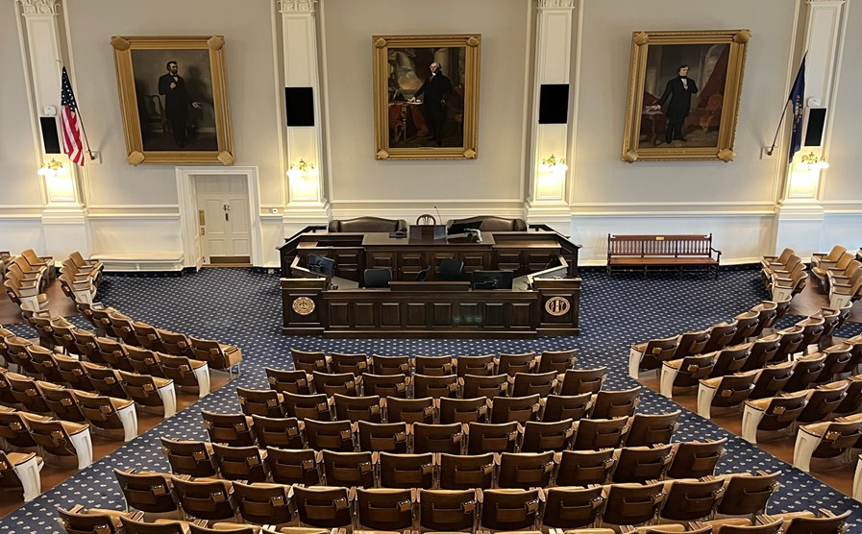
9. People Matter
Who Draws Legislative Maps?
Legislature: 35 states
Commission or Board: 15
Who Draws Congressional Maps?
Legislature: 34 states Commission:10 states

Slide 11

10. Resources
Wendy Underhill
303-802-6673
Wendy.Underhill@ncsl.org

