Slide 1

Clarke v. Wisconsin Elections Commission
September 2023

Slide 2
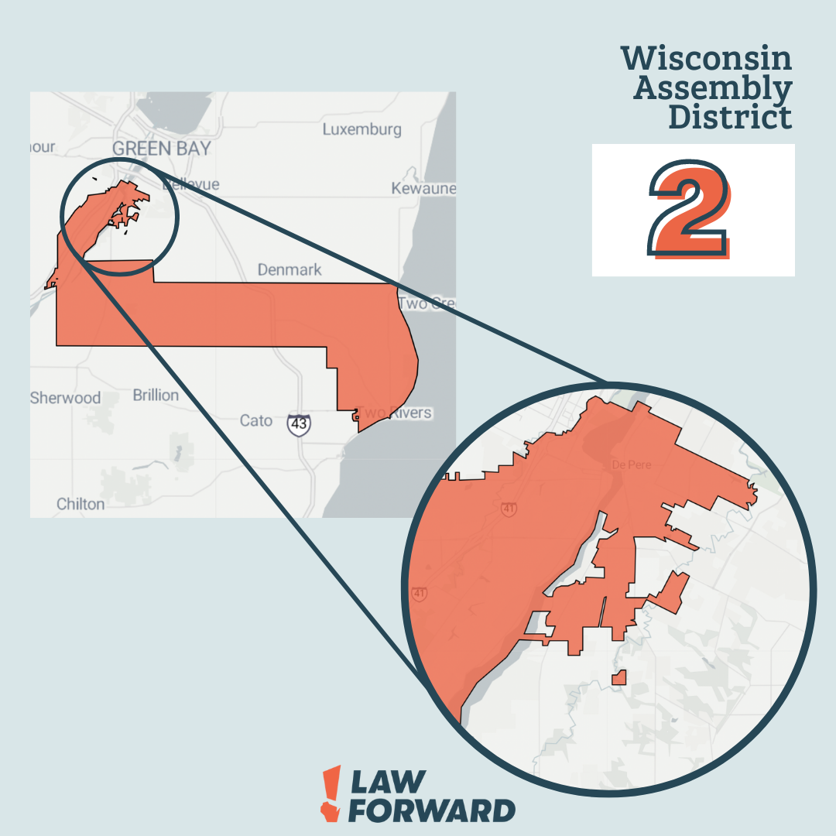
Clarke v. WEC
19 Individual Plaintiffs coming together
Diverse geographies, identities and claims
Government Defendants
Petition for Original Action SCOW

Slide 3
Partisan Gerrymander Claim
The existing legislative maps are an extreme partisan gerrymander that violates the Wisconsin Constitution. Specifically, the existing maps:
(1) retaliate against some voters based on their viewpoint and free speech, in violation of Wisconsin Constitution’s guarantees of free speech and assembly;
(2) treat some voters worse than others based on their political views and where they live, in violation of Wisconsin Constitution’s guarantee of equal protection;
(3) violate the promise of a free government found in the Wisconsin constitution. ​

Slide 4
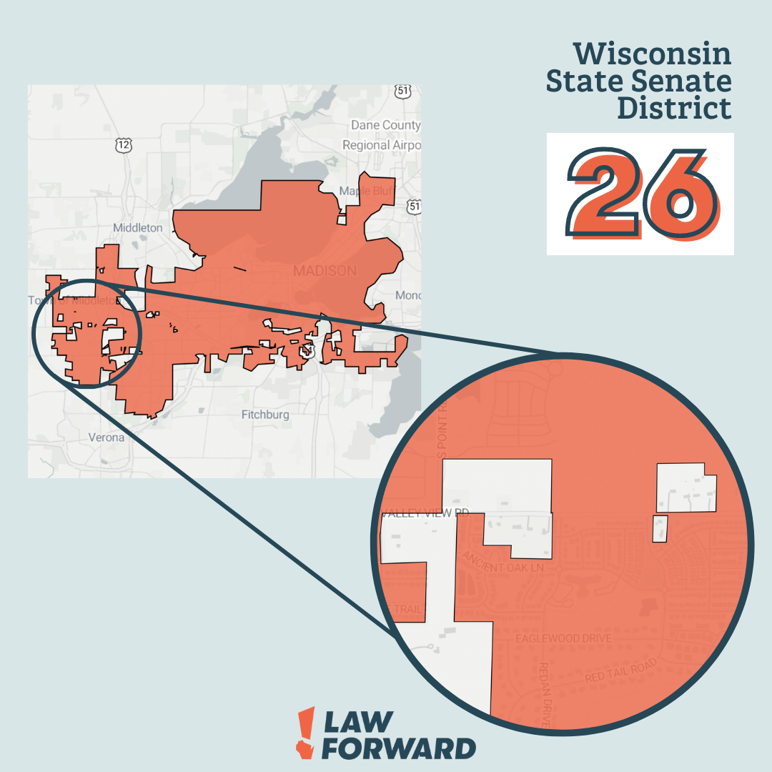
Other Claims
The existing maps are the same ones the Governor vetoed in Nov. 2021, a veto which the Legislature tried and failed to override. By making them the maps we use for elections, the Court violated Wisconsin’s separation-of-powers principle and the Governor’s constitutional authority to veto bills.
Wisconsin’s Constitution requires that all districts be contiguous—meaning they cannot be made up of separate pieces of detached territory. More than half of Wisconsin’s current districts violate this basic provision.

Slide 5
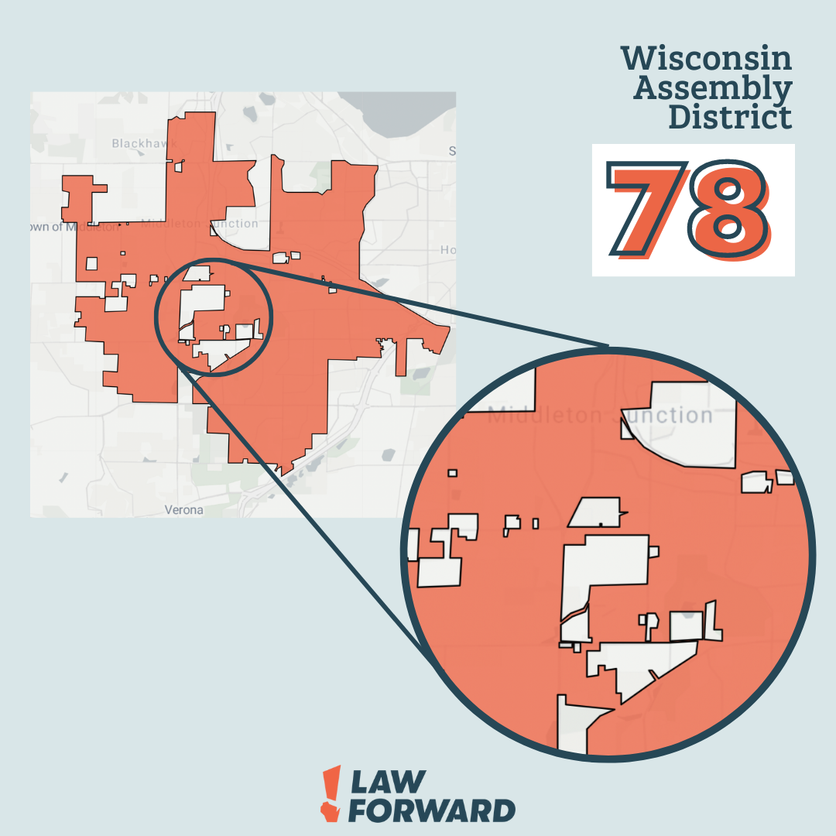
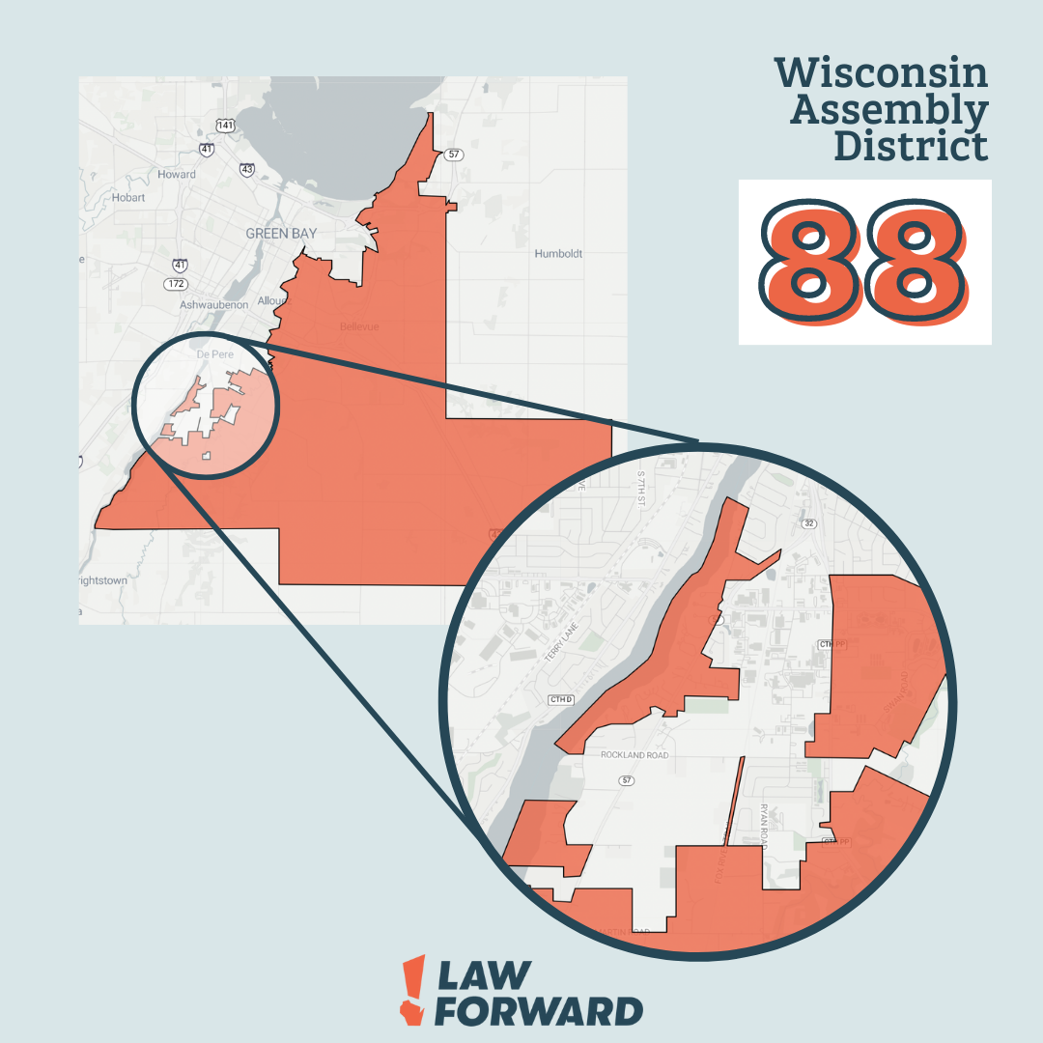
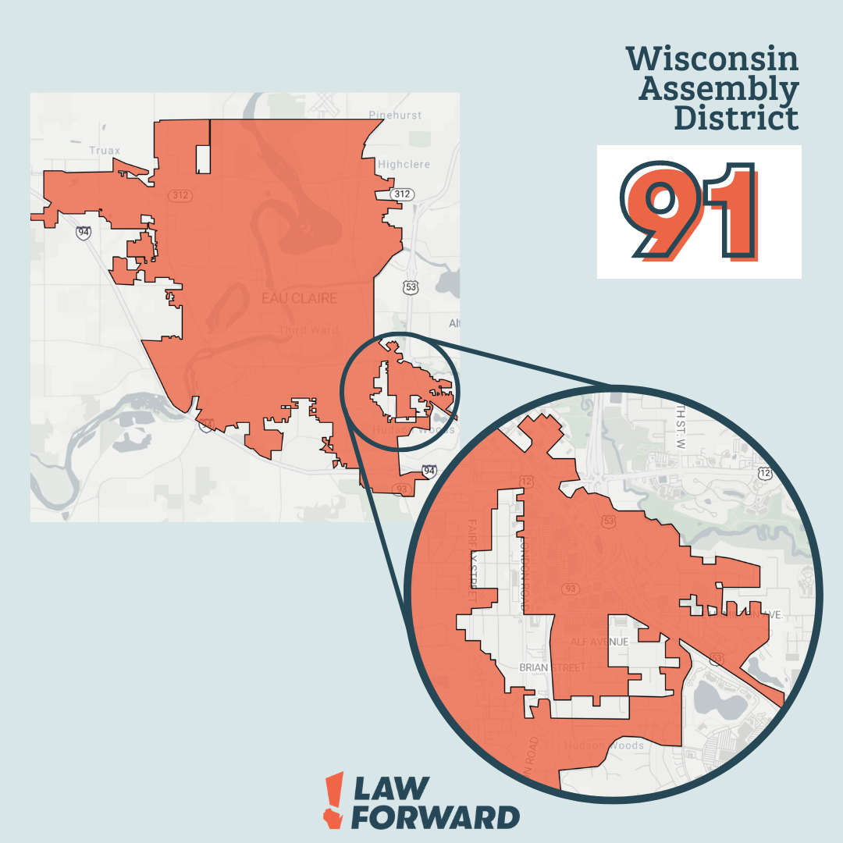
Noncontiguity

Slide 6
What’s Happened Since August 2?
August 4: Wright v. Wisconsin Elections Commission case filed.
August 15: Supreme Court issued a scheduling order in both Clarke and Wright, requiring responses to the Petitions be filed by August 22.
August 22: Responses came in from WEC, the Democratic Senators, and the Republican Senators. The Legislature also filed a brief and moves to intervene. The Legislature and the Republican Senators filed a motion asking Justice Protasiewicz to recuse herself.
August 29: Wright and Clarke petitioners, as well as Dem. Sens., responded to recusal motion.
September 5: Justice Protasiewicz released Judicial Commission dismissal of a complaint against her and ordered supplemental briefs on recusal be filed by September 18.
September 18: Wright and Clarke petitioners, Dem. Sens., Repub. Sens., and Legislature filed supplemental briefs on recusal.
Still to come: decision by Justice Protasiewicz on recusal, decisions by the Court on Clarke and Wright petitions, decision on Legislature’s intervention motion, possible consolidation ...

Slide 7
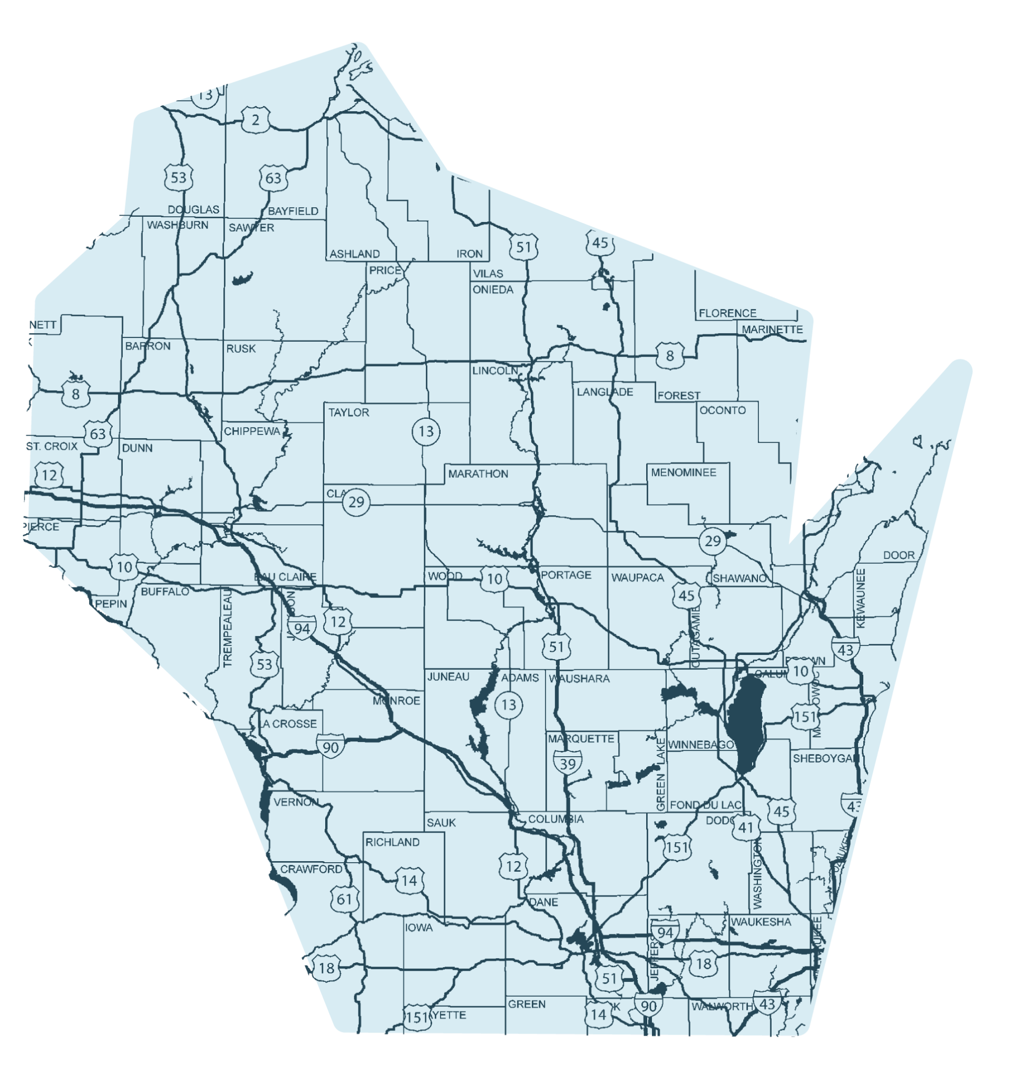
Resources: www.lawforward.org petitioner videos media@lawforward.org

