Slide 1
Investigating Trade and Business
Wahyu Dhyatmika (Tempo)

Slide 2
General Principles
Public Interest
Combination of Data driven and Field Reporting
Verified and Confirmed

Slide 3

Telkom Investment in GoJek
In October 2020, Tempo wrote the story behind the news about Telkomsel 400 million USD acquisition for 3 percent of GoJek’s shares.

Slide 4
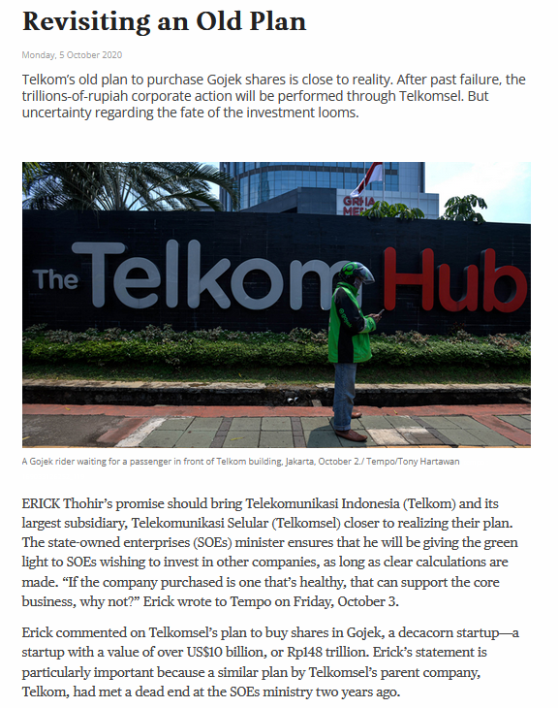
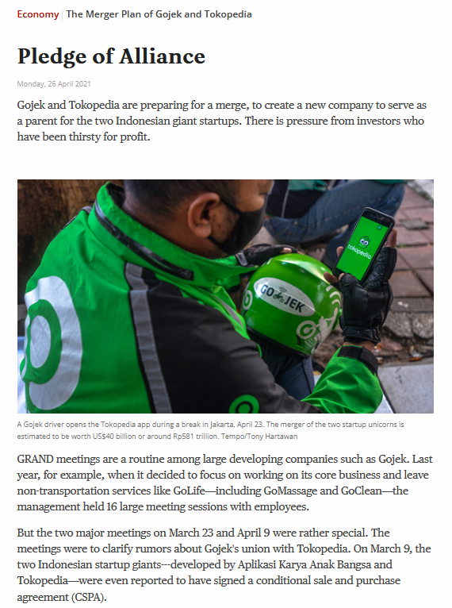
Focus on how the deal was done

Slide 5
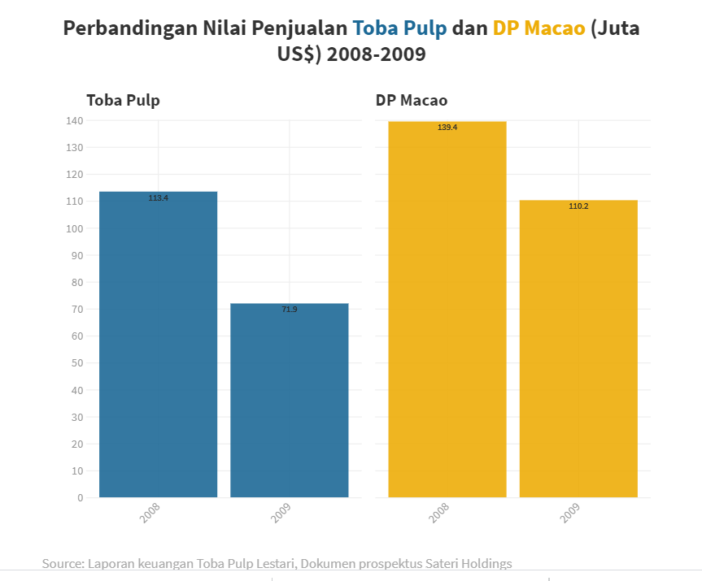
The Question About APRIL’s Export
In February 2020, IndonesiaLeaks consortium published a story about questionable export data of pulps from Toba Pulp Lestari, a subsidiary of APRIL

Slide 6

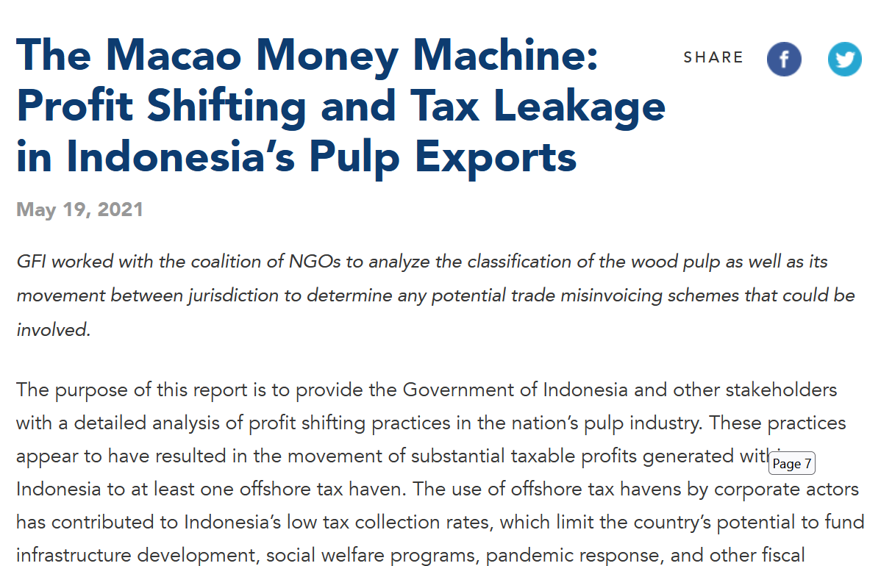
Using data to expose potential wrongdoing

Slide 7
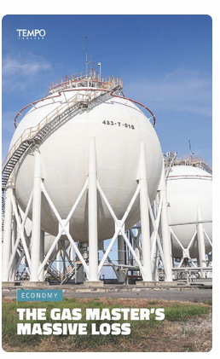
Making sure your story is bulletproof
The keys are simple: verified data and make sure you get the other side of the story

Slide 8
Thank you

