Slide 1
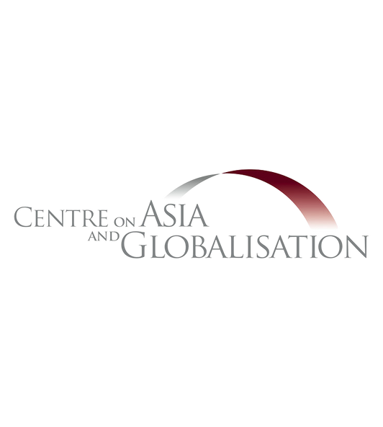


CHALLENGES IN REALISING THE ECONOMIC COMMUNITY(AEC) BY 2025
NATIONAL PRESS FOUNDATION, INTERNATIONAL TRADE FELLOWSHIP SINGAPORE
DENIS HEW, PHD
SENIOR RESEARCH FELLOW, CAG, LKYSPP
25 JULY 2023

Slide 2





THE AEC VISION
The ASEAN Economic Community (AEC) is envisioned to be a highly integrated, inclusive and resilient regional economy by 2025.
The AEC project was launched way back in 2003 during the ASEAN Summit in Bali (Bali Concord II).
Eventual goal connotes European-style common market with “free movement of goods, services, investments and skilled labour”.
Can this lofty end-goal be achieved by 2025? Is it realistic?
What are the challenges to realise the AEC by 2025?

Slide 3








AEC BLUEPRINT
According to the AEC Blueprint, a ten-year implementation plan (2016-2025), the AEC will have achieved 5 key milestones by 2025:
A highly integrated and cohesive economy
A resilient, inclusive people-oriented and people-centred ASEAN
Enhanced
connectivity and sectoral cooperation
A competitive, innovative, and dynamic ASEAN
A global ASEAN

Slide 4


BUILDING BLOCKS AND FTAS
ASEAN Trade in Goods Agreement (ATIGA)
ASEAN Comprehensive Investment Agreement (ACIA)
ASEAN Trade in Goods and Services Agreement (ATISA)
RCEP (ASEAN, China, Japan, Korea, Australia and New Zealand)
Some ASEAN countries are members of the CPTPP and APEC
MRAs (Professional & Skilled labour)
ASEAN + 1 FTAs

Slide 5
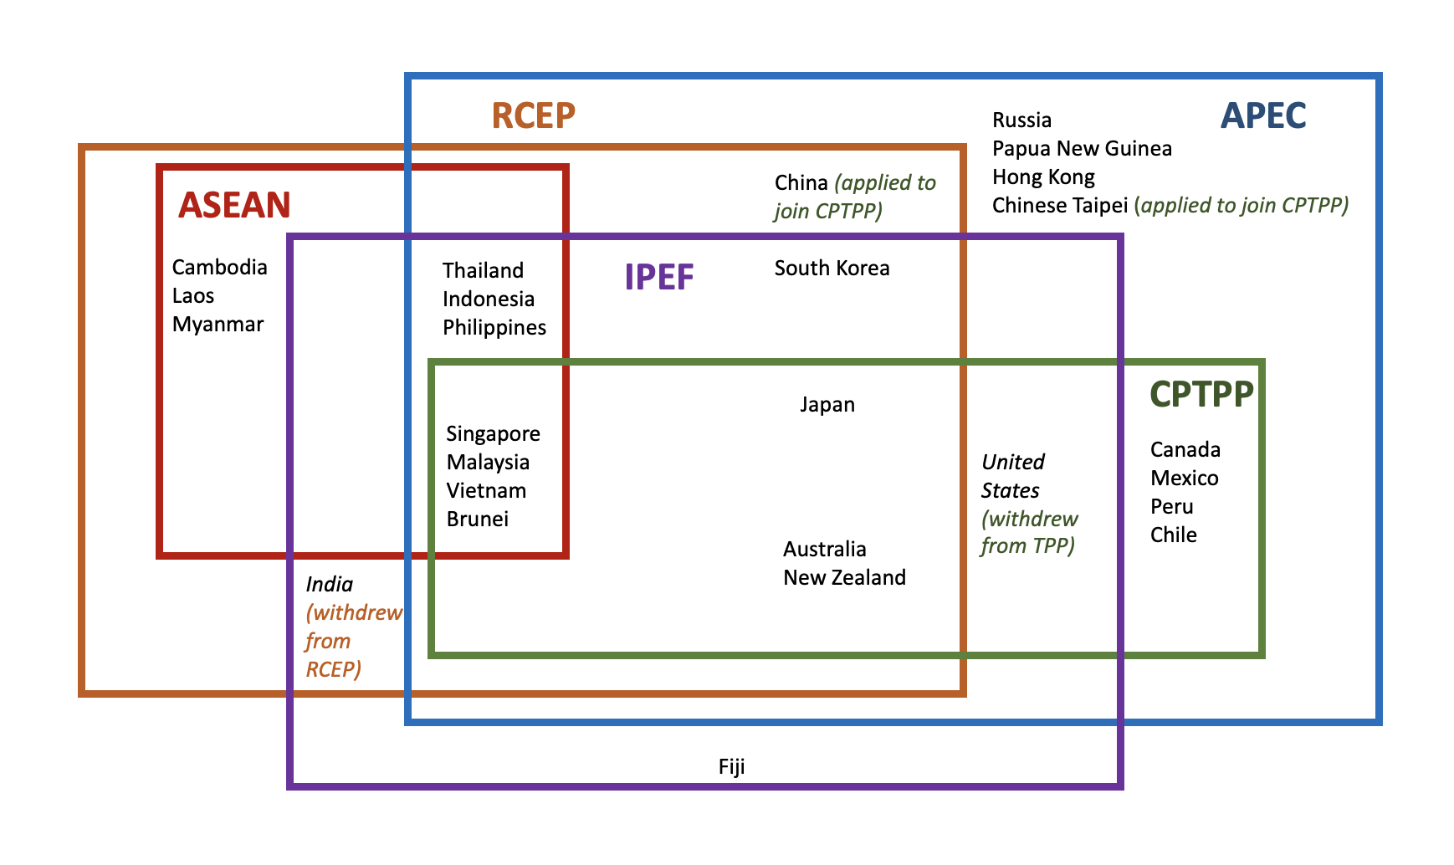


FTAS AND TRADE BLOCS

Slide 6

AEC BLUEPRINT IMPLEMENTATION
The MTR of the AEC Blueprint reported a little over half (54%) of its initiatives have been completed with another 34% in progress.
But final year of MTR in 2020 coincided with the onset of the Covid-19 pandemic.
Border controls, movement restrictions and quarantine measures imposed at the height of the Covid-19 pandemic led to a significant drop in economic activities.
Global supply chains were severely disrupted during this time due to logistic bottlenecks.

Slide 7
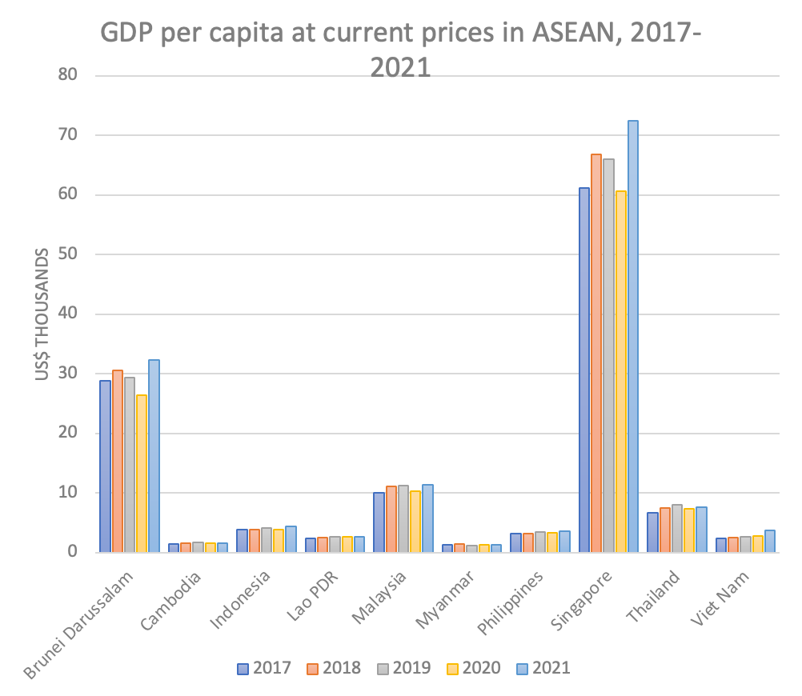
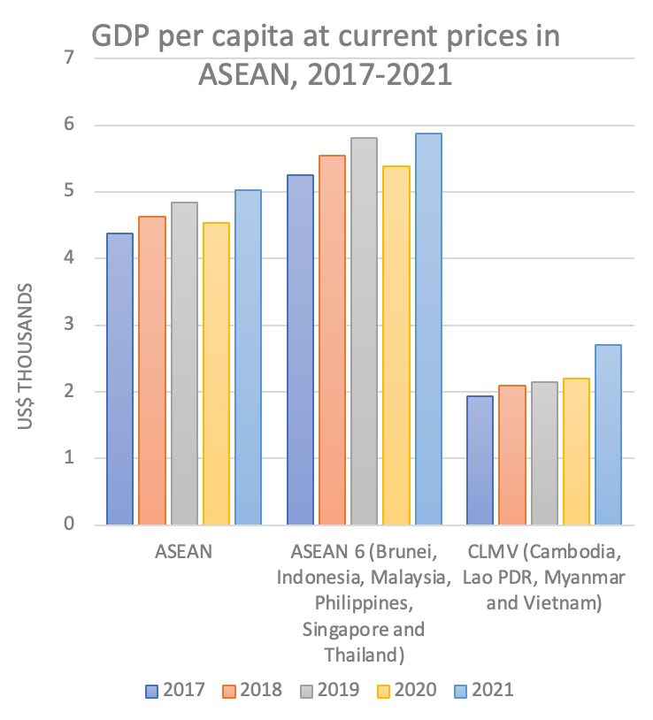
ECONOMIC DEVELOPMENT GAP
Source: ASEAN Statistical Yearbook (2022)

Slide 8
EMERGING CHALLENGES
such as digital transformation, accelerated AI adoption, climate change, job reskilling are not captured in the current AEC Blueprint
RISING TRADE PROTECTIONISM
There is a need for a workable
ASEAN DSM to handle trade disputes
ACUTE SHORTAGES
in skilled labour shortage, MRAs have been slow
ASEAN
ASEAN Secretariat needs to be strengthened, institutional reforms
WIDE ECONOMIC DIVIDE
in ASEAN continue to persist -
initiatives such as the IAI to narrow
the development gap not effective
CHALLENGES

Slide 9



AEC BY 2025 AND BEYOND
EU-style common market not realistic by 2025
ASEAN free trade area that’s plugged into global value chains more likely
More frequent reviews of the AEC Blueprint to fine-tune goals and add new initiatives
Economic landscape has changed dramatically, more uncertainties and downside risks as the global economy slows down
Economic convergence among ASEAN members needs to be take more seriously
ASEAN needs to be better prepared for challenges ahead and future external shocks
The AEC project will otherwise fail if it’s business as usual

Slide 10




THANK YOU
FOR YOUR TIME AND ATTENTION
cag@nus.edu.sg
@CAG_LKYSPP
@denishew

