Slide 1
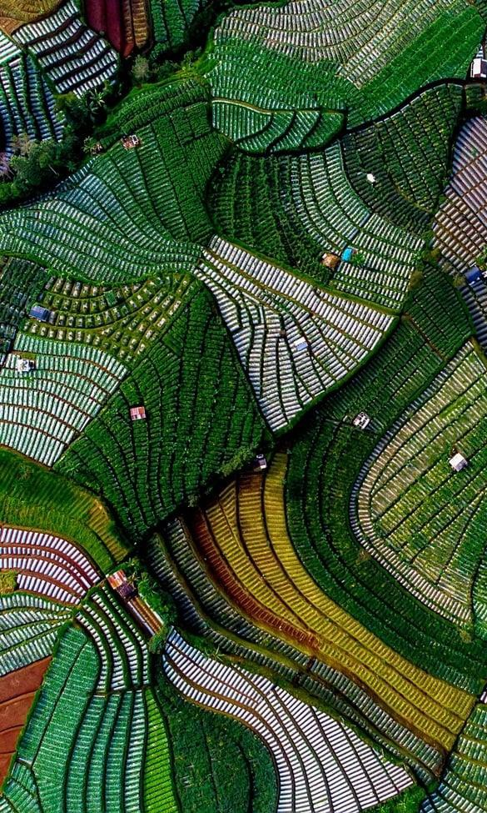
APEC and Trade Sustainability
Dr Rebecca Sta Maria
Executive Director, APEC Secretariat
International Trade Fellowship Singapore
National Press Foundation
24 July 2023

Slide 2
APEC is an informal, non-binding, consensus-driven forum that allows space for innovation and collaboration. Its members (called economies) make up a significant part of the global economy
62%
48%
38%
2.9 billion
people
USD 20
Trillion
USD 52
Trillion
World Population
Global Trade
World GDP

Slide 3
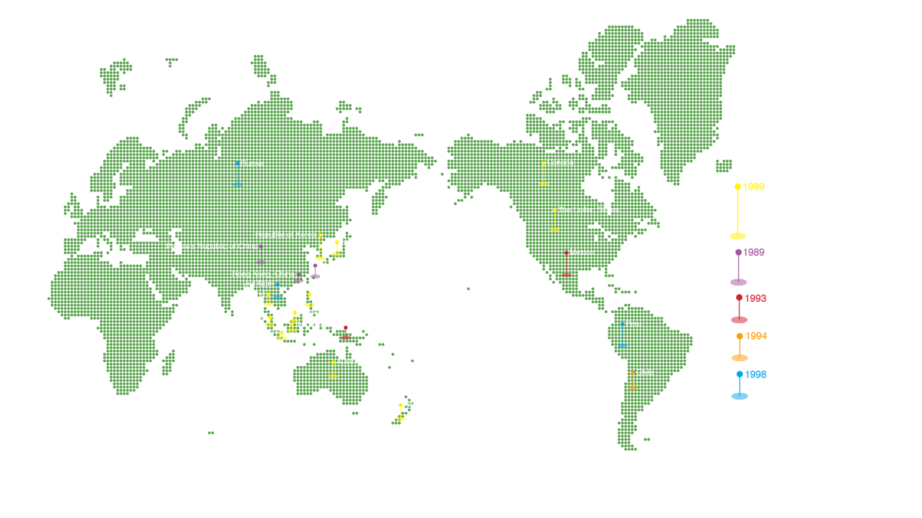
The 21 APEC Member Economies

Slide 4
The APEC Mission
Build sustainable, secure economic growth
Support economic and technical cooperation
Improve living standards
Promote trade and investment

Slide 5
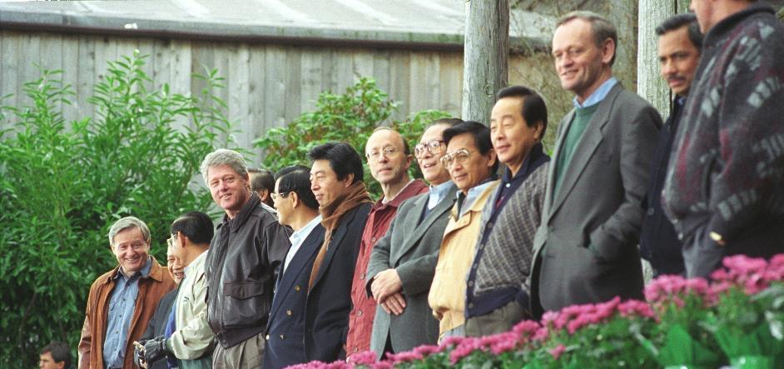
APEC: Working on green growth from the get-go
"Our environment is improved as we protect the quality of our air, water and green spaces and manage our energy resources and renewable resources to ensure sustainable growth and provide a more secure future for our people.”
APEC Economic Leaders’
Economic Vision Statement
November 1993
6

Slide 6
The New Vision: APEC Putrajaya Vision 2040
Our vision is an open, dynamic, resilient and peaceful Asia-Pacific community by 2040, for the prosperity of all our people and future generations.
Strong, Balanced,
Secure, Sustainable
& Inclusive Growth
Trade and Investment
Innovation and
Digitalization
Trade and
Investment

Slide 7
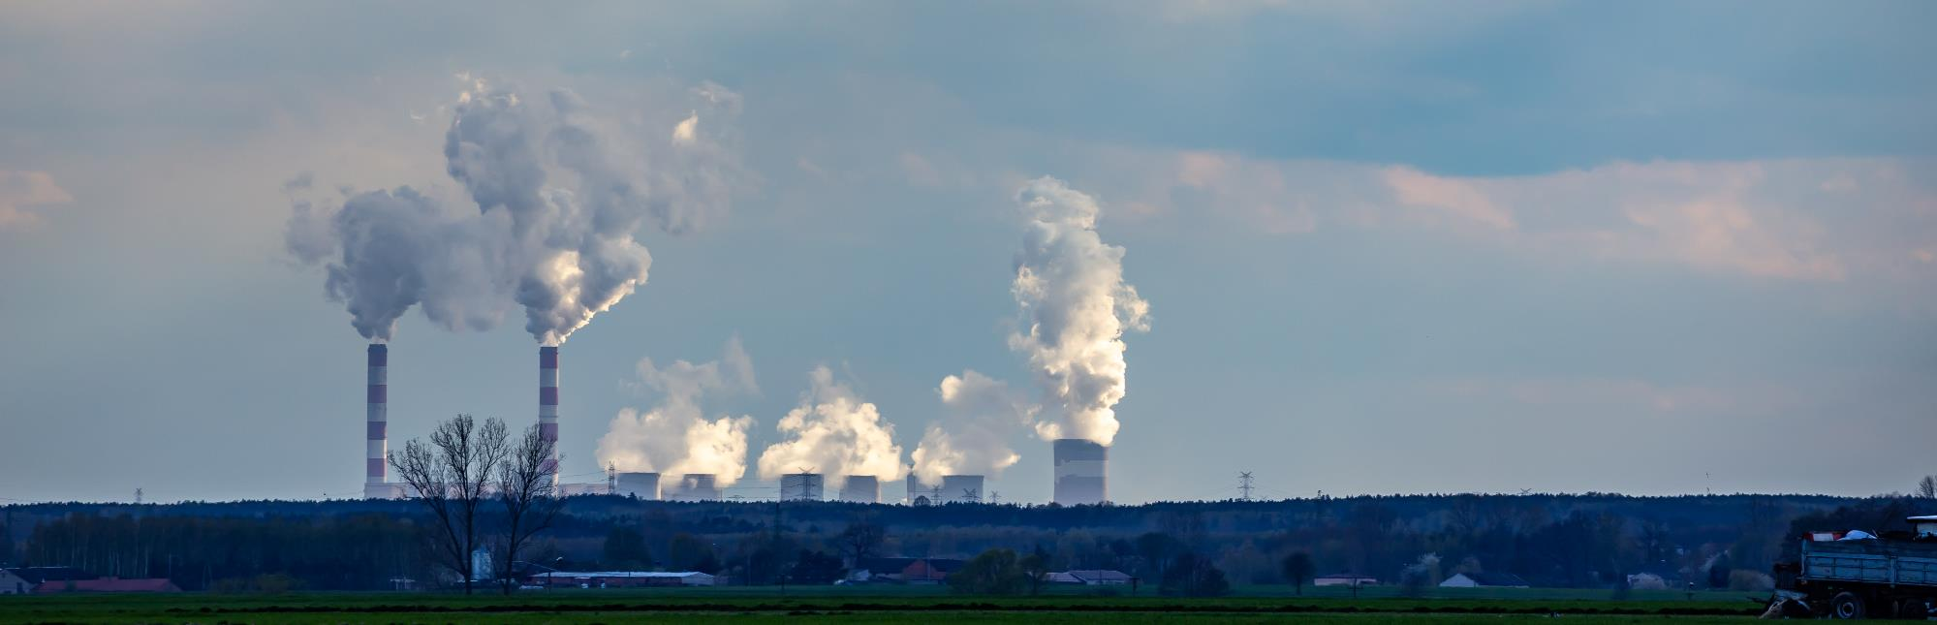
APEC contributes to about 60% of global greenhouse gas emissions and 65% of carbon emissions. 7 of the world’s top 10 CO2 emitting economies are in APEC
Between 1990 and 2018, the region’s greenhouse gas (GHG) emissions increased from 16.5 to 27.8 billion tons of CO2 equivalent.

Slide 8

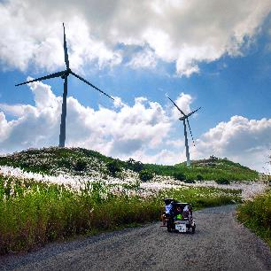
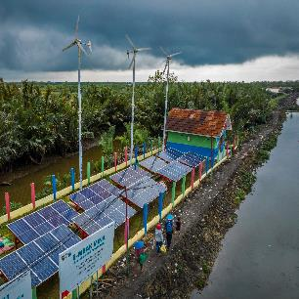
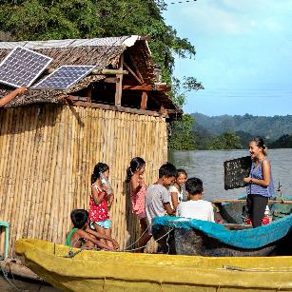
The Good News: APEC is addressing climate change
The region’s forest cover increased by 22.7 million hectares in 2008-2020
Economies are on track to doubling the share of renewables in their energy mix by 2030
The share of trade in environmental goods has increased to 5.2% of merchandise trade in 2019
Bonds issued to finance new or existing green projects reached USD 92.3 billion in 2020

Slide 9
Some salient initiatives
Resolved to reduce the energy use needed for economic output to 25 percent of 2005 levels by 2030
Discussions on fossil fuel subsidy reform; voluntary reporting mechanism framework; peer review methodology guidelines. Supported WTO efforts.
Greening the APEC supply chain through energy efficiency
Progress on the liberalisation of tariffs on environmental goods. Members agreed to a list of 54 Environmental Goods, the floor for discussions in other international fora, including the Environmental Goods Agreement negotiations in the WTO.
APEC Strategy for Green, Sustainable and Innovative MSMEs
Discussion on developing a new, voluntary, non-binding APEC Reference List of Environmental Goods
2007
2009
2011
2012
2017
2023

Slide 10
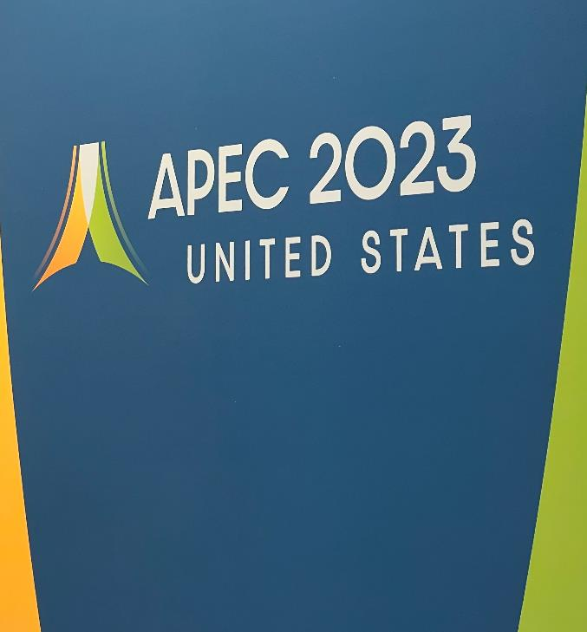
This year, the United States as APEC host economy, will advance work on a Just Energy Transition initiative, moving to a low-carbon economy while promoting equity and inclusivity
Supportive labour policies , access to work
Support for job losses and worker displacements
Opportunities for education, training, reskilling, upskilling & career development
Comprehensive Structural Reform
Macroeconomic policies that promote sustainable practices
Social safety systems that target vulnerable groups and workers
Trade and investment policies that boost green industries
Social Dialogue and Stakeholder Empowerment
Platform for stakeholders to discuss and negotiate
Inclusion of under-represented and vulnerable groups
Technological and Climate Change Readiness
Upgrade digital skills and infrastructure
Invest in digital technologies and promote innovation Address legal and regulatory challenges

Slide 11
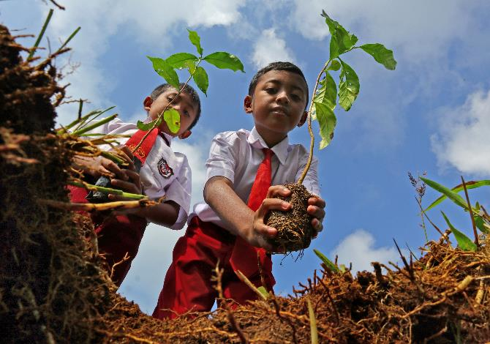
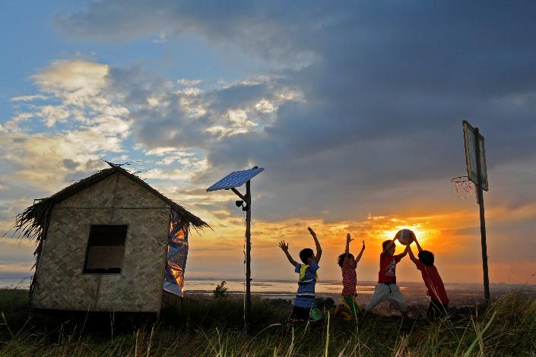
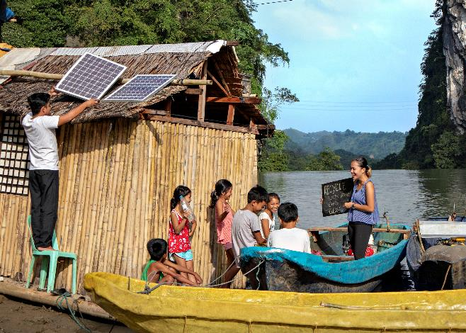
No standing still… New green economy agreements are currently emerging in APEC. APEC can provide templates and model measures to shape the form and substance of these agreements.
Ultimately, we must ensure that our work brings benefits to all our people

Slide 12
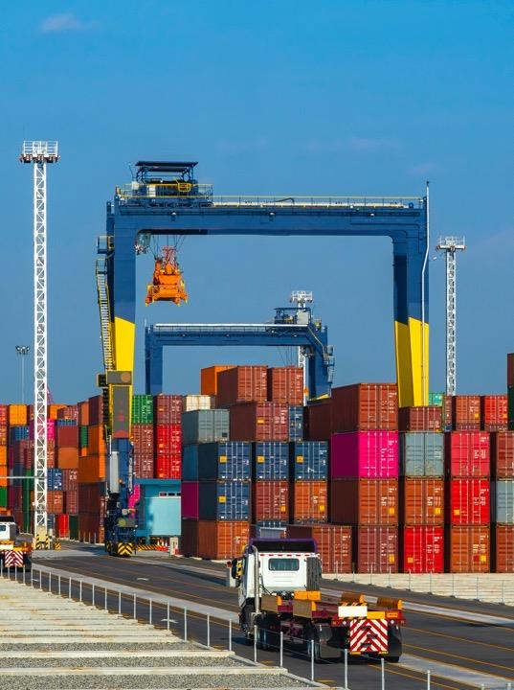
Issues Affecting Trade Sustainability in APEC
Carlos Kuriyama
Director, APEC Policy Support Unit
International Trade Fellowship Singapore
National Press Foundation
24 July 2023

Slide 13
1. Changes in supply chain strategies
Re-shoring and near-shoring
Moving closer to markets or headquarters for easier management.
More regional supply chains for easier management.
Just-in-case inventory management
Building redundancies (i.e. holding. precautionary stocks) or by diversifying suppliers
Additional stock gives extra time to plan their recovery when hit by disruptions.
Improving visibility
More supply chain visibility to anticipate shifts in market and react with flexibility
Better supply chain visibility is expected to result in 20 - 25% cost savings and overall improved levels of service.
Trade-off: Resilience is costly. Long-term resilience vs. short-term profits.

Slide 14
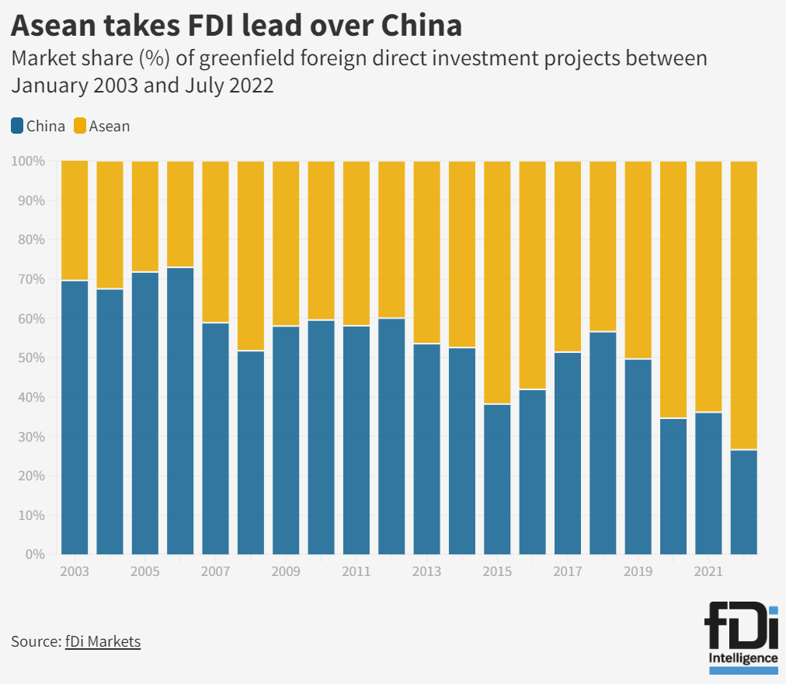
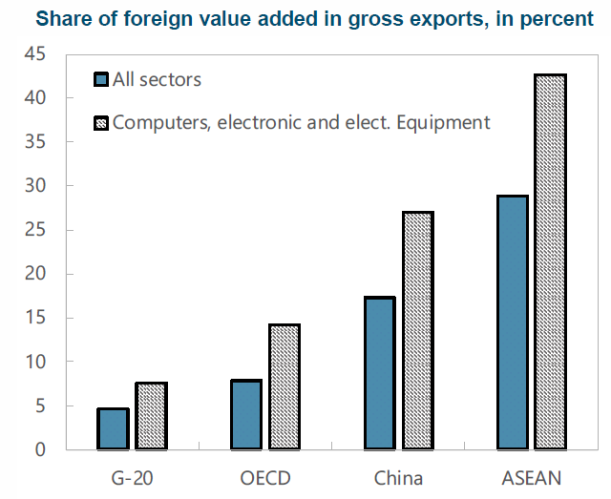
2. Geoeconomic fragmentation
Technology-intensive sectors
Sources: OECD TiVA, IMF calculations

Slide 15
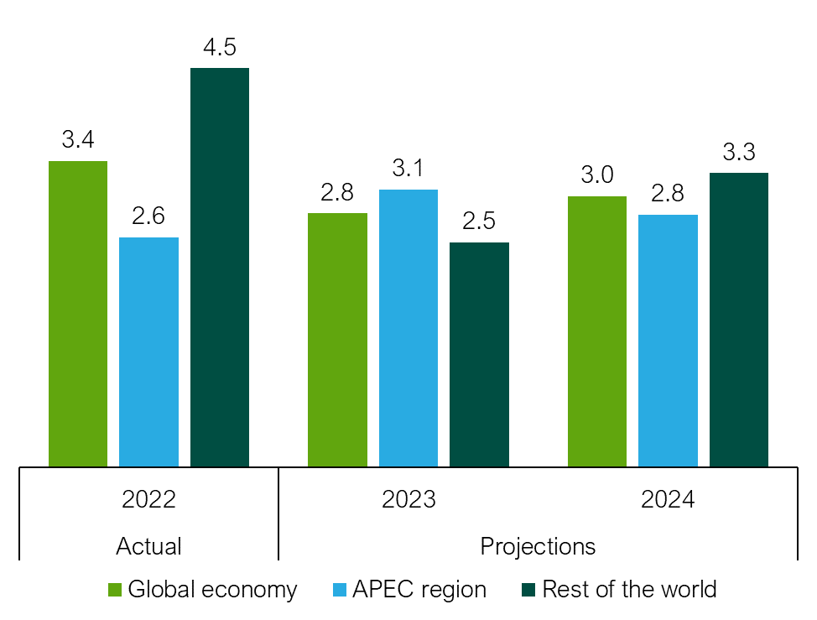
3. Economic slowdown
GDP Growth: Global, APEC and ROW (%)
Global slowdown means a reduced external demand
Trade is affected
Stubborn inflation and rising interest rates makes it harder for economic recovery
Sources: IMF, APEC PSU calculations

Slide 16
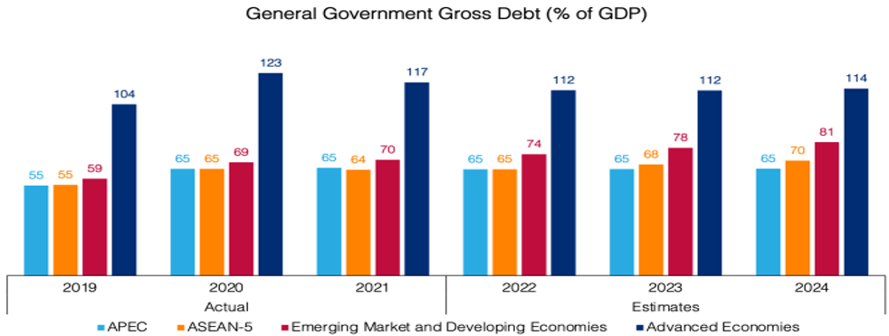






4. Higher public debt
Increasing debt means higher risk and higher interest rates.
Cost of credit increases and affect negatively trade finance
Sources: IMF, APEC PSU calculations

Slide 17
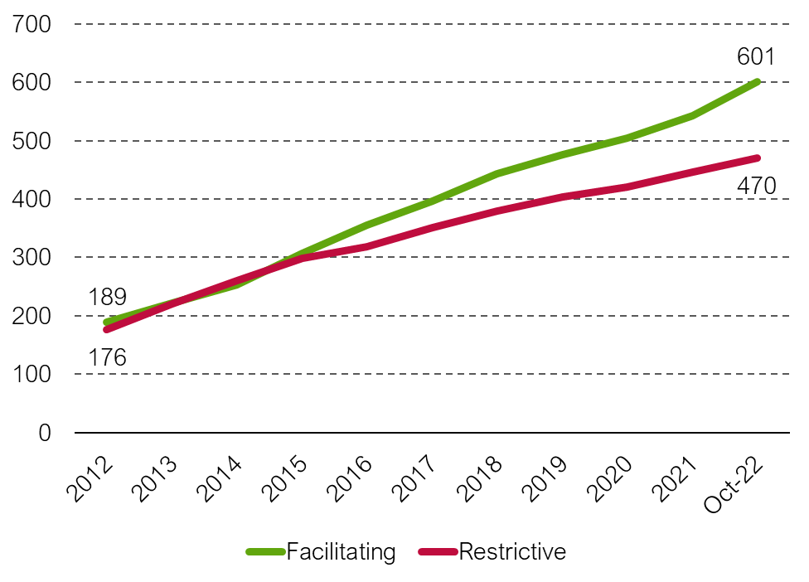
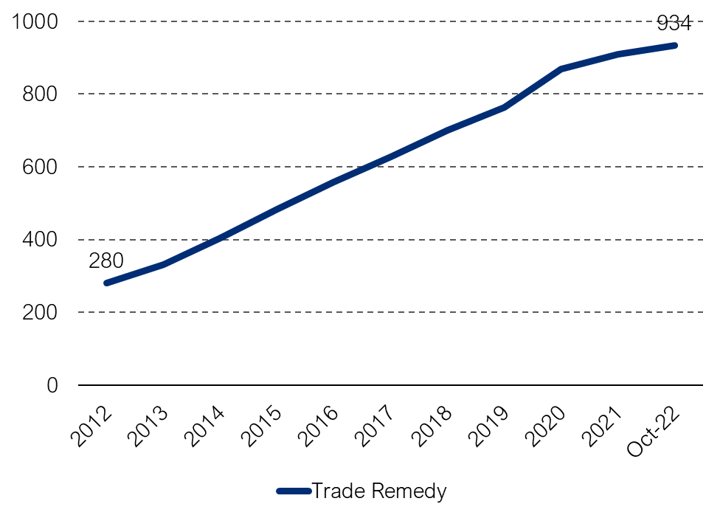

5. Accumulation of trade-restrictive measures
Trade-facilitating and trade-restrictive measures in force in APEC economies (accumulated number)
Trade remedies in force in APEC economies
(accumulated number)
Sources: WTO, APEC PSU calculations

Slide 18
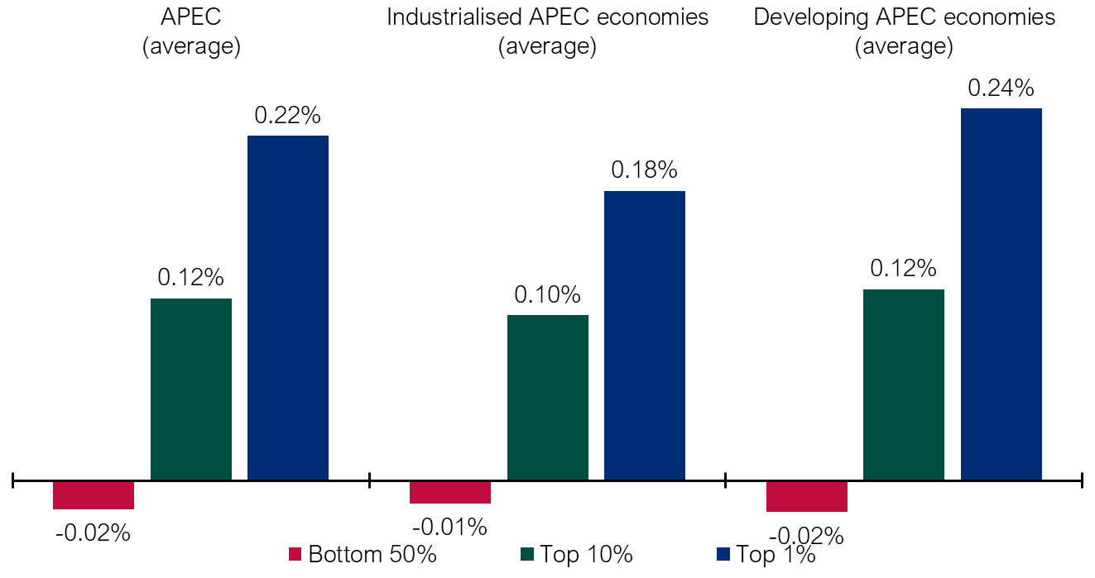
6. Inequality has risen since the pandemic started
Change in Share of Net Personal Wealth, by income group, 2019–2021 (%)
In terms of wealth and income, the poorest are worse off and the richest are better off
Inequality could drive socioeconomic and political instability
Instability could disrupt supply-chains and affect trade
Sources: World Inequality Database, APEC PSU calculations

Slide 19
6. Weather disruptions. El Niño Global
Curtailed economic growth: damage to infrastructure, disease outbreak
Supply shocks on trade: lower agricultural and fishing production. Global supply chains affected due to weather and infrastructure damage
External debt issues: reduce ability to repay debts
Higher risk of conflict: outbreak of conflicts between rebels and governments are higher during El Niño
How a strong El Niño global could affect the economy and trade?
Source: Peterson Institute for International Economics

