Slide 1

AI in International Trade: Changing the Game?
Dr Jason Grant ALLEN
Associate Professor of Law Director, Centre for AI & Data Governance
Presentation for National Press Foundation, 24 July 2023

Slide 2
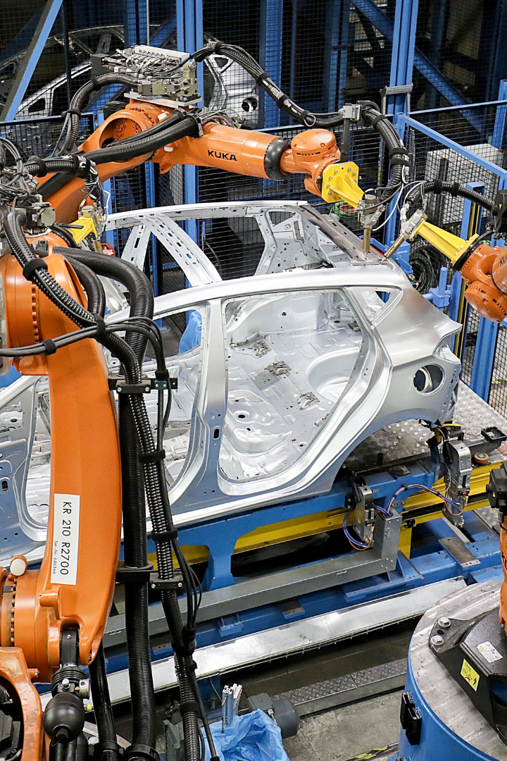
Preliminary Thoughts
1
"AI in Trade" touches many domains
2
AI is broad and poorly defined
No-one is expert in all of them, but we’ll try for a coherent overview.
"AI" is a general purpose cluster of technologies, not a single thing; every tech stack includes other established and emerging technologies.
3
There is a lot of "chatter" in the space
Lots of literature is aspirational and generic. Technology hype-cycles encourage self-proclaimed futurists and pundits, so choose whose voices you amplify.

Slide 3
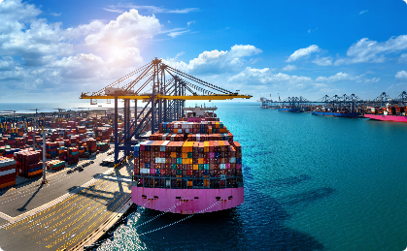

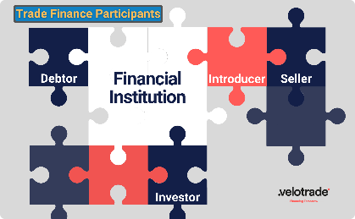

Some Domains of AI Application in the International Trade Context
Logistics
Trade Facilitation (GovTech/RegTech)
Trade-related Financial Services
Contract Automation
Warehouse management
Demand prediction
Just-in-time manufacturing
Trade route optimization
AI-enhanced Single Windows
Automated customs detection and compliance Translation services
Post-trade processes
Trade finance, factoring
Insurance
Financial documentation
"Smart legal contracts”
Digital trade documentation, e.g. MLETR/e-Bills of Lading
E-invoicing
Cross-Cutting Observations
Intersections in technology stack and business model for any given deployment—e.g. between trade finance, contract automation, asset tokenization, and AI predictive analytics, or between trade document automation and GenAI.
Trade in AI systems as products/services and as components of products/services important in its own right.

Slide 4
Policy Considerations around AI in International Trade
1
2
3
Cross-Border Data Flows
Geopolitical Tensions
Fragmentation of Legal Landscape
Data access crucial for AI development, but need to balance with privacy/personal data protection and national security considerations.
Trend towards data localization vs efforts towards bi-lateral/regional/multilateral data sharing frameworks.
AI is a front in current geopolitical fragmentation, including e.g. semiconductor supply chains and technology export.
US and China are large AI exporters. How will this impact global equality?
Regulation of trade-related AI is fragmented, e.g. from Intellectual Property to Personal Data Protection to treatment of AI embedded in goods. National fragmentation

Slide 5
Domestic Considerations Affecting International Trade
1
2
3
Workforce Displacement
Onshoring
Including (M)SMEs
How to distribute productivity windfall between capital, labour, and government? Could impact domestic economies fundamentally and affect trade profile.
AI-facilitated enhancement of manufacturing → (re) onshoring of production in Global North?
GenAI capabilities like Call Centre optimisation could impact services exports.
AI offers promise (e.g. translation services on digital platforms like eBay) for M/SMEs to access global markets. How to bridge the gap?

Slide 6

Concluding Thoughts
1
Granularity is key
2
Mind the implementation gap
It’s important to work out what kind of technology is being used for what purpose and to avoid buzzwords.
Opportunities abound, but there are important legal and infrastructural gaps to be addressed.
3
Looking at the broader context
Discussions too often get stuck on platitudes and are dominated by WTO/treaty law and personal data protection to neglect of e.g. cross-border commercial law and data governance broadly, which embraces e.g. national security and geopolitical competition.

Slide 7
Q&A
jgallen@smu.edu.sg

