Slide 1

Digging into Data:
Atlas of Economic Complexity
Annie White
Tim Cheston
The Growth Lab at Harvard University
National Press Foundation
July 25, 2023

Slide 2
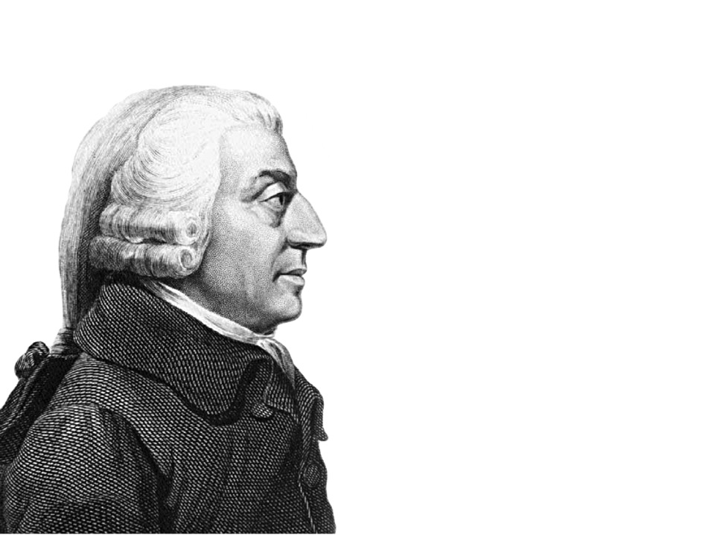
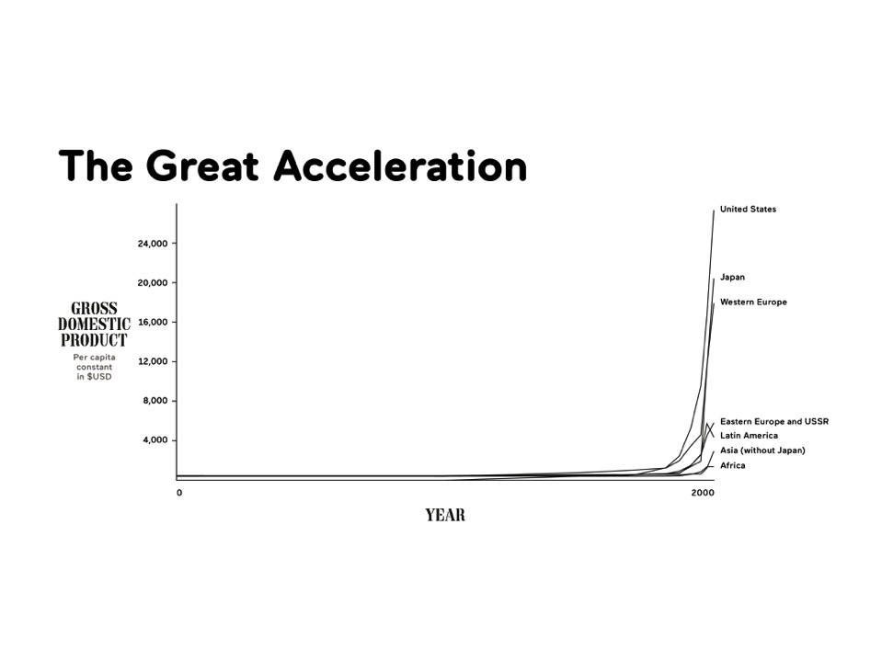

Slide 3
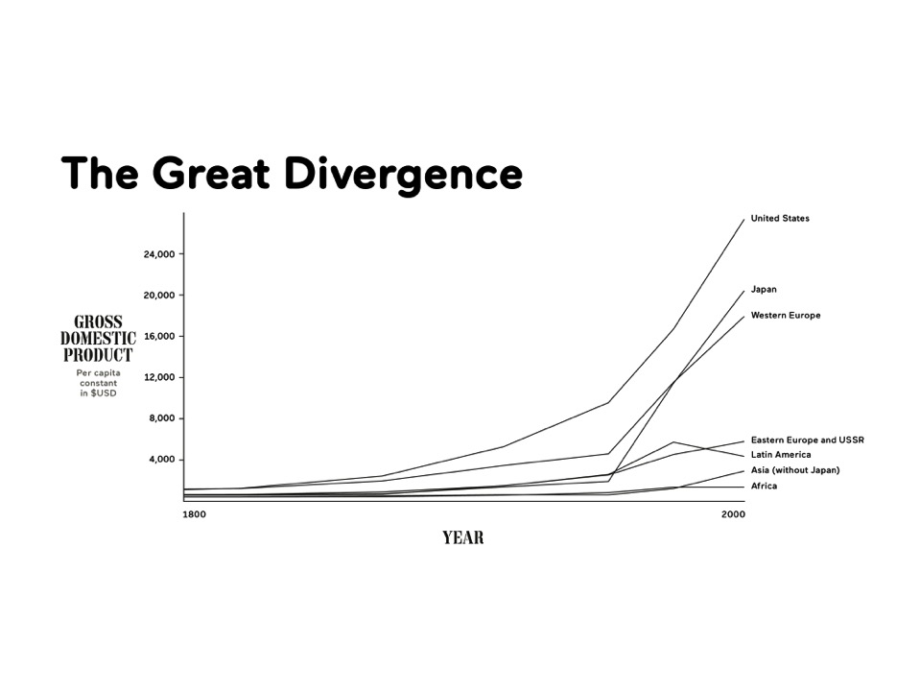

Slide 6


Slide 7


Slide 8


Slide 9


Slide 10
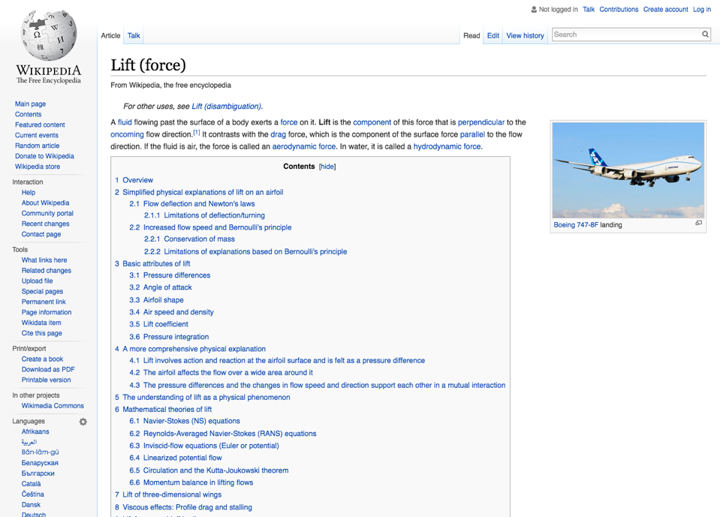

Slide 11
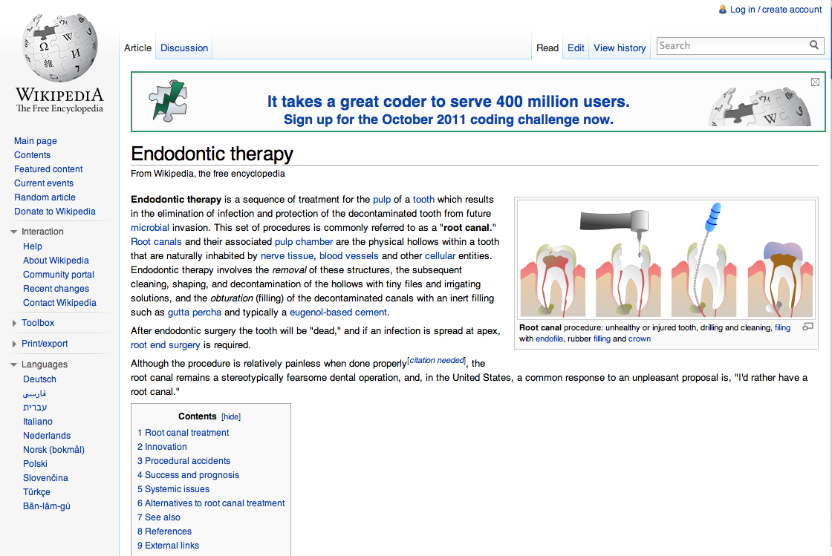
What do you do when your tooth hurts?

Slide 12

What do you do when your tooth hurts?
…or look for a dentist?

Slide 13
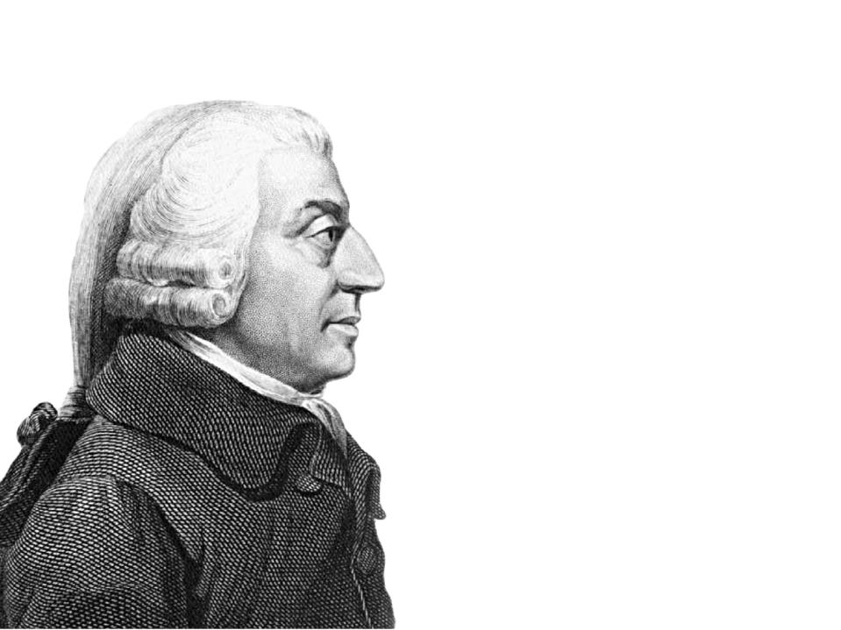

Knowhow
= the ability to perform a task

Slide 14


Slide 15


Slide 16




Division of knowledge now

Slide 17
Collective Knowhow
= the competence to do things that can only be done by teams

Slide 18


Slide 19


Slide 20
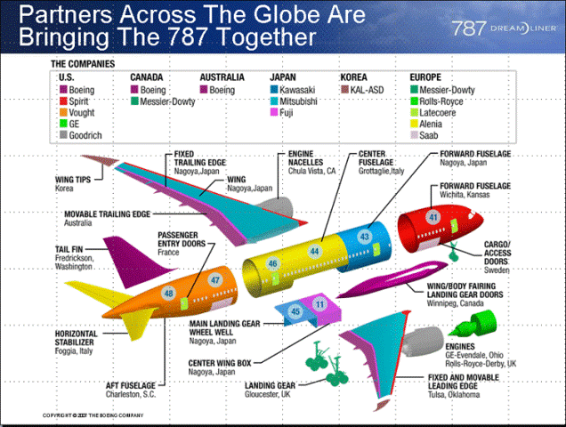

Slide 21
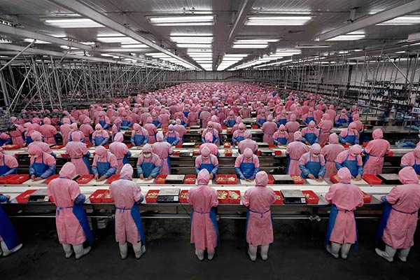

Slide 22


Slide 23
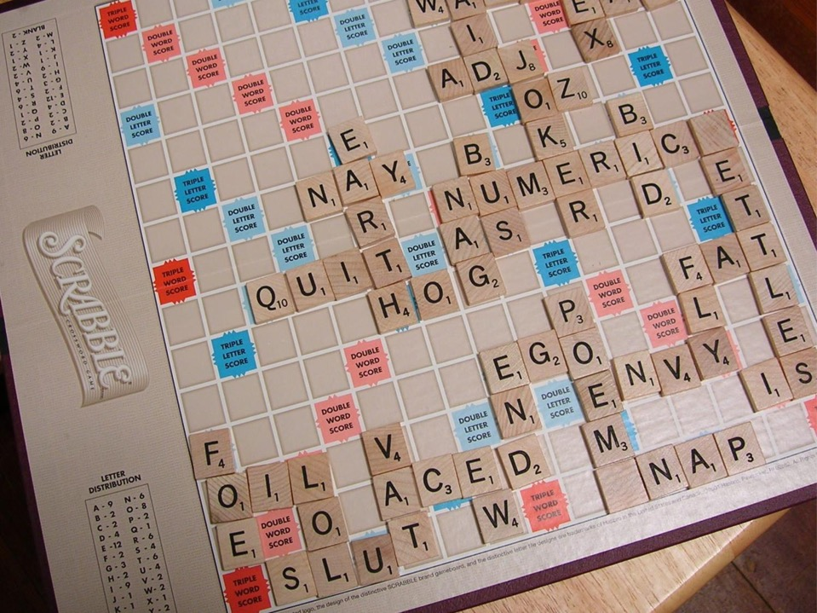

The Theory
of Economic Development

Slide 24
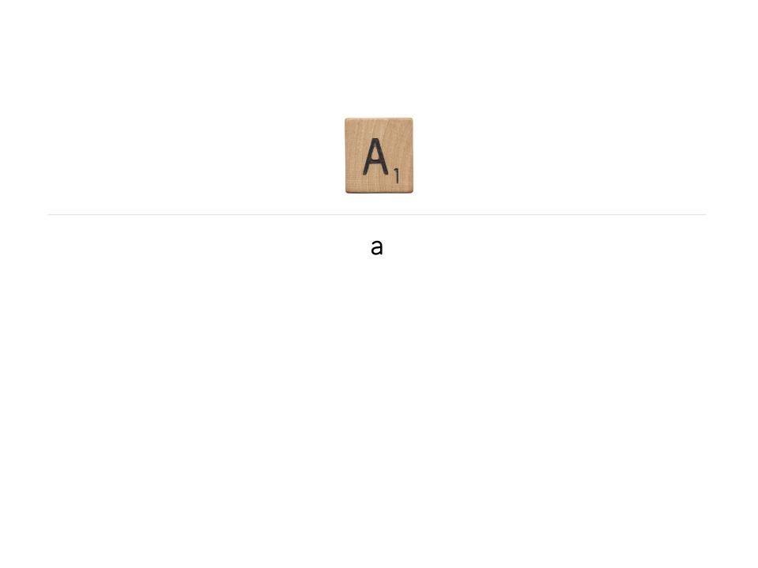
With 1 letter,
You can make 1 word, of 1 letter

Slide 25
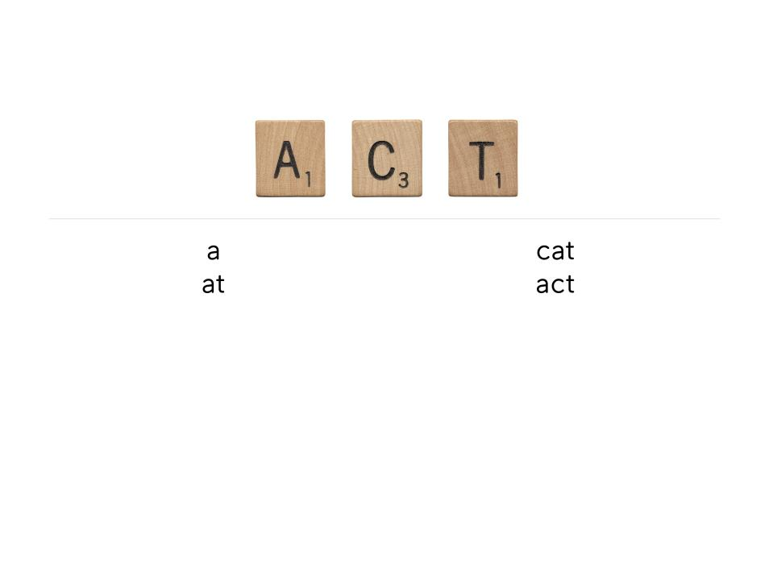
With 3 letters,
You can make 4 words, of up to 3 letters

Slide 26
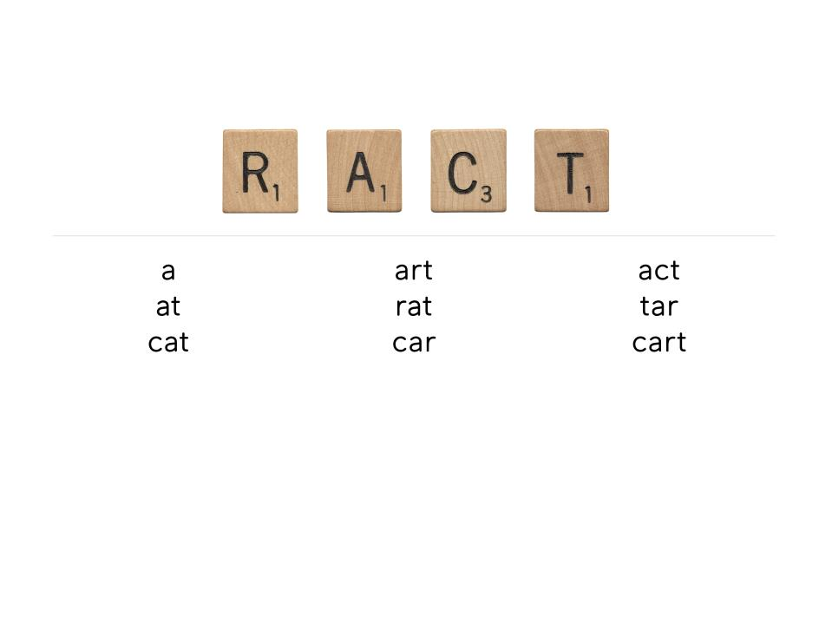
With 4 letters,
You can make 9 words, of up to 4 letters

Slide 27
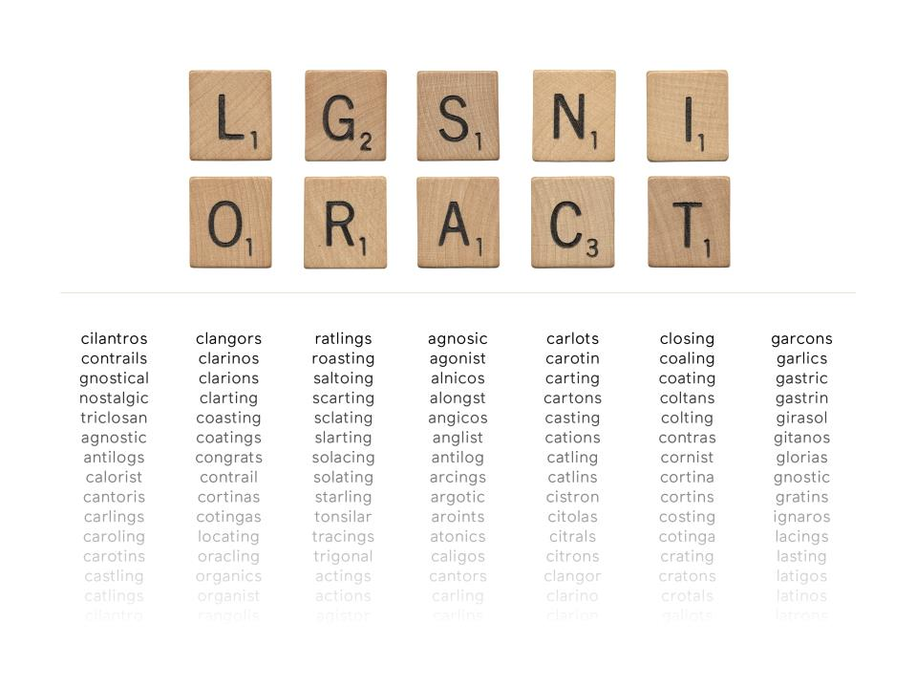
With 10 letters,
You can make 595 words, of up to 10 letters

Slide 28


What explains these differences in productivity?

Slide 29
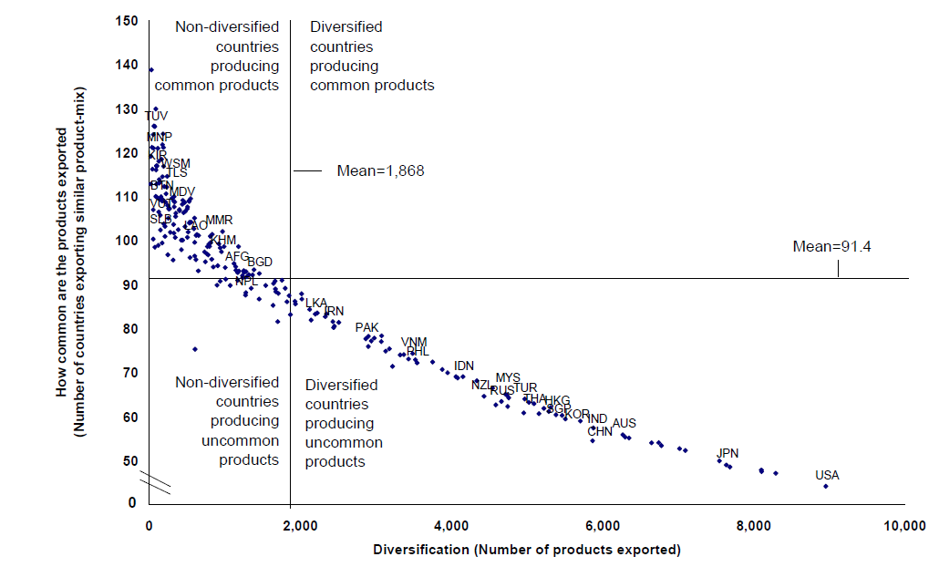
Diversification vs. Ubiquity (2009)

Slide 30
Diversification vs. Ubiquity (2009)

Slide 31
The Product Space

Slide 32
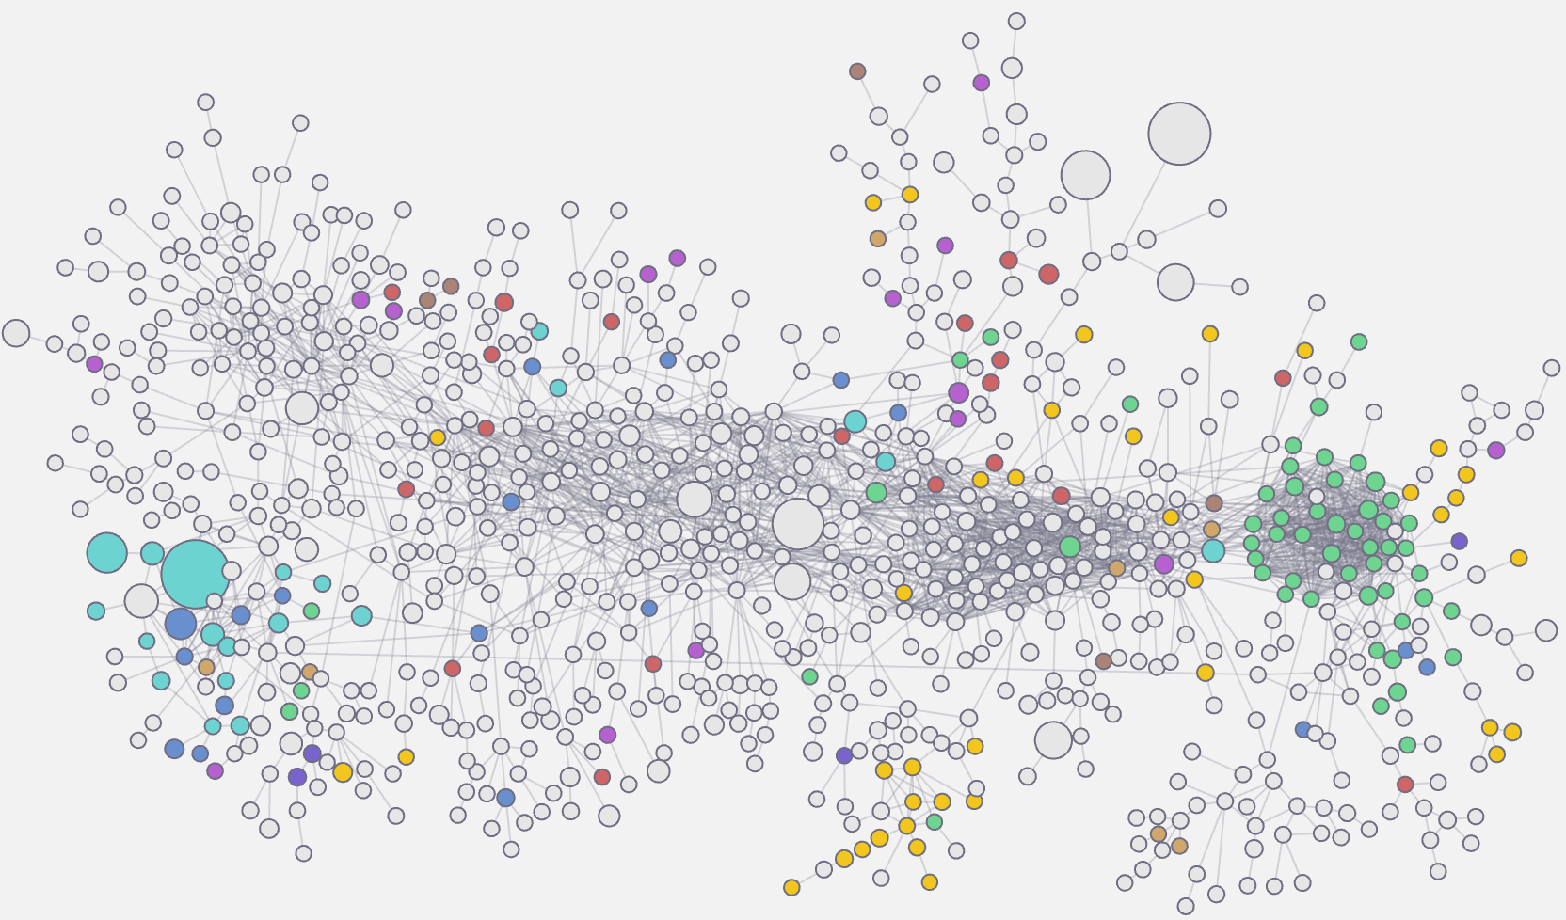
Vietnam
2021

Slide 33
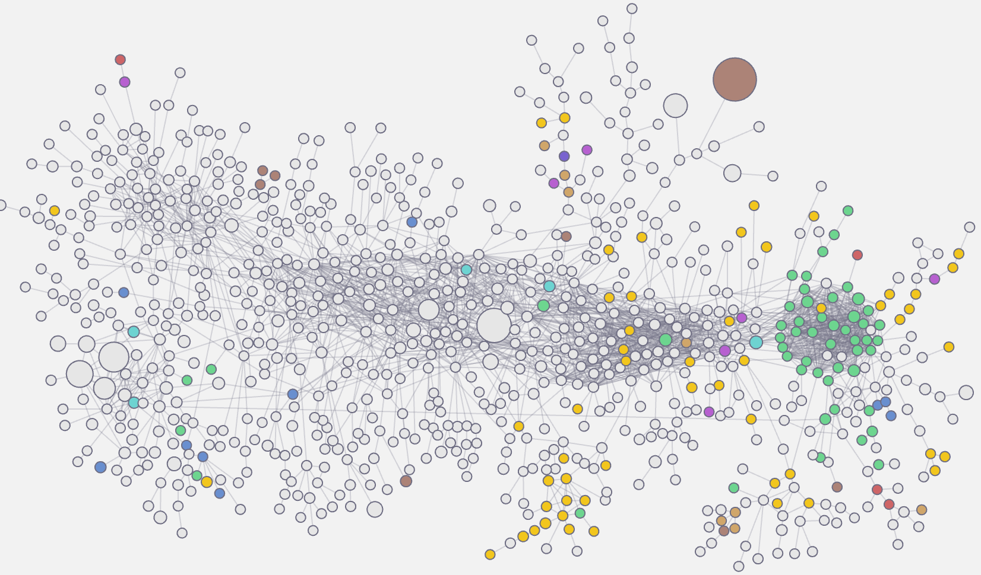
Vietnam
2000

Slide 34
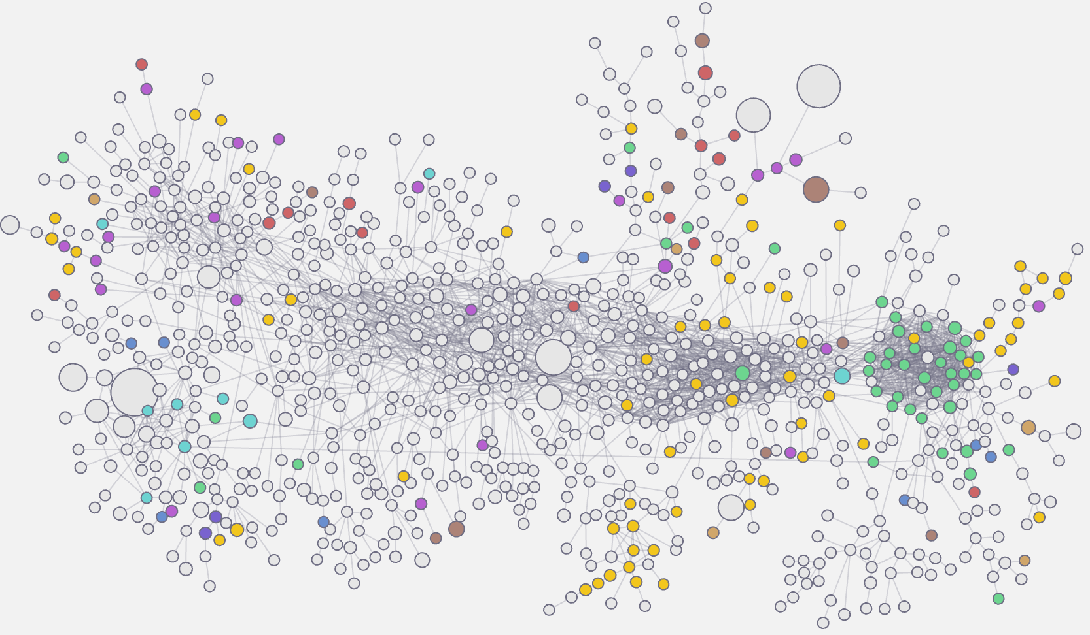
Indonesia
2021
Notes:
SITC

Slide 35
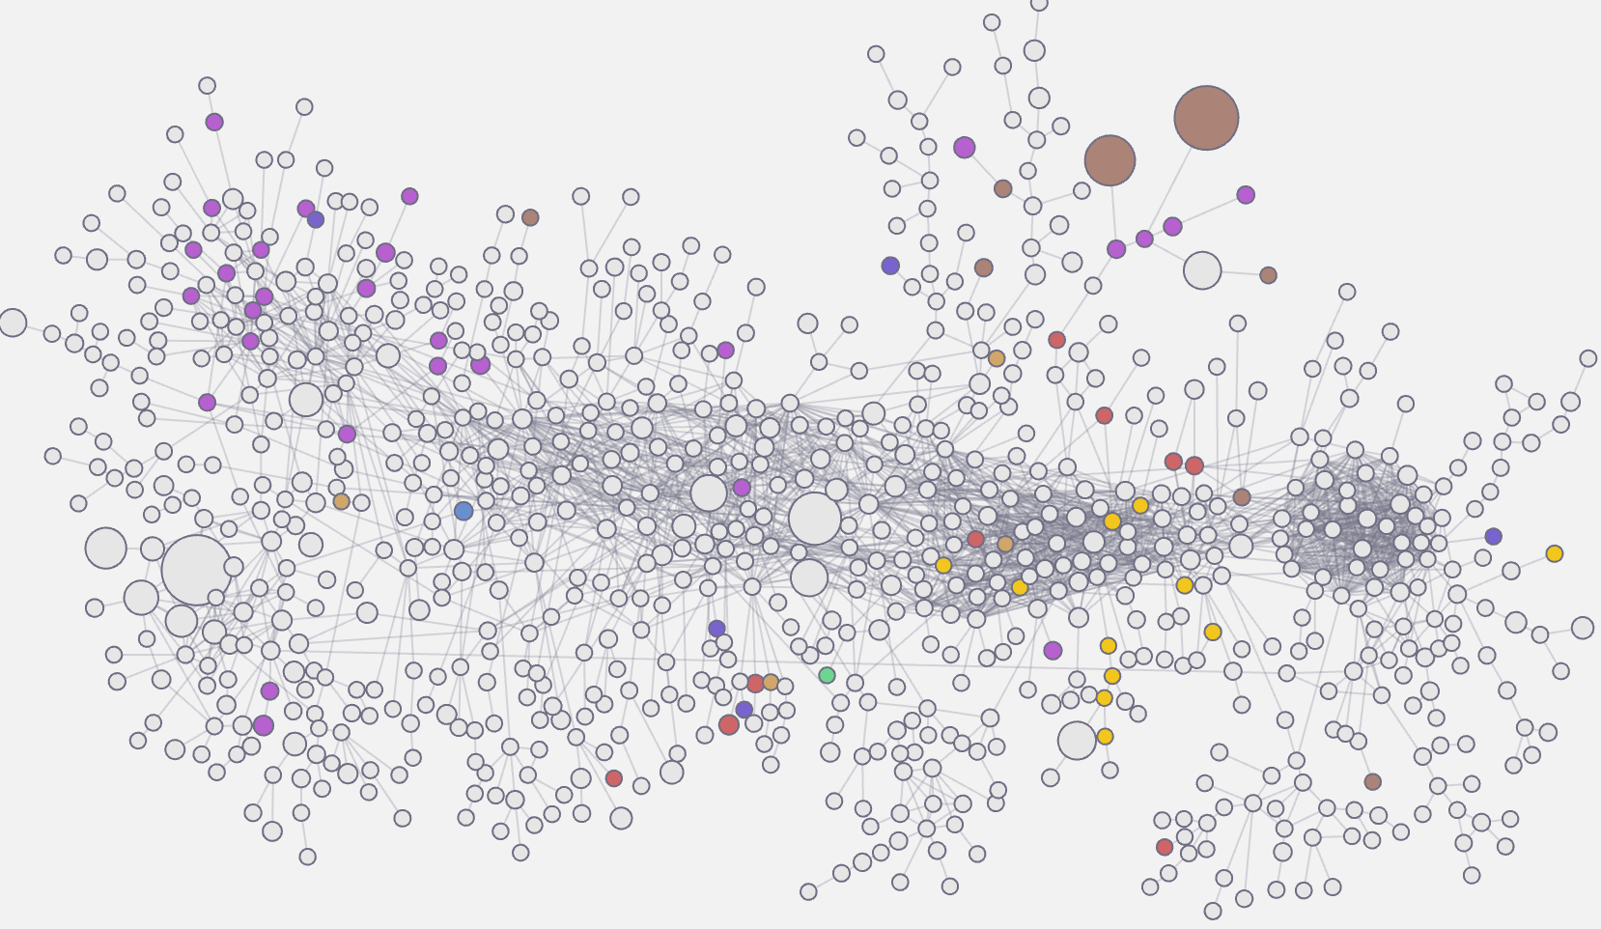
Saudi Arabia
2021
Notes:
SITC

Slide 36
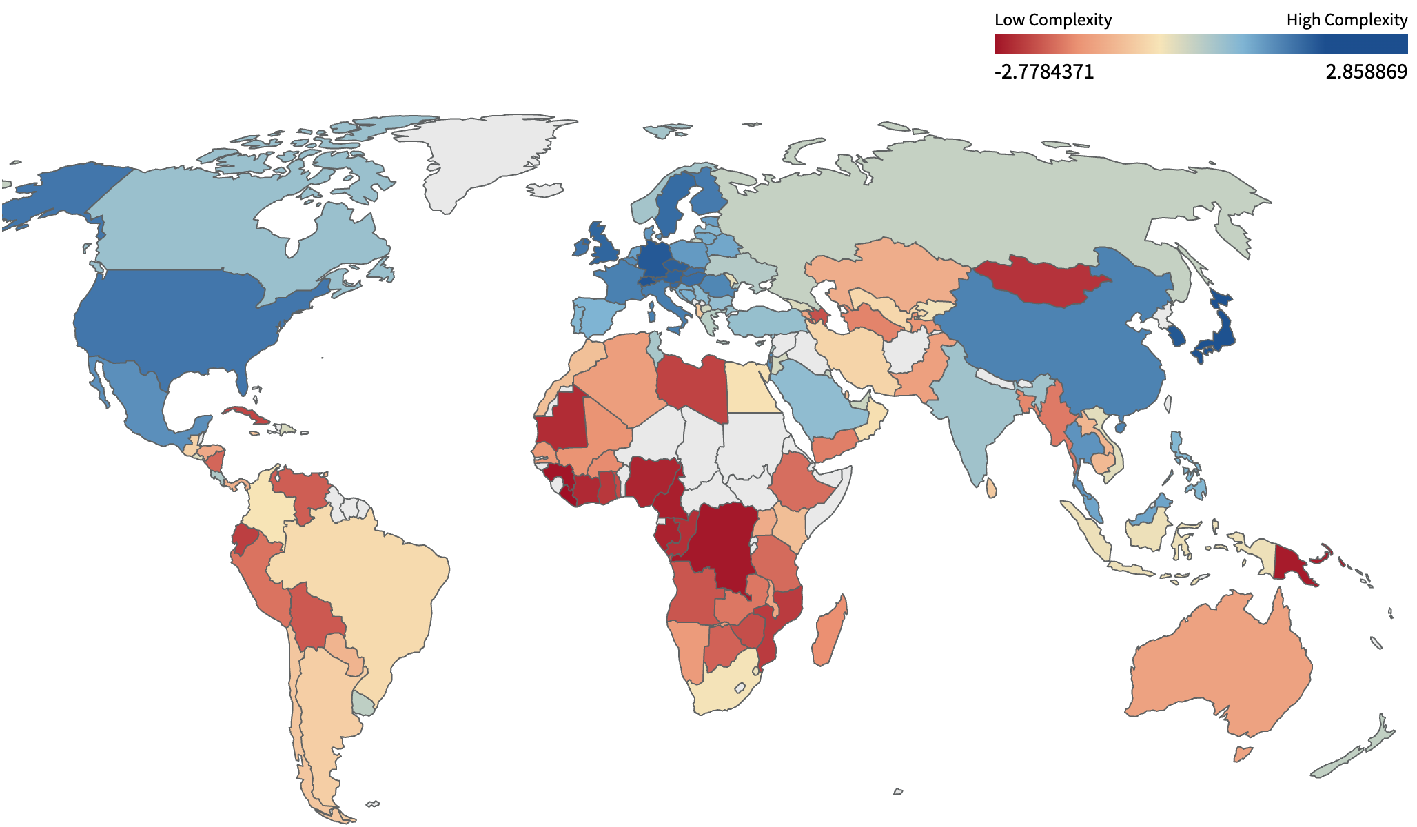
Economic Complexity Index (ECI)

Slide 37
Economic Complexity correlates to GDP per capita

Slide 38
Economic complexity relative to GDP predicts future growth
GRC

Slide 39
More letters
Easy to add more
How close are you to other good products?
Many letters
Hard to add more
by just copying others
Few letters
Hard to add more
How many letters do you have?

Slide 40
The strategic setting
Stairway to heaven
Parsimonious industrial policy
Help jump short distances to other products
Let it be
It ain’t broke
Ample space to move
in all directions
High
Ease to jump to new products: complexity outlook index
Hey Jude: make it better
Competitiveness policy
Improve the conditions of the sectors that already exist
Bridge over troubled waters
Strategic bets
Little space to improve quality and few nearby trees
Low
Low
High
Current level of complexity

Slide 41
The Strategic Setting: intensive vs. extensive (2015)
Stairway to heaven
Parsimonious industrial policy
Help jump short distances to other products
Let it be
It ain’t broke
Ample space to move
in all directions
ETH
Bridge over troubled waters
Strategic bets
Little space to improve quality and few nearby trees
Hey Jude: make it better
Competitiveness policy
Improve the conditions of the sectors that already exist
Notes:
Check if it is updated – ALSO RH uses to understand if it is self discovery or coordination – 2014 chart

Slide 42
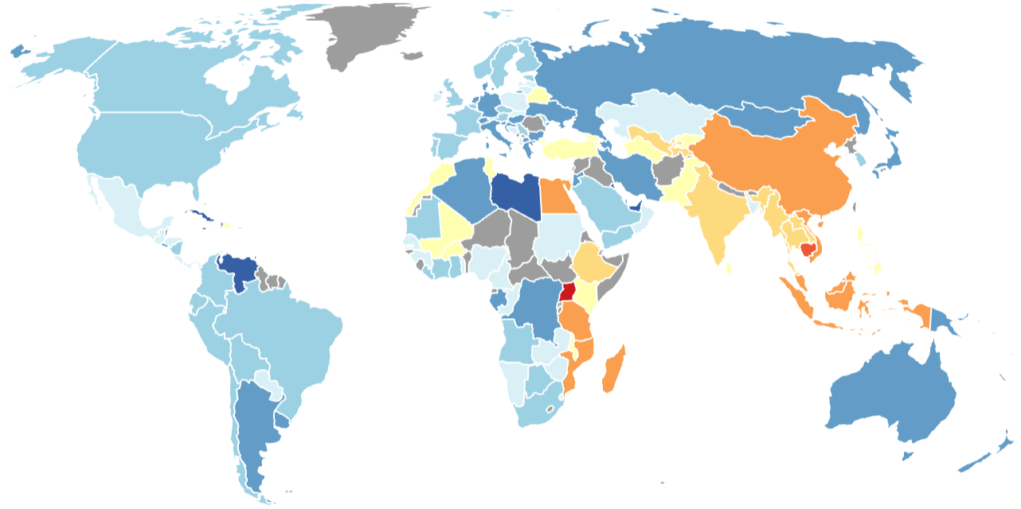
Economic Complexity Growth Projections
Projected Annual Growth to 2031
Source: Atlas of Economic Complexity

Slide 43


Slide 44
How are new letters accumulated?

Slide 45


Slide 46
The Product Space

Slide 47
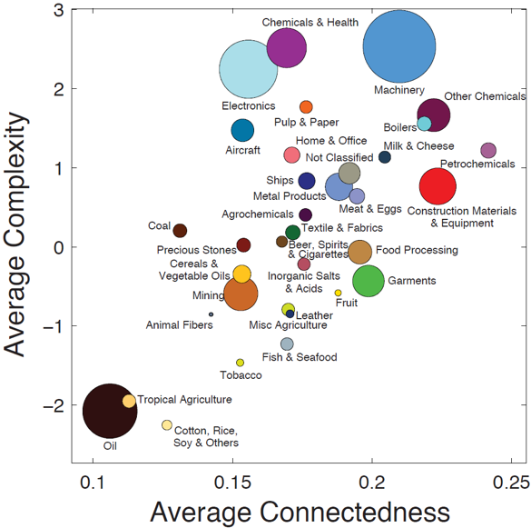
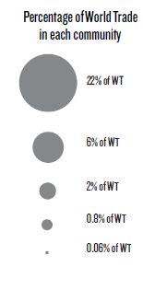
Product Complexity & Connectedness

Slide 48
Useful measures
Distance: How far is a certain industry from your current revealed capabilities?
  A measure of risk or how difficult it will be to develop it
Complexity: How complex is the industry?
  A measure of how profitable, or how high are the wages it would be able to pay
Opportunity Gain: How strategic is that industry?
  How connected is the industry? How would conquering it make future diversification easier?
The efficient frontier
  How to balance these criteria?

Slide 49
Summing up
Economic development results from the adoption of technology
Technology is tools, codes, and knowhow
Of these, knowhow is the hardest to move
  It exists in teams of brains
Knowhow plays a rather crucial role in production and technology adoption
Societies accumulate knowhow by putting different bits in different heads
  Societies know more when individuals know different
Implementing technology faces chicken and egg problems
…which cause change to be parsimonious
  From BEAR to ZEBRA
New knowhow enters through a process of infection
  (International) labor mobility plays a key role
Ethiopia as a whole is not well positioned in the product space
  But has made important investments to enter new product segments
Knowhow’s forms of accumulation and diffusion have outsized impacts on outcomes
Policies have been developed without recognizing these relationships

