Slide 1



Slide 2

Ohio’s Children’s Services Transformation Efforts

Slide 3
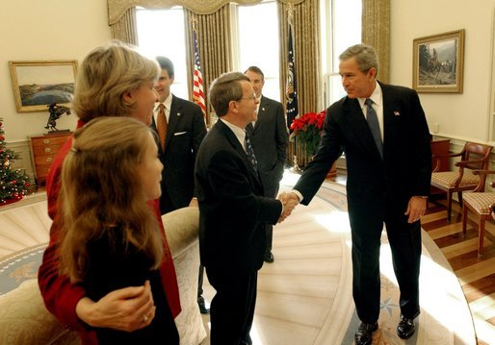
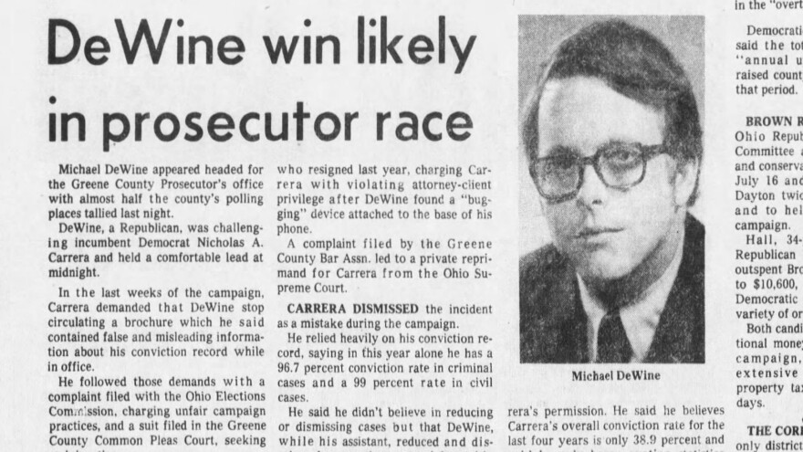

Slide 4
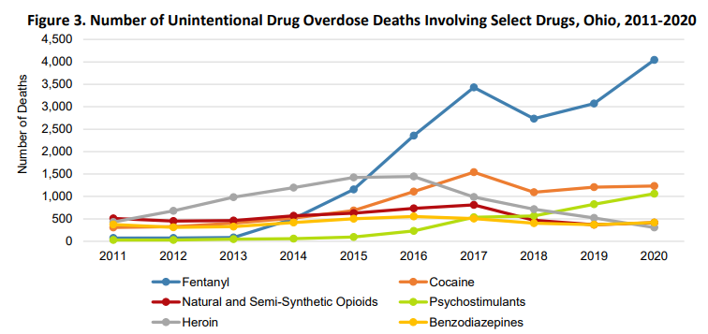

Slide 5
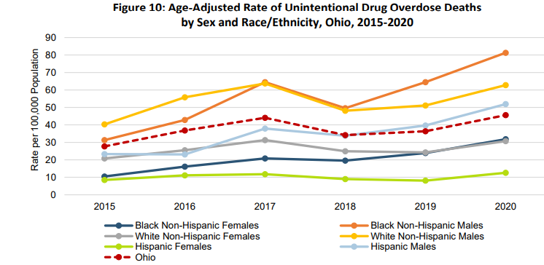

Slide 6
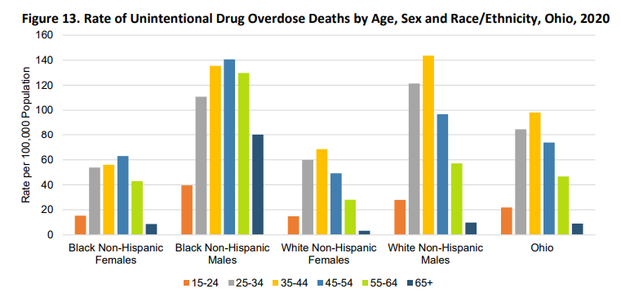

Slide 7
Children in Care

Slide 8
Removals due to Substance Use

Slide 10
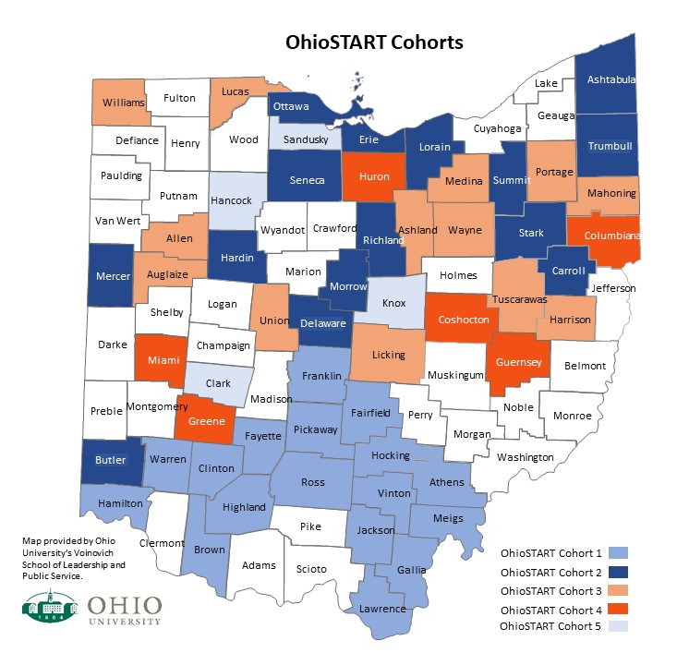

Notes:
Began in 2017 with 17 pilot counties. Has now grown to 54 counties.
Served nearly 4000 Ohioans, including more than 2000 children.

Slide 11
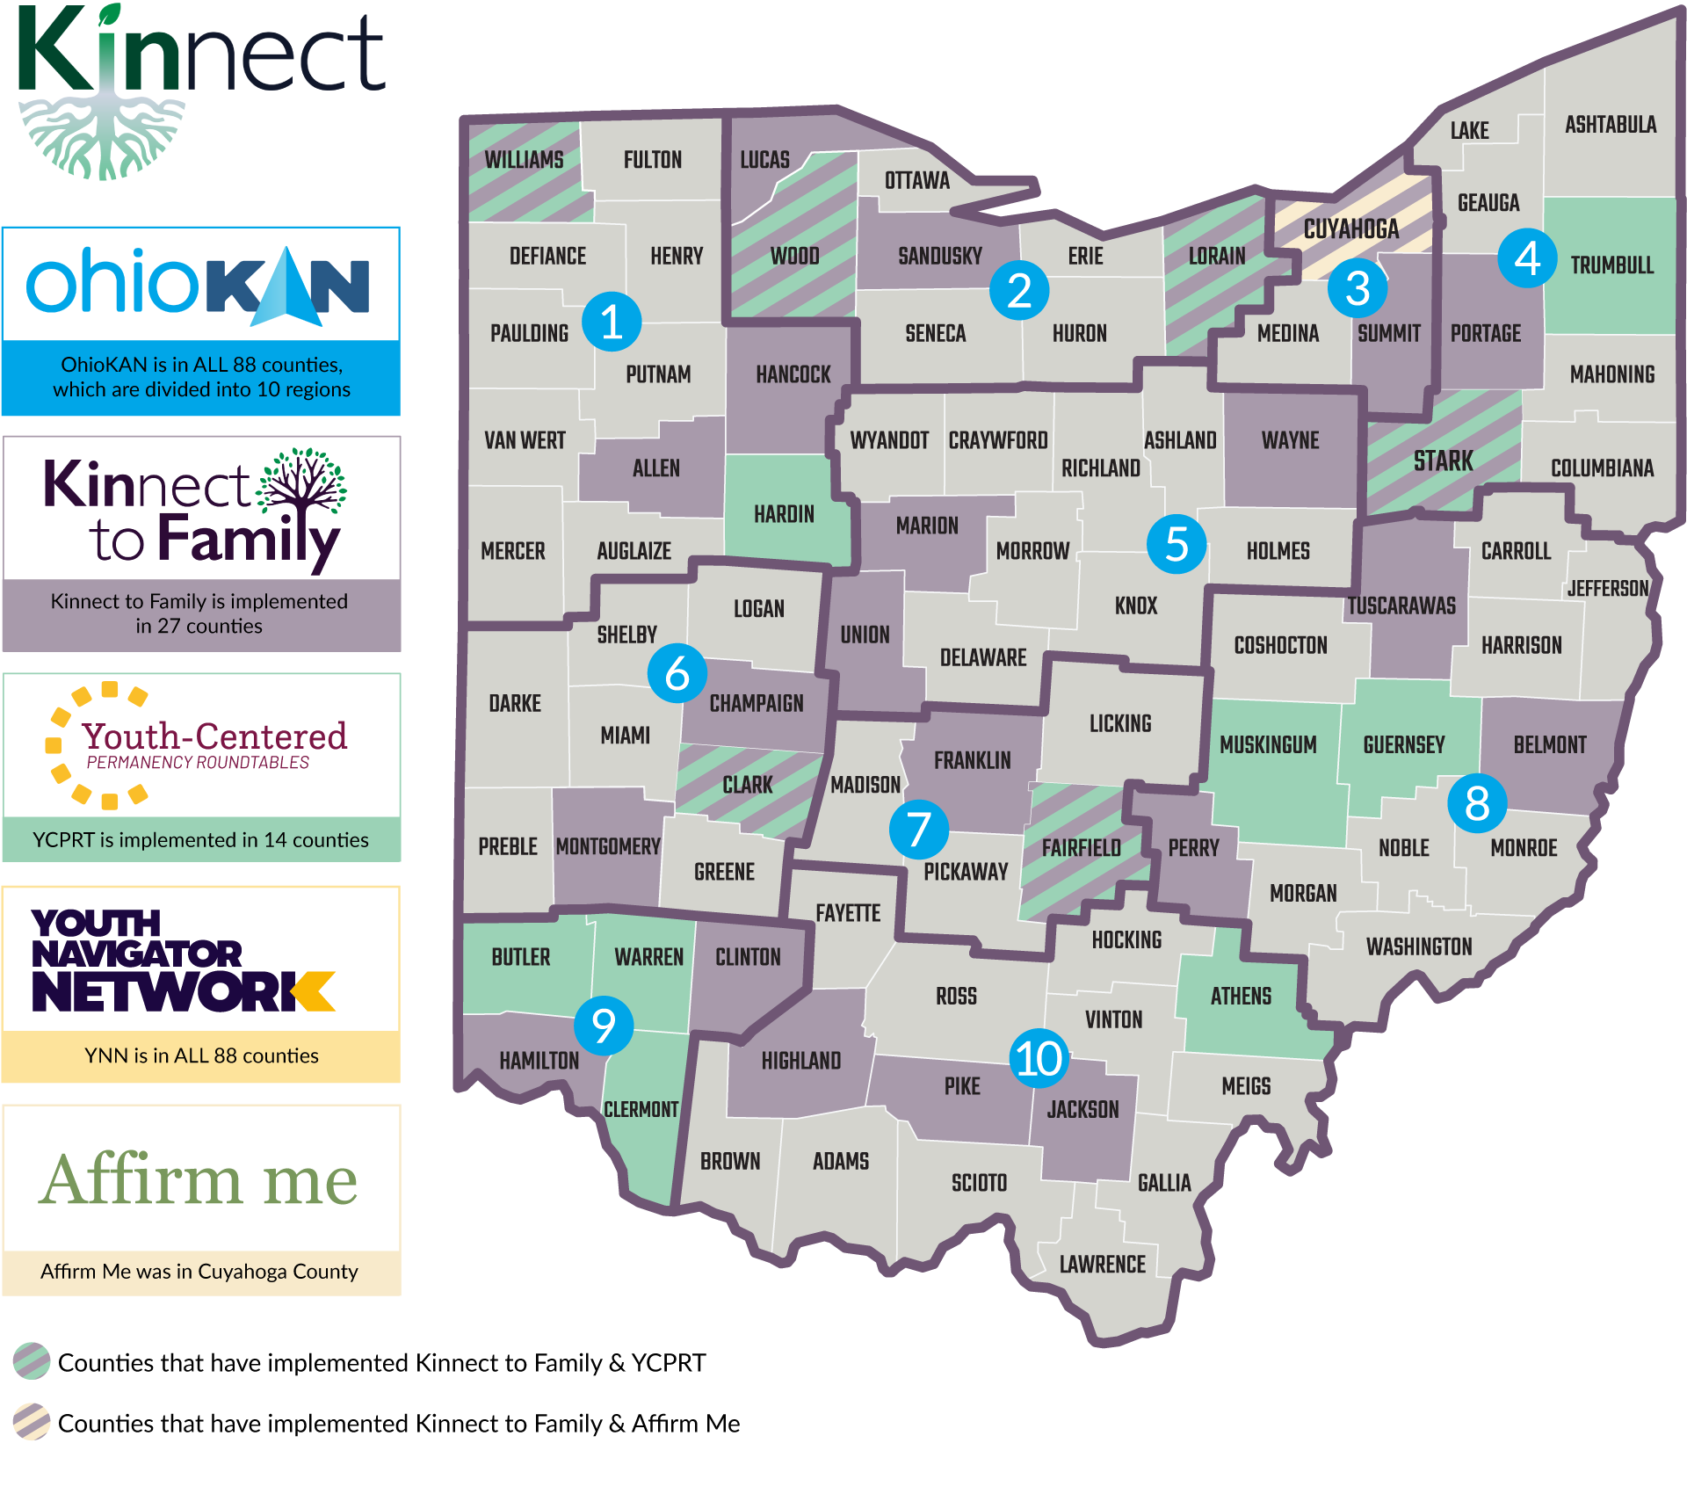
Notes:
Kinnect to Family was started in 2017 as well to help rapidly locate kinship caregivers for children entering the foster care system, building genograms and systems of support for children and their caregivers.
Currently in 27 counties, serving nearly 2,000 children and a 62% placement rate with kin.

Slide 12
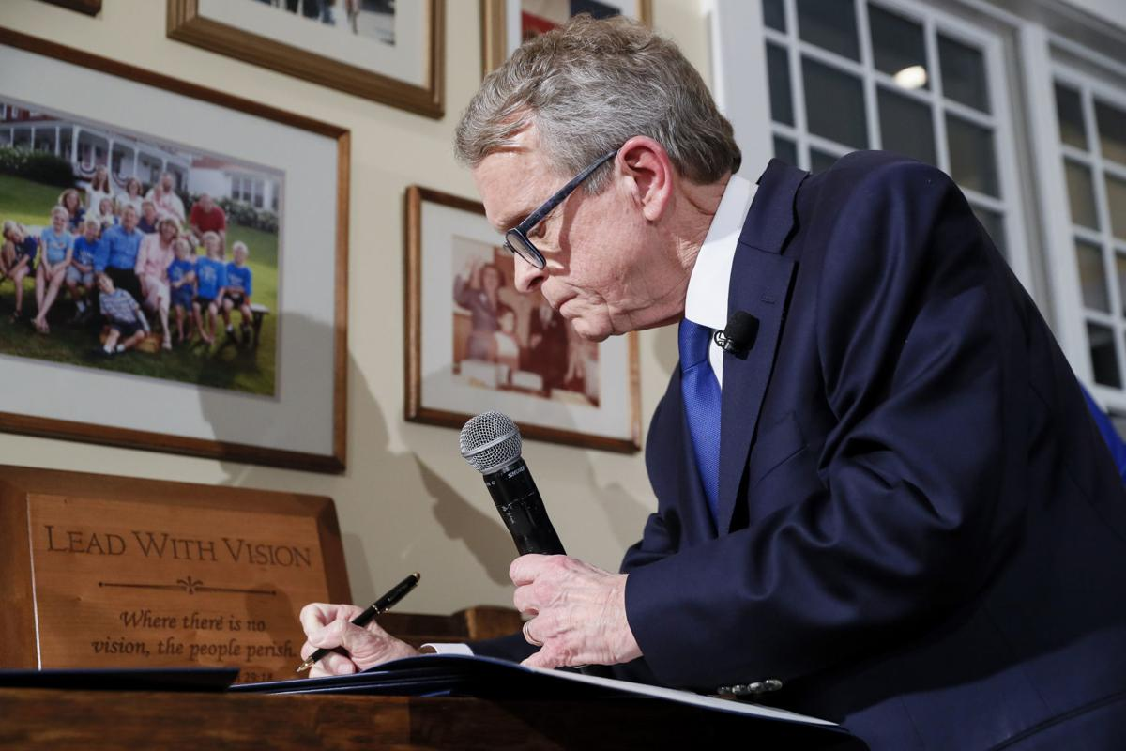

Slide 13
Children’s Initiatives Priorities
Increase access to evidence-based home visiting services.
Ensure high-quality childcare settings for all children and expand access.
Provide prevention education programming in every classroom, every year.
Ensure all children have access to a mental health professional in their school.
Reform the foster care system.

Slide 14
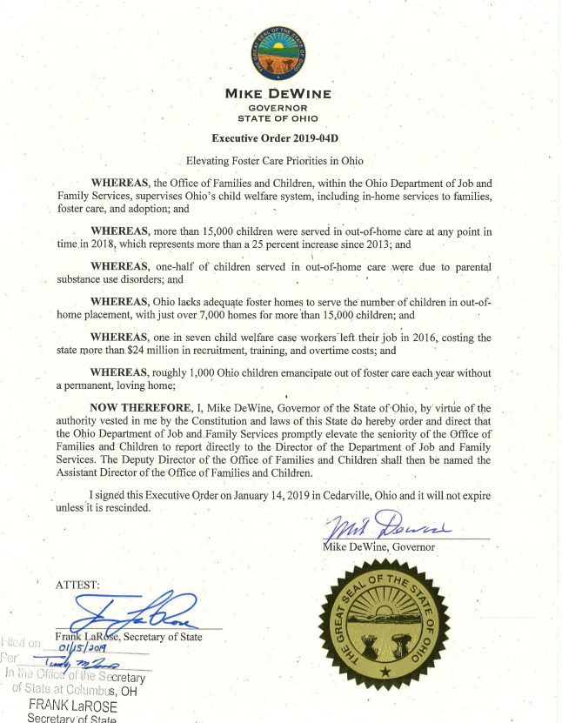
Restructured the Office of Families and Children
Doubled State Child Protection Allocation
Standardized caseworker recruitment and onboarding
Simplified foster caregiver training
Established a Rapid Response Team
Started a state-wide foster caregiver recruitment campaign
Established quality metrics for county PCSAs focused on key priorities, including timely investigations
Expanded prevention and treatment services
Created a Multi-System Youth Fund
Established a statewide ombudsman office

Slide 15
Children in Care

Slide 16
Children’s Services Transformation

Slide 17
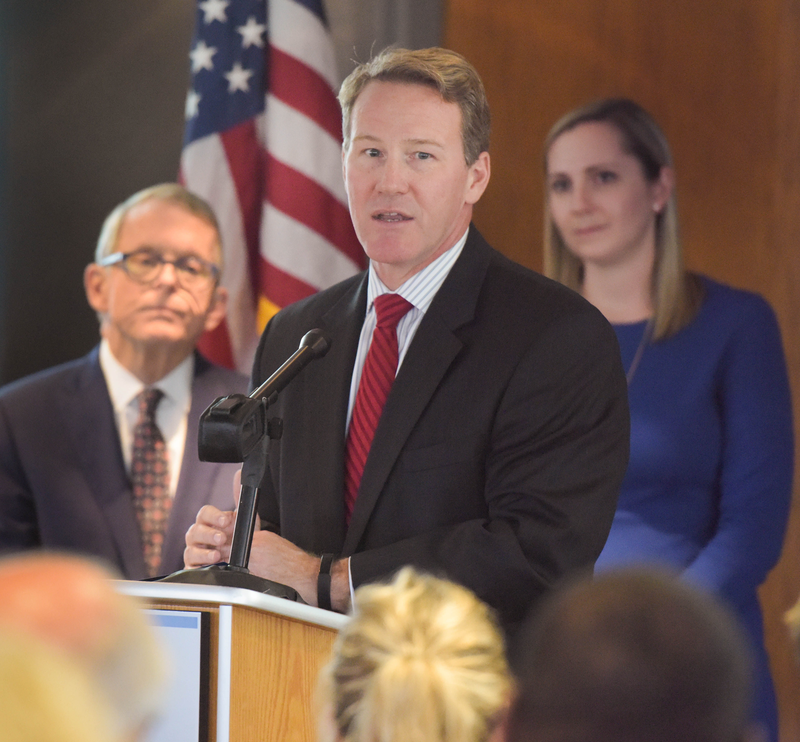
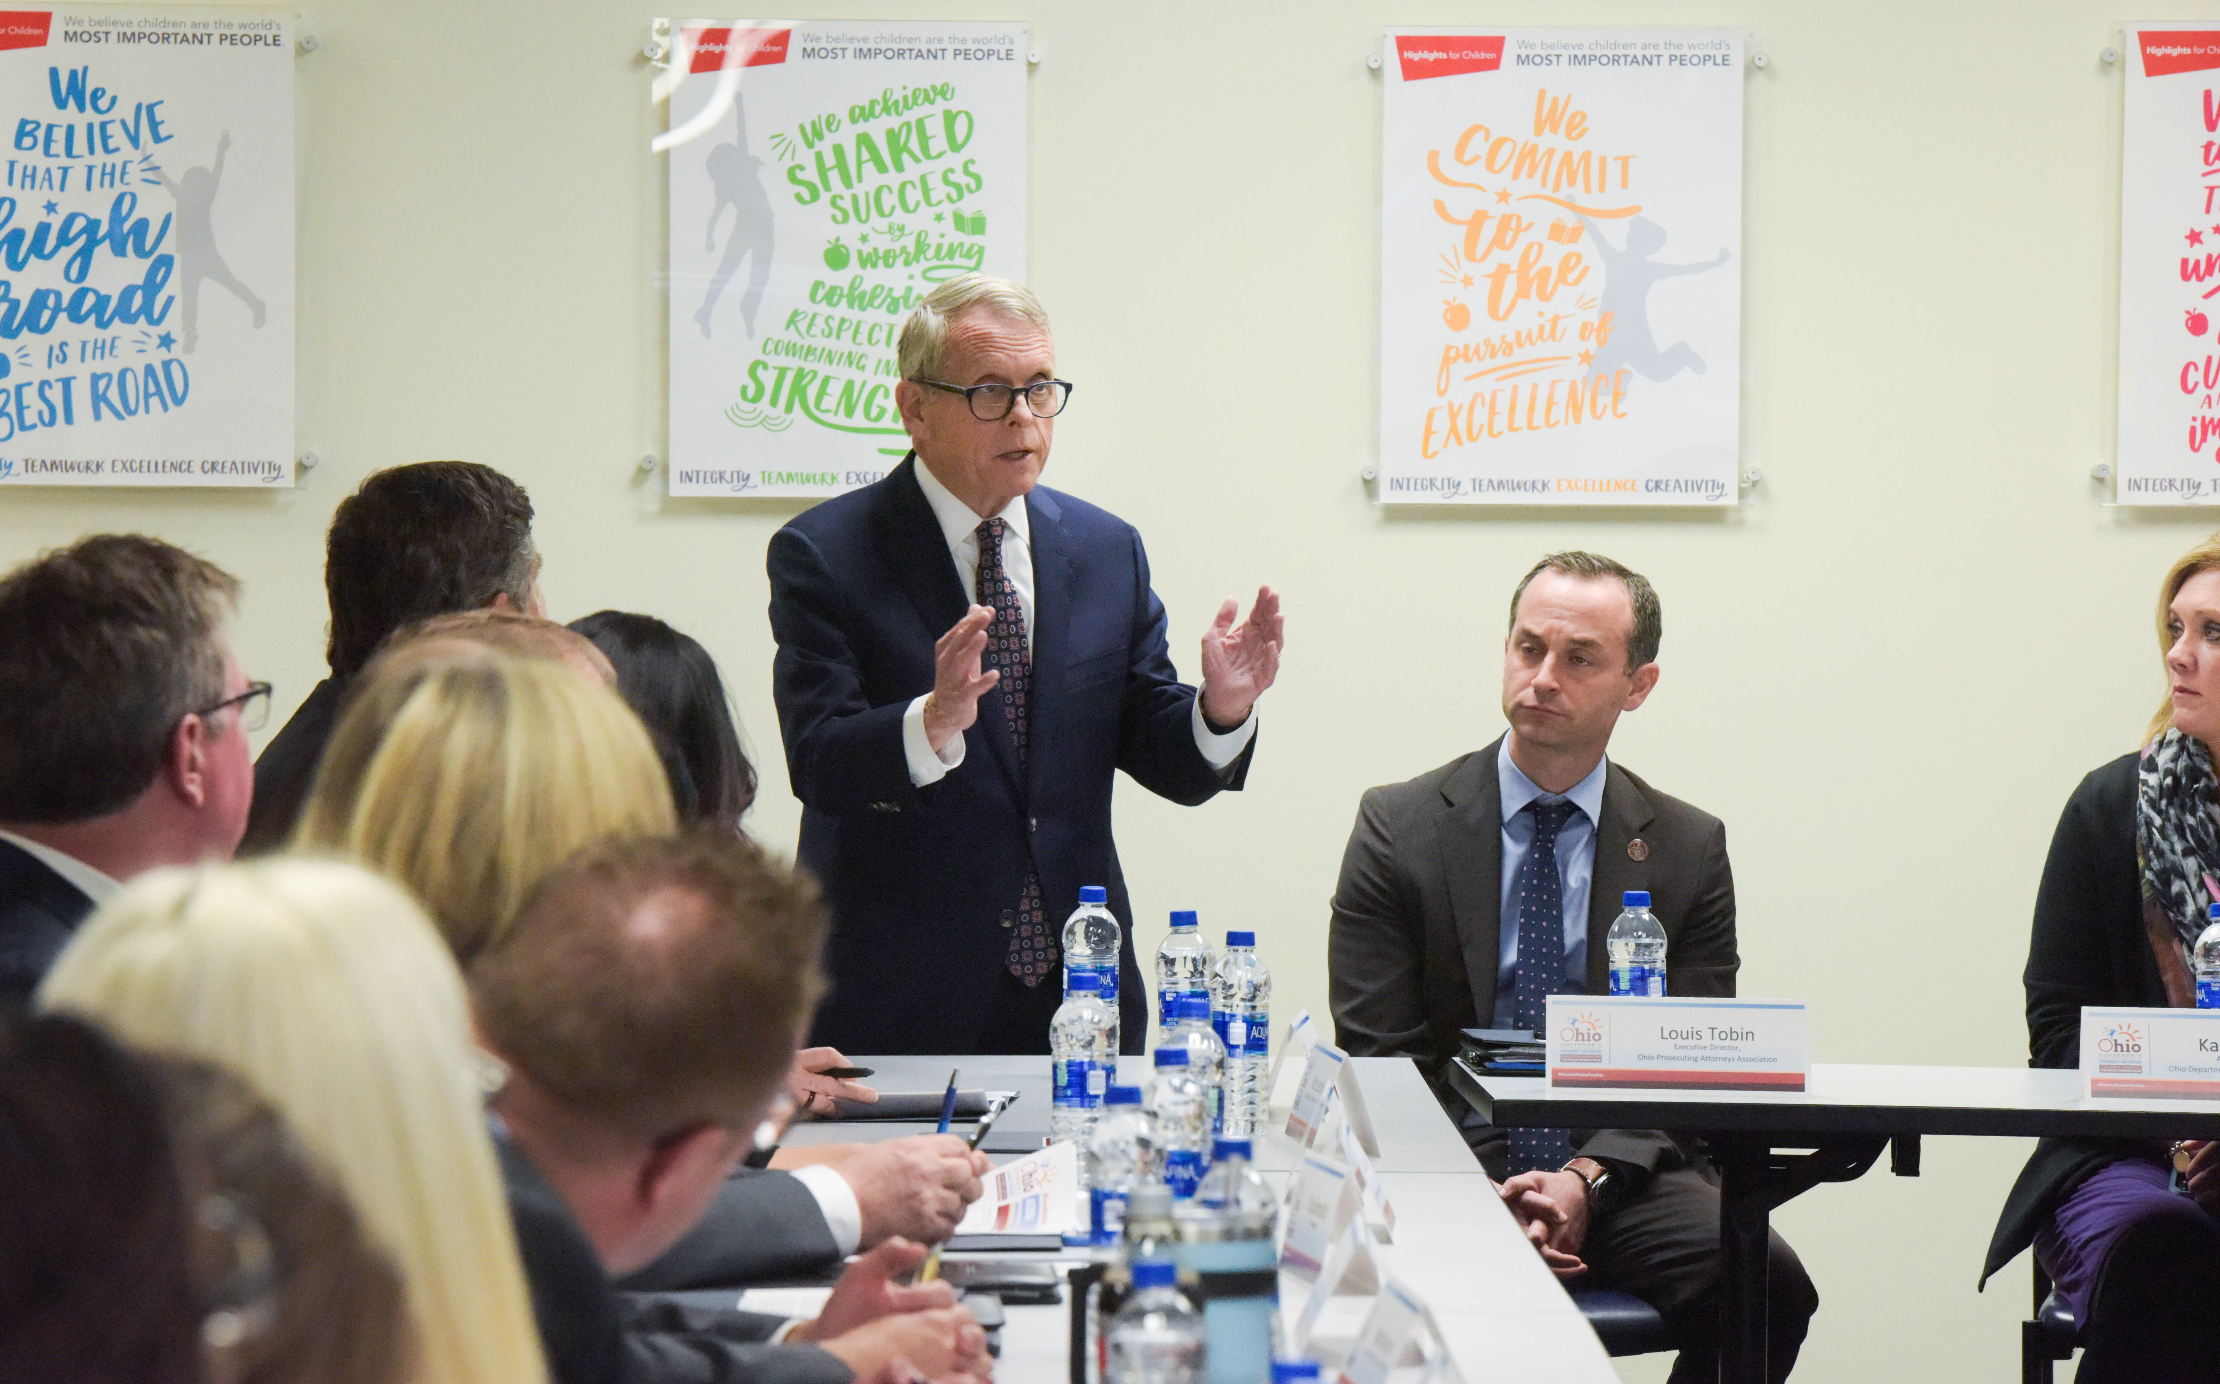

Slide 18
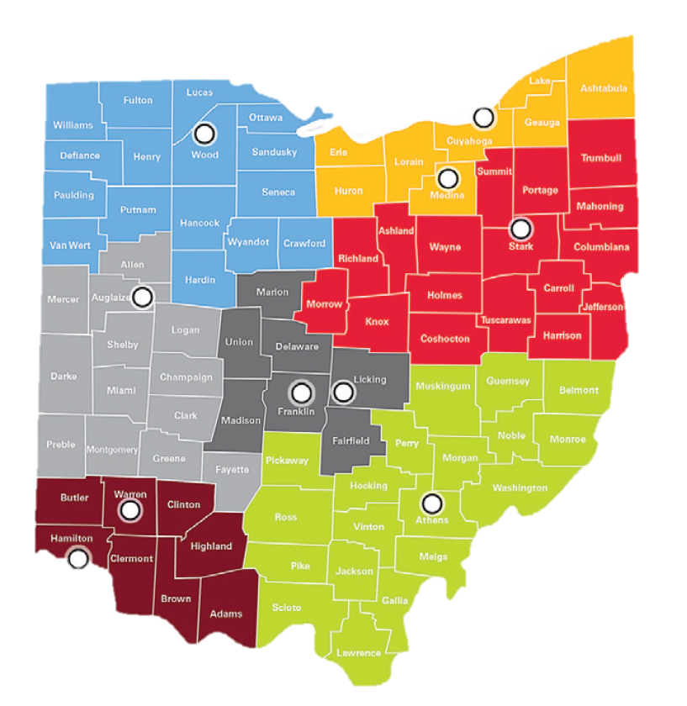
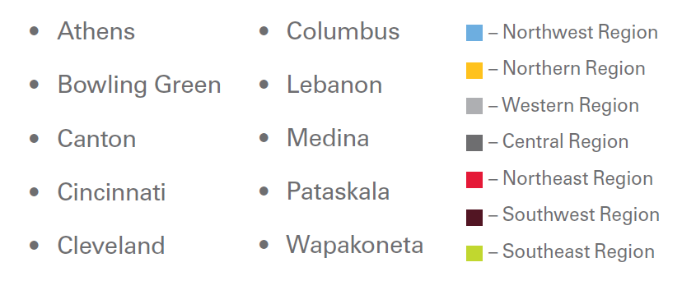

Slide 19
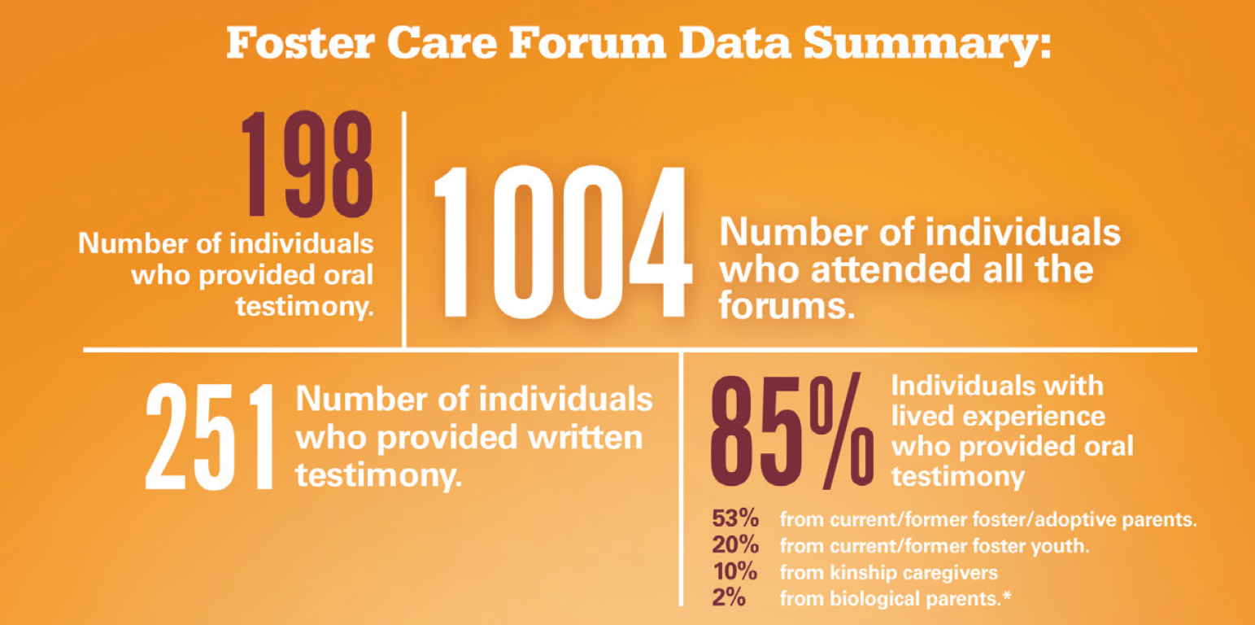

Slide 20

37 recommendations across seven domains, including:
Prevention
Workforce
Practice
Kinship
Foster care
Adoption
The Justice System
All 37 recommendations are fully implemented or in progress
Notes:
Home Visiting
Doubled funding
Increased eligibility – HMG & EI
Child Care
Increased quality of child care – achieved 2020 Step Up To Quality Goal
Increased eligibility
Supported child care providers through the pandemic
Prevention Education & Mental Health Supports
MTSS
$18 million in prevention funding
$2 million in teacher training
$1.2 billion in Student Wellness and Success funding
OhioRISE
Child and Adolescent Behavioral Health COE
Child Welfare Reform
2019 Workgroup
37 recommendations
36 currently implemented or underway
Resource Family & Foster Youth Bill of Rights
Ombudsman
WWK Expansion

Slide 21



KINSHIP
KINSHIP ACCOMPLISHMENTS
FUTURE PRIORITIES
Signed Kinship Caregiver Supports executive order, providing targeted trainings, needed resources, and meaningful supports
Continue training counties and promoting the Kinship Guardianship Assistance Program (KGAP) via community engagement and fairs
14k
Children have received Kinship Caregiver Support benefits
$13.3M
In total benefits
Launched the Kinship Guardianship Assistance Program as the preferred permanency option for children when reunification or adoption is not an option, delivering monthly support to caregivers
Continued expansion of the Ohio Kinship and Adoption Navigator Program (OhioKAN)
40
Children from 9 counties receiving KGAP payments
Increased awareness of the Kinship and Adoption Navigator program, a resource that helps children, caregivers, and families connect to programs and services that meet their unique needs.
4.5k
Unique families served since September 2020
Mandate intensive, ongoing efforts to identify and engage kin and strengthen court oversight
Simplified the licensing process and training requirements for kinship caregivers to become licensed in Foster Care.
Notes:
Efforts to increase placement and engagement with kin includes supporting our kin caregivers starting on the first day of placement, throughout the child’s time in care and then after the kinship caregiver has committed to being a permanent caregiver by accepting legal custody.
Thanks to the Kinship Support Program kinship caregivers in Ohio are able to receive financial support beginning the day the child enters their home
The Kinship Permanency Incentive Program (KPIP) provides eligible kinship caregivers who take legal custody of kin children with an incentive payment once every six months. The first incentive payment is $525 per child, and each subsequent payment is $300 per child. The caregiver may receive up to eight incentive payments. During SFY 2023, to date a total of $5,482,500 has been paid to kinship caregivers.
4 of the 5 CST recommendations in the kinship care action area have been implemented and the 5th has been partially implemented and expected to be fully implemented this Summer.
As a direct result of the recommendations many improvements related to our kinship caregivers have been accomplished to ensure they are located, engaged, treated as resources and provided a variety of supports including:
Kin caregivers along with foster parents are now seen as resources to not just the youth they are caring for, but to the birth parents and the agency.
Family search and engagement efforts have been prioritized this includes
Mandating intensive, ongoing efforts by custodial agencies to identify and engage kin
Strengthening court oversight to ensure agencies are conducting efforts
Providing agencies with tools such as the Connect our Kids Family Connection Tool and advanced search engines such as Accurint
Ensuring agencies have access family search and engagement training via online and in person trainings
Establishing a path for foster parents to become kin
We have great enhanced supports provided to our kin caregivers
Thanks to the Kinship Support Program kinship caregivers in Ohio are able to receive financial support beginning the day the child enters their home.
All kin caregivers in Ohio regardless of children services involvement can now access trainings both in person and virtually through the OhioKAN program on a variety of topics.
For kin who have placement of a child in children services custody we are working with our agencies to simplify the foster care licensing process by waiving non-safety items.
This includes allowing waivers for pre-licensure training and most of the paperwork requirements
As a result of the waivers, the process to get licensed as a foster parent for kin only requires a few additional steps which reduces the burden for both the caregiver and the agency licensing the home
Once licensed, the kin caregiver receives a foster per diem equal to any other foster home for the child
Kin who are foster parents to a child and who become a permanent home for the child are also eligible for either our federal or state Kinship Guardianship Assistance Program or KGAP for short.
KGAP provides a monthly subsidy to kinship caregivers who had a kin child, who is in the custody of an Ohio public children services agency, placed in their home as a foster care placement for at least six (6) months.
It supports the permanency option of legal custody that most kinship caregivers prefer to adoption.
Payments are equal to 80% of foster care per diem received for the child in foster care and are paid on a monthly basis.
Thanks to the Kinship Support Program kinship caregivers in Ohio are able to receive financial support beginning the day the child enters their home.
Though kinship caregivers have always been able to have non-safety items waived as a part of being licensed as a foster parent, our office has provided recent guidance documents and trainings to help our agencies understand this better.
As a result of the waivers, the process to get licensed as a foster parent for kin only requires a few additional steps which reduces the burden for both the caregiver and the agency licensing the home.
Ohio law actually requires agencies pay licensed kin caregiver foster homes an equal per diem to other foster parents based on the needs of the child.
The OhioKAN program has been implemented through our vendor, Kinnect. Kinnect subcontracts with local agencies across the state, at least one in each of the 10 regions, to house the navigators. This allows OhioKAN to be a statewide program with a local presence. OhioKAN services are offered on a continuum, based on family need. All families have access to the website and can sign up to receive the monthly newsletter, “Currents.” If a family needs a navigator, they can call in or email through the website. They will be guided to a navigator in their region to complete a brief needs assessment and then they are provided referrals to agencies near them that can meet those needs. If families need additional support, OhioKAN can create a Support Plan with the family to identify exactly how the navigator will work with the family to meet their needs. Navigators may provide warm handoffs, provide a referral directly to a provider, work with the Benefits Coordinator if there are barriers to accessing benefits, and have access to funds to cover needs that cannot be met in the community. OhioKAN funds have been use to help families who were at risk of having utilities shut off, who have expensive car repairs, or need computers for their children.
OhioKAN is being evaluated for inclusion on the Title IV-E Clearinghouse. Receiving a rating on the Clearinghouse would allow us to receive Federal Reimbursement for kinship navigation services. OhioKAN is using Kaye Implementation and Evaluation (KI&E) to conduct the Effectiveness Evaluation. Between Feb. 2022 – Feb. 2023, KI&E enrolled families into the Evaluation. They are currently analyzing all the enrolled families to determine if we have met the criteria for a Randomized Control Study, this should be completed by May 2023. The evaluators are collecting data from the enrolled families at 3-, 6- and 12-month intervals. If OhioKAN shows a positive impact on at least one outcome at any of those intervals, we can move forward to receive a rating of Promising on the Clearinghouse. The outcomes are: access to services, satisfaction with OhioKAN, child safety, child permanency or caregiver well-being. The earliest we would know about outcomes is August of 2023, after the 3 month data analysis has been completed. The latest that we would know if there was a positive outcome would be Summer of 2024, after analysis of the 12 month data collection. Based on families stories, OhioKAN is helping them get connected to services and families have been very satisfied with program.

Slide 22
FOSTER CARE
FOSTER CARE ACCOMPLISHMENTS
FUTURE PRIORITIES
Launched Tiered Foster Care Pilot, building out and testing rates, policies, placement process and actively moving children
Development of Ohio Certification for Agencies and Families (OCAF) to simplify the process of becoming a foster or adoptive parent at all steps in the process.
880+
homes assessed for tier level to shed light on capacity
Developed the Adoption and Resource Home Assessor Program to streamline the kinship assessment and home study process
500+
requests submitted to date
~50%
reduction in processing time
Strengthening county recruitment capabilities through expansion of the It Takes Heart recruiting and retention campaign
Established the Youth Navigator Network to further support youth
Set up regional children services hubs and partnered with OhioRISE to strengthen community partnerships and capacity to serve children
250
events held to date
Created a Bill of Rights for both Foster Youth and Resource Families
Continue work of the Tiered Foster Care (TFC) Pilot to determine new rates, policies, and updates to the placement process
New flexibility for foster parent training and training hours required
30%
Reduction in required training hours
Notes:
6 of the 8 CST recommendations in the foster care action area have been implemented and the 2 remaining have been partially implemented.
Ohio's Approach to Strengthening Relationships Between Primary and Resource Families promotes a collaborative co-parenting relationship between all the adults important in the child's life, reducing trauma for the youth and primary family and fostering efforts for reunification
Though kinship caregivers have always been able to have non-safety items waived as a part of being licensed as a foster parent, our office has provided recent guidance documents and trainings to help our agencies understand this better.
As a result of the waivers, the process to get licensed as a foster parent for kin only requires a few additional steps which reduces the burden for both the caregiver and the agency licensing the home.
Ohio law actually requires agencies pay licensed kin caregiver foster homes an equal per diem to other foster parents based on the needs of the child.
Substitute House Bill 8 signed by Governor DeWine on XX, created flexibility in the manner in which foster parent trainings are offered and immediately reduced the number of training hours required for foster caregivers and applicants.
House Bill 8 reduced the number of preplacement training hours from 36 to 24 for both family and specialized foster homes. Continuing training requirements were reduced from 45 to 30 hours for family foster homes and from 60 to 45 hours for specialized foster homes. The Ohio Child Welfare Training Program adjusted the caregiver preservice curriculum to reflect the new 24 hours. Preservice topics include system and agency, trauma, connections and permanency, nurturing and protective environment, and health.
Ohio Certification for Agencies and Families (OCAF) was developed with the goal to make Ohio one of the easiest places to become a foster or adoptive parent and, in turn, increase the available foster and/or adoptive homes in the state.
Up until the implementation of OCAF Phase 1 in November 2022, most of Ohio’s prospective families wanting to apply for foster care licensure or adoption approval only had the option of filling in a seven-page application form manually, which was a cumbersome process for both the applicants and the agencies involved.
OCAF Phase 2 is coming soon and will streamline and standardize both the inquiry and application process for prospective families with this user-friendly, online application. Phase 2 will also be integrated with the It Takes Heart website to improve data around inquiries and streamline the inquiry to application process.
As development continues in phases through the middle of 2024, OCAF will grow to include the inquiry, application and licensure activities for recommending agencies in Ohio, as well as all licensing activities for foster and adoptive homes, such as the homestudy and recertification processes.
OCAF is currently used by ten agencies. There have been 69 inquiries entered by these agencies and twelve prospective caregivers have started or submitted their JFS 01691 Application for Child Placement to their chosen agency through OCAF.

Slide 23
ADOPTION
ADOPTION ACCOMPLISHMENTS
FUTURE PRIORITIES
Expanded Wendy’s Wonderful Kids partnership to 83 recruiters serving 76 counties across Ohio
Further expand the Wendy’s Wonderful Kids partnership to 112 total recruiters, serving all 88 counties
1,500+
Resulting adoptions
Transitioned the Post Adoption Special Services Subsidy to the State level in 2022, standardizing the process for families
96%
Of applications approved
$4.9M
Total benefits
Continue strengthening and standardizing the Adoption Subsidy negotiation process across the State
Launched the Ohio Adoption Grant Program on April 7th
94%
Of applications approved
$2.3M
Total benefits
Establish a path for Foster Parents as Kin and strengthen equality in standing between Foster and Kin
Developed Statewide Adoption and Foster Care Assessor registry
1.2k
Assessors statewide
~50%
Available for contracting
23
Notes:
PASSS has been administered by local PCSAs since it's creation in 1997. While many counties have administered the PASSS program fairly and equitably over the years, it became evident that there were some inconsistencies in how it was being run from county to county.
In 2020, the Children Services Transformation advisory council came out with the final report of 37 recommendations for transformation of the children services system in Ohio. One of those recommendations was for the state to further look into bringing PASSS to the state level due to those inconsistencies.
To further support the work of the CST group and to ensure that PASSS is truly a statewide program available equally to all post adoptive families, the 2021 Budget Bill, or Amended House Bill 110, transitions the program to ODJFS beginning July 1 2022. The Ohio Revised Code requirement for that transition is located in 5101.1418 if anyone is interested in learning more about it.
Since July 2022, OhioKAN has received 887 applications.
The Office of Families and Children have approved 688.
Only 29 have been denied
The Office of Families and Children has approved $4,886,459.78
Total payments issued to date $1,750,417.83
Applicants may be eligible for $10,000, $15,000 if the parent was a foster caregiver to the child prior to adoption, or $20,000 if a qualified professional diagnosed the child as having one or more special needs (as defined by law) prior to the adoption finalization.
This program has been up and running for less than three weeks and all applications submitted have been reviewed promptly, as well as questions being answered which came through the mailbox: OFC-Ohioadoptiongrant@jfs.ohio.gov. Approved applications have been sent to Child Support Enforcement Agency manually for a review with no applications having funding held for arrearage accounts.
Next steps for the Ohio Adoption Grant program are for payments to be sent by check in the mail to the to the address of the payee identified on the submitted W-9 form and Phase 2 portal enhancements to be discussed.
Currently, the rules and forms are in Clearance as part of the normal rule process allowing stakeholders an ad­ditional opportunity to provide comments.
The data is as of 4/26/23
Initiated but not submitted – 261
Received – 23
Approved – 138
Denied – 10
Amount Approved - $2,075,000
Child Support Verified Payment Amount - $1,450,000

Slide 24
Progress – Children in Custody & Timely Investigations

Slide 25
Questions?

Slide 26
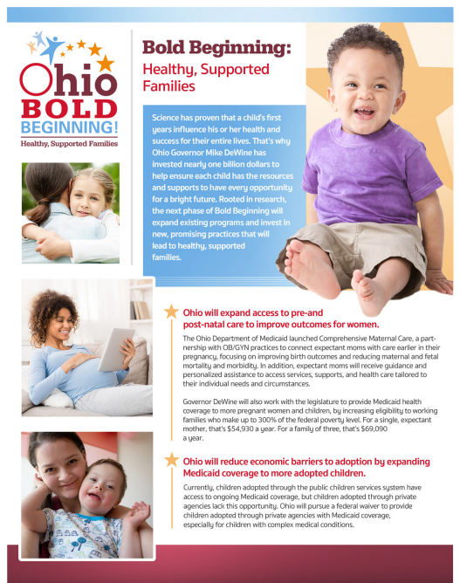




Ohio Bold Beginning: Healthy, Supported Families
In October 2022 Governor DeWine announced Ohio’s Bold Beginning Plan to ensure we had Healthy, Supported Families.
MISSION
“I have a vision for Ohio to be the best place in the nation to have a baby and raise a family. With Bold Beginning: Healthy, Supported Families, Ohio will provide even more options and supports that can be tailored to each family’s needs, while providing assistance to mothers most at-risk for poor outcomes, to help them as they begin or add to their family.”
-Ohio Governor Mike DeWine
PRIORITIES
Healthcare Access & Improving Care
Adoption & Children Services
Family Supports
Literacy – Science of Reading
Notes:
In October 2022 Governor DeWine announced Ohio’s Bold Beginning Plan to ensure we had Healthy, Supported Families
https://boldbeginning.ohio.gov/healthy-supported-families/family-stability

