Slide 1
Coverage of LGBTQ and Gender Affirming Care Legislation: Navigating the Partisanship Minefield
Andrew DeMillo

Slide 2
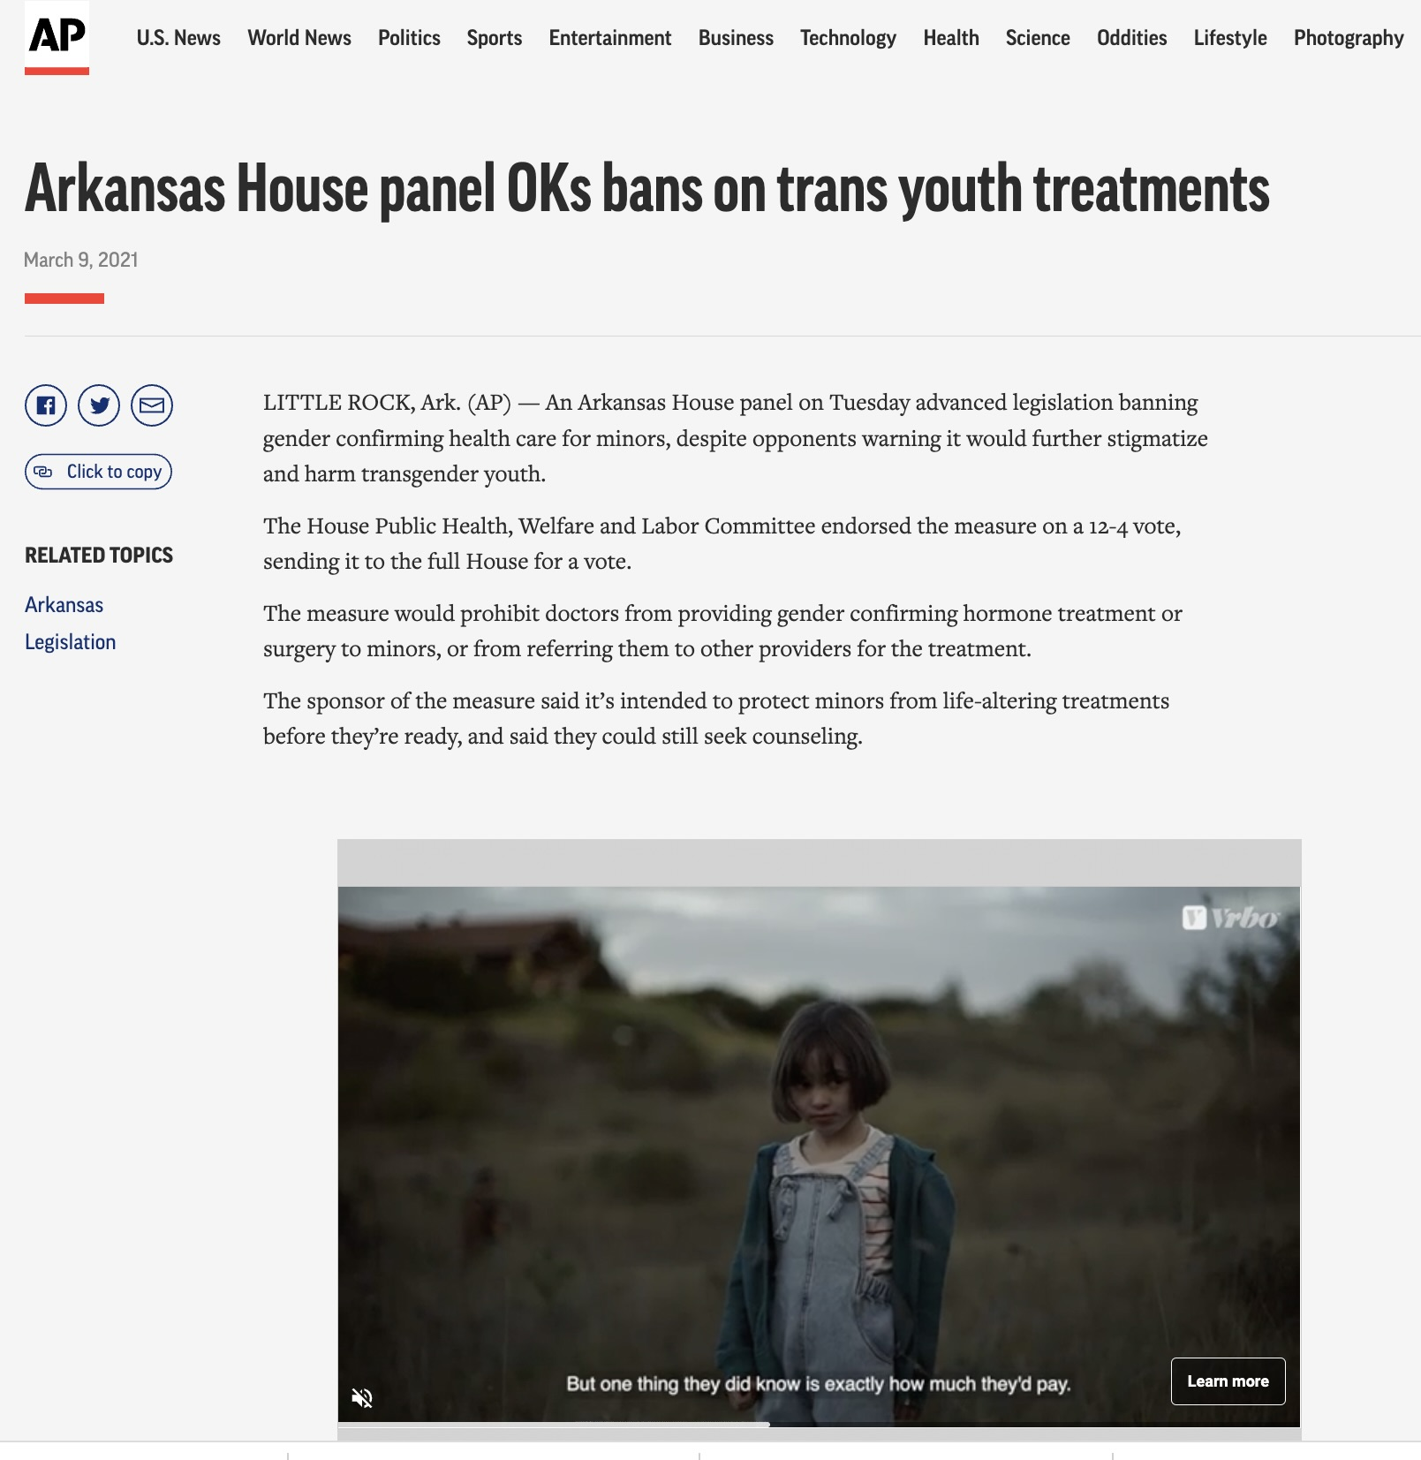
My Background, and How I Got to This Moment

Slide 3
ARKANSAS TIMELINE
The first state to enact a ban on gender affirming care with HB1750, the “Arkansas Save Adolescents from Experimentation” or SAFE Act. Bill passed easily in GOP-led Legislature in March of 2021.
The ban was vetoed by Republican Gov. Asa Hutchinson, who had supported other restrictions on trans youth including a sports ban. Hutchinson said the SAFE Act went too far and would have supported ban focused only on surgery. Legislature overrode Hutchinson’s veto.
May 2021: Four transgender youth and their families and two providers sue Arkansas over the ban
July 21, 2021: Federal judge blocks Arkansas from enforcing ban, said it would cause “irreparable harm”
August 2022: 8th Circuit Court of Appeals upholds temporary order blocking law
Nov/Dec 2022: Trial held over constitutionality of law, still awaiting decision
March 2023: Gov. Sarah Huckabee Sanders signs into law SB199, an effort to reinstate Arkansas’ ban by making it easier to sue providers of gender affirming care for malpractice. That is set to take effect late this summer.

Slide 4
WHERE THINGS STAND:
Gender affirming care
At least 16 states have enacted laws banning or restricting gender affirming care for minors: Alabama, Arkansas, Arizona, Georgia, Idaho, Indiana, Iowa, Kentucky, Mississippi, Montana, North Dakota, Oklahoma, Tennessee, Utah, South Dakota and West Virginia
The bans have been blocked by judges in Arkansas and Alabama
Before this year, only three states had enacted laws banning or restricting the care
Three other states _ Florida, Missouri and Texas _ have banned or restricted the care via administrative order, rules or regulations
Missouri’s went the furthest with restrictions on the care for both minors and adults. A judge has blocked those restrictions
Texas’s governor ordered child welfare officials to investigate reports of children receiving gender affirming care as child abuse.
A judge has blocked those investigations

Slide 5
TIPS
Familiarize yourself with research and standards of care for gender affirming care:
American Medical Association, World Professional Association for Transgender Health, filings in the Arkansas and Alabama cases
Familiarize yourself with AP’s stylebook entry on transgender coverage, discuss your own publication’s style
Ensure you have the voices of people affected by these bans (trans youth, families, medical providers).
Build sources through going to events, rallies, introducing yourself to witnesses at hearings, advocacy groups, etc.

Slide 6
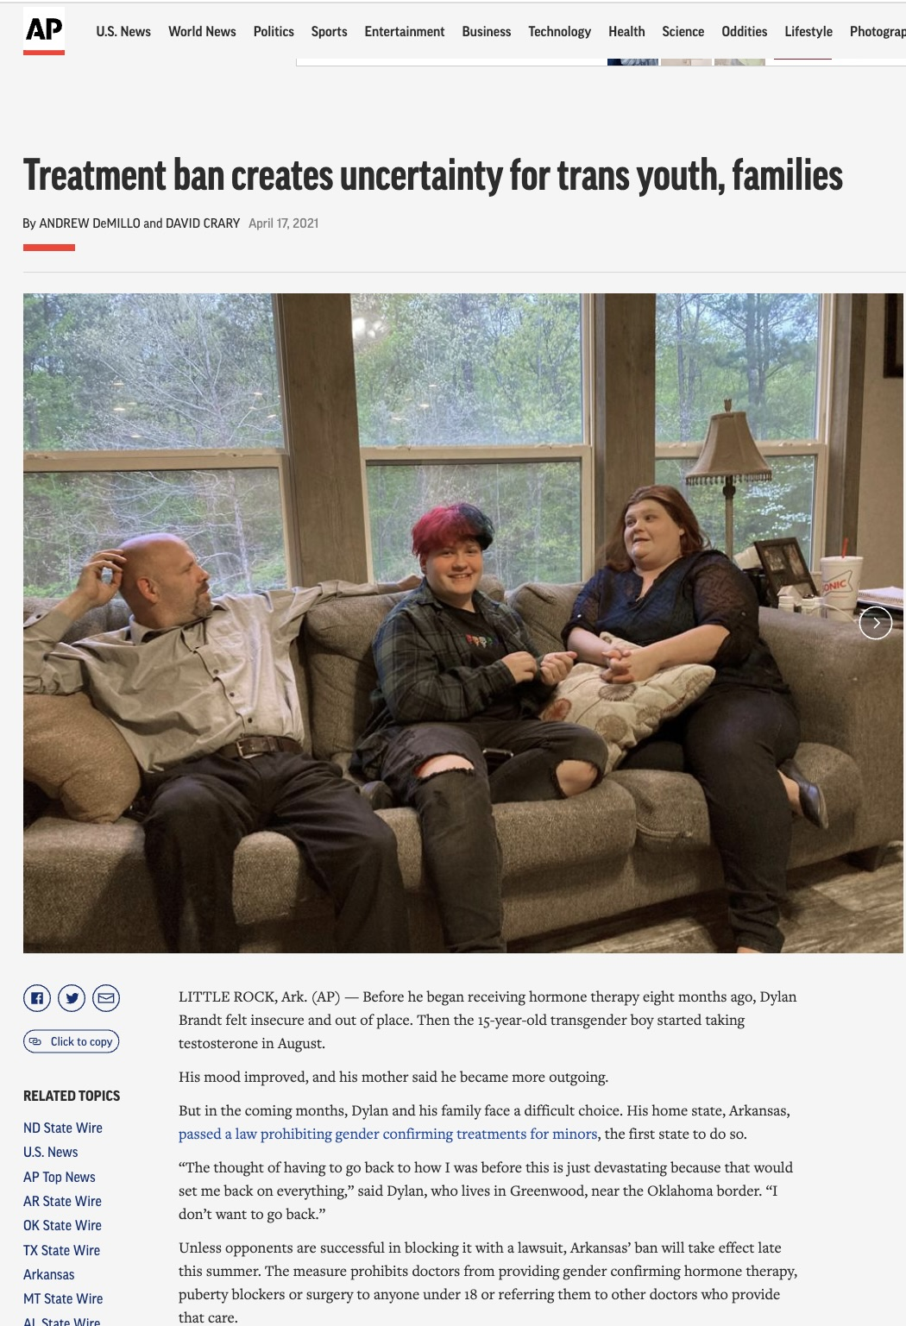
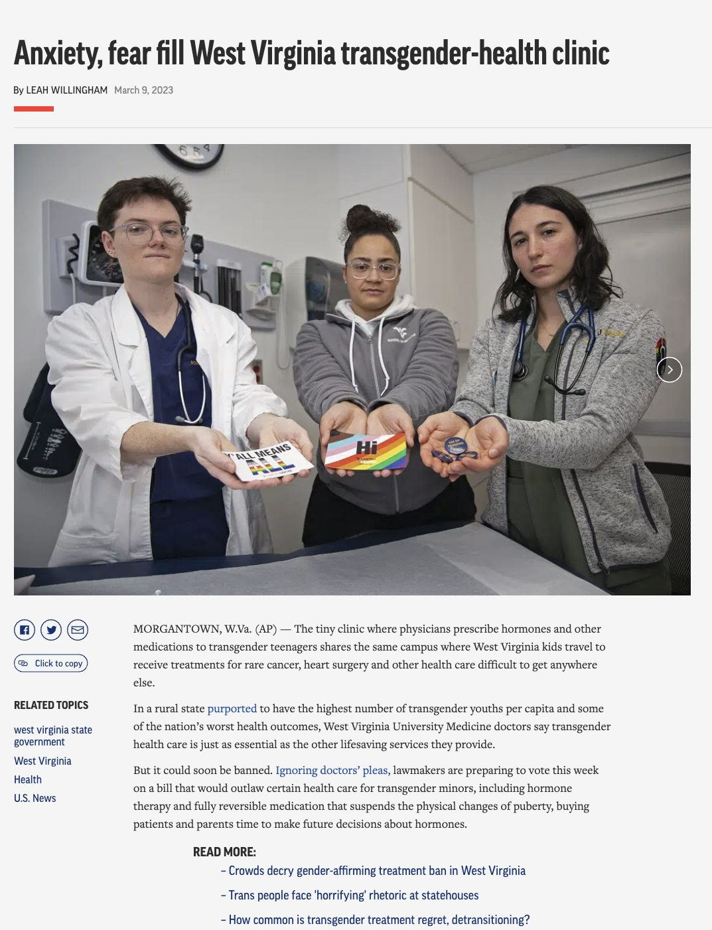
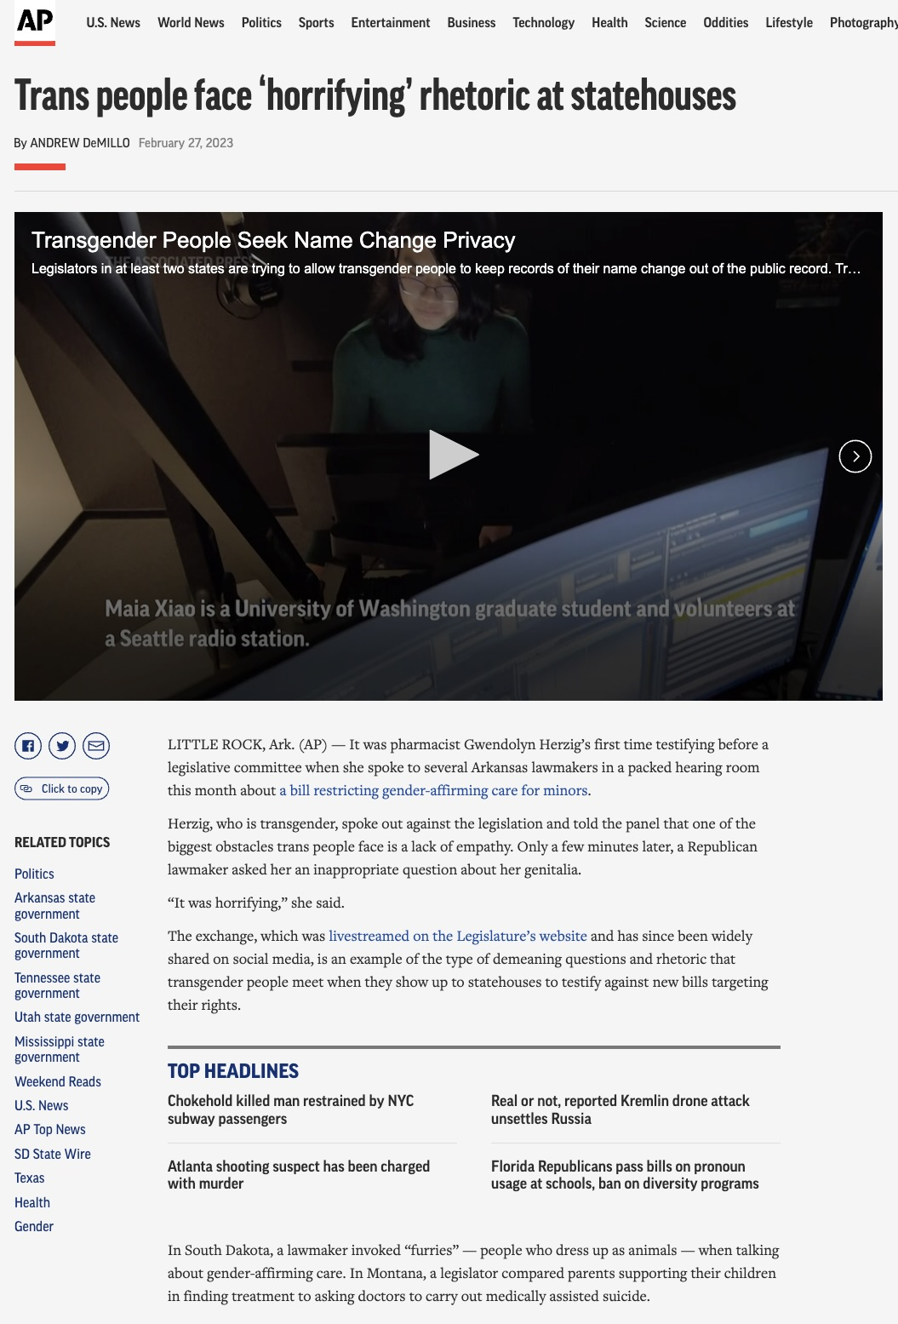
Covering Different Perspectives: Families, Medical Service Providers, Policymakers

Slide 7
REMINDERS:
Do’s:
Seek out voices of people affected by these bans, even for spot stories that may seem incremental
-Talk with experts to understand the process, standards of care
-Fact check claims made about the care
-Include national context
Don’t:
Treat it as a dry policy story
Leave out what medical groups say about this care
-Only write about this issue when there’s legislative action or a court hearing
-Assume

Slide 8
STORY IDEAS
What impact are the bans having on children? Are they having to move to receive the care? What impact does just the threat of these bans have?
Impact it has on providers: Does banning care in one state create a strain on resources in other states? Impact of threats, rhetoric on providers?
How would these bans get enforced? Any unintended consequences from them?
Fact checks, explainers, Q&A’s
A look at the rhetoric surrounding the bans and other restrictions

