Slide 1



OUR DEMOCRACY IS IN DANGER
How to tell whether a government investigation is proper — or an abuse of power
Kristy Parker Aaron Baird
Counsel Policy/Comms
MAY 2023 • PROTECTDEMOCRACY.ORG
Notes:
I’m Ben Raderstorf, I’m a policy advocate. An just quickly, a little about me — I came to Protect Democracy from foreign policy, and efforts to advance democracy, anti-corruption, and rule of law initiatives especially in Latin American democracies. I never had any intention of doing domestic work until all of the sudden I woke up and all of the sorts of threats I’d been working to support Venezuelans or Nicaraguans or Bolivians in building guardrails against in their countries was suddenly happening in my own. So I’m going to start there, on the global picture and the contours of the authoritarian threat, and then Shalini is going to dig deeper into some of the manifestations in various states.
I’m Shalini Goel Agarwal, counsel at Protect Democracy. I came to the organization after 15 years as a civil rights lawyer, at the Lawyers’ Committee for Civil Rights, the ACLU, and the Southern Poverty Law Center. Being in Florida for much of that time, I feel like I’ve had a front-row seat to authoritarianism at the state level, and I’ll be talking about some authoritarian moves at the state level. Apologies in advance for the Florida-centricness of my examples.

Slide 2

Global democracy has been in recession for 15 years.
Notes:
Ian B

Slide 3


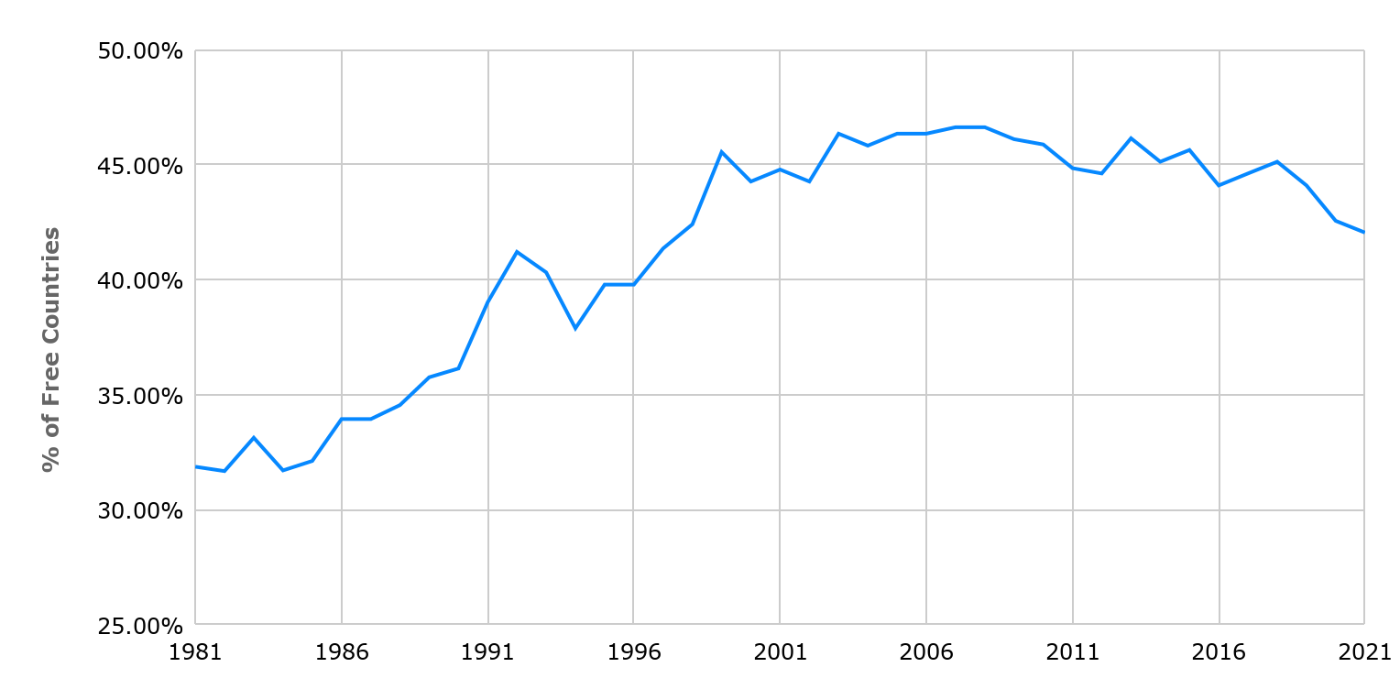
Freedom House shows the third wave cresting around 2007
Freedom House — Freedom In the World
Notes:
Freedom House has for many decades run a freedom in the world index—they find the latest wave of democratization and freedom peaking in 2007, and declining ever since.

Slide 4
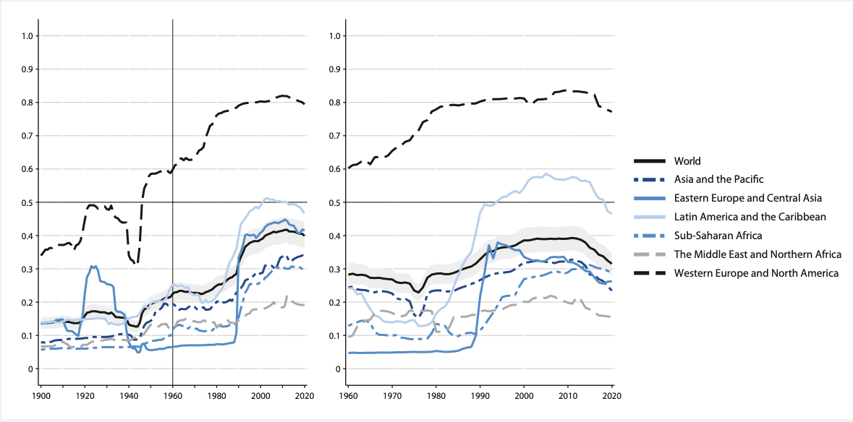
V-Dem shows a sharp decline in all regions of the world
Notes:
The Swedish V-Dem institute paints, if anything, an even scarier picture, of a dramatic dropoff in lived experiences of democracy across every region of the world

Slide 5

The Economist Intelligence Unit showed a nadir in 2021
The global average score hit an all-time low:
The average global score in the 2021 Democracy Index fell from 5.37 in 2020 to 5.28 in 2021.
“This fall is the biggest since 2010… and sets another dismal record for the worst global score since the world democracy index was first produced in 2006.”
Notes:
And finally, the Economist Intelligence Unit, which is newer, found that 2021 was the worst year for global democracy since the start of the index

Slide 6
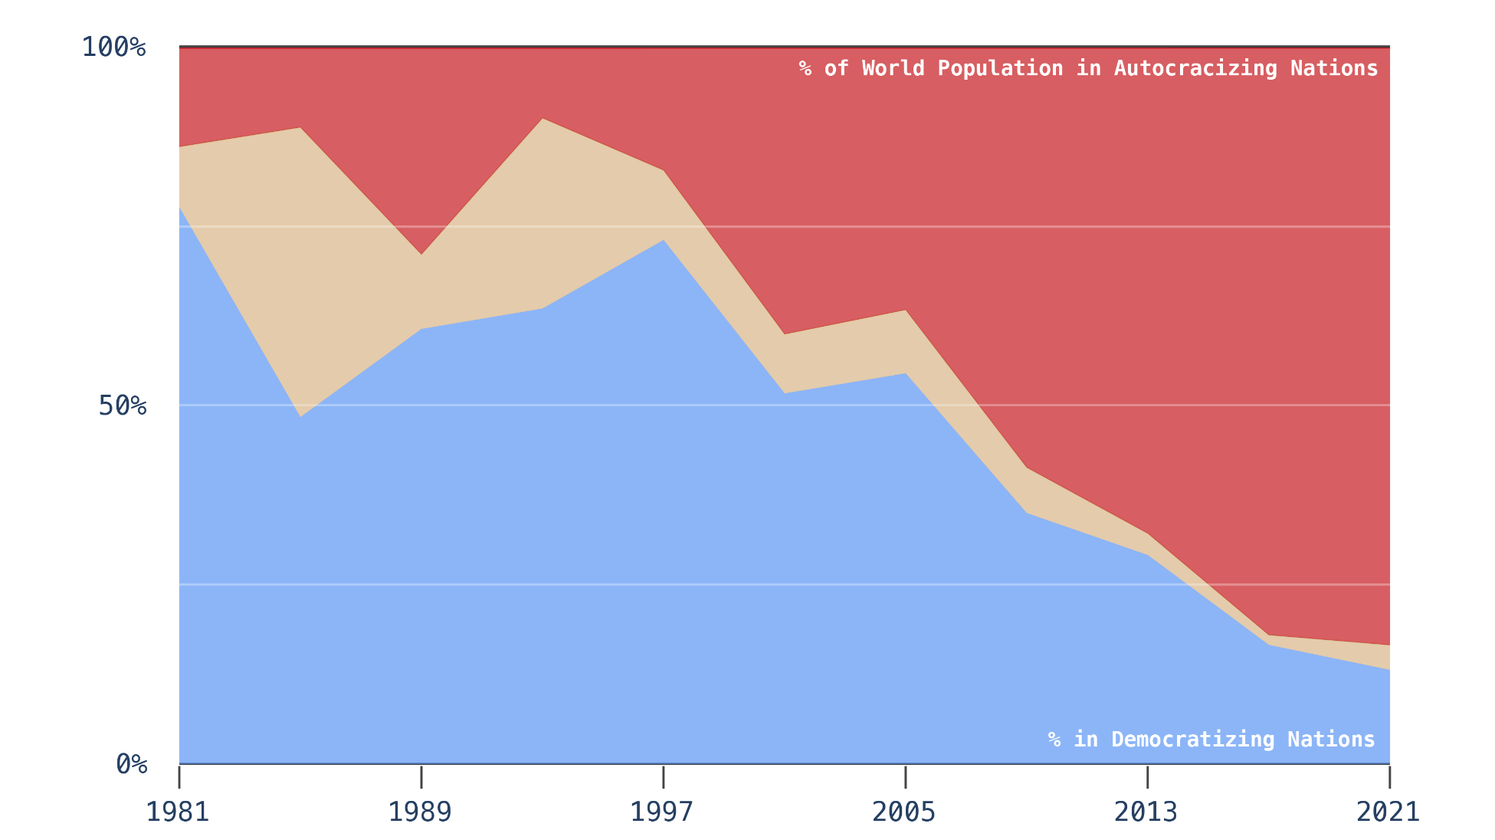
Autocratic regimes are rising in democracy’s place
V-Dem Institute Liberal Democracy Index, 2021
Notes:
So what does this add up to? Today, a greater percentage of world population lives under autocracy than on the day the Berlin Wall went up in 1961.
And the picture only gets worse looking forward. This is a graph of the percent of the percent of world population living in countries that are democratizing, in blue, autocratizing, in red, or stable, in tan. 25 years ago, 3 in 4 people around the world lived in a country on the upswing. Today, it’s down to one in five.
And the United States has been far from immune to this trend. We are in the red here.

Slide 7
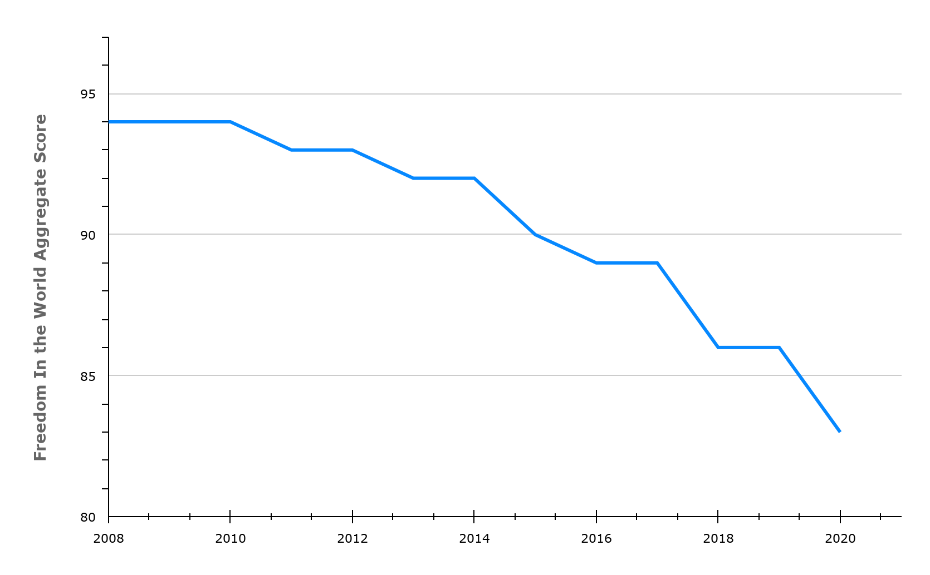
The United States has been far from immune to this trend
United States
Freedom House — Freedom In the World
Notes:
15 years ago, Freedom House rated us a 94 out of a hundred in terms of the quality of our democracy. Now we’re down to an 83, tied with Romania and Panama, and below countries like Argentina, Mongolia, and Belize.

Slide 8
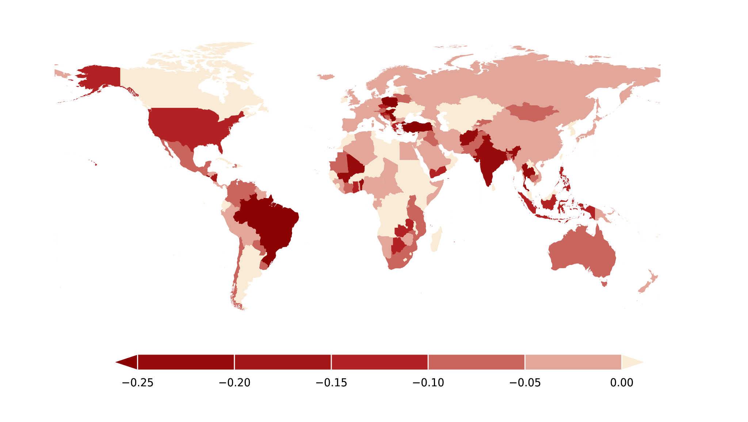
The U.S. is among top autocratizing countries in the past decade
V-Dem Institute Liberal Democracy Index, 2021
Notes:
In fact, we’ve been declining faster than almost anywhere else in the world, with the exception of the canonical examples of democratic backsliding, like India and Brazil.

Slide 9
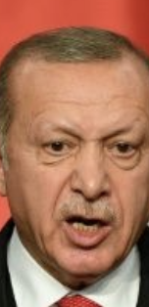
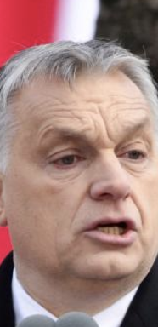
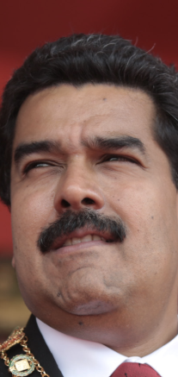
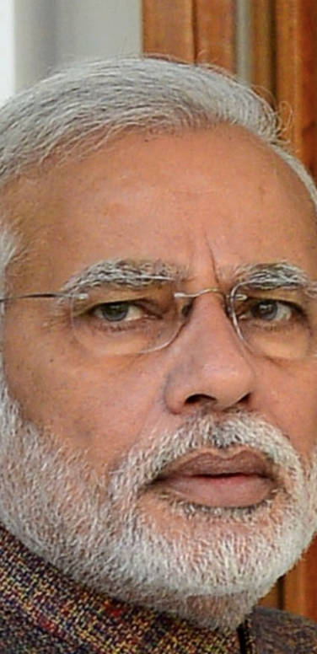
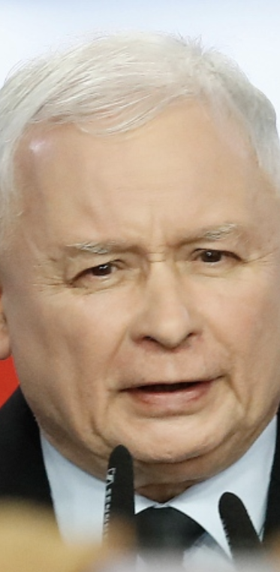
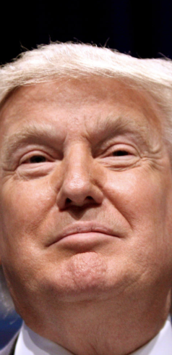
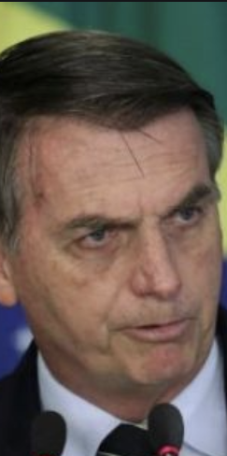
The result: a wave of autocrats
2003
2010
2013
2014
2015
2016
2018
Notes:
The result has been a wave of autocratic candidates, from the left, right, and center, running and winning in countries as diverse as Poland, India, Brazil, and yes, the United States.

Slide 10
Three criteria of pro-democracy parties
Unambiguously accept electoral defeat
Eschew violence
Break with extremist groups
Notes:
I’m partial to the definition proposed by a variety of political scientists: that to be pro-democracy a political party has to do three really basic things. One, they must unambiguously and universally accept electoral defeat, two they must categorically reject violence as a way to achieve their goals, and three they must be willing to break with extremists in their own ranks who are willing to violate the first two rules. I don’t think it’s controversial to say that the current Republican Party has failed to meet all three of these standards.

Slide 11
But how do we see it coming?
Notes:
The result has been a wave of autocratic candidates, from the left, right, and center, running and winning in countries as diverse as Poland, India, Brazil, and yes, the United States.

Slide 12
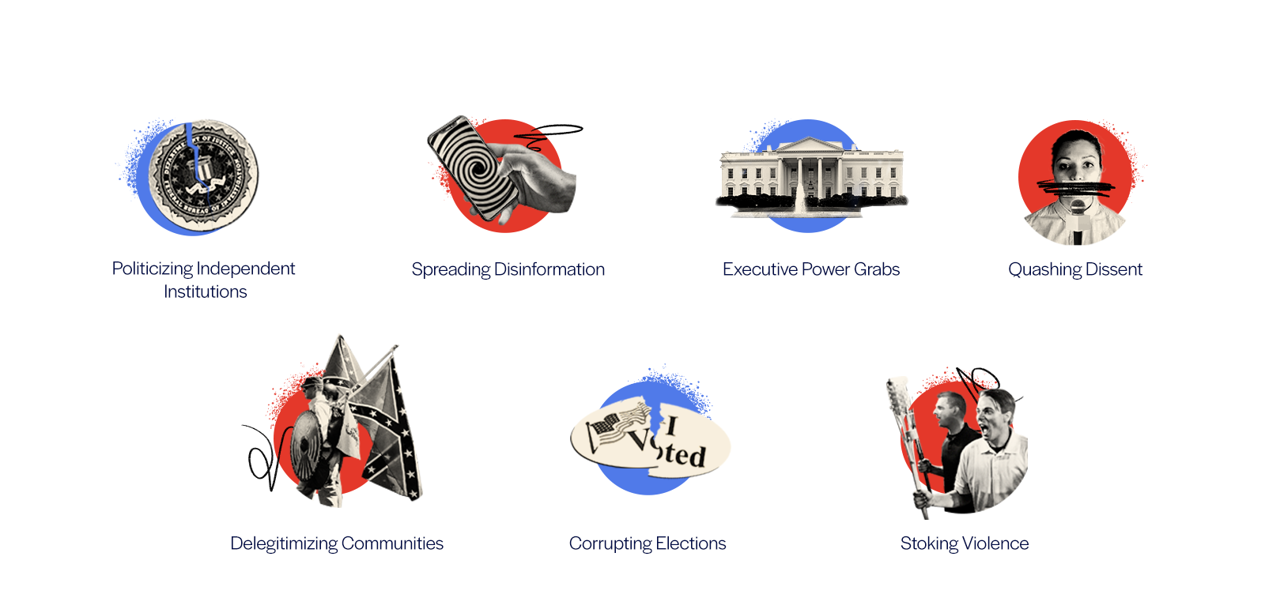
Modern authoritarians across the world use a similar playbook
Notes:
Update for 7 buckets

Slide 13

Read more about the Authoritarian Playbook media primer:
protdem.org/playbook
Notes:
Update for 7 buckets

Slide 14

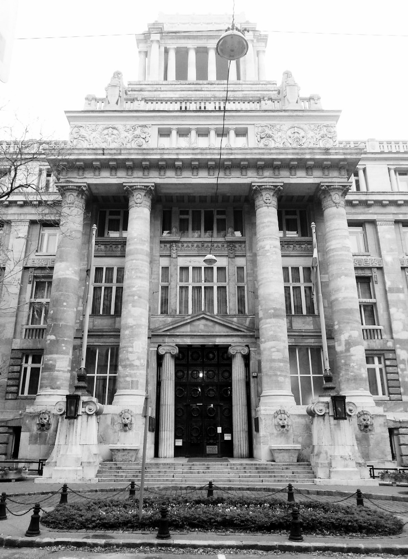
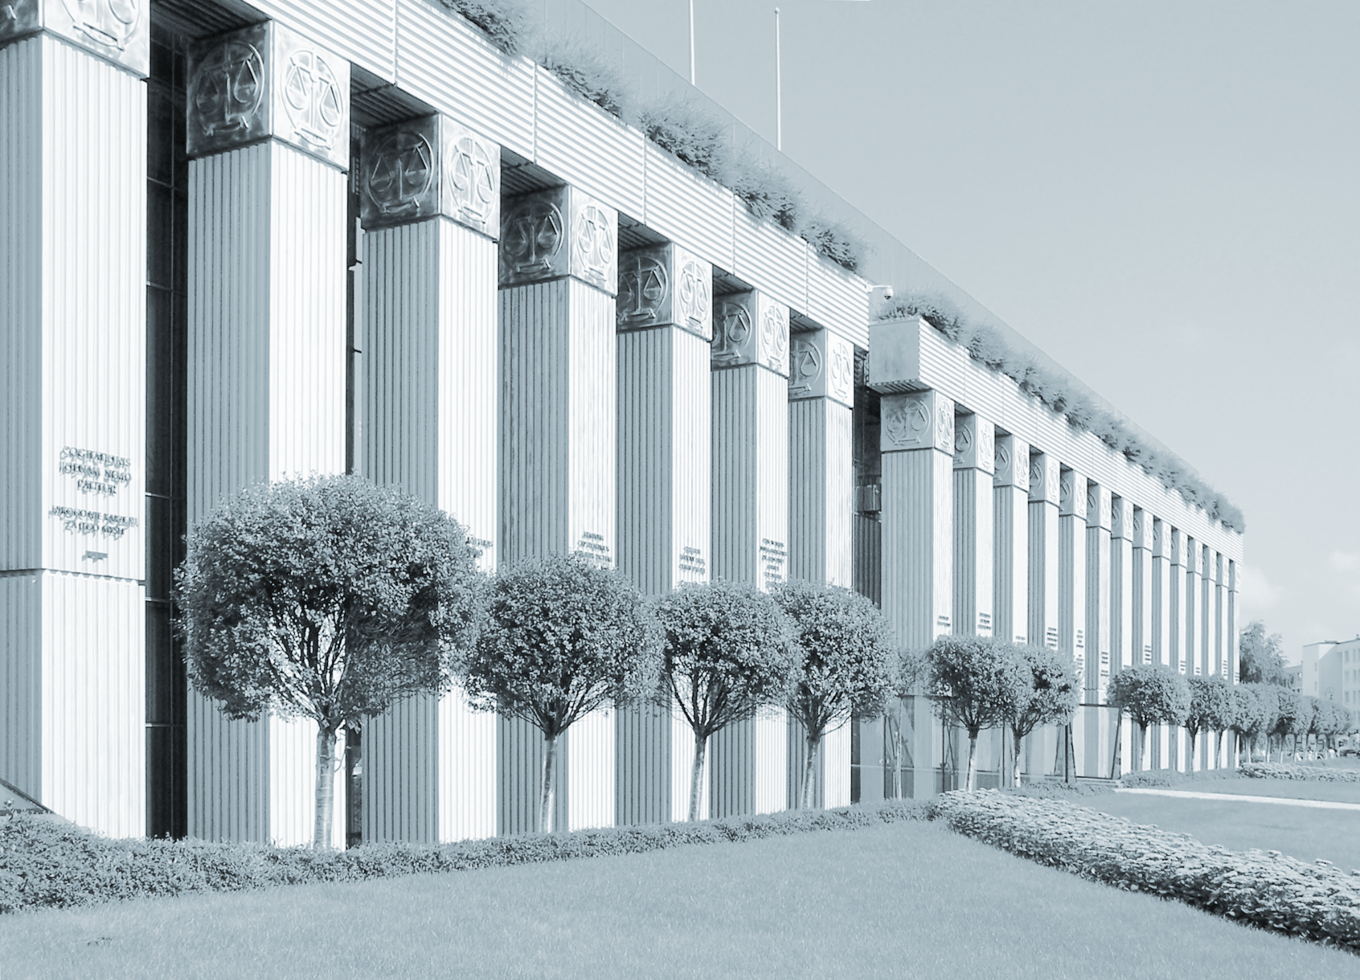
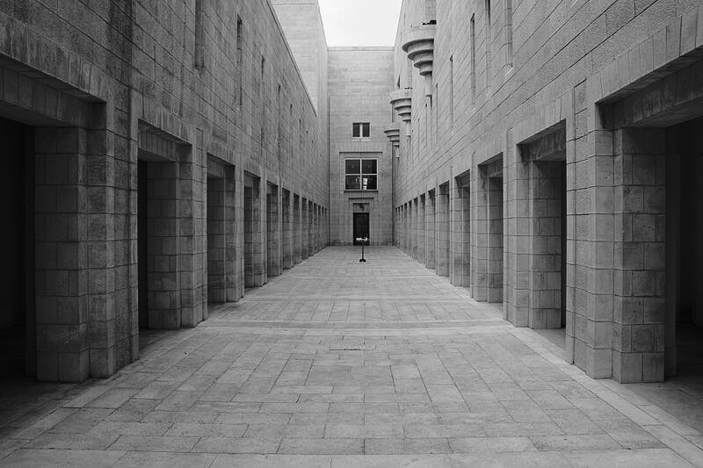
Autocrats around the world subvert the rule of law for nefarious ends
Supreme Court building, Warsaw
Supreme Court building, Jerusalem
Kúria of Hungary, Budapest
Notes:
General text slide with 1-column bullets

Slide 15


Is it undemocratic to investigate and prosecute a former president?
Notes:
Divider slide blue with serif header. Please use the serif version should be used for matters about the organization’s mission and values. Use the sans serif header for matters about work.

Slide 16
What’s at stake
“Sweeping” investigations and replacements of “Marxist prosecutors.”
Presidential power to hire and fire federal workers. Including disloyal investigators.
Congress to defund the Justice Department and the FBI.
…sound familiar?
Notes:
1-column bullets

Slide 17
The news media is part of the solution.
Notes:
The result has been a wave of autocratic candidates, from the left, right, and center, running and winning in countries as diverse as Poland, India, Brazil, and yes, the United States.

Slide 18


In our system, as this court has often stated, no one is above the law. That principle applies, of course, to a President.”
TRUMP V. VANCE, U.S. SUPREME COURT (2020)
Notes:
Featured text cream. Use the blue color to highlight any part of the large text, if desired.

Slide 19
How the Feds keep politics out of it
The Constitution
“Take Care” clause
Due process
The first amendment
DOJ norms, rules, and policies
White House contacts
Policies 🚫 election influencing
There’s even a manual!
Notes:
1-column bullets

Slide 20
Most state and local prosecutors are elected…
…but the same rules apply: the federal Constitution, the Bill of Rights, and their oaths of office.
Notes:
1-column bullets

Slide 21
States prosecute their most powerful public officials [because] prosecutions help deter future lawbreaking. Insofar as the law is applied consistently — without regard for the profile of the person in question — prosecutions send clear signals. Beliefs about the probability of punishment operate forcefully on people’s decisions.
GRANT TUDOR & IAN BASSIN, THE ATLANTIC
Notes:
Featured text cream. Use the blue color to highlight any part of the large text, if desired.

Slide 22


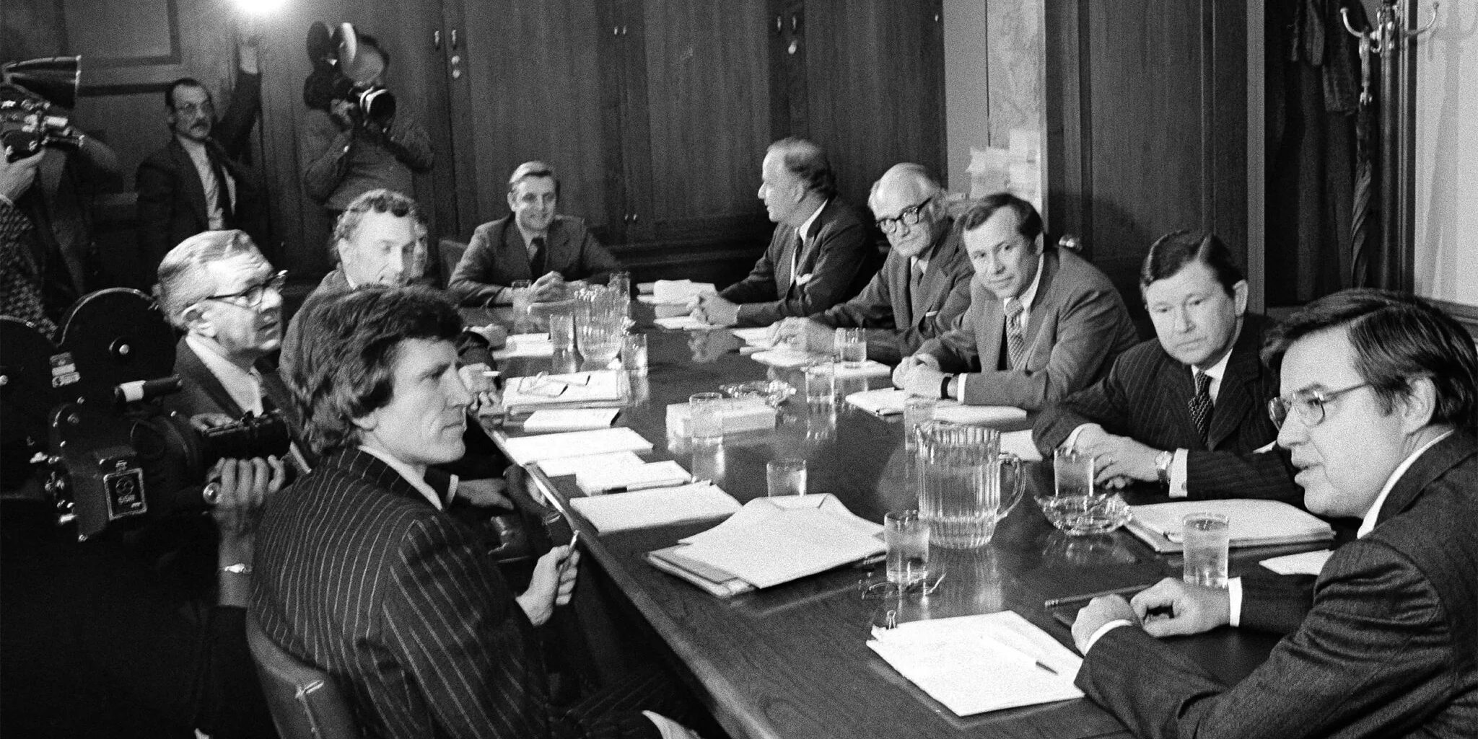
IMAGE HERE
The Church Committee, a bipartisan committee created to investigate the CIA, FBI, and other intelligence-gathering agencies, 1975.
AP File Photo/Henry Griffin
Notes:
Image frame cream with caption. To replace the image, select the image on the deck. On the toolbar, select “Replace Image” to upload a new image. The image will automatically crop to fit the same size as the placeholder.

Slide 23
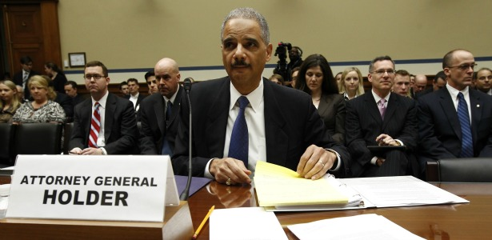


Operation
Notes:
Full width image. To replace the image, select the image on the deck. On the toolbar, select “Replace Image” to upload a new image. The image will automatically crop to fit the same size as the placeholder.

Slide 24
Limits on Congress’s oversight power
Trump v. Mazars, Supreme Court
Balance between Congress and Executive
Not a law enforcement agency
Linder Letter
Notes:
1-column bullets

Slide 25
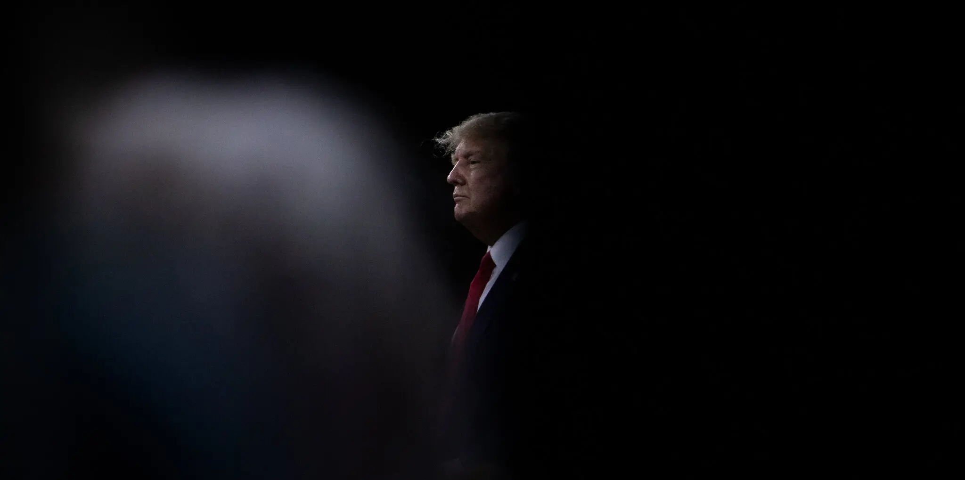
There will be ripple effects.
Damon Winter/The New York Times
Notes:
Full width image. To replace the image, select the image on the deck. On the toolbar, select “Replace Image” to upload a new image. The image will automatically crop to fit the same size as the placeholder.

Slide 26

Democracy depends on the public having unbiased information about what’s happening.
11
Notes:
Divider slide navy with image and sans serif header. Please use the sans serif header for matters about work. The serif version should be used for matters about the organization’s mission and values. To replace the illustration, select the image on the deck. On the toolbar, select “Replace Image” to upload a new illustration. The image will automatically crop to fit the same size as the placeholder.

Slide 27

Three ways to do this:
Provide the important context.
Help readers appreciate the stakes.
Believe that your role is critical.
Notes:
Divider slide navy with sans serif header. Please use the sans serif header for matters about work. The serif version should be used for matters about the organization’s mission and values.

Slide 28


Thank you.
PROTECTDEMOCRACY.ORG
Notes:
End slide cream

