Slide 1
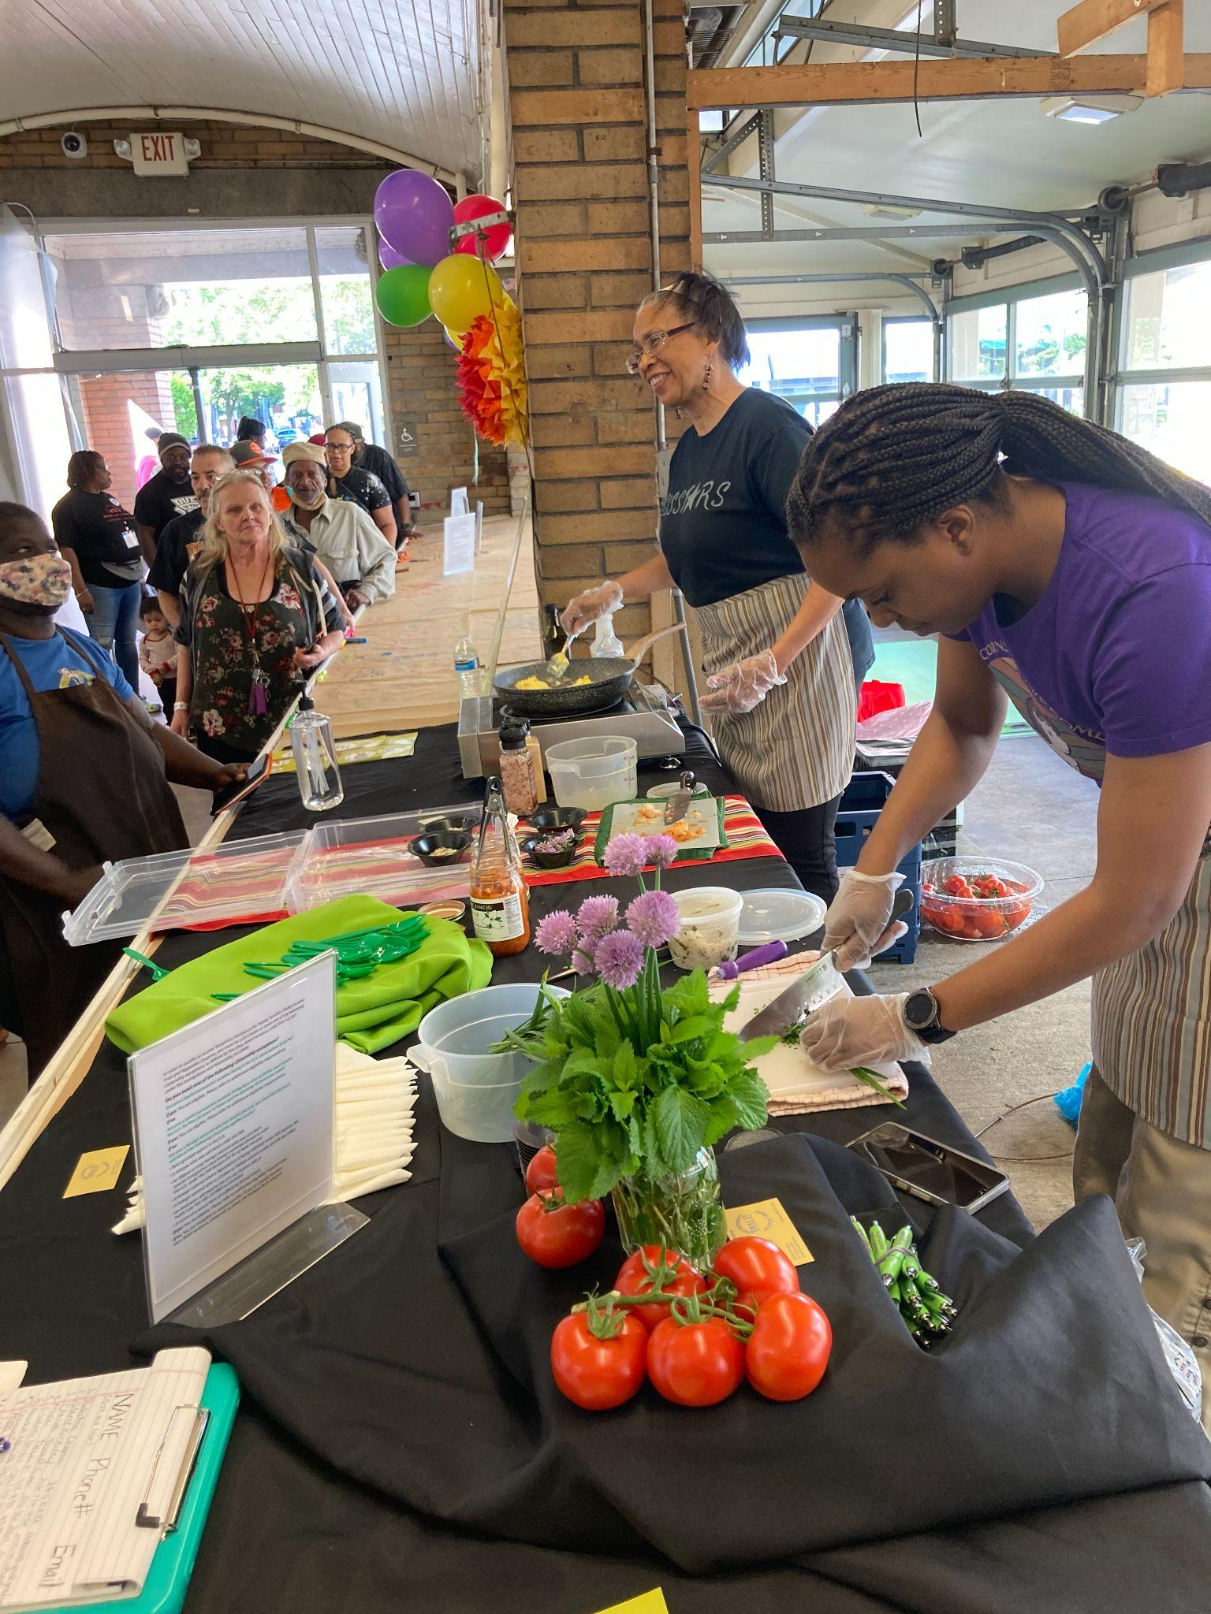
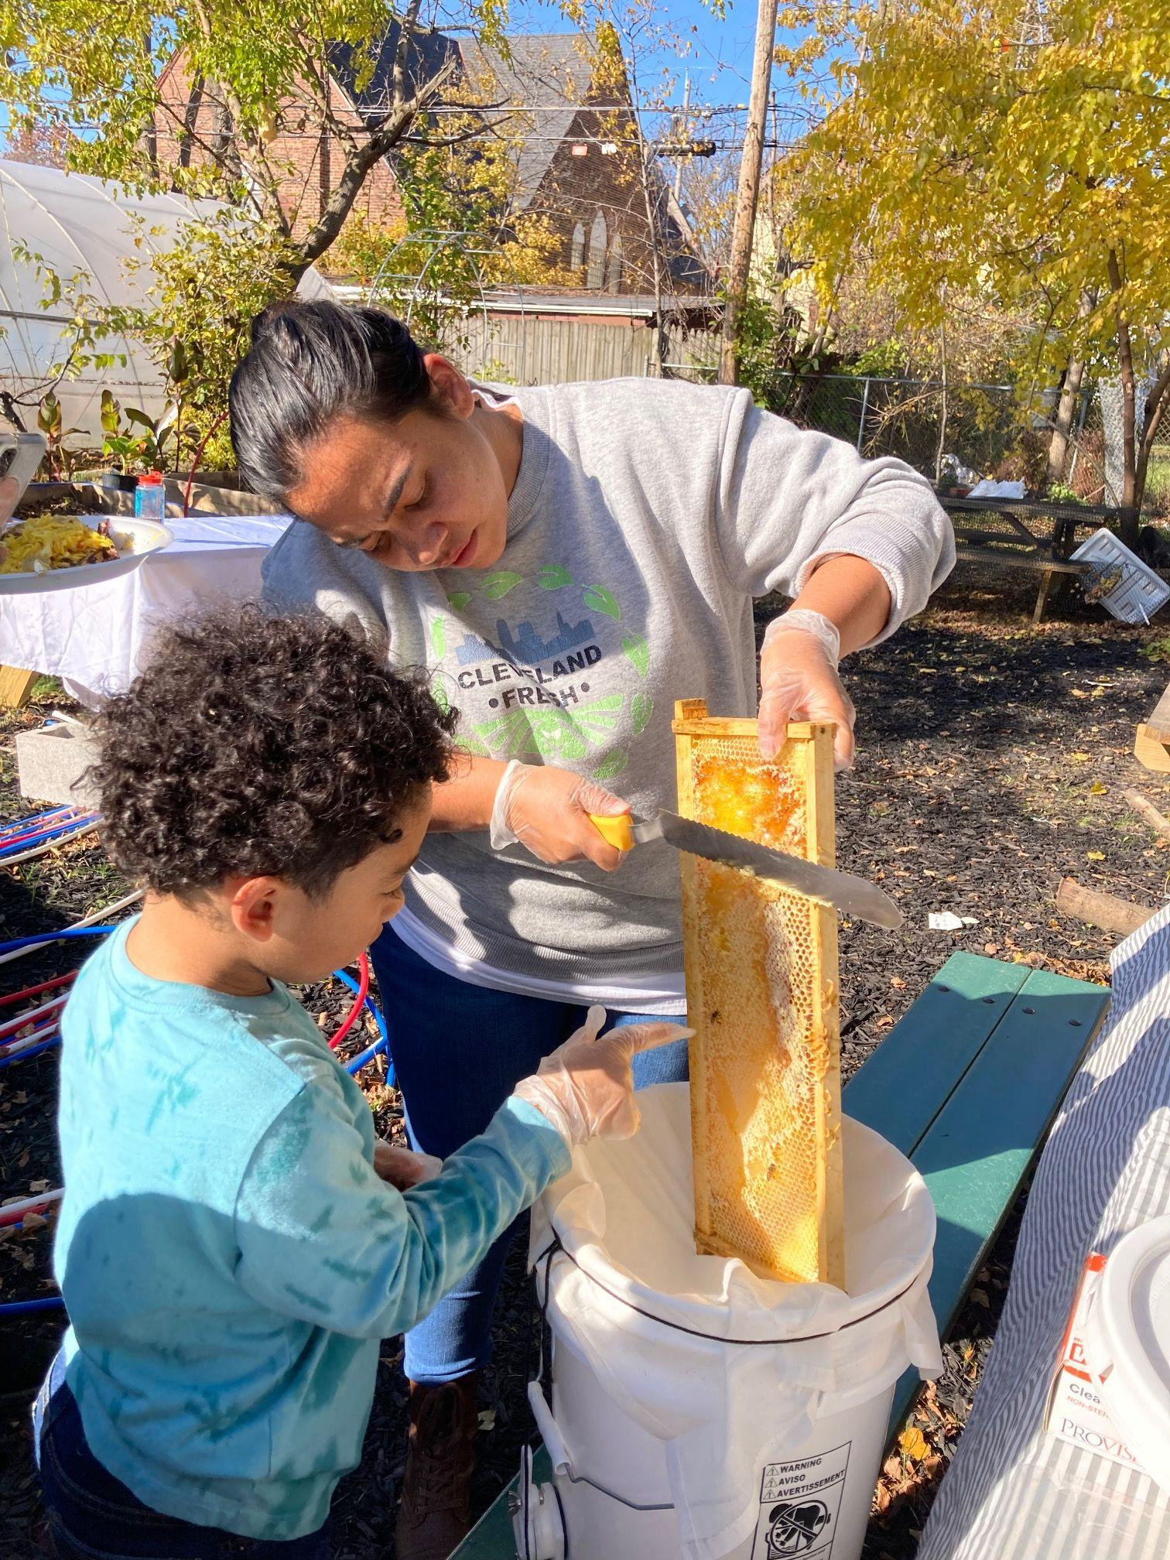
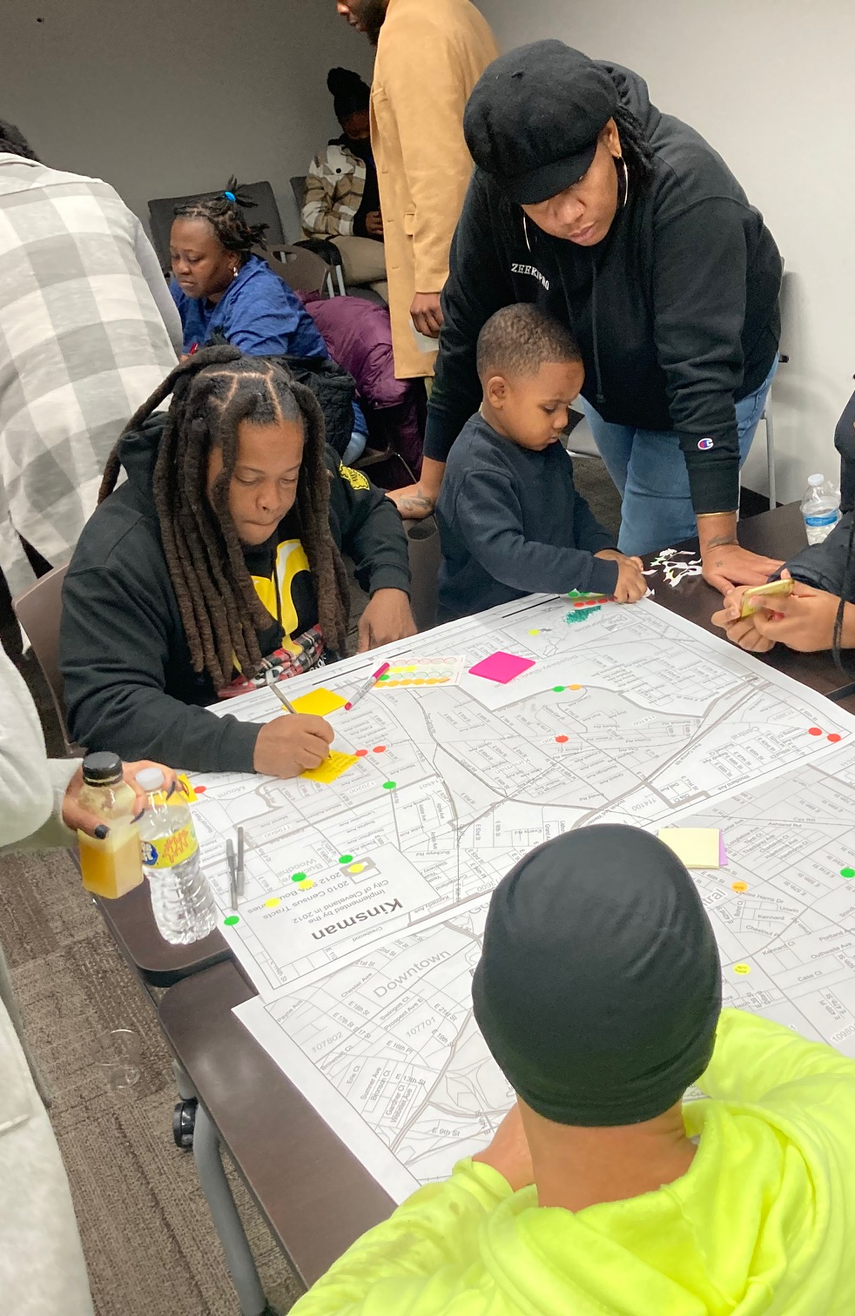

Food Apartheid: Covering How Equitable Access to Healthy Food Impacts
Children’s Futures
Morgan Taggart
Director, FARE
National Press Foundation
May 10, 2023

Slide 2
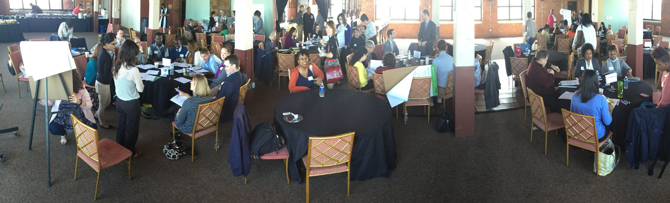
Health Equity Framework
Community Participatory Approach
Healthy Food Access
Social Determinants of Health
City Wide Convenings
Community Collectives
Healthy Food Retail and Heart Smarts
Nutrition Incentive Programs
Notes:
MORGAN

Slide 3
FARE’s Approach to Improving Access to Healthy Food
Community-driven and community-led
Designed with and for those most affected by the issue
Builds community capacity by providing support, technical assistance, resources
Comprehensive approach that identifies and honors the complexity and interconnectedness of the issues we want to address
Action-oriented and asset-based

Slide 4
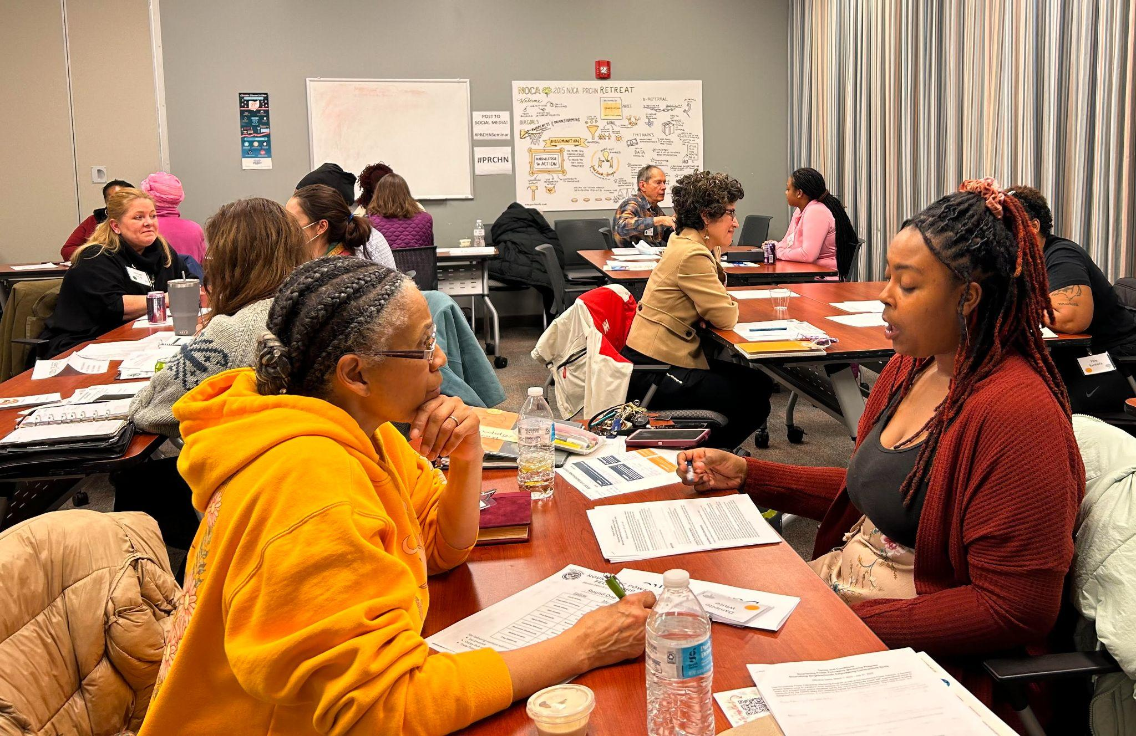
Current Projects
Produce Perks & PRx at West Side Market
Nourishing Power Fellowship | Case Western Reserve University
Heart Smarts | Small food retailers in Central-Kinsman
BeeBridge | Global Cleveland
Central Kinsman Food Co-op | Environmental Health Watch
Growing the Next Generation | Grassroots Organizations in Central, Hough and St Clair Superior

Slide 5
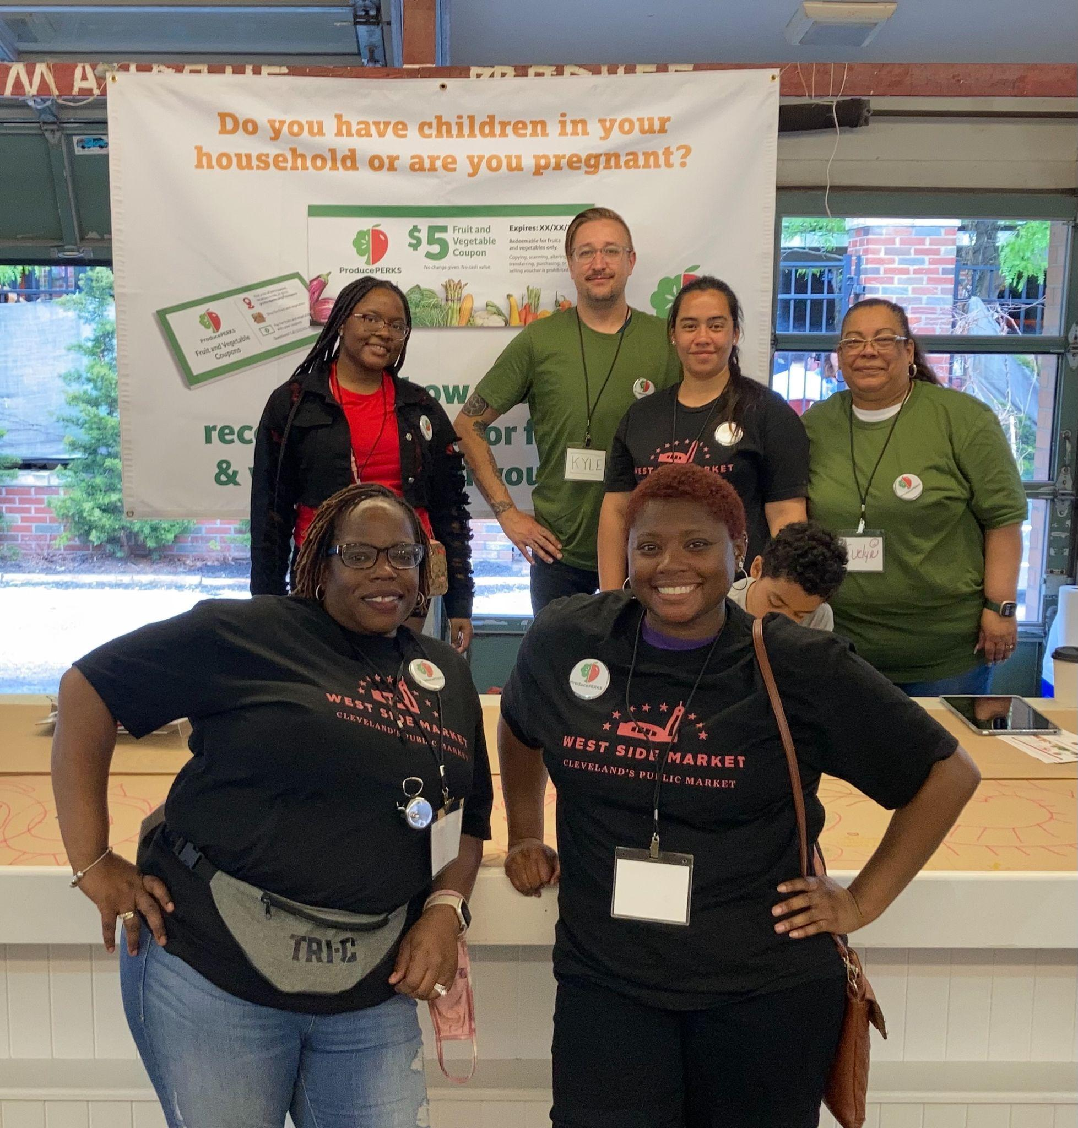
FARE | Food Access Raises Everyone
CURRENT PROJECTS
Urban Farmers and Gardeners Town Hall
Addressing policy barriers for urban growers accessing USDA programs and city policies
Reclaim CleveLAND | Neighborhood Connections
Elevating the voices of community members in green space initiatives
Central Kinsman Community Collective
Supporting residents’ questions and concerns about a new poultry facility in their community
Nutrition Incentives | Produce Perks Midwest
Requesting $1M in the State Budget for Produce Perks

Slide 6
The Language of Food

Slide 7
A LOCAL FOOD SYSTEM is one that supports long-term connections between farmers and consumers while meeting the economic, social, health and environmental needs of communities in a region.
A food system includes everything associated with growing, processing, storing, distributing, transporting and selling food.
A food system is local when it allows food producers and their customers to interact face-to-face; regional systems serve larger geographical areas, often within a state or metro area.

Slide 8
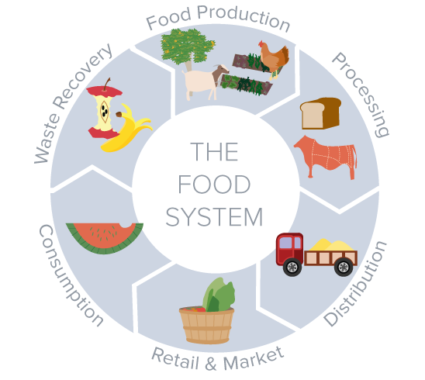

Slide 9
FOOD SECURITY is the physical and economic access to sufficient nutritious foods by all people at all times. When this access is disrupted or limited, food insecurity occurs. Food insecurity may be temporary — for example, if you run out of food for a day or two — or long-term, as exemplified by persistent poverty and poor access to food.

Slide 10
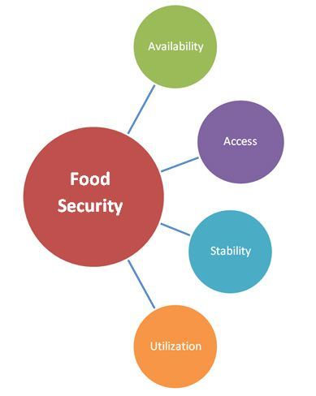
Four main dimensions of FOOD SECURITY can be identified:
Physical AVAILABILITY of food
Food availability addresses the “supply side” of food security and is determined by the level of food production, stock levels and net trade.
Economic and physical ACCESS to food
Food UTILIZATION
Utilization is commonly understood as the way the body makes the most of various nutrients in the food.
STABILITY of the other three dimensions over time. Even if your food intake is adequate today, you are still considered to be food insecure if you have inadequate access to food on a periodic basis.

Slide 11
FOOD DESERTS are communities that have poor access to healthy, affordable foods Food deserts are concentrated in low-income and historically marginalized areas throughout the United States. In food deserts, healthy foods like fruits, vegetables, whole grains, dairy, peas, beans, meat, and fish are often expensive or unobtainable. The lack of access to healthy foods in these communities translates to health disparities and high rates of chronic disease. [National Institutes of Health]

Slide 12
Food swamps refer to urban environments with few grocery stores but several non-nutritious food options such as corner stores or fast-food restaurants, with a general ratio of four unhealthy options for each healthy option.

Slide 13
FOOD APARTHEID is an emerging term meant to address the root causes of poor access to healthy, nutrient-dense foods by communities of color and low-income white people due to the systemic racism and health inequities of a corporate-controlled food system.
Malik Yakini & Food Apartheid https://www.youtube.com/watch?v=IUeFtaujl7E

Slide 14
FOOD JUSTICE is the acknowledgement that eating, growing and selling nutritious food is a right for all people. It is community-led, participatory and locally grown while also striving to respect peoples & communities, the environment and the land. [Congressional Hunger Center]

Slide 15
NUTRITION EQUITY is a state of having freedom, agency, and dignity in food traditions resulting in people and communities healthy in body, mind, and spirit. Expected outcomes of nutrition equity include economic opportunity, food security, and fair access to fresh and healthy food. [Case Western Reserve University]

Slide 16
Telling Stories About Food Apartheid
How are we telling these stories now?

Slide 17
Case Study: Urban Agriculture in Cleveland
Urban Agriculture | Producing, growing, distribution and selling food in cities
Issues that urban growers and community gardeners were facing
Zoning and land use regulations
Access to capital and support programs
Access to water
Access to land

Slide 18
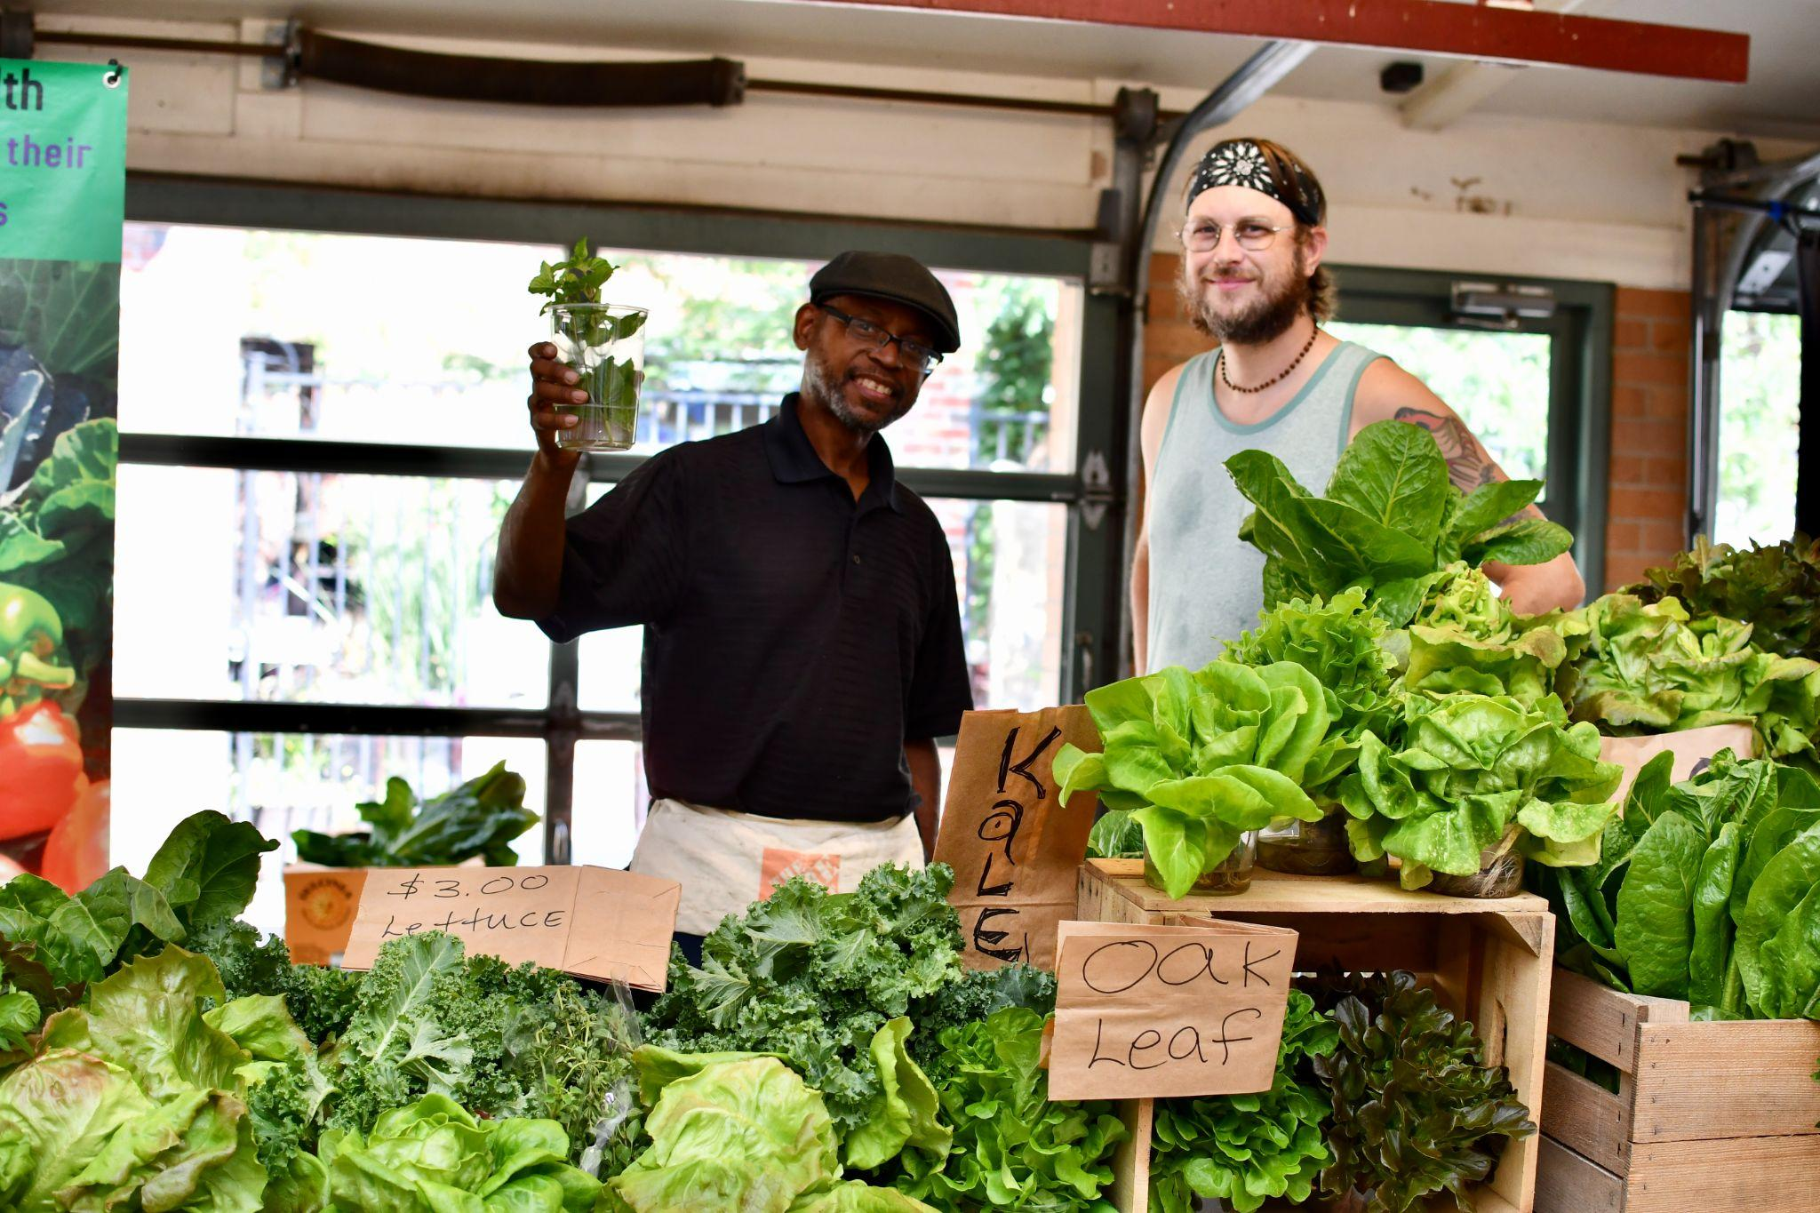
Case Study: Urban Agriculture Policy
Who influences policy decisions on urban agriculture?
Elected officials: Mayor and City Council
Planning Commission: Zoning and land use laws
Public Health: Nuisance Laws, Food Safety
Economic Development: Access to Capital
Community Development: Access to land bank lots
Water Department: Access to hydrants for temporary use

Slide 19
Telling the Story: Urban Agriculture Policy
Data | Number and location of urban gardens, number and location of gardeners and farmers, pounds of produce produced, number of businesses and entrepreneurs
Stories | Cleveland residents shared how these projects have benefitted their communities and what barriers and challenges they continue to face
Best Practices | How have other cities addressed these challenges? What have the good and bad impacts of those changes been?

Slide 20
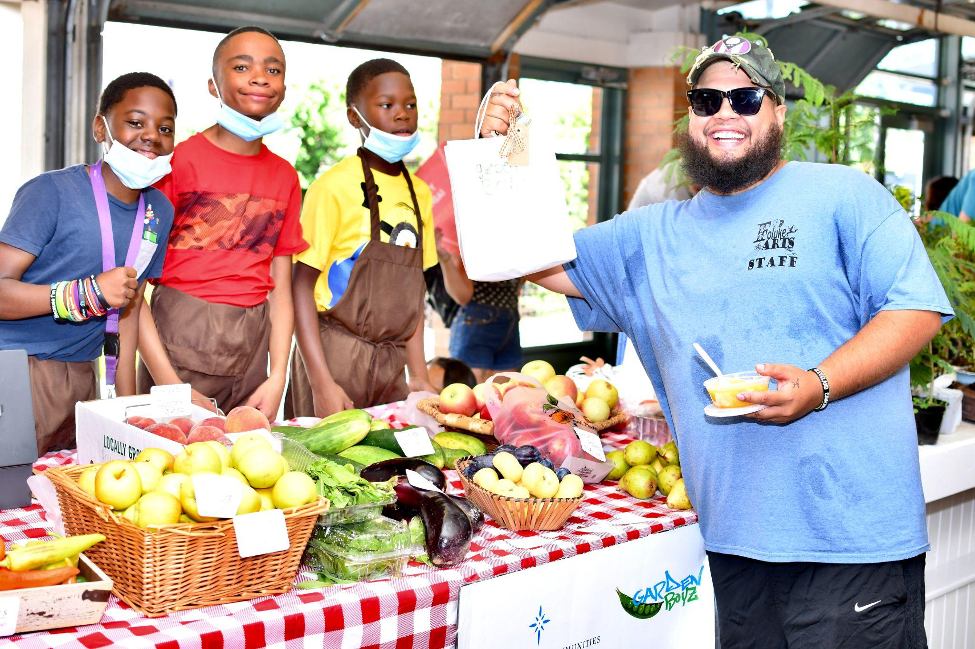
Case Study: Urban Agriculture Policy
Real Estate Market Crash | Positive strategy for addressing vacant land
Access to Healthy Foods | Supplying fresh foods in Cleveland’s neighborhoods
Engaged Communities | Providing safe spaces for neighbors to meet each other
Youth Development | Afterschool programming and summer employment

Slide 21
Mapping Food Access
What are the factors we look at when we map and use GIS to examine the food environment?
Store Location
Transportation
Income

Slide 22
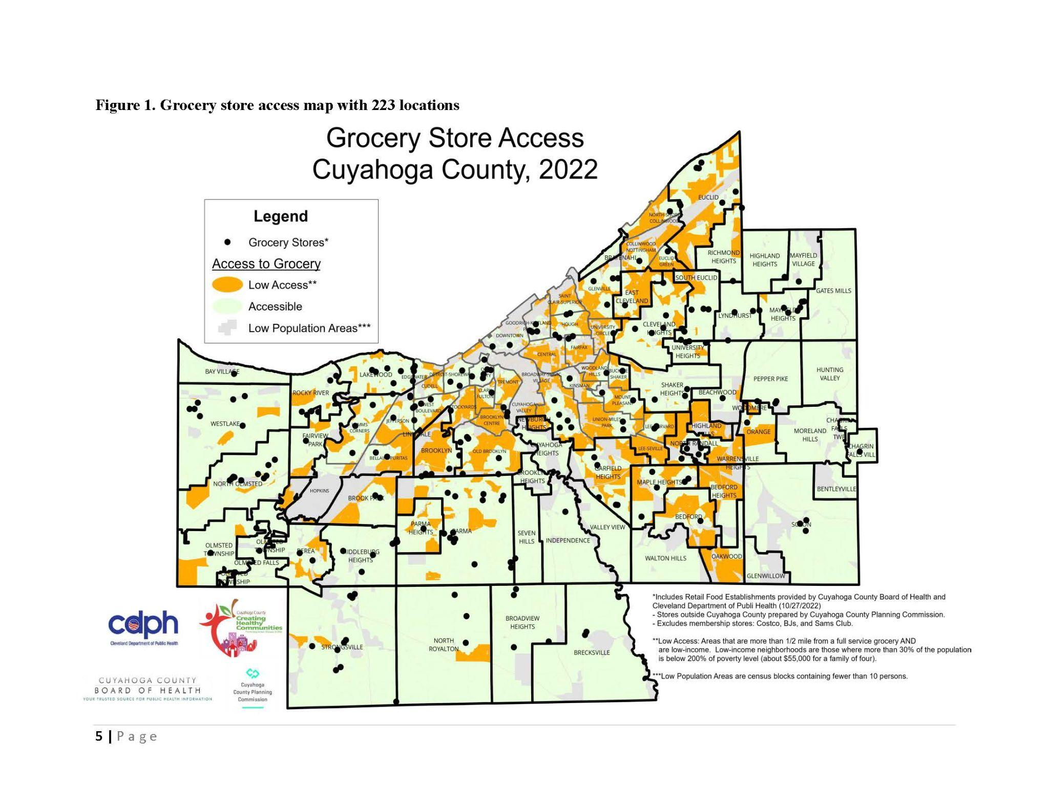

Slide 23
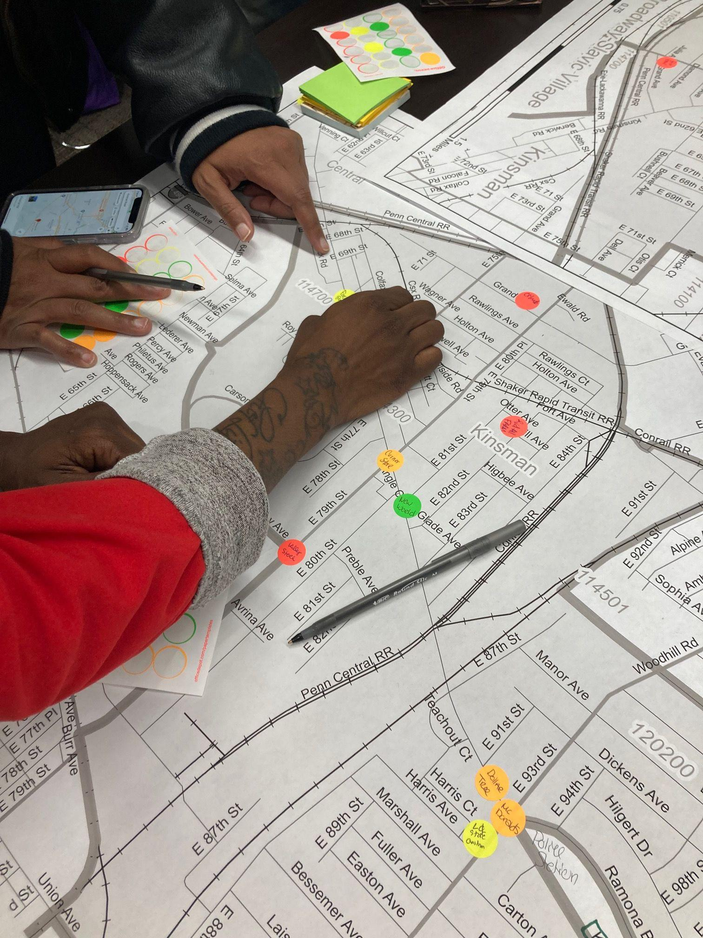
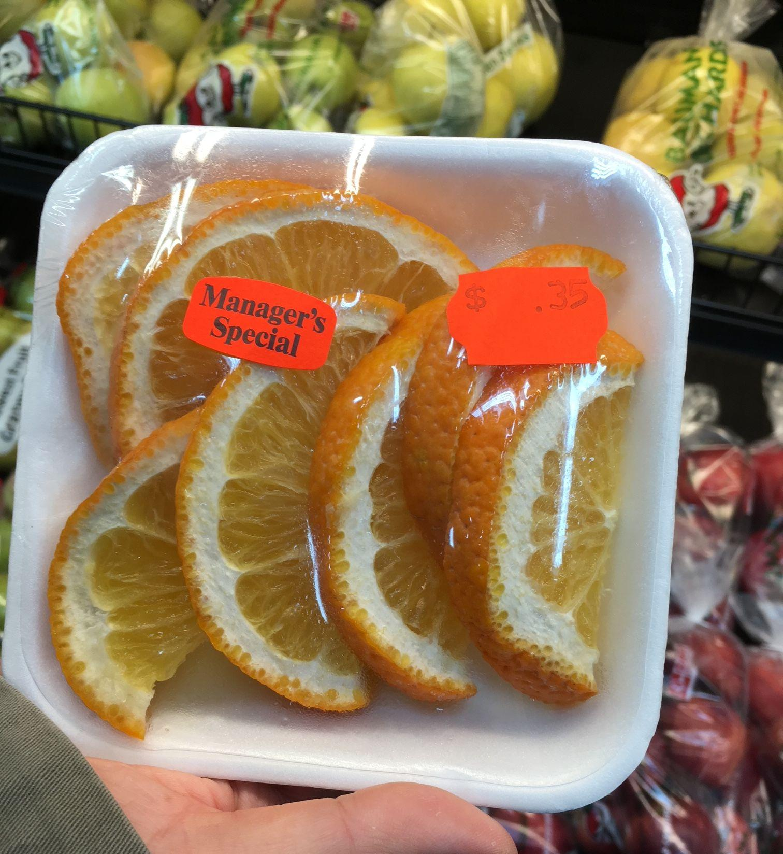
What are the limitations of this approach?
Quality and Affordability of Fresh Foods in these Stores
Service and Environment
Community Context
Diverse Perspectives and Experiences of Community Members
Children and Youth
Families
Seniors and Elders

Slide 24
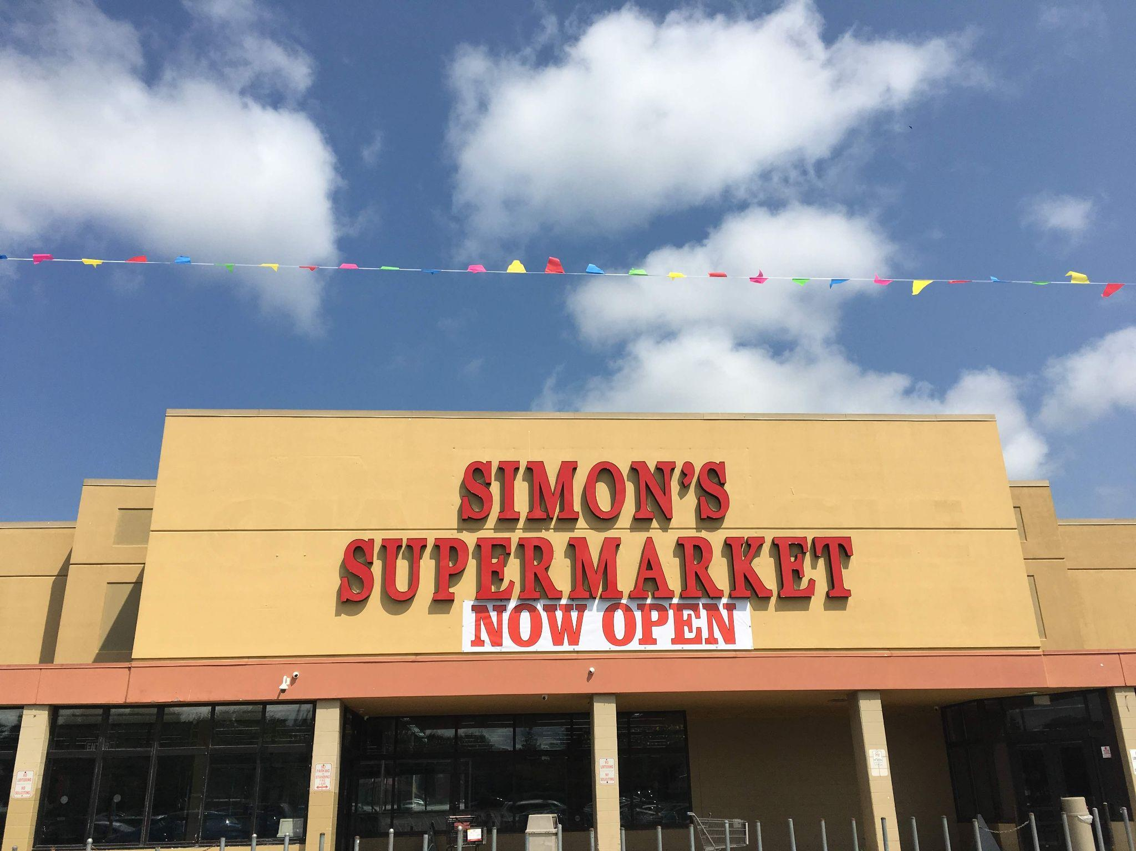
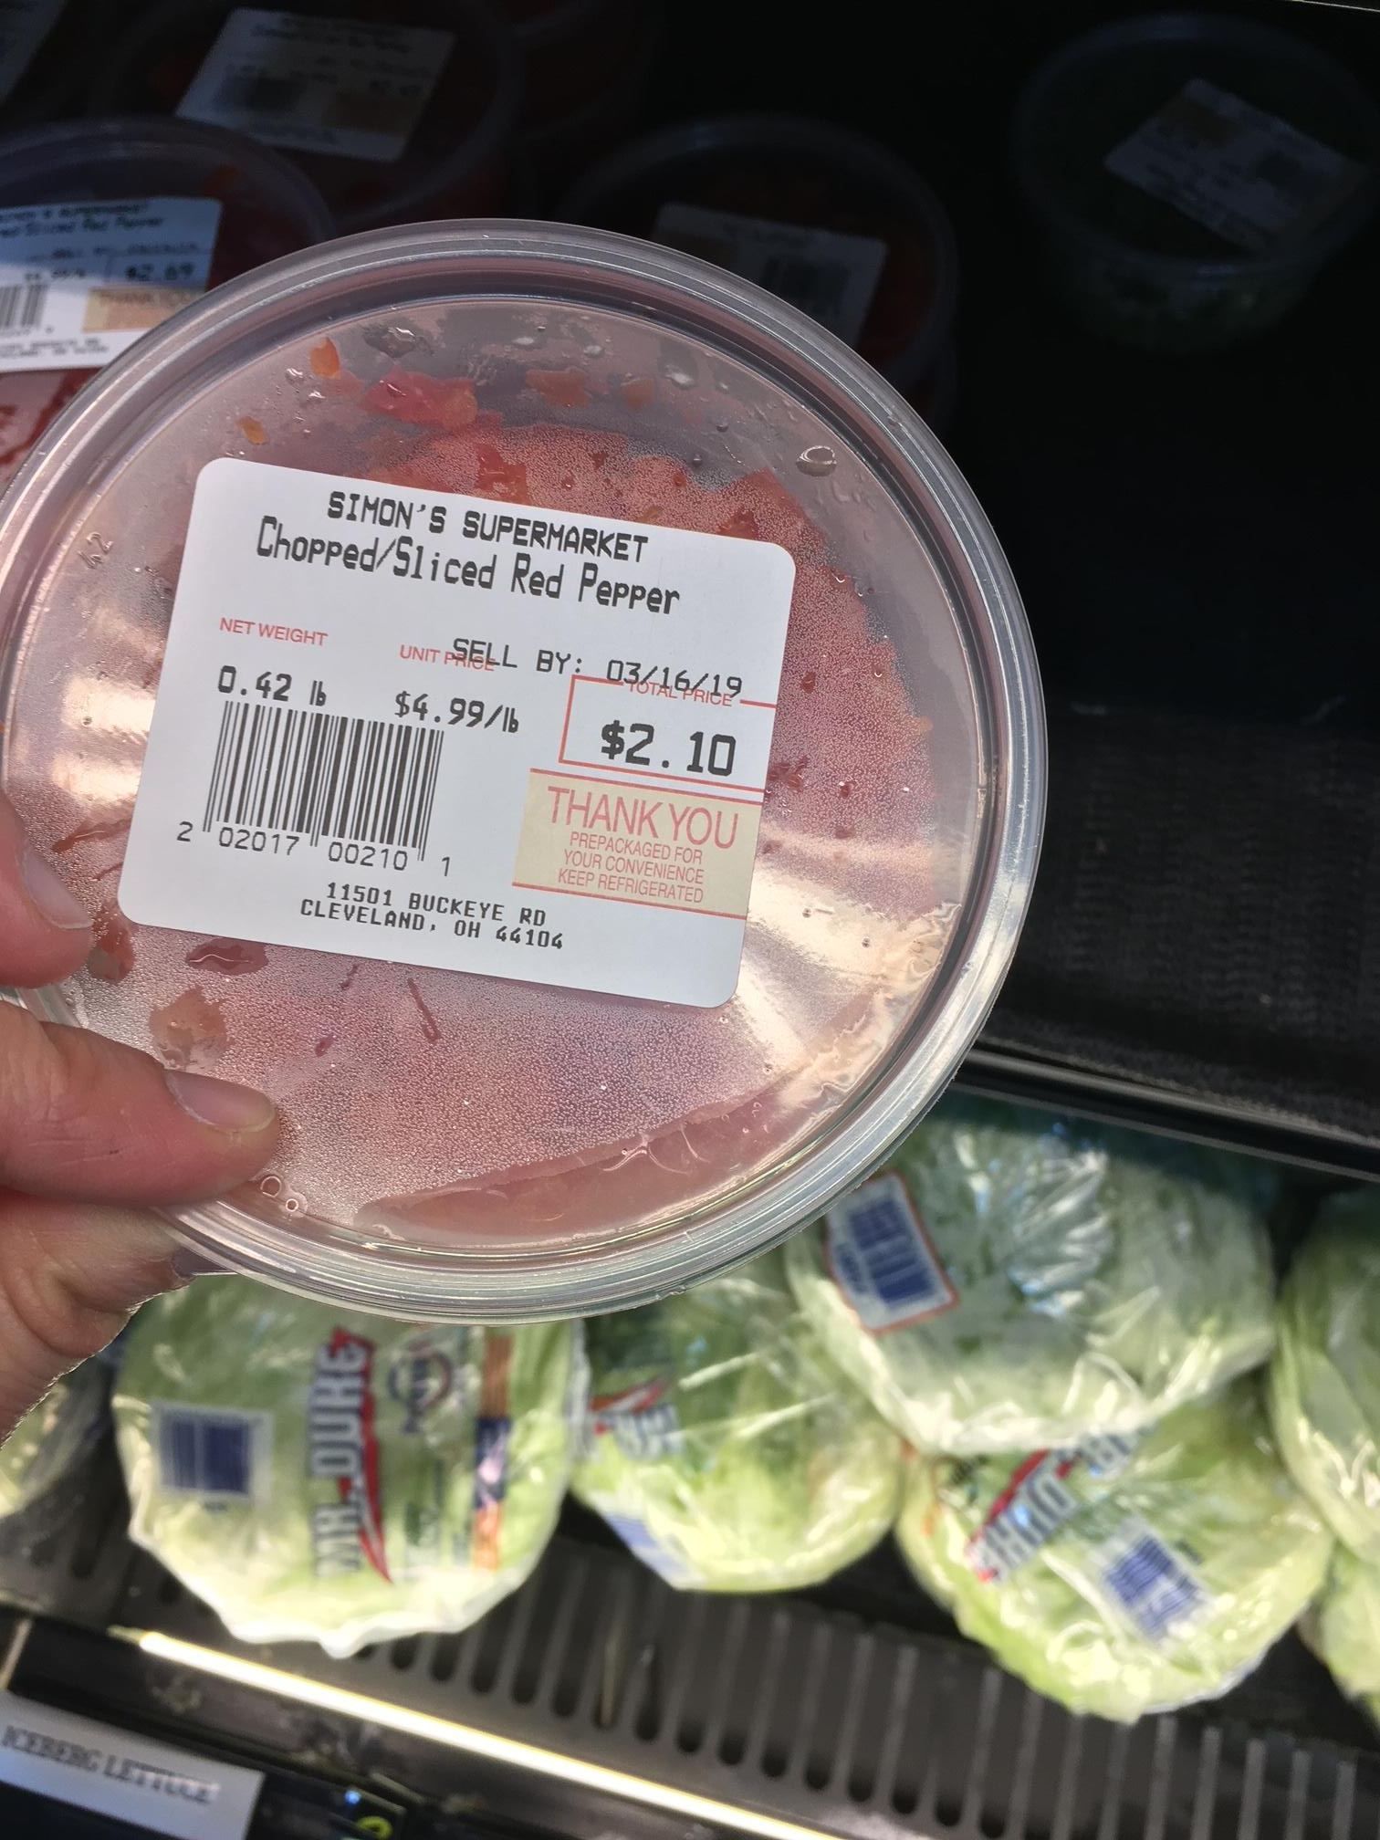
Case Study: Simon’s Supermarket

Slide 25
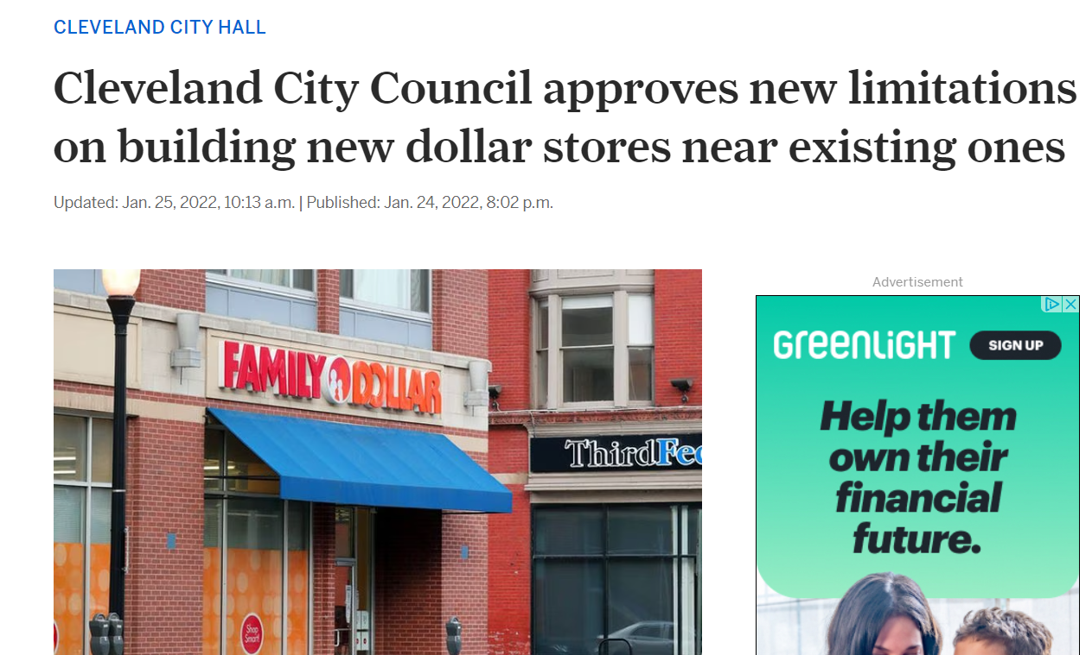
Dollar Store Moratorium Jan 2022

Slide 26
How are the experiences of children different from adults?
How and where do children and youth access food?
Schools
Afterschool programs
Corner and Convenience Stores
Summer Feeding Programs
Home

Slide 27
Children and the Food Retail Environment
Half of youth who live in urban areas make at least one trip per week to a corner or convenience store (2015)
They spend about $1.00 per visit on average
Purchase foods and beverages that average about 350 calories

Slide 28
How are children and youth impacted by the food system in ways that are different than adults?

Slide 29
How can we incorporate more of the youth perspective in these stories?

Slide 30
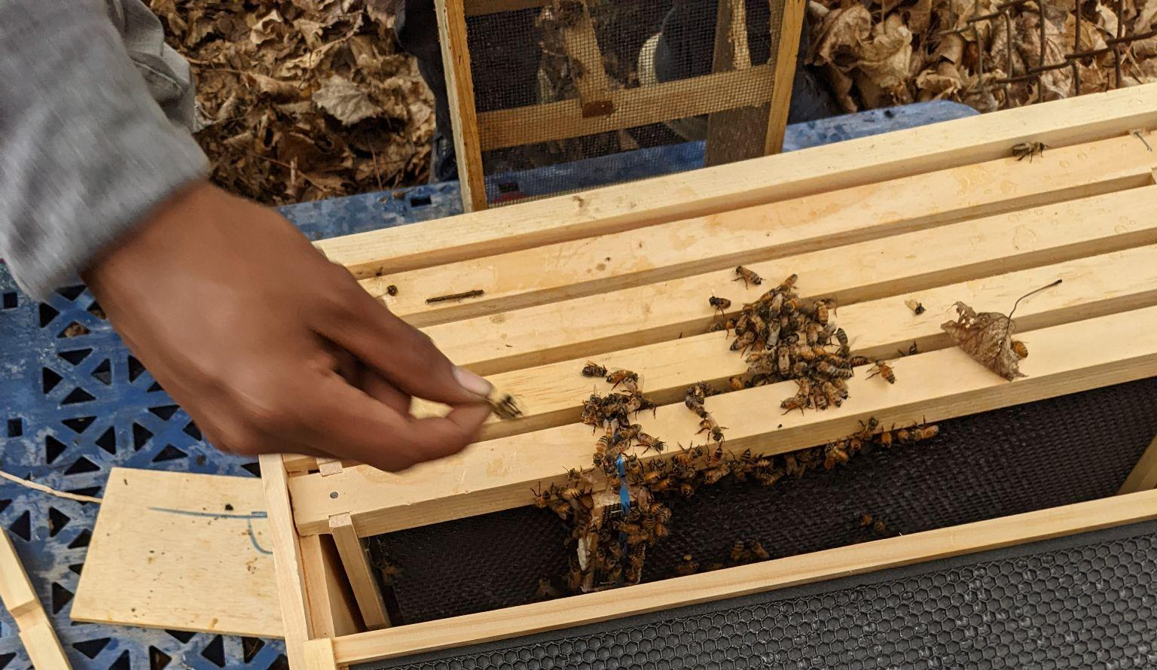
THANK YOU!
Morgan Taggart
morgan@thefareproject.org

